Slide 1
Introduction to Clustering
Distance measures, hierarchical clustering and k-means
Data Mining · Lecture 4 (sample material for the LearnLens AI demo)

Slide 2
What is clustering?
• Clustering is an unsupervised learning task: it groups observations so that observations in the same cluster are similar and observations in different clusters are dissimilar.
• No class labels are used; the groups are discovered from the data.
• Typical uses: customer segmentation, document grouping, image segmentation and anomaly detection.
• Two main families: hierarchical methods and partitioning methods such as k-means.

Slide 3
Distance measures
• Euclidean distance: d(i,j) = sqrt( Σ (x_ik − x_jk)² ), the straight-line distance.
• Manhattan distance: d(i,j) = Σ |x_ik − x_jk|, the sum of absolute differences (city-block distance).
• Minkowski distance generalizes both: d(i,j) = ( Σ |x_ik − x_jk|^m )^(1/m).
• m = 1 gives Manhattan distance and m = 2 gives Euclidean distance.
• Variables should be standardized first so that one variable with a large scale does not dominate the distance.

Slide 4
The distance matrix
• For n observations, the n × n distance matrix stores d(i,j) for every pair.
• The diagonal is zero: d(i,i) = 0.
• The matrix is symmetric: d(i,j) = d(j,i), so only the lower (or upper) triangle needs to be stored.
• Hierarchical clustering algorithms start from this matrix.

Slide 5
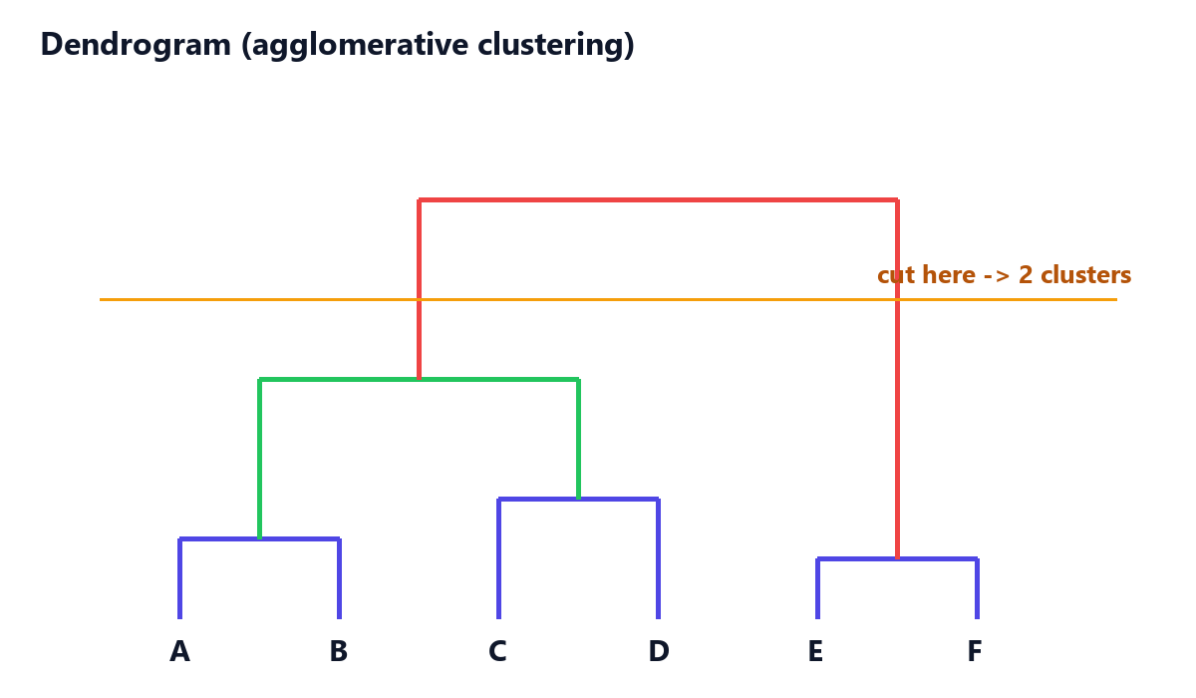
Hierarchical (agglomerative) clustering
• Start with every observation as its own cluster.
• Repeatedly merge the two closest clusters until only one cluster remains.
• The merge history is drawn as a dendrogram; cutting the dendrogram at a height gives the clusters.
• The result depends on how the distance between two clusters is defined (the linkage).

Slide 6
Linkage methods
Linkage | Distance between two clusters | Typical behaviour
Single linkage (nearest neighbour) | Distance between the two closest observations | Can create long, chained clusters
Complete linkage (furthest neighbour) | Distance between the two most distant observations | Compact clusters of similar diameter
Average linkage | Average distance over all pairs of observations | A compromise between single and complete
Ward's method | Increase in total within-cluster variance after merging | Spherical clusters of similar size

Slide 7
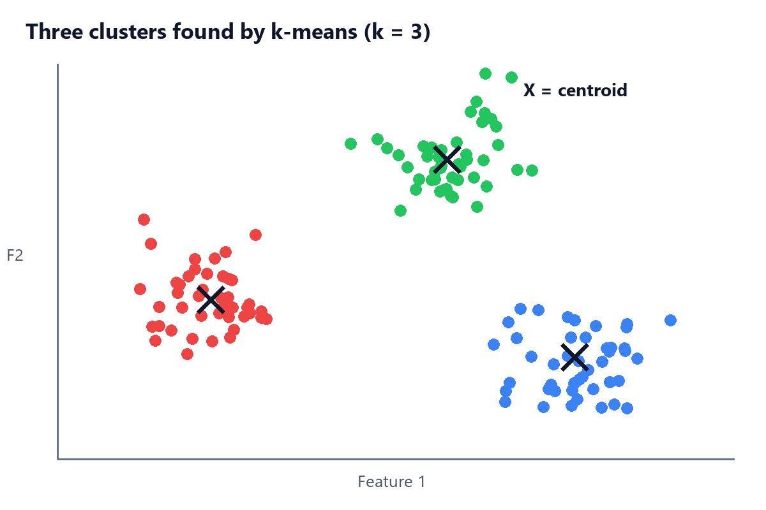
k-means clustering
• Goal: for a given number of clusters K, find the partition that minimizes the total within-cluster sum of squared errors (SSE).
• 1. Choose K initial centroids (for example K random observations).
• 2. Assign every observation to its nearest centroid.
• 3. Recompute each centroid as the mean of the observations assigned to it.
• 4. Repeat steps 2–3 until the assignments no longer change.

Slide 8
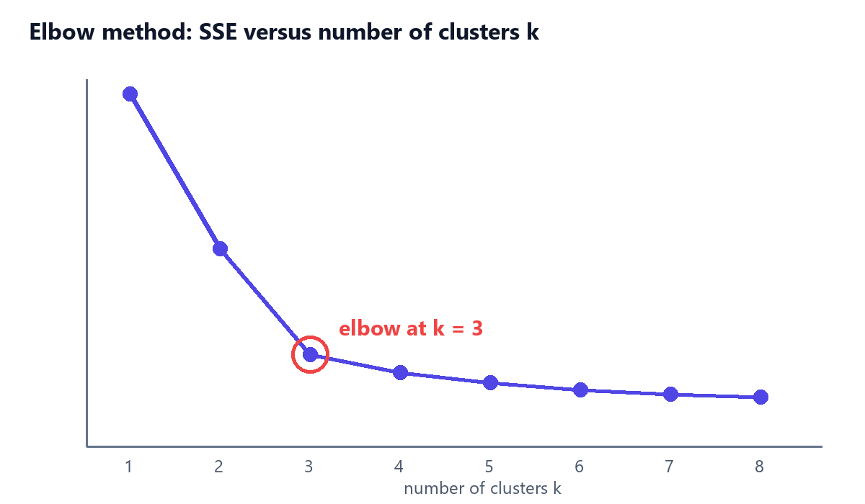
Choosing K and limitations of k-means
• The elbow method plots SSE against K; the 'elbow' where the curve flattens suggests a good K.
• k-means is sensitive to the initial centroids, so it is usually run several times (or with k-means++ initialization).
• It assumes roughly spherical clusters of similar size and is sensitive to outliers.
• K must be chosen in advance, unlike hierarchical clustering.

