Slide 1

Parallel computıng
Dr.öğr.üyesi betül ay

Slide 2
FLYNN’S TAXONOMY
Flynn's taxonomy is a system for classifying computer architectures. It is based on two main concepts:
Instruction flow: A system with n CPU has n program counters and, therefore, n instructions flows. This corresponds to a program counter.
Data flow: A program that calculates a function on a list of data has a data flow. The program that calculates the same function on several different lists of data has more data flows. This is made up of a set of operands.

Slide 3
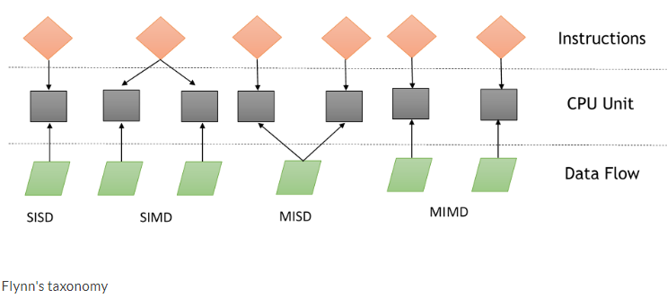
FLYNN’S TAXONOMY

Slide 4
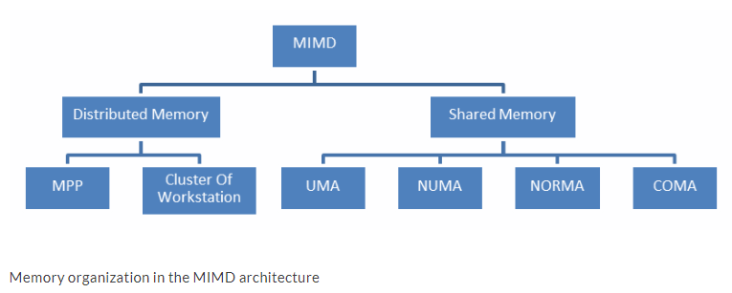
Memory organization
Notes:
Paralel mimarileri değerlendirmek için göz önünde bulundurmamız gereken bir diğer husus da bellek organizasyonu veya verilere erişilme şeklidir.
İşlem birimi ne kadar hızlı olursa olsun, eğer hafıza yeterli hızda instraction ve veri sağlayamaz ve sağlayamazsa, performansta bir gelişme olmaz.
The cycle time of the processor is typically much shorter than the cycle time of memory.
When a processor initiates a transfer to or from memory, the processor's resources will remain occupied for the entire duration of the memory cycle; furthermore, during this period, no other device (for example, I/O controller, processor, or even the processor that made the request) will be able to use the memory due to the transfer in progress:
Hafızaya erişim problemine yönelik çözümler, MIMD mimarisinin bir ikilemi ile sonuçlandı. Paylaşılan bellek sistemi olarak bilinen ilk sistem türü yüksek sanal belleğe sahiptir ve tüm işlemciler bu bellekteki verilere ve talimatlara eşit erişime sahiptir. Diğer sistem tipi, her işlemcinin diğer işlemciler tarafından erişilemeyen yerel belleğe sahip olduğu dağıtılmış bellek modelidir.
Dağıtılmış hafıza ile paylaşılan hafızayı ayırt eden şey, işlem birimi tarafından gerçekleştirilen hafıza erişiminin yönetimidir; Bu ayrım programcılar için çok önemlidir, çünkü paralel bir programın farklı bölümlerinin nasıl iletişim kurması gerektiğini belirler.
Özellikle, dağıtılmış bir bellek makinesi her yerel bellekte paylaşılan verilerin kopyalarını almalıdır. Bu kopyalar, bir işlemciden diğerine paylaşılacak verileri içeren bir mesaj gönderilerek oluşturulur. Bu bellek organizasyonunun bir dezavantajı, bazen, bu mesajların çok büyük olabileceği ve aktarılması nispeten uzun zaman alacağı, paylaşılan bir hafıza sisteminde mesaj alışverişi olmadığı ve asıl sorunun paylaşılan erişimi senkronize etmede yatması gerektiğidir. kaynaklar.

Slide 5
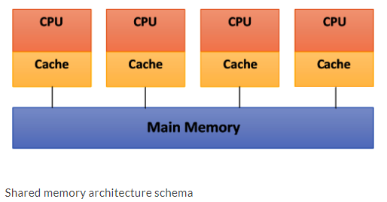
Shared memory
Main Features:
The memory is the same for all processors. For example, all the processors associated with the same data structure will work with the same logical memory addresses, thus accessing the same memory locations.
The synchronization is obtained by reading the tasks of various processors and allowing the shared memory. In fact, the processors can only access one memory at a time.
A shared memory location must not be changed from a task while another task accesses it.
Sharing data between tasks is fast. The time required to communicate is the time that one of them takes to read a single location (depending on the speed of memory access).
Notes:
Burada veri yolu yapısı, aynı kanalı paylaşan (önceki diyagramda gösterildiği gibi Ana Bellek) rastgele sayıda cihaza (önceki diyagramda CPU + Önbellek) izin verir. Veri yolu protokolleri başlangıçta tek bir işlemcinin ve bir ya da daha fazla disk ya da teyp denetleyicisinin burada paylaşılan bellek yoluyla iletişim kurmasına izin verecek şekilde tasarlanmıştı.
The problem occurs when a processor modifies data stored in the memory system that is simultaneously used by other processors. The new value will pass from the processor cache that has been changed to the shared memory. Later, however, it must also be passed to all the other processors, so that they do not work with the obsolete value. This problem is known as the problem of cache coherency—a special case of the problem of memory consistency, which requires hardware implementations that can handle concurrency issues and synchronization, similar to that of thread programming.
Sorun, bir işlemci aynı anda diğer işlemciler tarafından kullanılan bellek sisteminde depolanan verileri değiştirdiğinde ortaya çıkar. Yeni değer, paylaşılan belleğe değiştirilmiş olan işlemci önbelleğinden geçecektir. Ancak daha sonra, eski tüm değerlerle çalışmamaları için diğer tüm işlemcilere de geçirilmesi gerekir. Bu sorun, önbellek tutarlılığı sorunu olarak bilinir - eşzamanlılık sorunlarını ve iş parçacığı programlamada olduğu gibi eşitlemeyi kaldırabilen donanım uygulamaları gerektiren bellek tutarlılığı sorununa ilişkin özel bir durum.

Slide 6
Shared memory
Uniform Memory Access (UMA): The fundamental characteristic of this system is the access time to the memory that is constant for each processor and for any area of memory. For this reason, these systems are also called Symmetric Multiprocessors (SMPs). They are relatively simple to implement, but not very scalable. The coder is responsible for the management of the synchronization by inserting appropriate controls, semaphores, locks, and more in the program that manages resources.
Non-Uniform Memory Access (NUMA): These architectures divide the memory into high-speed access area that is assigned to each processor, and also, a common area for the data exchange, with slower access. These systems are also called Distributed Shared Memory (DSM) systems. They are very scalable, but complex to develop.
No Remote Memory Access (NoRMA): The memory is physically distributed among the processors (local memory). All local memories are private and can only access the local processor. The communication between the processors is through a communication protocol used for exchanging messages, which is known as the message-passing protocol.
Cache-Only Memory Architecture (COMA): These systems are equipped with only cached memories. While analyzing NUMA architectures, it was noticed that this architecture kept the local copies of the data in the cache and that this data was stored as duplicates in the main memory. This architecture removes duplicates and keeps only the cached memories; the memory is physically distributed among the processors (local memory). All local memories are private and can only access the local processor. The communication between the processors is also through the message-passing protocol.

Slide 7
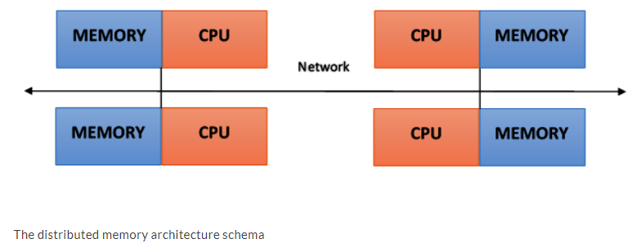
distributed memory
Main Features:
Memory is physically distributed between processors; each local memory is directly accessible only by its processor.
Synchronization is achieved by moving data (even if it's just the message itself) between processors (communication).
The subdivision of data in the local memories affects the performance of the machine—it is essential to make subdivisions accurate, so as to minimize the communication between the CPUs. In addition to this, the processor that coordinates these operations of decomposition and composition must effectively communicate with the processors that operate on the individual parts of data structures.
The message-passing protocol is used so that the CPUs can communicate with each other through the exchange of data packets. The messages are discrete units of information, in the sense that they have a well-defined identity, so it is always possible to distinguish them from each other.

Slide 8
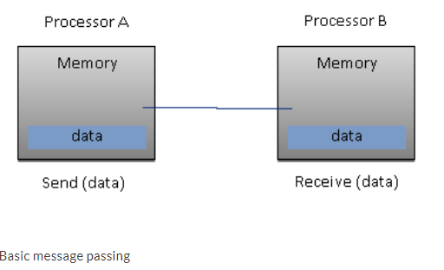
distributed memory
Advantages:
There are no conflicts at the level of the communication bus or switch. Each processor can use the full bandwidth of their own local memory without any interference from other processors.
The lack of a common bus means that there is no intrinsic limit to the number of processors. The size of the system is only limited by the network used to connect the processors.
There are no problems with cache coherency. Each processor is responsible for its own data and does not have to worry about upgrading any copies.
Notes:
The main disadvantage is that communication between processors is more difficult to implement. If a processor requires data in the memory of another processor, then the two processors should not necessarily exchange messages via the message-passing protocol. This introduces two sources of slowdown: to build and send a message from one processor to another takes time, and also, any processor should be stopped in order to manage the messages received from other processors. A program designed to work on a distributed memory machine must be organized as a set of independent tasks that communicate via messages:
En büyük dezavantajı, işlemciler arasındaki iletişimin uygulanması daha zor olmasıdır. Bir işlemci başka bir işlemcinin hafızasında veri gerektiriyorsa, iki işlemcinin mutlaka ileti iletme protokolü yoluyla ileti alışverişinde bulunmaması gerekir. Bu, iki yavaşlama kaynağı sunar: bir işlemciden bir işlemciden diğerine bir mesaj oluşturmak ve göndermek zaman alır ve ayrıca diğer işlemcilerden gelen mesajları yönetmek için herhangi bir işlemcinin durdurulması gerekir. Dağıtılmış bir bellek makinesinde çalışmak üzere tasarlanan bir program, iletilerle iletişim kuran bir dizi bağımsız görev olarak düzenlenmelidir:

Slide 9
Massively Parallel Processing (MPP)
MPP machines are composed of hundreds of processors (which can be as large as hundreds of thousands of processors in some machines) that are connected by a communication network.
The fastest computers in the world are based on these architectures; some examples of these architecture systems are Earth Simulator, Blue Gene, ASCI White, ASCI Red, and ASCI Purple and Red Storm.

Slide 10
Clusters of workstations
These processing systems are based on classical computers that are connected by communication networks. Computational clusters fall into this classification.
In a cluster architecture, we define a node as a single computing unit that takes part in the cluster.
For the user, the cluster is fully transparent—all the hardware and software complexity is masked and data and applications are made accessible as if they were all from a single node.

Slide 11
Clusters of workstations
Three types of clusters:
Fail-over cluster: In this, the node's activity is continuously monitored, and when one stops working, another machine takes over the charge of those activities. The aim is to ensure a continuous service due to the redundancy of the architecture.
Load balancing cluster: In this system, a job request is sent to the node that has less activity. This ensures that less time is taken to process the job.
High-performance computing cluster: In this, each node is configured to provide extremely high performance. The process is also divided into multiple jobs on multiple nodes. The jobs are parallelized and will be distributed to different machines.

Slide 12
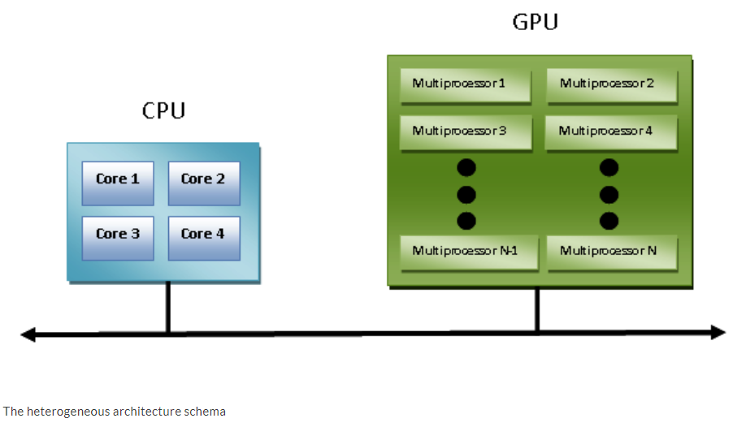
Heterogeneous architectures
Notes:
The introduction of GPU accelerators in the homogeneous world of supercomputing has changed the nature of how supercomputers are both used and programmed now. Despite the high performance offered by GPUs, they cannot be considered as an autonomous processing unit as they should always be accompanied by a combination of CPUs. The programming paradigm, therefore, is very simple: the CPU takes control and computes in a serial manner, assigning tasks to the graphics accelerator that are, computationally, very expensive and have a high degree of parallelism.
The communication between a CPU and a GPU can take place, not only through the use of a high-speed bus but also through the sharing of a single area of memory for both physical or virtual memory. In fact, in the case where both the devices are not equipped with their own memory areas, it is possible to refer to a common memory area using the software libraries provided by the various programming models, such as CUDA and OpenCL.
These architectures are called heterogeneous architectures, wherein applications can create data structures in a single address space and send a job to the device hardware, which is appropriate for the resolution of the task. Several processing tasks can operate safely in the same regions to avoid data consistency problems, thanks to the atomic operations.
So, despite the fact that the CPU and GPU do not seem to work efficiently together, with the use of this new architecture, we can optimize their interaction with, and the performance of, parallel applications:

Slide 13
Parallel programming models
The most widely used models for parallel programming are as follows:
Shared memory model
Multithread model
Distributed memory/message passing model
Data-parallel model
Notes:
Parallel programming models exist as an abstraction of hardware and memory architectures. In fact, these models are not specific and do not refer to any particular types of machines or memory architectures. They can be implemented (at least theoretically) on any kind of machines. Compared to the previous subdivisions, these programming models are made at a higher level and represent the way in which the software must be implemented to perform parallel computation. Each model has its own way of sharing information with other processors in order to access memory and divide the work.
In absolute terms, no one model is better than the other. Therefore, the best solution to be applied will depend very much on the problem that a programmer should address and resolve.

Slide 14
Shared memory model
In this model, tasks share a single memory area in which we can read and write asynchronously.
There are mechanisms that allow the coder to control the access to the shared memory; for example, locks or semaphores.
This model offers the advantage that the coder does not have to clarify the communication between tasks.
An important disadvantage, in terms of performance, is that it becomes more difficult to understand and manage data locality. This refers to keeping data local to the processor that works on conserving memory access, cache refreshes, and bus traffic that occurs when multiple processors use the same data.

Slide 15
Multithread model
In this model, a process can have multiple flows of execution.
For example, a sequential part is created and, subsequently, a series of tasks are created that can be executed in parallel.
Usually, this type of model is used on shared memory architectures.
So, it will be very important for us to manage the synchronization between threads, as they operate on shared memory, and the programmer must prevent multiple threads from updating the same locations at the same time.
The current-generation CPUs are multithreaded in software and hardware.
POSIX (short for Portable Operating System Interface) threads are classic examples of the implementation of multithreading on software.
Intel's Hyper-Threading technology implements multithreading on hardware by switching between two threads when one is stalled or waiting on I/O. Parallelism can be achieved from this model, even if the data alignment is nonlinear.

Slide 16
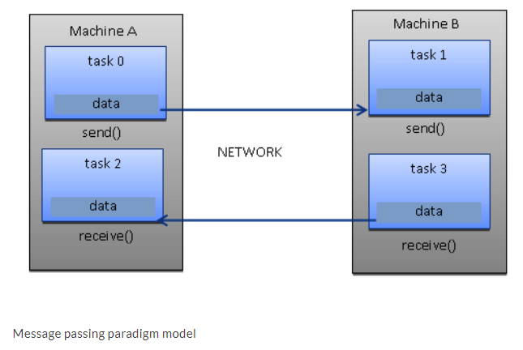
Message passing model
The message passing model is usually applied in cases where each processor has its own memory (distributed memory system). More tasks can reside on the same physical machine or on an arbitrary number of machines.
The coder is responsible for determining the parallelism and data exchange that occurs through the messages, and it is necessary to request and call a library of functions within the code.
Some of the examples have been around since the 1980s, but only in the mid-1990s was a standardized model created, leading to a de facto standard called a Message Passing Interface (MPI).
Notes:
The MPI model is clearly designed with distributed memory, but being models of parallel programming, a multiplatform model can also be used with a shared memory machine:

Slide 17
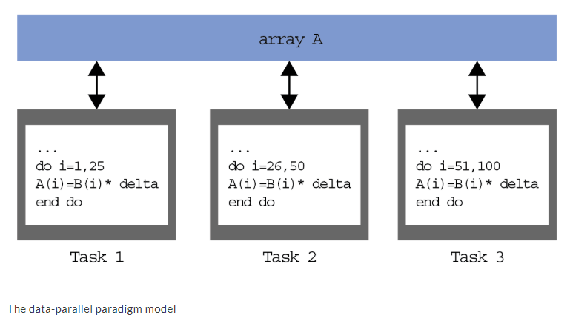
Data-parallel model
In this model, we have more tasks that operate on the same data structure, but each task operates on a different portion of data.
In the shared memory architecture, all tasks have access to data through shared memory and distributed memory architectures, where the data structure is divided and resides in the local memory of each task.
To implement this model, a coder must develop a program that specifies the distribution and alignment of data; for example, the current-generation GPUs are highly operational only if data (Task 1, Task 2, Task 3) is aligned, as shown in the following diagram:

Slide 18
Evaluating the performance of a parallel program
The development of parallel programming created the need for performance metrics in order to decide whether its use is convenient or not. Indeed, the focus of parallel computing is to solve large problems in a relatively short period of time.
The factors contributing to this objective are, for example, the type of hardware used, the degree of parallelism of the problem, and the parallel programming model adopted. To facilitate this, the analysis of basic concepts was introduced, which compares the parallel algorithm obtained from the original sequence.
The performance is achieved by analyzing and quantifying the number of threads and/or the number of processes used. To analyze this, let's introduce a few performance indexes:
Speedup
Efficiency
Scaling

Slide 19

Speedup
The speedup is the measure that displays the benefit of solving a problem in parallel. It is defined as the ratio of the time taken to solve a problem on a single processing element (Ts) to the time required to solve the same problem on p identical processing elements (Tp).
We denote speedup as follows:
Let's recap these conditions:
S = p is a linear or ideal speedup.
S < p is a real speedup.
S > p is a superlinear speedup.
Notes:
We have a linear speedup, where if S=p, then it means that the speed of execution increases with the number of processors. Of course, this is an ideal case. While the speedup is absolute when Ts is the execution time of the best sequential algorithm, the speedup is relative when Ts is the execution time of the parallel algorithm for a single processor.

Slide 20
Scaling
Scaling is defined as the ability to be efficient on a parallel machine. It identifies the computing power (speed of execution) in proportion to the number of processors.
By increasing the size of the problem and, at the same time, the number of processors, there will be no loss in terms of performance.
The scalable system, depending on the increments of the different factors, may maintain the same efficiency or improve it.

Slide 21


Evaluating the performance of a parallel program
The limitations of parallel computation are introduced by Amdahl's law.
To evaluate the degree of efficiency of the parallelization of a sequential algorithm, we have Gustafson's law.
Amdahl's law
Amdahl's law is a widely used law that is used to design processors and parallel algorithms. It states that the maximum speedup that can be achieved is limited by the serial component of the program:
Notes:
This means that, for example, if a program in which 90% of the code can be made parallel, but 10% must remain serial, then the maximum achievable speedup is 9, even for an infinite number of processors.

Slide 22

Evaluating the performance of a parallel program
Gustafson's law
Gustafson's law states the following:
we indicated in the equation the following applies:
P is the number of processors.
S is the speedup factor.
α is the non-parallelizable fraction of any parallel process.
Notes:
Gustafson's law is in contrast to Amdahl's law, which, as we described, assumes that the overall workload of a program does not change with respect to the number of processors.
In fact, Gustafson's law suggests that programmers first set the time allowed for solving a problem in parallel and then based on that (that is time) to size the problem. Therefore, the faster the parallel system is, the greater the problems that can be solved over the same period of time.
The effect of Gustafson's law was to direct the objectives of computer research towards the selection or reformulation of problems in such a way that the solution of a larger problem would still be possible in the same amount of time. Furthermore, this law redefines the concept of efficiency as a need to reduce at least the sequential part of a program, despite the increase in workload.

Slide 23
Process and thread
Gustafson's law
Gustafson's law states the following:
we indicated in the equation the following applies:
P is the number of processors.
S is the speedup factor.
α is the non-parallelizable fraction of any parallel process.

