Slide 1
Introduction to Parallel Computing
Adapted from https://computing.llnl.gov/tutorials/parallel_comp/

Slide 2
Kaynaklar
İnternet !
An Introduction to Parallel Programming Peter Pacheco, Morgan Kauffman Chapter 1-2
An Introduction to Parallel Programming Tobias Wittwer Chapter 2
Introduction to High Performance Scientific Computing Victor Eijkhout Chapter 1-2
Başvuru kaynağı The Sourcebook of Parallel Computing Dongarra, Foster, Fox

Slide 3
Kaynaklar
SP Parallel Programming Workshop http://www.mhpcc.edu/training/workshop/parallel_intro/MAIN.html
Introduction to Parallel Computing https://computing.llnl.gov/tutorials/parallel_comp/

Slide 4
1-Overview

Slide 5
What is Parallel Computing?
Traditionally, software has been written for serial computation:To be run on a single computer having a single Central Processing Unit (CPU);
A problem is broken into a discrete series of instructions.
Instructions are executed one after another.
Only one instruction may execute at any moment in time.

Slide 6
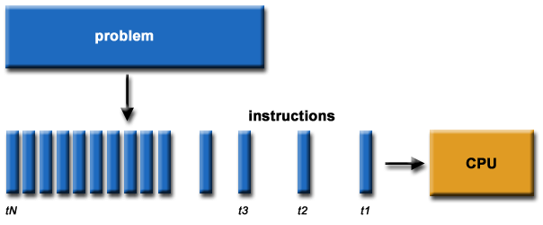
Serial Computation

Slide 7
What is Parallel Computing?
In the simplest sense, parallel computing is the simultaneous use of multiple compute resources to solve a computational problem:
To be run using multiple CPUs
A problem is broken into discrete parts that can be solved concurrently
Each part is further broken down to a series of instructions
Instructions from each part execute simultaneously on different CPUs

Slide 8
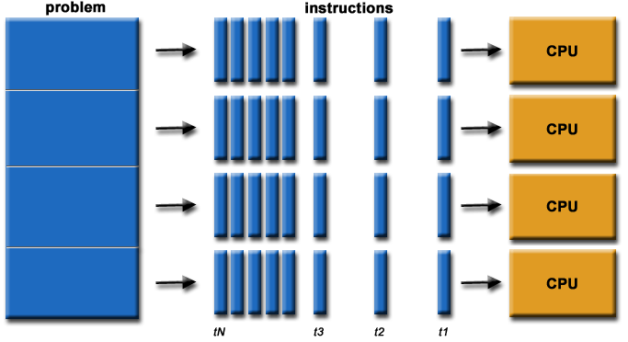
Parallel Computation

Slide 9
Resource/Problem
The compute resources can include:
A single computer with multiple processors;
An arbitrary number of computers connected by a network;
A combination of both.
The computational problem usually demonstrates characteristics such as the ability to be:
Broken apart into discrete pieces of work that can be solved simultaneously;
Execute multiple program instructions at any moment in time;
Solved in less time with multiple compute resources than with a single compute resource.

Slide 10
The Universe is Parallel
Parallel computing is an evolution of serial computing that attempts to emulate what has always been the state of affairs in the natural world: many complex, interrelated events happening at the same time, yet within a sequence. For example:
Galaxy formation
Planetary movement
Weather and ocean patterns
Tectonic plate drift
Rush hour traffic
Automobile assembly line
Building a space shuttle
Ordering a hamburger at the drive through.

Slide 11
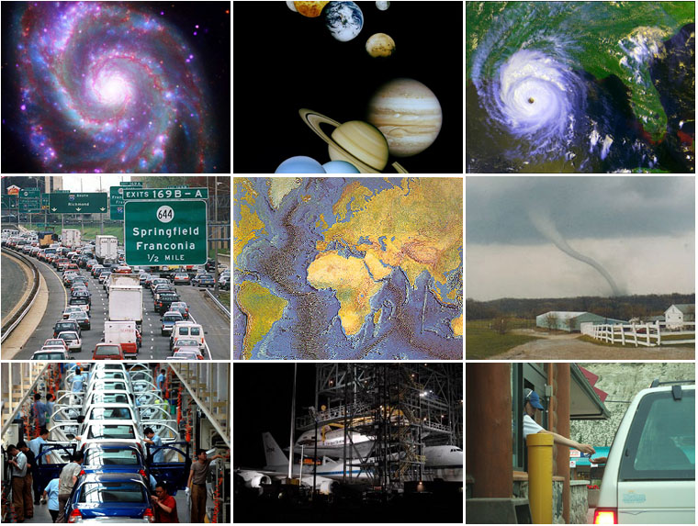

Slide 12
Uses for Parallel Computing
Historically, parallel computing has been considered to be "the high end of computing", and has been used to model difficult scientific and engineering problems found in the real world. Some examples:
Atmosphere, Earth, Environment
Physics - applied, nuclear, particle, condensed matter, high pressure, fusion, photonics
Bioscience, Biotechnology, Genetics
Chemistry, Molecular Sciences
Geology, Seismology
Mechanical Engineering - from prosthetics to spacecraft
Electrical Engineering, Circuit Design, Microelectronics
Computer Science, Mathematics

Slide 13
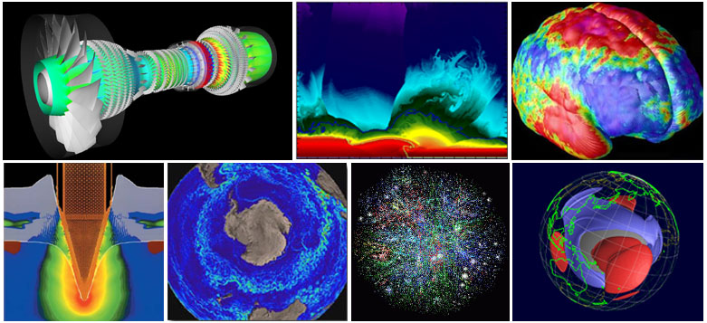

Slide 14
Uses for Parallel Computing
Today, commercial applications provide an equal or greater driving force in the development of faster computers. These applications require the processing of large amounts of data in sophisticated ways. For example:
Databases, data mining
Oil exploration
Web search engines, web based business services
Medical imaging and diagnosis
Pharmaceutical design
Management of national and multi-national corporations
Financial and economic modeling
Advanced graphics and virtual reality, particularly in the entertainment industry
Networked video and multi-media technologies
Collaborative work environments

Slide 15
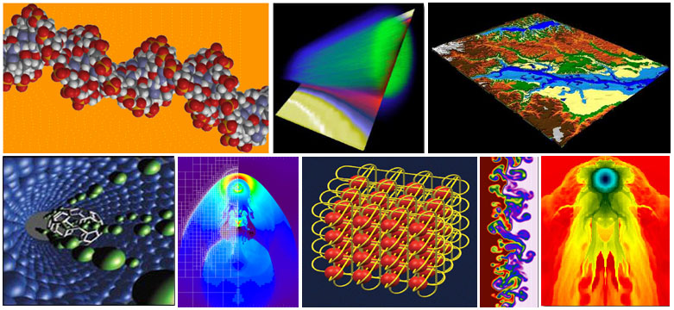

Slide 16
Why Use Parallel Computing?
Main Reasons:
Save time and/or money: In theory, throwing more resources at a task will shorten its time to completion, with potential cost savings. Parallel clusters can be built from cheap, commodity components.
Solve larger problems: Many problems are so large and/or complex that it is impractical or impossible to solve them on a single computer, especially given limited computer memory. For example:
"Grand Challenge" (en.wikipedia.org/wiki/Grand_Challenge) problems requiring PetaFLOPS and PetaBytes of computing resources.
Web search engines/databases processing millions of transactions per second

Slide 17
Why Use Parallel Computing?
Provide concurrency: A single compute resource can only do one thing at a time. Multiple computing resources can be doing many things simultaneously. For example, the Access Grid (www.accessgrid.org) provides a global collaboration network where people from around the world can meet and conduct work "virtually".
Use of non-local resources: Using compute resources on a wide area network, or even the Internet when local compute resources are scarce.

Slide 18
Why Use Parallel Computing?
Limits to serial computing: Both physical and practical reasons pose significant constraints to simply building ever faster serial computers:
Transmission speeds - the speed of a serial computer is directly dependent upon how fast data can move through hardware. Absolute limits are the speed of light (30 cm/nanosecond) and the transmission limit of copper wire (9 cm/nanosecond). Increasing speeds necessitate increasing proximity of processing elements.
Limits to miniaturization - processor technology is allowing an increasing number of transistors to be placed on a chip. However, even with molecular or atomic-level components, a limit will be reached on how small components can be.
Economic limitations - it is increasingly expensive to make a single processor faster. Using a larger number of moderately fast commodity processors to achieve the same (or better) performance is less expensive.

Slide 19
Who and What?
Top500.org provides statistics on parallel computing users - the charts below are just a sample. Some things to note:
Sectors may overlap - for example, research may be classified research. Respondents have to choose between the two.
"Not Specified" is by far the largest application - probably means multiple applications.

Slide 20
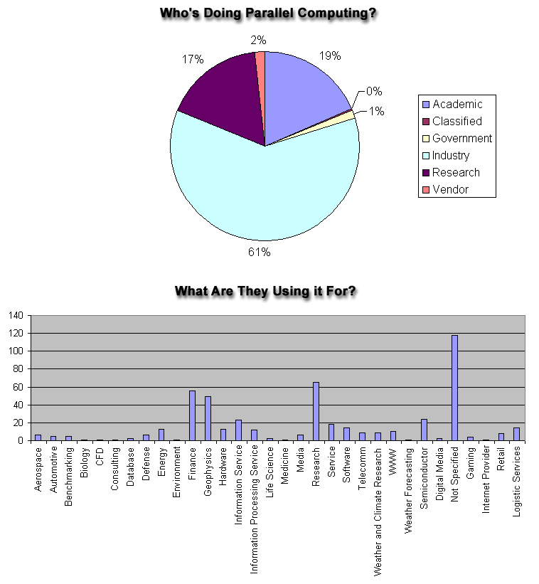

Slide 21
The Future
During the past 20 years, the trends indicated by ever faster networks, distributed systems, and multi-processor computer architectures (even at the desktop level) clearly show that parallelism is the future of computing.

