Slide 1
Where to open a steakhouse in New York?

Slide 2
Introduction
Imagine that you own of a steak house chain in US and want to open another restaurant in Toronto, nevertheless you have no idea about which neighborhood would be the best choice to open a new steak house. You would think that your restaurant would be visited more often if you open it in a neighborhood where there is not many steak house restaurants, compared to other neighborhoods where there are already many steak house options for people to visit.
Here I will try to provide you with the information regarding the frequency of steak house restaurants in different neighborhoods in Toronto so that you can choose the one with a low number of steak house restaurants to open you new venue!

Slide 3
Data
To solve the problem,
The list of neighborhoods in Toronto wre obtained from a Wikipedia page and BeatifulSoup package from bs4 was used to load and restructure the neighborhood data so that I can create a dataframe for these data.
Later on, the coordinate information for every neighborhood was obtained from the website: http://cocl.us/Geospatial_data and added to the dataframe. Using the obtained coordinate information, data regarding the venues in each neighborhood were extracted from Foursquare.
Number of Steakhouse restaurants was calculated for each neighborhood so that we have a list showing existing Steakhouse places in each neighborhood in a descending order.

Slide 4
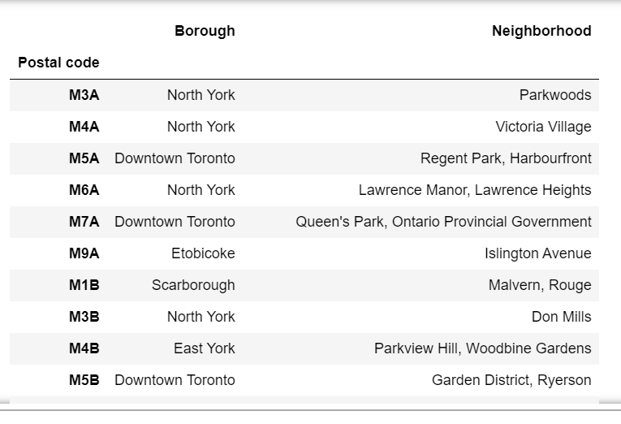
Methods
Borough and neighborhood information wasobtained from wikipedia and restructured in dataframe.

Slide 5
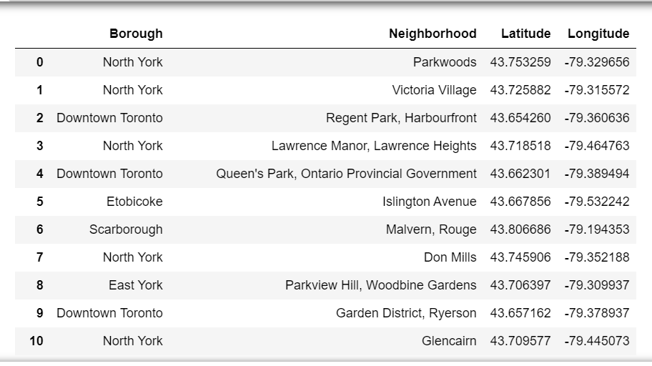
Methods
Location data was extracted from http://cocl.us/Geospatial_data and added to the data frame.

Slide 6
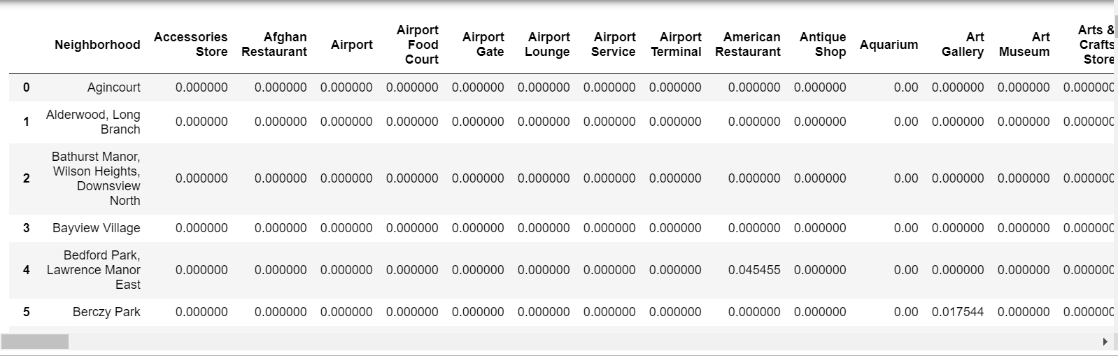
Methods
All the venues are grouped according to their categories for each neighborhood.

Slide 7
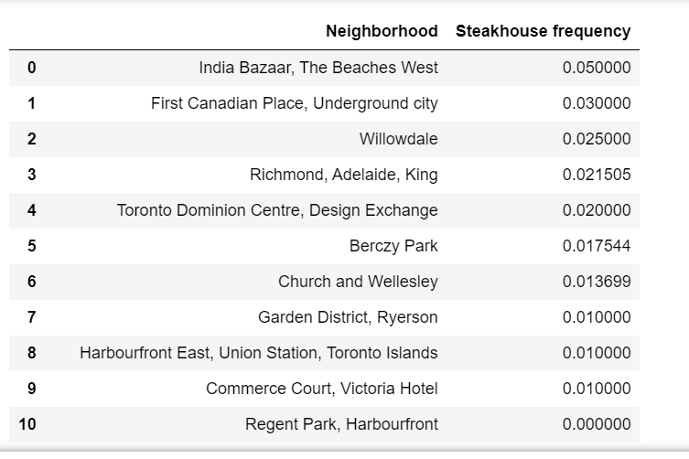
Result
When focused on the steak house data, it was observed that India Bazaar, the beaches West would not be the best option to open a steakhouse as there are already many steakhouses in this neughborhood. Instead, Commerce Court would be a good choice as it is not populated with many steakhouses.

