Slide 1
D2S
2016 GovHack

Slide 2







Slide 3


Slide 4


Slide 9


Slide 14


Slide 19
Demo

Slide 20








boj.org
Jobquilibrium
|
X
BOJ
We need to get to know you more before we can suggest anything
Boj: Hi, my name is Boj. Would you like me to assist you with finding the right course, so you are job ready?
SEND
Me: I like

Slide 21
boj.org
Jobquilibrium
|
X
BOJ
We need to get to know you more before we can suggest anything
Boj: Hi, my name is Boj. Would you like me to assist you with finding the right course, so you are job ready?
Yes please
SEND
Me: I like

Slide 22
boj.org
Jobquilibrium
|
X
BOJ
We need to get to know you more before we can suggest anything
Boj: Hi, my name is Boj. Would you like me to assist you with finding the right course, so you are job ready?
Me: Yes please
SEND
Me: I like

Slide 23
boj.org
Jobquilibrium
|
X
BOJ
We need to get to know you more before we can suggest anything
Boj: Hi, my name is Boj. Would you like me to assist you with finding the right course, so you are job ready?
Me: Yes please
Boj: Great! Tell me about yourself
SEND
Me: I like

Slide 24
boj.org
Jobquilibrium
|
X
BOJ
We need to get to know you more before we can suggest anything
I like technologies, I enjoy the
outdoors, and I like cars
Boj: Hi, my name is Boj. Would you like me to assist you with finding the right course, so you are job ready?
Me: Yes please
Boj: Great! Tell me about yourself
I like technologies, I enjoy the
SEND
outdoors, and I like cars
Me: I like

Slide 25
boj.org
Jobquilibrium
|
X
BOJ
Boj: Hi, my name is Boj. Would you like me to assist you with finding the right course, so you are job ready?
Processing….
Me: Yes please
Boj: Great! Tell me about yourself
Me: I like technologies, I enjoy the
outdoors, and I like cars
SEND
Me: I like

Slide 26



boj.org
Jobquilibrium
|
X
BOJ
Courses
University
Boj: Hi, my name is Boj. Would you like me to assist you with finding the right course, so you are job ready?
Bachelor of Computer Science
High interest, 142 pages views / day
Offers many IT and
engineering courses
Average salary after first year $85,000
Me: Yes please
Quality of educational experience 78%
Big court yards
Boj: Great! Tell me about yourself
Overall graduate satisfaction 81%
Near parks
Me: I like technologies, I enjoy the
outdoors, and I like cars
Current jobs requiring a computer science qualification 12%
Limited parking
Future jobs requiring a computer science qualification 38%
SEND
Me: I like

Slide 27
boj.org
Jobquilibrium
|
X
Boj: Hi, my name is Boj. Would you like me to assist you with finding the right course, so you are job ready?
BOJ
Courses
University
Bachelor of Computer Science
Me: Yes please
High interest, 142 pages views / day
Offers many IT and
engineering courses
Boj: Great! Tell me about yourself
Average salary after first year $85,000
Me: I like technologies, I enjoy the
outdoors, and I like cars
Quality of educational experience 78%
Big court yards
Overall graduate satisfaction 81%
Near parks
Boj: Awesome! What was your ATAR?
Current jobs requiring a computer science qualification 12%
Limited parking
Future jobs requiring a computer science qualification 38%
SEND

Slide 28
boj.org
Jobquilibrium
|
X
Boj: Hi, my name is Boj. Would you like me to assist you with finding the right course, so you are job ready?
BOJ
Courses
University
Bachelor of Computer Science
Me: Yes please
High interest, 142 pages views / day
Offers many IT and
engineering courses
Boj: Great! Tell me about yourself
Average salary after first year $85,000
Me: I like technologies, I enjoy the
outdoors, and I like cars
Quality of educational experience 78%
Big court yards
Overall graduate satisfaction 81%
Near parks
Boj: Awesome! What was your ATAR?
Current jobs requiring a computer science qualification 12%
Limited parking
93.6
Future jobs requiring a computer science qualification 38%
SEND

Slide 29
boj.org
Jobquilibrium
|
X
BOJ
Courses
University
Me: Yes please
Bachelor of Computer Science
Boj: Great! Tell me about yourself
High interest, 142 pages views / day
Offers many IT and
engineering courses
Me: I like technologies, I enjoy the
outdoors, and I like cars
Average salary after first year $85,000
Quality of educational experience 78%
Big court yards
Boj: Awesome! What was your ATAR?
Overall graduate satisfaction 81%
Near parks
Current jobs requiring a computer science qualification 12%
Me: 93.6
Limited parking
Future jobs requiring a computer science qualification 38%
SEND

Slide 30

boj.org
Jobquilibrium
Boj: Hi, my name is Boj. Would you like me to assist you with finding the right course, so you are job ready?
|
X
BOJ
Courses
University
Boj: Awesome! What was your ATAR?
Bachelor of Computer Science
Me: 93.6
High interest, 142 pages views / day
Offers many IT and
engineering courses
Boj: Nice! You are well above the average score of 76, I can find many courses you would be eligible for! Can I request access to your Facebook and Google account so I know a bit more about you?
Average salary after first year $85,000
Quality of educational experience 78%
Big court yards
Overall graduate satisfaction 81%
Near parks
Current jobs requiring a computer science qualification 12%
Limited parking
Future jobs requiring a computer science qualification 38%
SEND
Me: I like

Slide 31
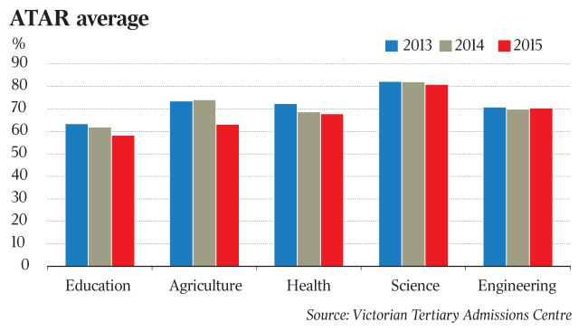
boj.org
Jobquilibrium
Boj: Hi, my name is Boj. Would you like me to assist you with finding the right course, so you are job ready?
|
X
x
BOJ
Courses
University
Boj: Awesome! What was your ATAR?
Bachelor of Computer Science
Me: 93.6
High interest, 142 pages views / day
Offers many IT and
engineering courses
Boj: Nice! You are well above the average score of 76, I can find many courses you would be eligible for! Can I request access to your Facebook and Google account so I know a bit more about you?
Average salary after first year $85,000
Quality of educational experience 78%
Big court yards
Overall graduate satisfaction 81%
Near parks
Current jobs requiring a computer science qualification 12%
Limited parking
Future jobs requiring a computer science qualification 38%
SEND

Slide 32
boj.org
Jobquilibrium
Boj: Hi, my name is Boj. Would you like me to assist you with finding the right course, so you are job ready?
|
X
BOJ
Courses
University
Boj: Awesome! What was your ATAR?
Bachelor of Computer Science
Me: 93.6
High interest, 142 pages views / day
Offers many IT and
engineering courses
Boj: Nice! You are well above the average score of 76, I can find many courses you would be eligible for! Can I request access to your Facebook and Google account so I know a bit more about you?
Average salary after first year $85,000
Quality of educational experience 78%
Big court yards
Overall graduate satisfaction 81%
Near parks
Current jobs requiring a computer science qualification 12%
Limited parking
Future jobs requiring a computer science qualification 38%
SEND

Slide 33
boj.org
Jobquilibrium
Boj: Hi, my name is Boj. Would you like me to assist you with finding the right course, so you are job ready?
|
X
BOJ
Boj: Awesome! What was your ATAR?
Courses
University
Me: 93.6
Bachelor of Computer Science
Boj: Nice! You are well above the average score of 76, I can find many courses you would be eligible for! Can I request access to your Facebook and Google account so I know a bit more about you?
High interest, 142 pages views / day
Offers many IT and
engineering courses
Average salary after first year $85,000
Quality of educational experience 78%
Big court yards
Overall graduate satisfaction 81%
Near parks
Current jobs requiring a computer science qualification 12%
Limited parking
Future jobs requiring a computer science qualification 38%
Accept
Reject

Slide 34
boj.org
Jobquilibrium
Boj: Hi, my name is Boj. Would you like me to assist you with finding the right course, so you are job ready?
|
X
BOJ
Boj: Awesome! What was your ATAR?
Me: 93.6
Processing….
Boj: Nice! You are well above the average score of 76, I can find many courses you would be eligible for! Can I request access to your Facebook and Google account so I know a bit more about you?
Accepted..
SEND

Slide 35
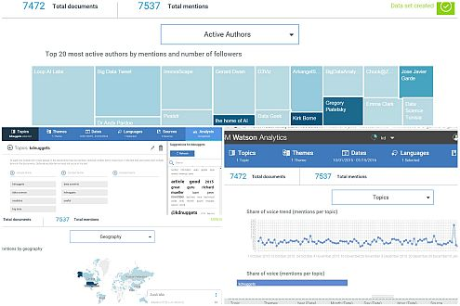
boj.org
Jobquilibrium
Boj: Hi, my name is Boj. Would you like me to assist you with finding the right course, so you are job ready?
|
X
BOJ
Me: 84.6
Boj: Nice! You are well above the average score of 76, I can find many courses you would be eligible for! Can I request access to your Facebook and Google account so I know a bit more about you?
Accepted..
Boj: Here is what I gathered about you…
View Recommendation
SEND

Slide 36

boj.org
Jobquilibrium
Boj: Hi, my name is Boj. Would you like me to assist you with finding the right course, so you are job ready?
|
X
BOJ
Boj: Nice! You are well above the average score of 76, I can find many courses you would be eligible for! Can I request access to your Facebook and Google account so I know a bit more about you?
Courses
University
Bachelor of Computer Science
High interest, 273 pages views / day
Offers many IT and
engineering courses
Average salary after first year $75,000
Accepted..
Quality of educational experience 90%
Near the beach
Boj: Here is what I gathered about you…
Overall graduate satisfaction 88%
Current jobs requiring a computer science qualification 12%
Many outdoor activities
In the area
Boj: How well did you think we did?
Future jobs requiring a computer science qualification 38%
UoW has been researching self driving cars with Tesla
1 2 3 4 5 6 7 8 9 10

