Slide 1
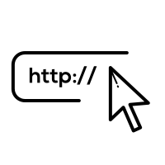

Automatic Phishing URL Identification
Team 5

Slide 2
The Team
Betz Moskowitz
N162 - Advanced Capabilities
Senior at University of Maryland studying Information Science and Business Analytics
Samuel Sommerer
N113 - Space Mission Integration
Rising Junior at University of Southern California studying Computer Science
Jacob Scrapchansky
L521 - Cyber Assessments
Rising Sophomore at Brunswick High School
Grant Dong
P232 - Safety Concepts and Evolution
Rising Senior at the University of Virginia studying Math and Computer Science
Julia Guskind
L522- Cyber Resiliency
Rising Junior at the University of Connecticut; Computer Science Major & Math Minor

Slide 3

Overview
Problem
Feature Engineering
Model Building
Results
Takeaways
Notes:
Sam

Slide 4

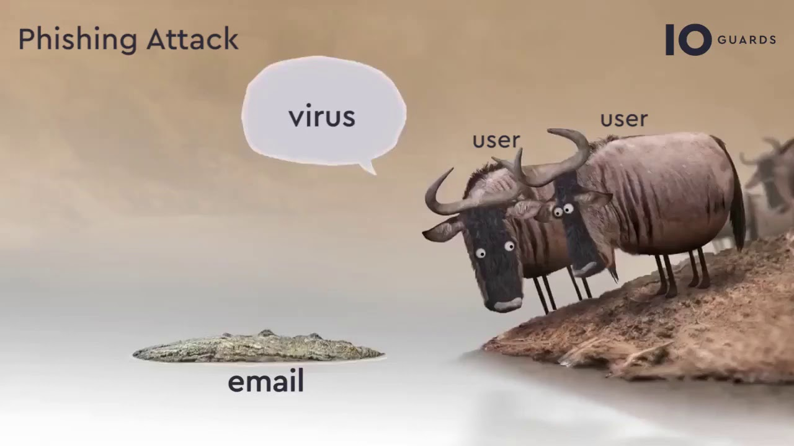
Our Problem
Notes:
The FBI reported that in 2020 alone, there were 241,324 phishing incidents.
Reference: https://www.tessian.com/blog/phishing-statistics-2020/
Phishing is a dangerous cyber threat often that often presents itself in the form of URLs.
Delete? → According to Wikipedia, phishing is a form of social engineering that attempts to steal sensitive info from a victim by disguising as something trustworthy.
Goal: Use Machine Learning to build a model that will automatically detect phishing URLs
Many people and organizations often fall victims to malicious phishing efforts.

Slide 5
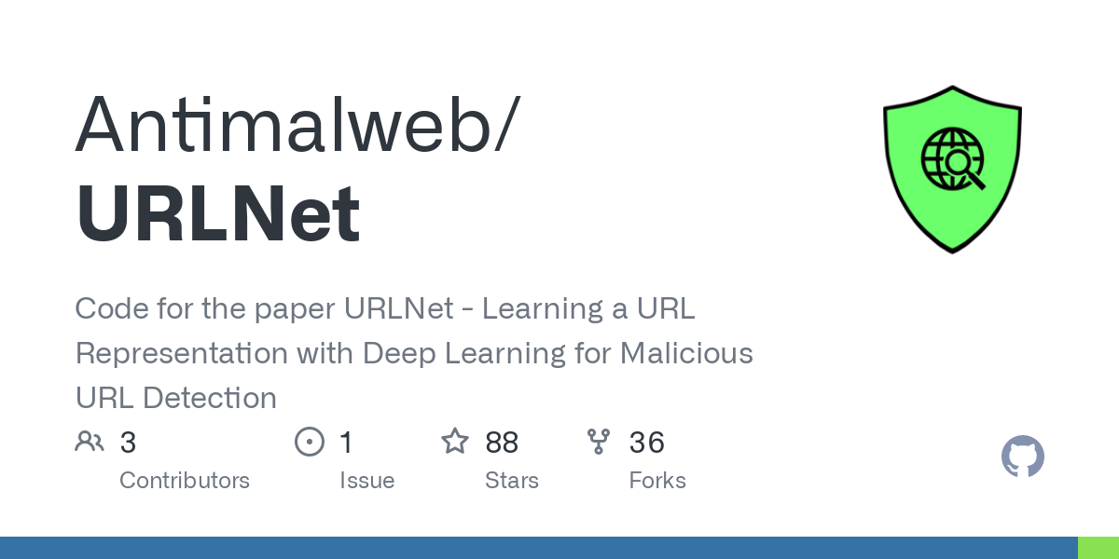









Tech Stack
Notes:
Sam

Slide 6

Feature Engineering
Example URL: http://account-google-com.ngate.my/c44cca40176...
Features extracted directly from the string URL
Number of domain periods → 2
Domain length → 25
Number of domain terms → 3 → ['account-google-com', 'ngate', 'my']
Has Sensitive Words → No → includes ['confirm', 'secure', 'login', etc...]
Has IP → No
Total Number of Periods → 2
Has Suspicious Character → Yes → includes ['-', '@', '%']
Total URL Length → 70
Number of Slashes → 3
Has Suspicious Files → No
Notes:
Grant

Slide 7
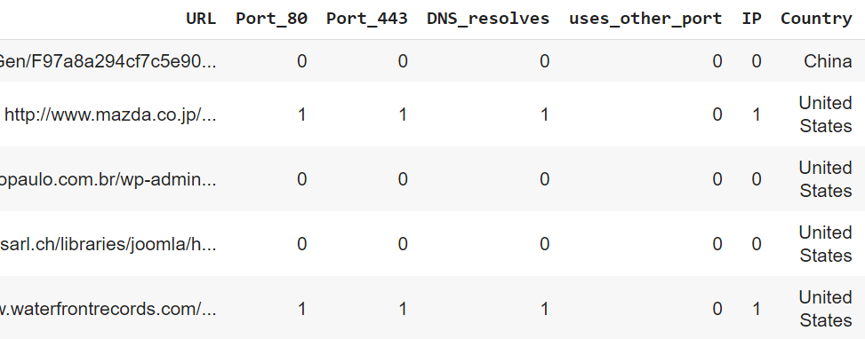
Additional Feature Engineering
Generated more information about each URL by pinging related servers
Scanned for if port 80 and port 443 were open for requests, http and https respectively
Checked if the DNS resolved given the URL’s domain/subdomain combination
Checked if the URL used a port other than 80 or 443
Extracted IP address from any domains that had a successful DNS response
Used IP address to determine most recent location using geoip2 lite country database.
Notes:
Jacob

Slide 8
URLNet Feature
URLNet: Learning a URL Representation with Deep Learning for Malicious URL Detection was a paper published that discussed using Deep Learning to detect malicious URLs
They have made their code open-source
Using their software, we used their model to make predictions on each URL
These predictions were added as features for our model
Notes:
Betz

Slide 9

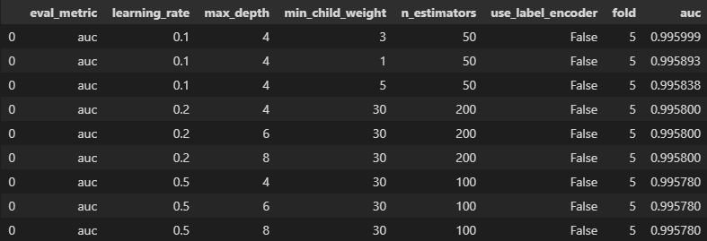
Model Building
Performed 5-fold cross-validation to tune for optimal hyperparameters for each model
Training data was split into 80% training data, and 20% validation.
Models were trained on the training data using the optimal hyperparameters, and the performance of each model was assessed predictions made on the validation data
Hyper-parameter tuning for Gradient Boosting Model
Notes:
Betz

Slide 10


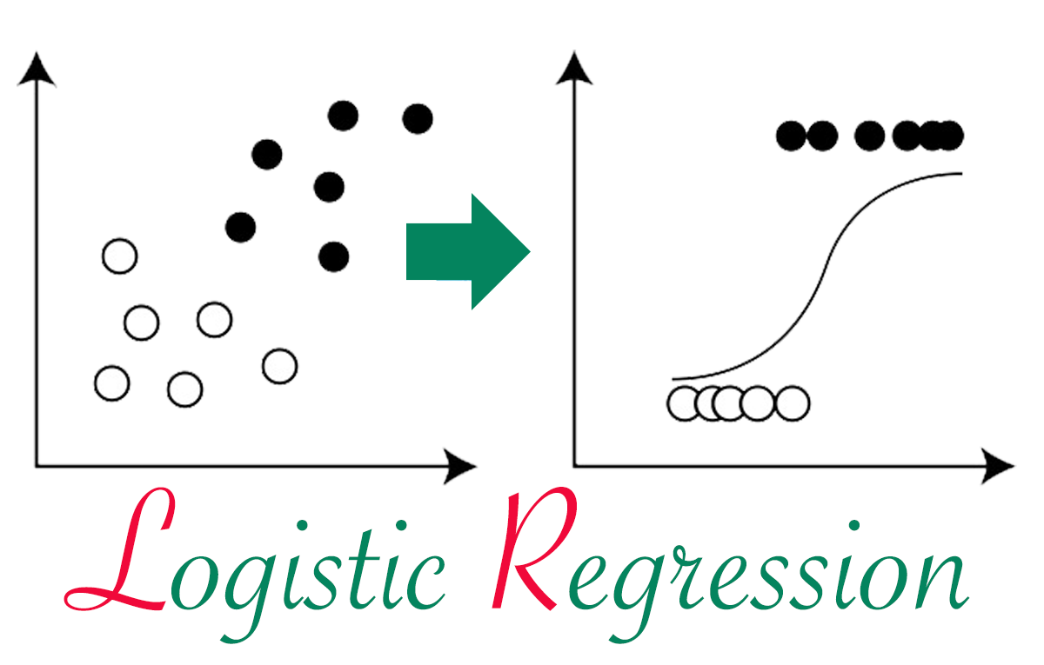

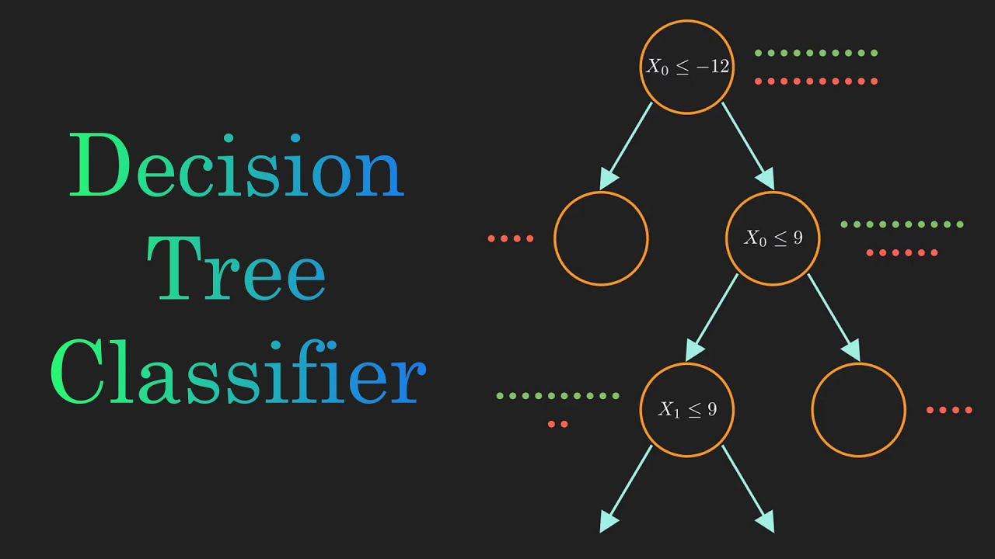
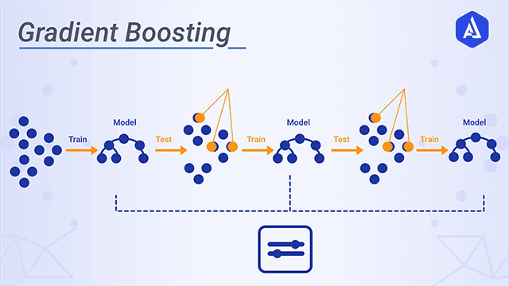

Models Used
Notes:
Betz

Slide 11
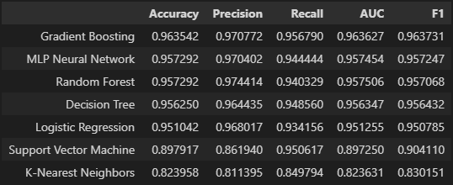
Results
Notes:
Betz
Sam talk about TensorFlow model

Slide 12
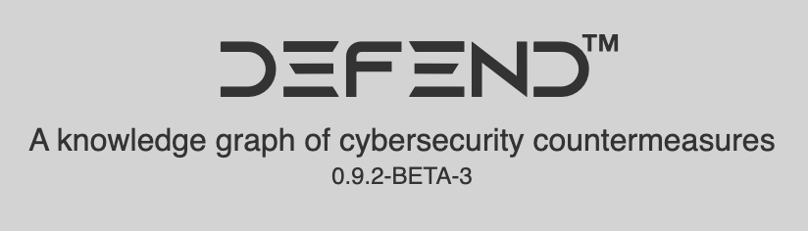

Takeaways
Most Important Features of URLs:
What would we do differently?
Real World Applications
Notes:
From the model that was built, we determined that ____ were the most important features when it came to detecting if a URL was legitimate or not.
As cybersec and AI become increasingly overlapping fields, ML models like this have more and more real world applications. An interesting prospect would be incorporating this ML model with MITRE’s ATT&CK and D3FEND frameworks, which include info about phishing attacks and URL analysis.
What would we do differently?
If we had more time we would integrate the additional features that we extracted by pinging the servers

