Slide 1
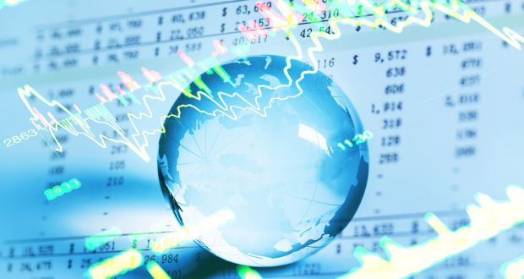
Make a crystal ball to see NZ stock market?
By Yonggang Li (18043158)
2019-09-10
Notes:
The background image is from https://www.irishtimes.com/business/personal-finance/guesswork-masquerades-as-expertise-in-stock-market-forecasts-1.3358919

Slide 2
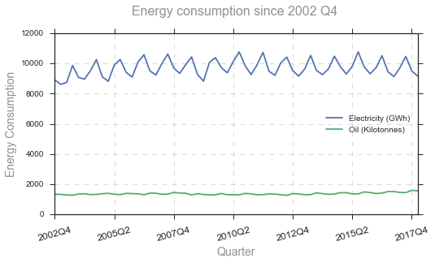
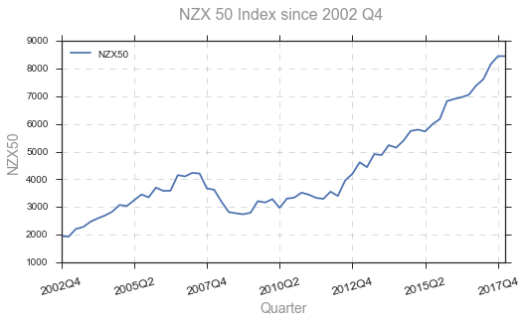
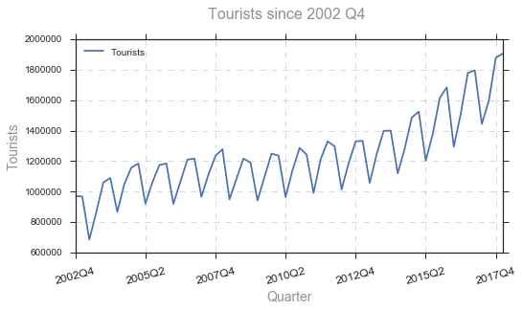
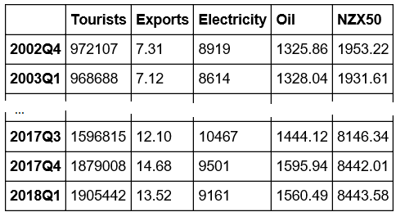
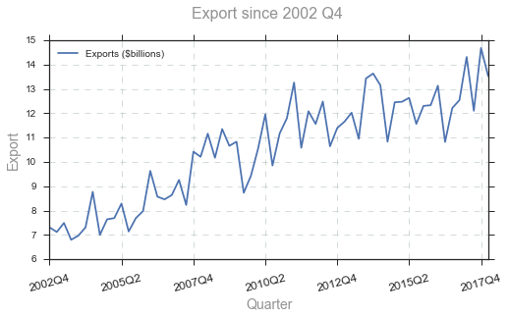
I know exactly how the economy performed ……

Slide 3
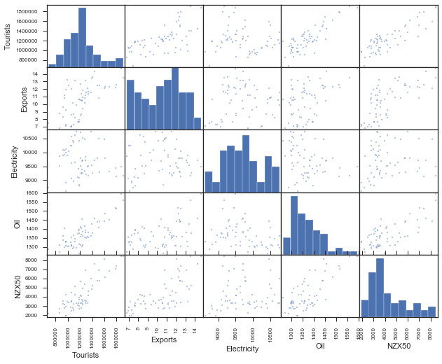
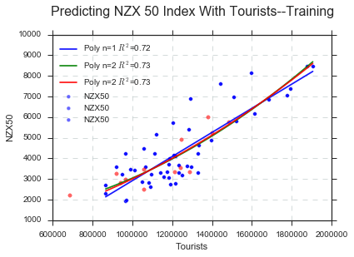
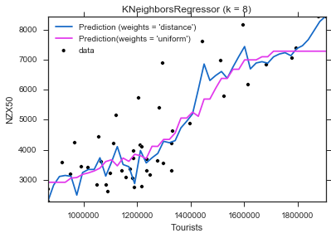
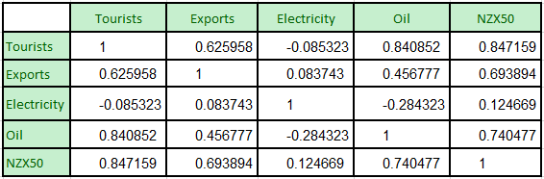
May I build prediction models to tell fortune?

Slide 4
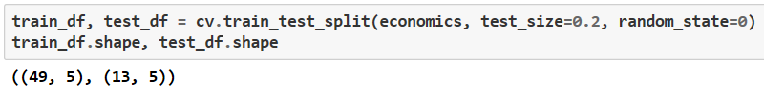
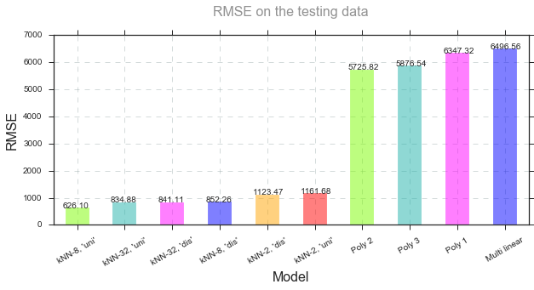
How do they perform?

Slide 5
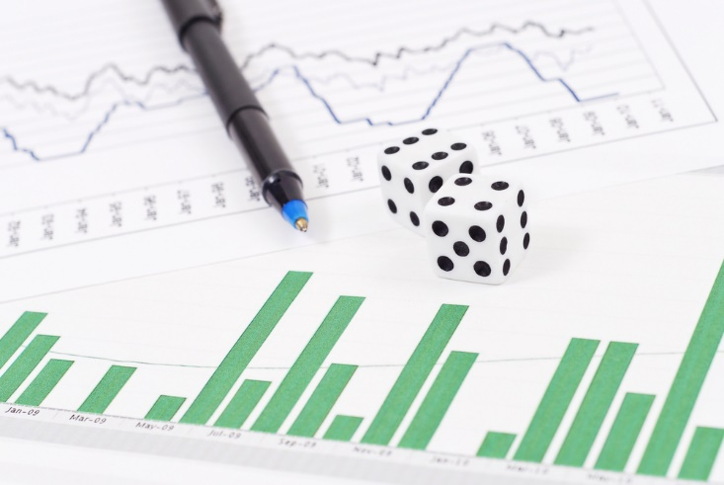
But “Expert predictions tend to be no more accurate than chance”
“Even if you had a crystal ball and knew exactly how the global economy would perform in 2018, you still could not be sure how this would impact on stock markets.”
Guesswork masquerades as expertise in stock market forecasts
Notes:
Picture is from http://retirementnews.net/time-exit-stock-market/#respond

Slide 6
Thank you!

