Slide 1
158755 Data Science - Making Sense of Data Poject 4
Question Answering Analysis
Base on Amazon question/answer data
18042783 Zoe Wang
17238744 Rebecca Liu
18043158 Yonggang Li

Slide 2
Contents
Project background
Data EDA and Cleaning
Naïve approach based on similiarties
DNN model
Limitations
References

Slide 3


What is Question Answering System
This technology can realize automatic speech recognition (ASR) through deep learning function, which can convert speech into text, and can recognize the intention of text through natural language understanding (NLU) technology.
Both Allo and Amazon are include the processing and classification of natural language texts

Slide 4
Our Goal
Build a model to answer the customer questions automatically
Answer questions based on simple similarities
Build Deep Neural Network with Tensorflow to generate answer

Slide 5
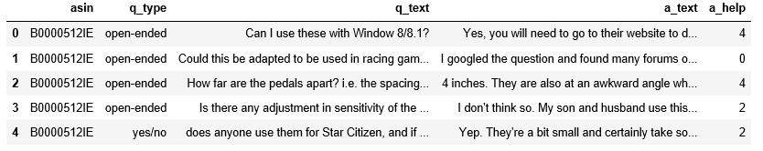
Raw Data Sample
Amazon video game Q&A http://jmcauley.ucsd.edu/data/amazon/qa/qa_Video_Games.json.gz
{ 'asin': 'B0000512IE', < -- product ID
'questions': [
{'questionType': 'open-ended',
'askerID': u'A39TQ7XW6P36BU',
'questionTime': u'June 29, 2014',
'questionText': u'Can I use these with Window 8/8.1?',
'answers': [
{'answerText': u"Yes, you will need to go to their website ...",
'answererID': u'AH14F9TYDABNH',
'answerTime': u'June 29, 2014',
'helpful': [2, 2]},
{'answerText': ...},
{'answerText': ...} ]
{'questionType': ...},
{'questionType': ...} ]
}
{ 'asin': 'B0000512IE',
'questions': …
}
Total 7744 questions

Slide 6
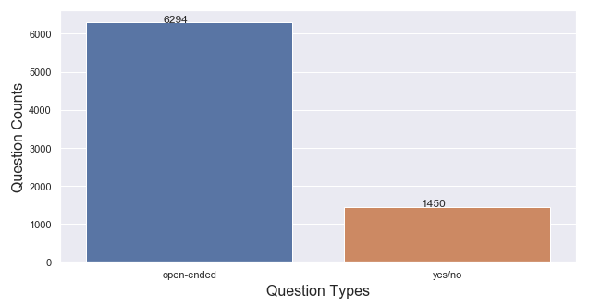
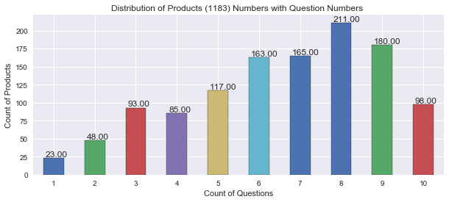
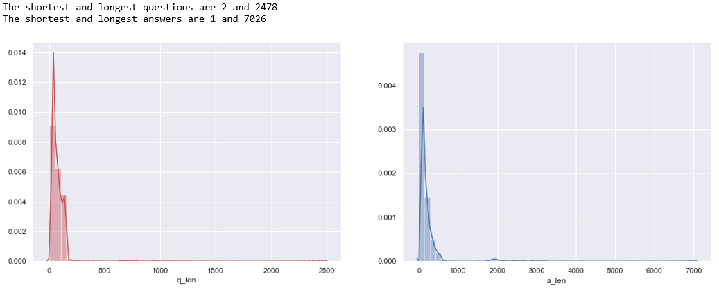
Look into Questions / Answers
Question length:
90 > 200
Answer length:
289 > 500
116 > 2000

Slide 7
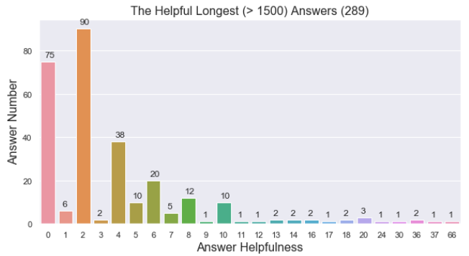
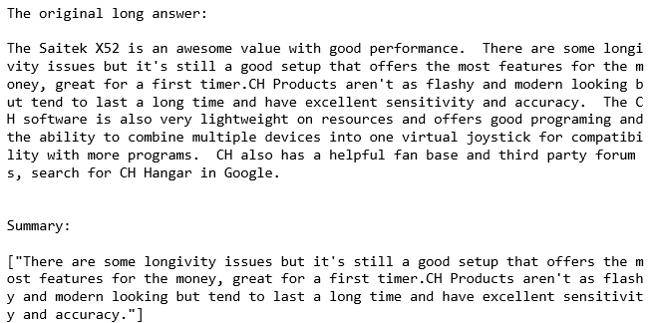
Helpfulness of the Long Answers
Since most of them are very helpful, we can give each of them a concise summary for user's quick reference.
Summarize the answer and show the top 1 sentence

Slide 8
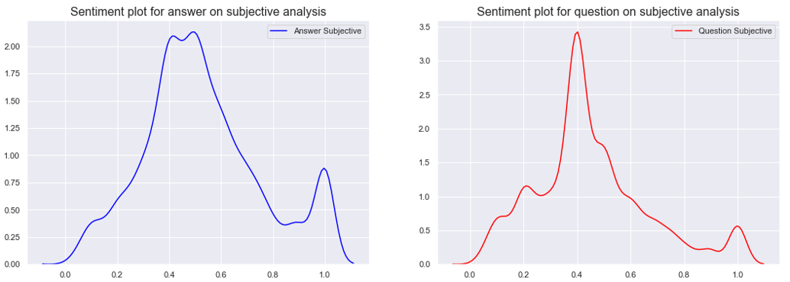
Sentiment Analysis
Questions and answers have the similar distributions
Pay attention to the peak at the right end, annoying or amazing products or usage?
Notes:
We did not analyze positive or negative

Slide 9
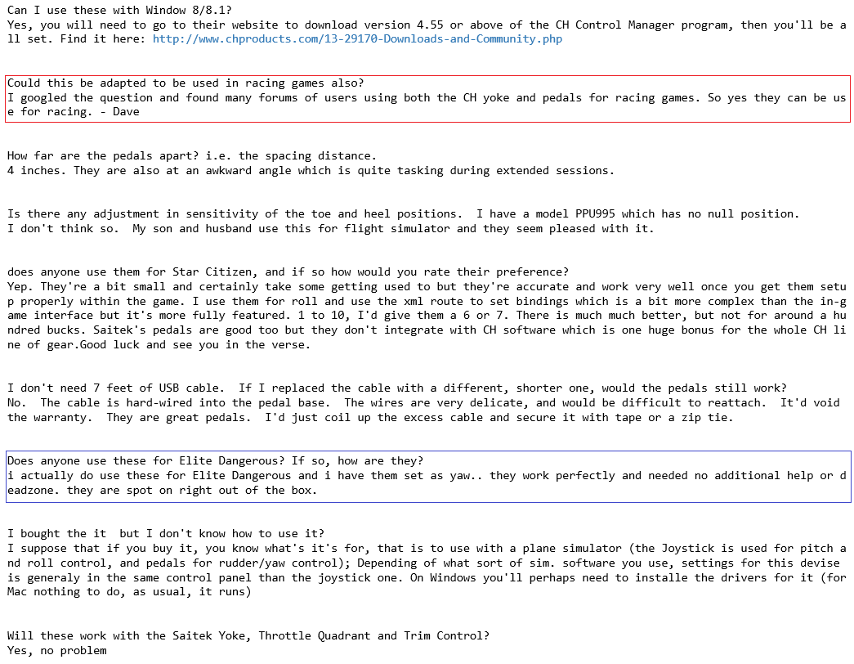
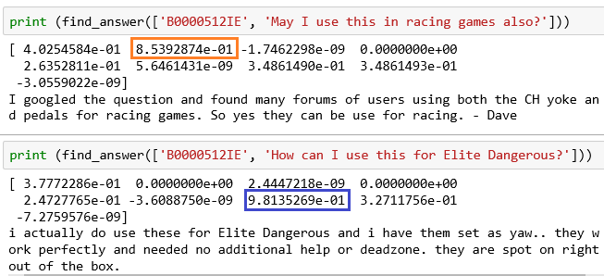
Naive way – Question Similarities
Intuitively, if a user asks a question that has been answered, we can simply return the answer. Generally, return the answer to the most ‘similar’
User only posts questions under a specific product, say ‘B0000512IE’
Set up a corpus with all questions of this product
corpus = [dictionary.doc2bow(text) for text in q_base]
Calculate the similarities
similarities.MatrixSimilarity(lsi_model[corpus])
Find the question which has the highest similarity and return the answer

Slide 10

Limitation of Naïve way
Quick, since only check the questions for the same product
Not leverage the whole knowledge base, e.g. could not recognize ‘computer’, ‘laptop’, ‘Mac book’ are same things
Could not respond to brand new questions or give a ridiculous answer
Notes:
Picture is from http://thebroadcastmusic.com/wp-content/uploads/2013/09/look-ahead.jpg

Slide 11
Neural Network Idea
Neural network
inputs and targets should be vectors of fixed dimensionality.
Q-A sequence mapping
a sequence of words representing the question
a sequence of words representing the answer
Multilayered Long Short-Term Memory (LSTM)
LSTM encoder: input sequence to a vector of a fixed dimensionality
LSTM decoder: to decode the target sequence from the vector.
our questions and answers has different lengths

Slide 12
Step1 Vectorize words
used to produce word embeddings.
These models are shallow, two-layer neural networks that are trained to reconstruct linguistic contexts of words.
Word2vec takes as its input a large corpus of text and produces a vector space, typically of several hundred dimensions, with each unique word in the corpus being assigned a corresponding vector in the space.
Word2vec takes as its input a large corpus of text and produces a vector space, typically of several hundred dimensions, with each unique word in the corpus being assigned a corresponding vector in the space.

Slide 13
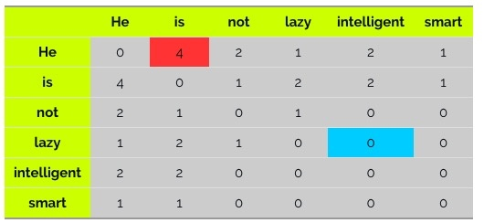
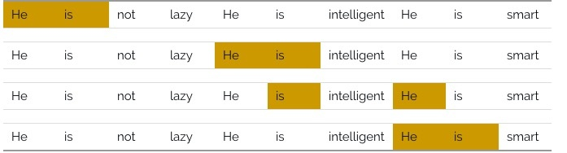
Word2Vec
Co-occurrence matrix
It keep the semantic relationship between words. For example, Men and women tend to have closer relationships than men and apples.
It use SVD at its core, and it produces a more accurate representation of terms than existing methods.
It only needs to be calculated once and can be used at any time, which means it's faster than the others
corpus = He is not lazy. He is intelligent. He is smart.

Slide 14
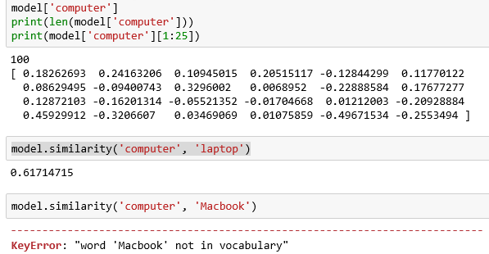
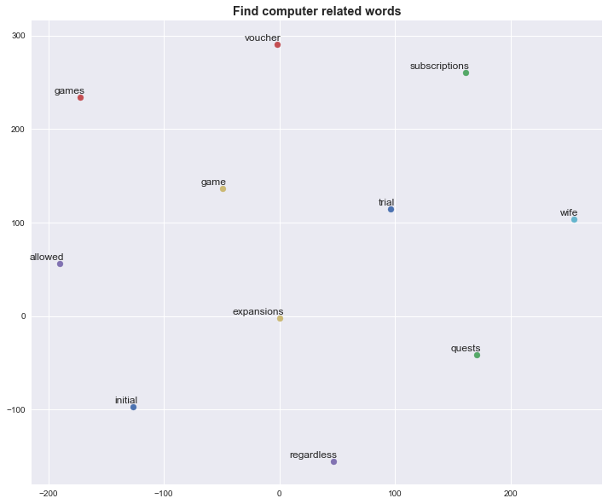
An example -- Computer
TSNE(perplexity=40, n_components=2, init='pca', n_iter=2500, random_state=23)

Slide 15
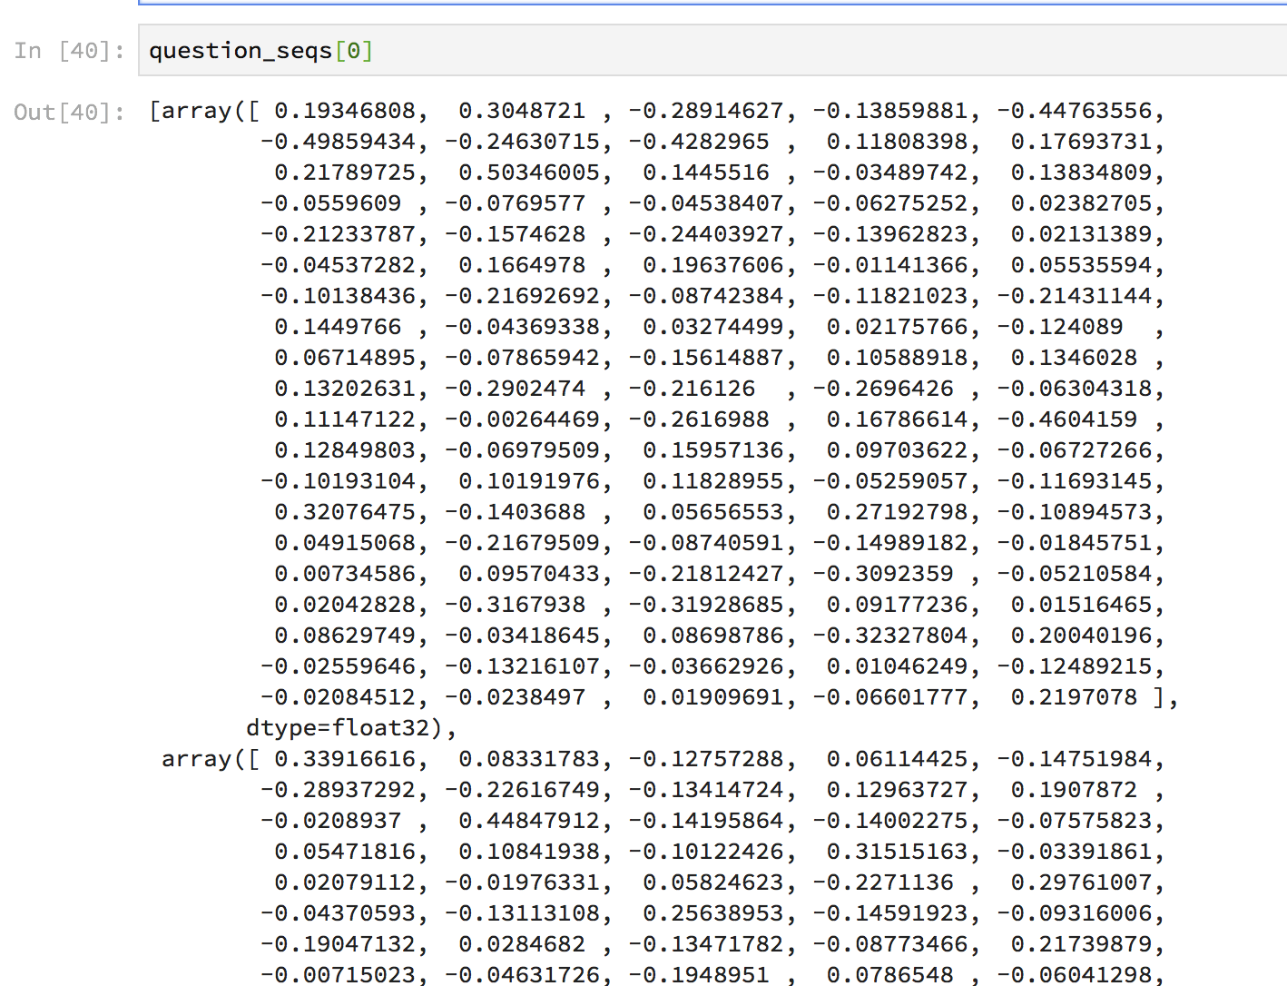
Step2 Q-A Senquence

Slide 16
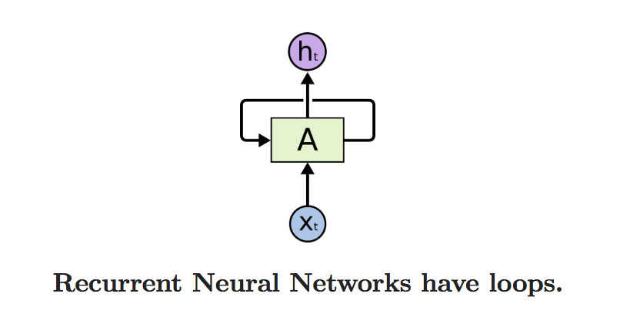
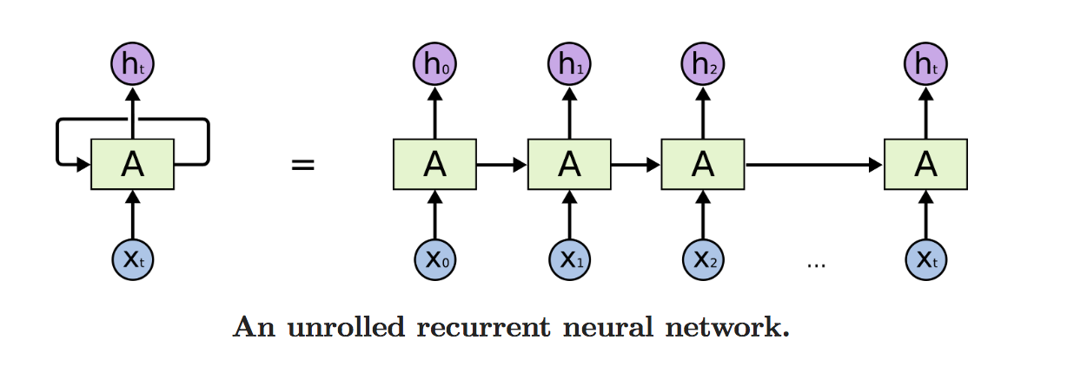
Long Short-Term Memory (LSTM)
As you read this essay, you understand each word based on your understanding of previous words.
They are networks with loops in them, allowing information to persist.
A recurrent neural network can be thought of as multiple copies of the same network, each passing a message to a successor.
One of the appeals of RNNs is the idea that they might be able to connect previous information to the present task.

Slide 17
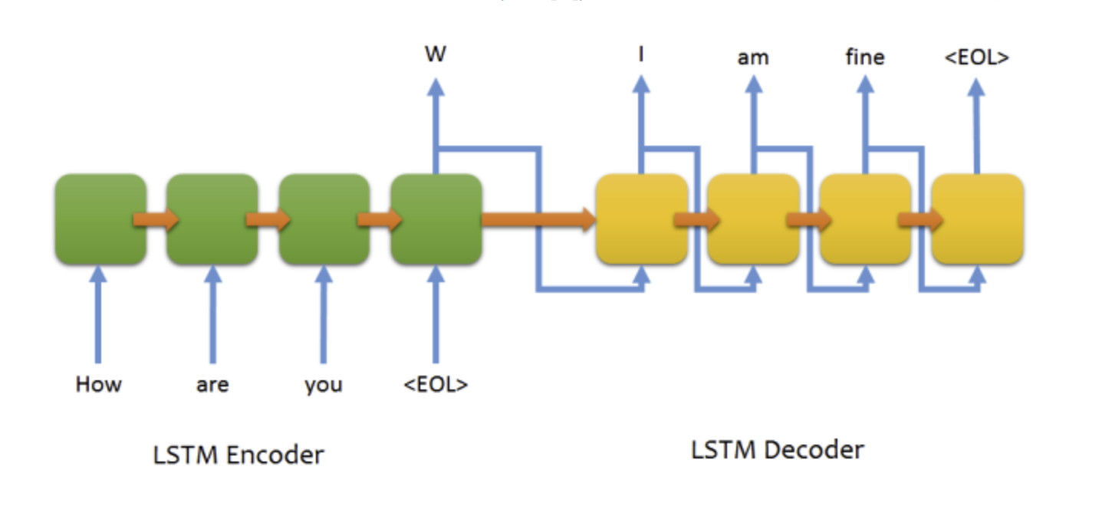
Sequence to Sequence Learning (Seq2seq)
Key features:
The lengths of input and output sequences can be different
LSTMs can transfer a ‘context vector’ from the previous sequence to the current sequence

Slide 18
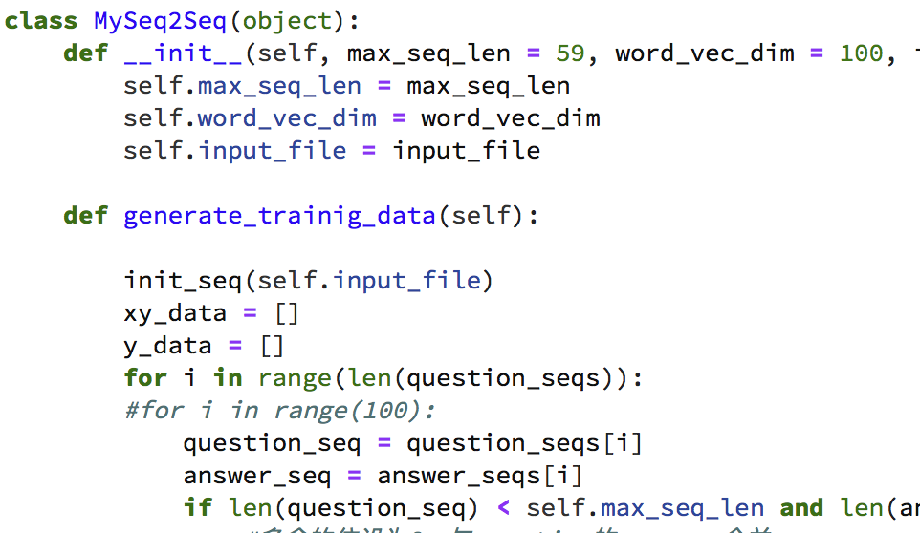
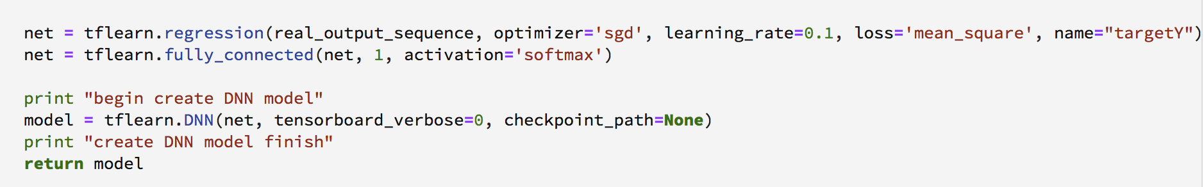
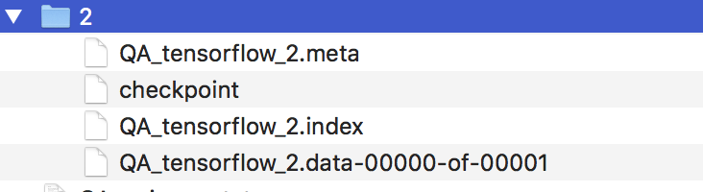
Step3 Implementation-Tensorflow
Gernate TrainX,TargetY
Seq2Seq Model
LSTM Encoder
LSTM Decoder
Tensorflow network
Train data

Slide 19
Step4 Predict
Input a question
Transfer the question to a Tensorflow input
Use our model to predict the target which is a list of vectors
Translate the target to a text

Slide 20
Limitation and Future Work
NLP is a big area, involve lots of knowledge and technologies, Word2Vec, RNN, …
Fast evolving libraries ，tensorflow, gensim, …
Take long time to train the model
Generate human friendly answers

Slide 21
Reference
Massey University Course 158755 tutorial
https://medium.com/@adityathakker/introduction-to-word2vec-how-it-works-453ab2fb0721
http://scikit-learn.org/stable/auto_examples/manifold/plot_t_sne_perplexity.html
https://radimrehurek.com/gensim/similarities/docsim.html
http://seaborn.pydata.org/generated/seaborn.barplot.html
Understanding LSTM Networks(http://colah.github.io/posts/2015-08-Understanding-LSTMs/)
https://github.com/farizrahman4u/seq2seq
Sequence to Sequence Learning with Neural Networks (http://cn.arxiv.org/pdf/1409.3215.pdf)

