Slide 1
Autoencoder and Deep Neural Network
159740_2018_S2FS_AKLI Seminar
18042783 Zoe Wang
17238744 Rebecca Liu
18043158 Yonggang Li

Slide 2
Content
What’s Autoencoder
Applications
Initialize deep Neural Network with Autoencoder
Implementation
discussion

Slide 3
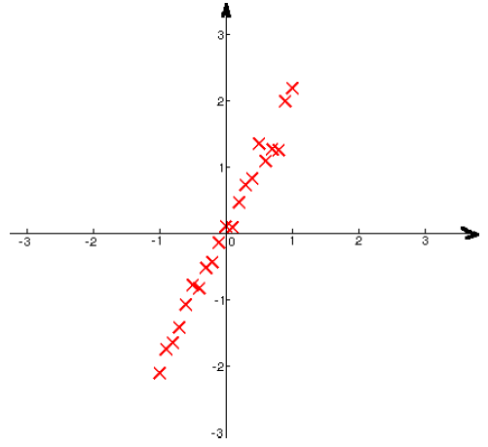
What’s Autoencoder -- a simple example
Problem: send some data from my cellphone to the cloud with limited network usage
I find Y=2X
Just send X
Reconstruct Y’=2X
Cost
Computation
Lossy
Benefit,
it reduces the network traffic by 50%

Slide 4
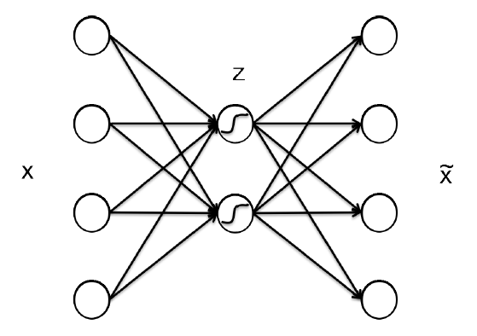
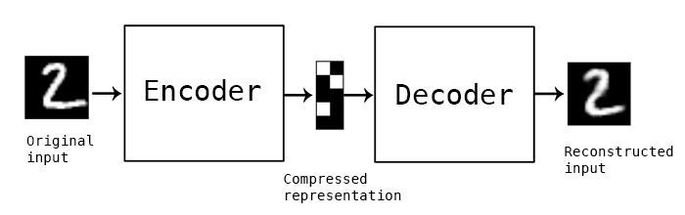
What’s Autoencoder -- formally
A general way to map a high dimensions data set X to another lower dimensionality data set Z, where Z can faithfully reconstruct X
map data from
4 dimensions to
2 dimensions
Input’=Decoder(Encoder(Input))
Learned representations
Notes:
An unsupervised learning algorithms, the data only have x's but do not have y.

Slide 5

Reconstruction error
As our goal is to have Z to approximate X, set up loss function
If the input is interpreted as vectors of bit probabilities, cross-entropy of the reconstruction error can be used:
Minimized by stochastic gradient descent

Slide 6
Activation functions of Autoencoders
Just like a normal neural network,
linear activation function if the data lie on a linear surface
f(x) = wx+b
If the data lie on a nonlinear surface, it makes more sense to use a nonlinear activation function
sigmoid, ReLU, tanh
If the data is highly nonlinear, one could add more hidden layers

Slide 7
Stacked/Deep Autoencoder
MNIST digit classification database,
Assuming a neural network architecture of 784-50-10, so two stacks of autoencoders
First 784-50-784,
the second takes the output of the previous autoencoder, will have the architecture 50-10-50.

Slide 8
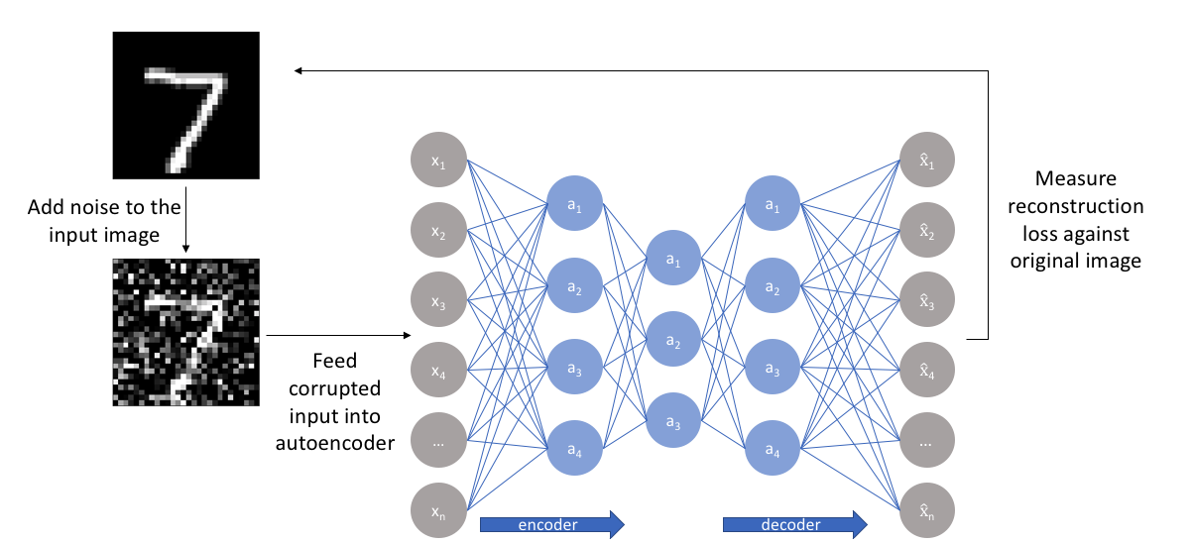
Denoising autoencoders
https://towardsdatascience.com/teaching-a-variational-autoencoder-vae-to-draw-mnist-characters-978675c95776
https://medium.com/@connectwithghosh/denoising-images-using-an-autoencoder-using-tensorflow-in-python-1e2e62932837
Notes:
The image shows how a "denoising“ autoencoder may be used to generate correct input from corrupted input.
With this approach, our model isn't able to simply develop a mapping which memorizes the training data because our input and target output are no longer the same. Rather, the model learns a vector field for mapping the input data towards a lower-dimensional manifold if this manifold accurately describes the natural data, we've effectively "canceled out" the added noise.
Another important autoencoder, Sparse Autoencoders, but that beyond my resource

Slide 9
Rebecca

Slide 10
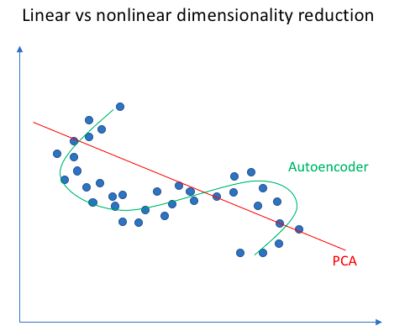
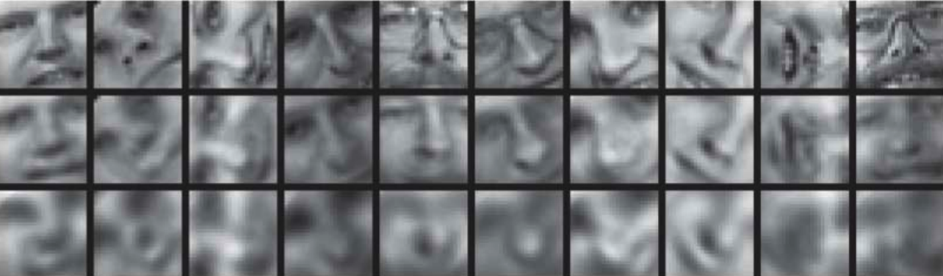
Applications -- Dimensionality
PCA attempts to discover a lower dimensional hyperplane which describes the original data,
Autoencoders are capable of learning nonlinear manifolds (a manifold is defined in simple terms as a continuous, non-intersecting surface).
Origin (2000)
Autoencoder (30)
PCA (30)

Slide 11
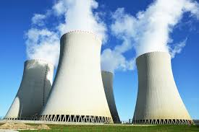

Applications--One-Class Classification
Sufficient data for the positive class and very few or no data for the negative class, e.g. the operational status of a nuclear plant or an airplane
Train an AE on positive data and learn features and then compute reconstruction error on the training set to find a threshold.
During testing, you can use this threshold to reject those test instances whose values are greater than this threshold.

Slide 12
Applications –initialize a Deep Neural Network
DNN is powerful, but,
The magnitudes of gradients in the lower layers and in higher layers are different
learning nothing or vanishing gradient problem
Deep networks have many parameters, which can remember training data and do not generalize well.
Deep networks trained with backpropagation (without unsupervised pretraining) perform worse than shallow networks (Bengio et al., NIPS 2007)
Notes:
It is very slow in networks with multiple hidden layers.

Slide 13
Solution to train a deep neural network
train a sequence of shallow autoencoders, greedily one layer at a time, using unsupervised data
train the last layer using supervised data
use backpropagation to tune the entire network using supervised data
Pre train

Slide 14
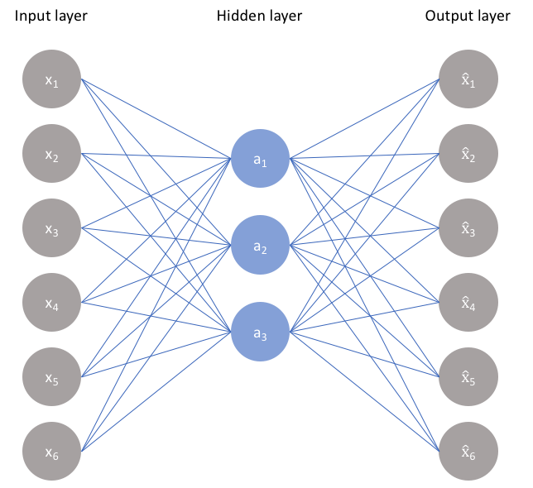

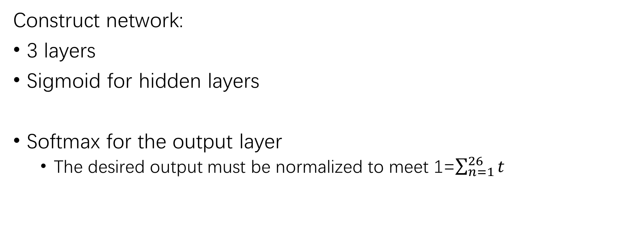
Construct Autoencoder
Construct network:
3 layers
Sigmoid for hidden layers
Softmax for the output layer
The desired output must be normalized to meet 1=$\sum_{n=1}^{26}{t}$

Slide 15
How – first layer
Include bias
W₂
W₃
W₁
W₁
W₁‘
…
Notes:
Suppose I would like to train a relatively deep network of two hidden layers to classify some data. The parameters of the first two hidden layers are W1 and W2 respectively. Such network can be pretrained by a sequence of two autoencoders, in the following manner:
To train the red neurons, we will train an autoencoder that has parameters W1 and W01
After this, we will use W1 to compute the values for the red neurons for all of our data, which will then
be used as input data to the subsequent autoencoder. The parameters of the decoding process W01
will
be discarded. The subsequent autoencoder uses the values for the red neurons as inputs, and trains an
autoencoder to predict those values by adding a decoding layer with parameters W02
.

Slide 16
How – second layer
Include bias
W₂
W₃
W₂
W₂‘
W₁
…

Slide 17
How -- last layer
Include bias
W₂
W₃
W₃
W₁
W₃‘
…
…
…
input
desired output

Slide 18
Bevan

Slide 19
Implementation
All code available at https://github.com/MasseyStudyGoup/Autoencoder
Neuron
Network
…
Layer

Slide 20
Implementation
class Layer
{
Layer(int leftNeurons, int neurons, int rightNeurons);
virtual void calcOutput(Layer* pLeft);
virtual void calcError(Layer* pRight);
virtual void updateWeights(Layer* pRight, double learningRate);
void copyWeights(Layer* fromLayer);
void setDesiredOuput(double* vals);
double* getOutput();
…
};
class Neuron
{
int m_connections;
double m_o; //actual ouput
double m_t; //desired output
double* m_w; //weights
};
class SoftmaxLayer : public Layer
{
SoftmaxLayer(int leftNeurons, int neurons, int rightNeurons);
virtual void calcOutput(Layer* pLeft);
virtual void calcError(Layer* pRight);
};

Slide 21
Implementation
Construct
Autoencoder::Autoencoder(int inputNeurons, int hiddenNeurons, double learningRate){
m_learningRate = learningRate;
m_pInput = new Layer(0, inputNeurons, hiddenNeurons);
m_pHidden = new Layer(inputNeurons, hiddenNeurons, inputNeurons);
m_pOutput = new SoftmaxLayer(hiddenNeurons, inputNeurons, 0);
}
Train
feed forward
pInput->setInput(input);
m_pHidden->calcOutput(m_pInput);
m_pOutput->calcOutput(m_pHidden);
back propagate
m_pOutput->calcError(nullptr);
m_pHidden->updateWeights(m_pOutput, learningRate);
m_pHidden->calcError(m_pOutput);
m_pInput->updateWeights(m_pHidden, learningRate);

Slide 22
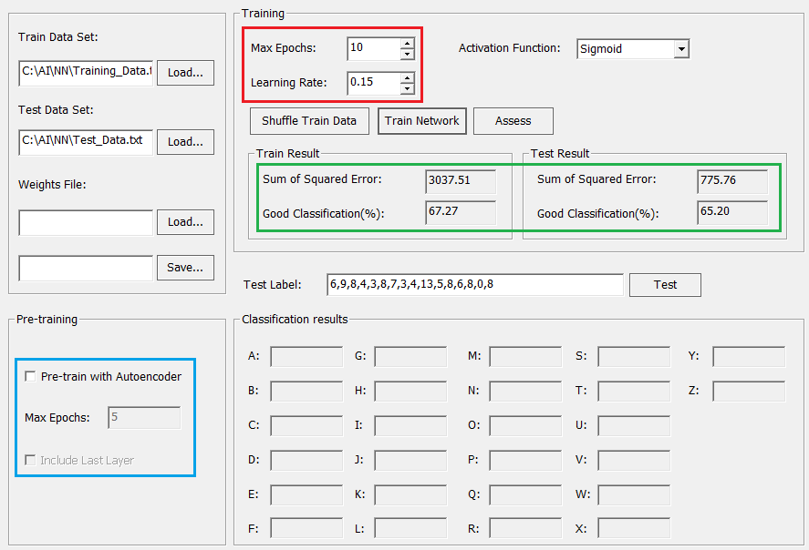
Demo and result – Random

Slide 23
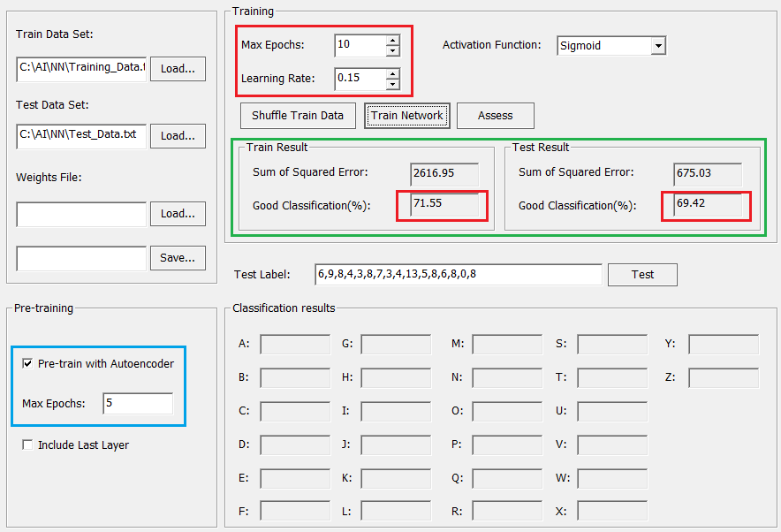
Demo and result – Autoencoder without the last layer

Slide 24
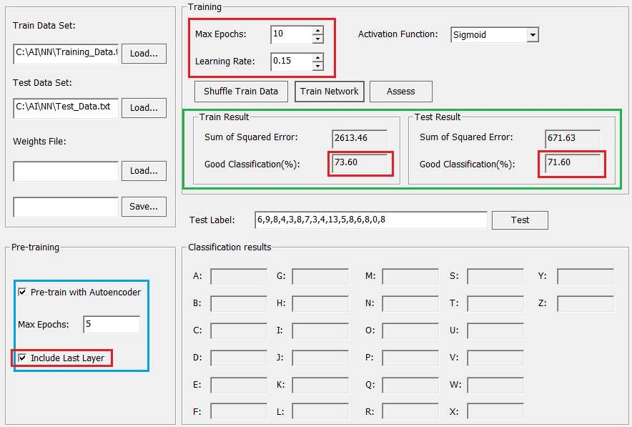
Demo and result – Fully Pre-train

Slide 25
Discussion
Autoencoder filters the noise and discovers the latent and robust features
“perhaps because pretraining is done one layer at a time which means it does not suffer from the difficulty of full supervised learning.” [2]
Dynamic learning rate?

Slide 26
Re-cap
What’s Autoencoder and its applications
Denoising and Stacked Autoencoders
How Autoencoder be used to initializing DNN
Our implementation and experiments

Slide 27
References
[1] https://www.jeremyjordan.me/autoencoders/
[2] Quoc V. Le, A Tutorial on Deep Learning Part 2: Autoencoders, Convolutional Neural Networks and Recurrent Neural Networks, October 20, 2015
[3] http://cs231n.stanford.edu/slides/2018/cs231n_2018_lecture12.pdf
[4] http://ufldl.stanford.edu/wiki/index.php/Stacked_Autoencoders
[5] https://web.stanford.edu/class/cs294a/sparseAutoencoder.pdf
[6] http://deeplearning.net/tutorial/dA.html#daa

Slide 28
Thank you!

