Slide 1
EDM Baseline vs CRUMB DDPM vs Classifier-Guided Diffusion
Class-conditional FR-I / FR-II radio-galaxy generation · CRUMB FITS, 150x150

Slide 2
Key differences
 | EDM baseline | diffusion (DDPM) | CGD
Role | literature reference (Vicanek Martinez 2024) | this project's CRUMB-dataset baseline | DDPM + external steer
U-Net | UNet2DModel, ~29.8M | UNet2DConditionModel, ~95.9M | same as DDPM
Conditioning | additive class embedding | cross-attention (dim 256) | cross-attention (dim 256)
Noise process | continuous sigma (Karras) | 1000-step discrete, linear beta | 1000-step discrete, linear beta
Target / loss | clean image / sigma-weighted L2 | noise (epsilon) / plain MSE | noise (epsilon) / plain MSE
Sampler | Heun ODE, 25 steps, EMA | ancestral DDPM, 50 steps | ancestral DDPM, 50 steps
Guidance | CFG (3.0) | CFG (7.5) | CFG + noise-aware classifier gradient (strength 3)
Shared: task, CRUMB FITS pipeline, symmetric-log-SNR normalisation, CFG-style class conditioning, FID/KID/PDF evaluation.

Slide 3
Results
Distributional metrics (best over training)
Model | FID ↓ | KID ↓ | pixel-PDF W ↓ | Epochs
EDM baseline (mean ± std, n=5: seeds 42-46) | 87.3 ± 5.0 | 0.048 ± 0.005 | 0.0036 ± 0.0009 | 400 (complete)
diffusion (DDPM+CFG) (mean ± std, n=4: seeds 42-45) | 73.4 ± 1.4 | 0.021 ± 0.003 | 0.0077 ± 0.0021 | 400 (complete)
CGD* (mean ± std, n=5: seeds 42-46) | 74.4 ± 5.2 | 0.024 ± 0.005 | 0.0078 ± 0.0009 | 400 (complete)
EDM and CGD have all 5 seeds; DDPM has 4 (seed 46 hit its time limit at epoch 260). Std is the sample std across seeds. *CGD sampled with its original, broken guidance classifier - effectively CFG only (see slide 6).
CRUMB VQ-VAE reconstruction fidelity (VQ-VAE trained only on real CRUMB)
Passed through the CRUMB VQ-VAE | N | Recon MSE ↓ | Recon NCC ↑
Real held-out CRUMB (reference) | 178 | 0.00377 | 0.652
EDM-generated (latest, final) | 32 | 0.00271 | 0.763
DDPM-generated | 16 | 0.00174 | 0.771
CGD-generated (latest, ep 290) | 32 | 0.00300 | 0.725
DDPM and (unguided) CGD beat EDM on FID/KID; EDM keeps the best pixel-PDF W. DDPM best on VQ-VAE reconstruction fidelity. Working-guidance CGD results: slides 6-8.

Slide 4
Classifier accuracy on generated samples
Does the model generate the class it was asked for? 128 samples per class per seed, scored by a held-out classifier
Model | Seeds | Class accuracy | FR-I | FR-II | Mean confidence
Real CRUMB test images (reference) | - | 78.1 % | 84.6 % | 73.0 % | -
EDM baseline | 5 | 80.7 ± 1.8 % | 71.6 ± 6.5 % | 89.8 ± 3.5 % | 0.743 ± 0.014
diffusion (DDPM+CFG) | 4 | 96.5 ± 1.5 % | 93.0 ± 2.9 % | 100.0 ± 0.0 % | 0.910 ± 0.015
CGD* (broken guidance classifier) | 5 | 97.1 ± 2.4 % | 95.3 ± 2.9 % | 98.9 ± 2.0 % | 0.891 ± 0.049
- A model matching real data would score like the reference row, not 100%. DDPM/CGD overshoot on both classes: their samples are more clear-cut than real galaxies.
- EDM is close to real overall, but every model reverses the real per-class pattern (real FR-I 85% > FR-II 73%) at every guidance scale - EDM most strongly (FR-I 72%, FR-II 90%).
- *CGD here is effectively CFG only: its guidance classifier was broken (slide 6). With a working one it improves (slides 7-8).
- Confound: EDM samples at CFG 3.0, DDPM/CGD at 7.5 - stronger guidance exaggerates class features.
Scored by eval_fits_bs8_seed42 (SimpleCNN, crumb_fits domain, never used to guide CGD; real-test reference from its confusion matrix, n=178). Mean ± sample std across seeds. DDPM seed 46 incomplete.

Slide 5
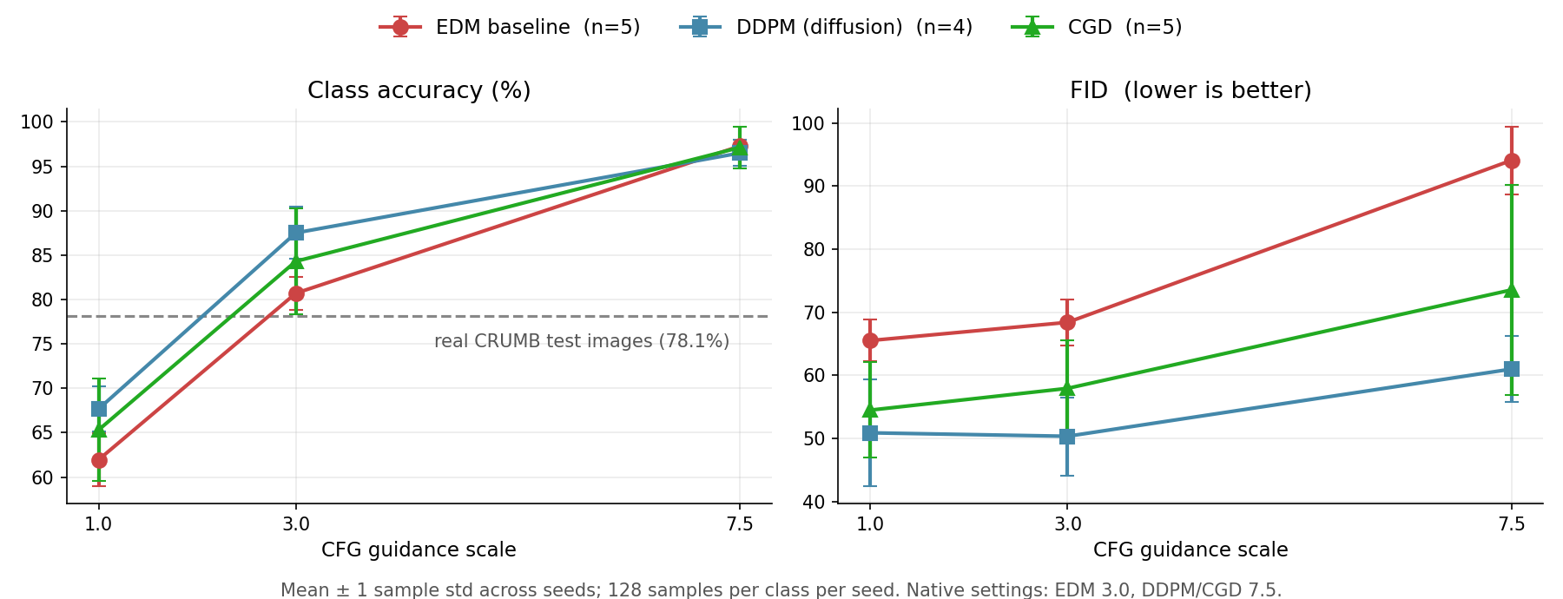
Matched guidance: accuracy and FID vs CFG scale
Same checkpoints re-sampled at CFG 1.0 / 3.0 / 7.5 - separates architecture from guidance strength
- At every matched scale DDPM beats EDM on FID (50.9 vs 65.5, 50.4 vs 68.4, 61.0 vs 94.1) and on class accuracy up to 3.0 - the lead is architectural, not guidance.
- CFG 7.5 costs every model FID; 3.0 is the better operating point (best FID, accuracy nearest real). CGD line: broken guidance classifier (effectively CFG only).
FID from 256 generated images per seed vs the 357-image crumb_fits val split - not comparable in absolute terms to the training-time FID table.

Slide 6
CGD's guidance classifier was broken
Guidance queries the classifier on noisy, half-formed images at every sampling step - it must work under noise
Guidance classifier | Trained on | Noise-aware | Clean acc | Acc @ t=100 | Acc @ t=200 | Behaviour during sampling
scratch (original CGD) | linear crumb (wrong domain) | no | 42 % | 42 % | 42 % | predicts FR-I for every image: gradient ~0
SimpleCNN, crumb_fits (quick fix) | crumb_fits | no | 77 % | 58 % | 58 % | predicts FR-II for all t > 50: last ~2 steps only
ResNet50 + timestep (robust) | crumb_fits + DDPM noise | yes | 75 % | 73 % | 63 % | tracks the requested class, 0.5 -> 0.9
- All earlier CGD results used 'scratch': collapsed to a constant prediction on crumb_fits images, so its gradient was 0.01-0.1% of the update - CGD was effectively DDPM + CFG.
- A correct-domain classifier trained on clean images still collapses once noise is added (t >= 50 of 1000), so it can only steer the final steps.
- Fix: noise-aware classifier (Dhariwal & Nichol 2021) - ResNet50 trained on crumb_fits images noised with the diffusion schedule, given t as input. Clean test acc 83.2 %.
- CGD checkpoints are unchanged - guidance acts only at sampling time, so no diffusion retraining was needed.
Accuracy on real crumb_fits validation images noised to timestep t (diagnose_cgd_guidance.py). Chance ~ 56 % (majority class).

Slide 7
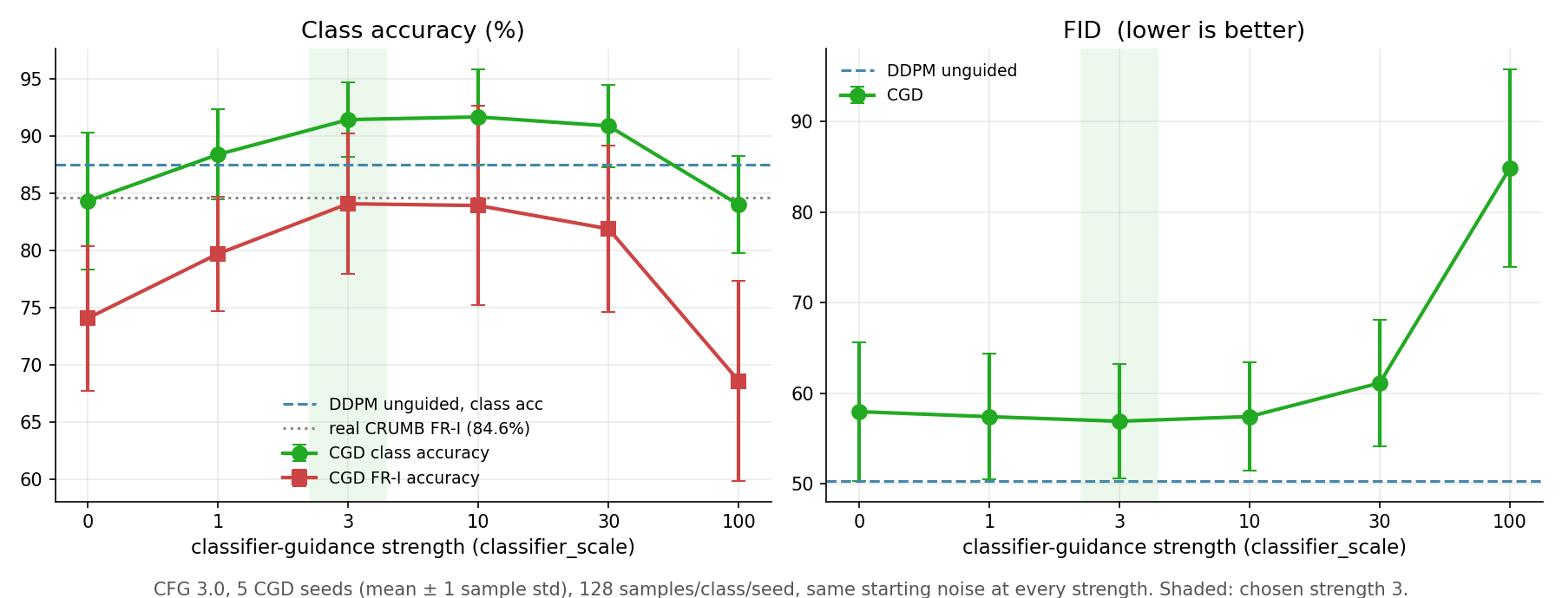
CGD with a working guidance classifier
Robust classifier guidance at CFG 3.0 - classifier-guidance strength sweep
- Strength 3: class accuracy 84.3 -> 91.4 %, FR-I 74.1 -> 84.1 % (real 84.6 %), FID 58.0 -> 56.9, KID 0.039 -> 0.037 - no quality cost.
- Plateau at 3-10; FID degrades from 30; at 100 guidance overwhelms the model (FID 84.9) and accuracy falls back to unguided.
Guide (ResNet50, noise-aware) and scorer (SimpleCNN) are independent architectures, so the gain is not the guide fooling a copy of itself.

Slide 8
All models at CFG 3.0
Same scoring classifier, same real reference, 128 samples per class per seed
Model | Seeds | Class acc | FR-I | FR-II | FID ↓ | KID ↓
Real CRUMB test images (reference) | - | 78.1 % | 84.6 % | 73.0 % | - | -
EDM baseline | 5 | 80.7 ± 1.8 % | 71.6 % | 89.8 % | 68.4 ± 3.7 | 0.056
DDPM | 4 | 87.5 ± 2.9 % | 79.5 % | 95.5 % | 50.4 ± 6.2 | 0.033
DDPM + robust guidance (strength 10) - prelim. | 1 of 4 | 96.9 % (89.8) | 93.8 % (85.9) | 100 % (93.8) | 55.6 (55.9) | 0.031 (0.036)
CGD, unguided | 5 | 84.3 ± 6.0 % | 74.1 % | 94.5 % | 58.0 ± 7.6 | 0.039
CGD + robust guidance (strength 3) | 5 | 91.4 ± 3.3 % | 84.1 % | 98.8 % | 56.9 ± 6.3 | 0.037
DDPM at CFG 7.5 (raising the CFG scale instead) | 4 | 96.5 ± 1.5 % | 93.0 % | 100 % | 61.0 ± 5.2 | 0.037
- Classifier guidance raises class fidelity without the FID cost of a higher CFG scale: CGD +7 pts at -1 FID, vs DDPM CFG 3 -> 7.5 +9 pts at +10.6 FID.
- CGD's remaining FID gap to DDPM is inherited from its weaker checkpoints, not caused by guidance. DDPM + guidance (seed 42) keeps DDPM's FID - remaining seeds pending.
Prelim. row: one seed; bracketed values are the same seed unguided. Mean ± sample std across seeds. FID from 256 samples/seed vs 357 real val images.

Slide 9
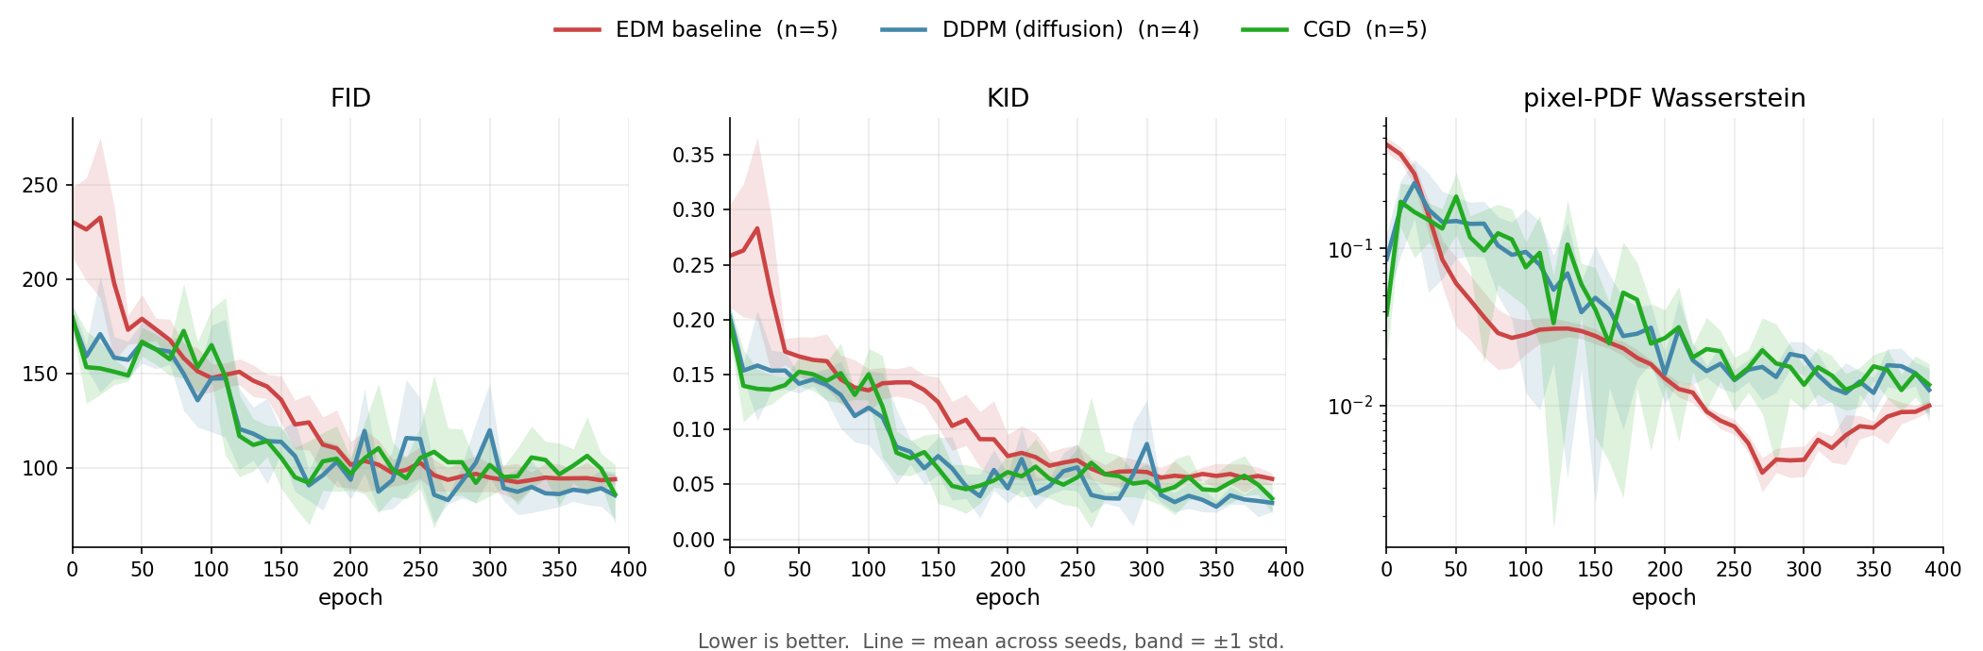
Metrics vs epoch

Slide 10
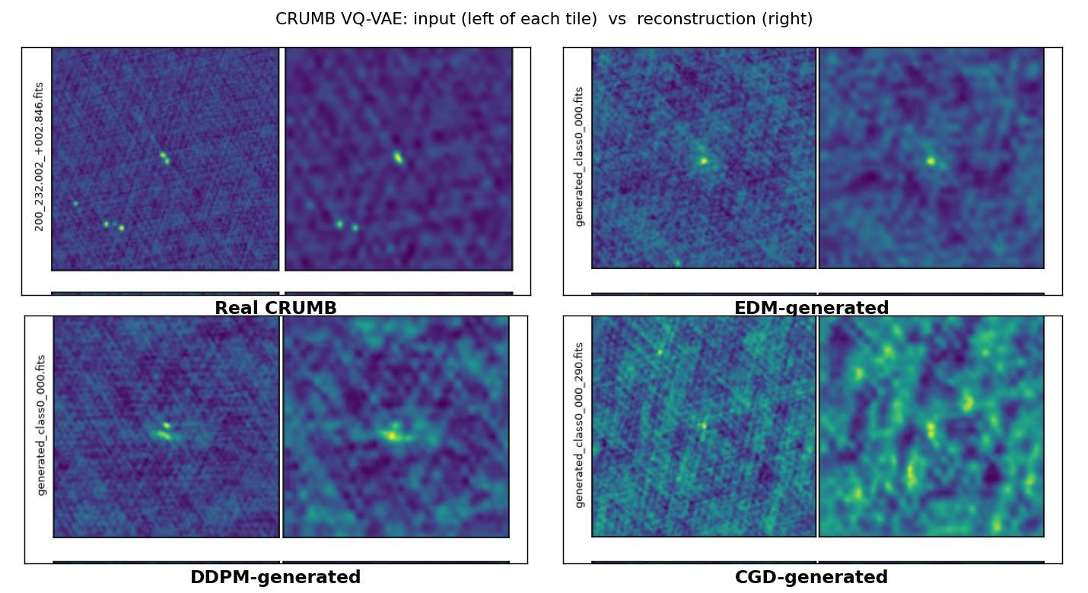
CRUMB VQ-VAE reconstruction
Generated images passed through a VQ-VAE trained only on real CRUMB - does their structure lie on the CRUMB manifold?
- One example pair per model (col 1 input, col 2 reconstruction).
- All models reconstruct at least as well as real held-out CRUMB.
- DDPM has the highest NCC this round - most CRUMB-like morphology.
- MSE flatters all models: generated fields are smoother than real CRUMB.
- Per-model example galleries on the following slides.
 | MSE ↓ | NCC ↑
Real CRUMB (reference) | 0.00377 | 0.652
EDM-generated (latest, final) | 0.00271 | 0.763
DDPM-generated | 0.00174 | 0.771
CGD-generated (latest, ep 290) | 0.00300 | 0.725

Slide 11
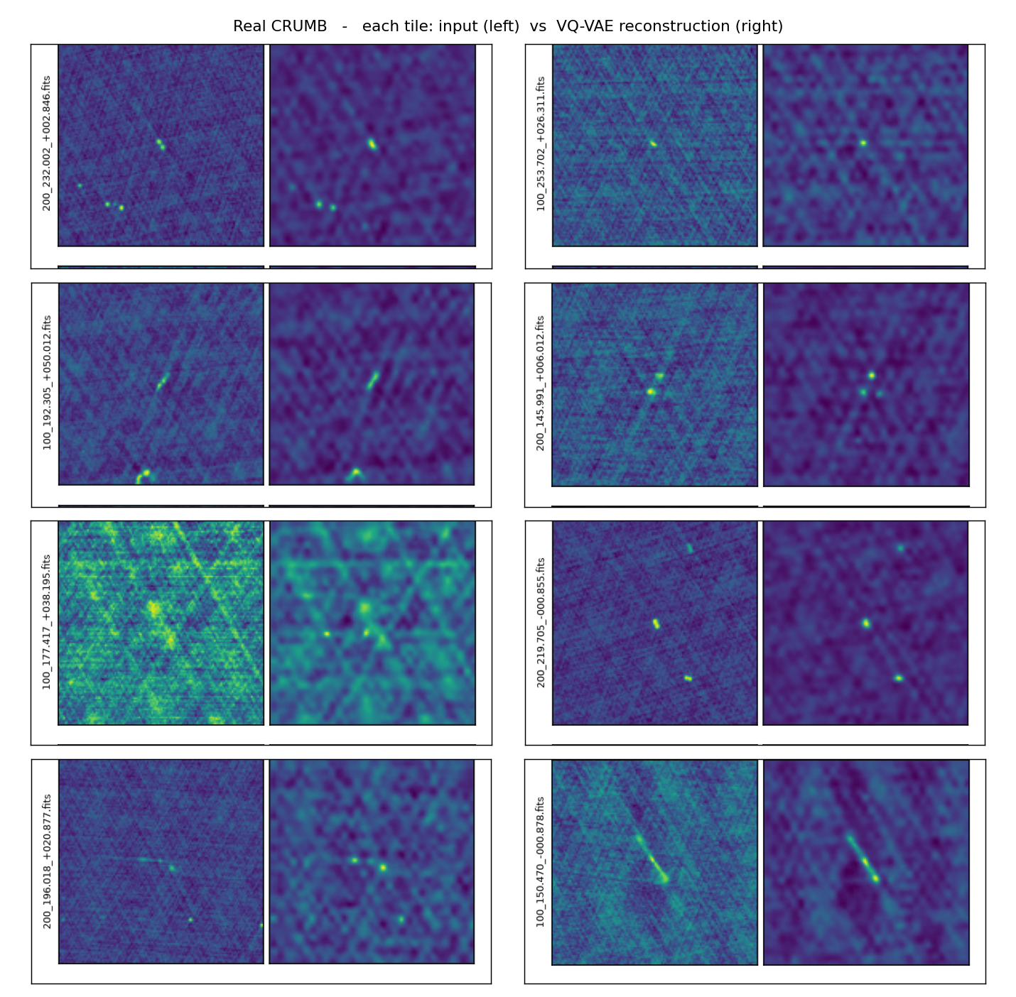
Reconstruction examples - Real CRUMB
col 1 = input · col 2 = CRUMB VQ-VAE reconstruction

Slide 12
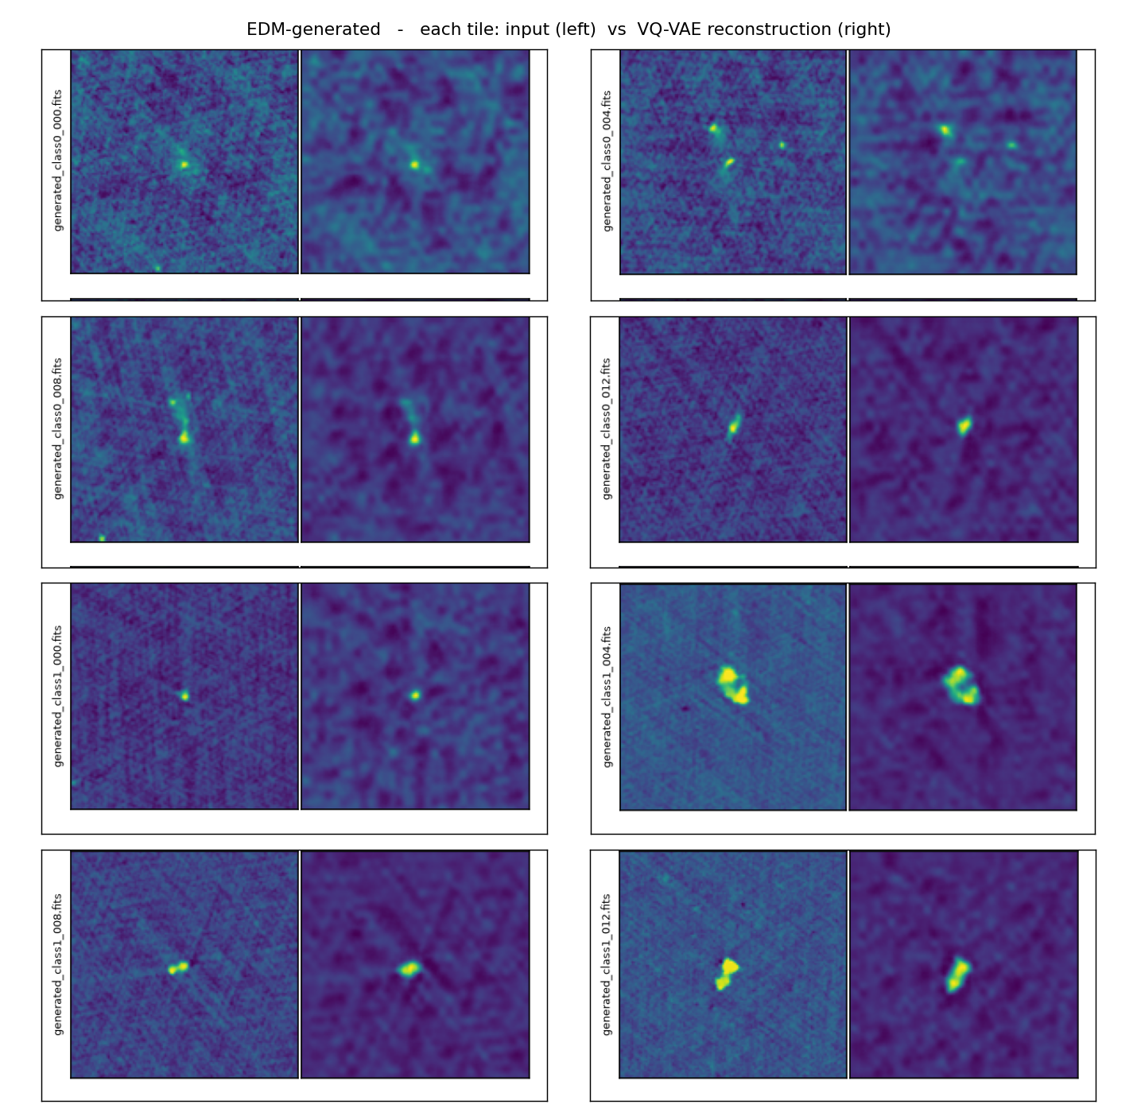
Reconstruction examples - EDM-generated
col 1 = input · col 2 = CRUMB VQ-VAE reconstruction

Slide 13
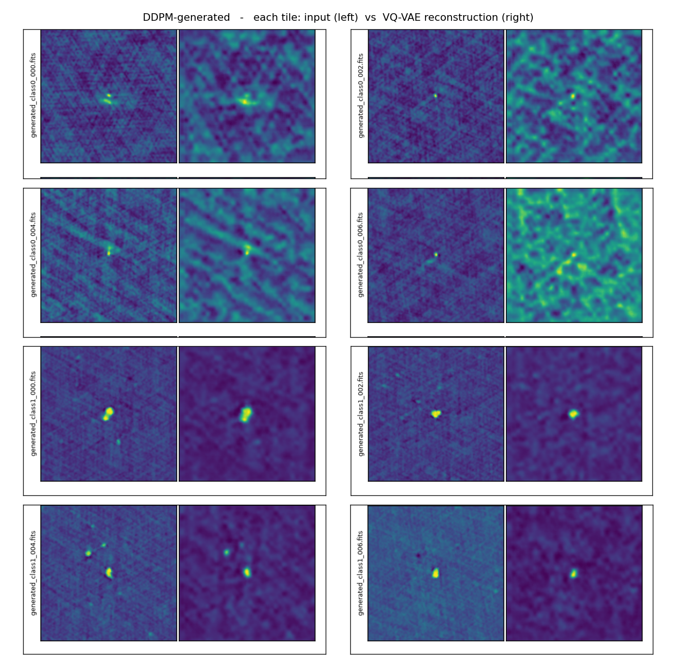
Reconstruction examples - DDPM-generated
col 1 = input · col 2 = CRUMB VQ-VAE reconstruction

Slide 14
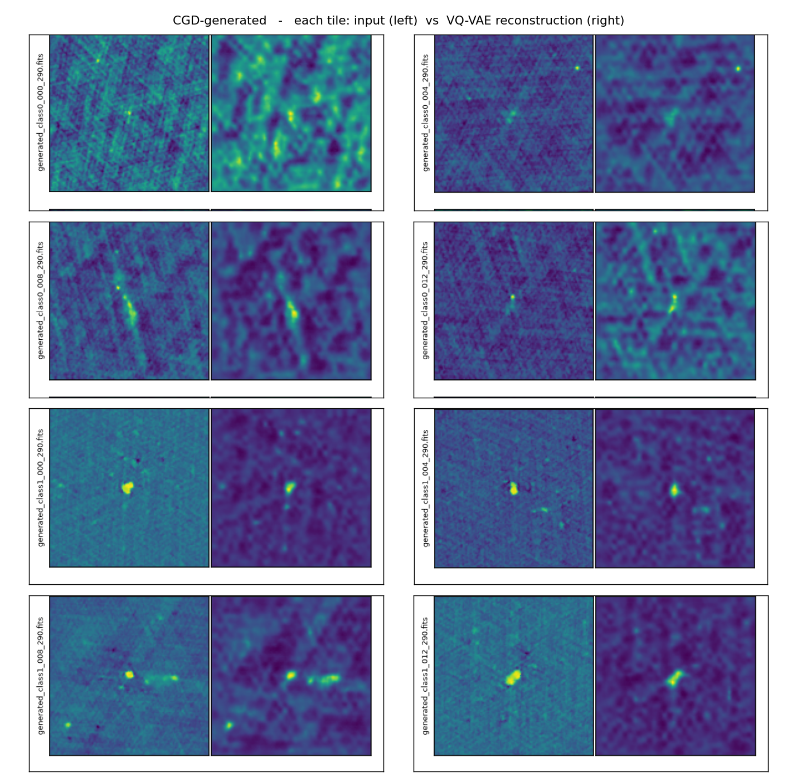
Reconstruction examples - CGD-generated
col 1 = input · col 2 = CRUMB VQ-VAE reconstruction

Slide 15
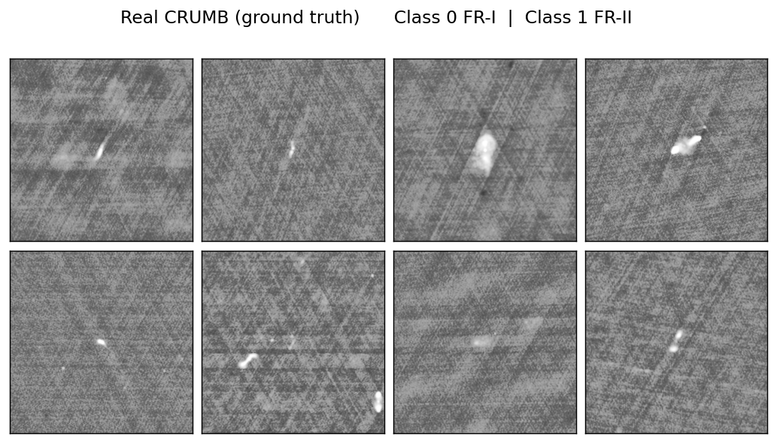
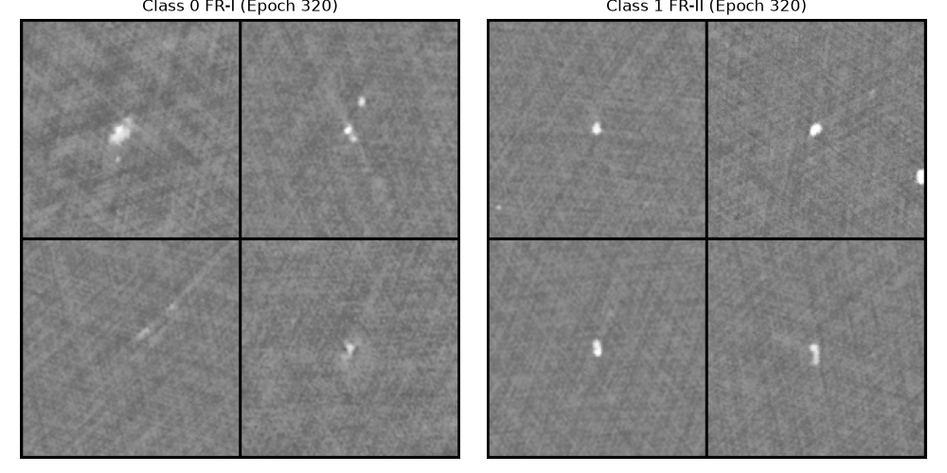
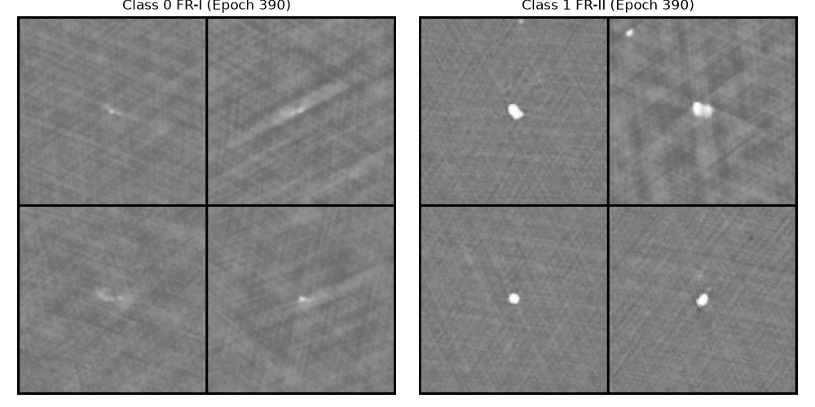
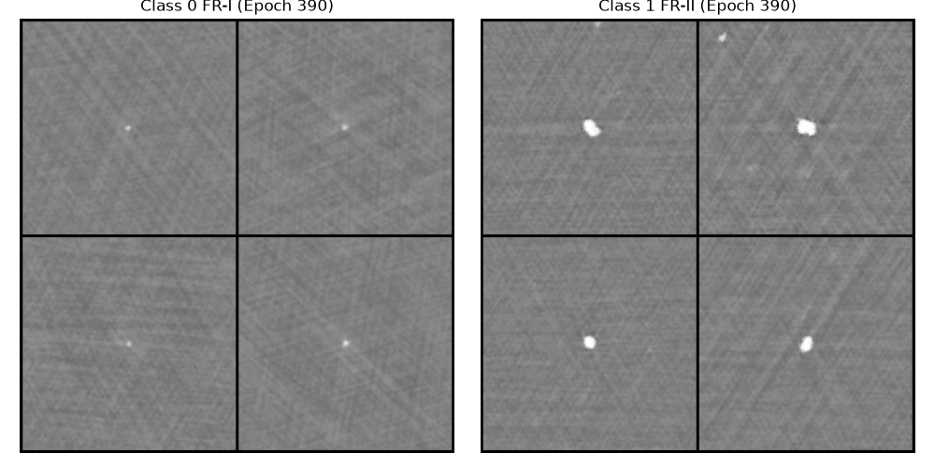
Samples (left cols FR-I · right cols FR-II)
Real CRUMB (ground truth)
EDM baseline (latest, 400 ep) - epoch 320
DDPM (latest, 400 ep) - epoch 390
CGD (latest, 400 ep) - epoch 390

