Slide 1
EDM Baseline vs CRUMB DDPM vs Classifier-Guided Diffusion
Class-conditional FR-I / FR-II radio-galaxy generation · CRUMB FITS, 150x150

Slide 2
Key differences
 | EDM baseline | diffusion (DDPM) | CGD
Role | literature reference (Vicanek Martinez 2024) | this project's CRUMB-dataset baseline | DDPM + external steer
U-Net | UNet2DModel, ~29.8M | UNet2DConditionModel, ~95.9M | same as DDPM
Conditioning | additive class embedding | cross-attention (dim 256) | cross-attention (dim 256)
Noise process | continuous sigma (Karras) | 1000-step discrete, linear beta | 1000-step discrete, linear beta
Target / loss | clean image / sigma-weighted L2 | noise (epsilon) / plain MSE | noise (epsilon) / plain MSE
Sampler | Heun ODE, 25 steps, EMA | ancestral DDPM, 50 steps | ancestral DDPM, 50 steps
Guidance | CFG (3.0) | CFG (7.5) | CFG (7.5) + frozen-classifier gradient at low noise
Shared: task, CRUMB FITS pipeline, symmetric-log-SNR normalisation, CFG-style class conditioning, FID/KID/PDF evaluation.

Slide 3
Results
Distributional metrics (best over training)
Model | FID ↓ | KID ↓ | pixel-PDF W ↓ | Epochs
EDM baseline (seed 42) | 106.9 | 0.081 | 0.0165 | 200
EDM baseline (seeds 43 / 44) | 97.5 / 98.7 | 0.069 / 0.063 | 0.019 / 0.019 | 200
diffusion (DDPM+CFG) | 99.7 | 0.053 | 0.0162 | 200
CGD | 77.5 | 0.031 | 0.0064 | 260
CRUMB VQ-VAE reconstruction fidelity (VQ-VAE trained only on real CRUMB)
Passed through the CRUMB VQ-VAE | N | Recon MSE ↓ | Recon NCC ↑
Real held-out CRUMB (reference) | 178 | 0.00377 | 0.652
EDM-generated | 32 | 0.00164 | 0.735
DDPM-generated | 16 | 0.00174 | 0.771
CGD-generated | 32 | 0.00181 | 0.846
CGD best on every distributional metric; all models' outputs reconstruct at least as well as real CRUMB (highest NCC = CGD).

Slide 4
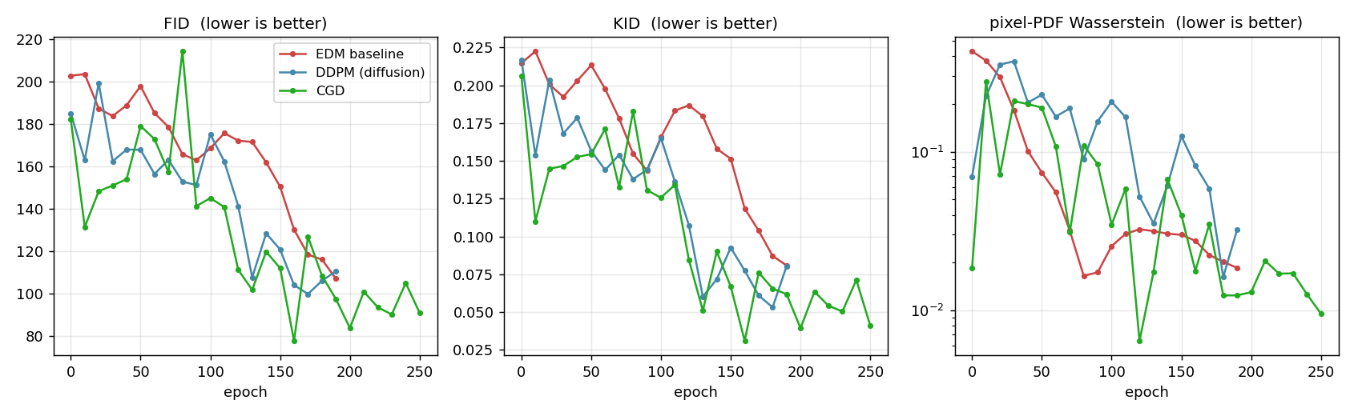
Metrics vs epoch

Slide 5
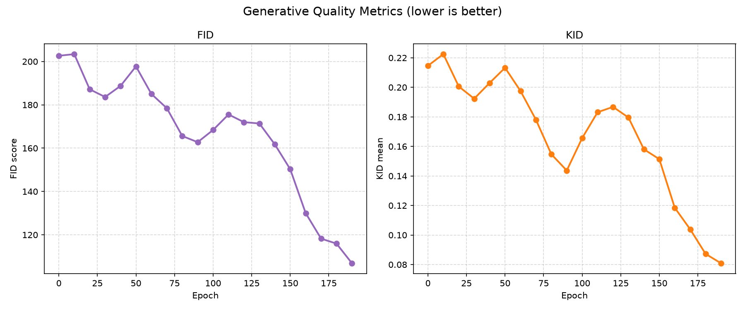
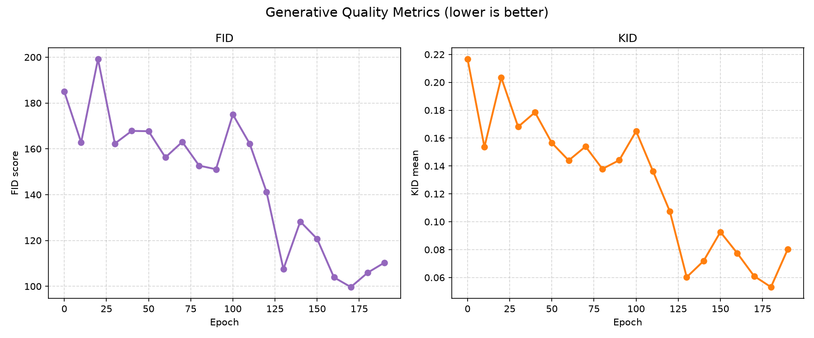
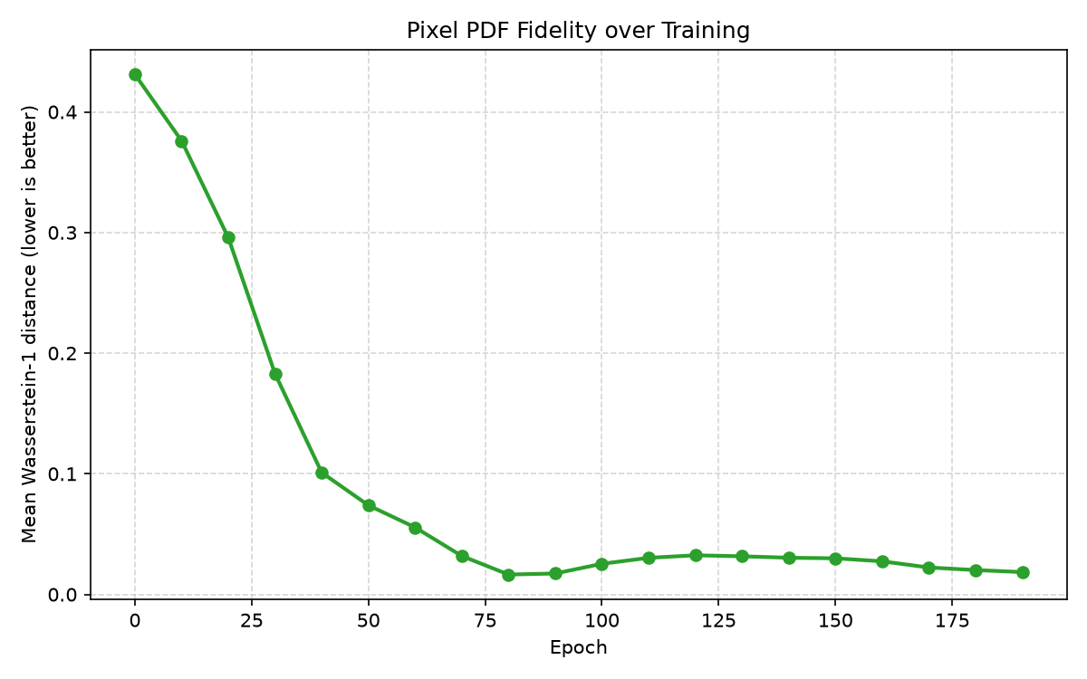
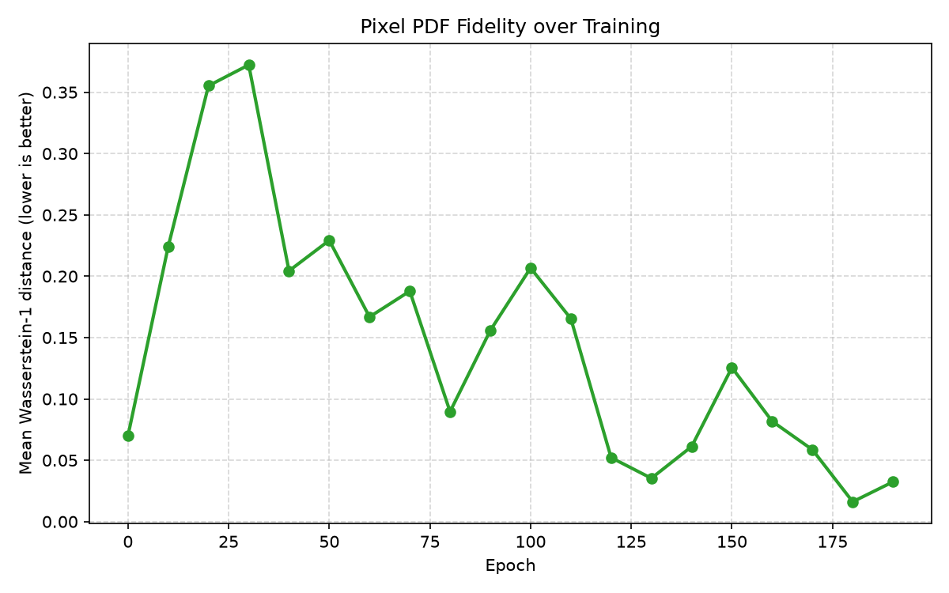
Per-run generative-metric curves
Left column: EDM baseline (seed 42). Right column: DDPM diffusion. Top: FID / KID. Bottom: pixel-PDF Wasserstein history.

Slide 6
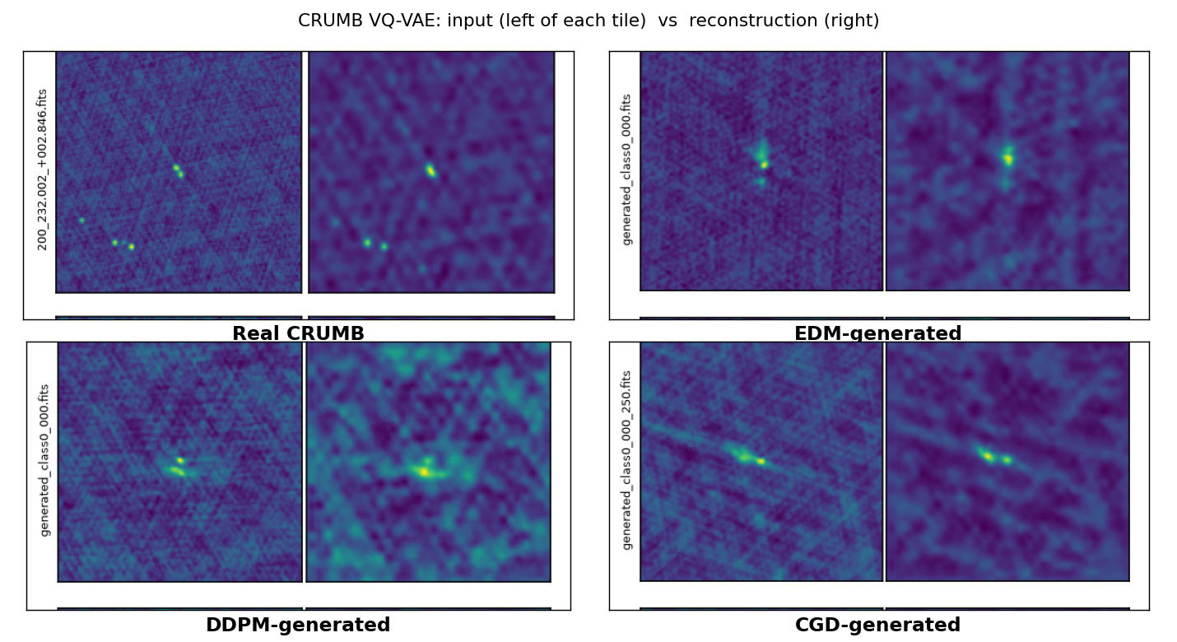
CRUMB VQ-VAE reconstruction
Generated images passed through a VQ-VAE trained only on real CRUMB - does their structure lie on the CRUMB manifold?
- One example pair per model (col 1 input, col 2 reconstruction).
- All models reconstruct at least as well as real held-out CRUMB.
- CGD has the highest NCC - most CRUMB-like morphology.
- MSE flatters all models: generated fields are smoother than real CRUMB.
- Per-model example galleries on the following slides.
 | MSE ↓ | NCC ↑
Real CRUMB (reference) | 0.00377 | 0.652
EDM-generated | 0.00164 | 0.735
DDPM-generated | 0.00174 | 0.771
CGD-generated | 0.00181 | 0.846

Slide 7
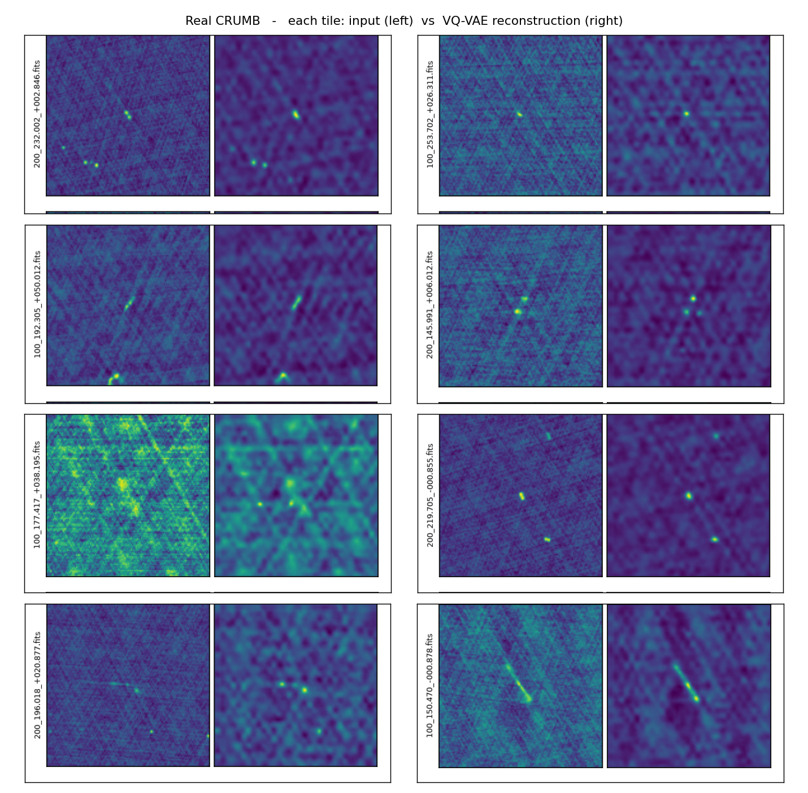
Reconstruction examples - Real CRUMB
col 1 = input · col 2 = CRUMB VQ-VAE reconstruction

Slide 8
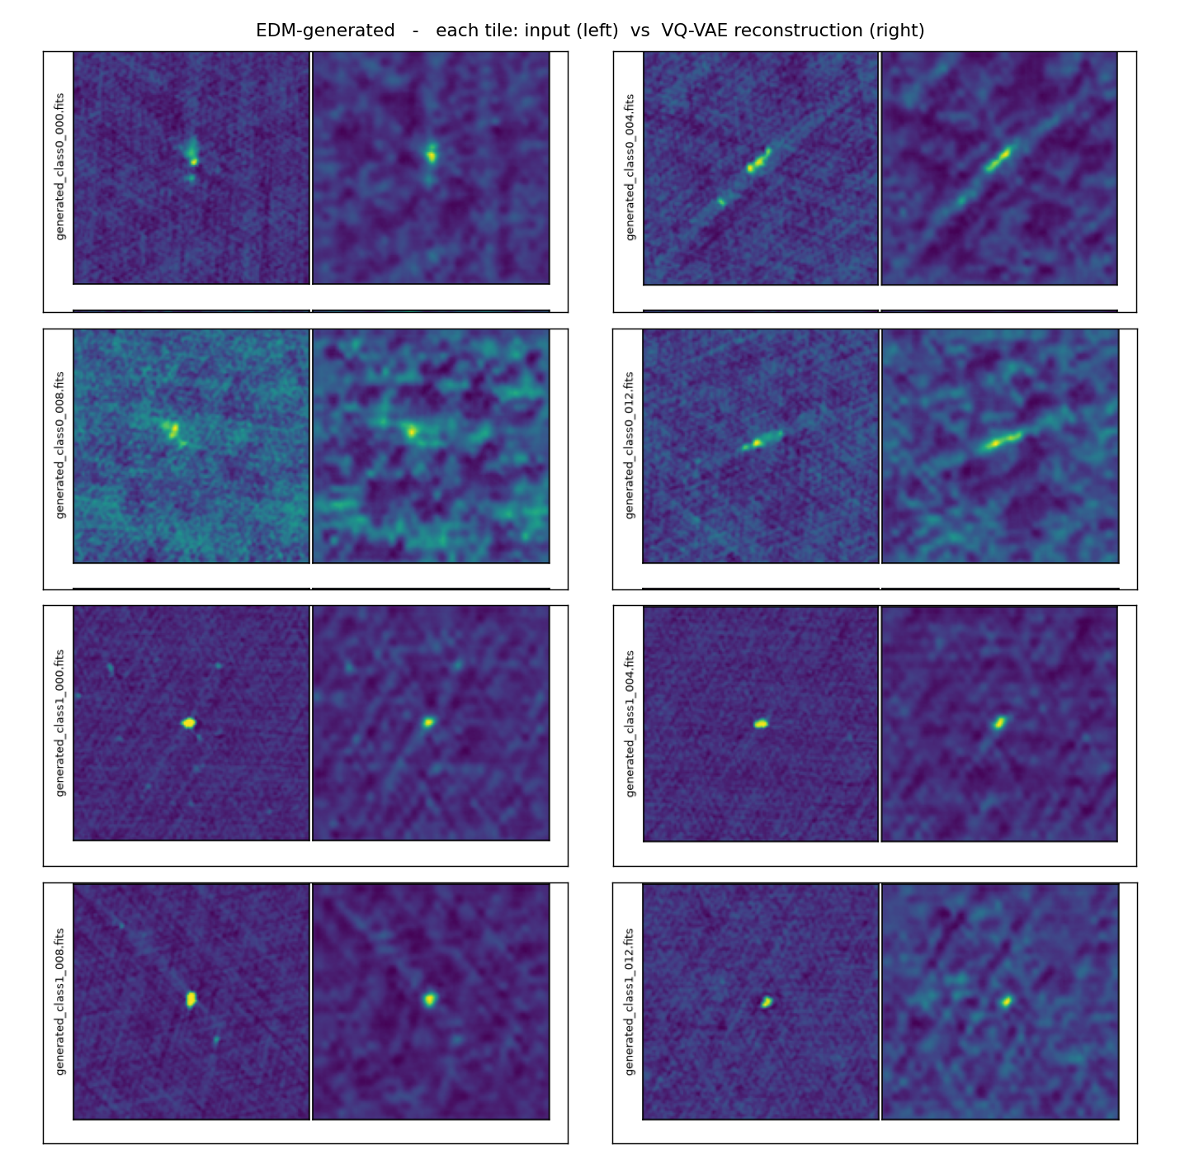
Reconstruction examples - EDM-generated
col 1 = input · col 2 = CRUMB VQ-VAE reconstruction

Slide 9
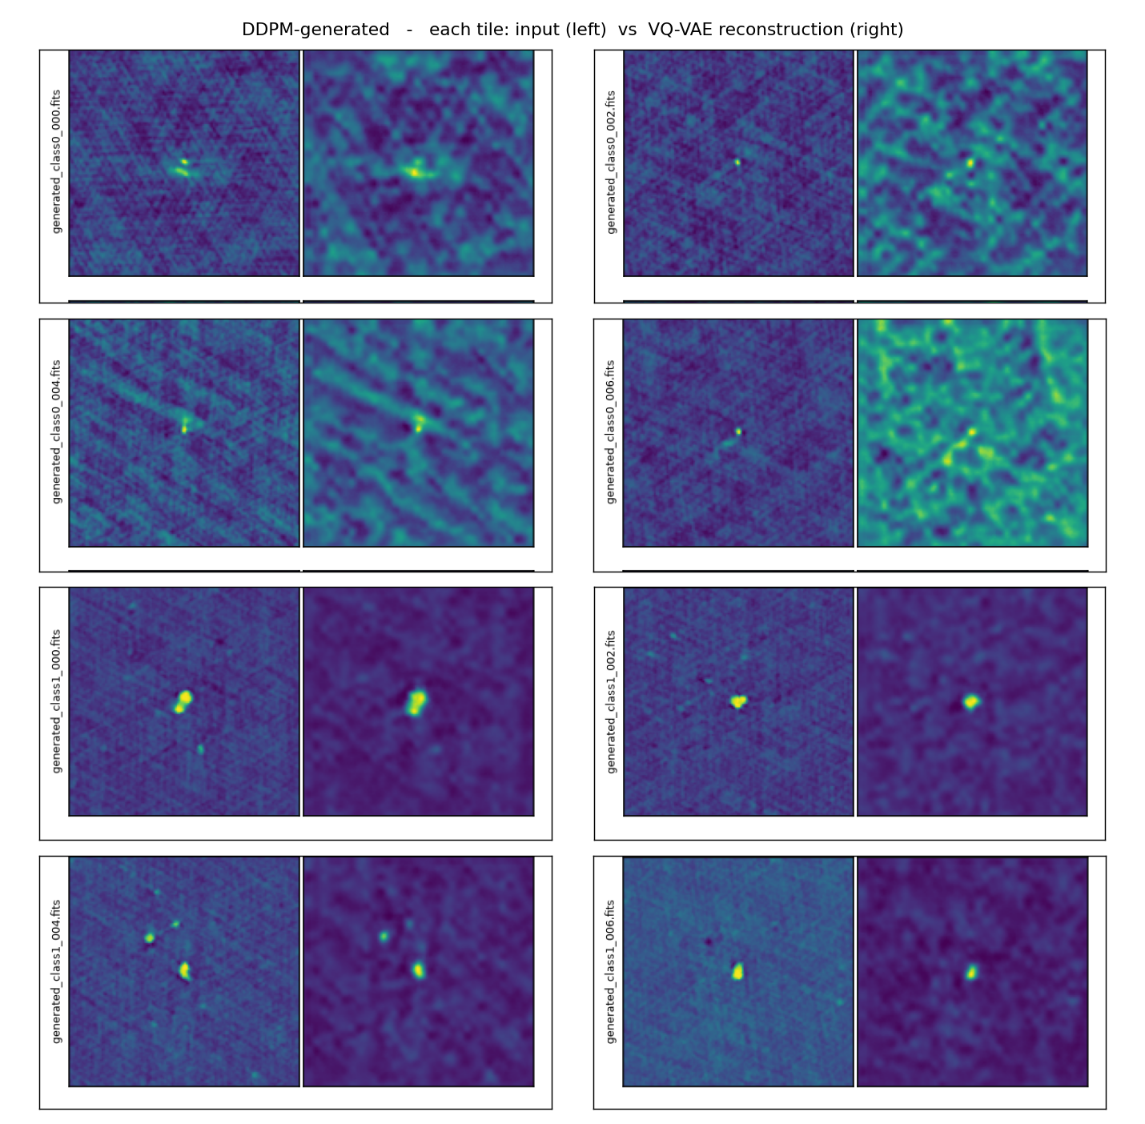
Reconstruction examples - DDPM-generated
col 1 = input · col 2 = CRUMB VQ-VAE reconstruction

Slide 10
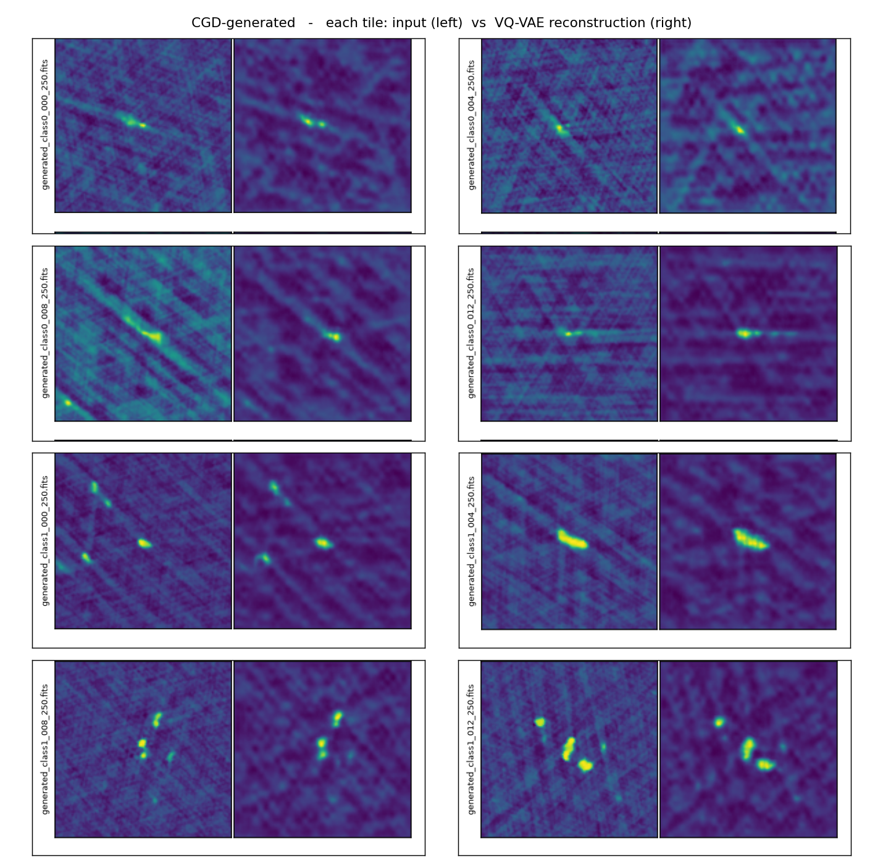
Reconstruction examples - CGD-generated
col 1 = input · col 2 = CRUMB VQ-VAE reconstruction

Slide 11
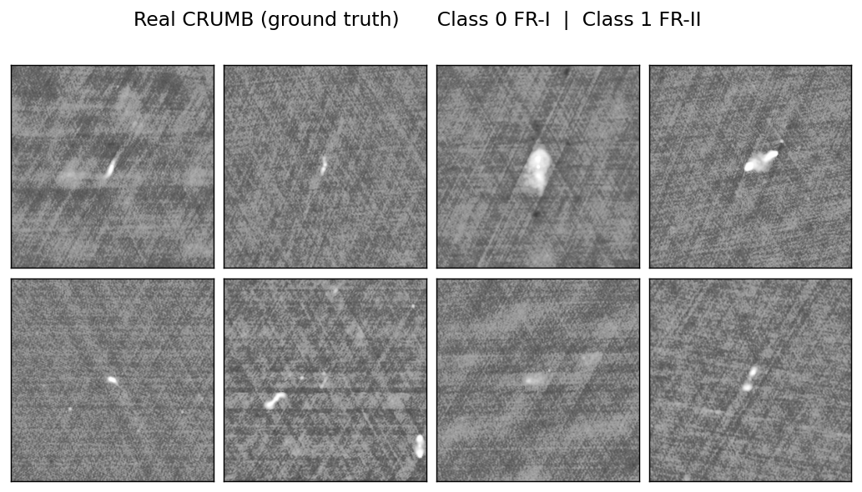
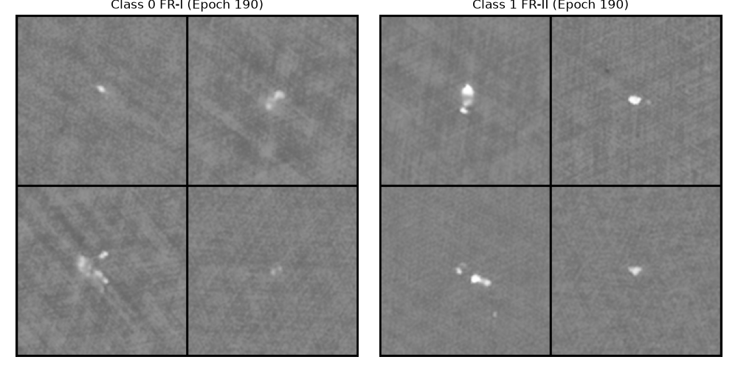
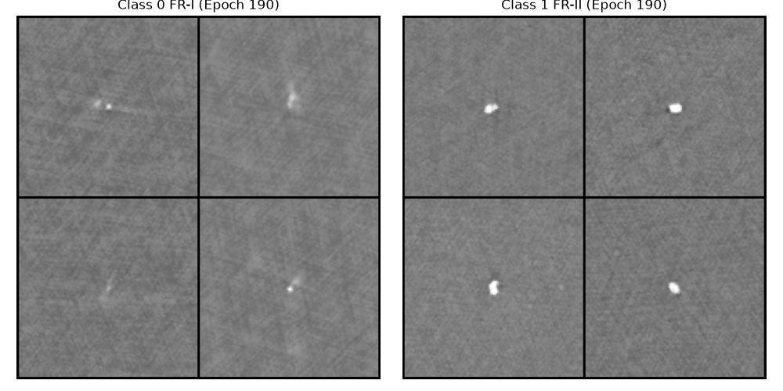
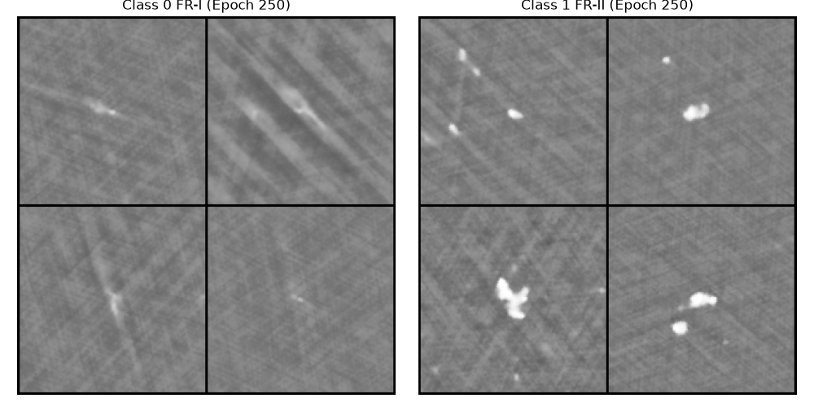
Samples (left cols FR-I · right cols FR-II)
Real CRUMB (ground truth)
EDM baseline - epoch 190
DDPM - epoch 190
CGD - epoch 250

