Slide 1
Classifier-Guided, Physics-Informed Diffusion for Radio Galaxy Morphology
Bevan Slabbert | ZAMLA Seminar

Slide 2
Why Radio Galaxy Morphology?
• Modern/upcoming surveys (MeerKAT, SKA) will produce far more radio sources than can be classified by hand
• Motivates: (1) automated classification, (2) generative models to augment scarce data to counter under-representation of entities in downstream machine learning tasks.

Slide 3
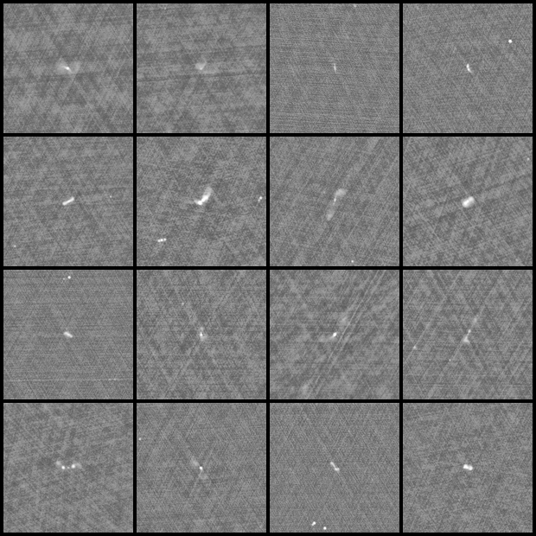
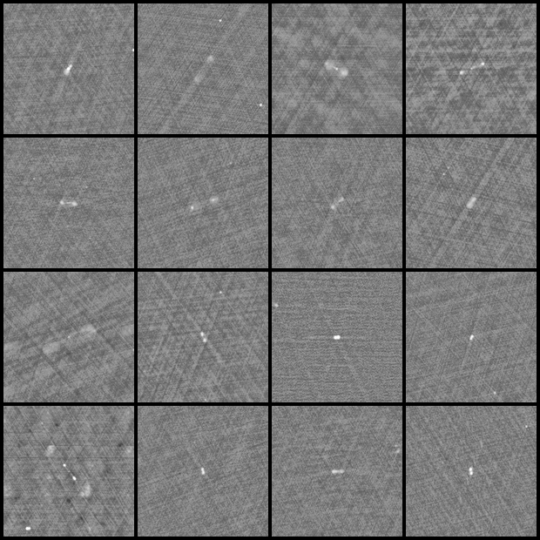
The Dataset: MiraBest
• MiraBest — single homogeneous survey, expert-vetted, ~770 images
• Binary FR-I / FR-II labels, 150×150 grayscale
FR-I examples
FR-II examples

Slide 4
Image Generation with Diffusion
• Forward process gradually adds Gaussian noise to a real image over T steps (fixed, not learned)
• Reverse process learns to remove noise step by step, turning pure noise back into an image
Forward process: add noise q(xt | xt-1)
x0 (image)
x1
x2
x3
xT (noise)
Reverse process: predict & remove noise p(theta)(xt-1 | xt) - learned by U-Net
Training: the U-Net learns to predict the noise added at each step; generation runs the reverse process from pure noise.

Slide 5
Data Pipeline:
• Training prep — convert each MiraBest FITS image with the same sym-log-SNR normalisation used at train time (clipped to [-1, 1])
• Diffusion model trained on the transformed/normalized data
• After generation — diffusion output tensors are inverted with a denormalization function (sym-log-SNR → approximate Jy/beam) and written back out as real FITS files

Slide 6
Project Architecture
• 1. Classifier — ResNet18, distinguishes FR-I / FR-II
• 2. Diffusion — DDPM generates synthetic radio galaxies
• 3. Physics-informed constraints — bilateral symmetry + non-negative flux losses
• 4. Incorporate physical constraints during training, classifier guidance during second stage of diffusion training.
• Goal: generate physically-plausible, class-faithful synthetic radio galaxies to augment scarce labeled data

Slide 7
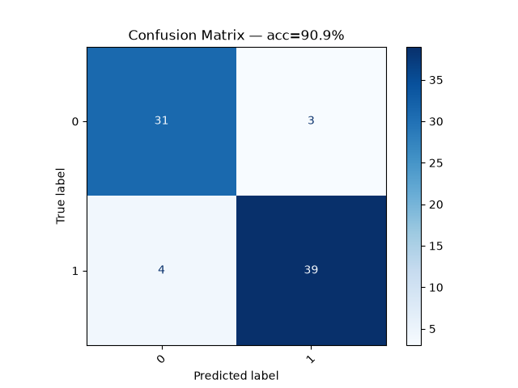
Classification Results
• MiraBest: ~90% test accuracy, consistent across multiple runs (88–94%)
• Independently verified: a random-sample check of the saved model got 90/100 correct
MiraBest confusion matrix — 90.9% accuracy

Slide 8
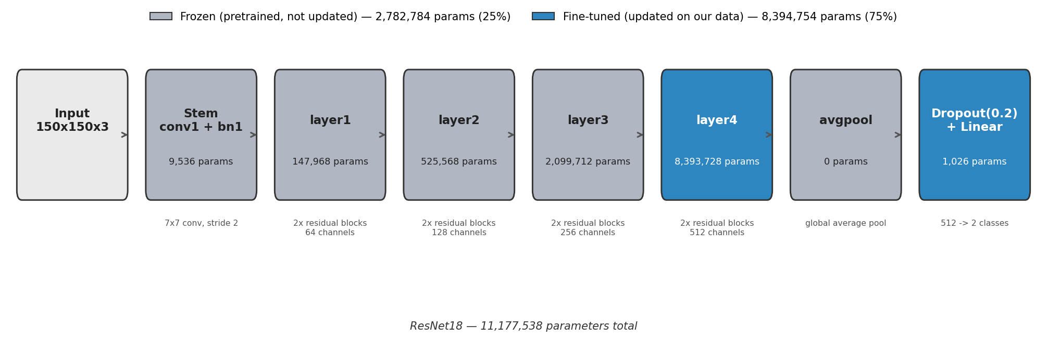
ResNet18: What We're Fine-Tuning
• ResNet18 has ~11.2 million parameters, arranged in a stem + 4 residual "layer" blocks + a final classification head
• Pretrained on ImageNet (natural photos) — the early layers learn general shape/edge features that transfer reasonably well
• We freeze layer1–layer3 (the early/mid layers) and only fine-tune layer4 + the head on our radio galaxy images
• layer4 still holds ~75% of all parameters — so "only fine-tuning one block" is not as small a change as it sounds

Slide 9
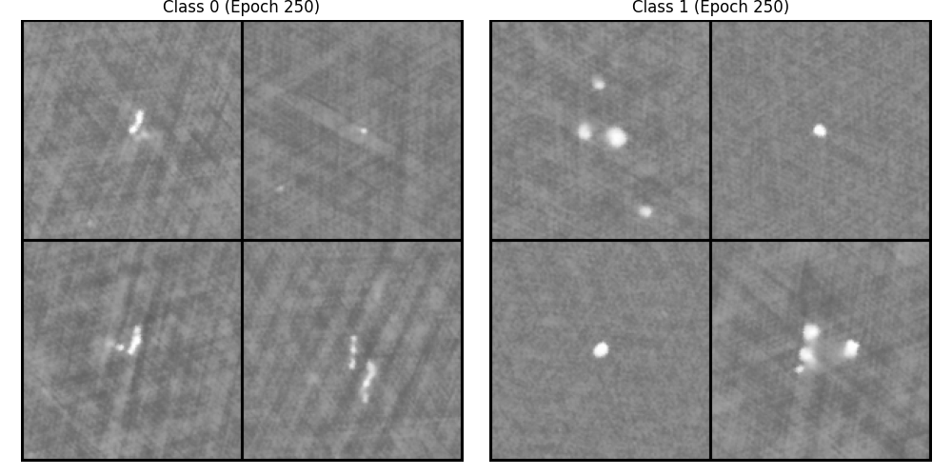
Class-Conditional Diffusion Generation
• Diffusion model
• Generates distinct FR-I / FR-II morphology after ~250 epochs
Generated samples, epoch 250 — Class 0 (FR-I) vs Class 1 (FR-II)

Slide 10
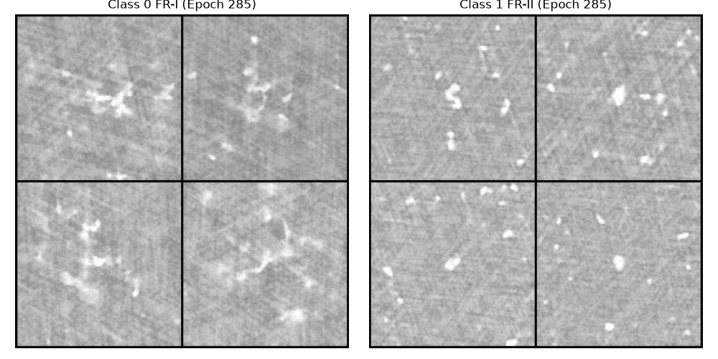
Physics-Informed Diffusion (PID)
• Adds physics-motivated loss terms to generation:
– Bilateral symmetry — radio jets are approximately symmetric about the core
PID-generated samples, epoch 285 — FR-I vs FR-II

Slide 11
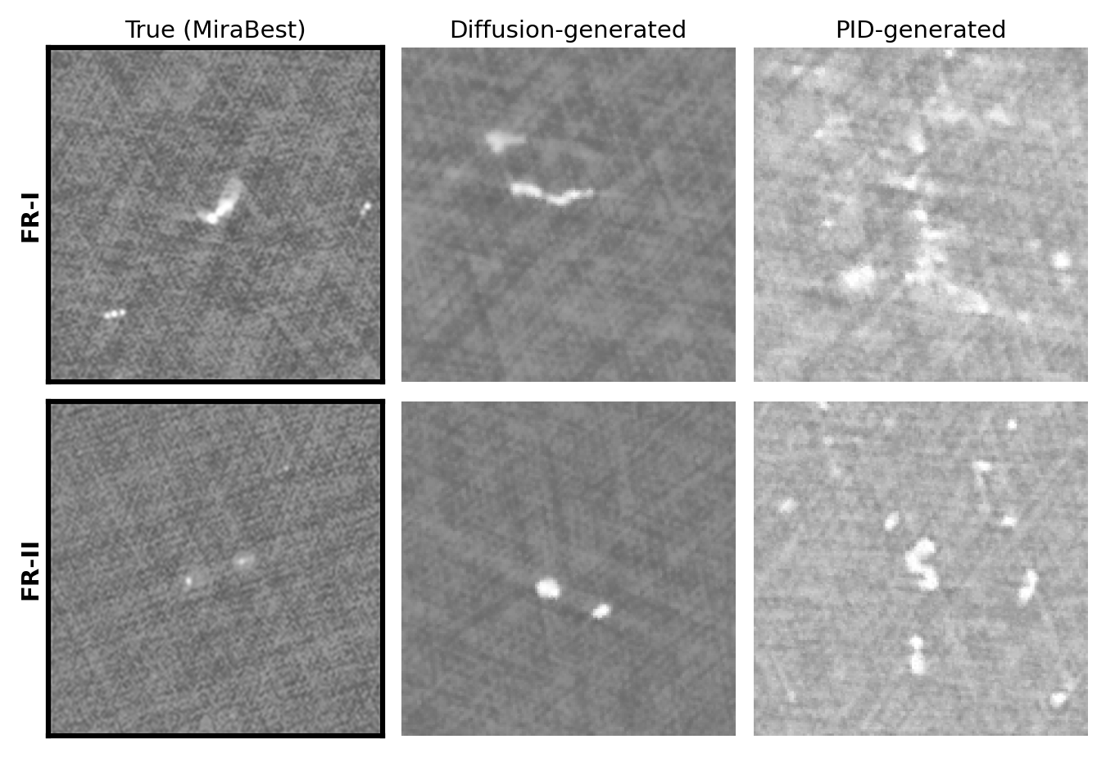
Real vs Generated: Side by Side
• Same class (FR-I / FR-II), three sources: a real MiraBest image, a plain diffusion sample, and a PID sample

Slide 12
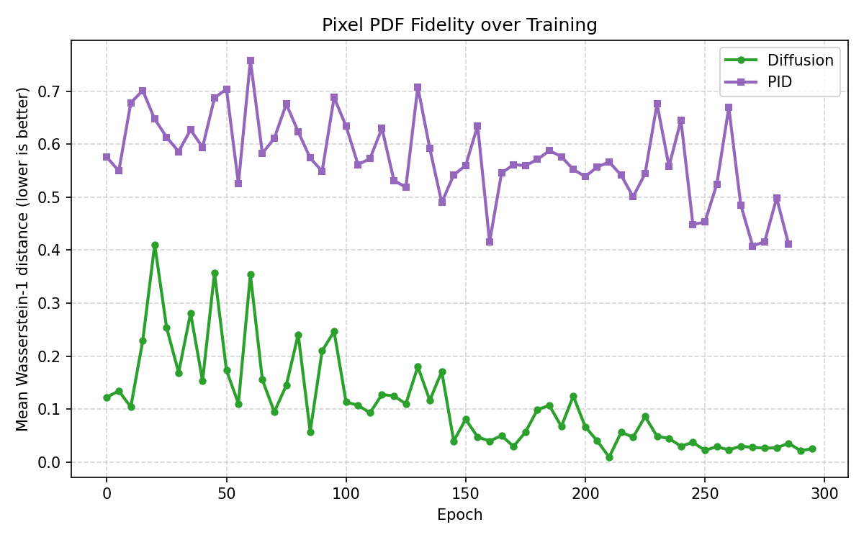
Measuring Generation Quality: Pixel Distribution Fit
• Metric: Wasserstein-1 distance between the pixel-intensity distribution of real vs generated images (lower = closer match)
• Tracked every few epochs during training, per class
• Distance drops from ~0.12 (and spikes early on) down to ~0.02–0.05 by epoch 250+ — generated images increasingly match the real pixel statistics

Slide 13
Future Work
• Wire up the robust classifier + guided-diffusion pipeline (currently not connected to the training dispatcher)
• Try a VAE to encode and reconstruct images — test whether it preserves the real pixel/morphology distribution as well as diffusion does
• Implement a classifier-confidence-based image-quality metric for generated samples

Slide 14
Thank you — Questions?

