Slide 1

Music Store Data Analysis

Slide 2
About me
I am Bevara Harika, a Bachelor of Science graduate in Computer Science. I have experience as a Technical Trainer at Coign Consultancy and am currently working as a Teaching Assistant at Sreenidhi University.
Why Data Analyst?
• I have developed a deep interest in working with data because I enjoy problem-solving and finding patterns, which inspired me to build a career as a Data Analyst.
LinkedIn: https://www.linkedin.com/in/bevara-harika-647a42325/
GitHub: https://github.com/bevaraharika5-stac

Slide 3
Objective of the Project
Build a Strong Analytical Base: Create a fully structured, relational Music Store Database from raw CSV files, ensuring proper relationships and data integrity through constraints.
Analyze Business Performance & Trends: Use SQL aggregation functions such as SUM, COUNT, and AVG along with complex JOIN operations across 10+ tables to measure key performance metrics.
Key Insights: Identify top-performing sales regions, determine the most valuable customer, and highlight leading artists and popular music genres.
Generate Strategic Insights: Leverage advanced SQL concepts like Window Functions and Subqueries to solve complex analytical problems and extract meaningful, actionable insights.
Develop a Data-Driven Strategy: Provide clear and practical recommendations for long-term inventory planning and targeted regional marketing, based on analyzed customer behavior and sales trends.

Slide 4
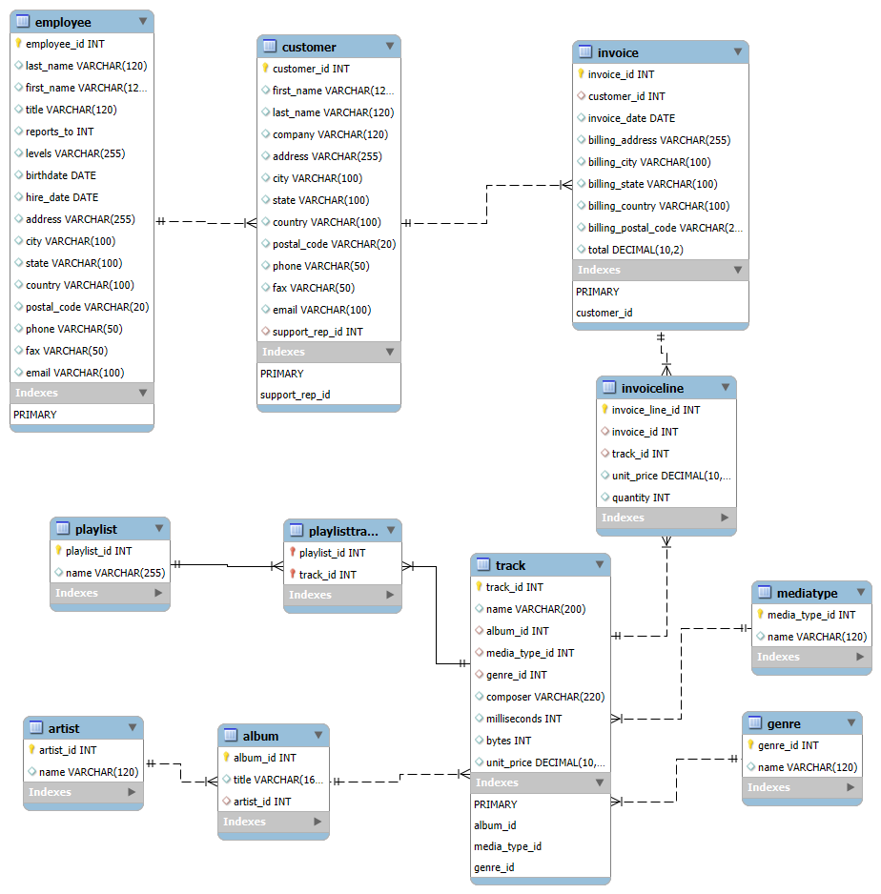
ER Diagram and Schema Explanation
The project was developed using a fully structured Relational Database Management System (RDBMS), containing 11 main tables such as Invoice, Customer, Track, and Artist.
The database design is divided into clear business segments:
Sales (Invoice, InvoiceLine)
Inventory (Track, Album, Genre)
Personnel (Employee, Customer)
Each table is properly linked using Primary Keys (PK) and Foreign Keys (FK), maintaining strong data consistency across Sales, Inventory, and Personnel modules.
Data validation was carefully performed to ensure correct data types and to eliminate orphan records, meaning every InvoiceLine is correctly associated with an existing Invoice and a valid Track.

Slide 5
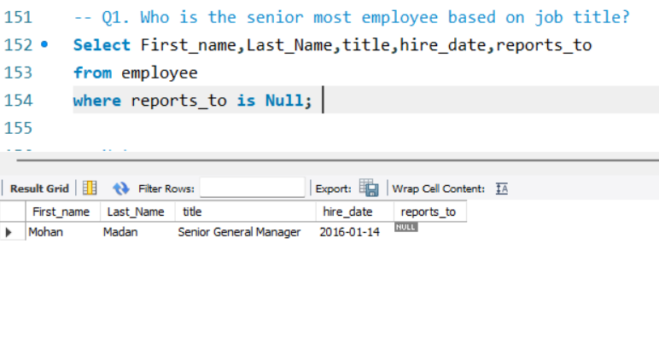
SQL query results
Q1. Who is the senior most employee based on job title?
Insights
Key Finding: Mohan Madan is the most experienced employee, based on both his job title and earliest hire date.
Business Impact: His experience can be effectively utilized for mentoring and guiding new employees. Additionally, his long tenure indicates strong reliability, making him a suitable candidate for senior leadership and decision-making roles.

Slide 6
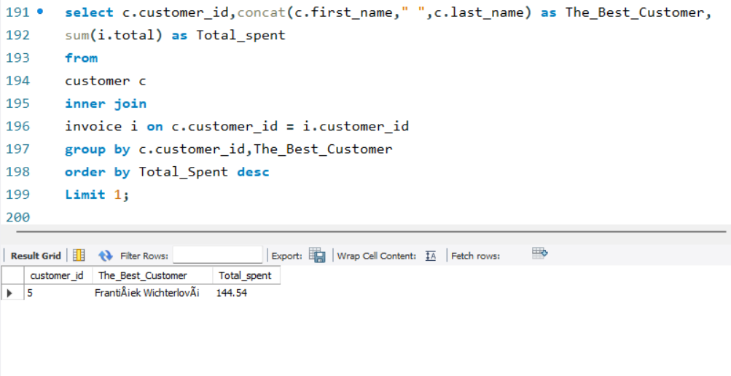
Q5. Who is the best customer?
The customer who has spent the most money will be declared the best customer.
Write a query that returns the person who has spent the most money
Insights
Key Finding: František Wichterlová stands out as the top-value customer.
Data Context: With a total spending of $144.54, his contribution is significantly higher than that of the average customer, highlighting his importance to overall revenue.

Slide 7
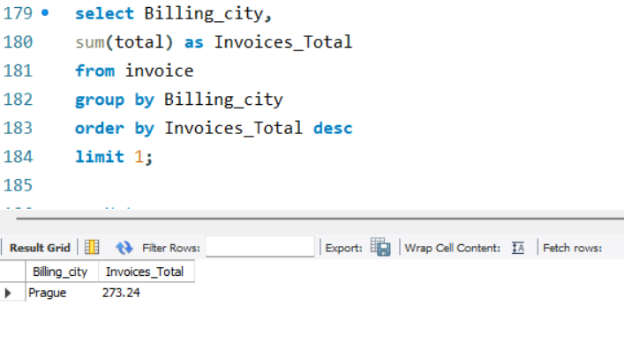
Q4. Which city has the best customers?
We would like to throw a promotional Music Festival in the city we made the most money.
Write a query that returns one city that has the highest sum of invoice totals. Return both the city name & sum of all invoice totals
Insights
Key Finding: Prague generates the highest overall revenue in terms of total customer spending.
Data Context: Even though it does not have the highest number of invoices, its total sales of $90.24 indicate a higher average purchase value and strong customer quality.
Business Impact: The sales approach used in Prague should be studied and adapted in other European cities with lower transaction volumes but high growth potential, to improve overall revenue quality and customer spending.

Slide 8
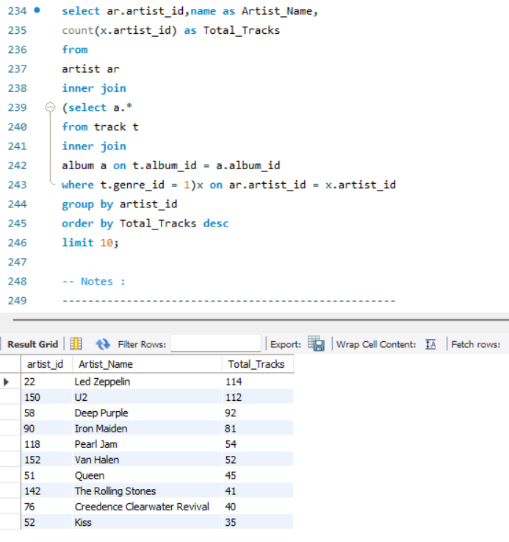
Q7. Let's invite the artists who have written the most rock music in our dataset.
Write a query that returns the Artist name and total track count of the top 10 rock bands
Insights
Key Finding: Led Zeppelin (114 tracks) and U2 (112 tracks) are the leading contributors in terms of content volume within the primary genre.
Data Context: Their extensive track collections make them key drivers of the store’s overall catalog strength and revenue potential.
Business Impact: These artists represent reliable, high-volume inventory assets. The business should capitalize on their large catalogs by negotiating more favorable long-term licensing agreements.

Slide 9
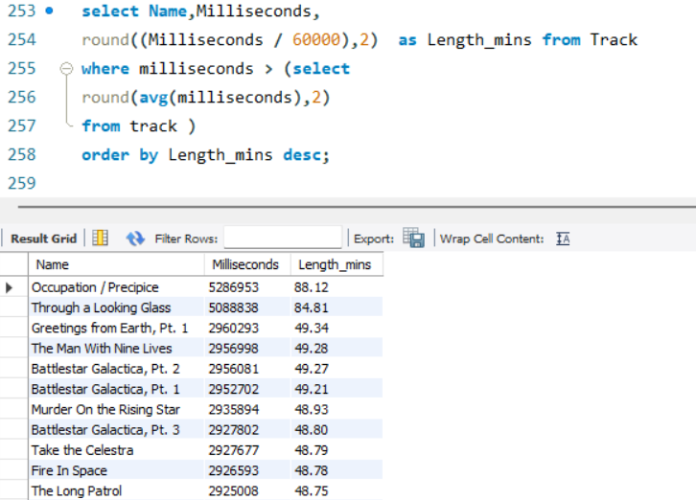
Q8. Return all the track names that have a song length longer than the average song length.
Return the Name and Milliseconds for each track. Order by the song length, with the longest songs listed first
Insights
Key Finding: A significant share of the inventory is made up of niche, long-duration tracks (exceeding the average length of 393,599 ms).
Data Context: More than 1,100 tracks are longer than the average, indicating a strong presence of categories such as Classical, Soundtracks, and TV Shows within the catalog.

Slide 10
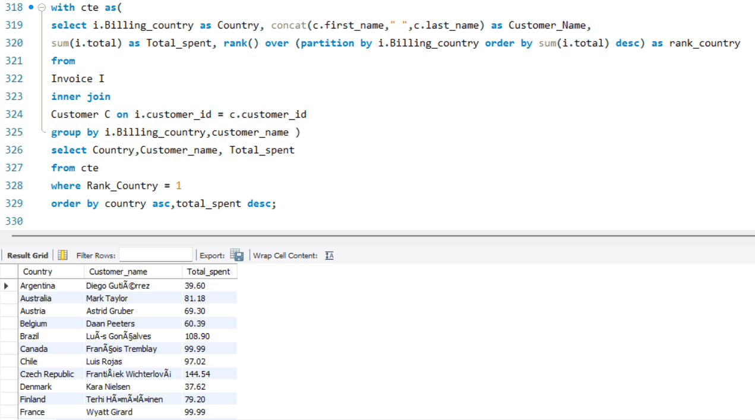
Q11. Write a query that determines the customer that has spent the most on music for each country.
Write a query that returns the country along with the top customer and how much they spent.
For countries where the top amount spent is shared, provide all customers who spent this amount
Insights
Key Finding: The analysis accurately identified the top-spending customer in each country.
Data Context: This was achieved using the RANK() window function, enabling efficient comparison of customer spending within each region.
Business Impact: This insight creates a valuable list of high-value customers across different countries. These top spenders can be targeted with personalized offers and engagement strategies to strengthen loyalty and drive sustained regional growth.

Slide 11
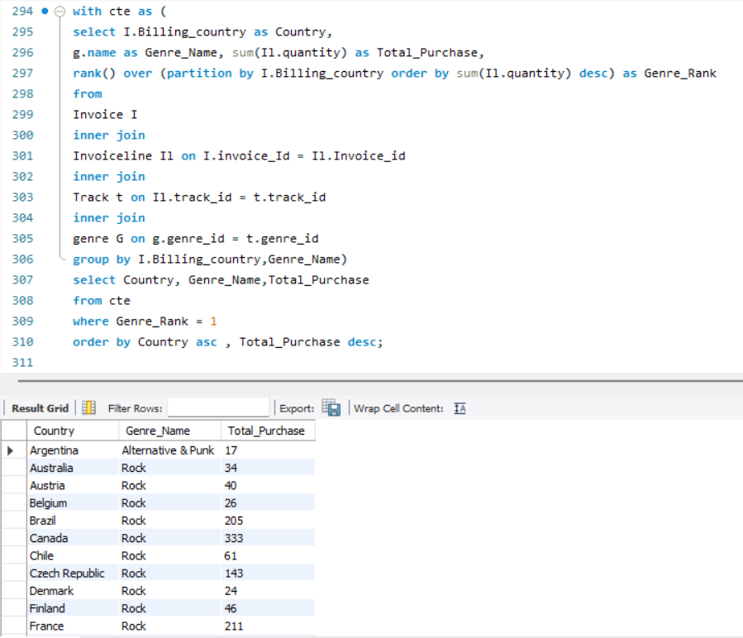
Q10. We want to find out the most popular music Genre for each country.
We determine the most popular genre as the genre with the highest amount of purchases.
Write a query that returns each country along with the top Genre.
For countries where the maximum number of purchases is shared, return all Genres
Insights
Key Finding: Rock music shows strong dominance across most regions, establishing it as a consistent global baseline.
Data Context: Argentina stands out as an exception, where Alternative & Punk leads in purchase quantity instead of Rock.
Business Impact: Argentina presents a low-risk opportunity to experiment with diversified inventory and region-specific genre marketing, which can later be scaled to other markets based on performance.

Slide 12
Final business insights and recommendations
Focus on High-Demand Inventory
Allocate most of the inventory budget (85%+) to top-performing artists and Rock genre to ensure consistent sales and maximize returns.
Strengthen Customer Loyalty
High-value customers like František Wichterlová should be targeted with personalized offers and loyalty programs to increase retention and lifetime value.
Leverage Regional Insights
Customer spending is concentrated, so focusing on top customers in each region can significantly improve revenue with minimal marketing effort.
Test Market Diversification
Use Argentina as a pilot market to experiment with Alternative & Punk content before expanding diversified strategies globally.
Replicate High-Value Sales Models
Analyze Prague’s high average spending behavior and apply similar sales and marketing strategies in other regions to boost revenue quality.

Slide 13


Slide 14
Experience/Challenges
Gained practical experience in designing, implementing, and populating an 11-table relational database, along with understanding the EER diagram using Primary Key and Foreign Key relationships.
One of the main challenges was writing and optimizing complex SQL queries that involved joining 4–6 tables to derive meaningful insights.
Utilized advanced SQL techniques such as Window Functions and CTEs to address complex business problems, including identifying the top customer and most popular genre for each country.
Initially faced difficulties with JOINs and subqueries, but improved understanding through consistent practice and solving different query scenarios.
Encountered real-world challenges while debugging aggregation logic and ensuring correct data formats during the data cleaning, transformation, and CSV loading process.

Slide 15

THANK YOU

