Slide 1

LAPTOP SELECTION AND PRICE PREDICTION
TEAM BY
S190361
S190005

Slide 2

Why we choose this project?

Slide 3
The technology is constantly evolving, and new laptops are regularly introduced with updated specifications and features. Laptop selection and price prediction allows users to stay up-to-date with the latest offerings, ensuring they make choices that incorporate the most recent advancements in hardware and software.
This project make the selection process easy. Laptop selection and price prediction project provide users with detailed information, comparisons, and insights, supporting them in making informed decisions.
This project helps in decision making of the selection of the laptop.
The main aim of this project is to use the datascience methodologies to cre- ate one model that can helps users in selecting most suitable laptop for their needs.By analyzing the features of the laptop and user preferences develop best system that can provides more accurate values and recommendations.

Slide 4
Overall, laptop selection and price prediction contribute to improved decision-making, cost optimization, and personalized recommendations, benefiting both individual users and businesses in the laptop market.
These projects provide valuable insights into the dynamics of the laptop market, helping users and businesses understand market conditions, make informed investment decisions, and gain a deeper understanding of the industry as a whole.

Slide 5
INTRODUCTION TO PROJECT
In this project we collect the information from the online websites like kaggle and github.later using datascience methodilogies to analyze data after analsing it gives best laptop among all laptops available in market,best laptop based on user preferences and also predict prices of the laptop.
The selected dataset mainly contains laptop features like Ram,display,storage,os,processsor type etc..

Slide 6
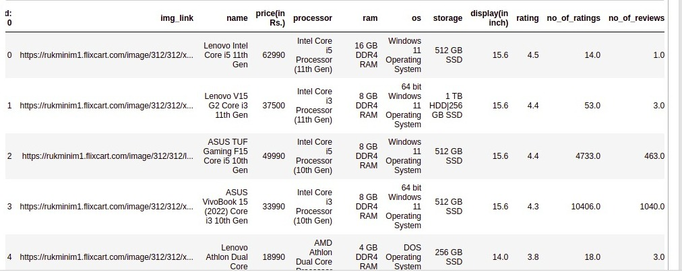
Dataset:

Slide 7
Model selection
Coming to selecting model for this project, there are several approaches are available the choice of model selection depends on available data.
Regression Models: Regression models are commonly used for price prediction tasks. Linear regression, polynomial regression,Random forest regressor and support vector regression (SVR) are some popular techniques. These models can capture the relationship between input features (e.g., specifications, brand, market trends) and laptop prices, allowing you to predict prices based on the given inputs.

Slide 8
Decision Trees and Random Forests: Decision tree-based models, such as decision trees and random forests, are useful for feature selection and prediction tasks. They can handle both numerical and categorical features, and their ensemble nature helps reduce overfitting. These models can be effective for laptop selection, as they can consider various features and make decisions based on the importance of each feature.

Slide 9
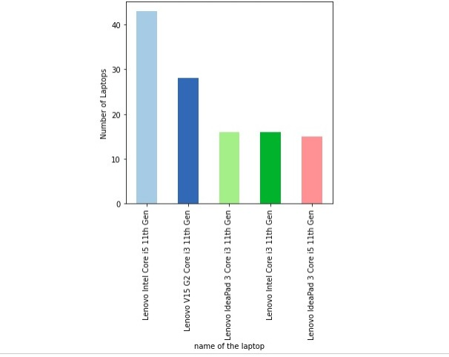
TOP 5-BRANDS IN MARKET

Slide 10
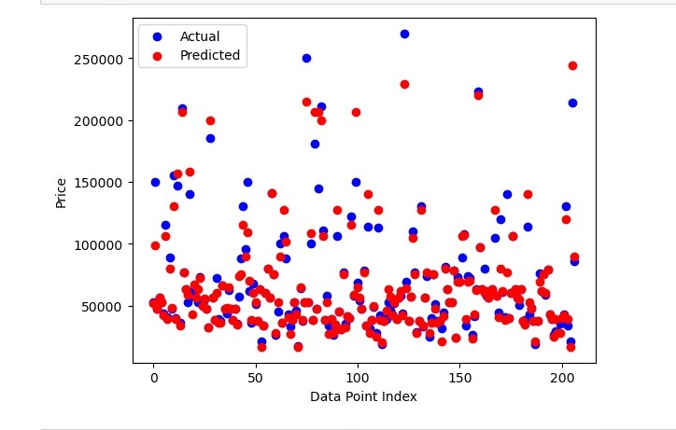
ACTAUAL PRICE VALUES VS PREDICTED PRICE VALUES

Slide 11
CONCLUSION:
In conclusion we gather the user preferences and specifications on features like Ram,Os,Processor,Storage etc and also takes features of the laptop as input.
After data processing training the model with the selected dataset.later it gives the persionalized reccommened the best laptop based on specifications and budget also gives the predicted price of laptop based on features which are given as input to particular model.
Through the laptop selection and price prediction process, users can benefit from a better understanding of the factors influencing laptop prices and the ability to compare different laptops based on their preferences and budget constraints. The project provides a valuable tool to assist users in selecting the most suitable laptop for their specific needs and helps them make informed purchasing decisions.

Slide 12
Reference Links:
https://www.kaggle.com/code/danielbethell/laptop-prices-prediction/notebook
https://github.com/topics/laptop-price-prediction
https://www.youtube.com/watch?v=BgpM2IiCH6k

Slide 13


