Slide 1
WHERE-IS-IT
Have You Ever Lost Your Things?
TEAM OILIL7 | SHWE YIN MIN OO · SHWE YI WIN LAE · SU WAI TUN
Notes:
Good afternoon, Professor and everyone.
Today, our team would like to introduce our project, called Where-Is-It AI.

Slide 2
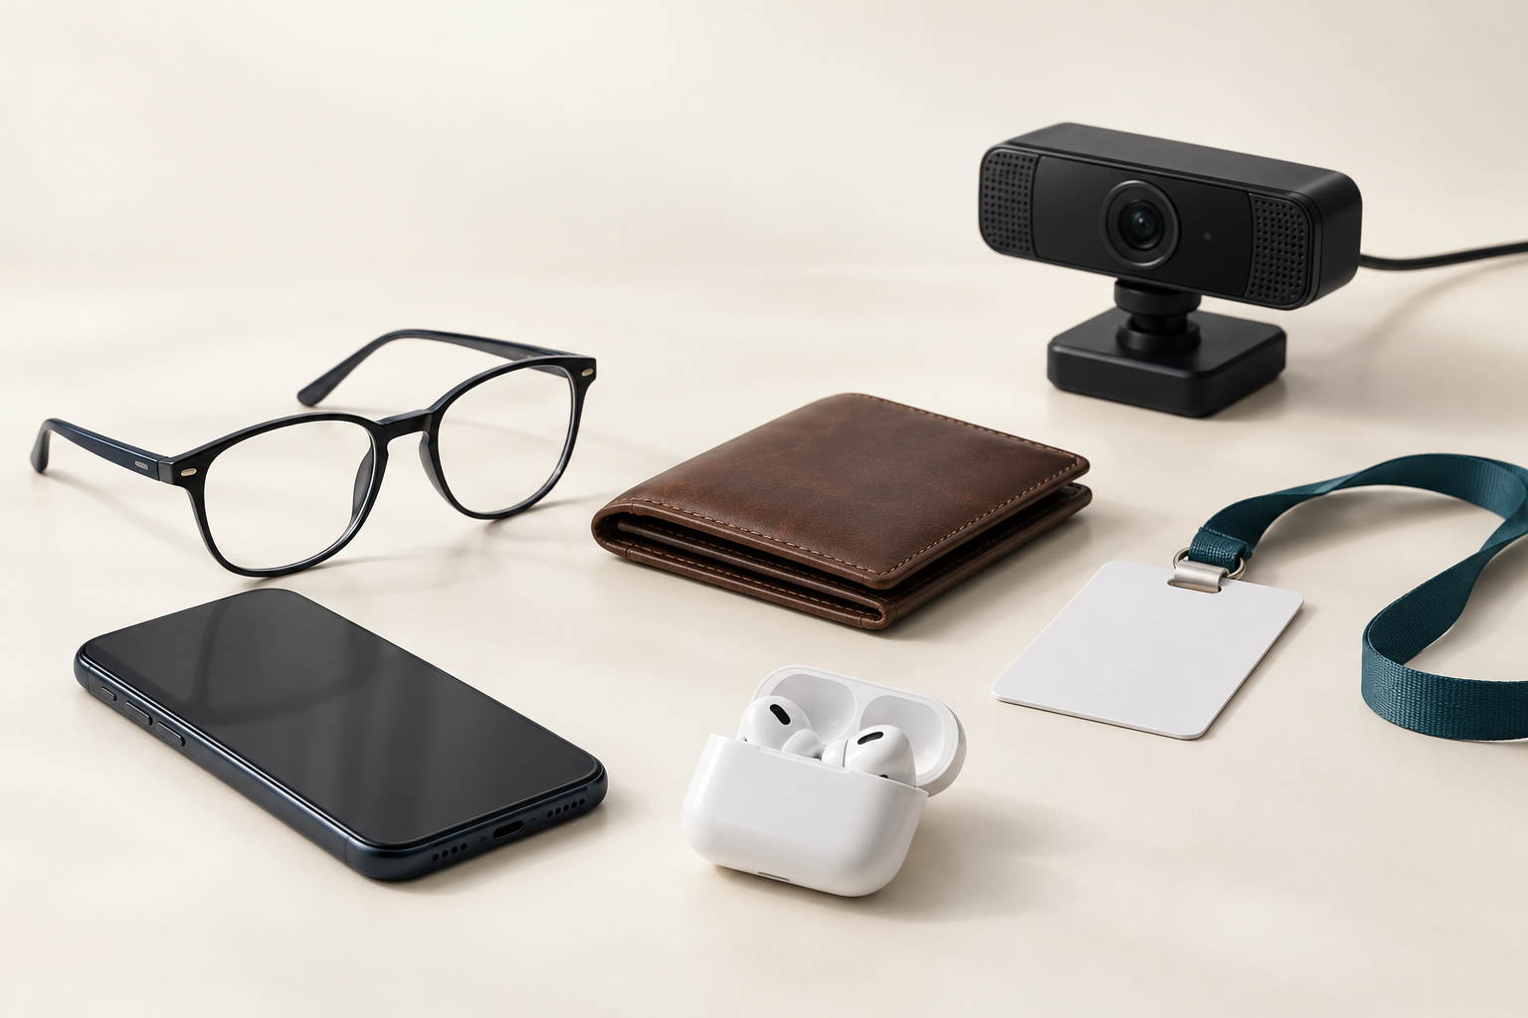
Table of Contents
01 Interview Process
02 Main Interview Findings
03 Problem Definition
04 Mini Ontology
05 Specification Version 1
06 Validation & Limitations
07 Conclusion
Notes:
Today, I will first explain our interviews and what we found. Then I will show the problem we defined from that evidence, and how we used it to design our proposed solution.

Slide 3
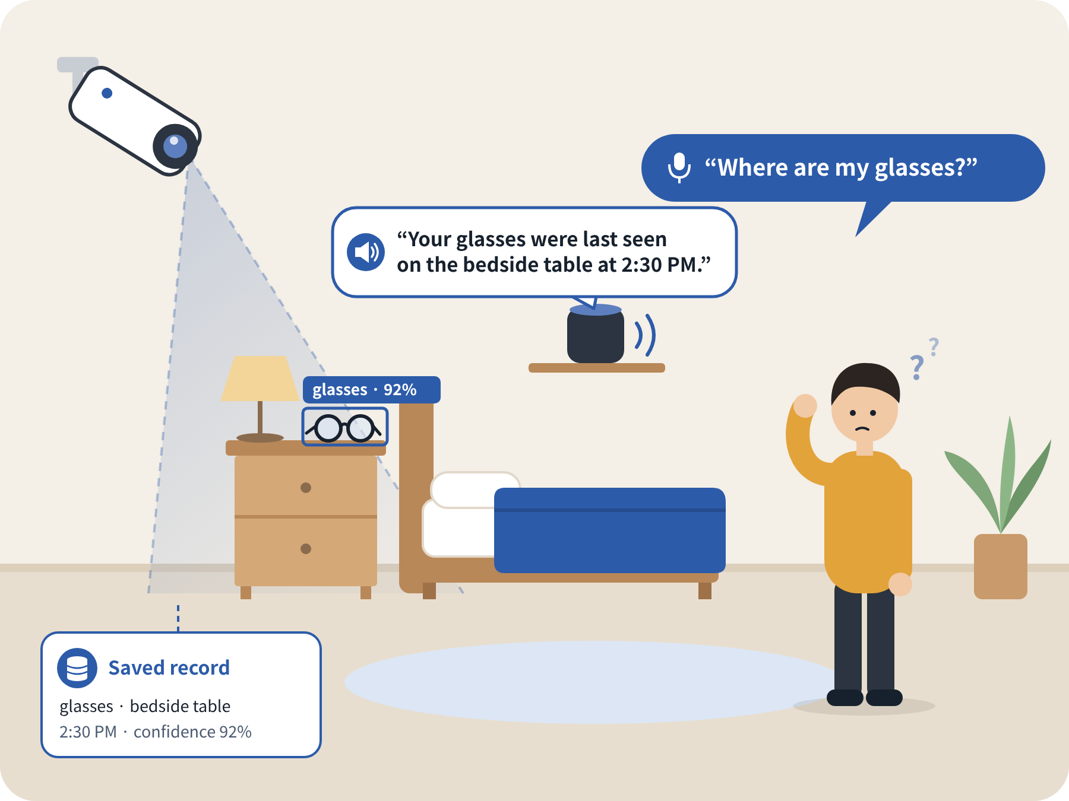
Where-Is-It AI
An AI Assistant for Finding Misplaced Everyday Belongings
Notes:
Before developing our solution, we wanted to make sure that the problem actually exists and that people experience it in their daily lives.

Slide 4
Where-Is-It AI
Our Approach
Before designing a solution, we first verified that the problem really exists by interviewing 10 Ajou University students.
Project Overview
User interviews
Problem definition based on interview evidence
Mini ontology development
Specification
Version 1
Notes:
For this reason, we conducted interviews with ten Ajou University students and analyzed their experiences with misplaced belongings.
Based on these interviews, we created our problem definition, mini ontology, and the first version of our project specification.

Slide 5
Interview Process
User Interviews
Category | Description
Participants | 10 Ajou University students
Questions | 10 interview questions
Focus | Actual experiences with misplaced belongings
Objective | Identify common searching behaviors and difficulties
Q1. Do you sometimes have trouble remembering where you put your things?
Q6. Where did you search after that, and in what order?
Q7. Have you ever used an app, tracking device, or another person's help to find an item? If yes, did it actually help?
Q2. What kinds of items do you usually have trouble finding?
Q3. Tell me about the most recent time you had difficulty finding something.
Q8. How long did it take, and what was the most inconvenient part of the search?
Q4. When and how did you realize that you could not find the item?
Q9. Where did you finally find the item, and what made you check that place?
Q5. Where did you look first, and why did you check that place first?
Q10. What information or help would have helped you find the item faster at that time?
Notes:
First, to understand whether this problem really exists, we interviewed ten Ajou University students.
We asked ten questions about their actual experiences with losing or misplacing everyday belongings.

Slide 6
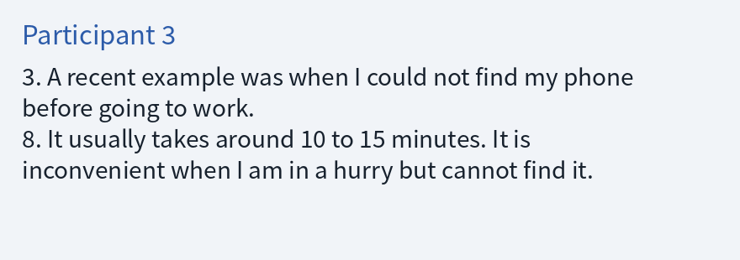
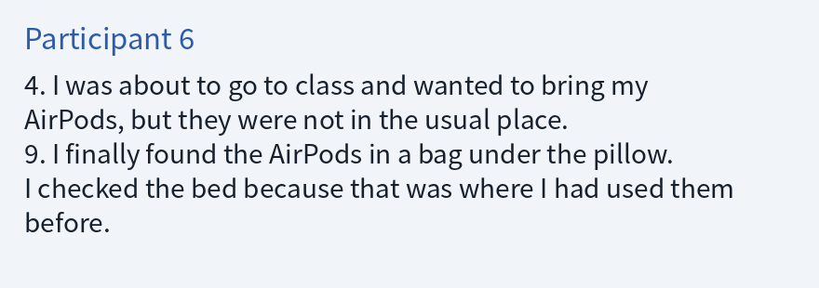
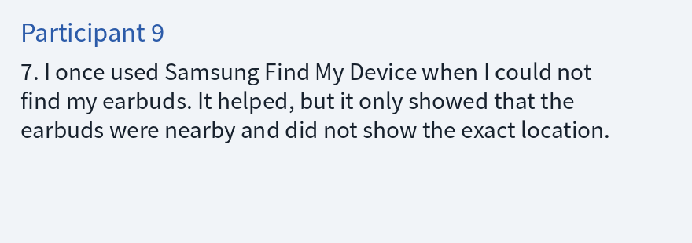
Interview Evidence
Interview Questions (5 Core Topics)
Interview answer excerpts
Misplaced Objects: What belongings are difficult to find?
Recent Experiences: When and how did the problem occur?
Searching Behavior: Where did participants search first and next?
Existing Solutions: What applications or methods did they use?
User Needs: What information would help them find items faster?
Overall Finding
10/10 participants reported having experienced difficulty finding personal belongings.
We asked about real past experiences, not whether participants would like to use our app.
Notes:
We focused particularly on their most recent experiences, where they searched, how long it took, and how they finally found their belongings.
We focused on their real experiences rather than simply asking whether they would like to use our application.
This is important because someone saying that an application sounds useful does not necessarily prove that they have a real problem.
After collecting the interviews, we compared the answers and identified several common patterns.
All ten participants reported having had trouble finding personal belongings.
However, we also wanted to understand exactly when the problem happened and why searching became difficult.

Slide 7
Main Interview Findings
Five Key Findings
1. Small Everyday Objects Are Difficult to Find
2. Missing Items Are Often Noticed When Needed
Common items: glasses, cards, earphones, phones, chargers, and hair ties.
Small size and low visibility make searching difficult.
Participants experienced difficulties before leaving home.
Participant 3: Searching for a phone took approximately 10–15 minutes.
3. Users Check Familiar Locations First
4. Existing Tracking Applications Have Limitations
All 10 participants described checking familiar locations.
Common locations: desks, beds, and bags.
Some participants repeatedly checked the same places.
Applications mentioned: Apple Find My and Samsung Find My Device.
Participants 6 and 9 reported difficulties identifying exact indoor locations.
5. Last-Seen Information Helps
Several participants found items by remembering their last-used locations.
Participant 10 found an item under clothes near its previous usage location.
Main Insight
Remembering where an object was last seen can reduce unnecessary searching → we focus on recording and retrieving last-seen locations.
Notes:
From our interviews, we identified five important findings.
The first finding is that small everyday objects are difficult to find.
Participants frequently mentioned items such as glasses, cards, earphones, phones, chargers, and hair ties.
This shows that object size and visibility can make searching more difficult.
The second finding is that people usually notice missing items when they need them.
For example, participant three could not find their phone before going to work.
They explained that searching usually took around ten to fifteen minutes and was inconvenient when they were in a hurry.
Other participants experienced similar situations before going to class or leaving home.
Therefore, the problem is not only about forgetting where an item is. It is also about losing time when the item is urgently needed.
The third finding is that people first check their usual locations.
All ten participants described checking familiar places, such as their desks, beds, or bags.
When they didn't find it there, they kept searching other possible locations.
In some cases, they even checked the same places repeatedly.
This shows that without reliable location information, users may waste time searching places they have already checked.
This repeated searching is one of the main problems we want to reduce.
The fourth finding is that existing tracking applications have limitations.
Some participants used Apple Find My or Samsung Find My Device.
However, participants six and nine explained that these applications could indicate that an item was nearby without showing its exact indoor location.
As a result, they still needed to search physically.
The fifth finding is that remembering the last-used location is helpful.
Several participants eventually found their missing belongings by remembering where they had last used them.
For example, participant ten found an item under clothes near the place where it had been used the previous night.
This was especially important to our project because it showed us that information about an object’s previous location could help users decide where to search first.
Based on these findings, we defined our problem, which I will explain next.

Slide 8
Problem Definition
Problem Statement
University students who frequently misplace everyday belongings have difficulty finding them when the items are not in their usual locations. Because they do not know where the items were last seen, they spend unnecessary time searching multiple places.
Key Problems
Target Users
Not knowing where items were last seen
University students living in small spaces (dormitories or one-room apartments) who frequently spend time searching for misplaced belongings
Searching multiple possible locations
Repeated searching and unnecessary time loss
Project Goal
Help students find misplaced belongings faster and reduce unnecessary searching stress.
Increased stress when in a hurry
Out of Scope: Large-scale lost-and-found services, business equipment, and tracking outside the home.
Notes:
Based on these findings, we defined our problem.
For example, imagine that you are getting ready to go to university, but suddenly you cannot find your wallet or earphones.
You check your desk because that is where you usually keep them. However, they are not there.
Then you start checking your bed, your bag, and other places around your room.
This situation may seem like a small problem, but it can become stressful, especially when you are in a hurry.
This is exactly the situation our participants described, and our project focuses on it.
Our problem definition is:
University students who frequently misplace everyday belongings have difficulty finding them when the items are not in their usual locations. Because they do not know where the items were last seen, they spend unnecessary time searching multiple places.
Target User:
Our primary target users are university students living in small spaces, such as dormitories or one-room apartments, who frequently spend time searching for misplaced belongings.
We distinguish them from students who rarely experience significant inconvenience when looking for their belongings.
We are not focusing on large-scale lost-and-found services, business equipment, or tracking belongings outside the home.
Our goal is to help students find their personal belongings more quickly and reduce unnecessary stress from searching.

Slide 9
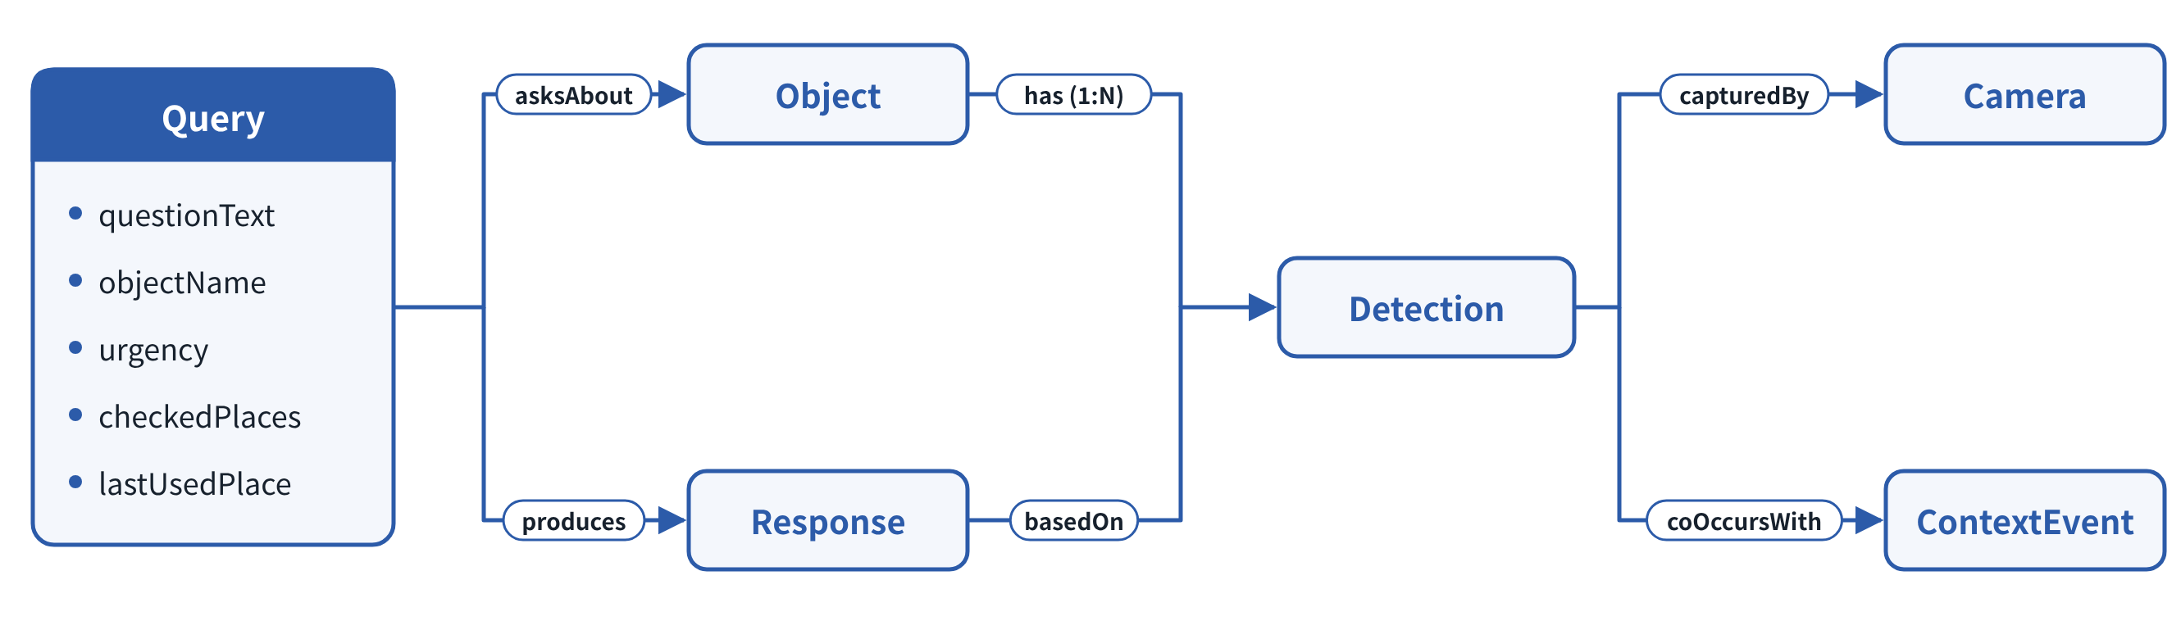
Mini Ontology
Proposed Solution
Main Entities & Relationships
A camera-based AI assistant that helps users locate misplaced belongings.
Query
Object
Response
User’s question
urgency, checkedPlaces, lastUsedPlace
Item the user wants to find
Answer provided to the user
Example
Query: “Where is my wallet?”
System: Retrieves the latest reliable detection of the wallet.
Camera
Detection
Context Event
Camera and associated room
Location, time, confidence score
Person or pet near an object
Reliability Rule
Detection confidence ≥ 75%
Only these detections are treated as reliable records.
Context-based guesses are shown as possibilities, never as confirmed locations.
Diagram: Relationship between Entities
Notes:
Our proposed solution is a camera-based AI assistant that helps users locate misplaced belongings.
After analyzing the interview results, we created a mini ontology to organize the important information our system needs.
Our ontology contains six main entities.
These are Object, Query, Detection, Camera, Context Event, and Response.
Each entity has its own attributes, and we defined relationships between them.
Let me explain them briefly.
Object represents the item the user wants to find, such as glasses or a wallet.
Query represents the user's question, such as "Where are my glasses?"
Based on our interviews, Query also includes attributes such as urgency, checkedPlaces, and lastUsedPlace.
For example, participant three’s experience before work relates to urgency, while participants’ searching behavior relates to checkedPlaces.
Detection stores information about where and when the item was detected, together with a confidence score.
Camera identifies the camera and room associated with the detection.
Context Event represents relevant surrounding events, such as a person or pet appearing near an object.
Finally, Response represents the answer provided to the user.
These entities are connected to help the system understand the relationship between a user's question and the available camera evidence.
For example, when a user asks where their wallet is, the system searches for the latest reliable detection of that wallet and uses it to prepare a response.
Our ontology also defines an important rule: detections must have at least 75 percent confidence to be treated as reliable records.
If the system uses contextual information to suggest a possible location, it must clearly distinguish that possibility from a confirmed detection.
This helps prevent the system from providing uncertain information as a confirmed fact.

Slide 10
Specification Version 1
System Workflow
Detect → Save → Search → Explain
1. Detect
2. Save
3. Search
4. Explain
Camera periodically captures room images.
AI detects supported objects.
Store object locations and timestamps.
Retrieve relevant detection records based on the user’s query.
Provide the detected or last-seen location.
Example Scenario
User: “Where are my glasses?”
AI (not visible now): “Your glasses were last seen on the bedside table at 2:30 PM.”
Important: The system must distinguish between currently detected and previously detected locations.
Notes:
Based on our interview findings and ontology, we created our first specification.
The basic process is:
Detect, Save, Search, and Explain.
First, we need a home camera or CCTV. The camera periodically captures images of the room.
Second, the AI detects supported objects in those images.
Third, the system saves their detected locations and timestamps.
Finally, when a user asks a question, the system searches the available records and provides an answer.
For example, imagine that the user asks:
"Where are my glasses?"
If the glasses are visible in the latest camera image, the system can provide their detected location.
However, if the glasses are no longer visible, the system searches previous records.
It might answer:
"Your glasses were last seen on the bedside table at 2:30 PM."
Importantly, the system should not claim that the glasses are still there if the latest camera image does not confirm this.

Slide 11
Initial Requirements
Specification V1 Scope
Not Included in V1
Pre-captured camera images
Multiple-camera tracking
Limited number of everyday objects
Voice interaction
Simple text-based interface
Predictive search
Initial Evaluation Targets
Metric | Object Detection Accuracy | False Positive Rate | Total Response Time
Target | > 90% | < 5% | < 6 seconds
Note: These are development targets, not achieved results.
Acceptance Criteria (testable)
A detection with only 60% confidence must not be used as a confirmed location (threshold: 75%).
If no reliable detection exists, the system must say the location cannot be determined instead of guessing.
If the latest image does not show the item, the system must not claim it is still there.
Notes:
Our specification also defines testable acceptance criteria.
For example, if a detection has only 60 percent confidence, it must not be used as a confirmed location because our threshold is 75 percent.
If no reliable detection exists, the system must clearly state that the location cannot be determined instead of guessing.
For our first version, we focus on pre-captured images, a limited number of everyday objects, and a simple text-based interface.
We also exclude multiple-camera tracking, voice interaction, and predictive search from Version 1.
Our specification also includes initial evaluation targets, such as object detection accuracy above 90 percent, a false positive rate below 5 percent, and a total response time below six seconds.
These are targets for development and testing, not results we have already achieved.

Slide 12
Validation & Limitations
Validation Plan
Current Limitations
We will compare search time with and without Where-Is-It AI and check whether the system:
Camera Visibility: Cannot detect objects hidden in closed bags or drawers.
Detection Uncertainty: Without reliable evidence, the system says the location cannot be confirmed instead of guessing.
Privacy & Security: Camera information requires appropriate protection.
Gives correct last-seen information
Encourages users to check the suggested last-seen location
Helps users search the suggested location first
Reduces the time needed to find belongings
Current Status
Interviews support the existence of the problem, but the proposed solution still requires testing.
Notes:
Finally, we understand that interview evidence alone does not prove that our solution will be successful.
Our interviews support the existence of the problem, but we still need to test whether our system helps users.
To evaluate this, we plan to compare how long users take to find belongings with and without Where-Is-It AI.
We will also observe whether users check the suggested location first and whether the system provides correct last-seen information.
We plan to evaluate whether users check the last-seen location, search the suggested place first, and spend less time finding their belongings.
We also recognize several limitations.
For example, a camera cannot detect objects hidden inside closed bags or drawers.
Therefore, if there is no reliable evidence, the system should clearly explain that the object's location cannot be confirmed instead of guessing.
We also need to consider privacy and the security of camera information.

Slide 13
Conclusion
What We Accomplished
Interviewed 10 university students
Identified five key findings
Defined the problem and target users
Developed a mini ontology
Created Specification Version 1
Key Takeaway
Difficulty finding everyday belongings is a real problem for our participants, especially when they are in a hurry.
Next Step
Run real user experiments to validate whether Where-Is-It AI helps users find misplaced belongings more efficiently.
Thank You! Questions?
Notes:
To conclude, our interviews showed that difficulty finding everyday belongings is a real problem among our participants, especially when they are in a hurry.
Based on this evidence, we defined our target users, created a mini ontology, and developed our first specification.
Our next goal is to validate whether Where-Is-It AI can help users find their belongings more efficiently.
Thank you for listening. We are happy to answer your questions.

