Slide 1
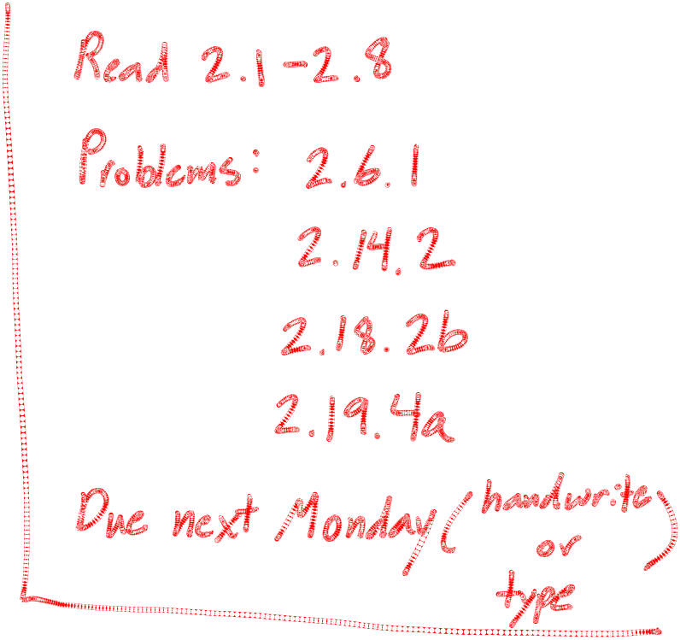
MIPS Calling Convention
Chapter 2.8

Slide 2
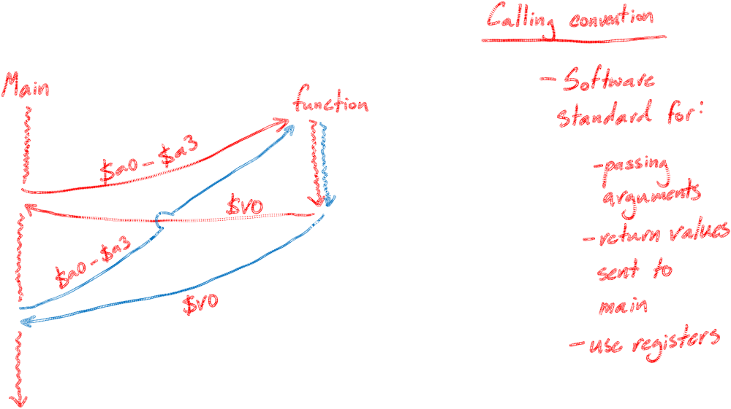
Procedure Calls

Slide 3
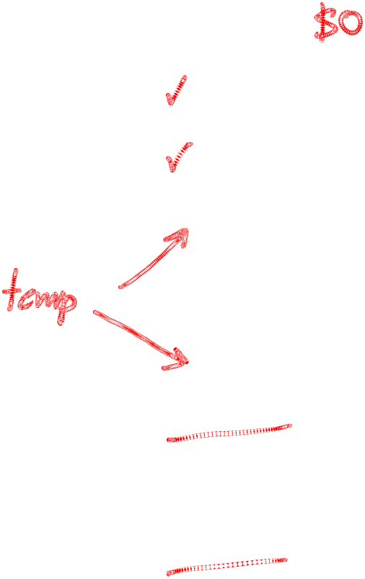
MIPS-specific info
Page 121
Name | Reg Number | Usage | Preserved across call?
$zero | 0 | The constant 0 | Yes
$v0-$v1 | 2-3 | Function results | No
$a0-$a3 | 4-7 | Function Arguments | No
$t0-$t7 | 8-15 | Temporaries | No
$s0-$s7 | 16-23 | Saved | Yes
$t8-$t9 | 24-25 | More temporaries | No
$gp | 28 | Global pointer | Yes
$sp | 29 | Stack pointer | Yes
$fp | 30 | Frame pointer | Yes
$ra | 31 | Return address | Yes

Slide 4
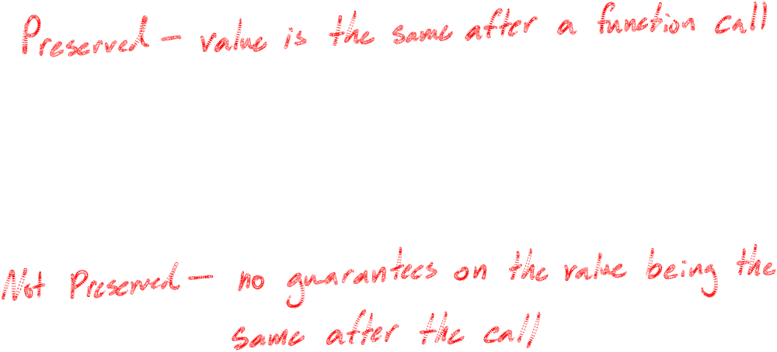
MIPS-specific info

Slide 5
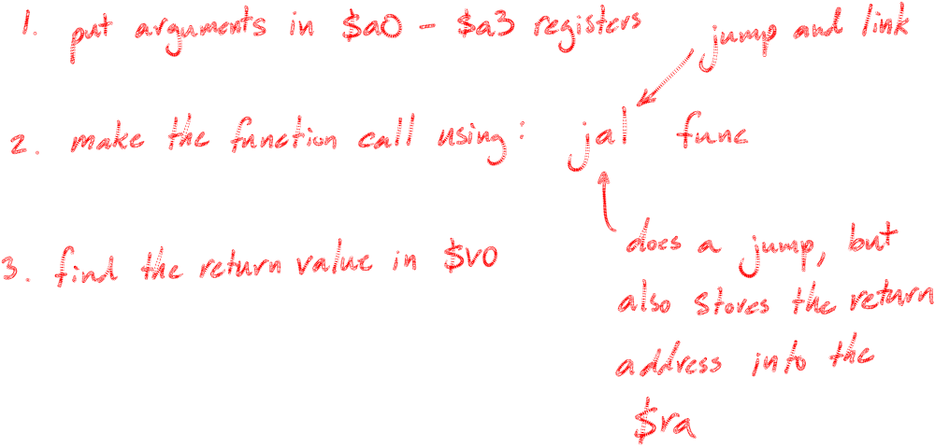
Steps for caller

Slide 6
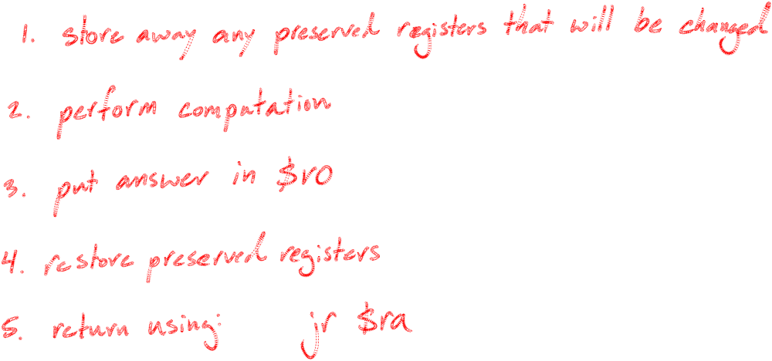
Steps for procedure (callee)

Slide 7
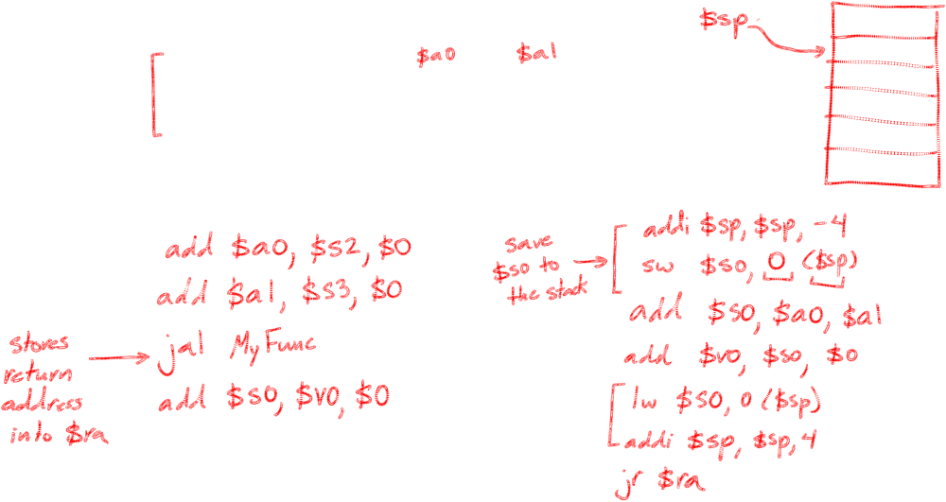
Write the caller & procedure code for the following function:
int MyFunc(int g, int h)
{ return (g + h);}
Caller:
Callee:
Assume: g,h are in $s2,$s3. We want return value in $s0.

Slide 8
Preserved Registers
Name | Reg Number | Usage | Preserved across call?
$zero | 0 | The constant 0 | Yes
$v0-$v1 | 2-3 | Function results | No
$a0-$a3 | 4-7 | Function Arguments | No
$t0-$t7 | 8-15 | Temporaries | No
$s0-$s7 | 16-23 | Saved | Yes
$t8-$t9 | 24-25 | More temporaries | No
$gp | 28 | Global pointer | Yes
$sp | 29 | Stack pointer | Yes
$fp | 30 | Frame pointer | Yes
$ra | 31 | Return address | Yes

Slide 9
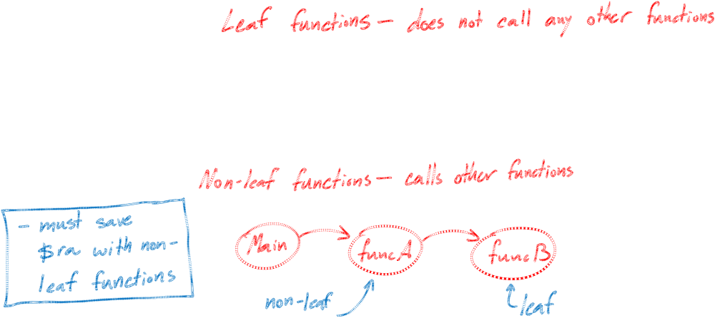
Definitions

Slide 10
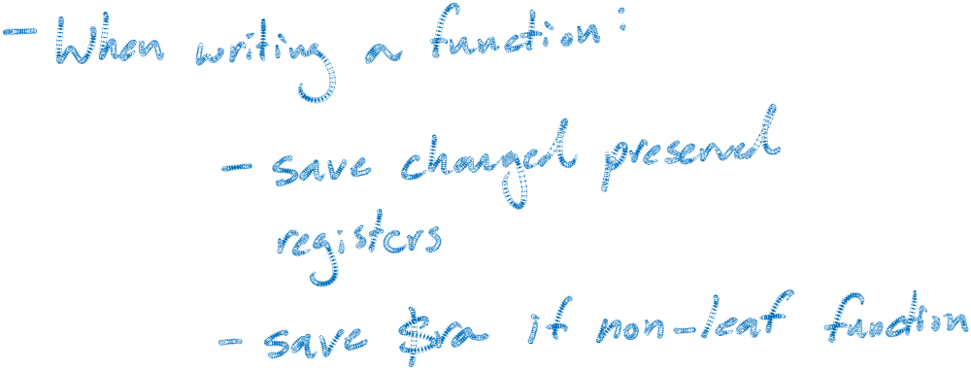
How much stack space?

Slide 11
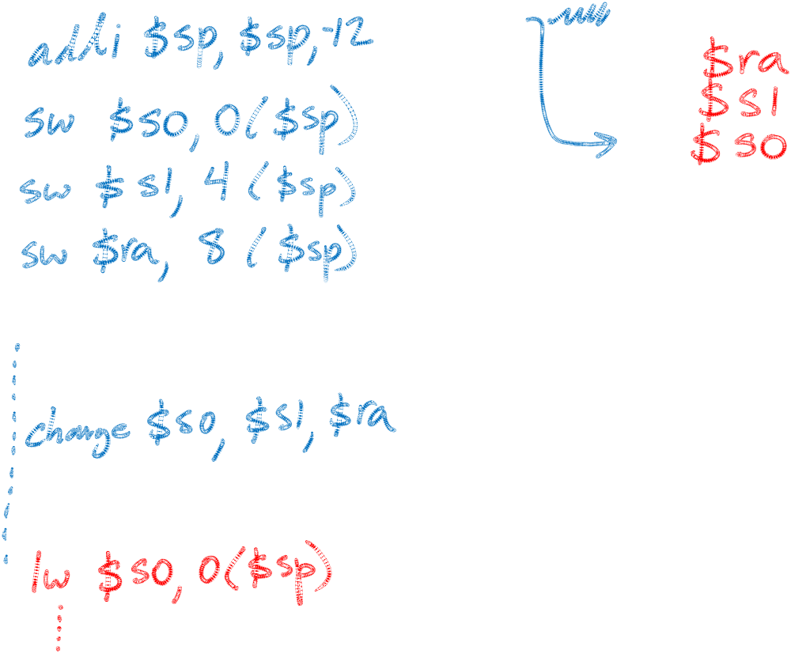
Allocating stack space
$sp

