Slide 1
Schedule-It!
Haley Kwiat, Scott Campana, Eric Ha, Ben Wasko, Hayden Nix

Slide 2
Schedule it is the be all end all of scheduling your life and events. We saw a problem in the fact that in classes we could never decide when and where to meet with our groups. We decided to solve that problem.

Slide 3
The app is designed to…
Allow you to create events and invite your friends via our webapp where they can quickly say whether or not they can attend what time you had picked
They can also create groups of people with which they can invite e.g. your software development group to an event.

Slide 4
Methodology
Using a less formal agile method we…
We used Heroku to host our web app
The app is mostly html, css, and php paired with mysql to setup our database
We used a Jquery Calendar api from a public github repository
We used githubs project tracking software to document to-do’, done, and in progress tasks

Slide 5
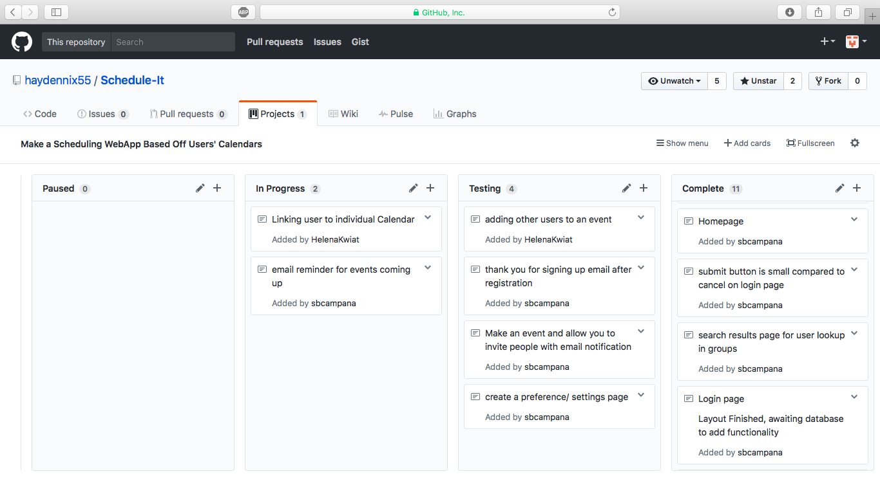

Slide 6
Challenges…
Spelling Calender or Calendar… ☺
Merging database
Registration emails and exposing API’s
Trying to figure out Calendar API
Having separate user info

Slide 7
Demo!
http://schedule-it.herokuapp.com

