Slide 1
Biomedical and Electrical Engineering – Robotic Control in Medicine
Launchpad workshop

Slide 2

Biomedical Robotics
Example applications
Knee prosthesis implant surgery
Dental surgery
Robotic arm prosthesis
“Neural prosthesis” through brain-computer interface
Core components:
Microcontrollers
Sensors - Sense information from the patient’s body or the patient’s environment
make decisions, e.g.:
how to move a surgical tool, or
how to deliver an electrical therapy
how much medicine to deliver
how to move a device designed to assist people who cannot move their legs or arms
Image credit: Chris Newmarker, The Robot Report

Slide 3
Scientific Questions to Answer Today
What are applications of medical robotics?
What are microcontrollers and why are they useful?
What are examples of sensors that could be used in medicine?
How do we make robots and devices carry out desired actions?
How do we make a pump run without manual human labor?
How do we move an object (arm) where we want it to go?
How do we make a robot know when to stop (or start) on its own?

Slide 4
Today’s Lab Activity
Shampoo Dispensing
DC Motor to Power Supply
Arm Position
Stepper Motor
Scrub
Servo motor
Feedback control with Gripper
Servo Motor
FSR

Slide 5
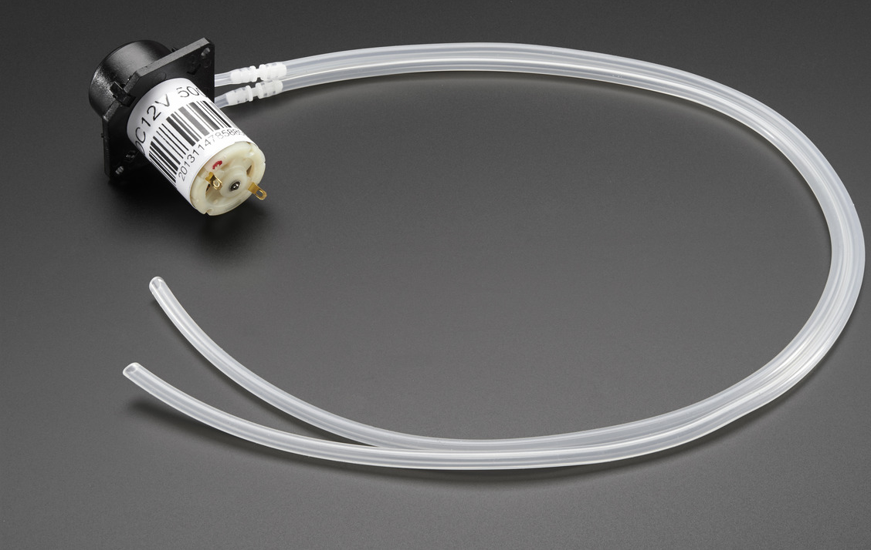
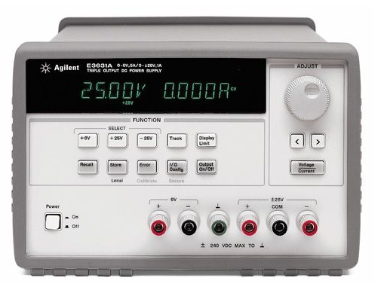
Shampoo Dispensing
Control flow rate:
Before connecting anything, turn power supply on. Select Output On and +25 V button. Adjust the knob to 0V. Then turn off power supply.
Connect DC motor to power supply with power supply off. Red banana cable to the power supply and red alligator clip to white motor lead. Black banana cable to the power supply and black alligator clip to brown motor lead.
Turn power supply on, follow the same steps and gradually adjust the voltage control knob clockwise. Control decimal to the nearest 10th by using the right arrow. Log results.
Turn off and attach the pump (plastic housing) and tubing. Dip the inlet tubing into the shampoo and the outlet tubing into the empty graduated cylinder.
Turn power supply on and increase the voltage until the shampoo starts moving through the tubing.
Determine flow rate by timing how long it takes to fill graduated cylinder with 10mL of shampoo. Log results

Slide 6
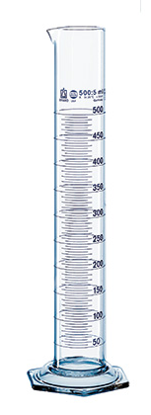
Shampoo Dispensing
Control timing:
Empty and wash out graduated cylinder.
Disconnect the positive power supply lead.
Add the push button in series.
Based on flow rate, determine how long to turn pump on in order to get 8mL of shampoo dispensed.
Set timer for partner to turn the switch off to get 8mL of shampoo dispensed.
Have your partner turn her back to the graduated cylinder and turn the switch on, time the designated duration, and then switch the pump off when she thinks 8mL has been dispensed. Log results.

Slide 7
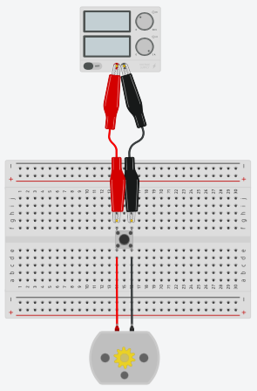
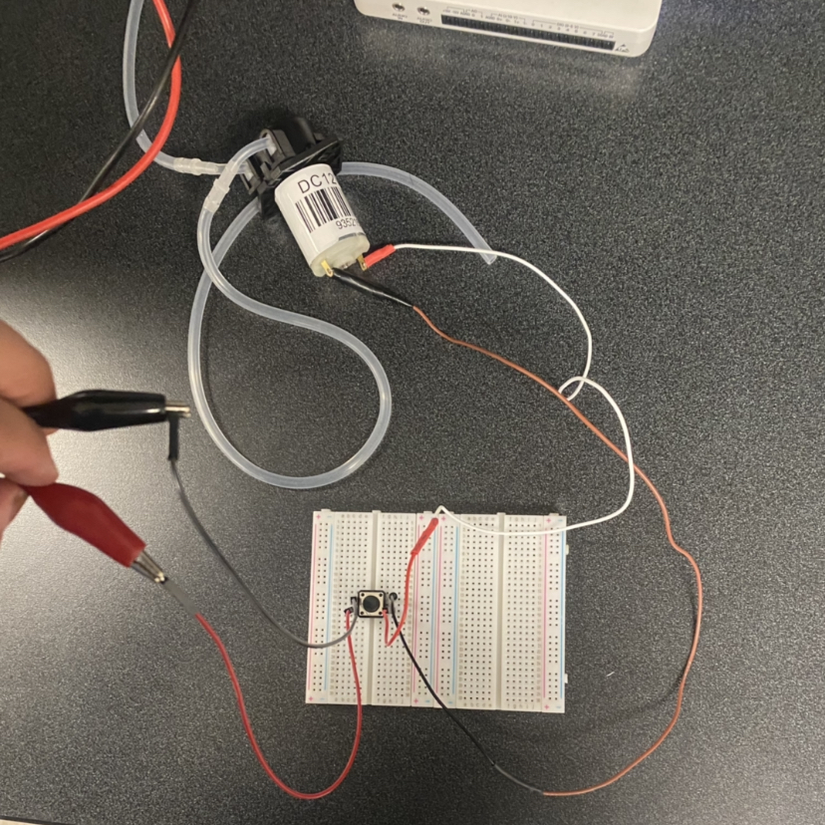
Switch in Series

Slide 8
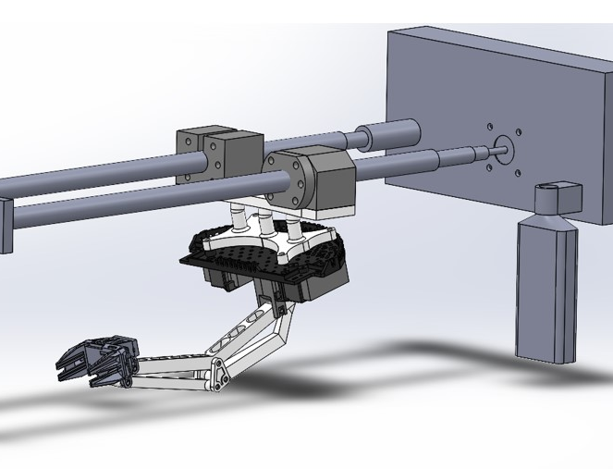
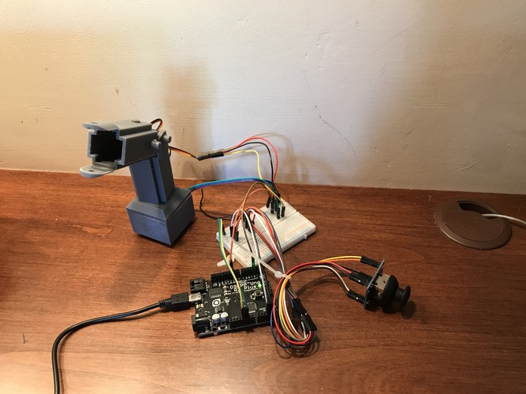
Position Arm – Stepper Motor
Controlling angular position of stepper motor
Connect H-bridge to stepper motor according to wiring diagram in Fig. 1
Connect your laptop to the Pynq board, turn Pynq board on.
Launch Moba xTerm.
Click Session
Click Serial
Select Serial Port that Pynq is connected to (if you’re not sure which one,
ask the mentors to help you)
Select 115200 for Speed.
Hit OK
WARNING: MOTOR SHIELD and STEPPER MOTOR gets hot! Do not touch the motor or chips!
If you need any assistance with wiring, please let a student facilitator know if you're in need of any help.

Slide 9
Position Arm – Stepper Motor
Control angular position
When the terminal (black window) appears, hit enter.
For user: enter “xilinx”
For password: enter “xilinx”
Type ip a
Under eth0, find the address that is a series of 4 numbers separated by “.” – e.g., 192.168.137.176. Copy and paste the address into a web browser
Find and open the Stepper_motor_code.ino file.
Run the code and watch the stepper motor. Can you control its angular position?
Log results.

Slide 10

Position Arm – Stepper Motor​
Control linear position
Now, see if you can adjust one number in the code to get the arm jig to be positioned at certain points along the rail:
approximately halfway across and
~¼ of the way across.​
Log results.​

Slide 11
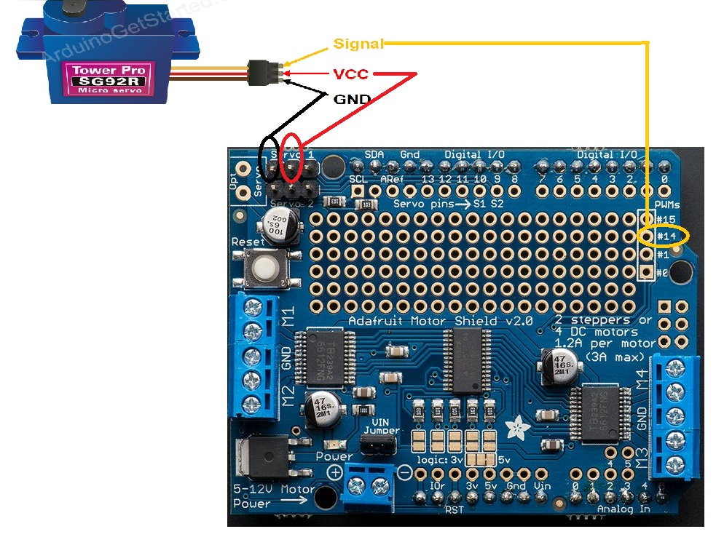
Scrub – servo motor
View and predict PWM output
Wire servomotor to Pynq board as shown in Fig. 2.
Connect the PWM output to the oscilloscope. In your workbook, sketch the output you predict to see.
Now run servoGo.ipynb and log results.
Adjust the code to make it scrub for 5s.
Adjust the code to make the arm scrub more of the back (i.e., control the length along back that it scrubs)
Adjust the code to make arm scrub faster.
Log results.
Log results.
Figure 1

Slide 12
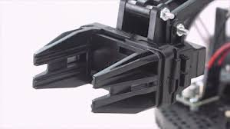
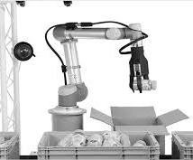
Feedback control with gripper
Open and close gripper
On your Yoga tablet, open the Arduino app
In C:\LaunchPadBW\ => find and open gripper.ino.
Run through the code and observe the actions of the gripper. The gripper should open and close.
Find the place in the code where the gripper position (or how wide the gripper is open or closed) is controlled.
In your worksheet, plan how you will adjust the code to try to get the gripper to close on the sponge and be able to hold the sponge without squishing the sponge. Then implement the code changes. In order to test out how well you managed to get your controller to hold onto something without squashing it, you will actually use your finger in place of the sponge. When the gripper is wide open, insert your index finger.
Log results.

Slide 13
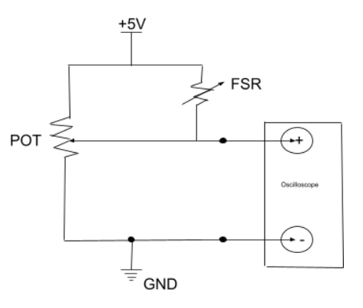
Feedback control with gripper
Adding the FSR: voltage divider output
Wire the voltage divider circuit with the FSR as shown in Fig. 3
Plug in the Arduino board so that now the 5V supply to your circuit board is on.
Gradually push harder and softer on the FSR. Log results. What do you see on the oscilloscope as you push harder on the FSR? As you release the FSR?
Figure 3

Slide 14
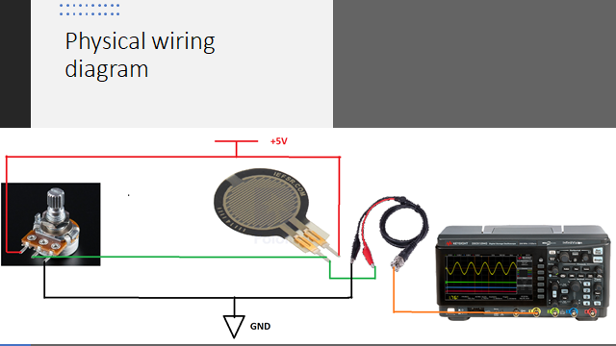

Slide 15
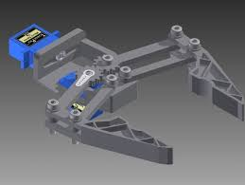
Feedback control with Gripper
Get gripper to hold sponge with right amount of pressure
Open pressureSensing.ino
Adjust the code so that the gripper will stop closing when the FSR senses pressure against the sponge.
Holding the terminal end (not the sensor end), hold the FSR sensor portion against the sponge. Run the code and test whether the gripper is able to automatically stop closing when it reaches the desired pressure. Log results.

