Slide 1
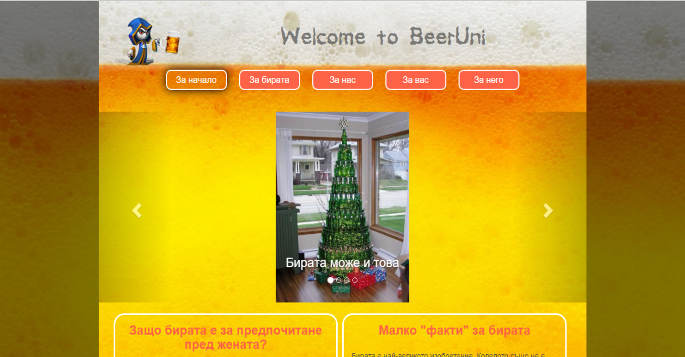

Team “Allied-Tion”
presents

Slide 2
GitHub & Live version
https://github.com/bewolf/Allied-Tion
http://allied-tion.matsov.com/index.html

Slide 3
Live Demo

Slide 4
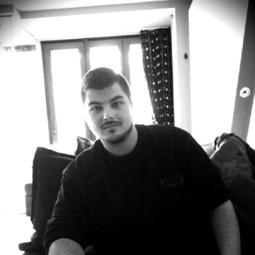
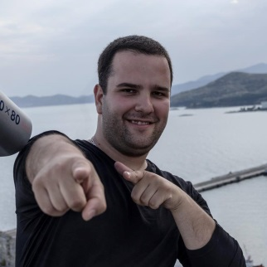
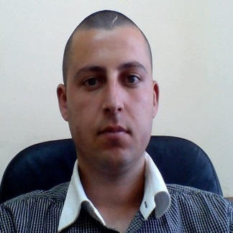
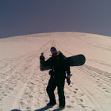
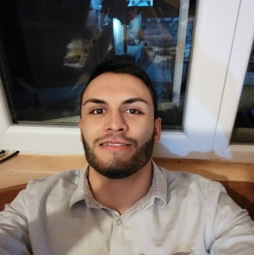
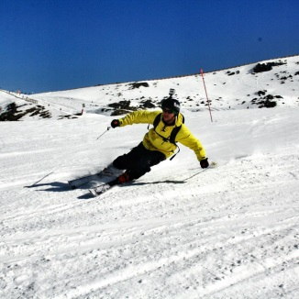
Team members:
Yavor Tenev
Atanas Bogdanov
Georgi Matsov
Тихомир Цветков
Konstantin Yanchev
Атанас Кефсизов
Tihomir Tsetkov
Atanas Kefsizof

Slide 5

Thanks for your attention.

