Slide 1
Chapter 12
A display model
Bjarne Stroustrup
www.stroustrup.com/Programming

Slide 2
Abstract
This lecture presents a display model (the output part of a GUI), giving examples of use and fundamental notions such as screen coordinates, lines, and color. Some examples of shapes are Lines, Polygons, Axis, and Text.
Stroustrup/Programming

Slide 3
Overview
Why graphics?
A graphics model
Examples
Stroustrup/Programming

Slide 4
Why bother with graphics and GUI?
It’s very common
  If you write conventional PC applications, you’ll have to do it
It’s useful
  Instant feedback
  Graphing functions
  Displaying results
It can illustrate some generally useful concepts and techniques
Stroustrup/Programming

Slide 5
Why bother with graphics and GUI?
It can only be done well using some pretty neat language features ☺
Lots of good (small) code examples
It can be non-trivial to “get” the key concepts
  So it’s worth teaching
  If we don’t show how it’s done, you might think it was “magic”
Graphics is fun!
Stroustrup/Programming

Slide 6
Why Graphics/GUI?
WYSIWYG
  What you see (in your code) is what you get (on your screen)
direct correspondence between concepts, code, and output
Stroustrup/Programming

Slide 7
Display model
Shape
Display
Engine
attach()
draw()
“window”
Square
attach()
Objects (such as graphs) are “attached to” a window.
The “display engine” invokes display commands (such as “draw line from x to y”) for the objects in a window
Objects such as Square contain vectors of lines, text, etc. for the window to draw
Stroustrup/Programming

Slide 8
Display model
An example illustrating the display model
  int main()
  {
  using namespace Graph_lib; // use our graphics interface library
  Point tl(100,200); // a point (obviously)
  Simple_window win(tl,600,400,"Canvas"); // make a simple window
  Polygon poly; // make a shape (a polygon, obviously)
  poly.add(Point(300,200)); // add three points
  poly.add(Point(350,100));
  poly.add(Point(400,200));
  poly.set_color(Color::red); // make the polygon red (obviously)
  win.attach(poly); // connect poly to the window
  win.wait_for_button(); // give control to the display engine
  }
Stroustrup/Programming

Slide 9
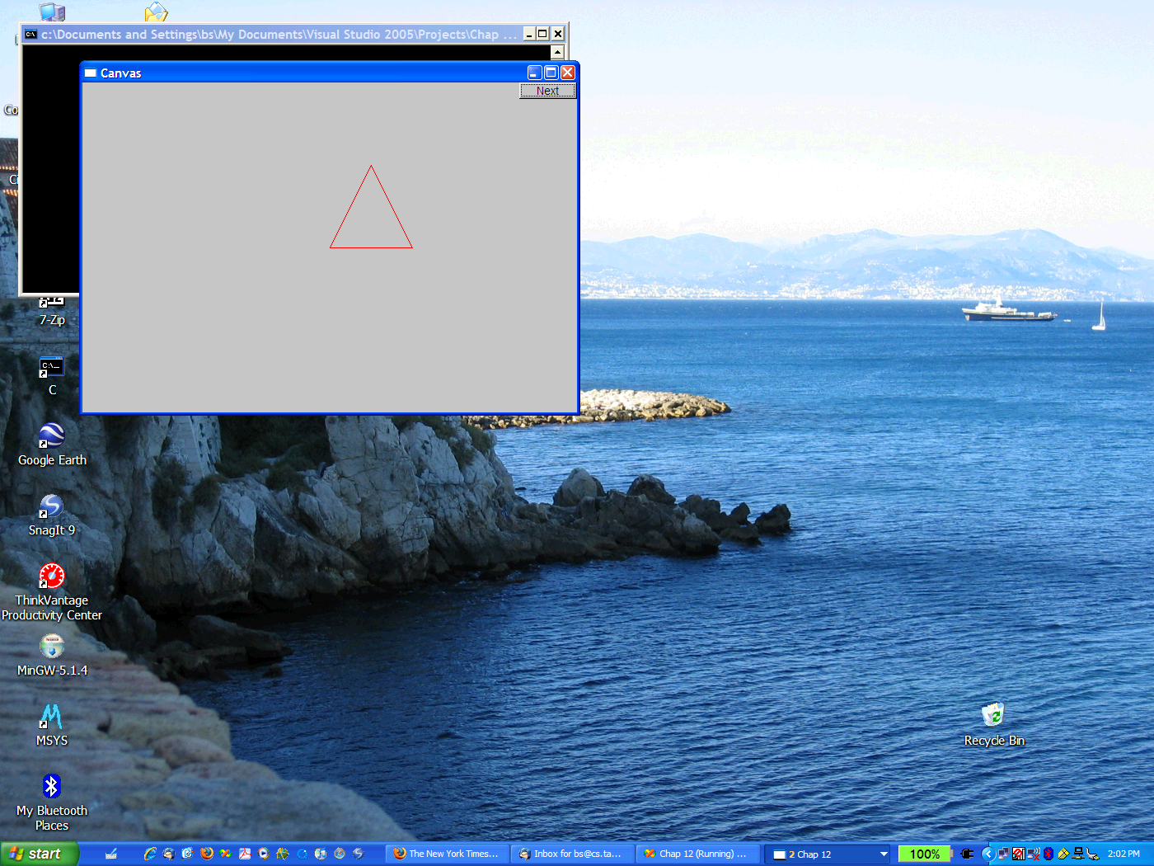
The resulting screen
Stroustrup/Programming

Slide 10
Graphics/GUI libraries
You’ll be using a few interface classes we wrote
  Interfacing to a popular GUI toolkit
    GUI == Graphical User Interface
    FLTK: www.fltk.org // Fast Light Tool Kit
  Installation, etc.
    see Appendix D and ask instructor/friend
      FLTK
      Our GUI and graphics classes
      Project settings
This model is far simpler than common toolkit interfaces
  The FLTK (very terse) documentation is 370 pages
  Our interface library is <20 classes and <500 lines of code
  You can write a lot of code with these classes
    And what you can build on them
Stroustrup/Programming

Slide 11
Graphics/GUI libraries (cont.)
The code is portable
  Windows, Unix, Mac, etc.
This model extends to most common graphics and GUI uses
The general ideas can be used with any popular GUI toolkit
  Once you understand the graphics classes you can easily learn any GUI/graphics library
    Well, relatively easily – these libraries are huge
Stroustrup/Programming

Slide 12
Graphics/GUI libraries
Our code
Our interface library
A graphics/GUI library (here FLTK)
The operating system (e.g. Windows or Linux)
Our screen
Often called “a layered architecture”
Stroustrup/Programming

Slide 13
Coordinates
0,0
200,0
50,50
200,100
0,100
Oddly, y-coordinates “grow downwards” // right, down
Coordinates identify pixels in the window on the screen
You can re-size a window (changing x_max() and y_max())
Stroustrup/Programming

Slide 14
Interface classes
Line_style
Window
Color
Shape
Point
Simple_window
Line
Lines
Polygon
…
Rectangle
Text
An arrow means “is a kind of”
Color, Line_style, and Point are “utility classes” used by the other classes
Window is our interface to the GUI library (which is our interface to the screen)
Stroustrup/Programming

Slide 15
Interface classes
Current
  Color, Line_style, Font, Point,
  Window, Simple_window
  Shape, Text, Polygon, Line, Lines, Rectangle, …
  Axis
Easy to add (for some definition of “easy”)
  Grid, Block_chart, Pie_chart, etc.
Later, GUI
  Button, In_box, Out_box, …
Stroustrup/Programming

Slide 16
Demo code 1
// Getting access to the graphics system (don’t forget to install):
#include “Simple_window.h" // stuff to deal with your system’s windows
#include "Graph.h" // graphical shapes
using namespace Graph_lib; // make names available
// in main():
Simple_window win(Point(100,100),600,400,"Canvas");
// screen coordinate (100,100) top left of window
// window size(600*400)
// title: Canvas
win.wait_for_button(); // Display!
Stroustrup/Programming

Slide 17

A “blank canvas”
Stroustrup/Programming

Slide 18
Demo code 2
  Axis xa(Axis::x, Point(20,300), 280, 10, "x axis");
  // make an Axis
  // an axis is a kind of Shape
  // Axis::x means horizontal
  // starting at (20,300)
  // 280 pixels long
  // 10 “notches”
  // text “x axis
  win.set_label("Canvas #2");
  win.attach(xa); // attach axis xa to the window
  win.wait_for_button();
Stroustrup/Programming

Slide 19
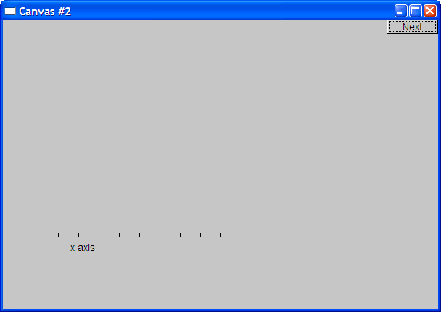
Add an X-axis
Stroustrup/Programming

Slide 20
Demo code 3
  win.set_label("Canvas #3");
  Axis ya(Axis::y, Point(20,300), 280, 10, "y axis");
  ya.set_color(Color::cyan); // choose a color for the axis
  ya.label.set_color(Color::dark_red); // choose a color for the text
  win.attach(ya);
  win.wait_for_button();
Stroustrup/Programming

Slide 21
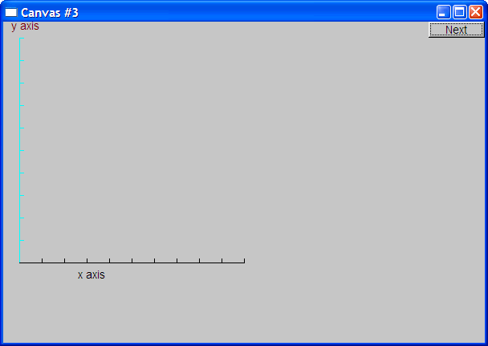
Add a Y-axis (colored)
Yes, it’s ugly, but this is a programming course, not a graphics design course
Stroustrup/Programming

Slide 22
Demo code 4
win.set_label("Canvas #4");
Function sine(sin,0,100,Point(20,150),1000,50,50); // sine curve
// plot sin() in the range [0:100)
// with (0,0) at (20,150)
// using 1000 points
// scale x values *50, scale y values *50
win.attach(sine);
win.wait_for_button();
Stroustrup/Programming

Slide 23
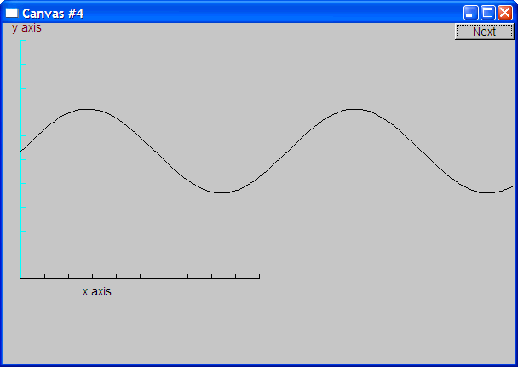
Add a sine curve
Stroustrup/Programming

Slide 24
Demo code 5
win.set_label("Canvas #5");
sine.set_color(Color::blue); // I changed my mind about sine’s color
Polygon poly; // a polygon, a Polygon is a kind of Shape
poly.add(Point(300,200)); // three points makes a triangle
poly.add(Point(350,100));
poly.add(Point(400,200));
poly.set_color(Color::red); // change the color
poly.set_style(Line_style::dash); // change the line style
win.attach(poly);
win.wait_for_button();
Stroustrup/Programming

Slide 25
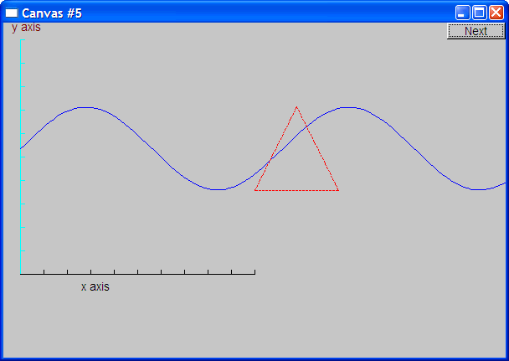
Add a triangle (and color the curve)
Stroustrup/Programming

Slide 26
Demo code 6
win.set_label("Canvas #6");
Rectangle r(Point(200,200), 100, 50);
win.attach(r);
win.wait_for_button();
Stroustrup/Programming

Slide 27
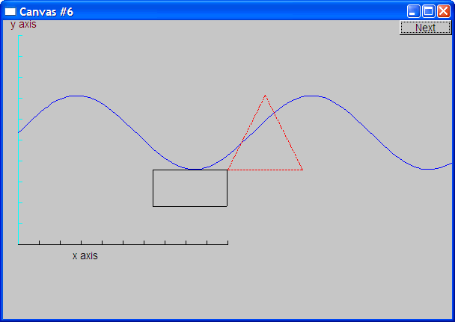
Add a rectangle
Stroustrup/Programming

Slide 28
Demo code 6.1
Add a shape that looks like a rectangle
  Closed_polyline poly_rect;
  poly_rect.add(Point(100,50));
  poly_rect.add(Point(200,50));
  poly_rect.add(Point(200,100));
  poly_rect.add(Point(100,100));
  win.set_label("Canvas #6.1");
Stroustrup/Programming

Slide 29
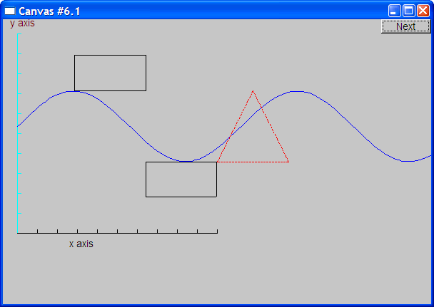
Add a shape that looks like a rectangle
But is it a rectangle?
Stroustrup/Programming

Slide 30
Demo code 6.2
We can add a point
  poly_rect.add(Point(50,75); // now poly_rect has 5 points
  win.set_label("Canvas #6.2");
“looking like” is not the same as “is”
Stroustrup/Programming

Slide 31
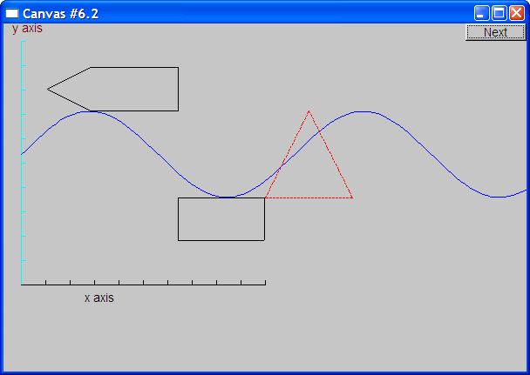
Obviously a polygon
Stroustrup/Programming

Slide 32
Add fill
  r.set_fill_color(Color::yellow); // color the inside of the rectangle
  poly.set_style(Line_style(Line_style::dash,4)); // make the triangle fat
  poly_rect.set_fill_color(Color::green);
  poly_rect.set_style(Line_style(Line_style::dash,2));
  win.set_label("Canvas #7");
Stroustrup/Programming

Slide 33
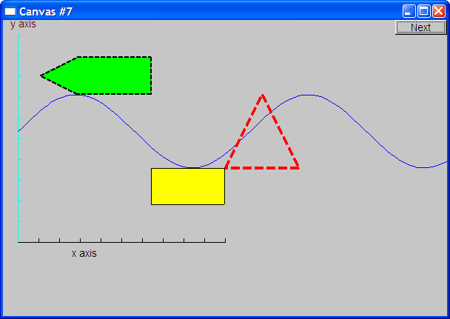
Add fill
Stroustrup/Programming

Slide 34
Demo Code 8
Text t(Point(100,100),"Hello, graphical world!"); // add text
win.set_label("Canvas #8");
Stroustrup/Programming

Slide 35

Add text
Stroustrup/Programming

Slide 36
Demo Code 9
Modify text font and size
  t.set_font(Font::times_bold);
  t.set_font_size(20);
Stroustrup/Programming

Slide 37
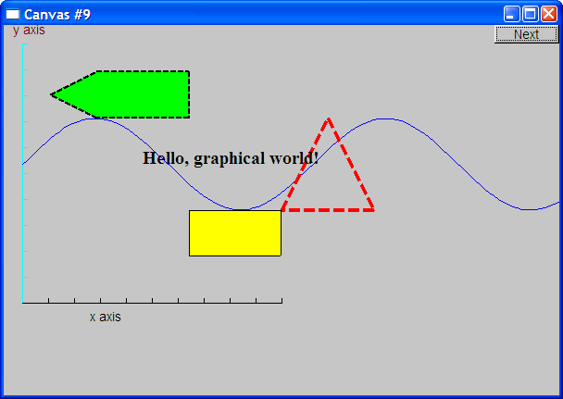
Text font and size
Stroustrup/Programming

Slide 38
Add an image
Image ii(Point(100,50),"image.jpg"); // open an image file
win.attach(ii);
win.set_label("Canvas #10");
Stroustrup/Programming

Slide 39
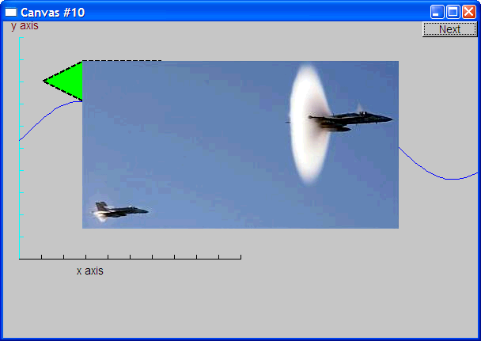
Add an image
Stroustrup/Programming

Slide 40
Oops!
The image obscures the other shapes
  Move it a bit out of the way
ii.move(100,200);
win.set_label("Canvas #11");
win.wait_for_button();
Stroustrup/Programming

Slide 41
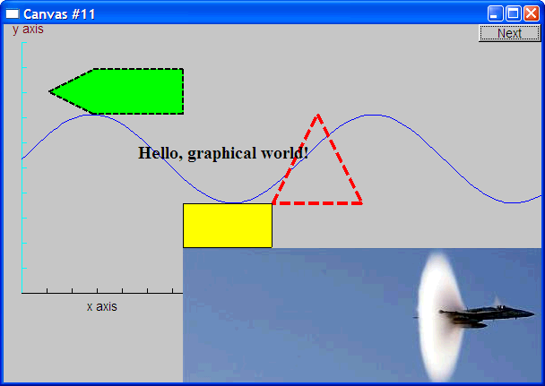
Move the image
Note how the parts of a shape that don’t fit in the window is “clipped” away
Stroustrup/Programming

Slide 42
Demo Code 12
Circle c(Point(100,200),50);
Ellipse e(Point(100,200), 75,25);
e.set_color(Color::dark_red);
Mark m(Point(100,200),'x');
ostringstream oss;
oss << "screen size: " << x_max() << "*" << y_max()
<< "; window size: " << win.x_max() << "*" << win.y_max();
Text sizes(Point(100,20),oss.str());
Image cal(Point(225,225),“snow_cpp.gif"); // 320*240 pixel gif
cal.set_mask(Point(40,40),200,150); // display center of image
win.set_label("Canvas #12");
win.wait_for_button();
Stroustrup/Programming

Slide 43
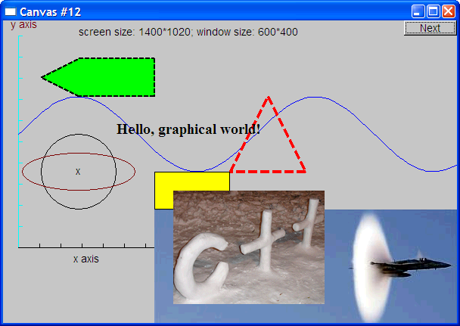
Add shapes, more text
Stroustrup/Programming

Slide 44
Boiler plate
#include "Graph.h" // header for graphs
#include “Simple_window.h" // header containing window interface
int main ()
try
{
// the main part of your code
}
catch(exception& e) {
cerr << "exception: " << e.what() << '\n';
return 1;
}
catch (...) {
cerr << "Some exception\n";
return 2;
}
Stroustrup/Programming

Slide 45
Primitives and algorithms
The demo shows the use of library primitives
  Just the primitives
  Just the use
Typically what we display is the result of
  an algorithm
  reading data
Next lectures
  13: Graphics Classes
  14: Graphics Class Design
  15: Graphing Functions and Data
  16: Graphical User Interfaces
Stroustrup/Programming

