Slide 1
Chapter 15
Functions and graphing
Bjarne Stroustrup
www.stroustrup.com/Programming

Slide 2
Abstract
Here we present ways of graphing functions and data and some of the programming techniques needed to do so, notably scaling.
Stroustrup/Programming

Slide 3
Note
This course is about programming
  The examples – such as graphics – are simply examples of
    Useful programming techniques
    Useful tools for constructing real programs
  Look for the way the examples are constructed
  How are “big problems” broken down into little ones and solved separately?
  How are classes defined and used
    Do they have sensible data members?
    Do they have useful member functions?
  Use of variables
    Are there too few?
    Too many?
    How would you have named them better?
Stroustrup/Programming

Slide 4
Graphing functions
Start with something really simple
  Always remember “Hello, World!”
We graph functions of one argument yielding a one value
  Plot (x, f(x)) for values of x in some range [r1,r2)
Let’s graph three simple functions
    double one(double x) { return 1; } // y==1
    double slope(double x) { return x/2; } // y==x/2
    double square(double x) { return x*x; } // y==x*x
Stroustrup/Programming

Slide 5
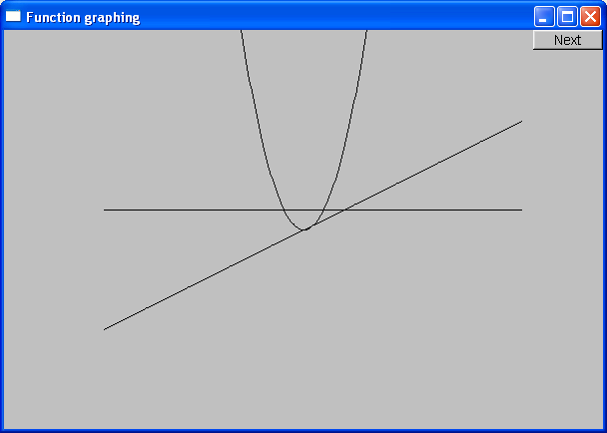
Functions
    double one(double x) { return 1; } // y==1
    double slope(double x) { return x/2; } // y==x/2
    double square(double x) { return x*x; } // y==x*x
Stroustrup/Programming

Slide 6
How do we write code to do this?
Function to be graphed
Simple_window win0(Point(100,100),xmax,ymax,"Function graphing");
Function s(one,-10,11,orig,n_points,x_scale,y_scale);
Function s2(slope,-10,11,orig,n_points,x_scale,y_scale);
Function s3(square,-10,11,orig,n_points,x_scale,y_scale);
win0.attach(s);
win0.attach(s2);
win0.attach(s3);
win0.wait_for_button( );
Range in which to graph
“stuff” to make the graph fit into the window
Stroustrup/Programming

Slide 7
We need some Constants
const int xmax = 600; // window size
const int ymax = 400;
const int x_orig = xmax/2;
const int y_orig = ymax/2;
const Point orig(x_orig, y_orig); // position of (0,0) in window
const int r_min = -10; // range [-10:11) == [-10:10] of x
const int r_max = 11;
const int n_points = 400; // number of points used in range
const int x_scale = 20; // scaling factors
const int y_scale = 20;
// Choosing a center (0,0), scales, and number of points can be fiddly
// The range usually comes from the definition of what you are doing
Stroustrup/Programming

Slide 8
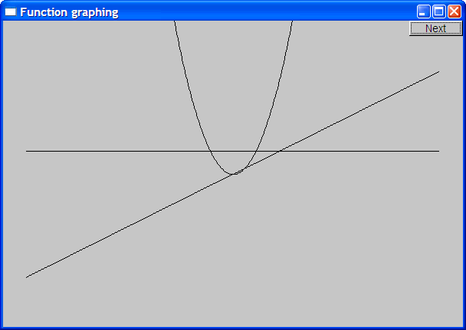
Functions – but what does it mean?
What’s wrong with this?
No axes (no scale)
No labels
Stroustrup/Programming

Slide 9
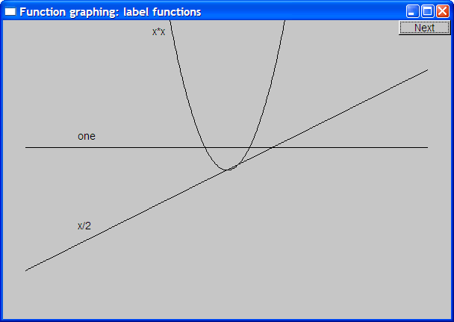
Label the functions
Text ts(Point(100,y_orig-30),"one");
Text ts2(Point(100,y_orig+y_orig/2-10),"x/2");
Text ts3(Point(x_orig-90,20),"x*x");
Stroustrup/Programming

Slide 10
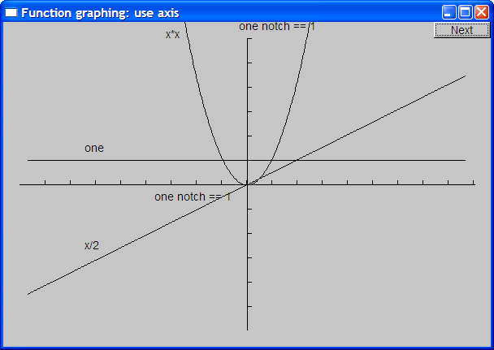
Add x-axis and y-axis
We can use axes to show (0,0) and the scale
  Axis x(Axis::x, Point(20,y_orig), xlength/x_scale, "one notch == 1 ");
  Axis y(Axis::y, Point(x_orig, ylength+20, ylength/y_scale, "one notch == 1");
Stroustrup/Programming

Slide 11
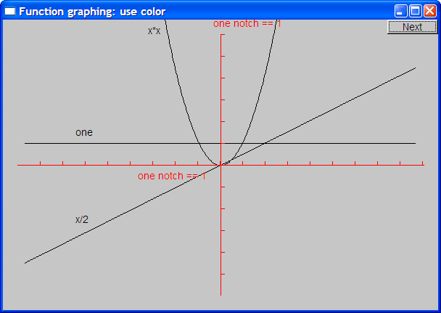
Use color (in moderation)
s.set_color(Color::green); x.set_color(Color::red);
y.set_color(Color::red); ts.set_color(Color::green);
Stroustrup/Programming

Slide 12
The implementation of Function
We need a type for the argument specifying the function to graph
  typedef can be used to declare a new name for a type
    typedef int Color; // now Color means int
  Define the type of our desired argument, Fct
    typedef double Fct(double); // now Fct means function
    // taking a double argument
    // and returning a double
  Examples of functions of type Fct:
  double one(double x) { return 1; } // y==1
  double slope(double x) { return x/2; } // y==x/2
  double square(double x) { return x*x; } // y==x*x
Stroustrup/Programming

Slide 13
Now Define “Function”
struct Function : Shape // Function is derived from Shape
{
// all it needs is a constructor:
Function(
  Fct f, // f is a Fct (takes a double, returns a double)
  double r1, // the range of x values (arguments to f) [r1:r2)
  double r2,
  Point orig, // the screen location of (0,0)
  int count, // number of points used to draw the function
  // (number of line segments used is count-1)
  double xscale , // the location (x,f(x)) is (xscale*x,yscale*f(x))
  double yscale
  );
};
Stroustrup/Programming

Slide 14
Implementation of Function
Function::Function( Fct f,
double r1, double r2, // range
Point xy,
int count,
double xscale, double yscale )
{
if (r2-r1<=0) error("bad graphing range");
if (count <=0) error("non-positive graphing count");
double dist = (r2-r1)/count;
double r = r1;
for (int i = 0; i<count; ++i) {
add(Point(xy.x+int(r*xscale), xy.y-int(f(r)*yscale)));
r += dist;
}
}
Stroustrup/Programming

Slide 15
Default arguments
Seven arguments are too many!
  Many too many
  We’re just asking for confusion and errors
  Provide defaults for some (trailing) arguments
    Default arguments are often useful for constructors
struct Function : Shape {
Function( Fct f, double r1, double r2, Point xy,
int count = 100, double xscale = 25, double yscale=25 );
};
Function f1(sqrt, 0, 11, orig, 100, 25, 25 ); // ok (obviously)
Function f2(sqrt, 0, 11, orig, 100, 25); // ok: exactly the same as f1
Function f3(sqrt, 0, 11, orig, 100); // ok: exactly the same as f1
Function f4(sqrt, 0, 11, orig); // ok: exactly the same as f1
Stroustrup/Programming

Slide 16
Function
Is Function a “pretty class”?
  No
    Why not?
  What could you do with all of those position and scaling arguments?
    See 15.6.3 for one minor idea
  If you can’t do something genuinely clever, do something simple, so that the user can do anything needed
    Such as adding parameters so that the caller can control
Stroustrup/Programming

Slide 17
Some more functions
#include<cmath> // standard mathematical functions
// You can combine functions (e.g., by addition):
double sloping_cos(double x) { return cos(x)+slope(x); }
Function s4(cos,-10,11,orig,400,20,20);
s4.set_color(Color::blue);
Function s5(sloping_cos,-10,11,orig,400,20,20);
Stroustrup/Programming

Slide 18
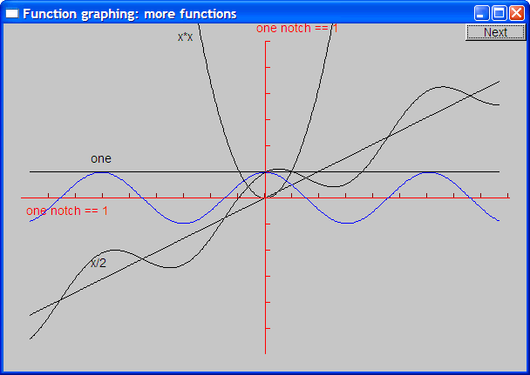
Cos and sloping-cos
Stroustrup/Programming

Slide 19
Standard mathematical functions (<cmath>)
  double abs(double); // absolute value
  double ceil(double d); // smallest integer >= d
  double floor(double d); // largest integer <= d
  double sqrt(double d); // d must be non-negative
  double cos(double);
  double sin(double);
  double tan(double);
  double acos(double); // result is non-negative; “a” for “arc”
  double asin(double); // result nearest to 0 returned
  double atan(double);
  double sinh(double); // “h” for “hyperbolic”
  double cosh(double);
  double tanh(double);
Stroustrup/Programming

Slide 20
Standard mathematical functions (<cmath>)
  double exp(double); // base e
  double log(double d); // natural logarithm (base e) ; d must be positive
  double log10(double); // base 10 logarithm
  double pow(double x, double y); // x to the power of y
  double pow(double x, int y); // x to the power of y
  double atan2(double x, double y); // atan(x/y)
  double fmod(double d, double m); // floating-point remainder // same sign as d%m
  double ldexp(double d, int i); // d*pow(2,i)
Stroustrup/Programming

Slide 21
Why graphing?
Because you can see things in a graph that are not obvious from a set of numbers
  How would you understand a sine curve if you couldn’t (ever) see one?
Visualization is
  key to understanding in many fields
  Used in most research and business areas
    Science, medicine, business, telecommunications, control of large systems
Stroustrup/Programming

Slide 22
An example: e^{x}
e^{x} == 1
+ x
+ x²/2!
+ x³/3!
+ x⁴/4!
+ x⁵/5!
+ x⁶/6!
+ x⁷/7!
+ …
Where ! Means factorial (e.g. 4!==4*3*2*1)
Stroustrup/Programming

Slide 23
Simple algorithm to approximate e^{x}
double fac(int n) { /* … */ } // factorial
double term(double x, int n) // x^{n}/n!
{
return pow(x,n)/fac(n);
}
double expe(double x, int n) // sum of n terms of x
{
double sum = 0;
for (int i = 0; i<n; ++i) sum+=term(x,i);
return sum;
}
Stroustrup/Programming

Slide 24
Simple algorithm to approximate e^{x}
But we can only graph functions of one argument, so how can we get graph expe(x,n) for various n?
int expN_number_of_terms = 6; // nasty sneaky argument to expN
double expN(double x) // sum of expN_number_of_terms terms of x
{
return expe(x,expN_number_of_terms);
}
Stroustrup/Programming

Slide 25
“Animate” approximations to e^{x}
Simple_window win(Point(100,100),xmax,ymax,"");
// the real exponential :
Function real_exp(exp,r_min,r_max,orig,200,x_scale,y_scale);
real_exp.set_color(Color::blue);
win.attach(real_exp);
const int xlength = xmax-40;
const int ylength = ymax-40;
Axis x(Axis::x, Point(20,y_orig),
xlength, xlength/x_scale, "one notch == 1");
Axis y(Axis::y, Point(x_orig,ylength+20),
ylength, ylength/y_scale, "one notch == 1");
win.attach(x);
win.attach(y);
x.set_color(Color::red);
y.set_color(Color::red);
Stroustrup/Programming

Slide 26
“Animate” approximations to e^{x}
for (int n = 0; n<50; ++n) {
ostringstream ss;
ss << "exp approximation; n==" << n ;
win.set_label(ss.str().c_str());
expN_number_of_terms = n; // nasty sneaky argument to expN
// next approximation:
Function e(expN,r_min,r_max,orig,200,x_scale,y_scale);
win.attach(e);
wait_for_button(); // give the user time to look
win.detach(e);
}
Stroustrup/Programming

Slide 27
Demo
The following screenshots are of the successive approximations of exp(x) using expe(x,n)
Stroustrup/Programming

Slide 28
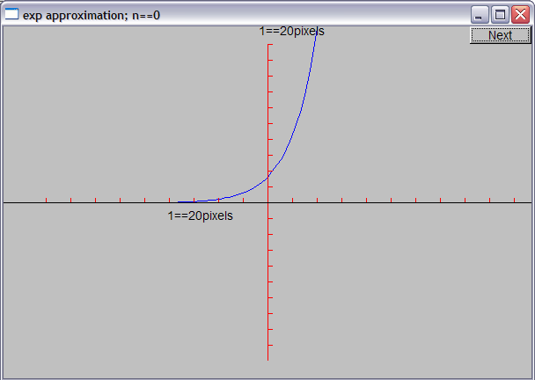
Demo n = 0
Stroustrup/Programming

Slide 29
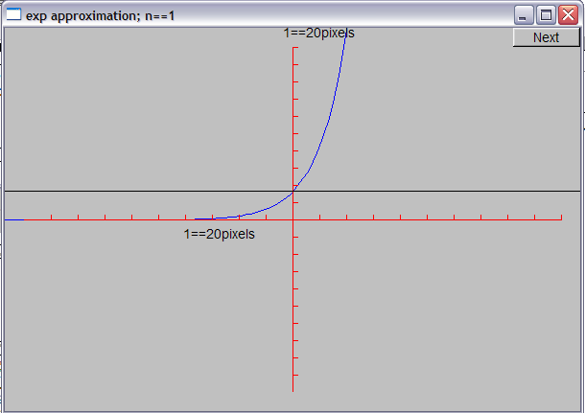
Demo n = 1
Stroustrup/Programming

Slide 30
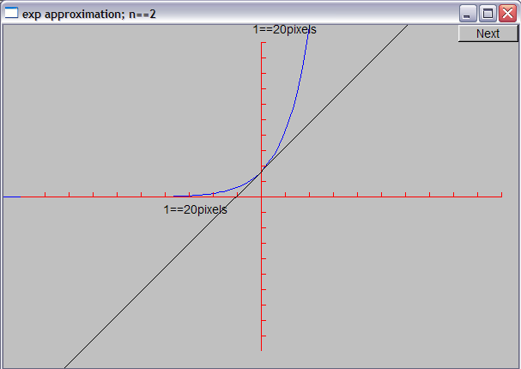
Demo n = 2
Stroustrup/Programming

Slide 31
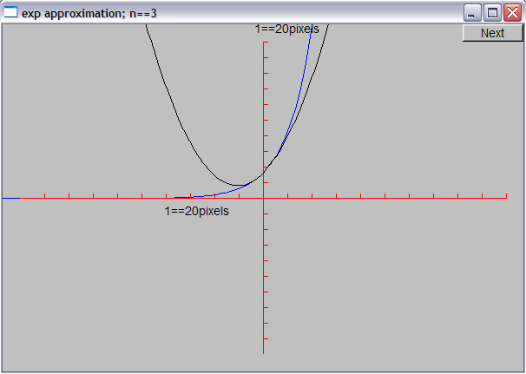
Demo n = 3
Stroustrup/Programming

Slide 32
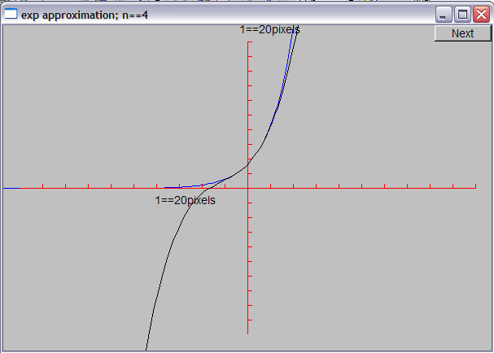
Demo n = 4
Stroustrup/Programming

Slide 33
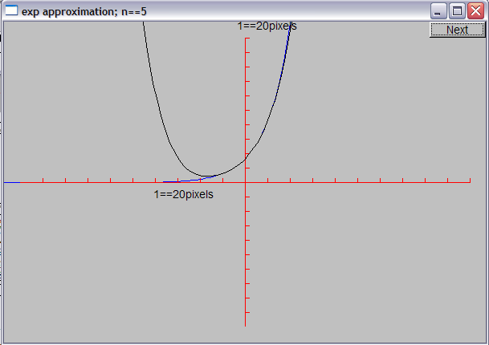
Demo n = 5
Stroustrup/Programming

Slide 34
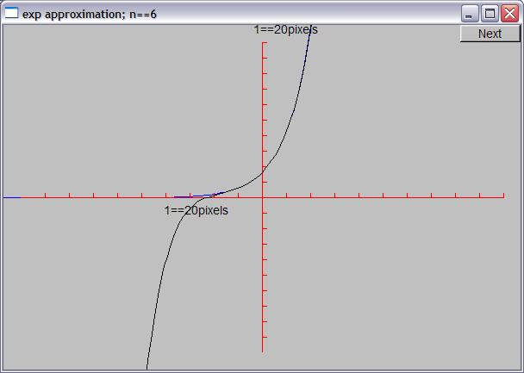
Demo n = 6
Stroustrup/Programming

Slide 35
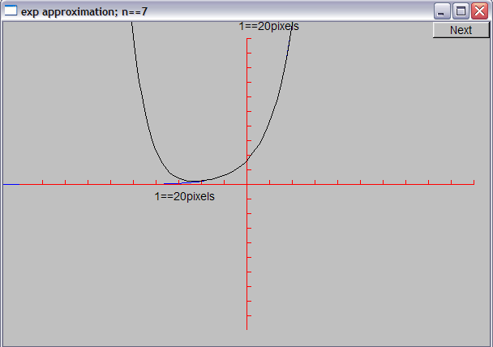
Demo n = 7
Stroustrup/Programming

Slide 36
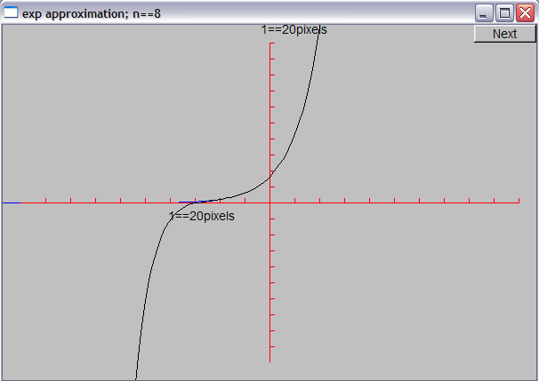
Demo n = 8
Stroustrup/Programming

Slide 37
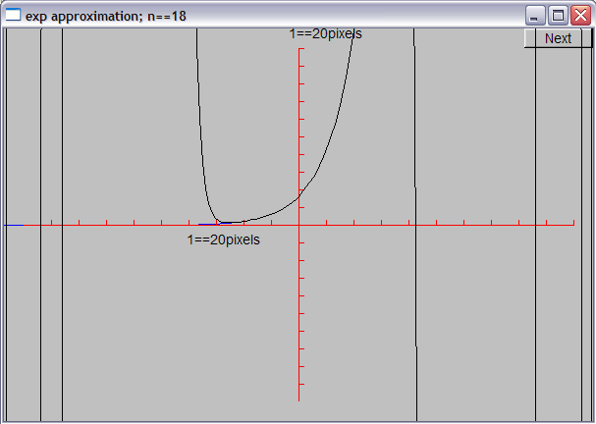
Demo n = 18
Stroustrup/Programming

Slide 38
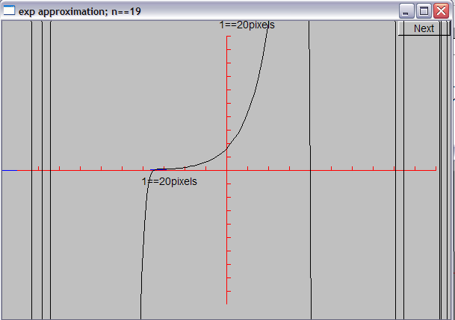
Demo n = 19
Stroustrup/Programming

Slide 39
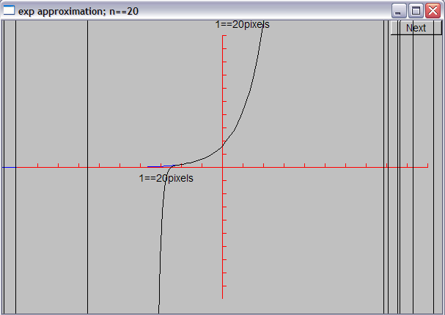
Demo n = 20
Stroustrup/Programming

Slide 40
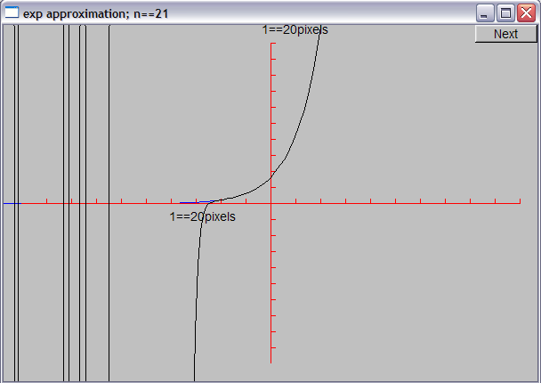
Demo n = 21
Stroustrup/Programming

Slide 41
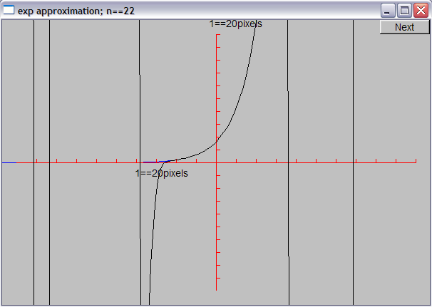
Demo n = 22
Stroustrup/Programming

Slide 42
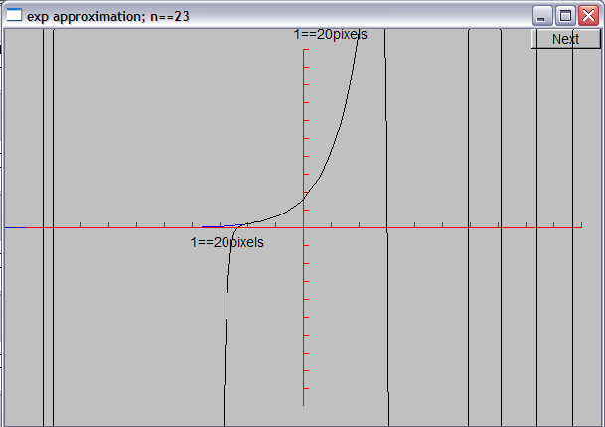
Demo n = 23
Stroustrup/Programming

Slide 43
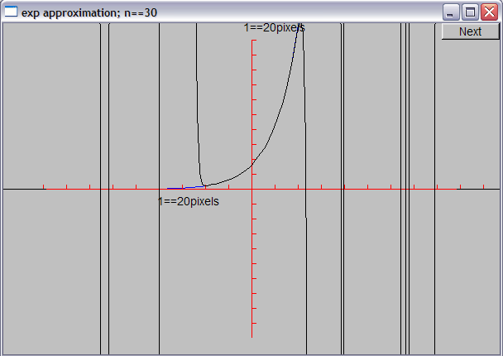
Demo n = 30
Stroustrup/Programming

Slide 44
Why did the graph “go wild”?
Floating-point numbers are an approximations of real numbers
  Just approximations
  Real numbers can be arbitrarily large and arbitrarily small
    Floating-point numbers are of a fixed size
  Sometimes the approximation is not good enough for what you do
  Here, small inaccuracies (rounding errors) built up into huge errors
Always
  be suspicious about calculations
  check your results
  hope that your errors are obvious
    You want your code to break early – before anyone else gets to use it
Stroustrup/Programming

Slide 45
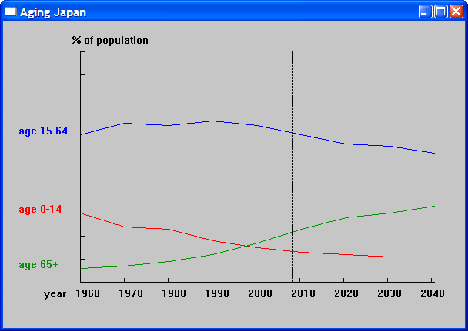
Graphing data
Often, what we want to graph is data, not a well-defined mathematical function
  Here, we used three Open_polylines
Stroustrup/Programming

Slide 46
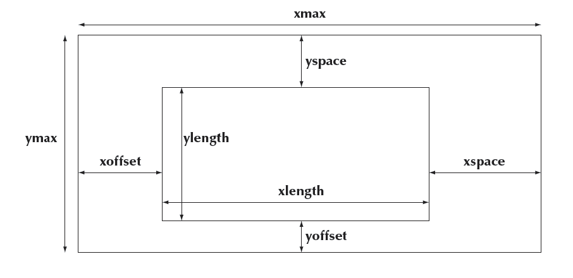
Graphing data
Carefully design your screen layout
Stroustrup/Programming

Slide 47
Code for Axis
struct Axis : Shape {
enum Orientation { x, y, z };
Axis(Orientation d, Point xy, int length,
int number_of_notches=0, // default: no notches
string label = "" // default : no label
);
void draw_lines() const;
void move(int dx, int dy);
void set_color(Color); // in case we want to change the color of all parts at once
// line stored in Shape
// orientation not stored (can be deduced from line)
Text label;
Lines notches;
};
Stroustrup/Programming

Slide 48
Axis::Axis(Orientation d, Point xy, int length, int n, string lab)
:label(Point(0,0),lab)
{
if (length<0) error("bad axis length");
switch (d){
case Axis::x:
{ Shape::add(xy); // axis line begin
Shape::add(Point(xy.x+length,xy.y)); // axis line end
if (1<n) {
int dist = length/n;
int x = xy.x+dist;
for (int i = 0; i<n; ++i) {
notches.add(Point(x,xy.y),Point(x,xy.y-5));
x += dist;
}
}
label.move(length/3,xy.y+20); // put label under the line
break;
}
// …
}
Stroustrup/Programming

Slide 49
Axis implementation
void Axis::draw_lines() const
{
Shape::draw_lines(); // the line
notches.draw_lines(); // the notches may have a different color from the line
label.draw(); // the label may have a different color from the line
}
void Axis::move(int dx, int dy)
{
Shape::move(dx,dy); // the line
notches.move(dx,dy);
label.move(dx,dy);
}
void Axis::set_color(Color c)
{
// … the obvious three lines …
}
Stroustrup/Programming

Slide 50
Next Lecture
Graphical user interfaces
Windows and Widgets
Buttons and dialog boxes
Stroustrup/Programming

