Slide 1

M4 Project Work: First Tables and Graphs Presentation
NEXTGEN
ANALYTICS
TEAM MEMBERS:
Sylvester Vhashe
Bekithemba Nkomo
Innocent Mujokoro
Tapiwanashe Mutarimanja

Slide 2
TITLE :
Data-Driven Enforcement for Improved Housing Conditions and Code Compliance in NYC
Welcome to our analysis of housing conditions and code compliance in New York City, where we leverage data to understand tenant experiences and identify critical areas for improvement.

Slide 3


Table 1 illustrates the percentage change in complaints across different boroughs from 2019 to 2024. Understanding these trends is crucial for assessing service performance, identifying areas of concern, and allocating resources effectively.
Key Insights:
Trends Over Time: The data reveals how complaint volumes have fluctuated in each borough, highlighting periods of significant increase or decrease.
Borough Comparisons: We can compare the percentage changes among boroughs to identify which areas may require more attention or support.
Strategic Planning: By analyzing these changes, we can better inform our strategies for improving response times and addressing the most pressing issues faced by residents.

Slide 4

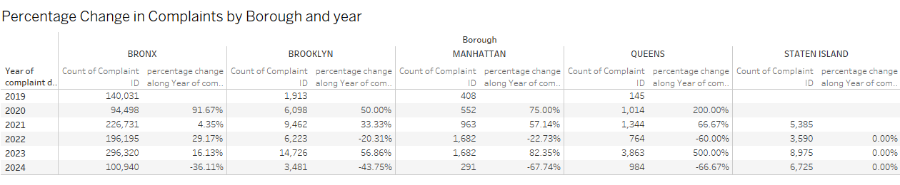



TABLE 1

Slide 5

Table 2 provides a comprehensive breakdown of total incidents reported across the over the years 2019 to 2024. It focuses on several key areas, including the major categories of incidents (Electric, Flooring/Stairs, Heat/Hot Water, Plumbing, and Water Leak) and their corresponding counts and average response times in seconds.
Context: Understanding the frequency and response times of incidents is crucial for evaluating the effectiveness of the services and identifying areas for improvement. This data allows us to pinpoint trends over time, assess resource allocation, and determine if response times are meeting performance standards.
Key Insights:
Incident Counts: The data reveals how many incidents were reported in each borough, helping to identify hotspots or areas with higher service demands. For instance, if Brooklyn shows a significantly higher count of Plumbing incidents, it may indicate a need for increased resources or targeted initiatives in that area.
Response Times: Average response times across different incident categories provide insight into operational efficiency. If certain categories consistently show longer response times, this could signal a need for process improvements or additional training for staff.
Trend Analysis: By examining data over the years, we can identify trends or patterns—such as seasonal spikes in certain types of incidents—that could inform proactive measures and strategic planning.

Slide 6
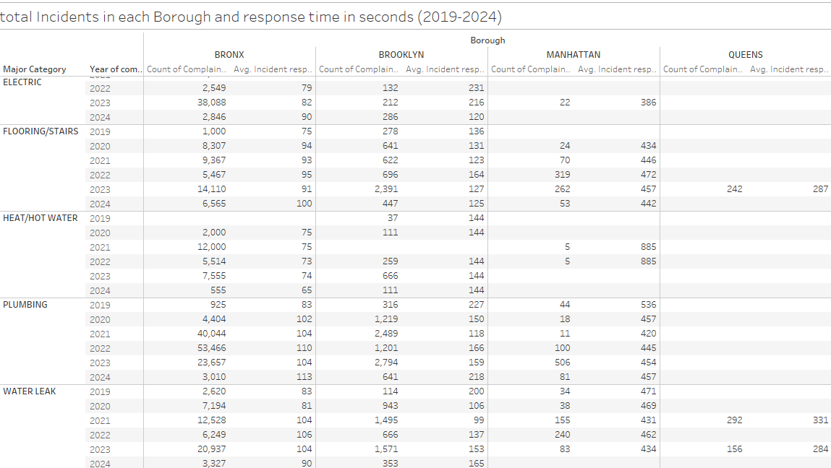
TABLE 2

Slide 7
Table 3 provides a comprehensive overview of complaints categorized by Unit Type and Major Category across different boroughs. The data spans various complaint types, such as Appliance, Plumbing, and Water Leak, offering insights into the frequency and distribution of issues reported in residential and building-wide settings.
Key Context for the Project Sponsor:
Borough-Specific Insights:
The breakdown by borough (Bronx, Brooklyn, Manhattan, Queens, Staten Island) allows us to identify which areas are experiencing the highest volume of complaints. This information can help prioritize resource allocation and response strategies.
Unit Type Focus:
By distinguishing between Apartment and Building-Wide unit types, we can assess whether complaints are more prevalent in individual units or common areas. This can inform targeted maintenance or communication efforts.
Major Categories of Complaints:
Understanding the major categories of complaints enables us to pinpoint recurring issues that may need systemic solutions, whether through improved communication, enhanced maintenance protocols, or policy changes.
Total Complaints:
The Grand Total column provides a quick reference for the overall volume of complaints, facilitating a holistic view of the situation across all unit types and boroughs.

Slide 8
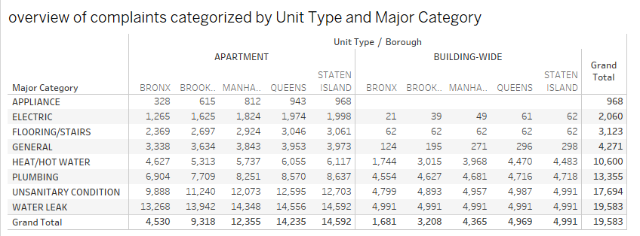
TABLE 3

Slide 9
The Bar chart visualization provides a comprehensive overview of the incidents reported across different boroughs from 2019 to 2024, highlighting trends over the years.
Key Insights
Incident Trends: The graph illustrates the count of complaints received by each borough annually. This allows us to identify patterns, such as increases or decreases in incidents over time.
Borough Comparison: By comparing the complaint counts across boroughs, we can pinpoint areas with the highest incident rates, which may require targeted interventions or resource allocation.
Yearly Analysis: The data highlights significant fluctuations in complaints per year, enabling us to investigate the factors contributing to these changes, whether they be policy shifts, demographic changes, or external events.
Strategic Decision-Making: Understanding these trends can guide strategic decision-making, helping to allocate resources effectively, improve response times, and enhance service delivery.

Slide 10
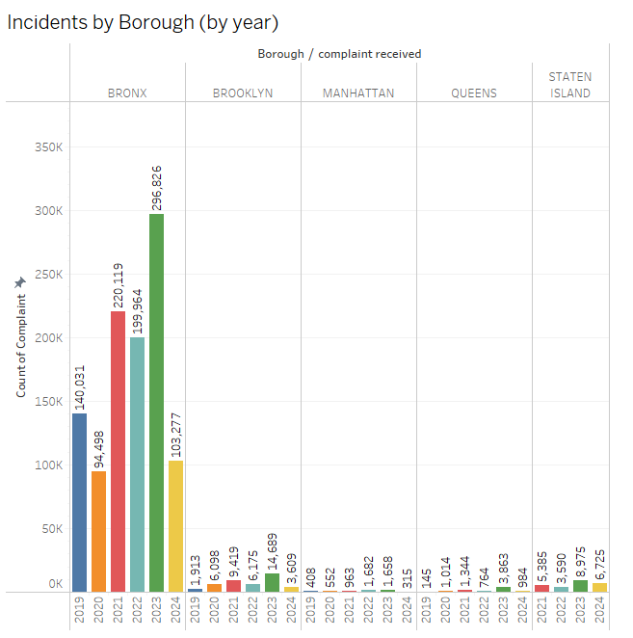
Bar Graph

Slide 11
The Line Chart presents the number of complaints received each month across various minor categories. It highlights trends and variations in complaints over the year, providing valuable insights into areas that may require targeted attention or resources.
Key insights:
Trend Analysis: The line chart allows us to observe how complaints fluctuate month-to-month, identifying peak periods where certain issues are more prevalent.
Category Breakdown: Each line represents a different minor category of complaints (e.g., Carbon Monoxide, Electric Gas Range, etc.), which helps in understanding which specific issues are driving the overall complaint volume.
Seasonal Patterns: We can analyze whether certain types of complaints are seasonal, enabling proactive measures during peak months.
Actionable Insights: By identifying trends, we can allocate resources effectively, implement preventive measures, and improve response strategies to enhance overall service quality.

Slide 12
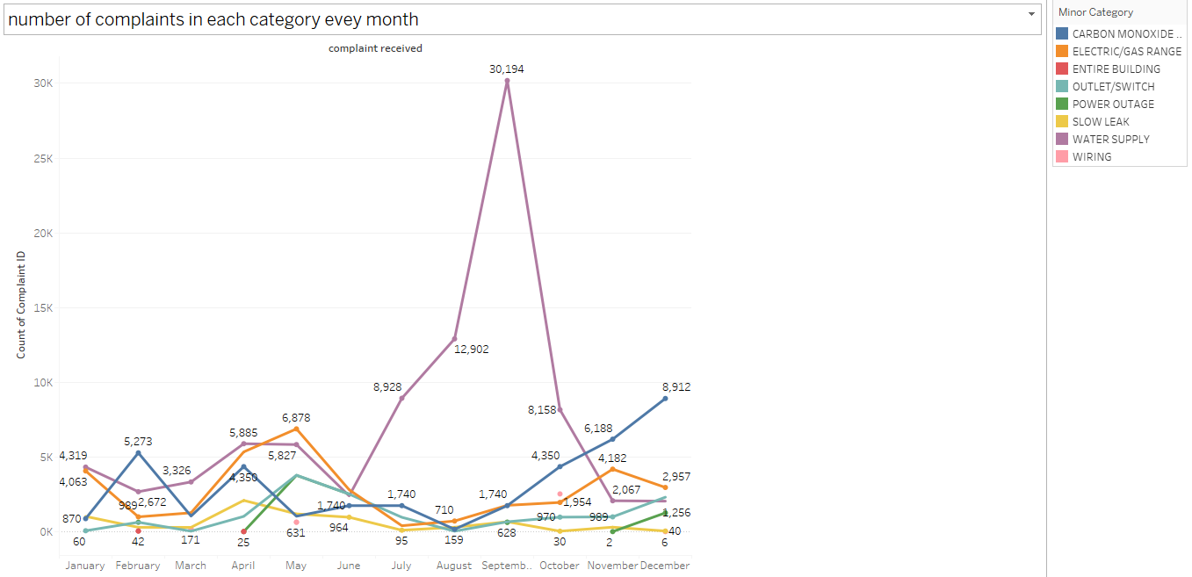
Line Chart

Slide 13
The Pie Chart presents the average response times for various major complaint categories. Understanding these response times is critical for evaluating the efficiency of service delivery and identifying areas for improvement.
Key Insights:
Performance Overview: Each segment of the pie chart represents a major category of complaints, such as Appliance, Electric, Heat/Hot Water, Plumbing, Unsanitary Conditions, and Water Leak. The average response times are indicated in seconds, providing a clear comparison across categories.
Identifying Priorities: By analyzing these averages, we can pinpoint which categories may require additional resources or process improvements to enhance our response times.
Goal Alignment: This data aligns with our goal of improving customer satisfaction and ensuring timely resolutions to complaints.

Slide 14
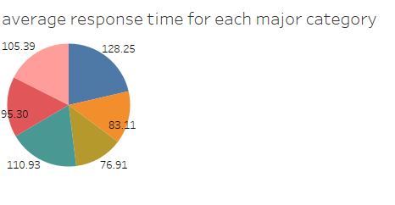
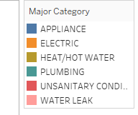
Pie Chart

Slide 15
Summary
The project "Data-Driven Enforcement for Improved Housing Conditions and Code Compliance in NYC" analyzes complaint trends from 2019 to 2024 to improve tenant experiences. It examines incident types, response times, and borough-specific patterns to optimize resource allocation and operational efficiency.
Key Findings:
Complaint volumes vary over time and by borough, highlighting priority areas.
Incident analysis reveals operational strengths and areas needing more resources.
Differentiating unit types (apartment vs. building-wide) helps tailor maintenance strategies.
Seasonal patterns and performance metrics guide proactive measures and customer satisfaction improvements.
Conclusion:
This data-driven analysis informs strategic decision-making, enhances resource allocation, and improves housing conditions and code compliance across NYC, ultimately leading to better tenant experiences.

Slide 16
Thank You

