Slide 1

M4 Project Work: First Tables and Graphs Presentation
NEXTGEN
ANALYTICS
TEAM MEMBERS:
Sylvester Vhashe
Bekithemba Nkomo
Innocent Mujokoro
Tapiwanashe Mutarimanja

Slide 2
TITLE :
Data-Driven Enforcement for Improved Housing Conditions and Code Compliance in NYC
Welcome to our analysis of housing conditions and code compliance in New York City, where we leverage data to understand tenant experiences and identify critical areas for improvement.

Slide 3
IMPROVEMENTS In our previous assignment, the information we provided was not accurate and showed missing values in the visuals. Now, we have accurate information, and the visuals display different, accurate trends. So both the tables and graphs are completely different

Slide 4


Table 1 presents the problem status over the years, specifically focusing on the number of "OPEN" and "CLOSE" problem statuses. It covers the years 2019 to 2024, providing a historical view of problem resolution.
Insights:
Significant Increase in Closed Problems: There's a noticeable increase in the number of closed problems from 467,297 in 2020 to 828,151 in 2024. This could indicate improved problem-solving efficiency or an increase in overall activity.
Open Problems Fluctuations: While closed problems have increased, the number of open problems has fluctuated. It peaked in 2024 at 14,908, significantly higher than previous years. This might suggest a recent surge in new issues or challenges in resolving them.
2024 as an Outlier: 2024 shows a dramatic increase in both closed and open problems compared to previous years. This could be due to various factors, such as a change in the scale of operations, a new type of problem, or a change in the tracking methodology.

Slide 5

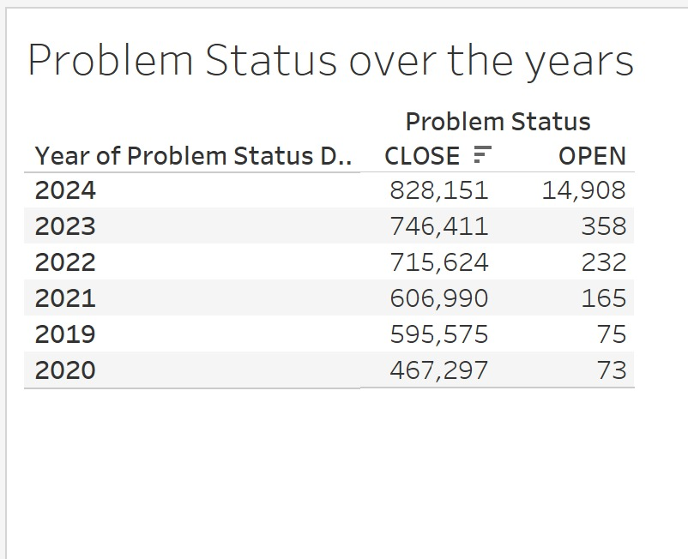



TABLE 1

Slide 6

Table 2 :This table presents the breakdown of approved violations in New York City, categorized by violation class (A, B, C, and I) and grouped by borough (Bronx, Brooklyn, Manhattan, Queens, and Staten Island) for the years 2019 through 2024. This data provides insights into the distribution and trends of violations across different boroughs and violation severity levels.
Insights:
Overall Increase in Violations: Looking at the "Grand Total" column, there's a clear upward trend in the total number of violations across all classes and boroughs from 2019 to 2024. This indicates a potential increase in enforcement, a rise in non-compliance, or both.
Dominance of Class B Violations: Class B violations consistently represent the largest category of violations across all years and boroughs. This suggests that the issues classified as "B" are the most prevalent.
Brooklyn Leading in Violations: Brooklyn consistently has the highest number of violations across all classes and years, indicating a potentially higher rate of non-compliance or more stringent enforcement in that borough.
Manhattan and Queens as Significant Contributors: Manhattan and Queens also contribute significantly to the overall violation numbers, particularly for Class B and C violations.
Fluctuations in Class I Violations: Class I violations show significant fluctuations, with a notable spike in 2022. This could be due to specific enforcement initiatives or changes in the classification of violations.

Slide 7
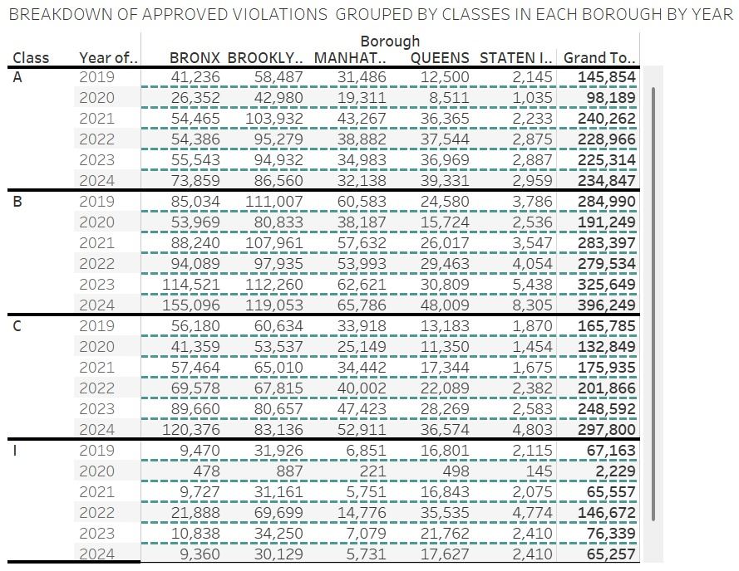
TABLE 2

Slide 8
Table 3 highlights the top causes of fires categorized by borough in New York City. It aims to provide insights into prevalent fire hazards, which can inform safety measures and resource allocation.
Data Composition:
The table lists the leading fire causes, including wiring, cooking gas, electric/gas range, and slow leak, along with the number of incidents reported in each borough: Bronx, Brooklyn, Manhattan, Queens, and Staten Island.
The grand total of reported fire causes across all boroughs is also provided, enabling a comprehensive view of fire safety concerns citywide.

Slide 9
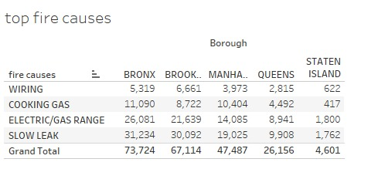
TABLE 3

Slide 10
Bar chart
Purpose of the Data:
This dataset provides a comprehensive overview of the count of complaints received across different boroughs from 2019 to 2024. It aims to identify trends and variations in community concerns, facilitating informed decision-making.
Data Composition:
The bar chart displays the number of complaints for each borough—Bronx, Brooklyn, Manhattan, Queens, and Staten Island—broken down by year.This visual representation allows for easy comparison of complaint volumes across both boroughs and time periods.

Slide 11
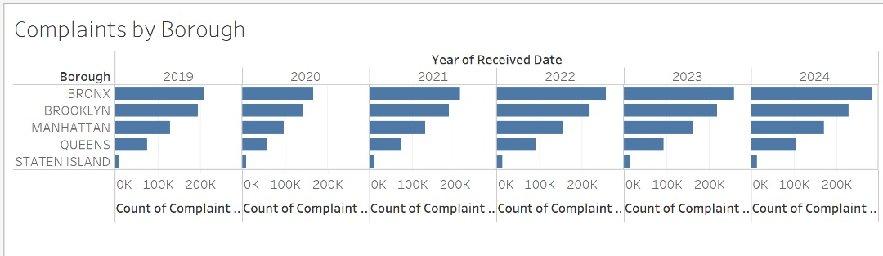
Bar Graph

Slide 12
Box Plot
Purpose of the Data:
This dataset provides a detailed analysis of the spread of complaints in New York City from 2019 to 2024, segmented by borough. It aims to uncover trends and variations in community concerns over time.
Data Composition:
The visualization displays the count of complaints received each year, categorized by borough: Bronx, Brooklyn, Manhattan, Queens, and Staten Island.Each borough's data is represented in box plots, which illustrate the distribution, median, and range of complaints for each year.

Slide 13
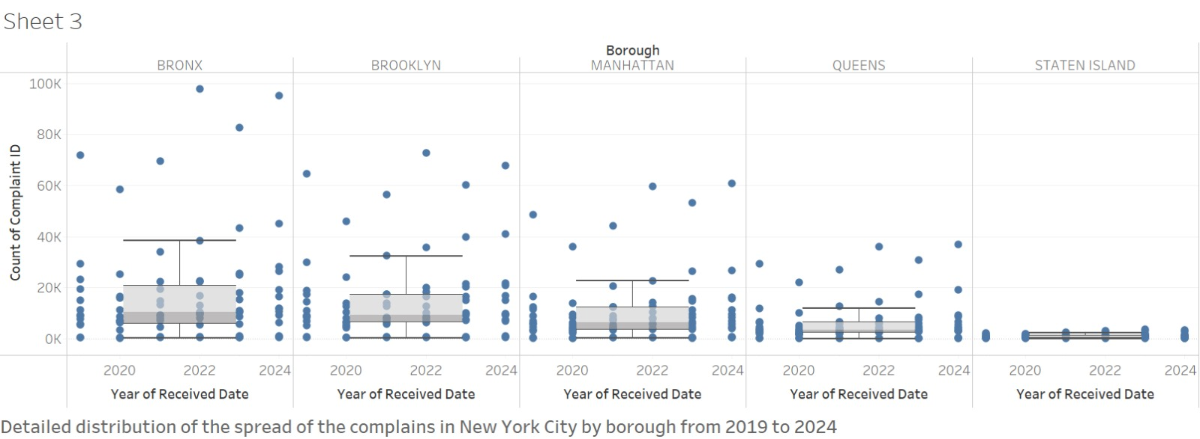
Box plot

Slide 14
Line Chart
Purpose of the Data:
This dataset provides a monthly trend analysis of complaints over the year, categorized by various complaint types. It aims to identify patterns and fluctuations in New York complaints major categories throughout the year.
Data Composition:
The line graph illustrates the count of complaints received each month, segmented by major categories such as appliance issues, elevator problems, plumbing, and more.Each complaint type is represented by its own line, allowing for easy comparison and identification of trends across different categories. Heat/ hot water is high in December and January because they are the coldest months of the year.

Slide 15
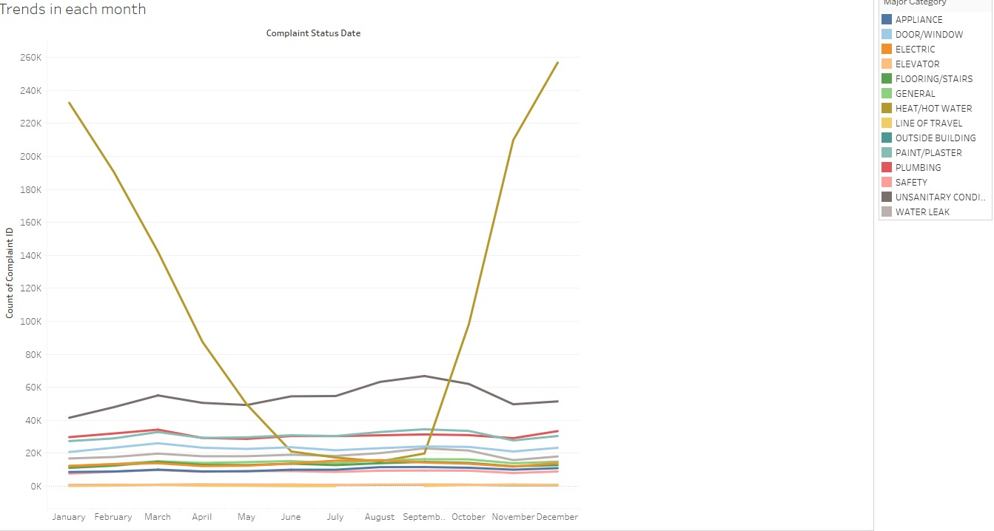
Line Chart

Slide 16
Heat Map
Purpose of the Data:
This dataset provides insights into complaints made within the Bronx, visualized through a geographic map. It allows for identification of areas with high complaint volumes and can inform decision-making for resource allocation and service improvement.
Data Composition:
The map is based on longitude and latitude coordinates, displaying the distribution of complaints across different boroughs, specifically focusing on Bronx.The size of the circles represents the count of complaints, offering a visual cue to areas with more significant issues.

Slide 17
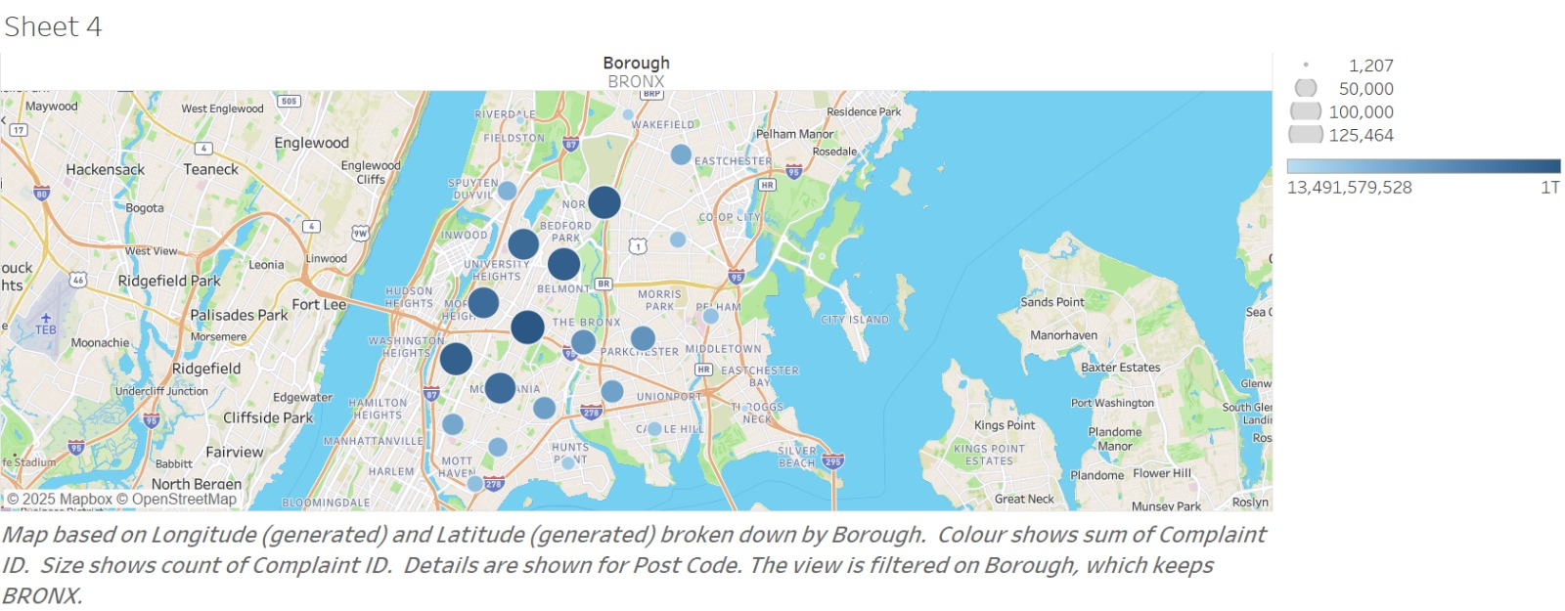
Heat map

Slide 18
Conclusion
This report presents a data-driven analysis of housing conditions and code compliance in New York City, utilizing historical data from 2019 to 2024. Through various tables and visualizations, we examine problem resolution trends, violation patterns, fire hazard causes, and complaint distributions across boroughs.
Key findings include a significant rise in closed problem cases, suggesting improved enforcement or increased activity, while fluctuations in open problems indicate evolving challenges. Violation analysis highlights Brooklyn as the borough with the highest non-compliance rates, with Class B violations being the most prevalent. Fire hazard data provides insights into borough-specific risks, supporting targeted safety measures.
Visualizations, including bar charts, box plots, line graphs, and heat maps, reveal borough-wise complaint trends and seasonal patterns, enabling better resource allocation. This comprehensive analysis informs policy-making and enforcement strategies for improved housing conditions in NYC.

Slide 19
Thank You

