Slide 1

M8 Project Work: VISUALIZATIONS
NEXTGEN
ANALYTICS
TEAM MEMBERS:
Sylvester Vhashe
Bekithemba Nkomo
Innocent Mujokoro
Tapiwanashe Mutarimanja

Slide 2
TITLE :
Data-Driven Enforcement for Improved Housing Conditions and Code Compliance in NYC.
Welcome to our analysis of housing conditions and code compliance in New York City, where we leverage data to understand tenant experiences and identify critical areas for improvement.

Slide 3
IMPROVEMENTS For a better presentation we have re arranged the flow of slides. New insights have also been added.

Slide 4



Table 1 : Complaints leading to violations
Key Insights from the "Boroughs with the Most Complaints Leading to Violations" Table:
Brooklyn has the Highest Complaint Volume: Brooklyn has significantly more complaints (449,391) than any other borough, more than double the next highest (Bronx).
Bronx has the Highest Percentage of Complaints Leading to Violations: While Brooklyn has the most complaints, the Bronx has the highest percentage of those complaints resulting in violations (46%). This suggests a potential issue with the severity or validity of complaints in the Bronx.
Queens has the Lowest Percentage of Complaints Leading to Violations: Queens has the lowest percentage of complaints resulting in violations (21%). This could indicate a more efficient resolution process or potentially a lower rate of valid complaints.
Staten Island has the Lowest Complaint Volume: Staten Island has the fewest complaints overall, which may reflect its smaller population or potentially different reporting patterns.
Overall Violation Rate is 31%: Across all boroughs, approximately 31% of complaints result in violations.

Slide 5

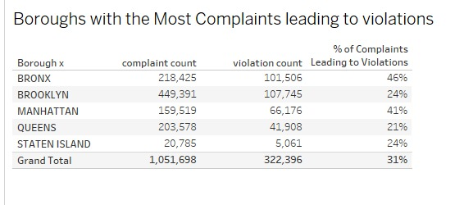


Table 1

Slide 6

Table 2: Key Insights
Borough Comparison:
Brooklyn has the highest number of total complaints at 249,345, suggesting it may have more residents or a higher frequency of issues.
Bronx follows with 217,563 complaints, indicating a substantial number of reported problems as well.
Queens, Manhattan, and Staten Island have fewer complaints, with Staten Island being the lowest at 32,720.
Major Categories:
Heat/Hot Water has the highest number of complaints in multiple boroughs, especially in Brooklyn (107,493) and the Bronx (81,003), indicating potential issues with heating systems that may need addressing.
Plumbing also shows significant complaints, particularly in Brooklyn (46,137) and Bronx (38,133), suggesting a need for plumbing infrastructure improvements. Other categories like Electric and Water Leak also contribute to the overall complaint count, with notable figures in all boroughs.
Issue Distribution:
The data suggests specific areas (like Brooklyn and Bronx) may require targeted interventions for heating and plumbing issues, given the high number of related complaints.
Focus Areas for Improvement:
The boroughs with the highest complaint counts should be prioritized for resource allocation and infrastructure improvements to address the most pressing issues reported by residents.

Slide 7
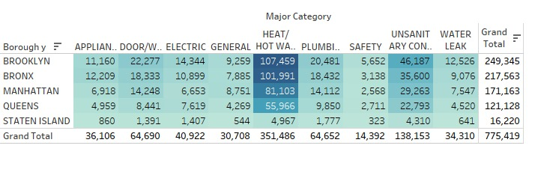
Table 2

Slide 8
Table 3: Following up on the violations that may have risen from complaints following are key insights on improving service delivery:
Heat/Hot Water:
This is a major issue across all boroughs with high complaint volumes. Prioritize addressing it.
Resolution Times Vary:
Queens and Staten Island generally resolve complaints faster, while the Bronx has the longest resolution times.
Borough-Specific Challenges:
Bronx: Longest resolution times for Heat/Hot Water, Water Leaks, and Plumbing.
Staten Island: Longest resolution time for Paint/Plaster.
Appliance/Electrical: These issues are generally resolved relatively quickly.

Slide 9
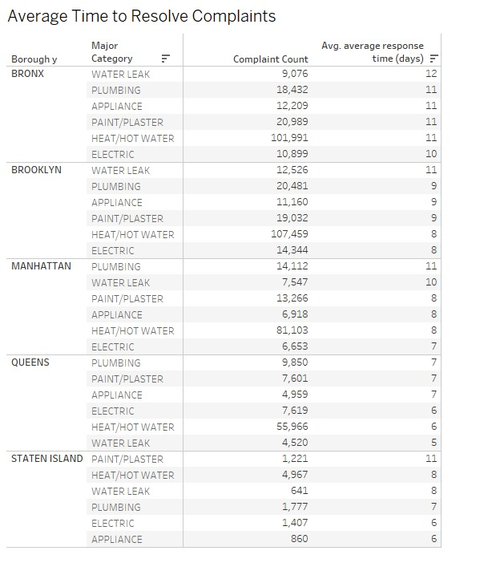
Table 3

Slide 10
Table 4
Provides insights into the average response time (in days) for different violation severity levels across boroughs.
Key Insights:
Higher Severity = Faster Response Time
High Priority (Class C) violations have the shortest response times across all boroughs, averaging around 25.5 days.
Medium Priority (Class B) violations take longer, averaging between 35 to 42.8 days.
Low Priority (Class A) violations have the longest response times, ranging from 96.07 to 98.79 days.
Consistency Across Boroughs
Response times for each severity level are relatively similar across all boroughs, suggesting a standardized approach to handling violations.
Brooklyn has the highest response time for Low Priority violations (98.79 days), while the Bronx has the highest for Medium Priority (42.83 days).
Staten Island generally has the lowest response times across all priority levels.
Significance for Resource Allocation
Authorities prioritize High Priority violations efficiently, responding within a month.
Low Priority violations take over three months to address, possibly indicating a backlog or resource constraints.

Slide 11
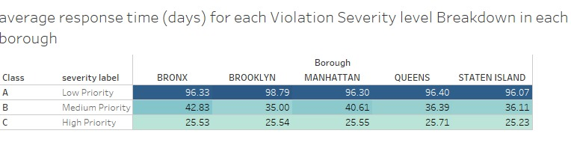
Table 4

Slide 12
Table 5 presents a follow up on the average time take to resolve a complaint.
Insights:
Significant Increase in Closed Problems: There's a noticeable increase in the number of closed problems from 467,297 in 2020 to 828,151 in 2024. This could indicate improved problem-solving efficiency or an increase in overall activity.
Open Problems Fluctuations: While closed problems have increased, the number of open problems has fluctuated. It peaked in 2024 at 14,908, significantly higher than previous years. This might suggest a recent surge in new issues or challenges in resolving them.
2024 as an Outlier: 2024 shows a dramatic increase in both closed and open problems compared to previous years. This could be due to various factors, such as a change in the scale of operations, a new type of problem, or a change in the tracking methodology.

Slide 13
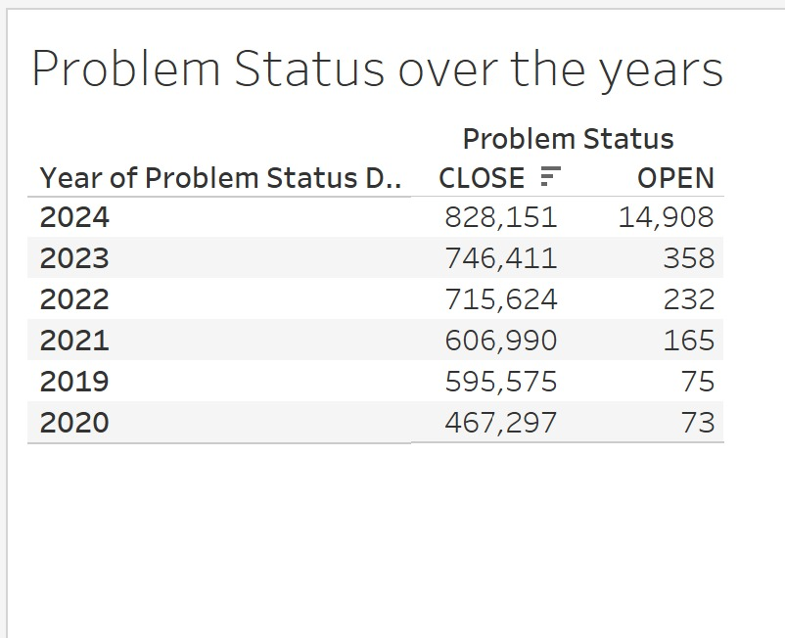
Table 5

Slide 14
Bar graph Complaints per Borough
It visualizes the yearly trend of complaints across NYC boroughs, highlighting variations in complaint volumes over time.
Key Insights
The bar graph shows distinct colors for each year, making it easier to differentiate between years and see trends clearly.
We can clearly see changes in complaint counts over time for each borough, allowing for quick comparisons and insights into patterns.
Bronx and Brooklyn having the most complaints due to high numbers in population and Staten Island having the least also population being the main factor.
Here you can see that data is combined from multiple years in one view, making it easier to analyze longer-term trends. It is clear that for each borough it seems complaints keep on rising as each year pass reflecting on negligence or slow response to complaints.

Slide 15
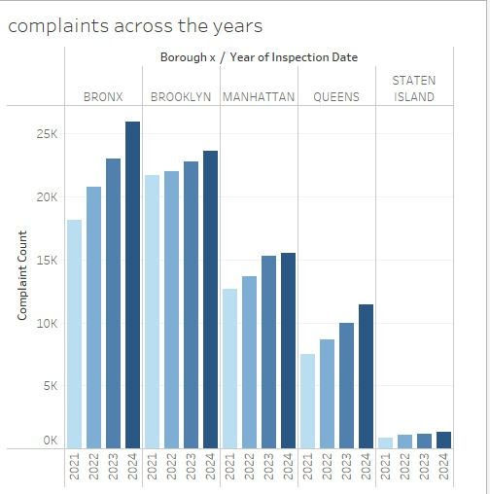
Bar Graph

Slide 16
Bar Graph for percentage change of complaints over the years
Visualizes the percentage change in complaint counts by category each year, highlighting fluctuations, with a notable spike in water leak complaints around 2021.
Key insights:
Water Leak Complaints Show the Most Volatility: Water leak complaints exhibit the most significant percentage changes year-over-year. There's a dramatic increase in 2022, followed by decreases in subsequent years. This suggests that water leak issues may be particularly sensitive to specific events or conditions.
Heat/Hot Water Complaints Show a General Decreasing Trend: Heat/Hot Water complaints generally show a decrease in 2021, and then a trend of increase, suggesting improvements in this area in 2021, but a return to worse conditions in other years.
Plumbing Complaints are Relatively Stable: Plumbing complaints show more consistent changes, with increases in some years and decreases in others, but the fluctuations are not as extreme as with water leaks.
Appliance Complaints have a general increasing trend: Appliance complaints generally show an increasing trend over the years, with some minor decreases.
Electric Complaints have a general increasing trend: Electric complaints generally show an increasing trend over the years, with some minor decreases.

Slide 17
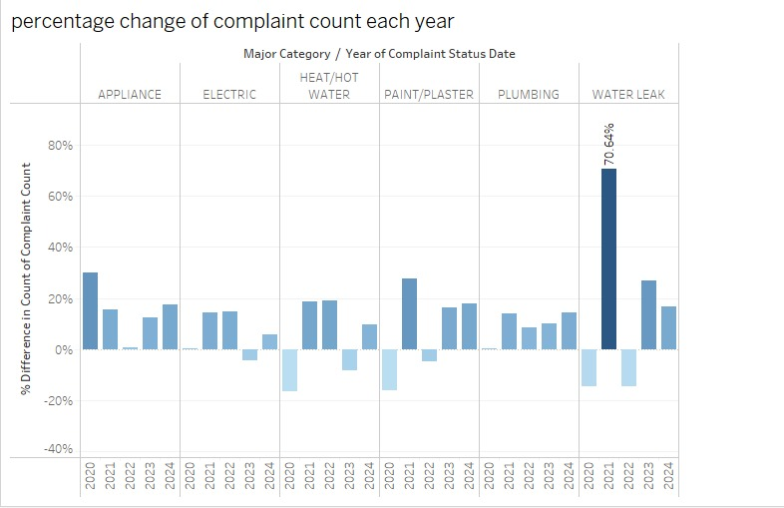
Bar Graph

Slide 18
Box Plot
Purpose of the Data:
Focuses on the statistical distribution of complaint counts over time, highlighting variations, medians, and outliers within each borough.
Key Insights:
The visualization displays the count of complaints received each year, categorized by borough: Bronx, Brooklyn, Manhattan, Queens, and Staten Island.Each borough's data is represented in box plots, which illustrate the distribution, median, and range of complaints for each year.

Slide 19
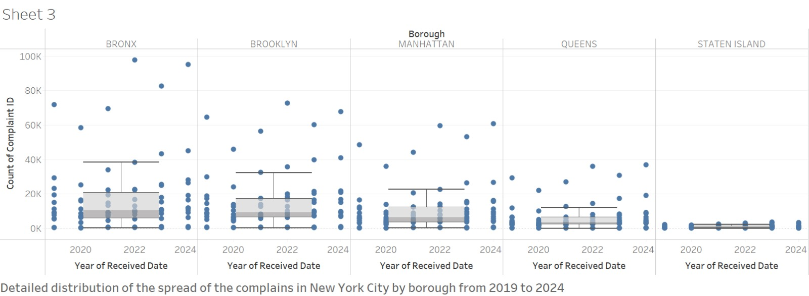
Box plot

Slide 20
Line Chart
Purpose of the Data:
The chart shows monthly trends in complaint counts, with heat/hot water issues peaking in winter and dropping in summer, while other categories remain stable.
Key Insights:
The line graph illustrates the count of complaints received each month, segmented by major categories such as appliance issues, elevator problems, plumbing, and more. Each complaint type is represented by its own line, allowing for easy comparison and identification of trends across different categories. Heat/ hot water is high in December and January because they are the coldest months of the year.
Other categories are constant with fluctuating ups and downs showing that the complaints there are no much newer or lesser complaints

Slide 21
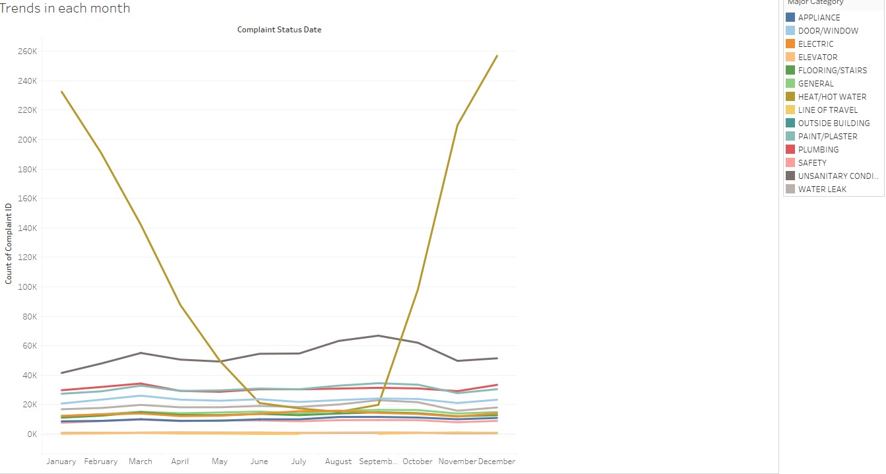
Line Chart

Slide 22
Heat Map Overview:
This heat map visualizes complaint counts by borough, providing a geographic overview of service demand across the area. It highlights where complaints are concentrated, helping to identify hotspots that may require urgent attention.
Key Features:
Borough Representation: The map clearly delineates complaints by borough—Bronx, Brooklyn, Manhattan, Queens, and Staten Island—allowing for easy identification of geographic trends.
Complaint Density: Different colors represent varying complaint counts, with a gradient indicating areas of higher and lower complaint volumes. The larger and more intense the color, the higher the number of complaints.
Insights:
Identifying Hotspots:
Areas with the highest complaint counts can be quickly identified, enabling targeted interventions. For example, if Brooklyn shows a concentration of complaints, this could indicate specific issues that need addressing.
Geographic Trends: Understanding the geographic distribution of complaints can inform resource allocation and operational strategies, ensuring that teams are deployed effectively.
Focuses on the geographic distribution of complaints across NYC, showing where complaints are most concentrated. It helps identify spatial patterns and hotspots.

Slide 23
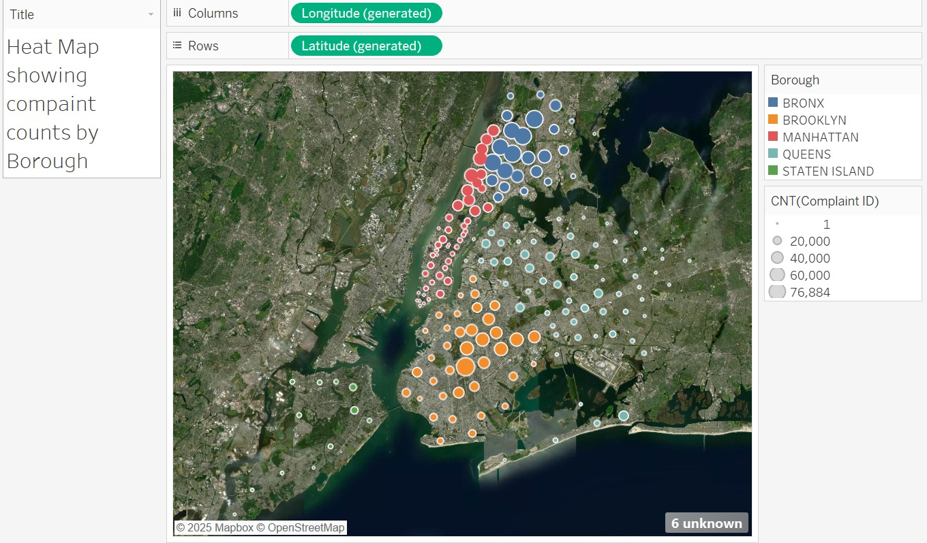
Heat map

Slide 24
Thank You

