Slide 1
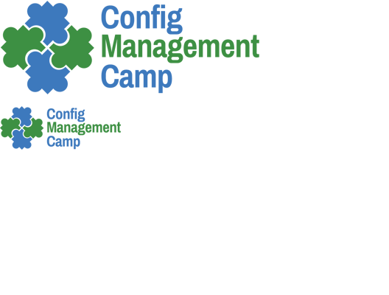
Nulecule
Packaging, Distributing & Deploying Container Applications the Cloud Way
2016 - Ghent, Belgium

Slide 2


Brian Exelbierd
vpavlin@localhost $ su - bexelbie
bexelbie@localhost $
Container Tools Engineer @ Red Hat
https://github.com/bexelbie
https://twitter.com/bexelbie
Slides heavily based on Václav Pavlín’s Originals

Slide 3
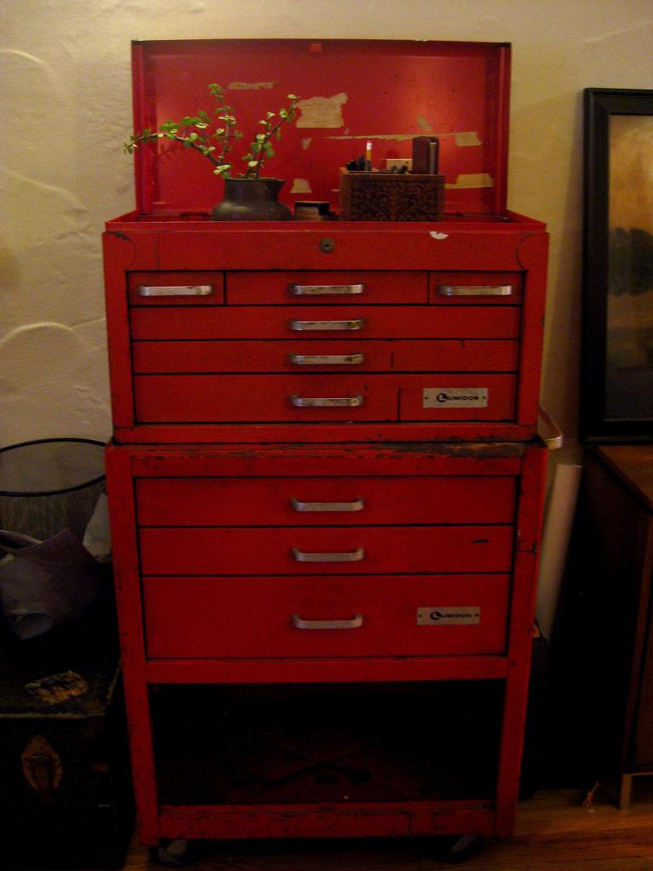

Atomic
Developer Bundle
An easy start Linux container development environment.
Enabling development with Docker, Kubernetes, OpenShift, Mesos-Marathon and Nulecule
Toolbox

Slide 4
<insert containers talk>
I don’t have to do this, do I?

Slide 5
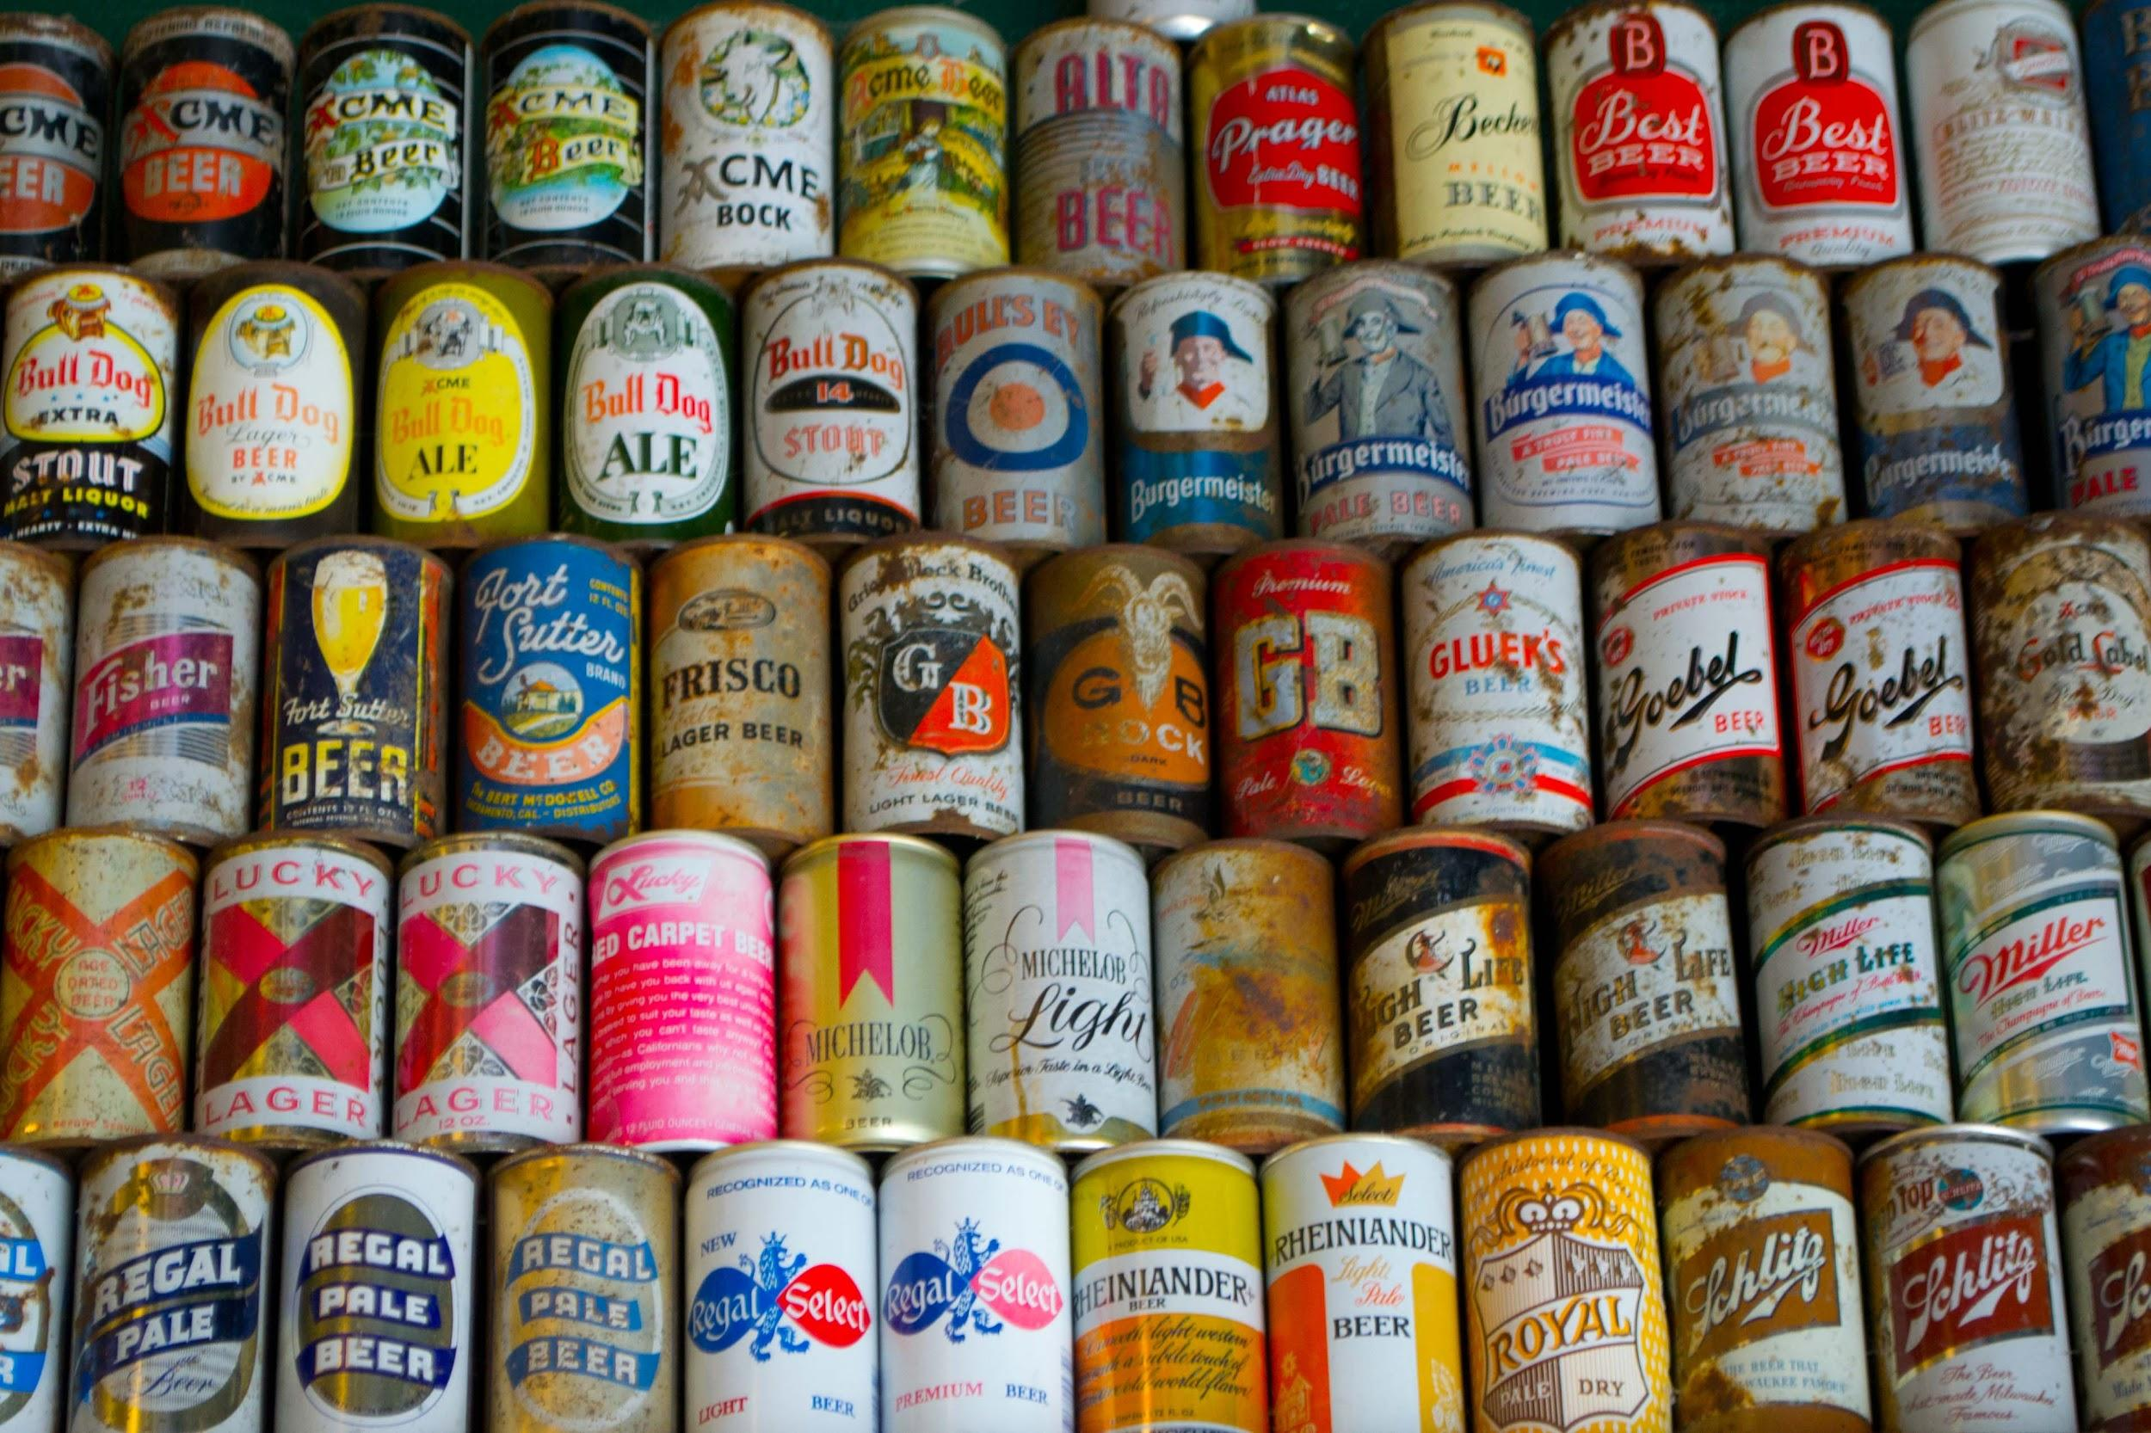
Container Packaging
Simple, Clean & Beautiful*
But … no dependency defs, no instructions, all “open” differently and everyone makes a new one.
*The debate on these terms is another talk
Beverage Can

Slide 6
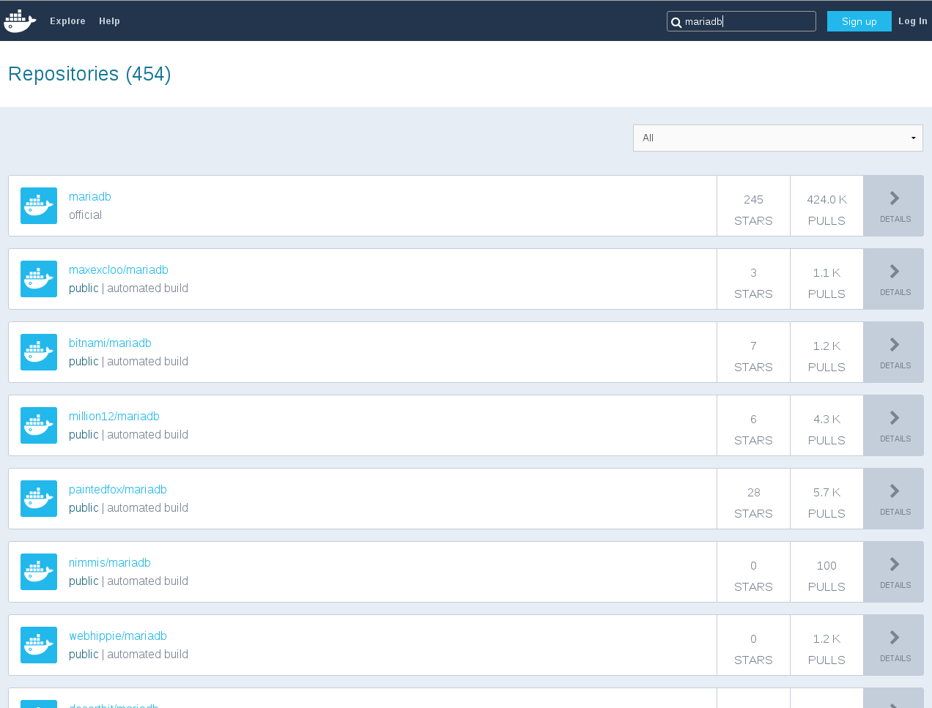
Everybody Repackages
Bonus: Most are poorly documented, not easily changed, not audited, and generally scary
Search for MariaDB

Slide 7
Everybody Repackages
587
Bonus: Most are poorly documented, not easily changed, not audited, and generally scary
Search for MariaDB

Slide 8
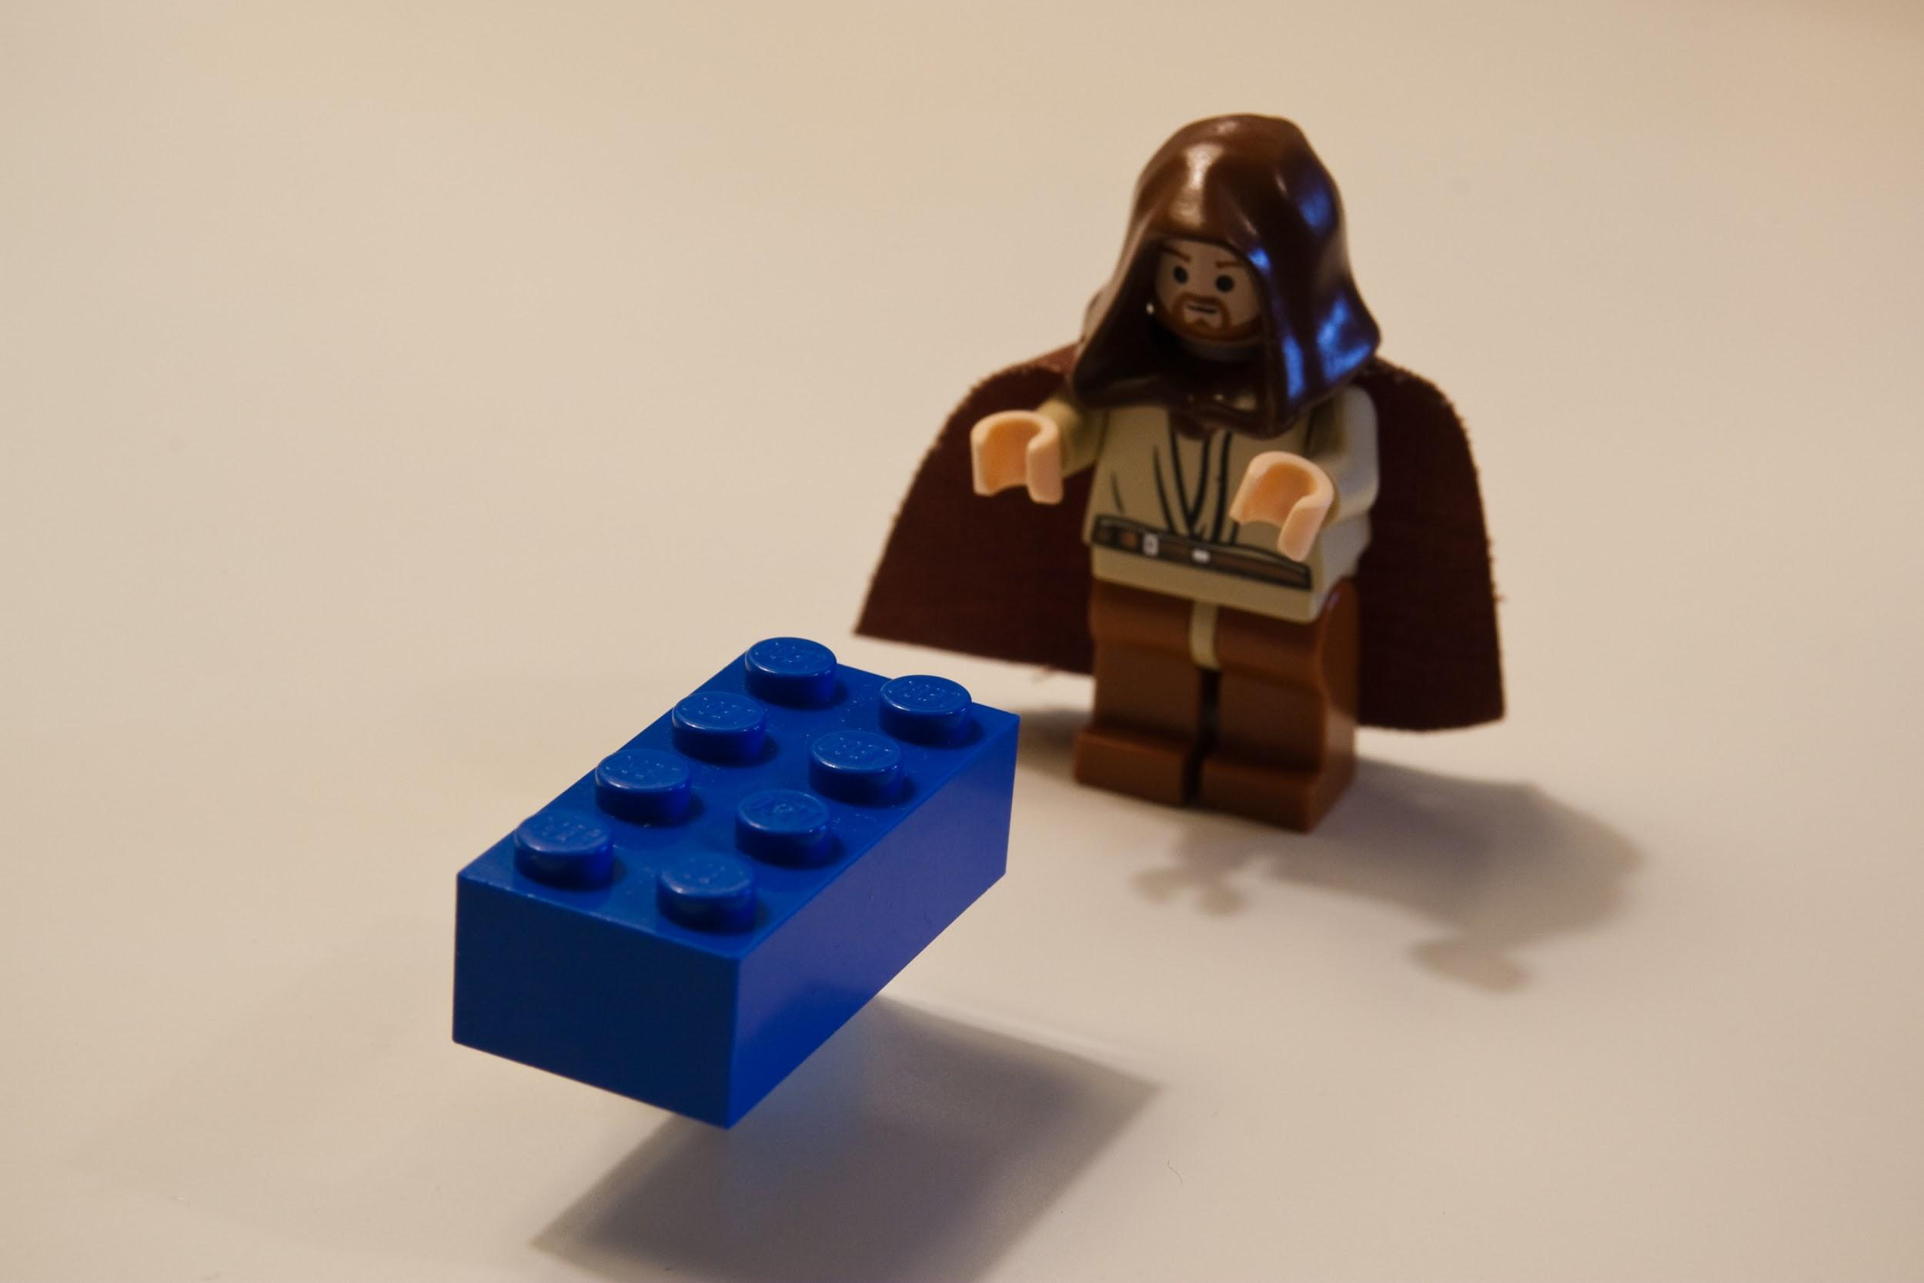
Containers
are fun!
Gary H

Slide 9
READMEs
Run the mariadb container:
# docker run --name=mydb -e USER=wordpress -e PASS=$(pwgen -s -1) -e NAME=wordpress -d <yourname>/mariadb
Then run the wordpress container, using the alias 'db' for the linked MariaDB container:
# CID=$(docker run -p 80 --link=mydb:db -d <yourname>/wordpress)
Then find the external port assigned to your container:
# docker port $CID 80
Visit in a web browser, then fill out the form. No need to mess with wp-config.php, it has been auto-generated with proper values.
The “UX” of choice
for containers

Slide 10
Containers
are fun!
Gary H

Slide 11
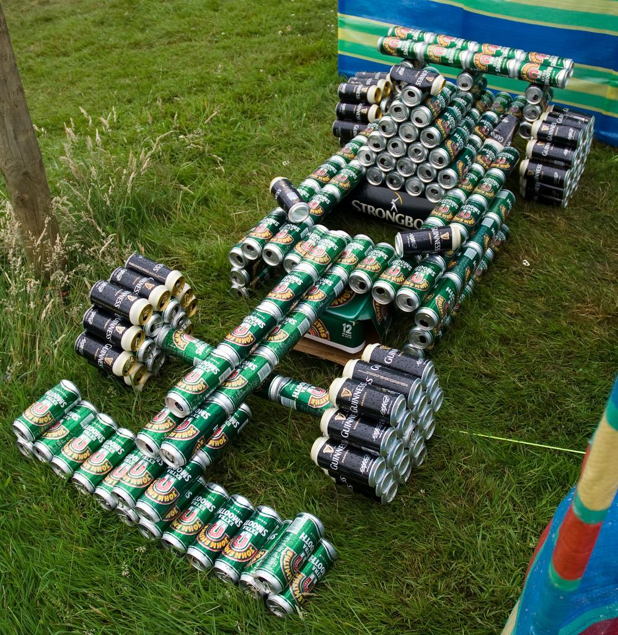
Multi-container Application
2-n container images, operated as a single unit, re-using existing components
F1 Beer Car

Slide 12

An application consists of
many parts, that need to be operated together
Gitlab
Redis Master
PostgerSQL
Redis Slaves

Slide 13
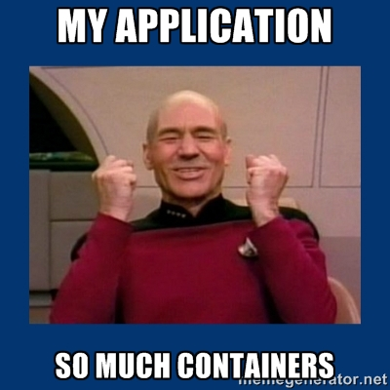
An application consists of
many parts, that need to be operated together
Coming Soon: Microservices
Gitlab
Redis Master
PostgerSQL
Redis Slaves

Slide 14
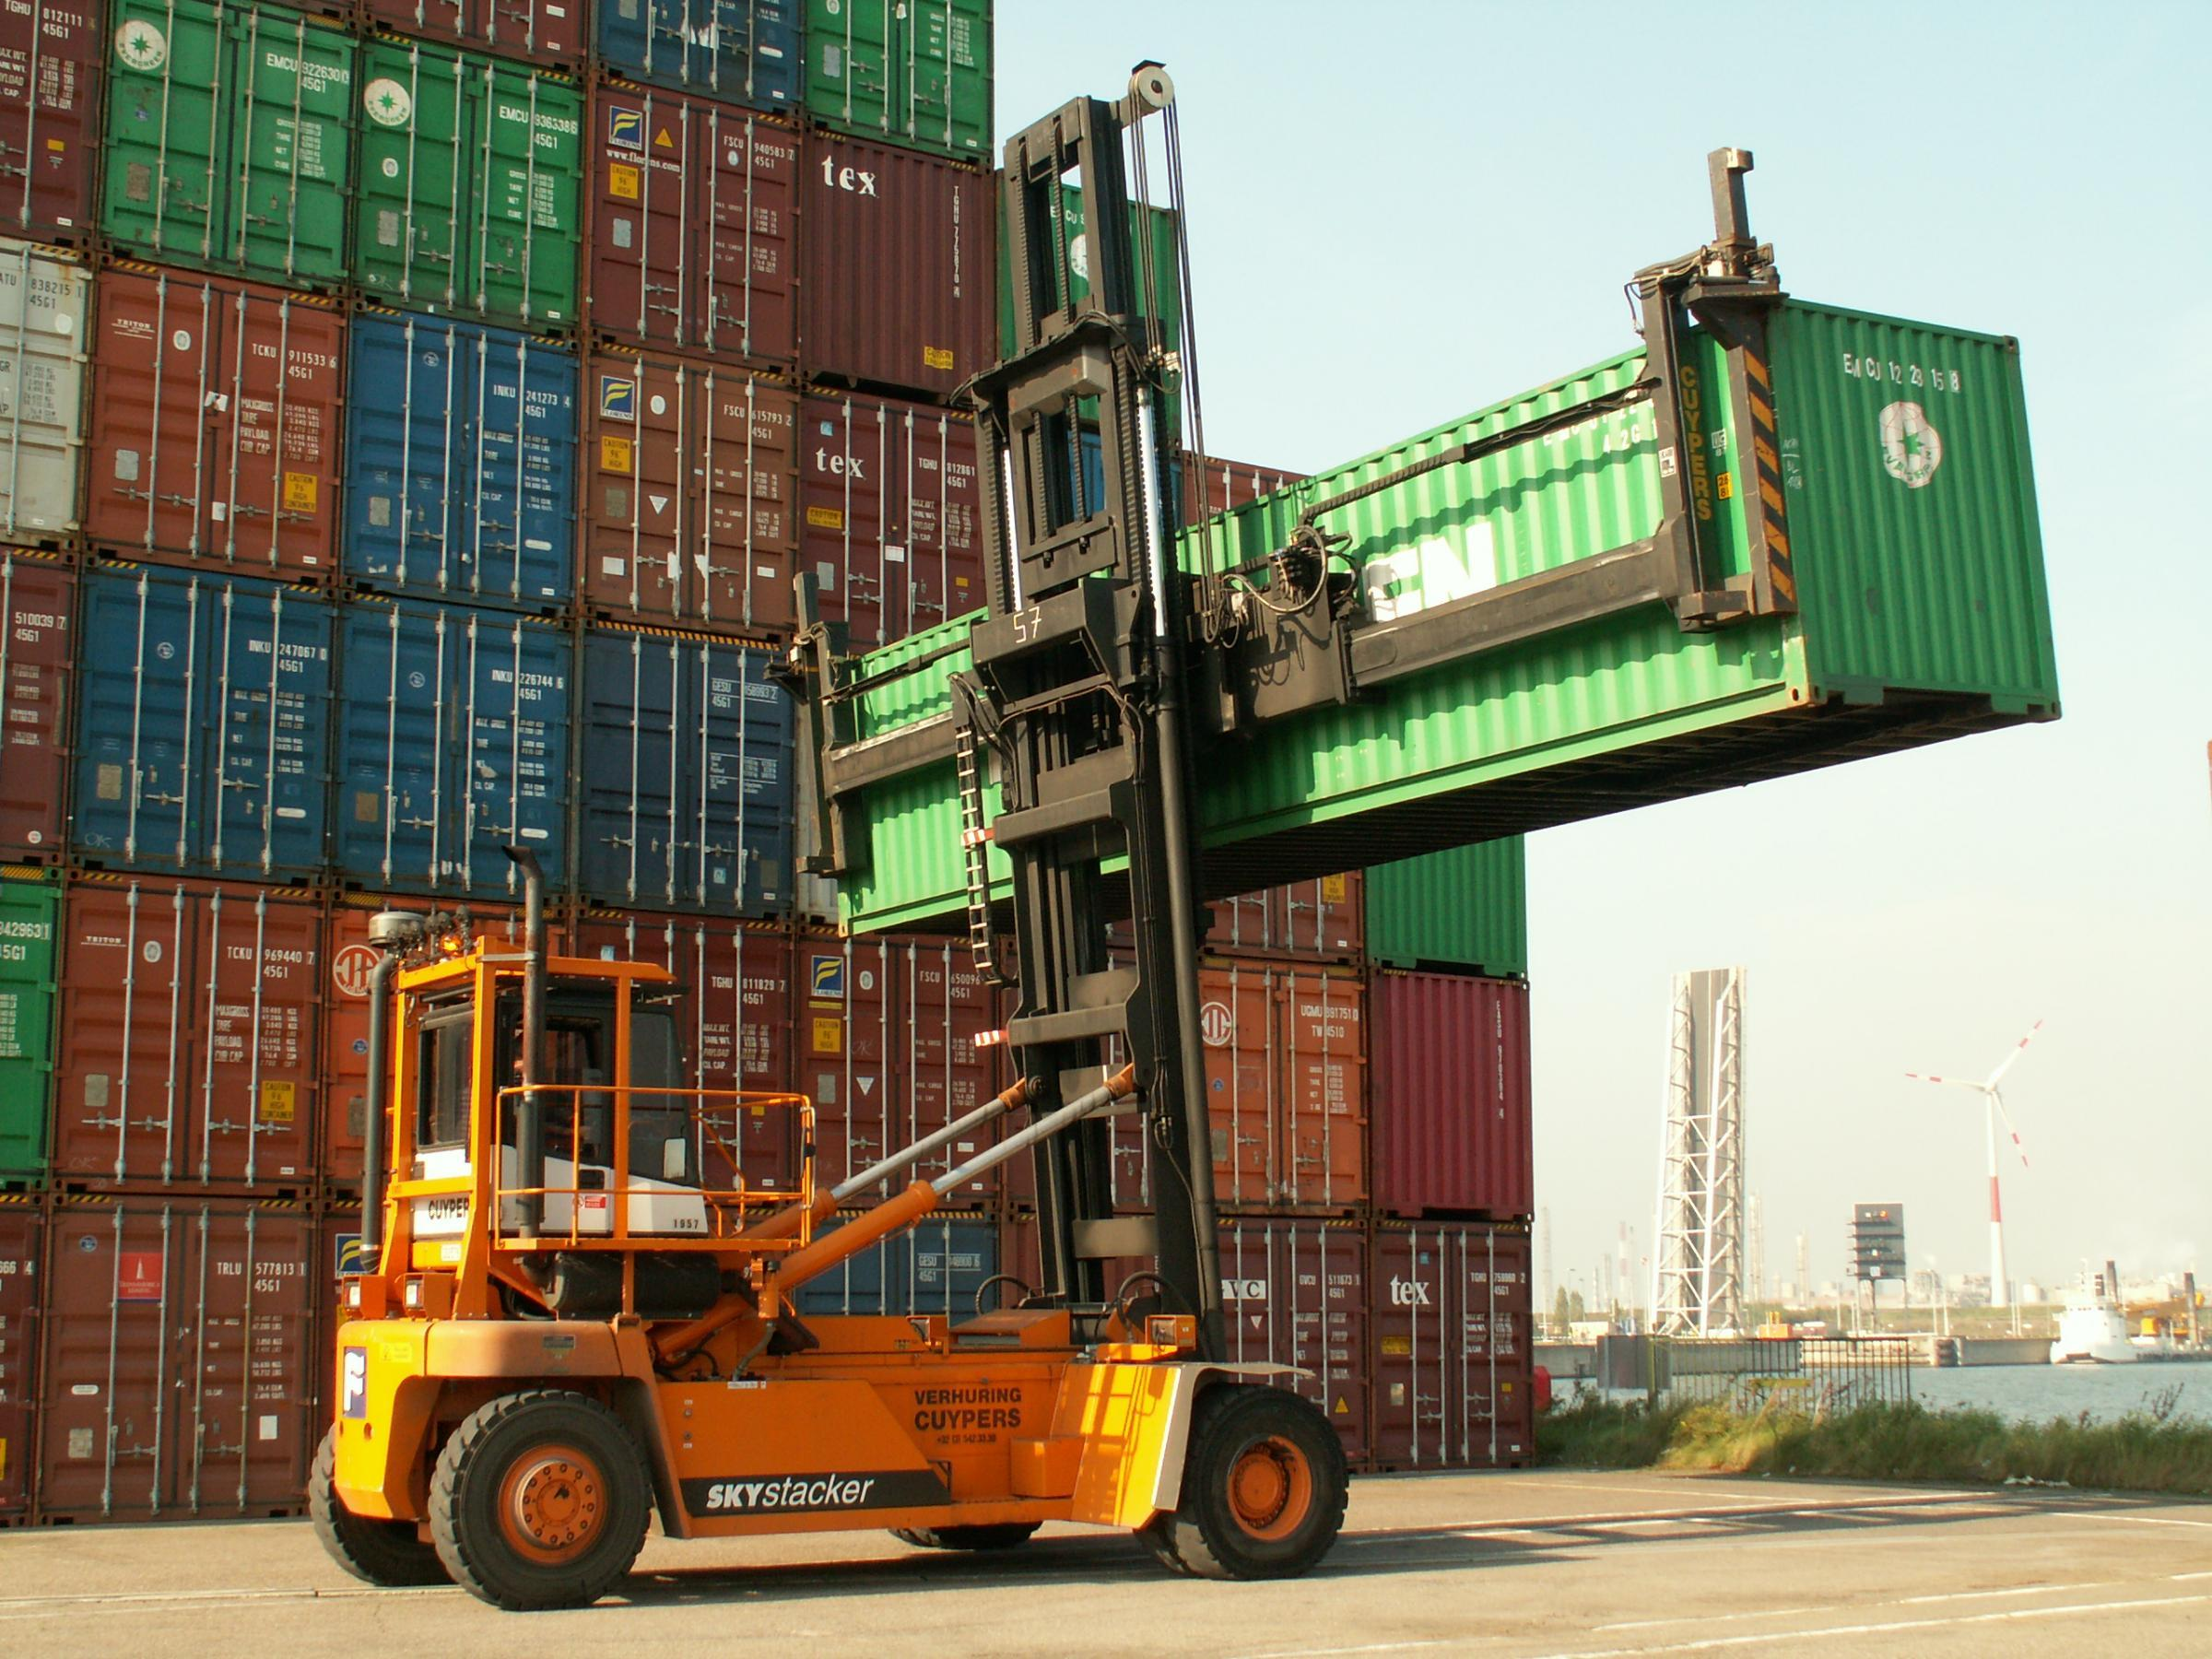
Orchestration
Hooray - metadata separated
from images
Skystacker

Slide 15
Metadata Distribution
$ curl -O https://raw.githubusercontent.com/kube...
$ ls redis-master-controller.yaml
$ kubectl create -f redis-master-controller.yaml
No common way to transfer metadata to Ops or other users

Slide 16
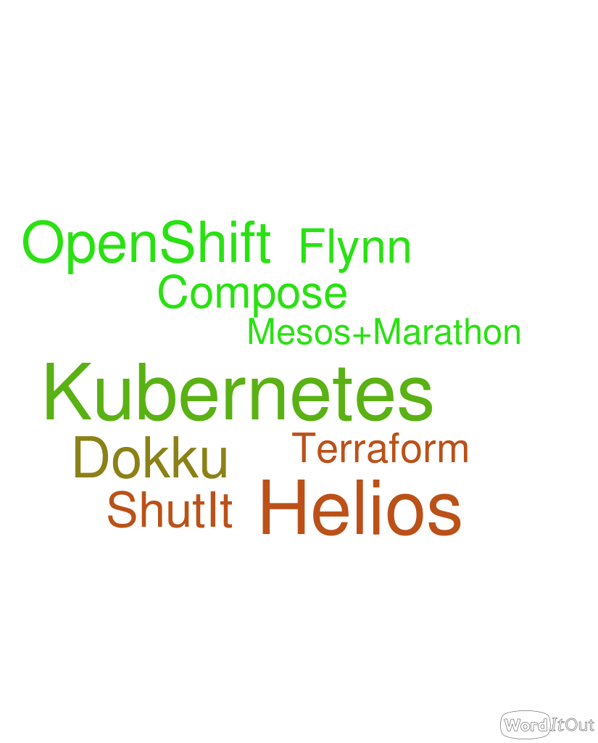
Various Orchestration Projects
There is no winner yet and each defines it’s own format to describe the deployment

Slide 17
Metadata Modifications
"env": [ { "name": "MYSQL_SERVICE_IP", "value": "1.2.3.4" }, { "name": "MYSQL_SERVICE_PORT", "value": "3306" }, { "name": "MYSQL_PASSWORD", "value": "1234" } ]
Note: Remember to substitute environment variable values in json file before creating replication controller.
Quoted from Phabricator Kubernetes example
Most environment changes will require some metadata changes

Slide 18
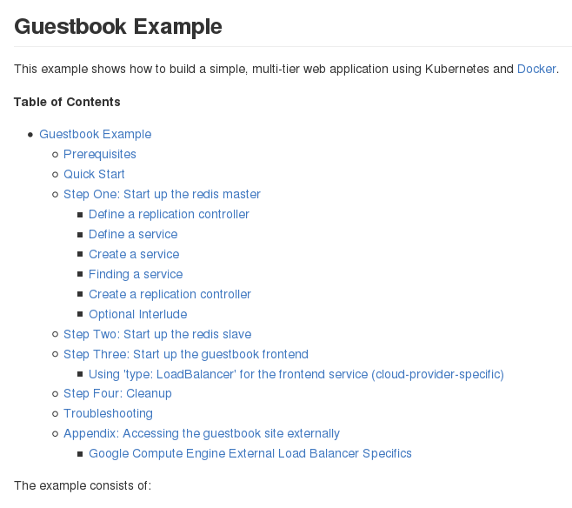
READMEs
Kubernetes Guestbook Example
725 lines/paragraphs - +30 KB
The “UX” of choice for multi-container
orchestrated apps

Slide 19
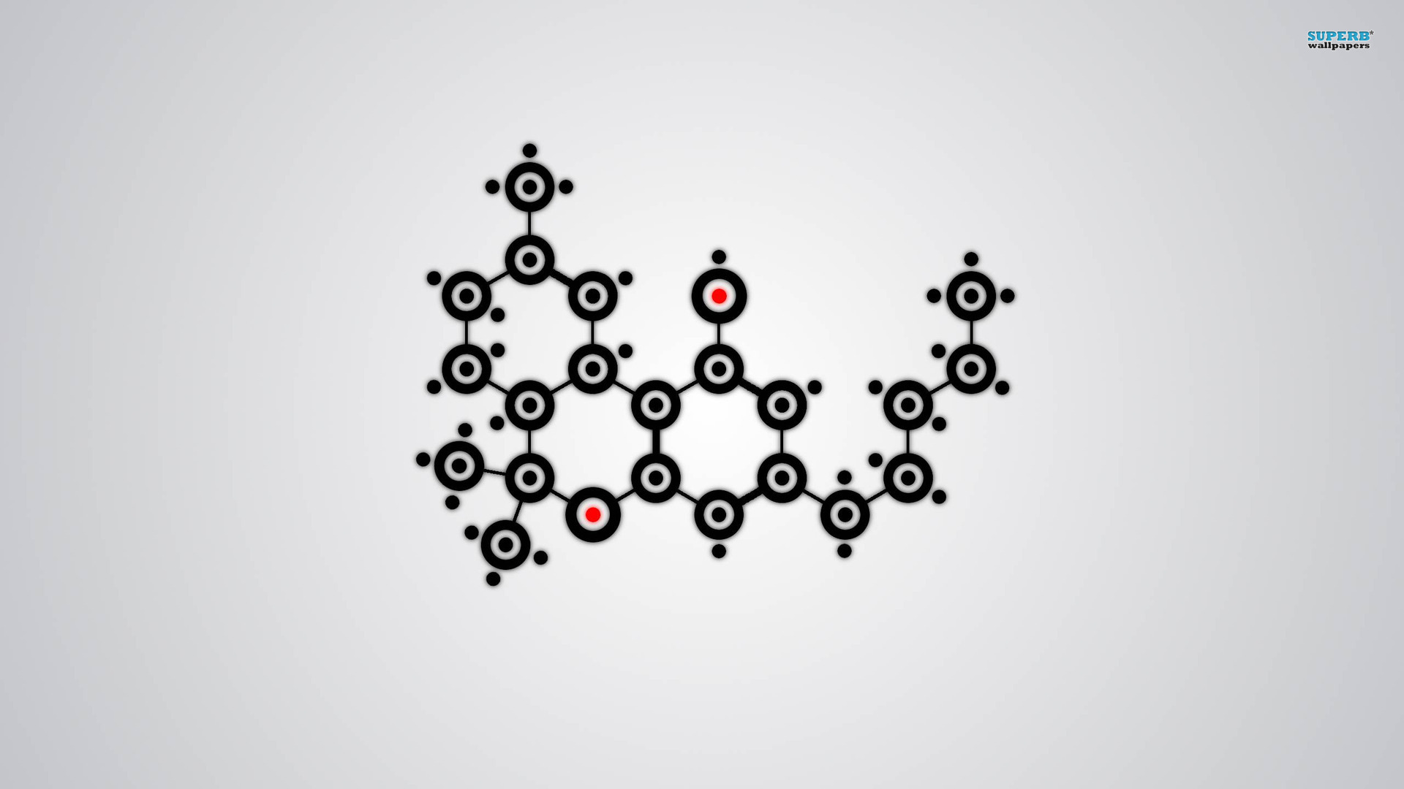
Nulecule
Specification, composability, common distribution, parametrization, orchestration providers
Molecule Wallpaper

Slide 20
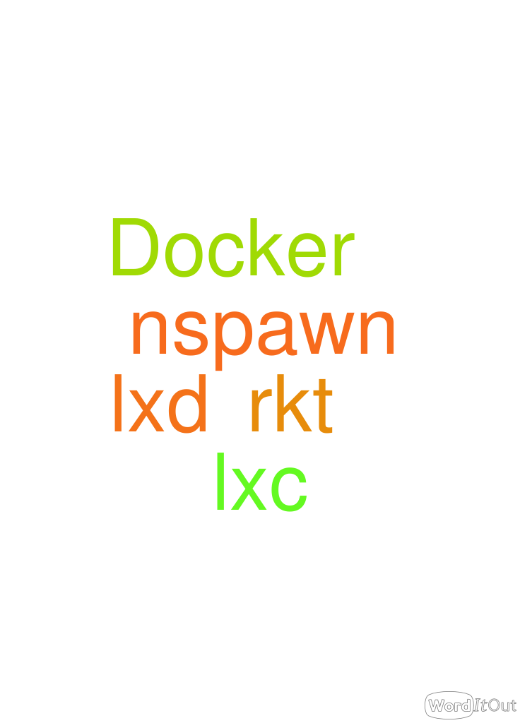
Just a Spec
Container engine independent
Orchestrator embracing

Slide 21
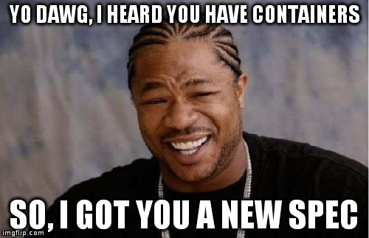
Why another thing?
Tool agnostic - and doesn’t push
Allow high-level thought with low-level tweaks
Easy enough for a junior sysadmin to use
Able to integrate with existing tools
Open, including implementatoin

Slide 22
Graph
graph: - name: guestbookfront-app ...
- name: redis-centos7-atomicapp ...
Guestbook
DAG to define application components and dependencies
Redis Master
Redis Slaves

Slide 23
Manages Dependencies
graph: - name: guestbookfront-app ...
- name: redis-centos7-atomicapp source: docker://projectatomic/redis-centos7-atomicapp
guestbookfront-app
redismaster-app
All dependencies are pulled during “install” as defined in Nulecule.
redisslave-app
docker pull projectatomic/redis-centos7-atomicapp
graph: - name: redismaster-app ...
- name: redisslave-app ...

Slide 24
Parametrization
graph: - name: helloapache-app params: - name: image description: The webserver image default: centos/httpd - name: hostport description: The host TCP port default: 80
constraints:
- allowed_pattern: ^[0-9]+$
description: Port number has to be a numeric value
Provide the right values at deployment time
0

Slide 25
Parametrization
graph: - name: helloapache-app params: - name: image description: The webserver image default: centos/httpd - name: hostport description: The host TCP port default: 80
constraints:
- allowed_pattern: ^[0-9]+$
description: Port number has to be a numeric value
Every component has its own parameters
1

Slide 26
Parametrization
graph: - name: helloapache-app params: - name: image description: The webserver image default: centos/httpd - name: hostport description: The host TCP port default: 80
constraints:
- allowed_pattern: ^[0-9]+$
description: Port number has to be a numeric value
Default values can be provided and overridden
2

Slide 27
Parametrization
graph: - name: helloapache-app params: - name: image description: The webserver image default: centos/httpd - name: hostport description: The host TCP port default: 80
constraints:
- allowed_pattern: ^[0-9]+$
description: Port number has to be a numeric value
Parameters can be constrained by regular expression
3

Slide 28
Answers file
[general] provider = kubernetes [helloapache-app] image = centos/httpd
hostport = 80
A file containing “answers” to questions defined by parameters
0

Slide 29
Answers file
[general] provider = kubernetes [helloapache-app] image = fedora/httpd
hostport = 8080
A file containing “answers” to questions defined by parameters
1

Slide 30
Providers
artifacts: kubernetes: - file://...kubes/gitlab-rc.json - file://...kubes//gitlab-http-service.json docker: - file://...docker/gitlab-link-run
openshift:
- file://...shift/os-route.json
- inherit:
- kubernetes
These represent orchestrators

Slide 31
Artifacts
artifacts: kubernetes: - file://...kubes/gitlab-rc.json - file://...kubes//gitlab-http-service.json docker: - file://...docker/gitlab-link-run
openshift:
- file://...shift/os-route.json
- inherit:
- kubernetes
Deployment metadata templates for orchestrators

Slide 32
Artifacts are Parameterized
"image": "$image", "name": "helloapache", "ports": [ { "containerPort": 80, "hostPort": $hostport, "protocol": "TCP" } ]
Dollar sign variable replacement

Slide 33
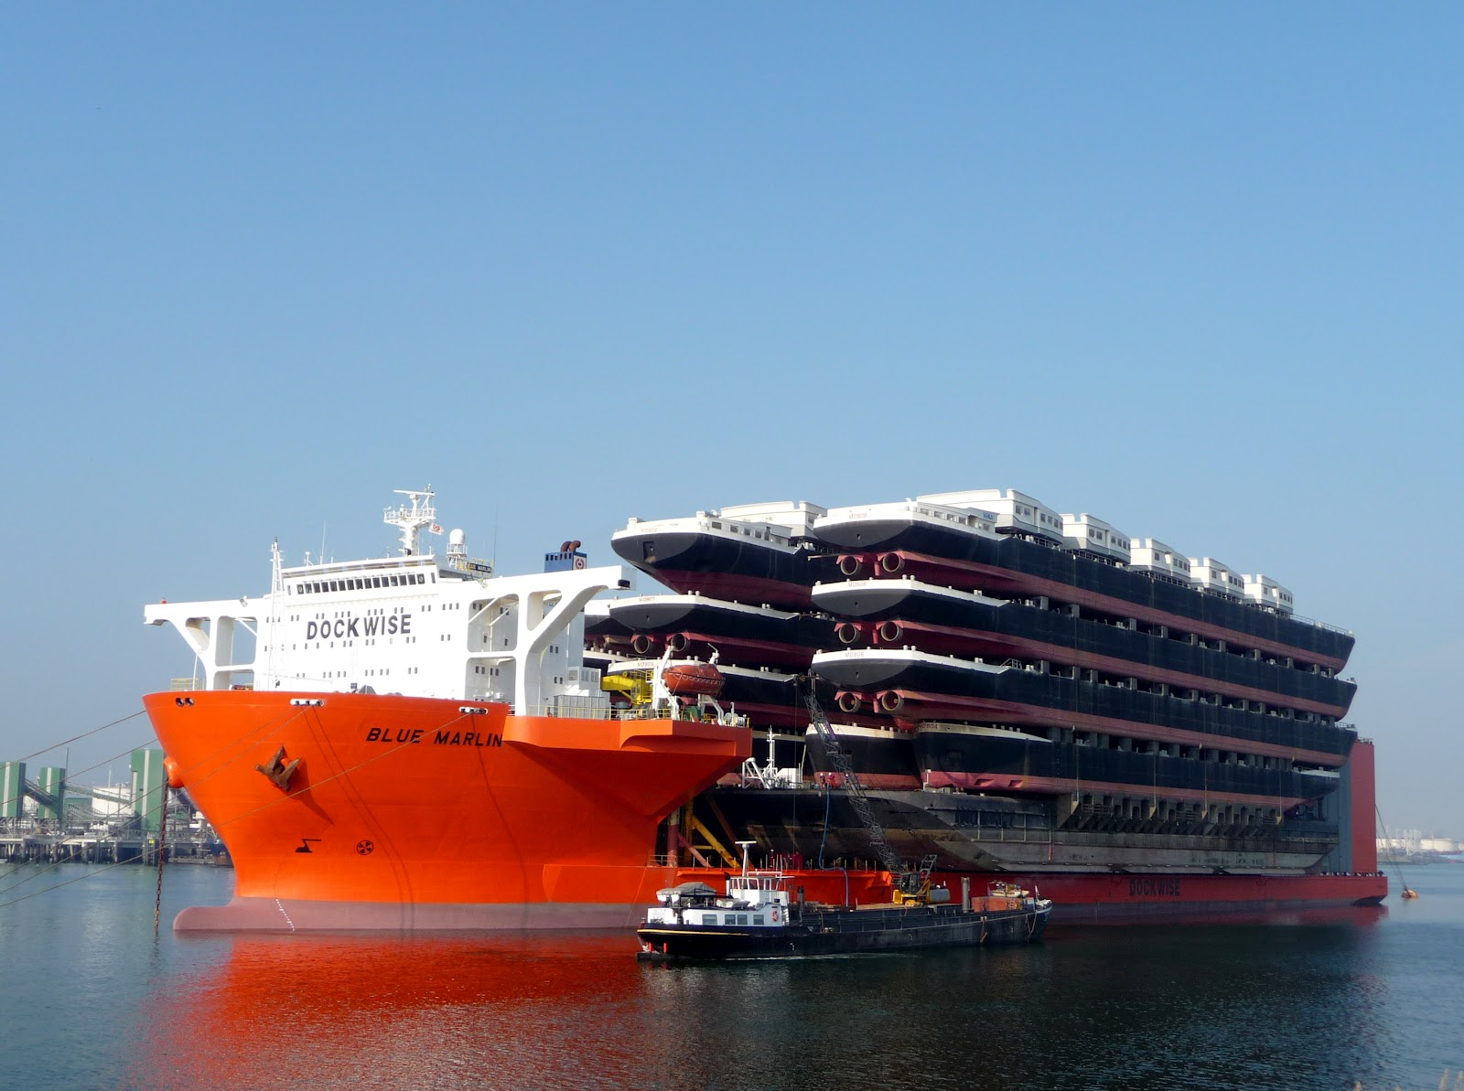
It’s not Slideware …
Atomic App
Reference Implementation of Nulecule
Nulecule app installer and manager, container-enabled, provider plugins, single command deployment
Ship Shipping Ships

Slide 34
Base for application images
FROM projectatomic/atomicapp:0.4.0
MAINTAINER Red Hat, Inc. <container-tools@redhat.com>
LABEL io.projectatomic.nulecule.specversion="0.0.2" \
io.projectatomic.nulecule
providers="kubernetes,docker"\
Build="docker build --rm --tag
test/gitlab-atomicapp ."
ADD /Nulecule /Dockerfile README.md gpl-3.0.txt
/application-entity/
ADD /artifacts /application-entity/artifacts
You build your app on top of our Atomic App base image

Slide 35
Demo Thanks:
Tomas Kral (@kadel)
Michael Scherer

Slide 36

D
E
M
O
T
I
M
E
Indiana Jones and the Temple of Doom

Slide 37
Learn More at
Project Site: www.projectatomic.io
Github:
https://github.com/projectatomic/nulecule
https://github.com/projectatomic/atomicapp
IRC: #nulecule @ Freenode
Mailing List: container-tools@redhat.com
Brian “bex” Exelbierd @bexelbie, bex@pobox.com, bexelbie@redhat.com
Slides and examples: https://github.com/bexelbie/nulecule-talk-demo
Nulecule: Packaging, Distributing & Deploying Container Applications the Cloud Way by Brian Exelbierd is based on Nulecule: Packaging, Distributing & Deploying Container Applications the Cloud Way by Václav Pavlín. Both are licensed under a Creative Commons Attribution-ShareAlike 4.0 International License.

