Slide 1
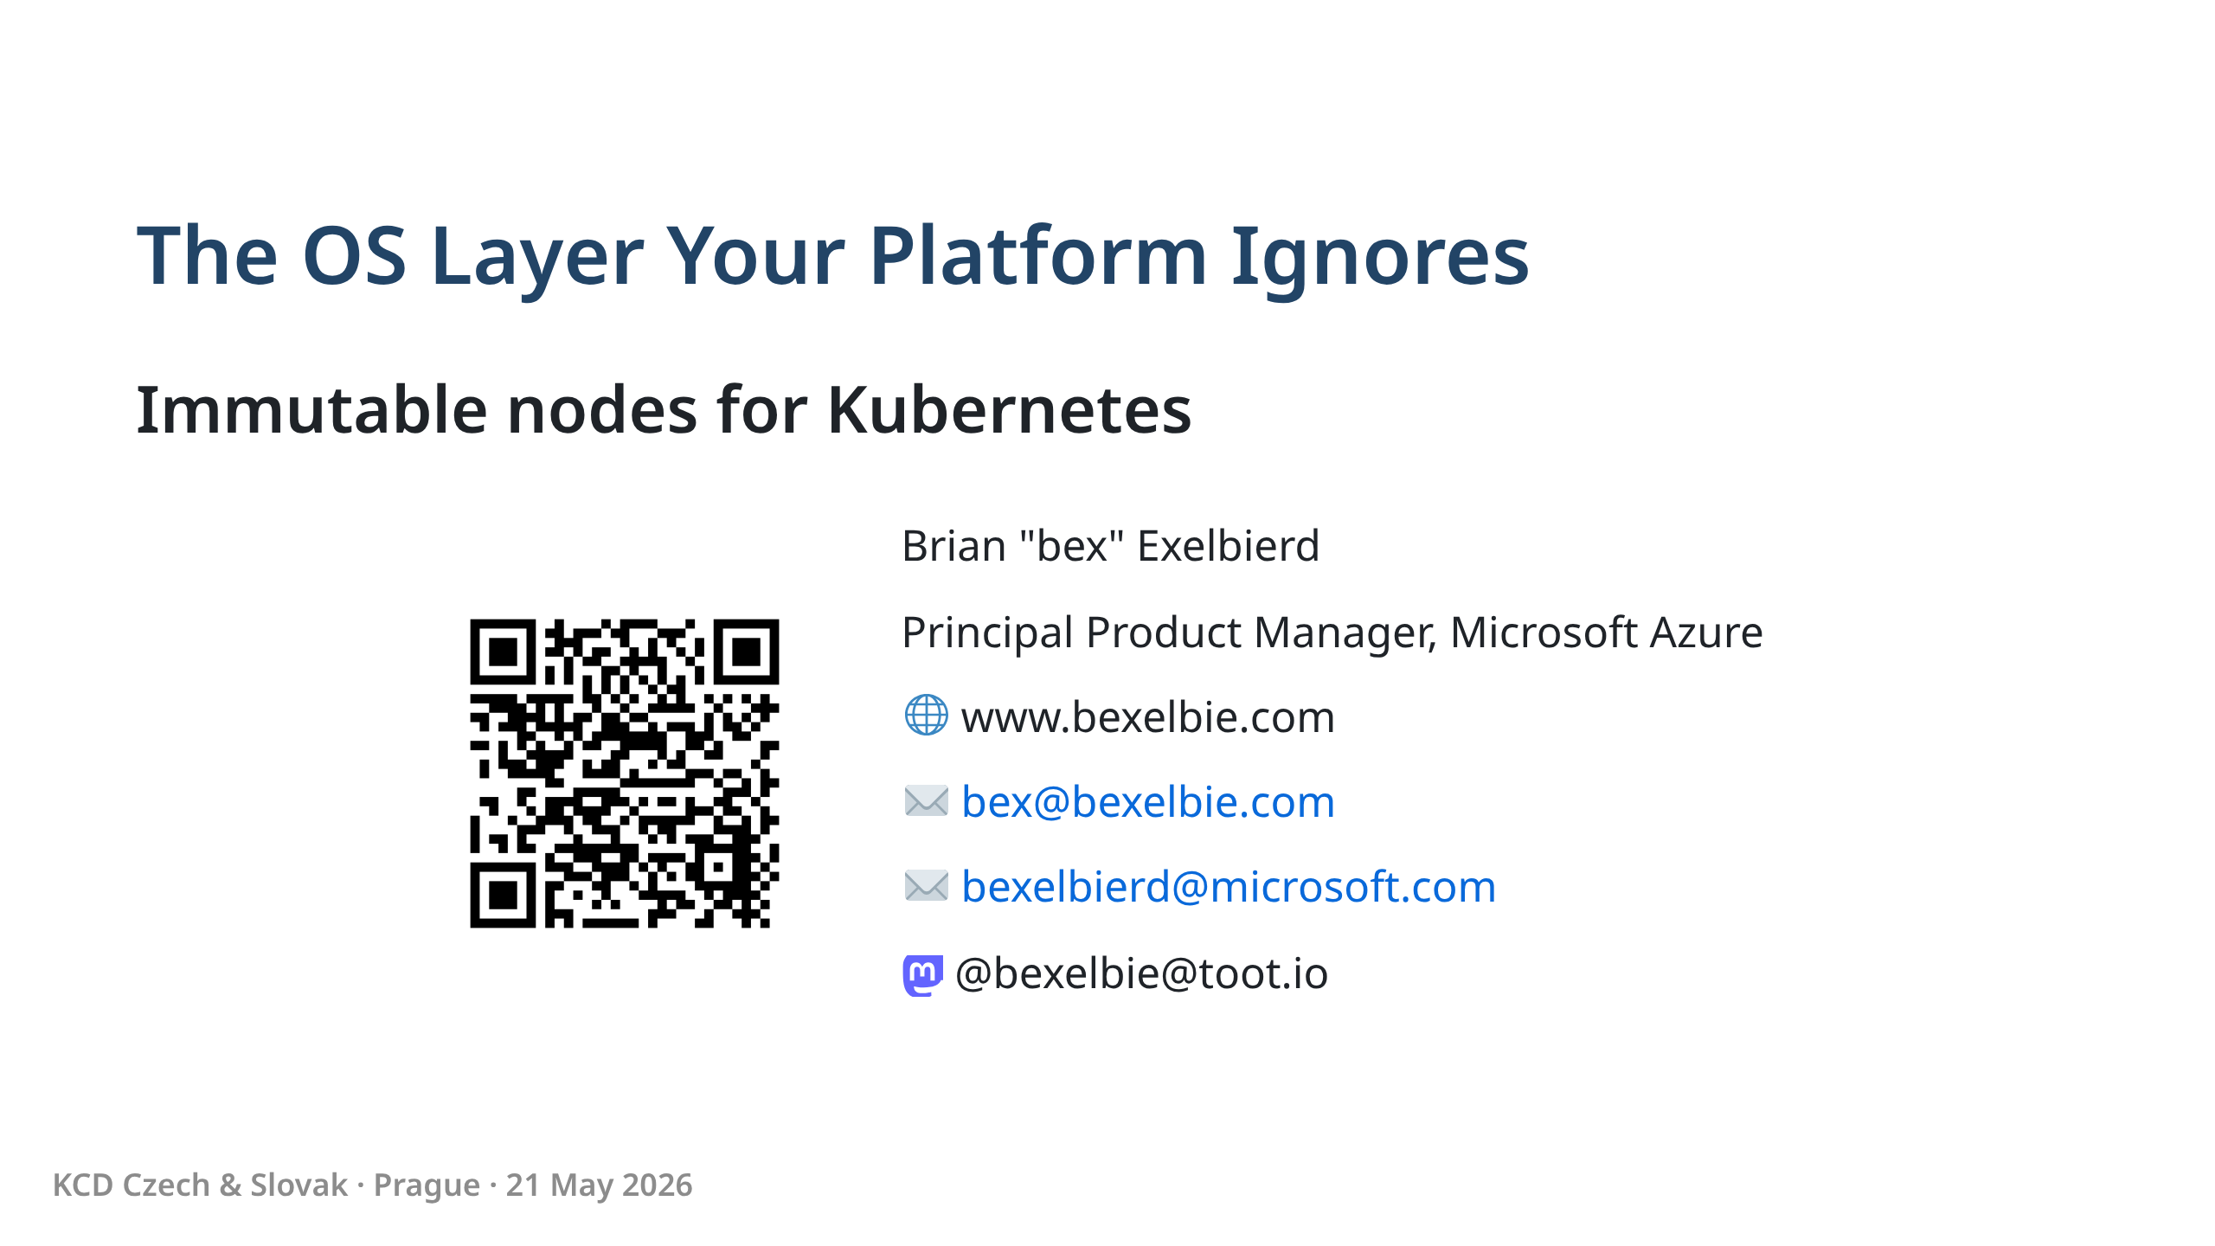
Notes:
Regen QR Code! - Linux for 20+ years - Microsoft Azure doing Upstream Linux - Using Azure today because that's what I have - Works on AWS, GCP, bare metal, or this 2017 laptop in front of me - Linux guy, not a Kubernetes guy - Vanilla kubeadm - no special sauce - Using Headlamp - Errors in Kube are mine - Slides at the QR code and on my website

Slide 2
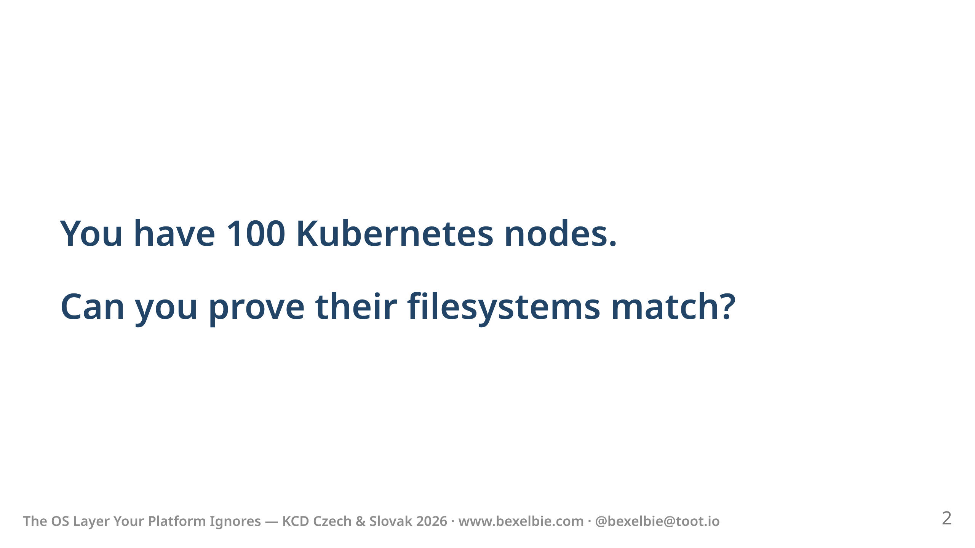
Notes:
- This is the question - Most people can't answer this correctly - Edge cases make most wrong - Let me explain why.

Slide 3
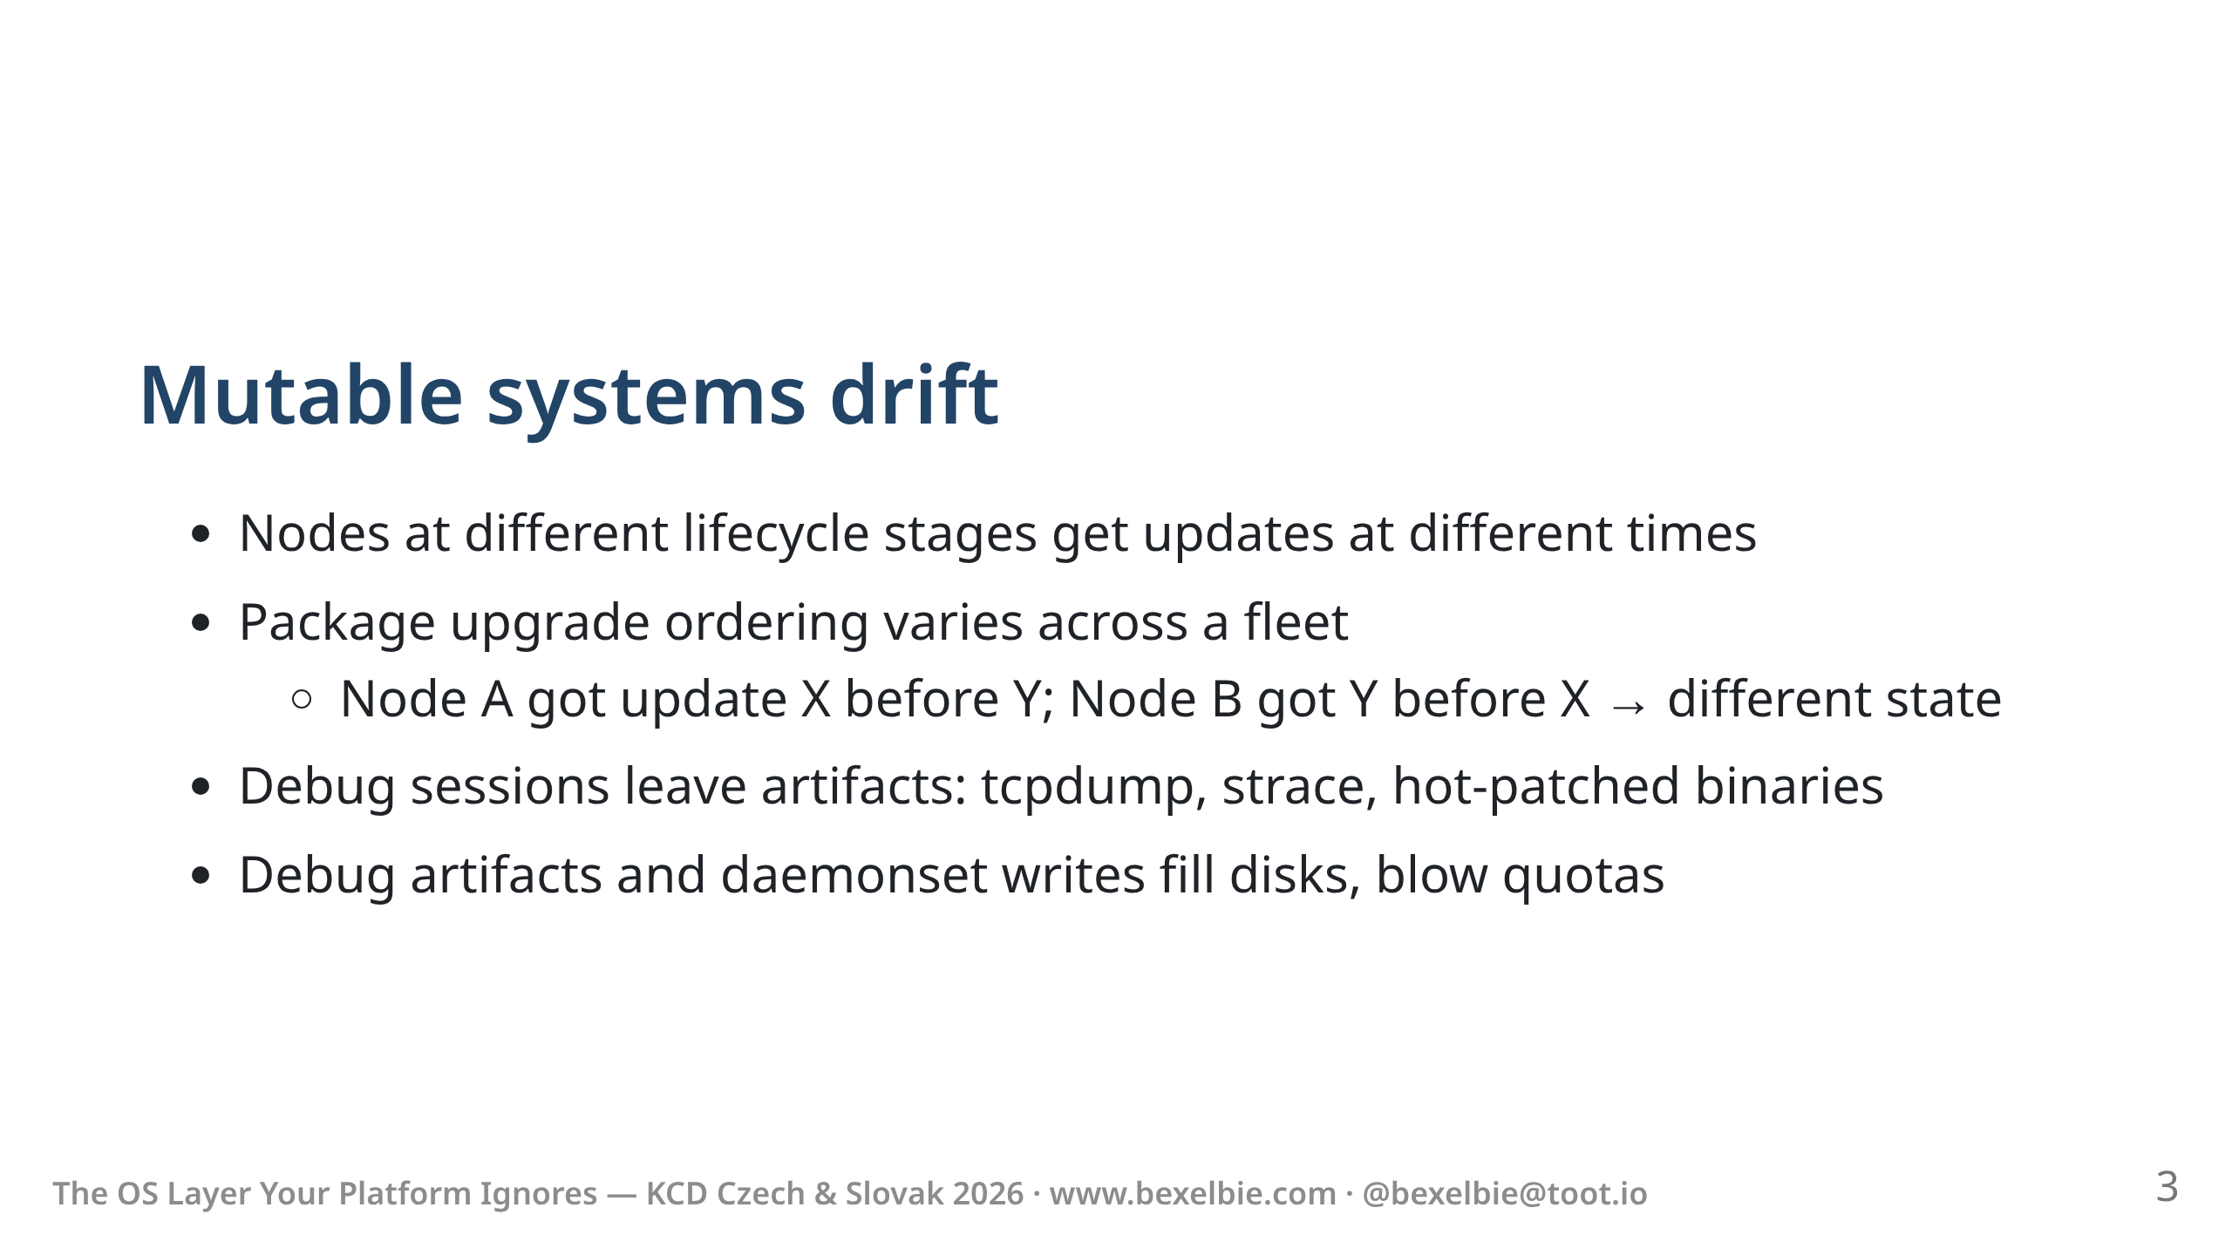
Notes:
- We use mutable nodes under Kube - Mutable nodes ... mutate - Old nodes differ from new nodes - Mutable systems are non-deterministic at scale - The order of package installations matters - This is why enterprise Linux getting rid of scriptlets - Perfect with Gold images and Infra as Code? - Engineers SSH in to debug problems and leave things behind. - Logs or dumps that create disk issues - Replaced binaries that haven't been CI'ed

Slide 4
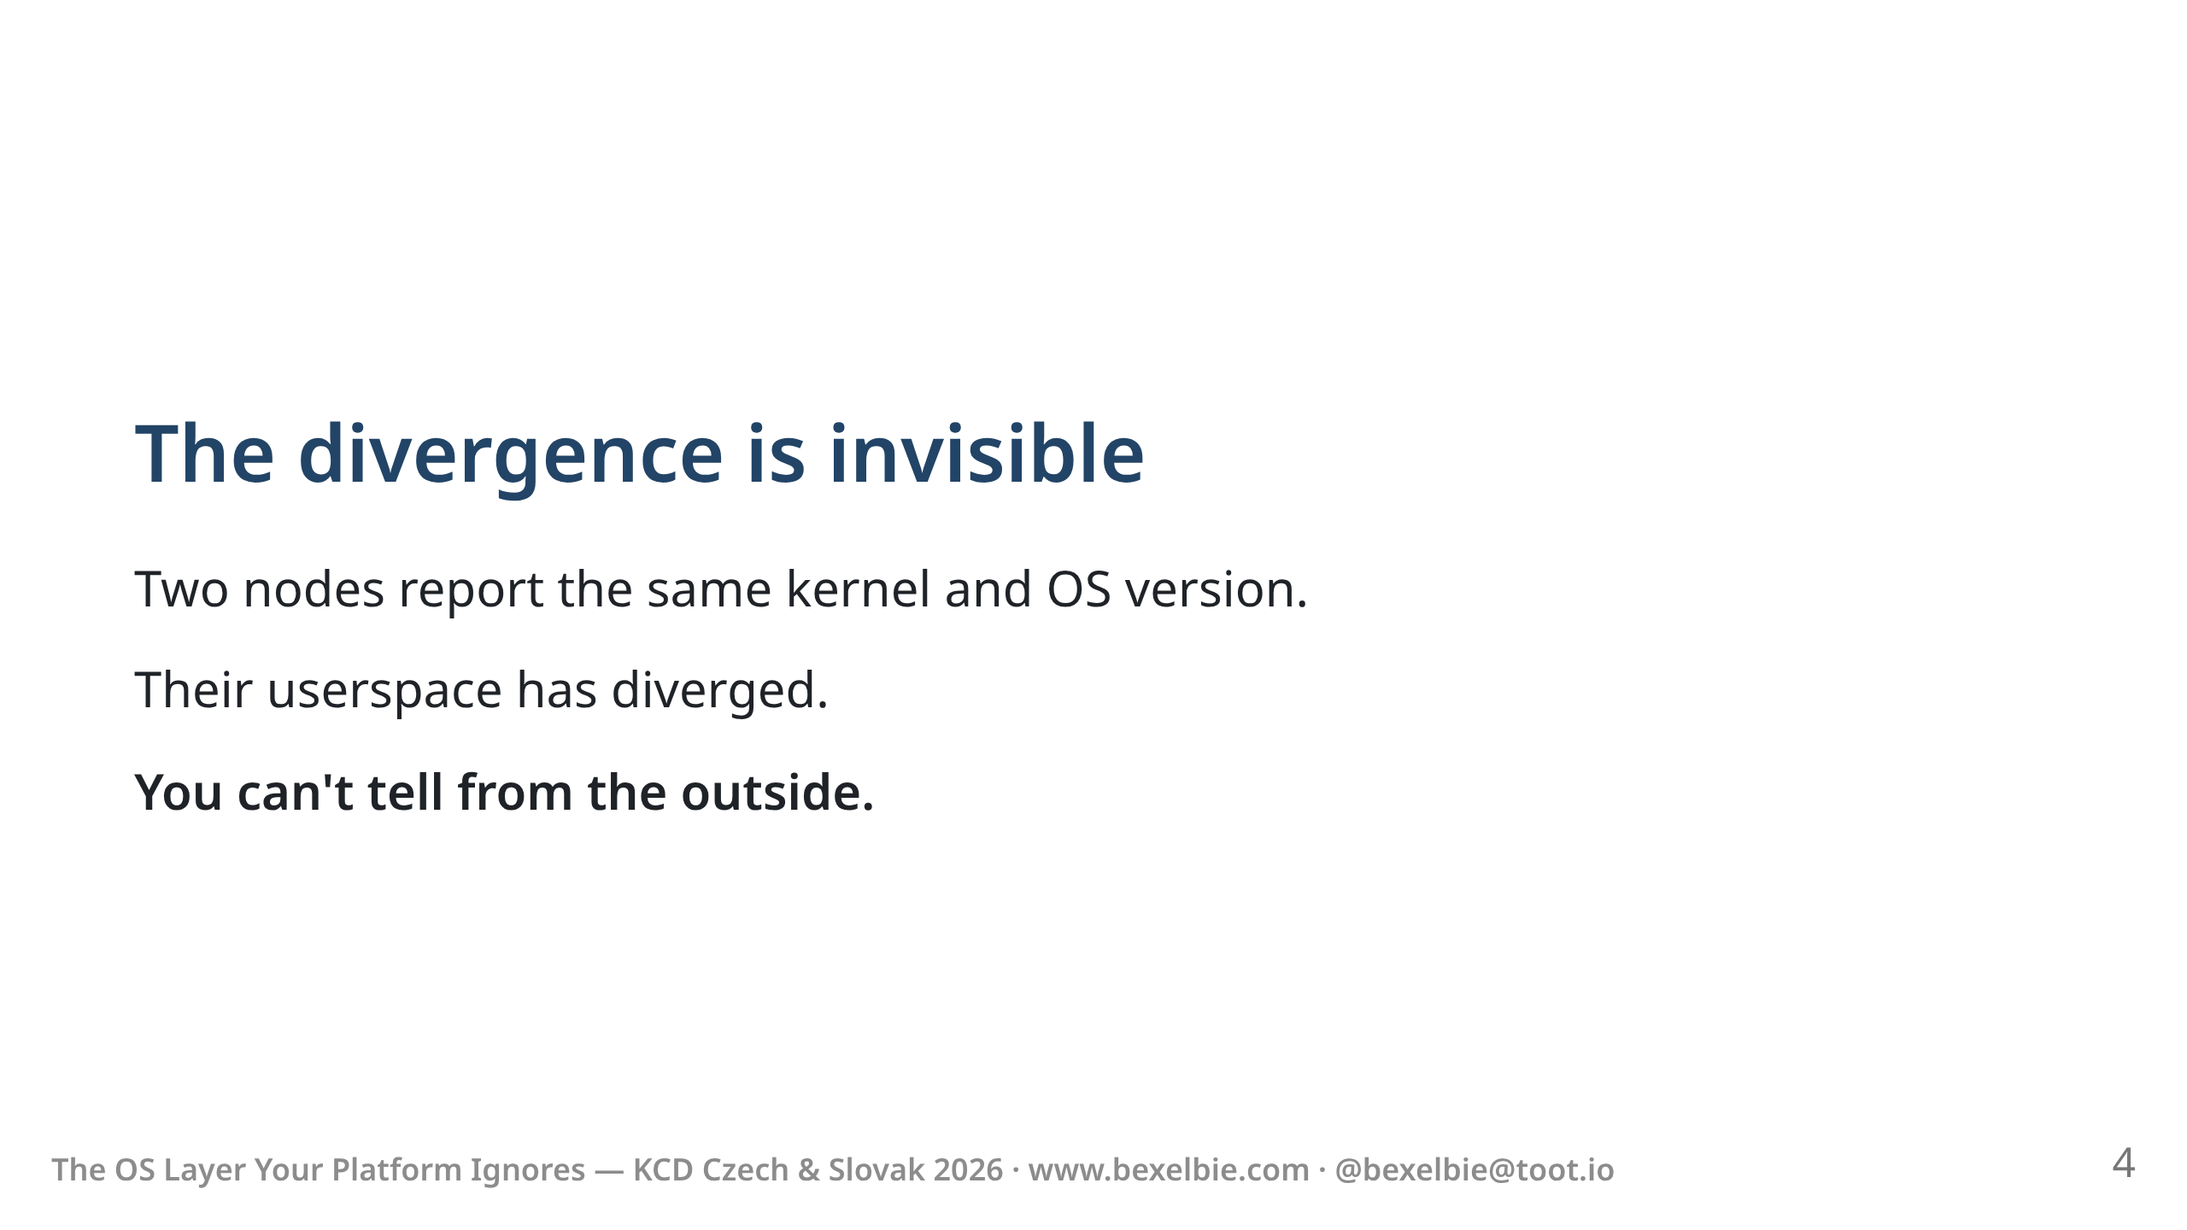
Notes:
- Divergence is invisible - Same kernel, same OS version string, same kubelet version - Still different - package-level/file-level audit of every node - At 100 nodes? 1000? continuously? - Start from same base .. day 2 is different from Day 1

Slide 5
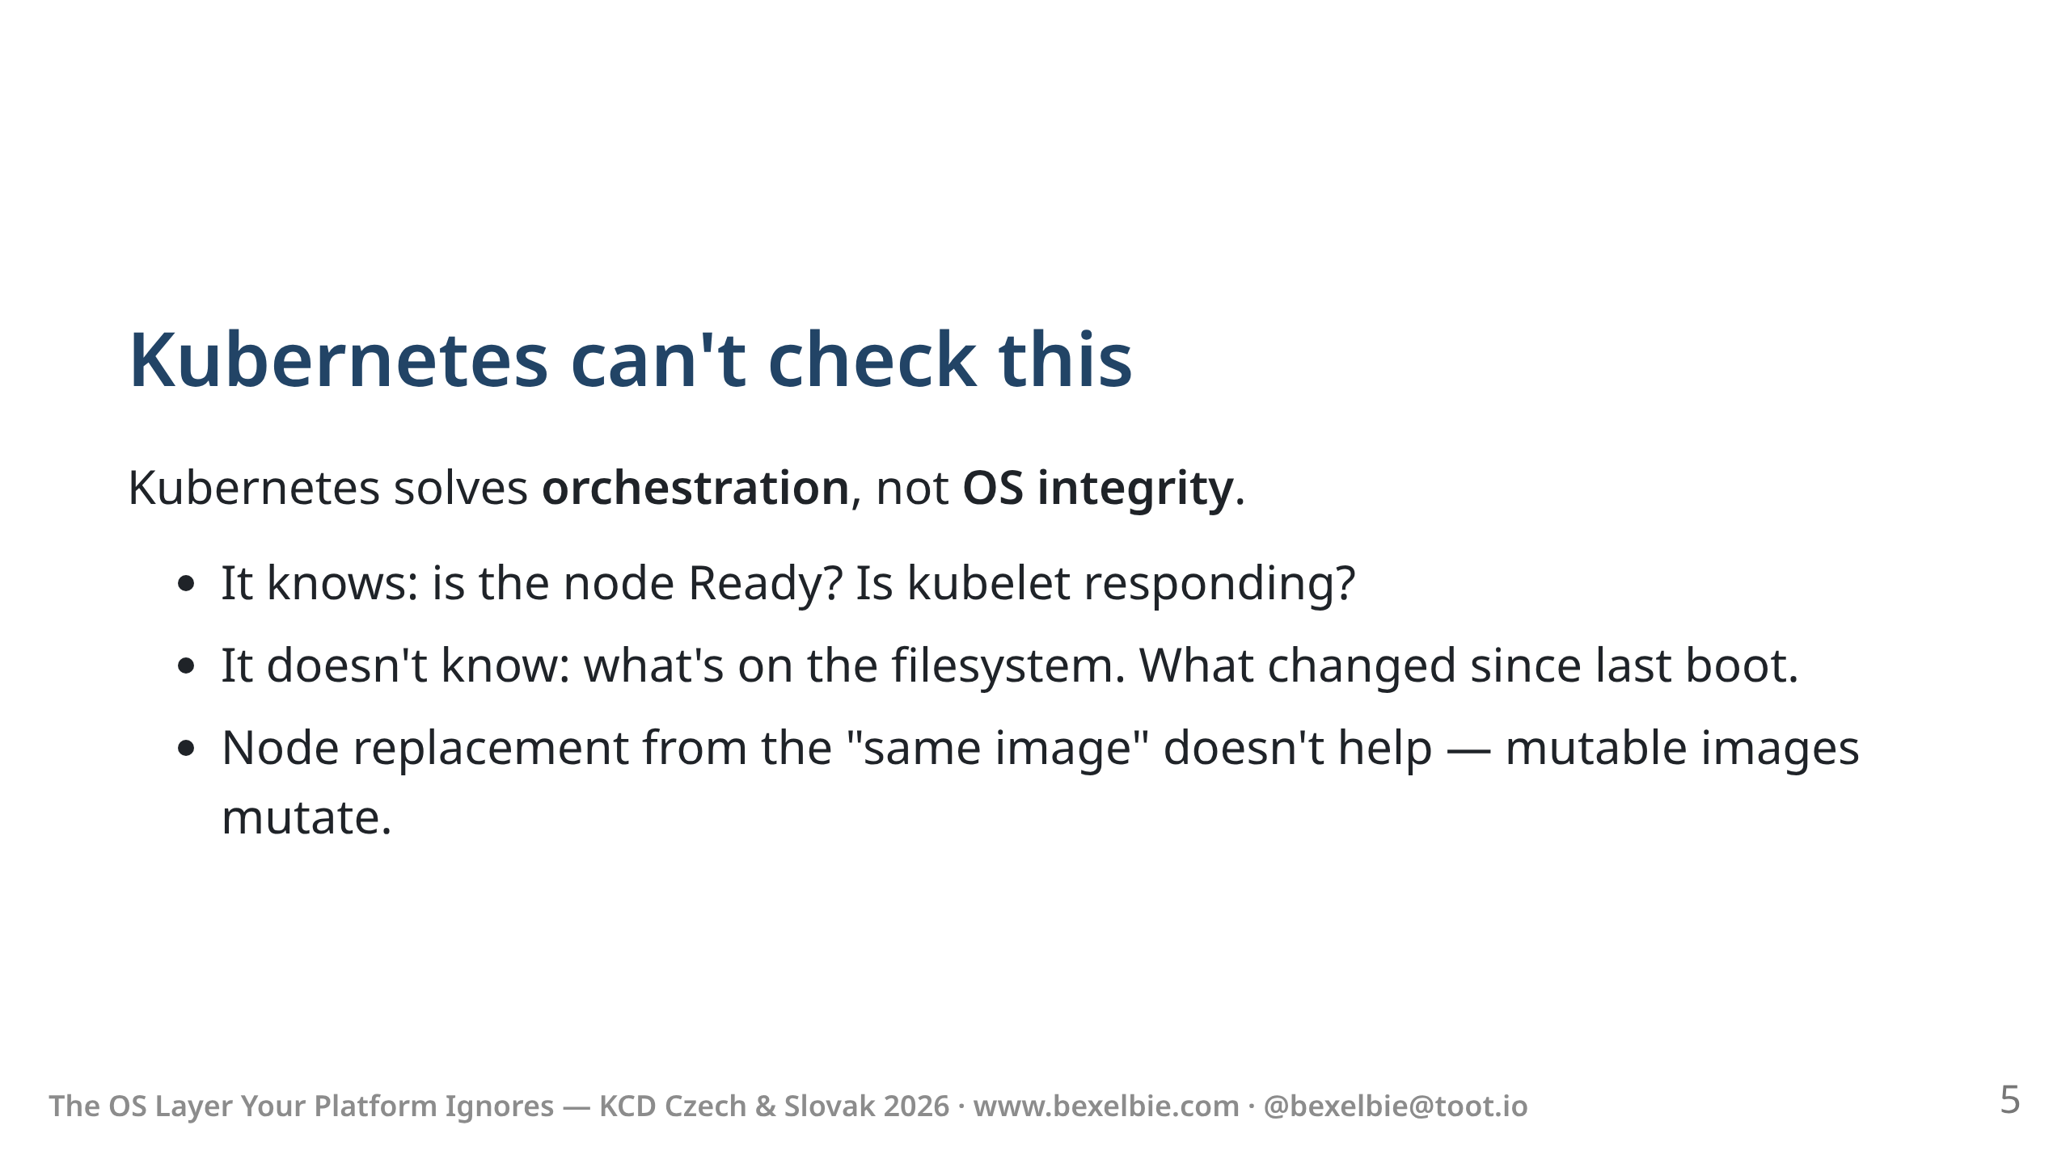
Notes:
- This isn't a Kube problem - Kubernetes is great at managing workloads - Zero visibility into the node OS - kubelet health check tells alive, workload ready - NOT correct/consistent - from where you look, nodes look identical

Slide 6
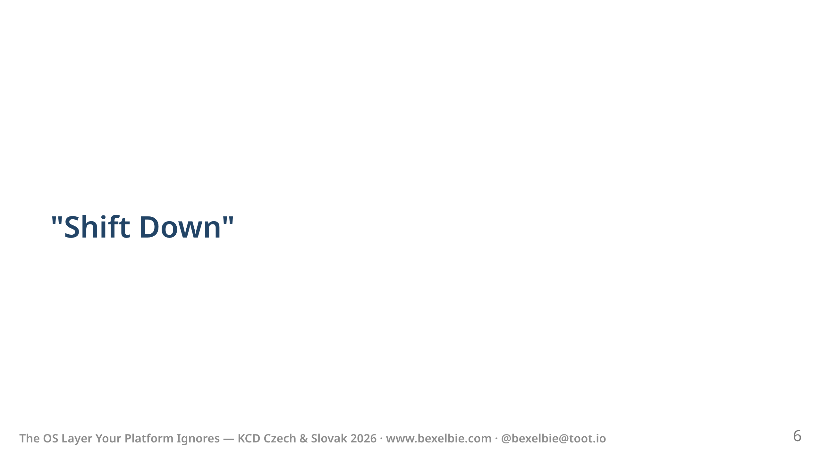
Notes:
- So what do we do about this? - Kubernetes Security community described "Shift Down" - "Shift Left" — move security earlier in the pipeline - "Shift Down" push security guarantees deeper into the platform - The white paper talks about embedding security policies deeper into Kubernetes - I'm taking it one step further: - push it into the node os

Slide 7
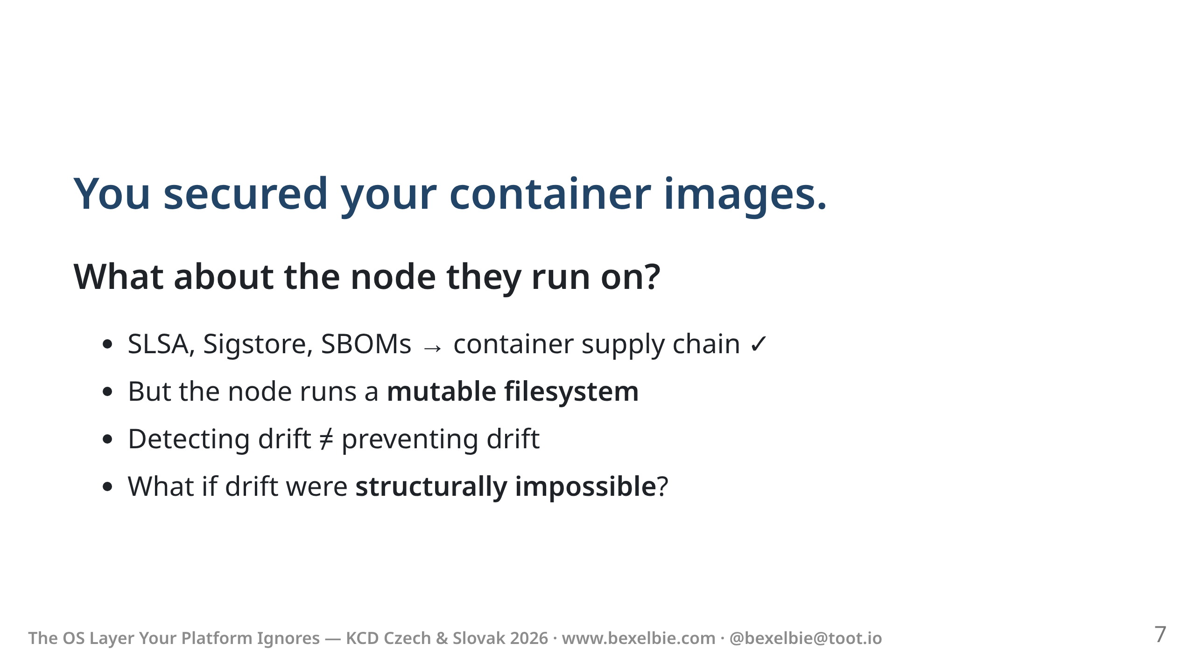
Notes:
- We have history here - CNCF ecosystem has done amazing work on container image supply chain - SLSA levels, Sigstore for signing, SBOMs for transparency - But this is above Kube - in the workload - Most drift defenses detect changes after the fact - detection is not prevention - What if we made it so drift COULDN'T happen? - Push integrity into the platform

Slide 8
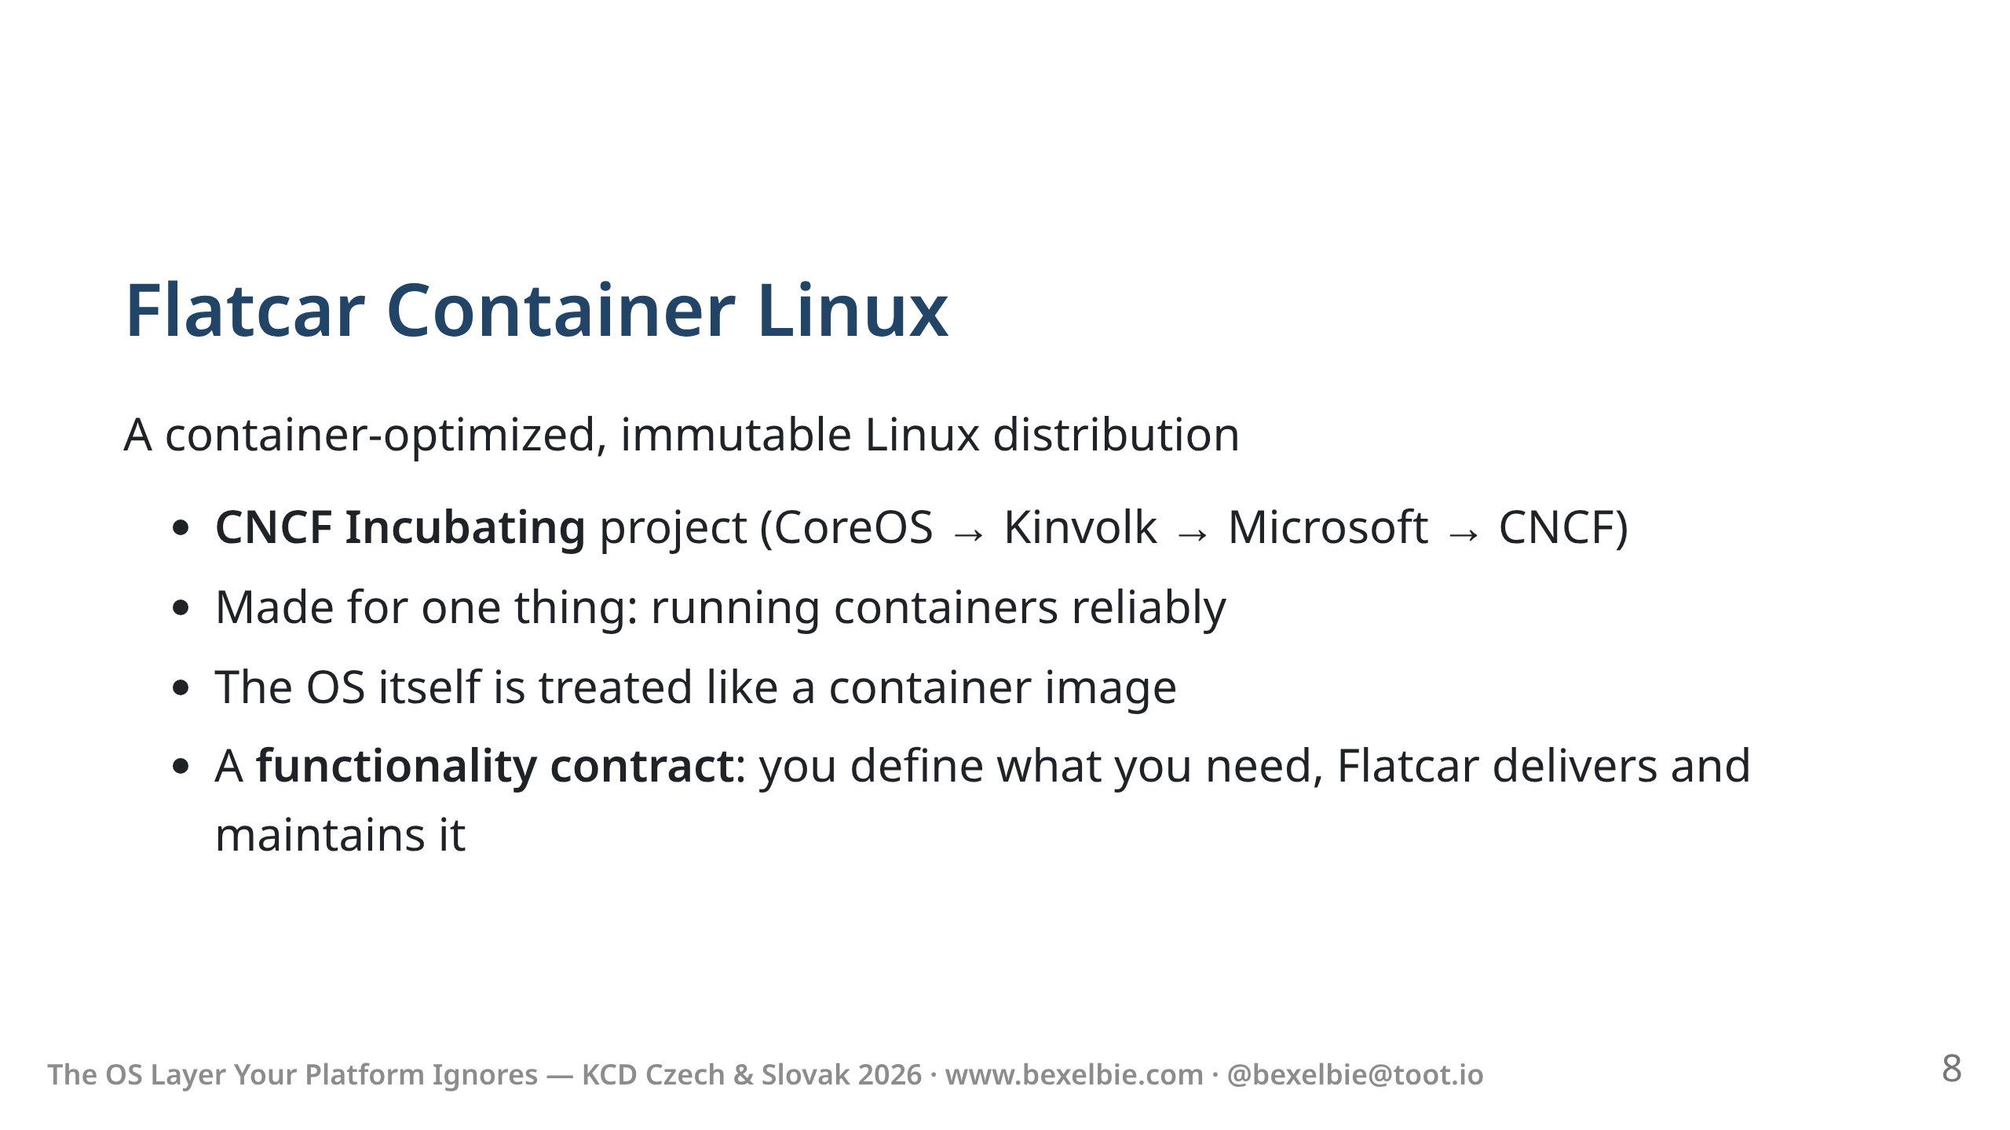
Notes:
- Flatcar is a special-purpose OS. It runs containers. That's it. - It's a CNCF project — vendor-neutral, community-governed. - The brand, the assets, the IP — all CNCF. - Incubating doesn't tell the whole story - Long lineage: CoreOS made concepts from ChromiumOS into Container Linux - Red Hat bought CoreOS and changed the tech - Kinvolk forked and continued it as Flatcar - Microsoft acquired Kinvolk and donated Flatcar to CNCF.

Slide 9
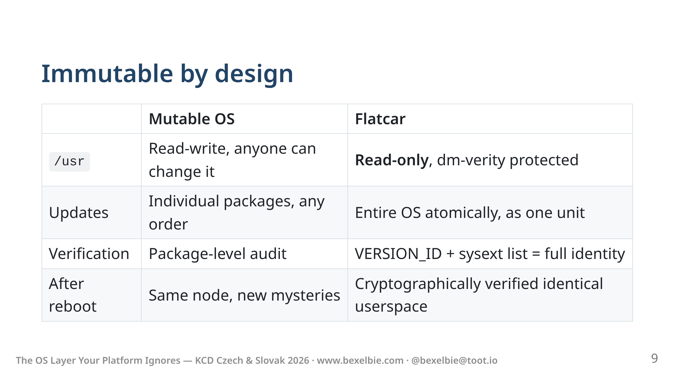
Notes:
- /usr is read-only and dm-verity protected - dm-verity means cryptographic hash verification at the block level - Every block is verified against a hash at read - If anything has been tampered with — it won't run - Not "alert" — won't execute. - Not even a cosmic bit-flip gets through. - There is no package manager. You cannot install something on /usr - Updates are atomic, deterministic - more to come on updates and adding software - Two checks give you full userspace identity: - VERSION_ID and a similar string for added software Together, these tell you the complete userspace state - /etc is still writable — more to come - This is the "Shift Down" made concrete and pushed deeper - Userspace drift isn't detected — it's impossible

Slide 10
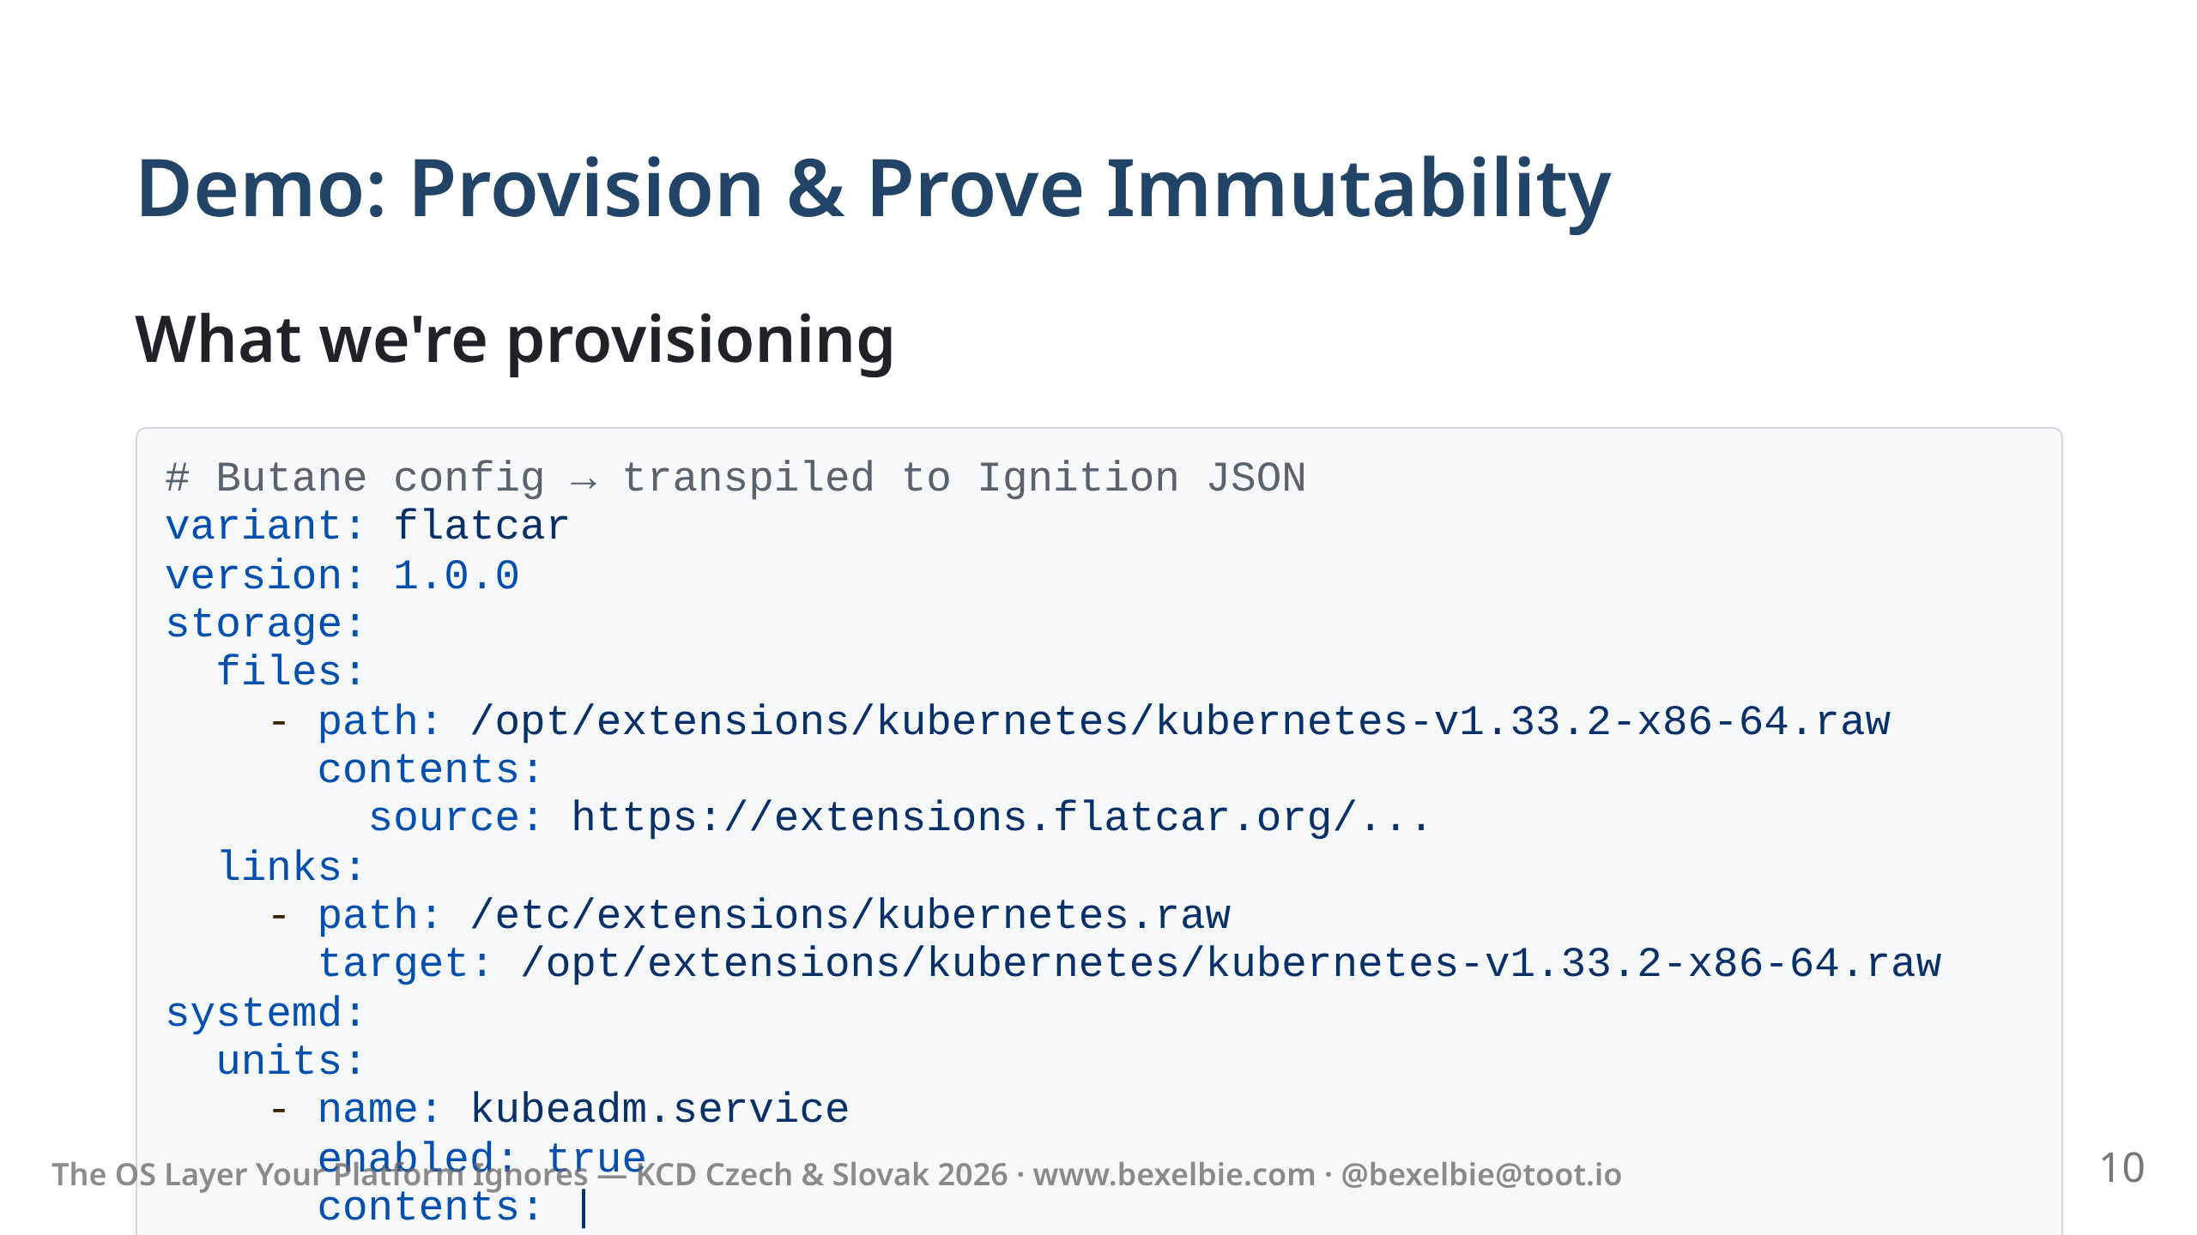
Notes:
- Flatcar is an OS you deploy, not configure - This Butane yaml defines the contract between workload and OS - transpile to json and deploy on your platform of choice - we provide a system that meets this contract - This is a simplified view of the Butane config I am using. - SSH key, kubernetes sysext, kubeadm join command. - One declarative file. Same file = same machine. Every time.

Slide 11
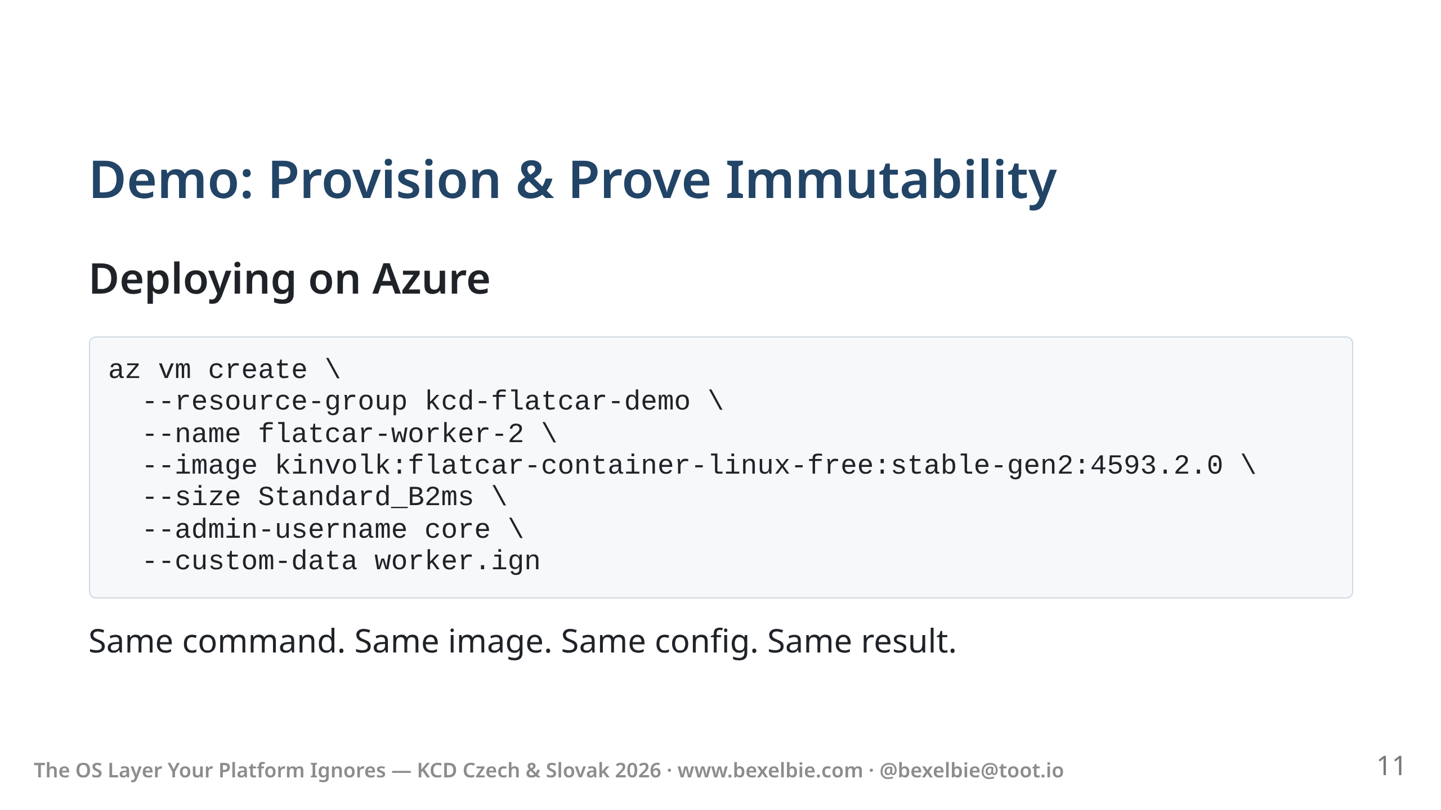
Notes:
- This is the Azure CLI command. - One command, one config file. - --custom-data passes our Ignition JSON. Flatcar reads it on first boot. - I'll add a worker to an existing cluster - bring up workload on it - prove it is identical to an existing worker - flip to headlamp

Slide 12
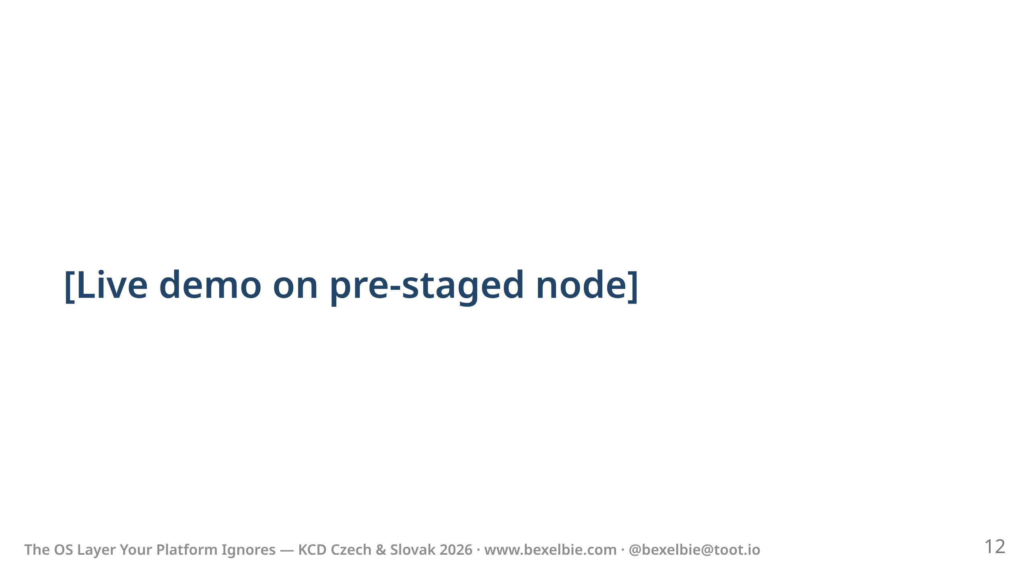

Slide 13
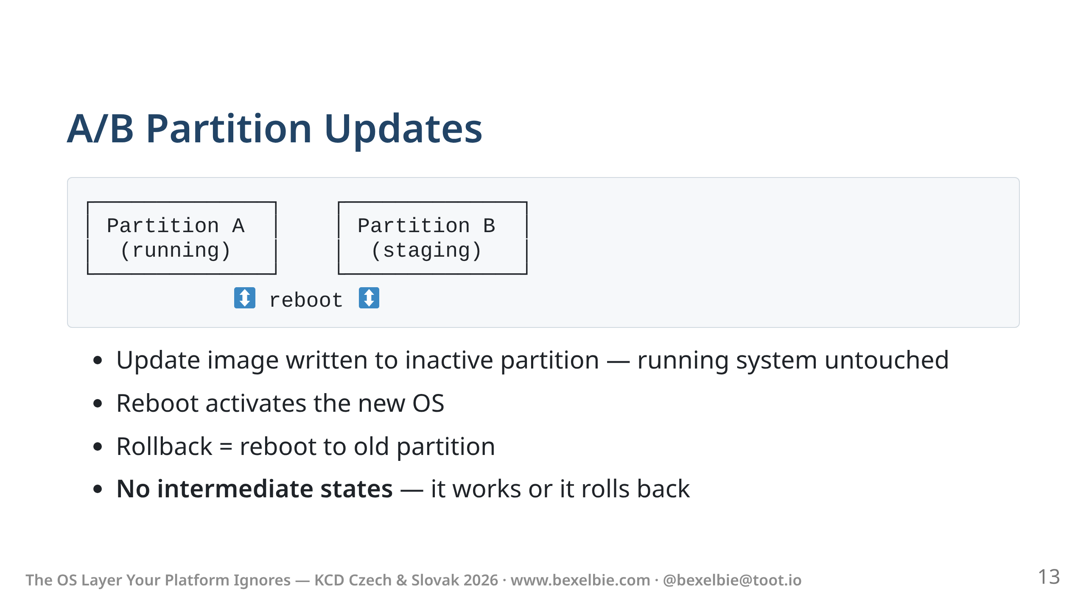
Notes:
- Flatcar doesn't do in-place package updates - The entire OS is downloaded, verified image and written - While this happens, the running system is completely untouched - any problems, no change in run time system - Reboot swaps to the new partition. Health check runs. - If it fails, next reboot goes back to the old partition - In Kubernetes context: drain the node, update, reboot, rejoin, uncordon. - FLUO (Flatcar Linux Update Operator) or Kured or whatever comes next automate this across a fleet. - Respects your policies and rules

Slide 14
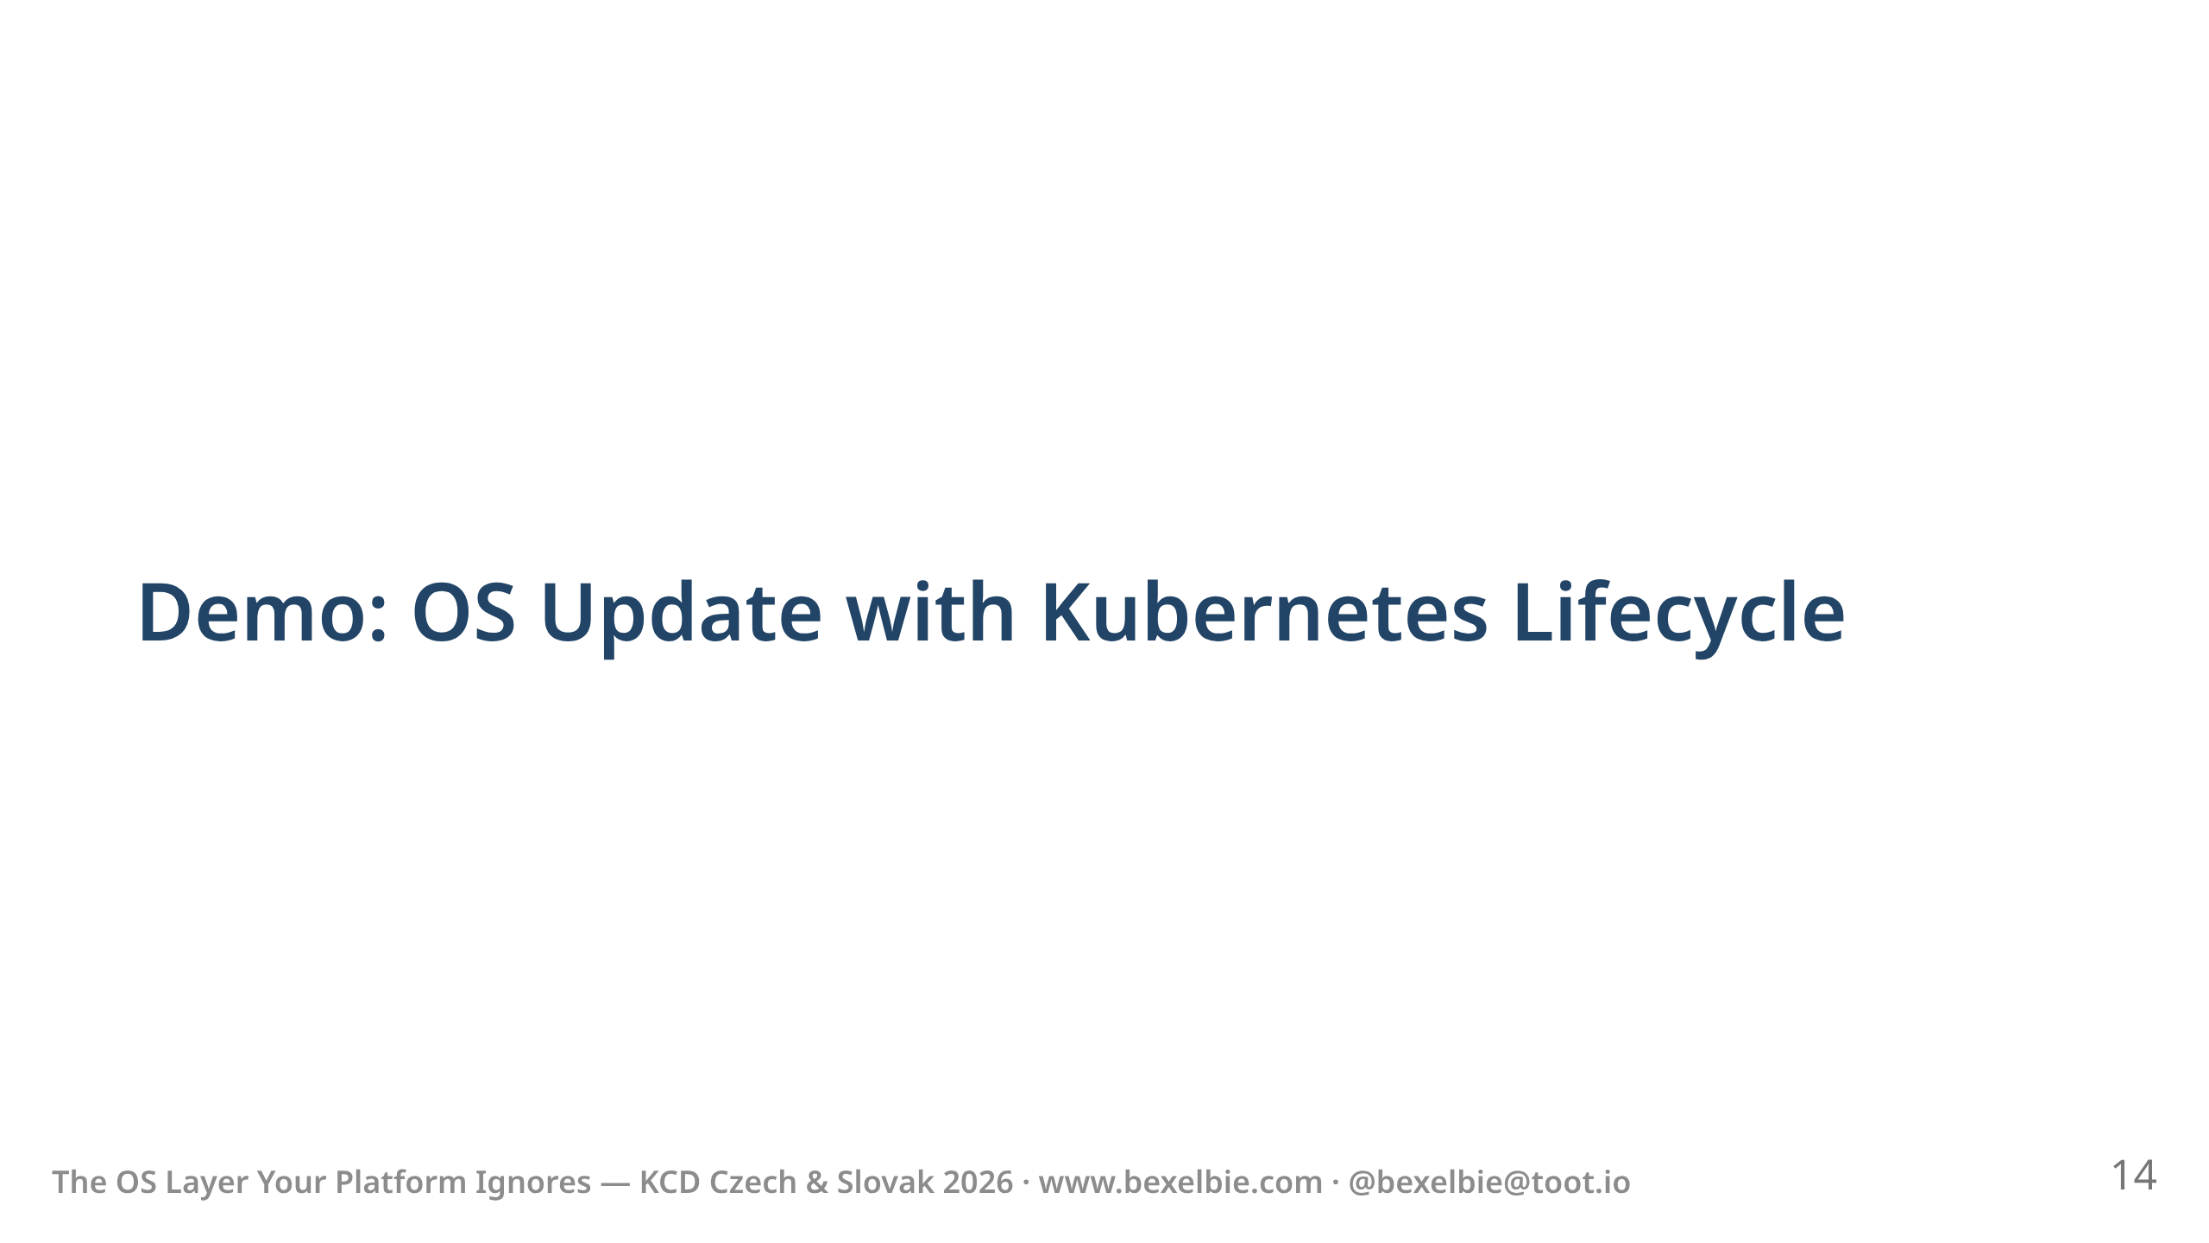

Slide 15
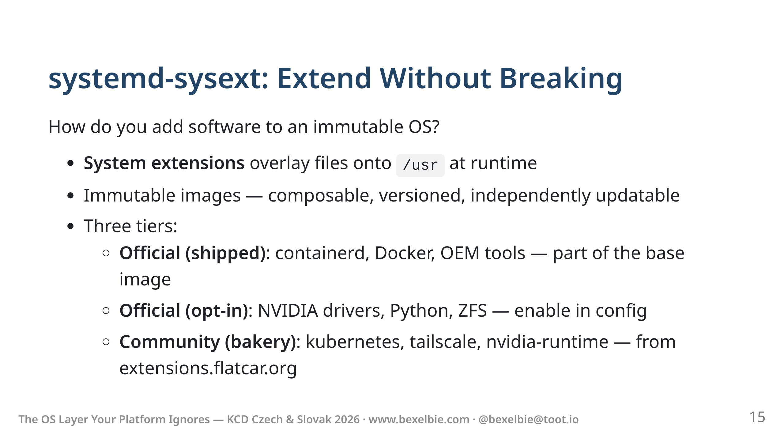
Notes:
- If /usr is read-only, how do you add anything? - systemd-sysext provides an overlay mechanism. Think of it like a container layer — but for the OS. - Each sysext is a self-contained, immutable image (usually squashfs). It overlays its contents onto /usr at boot. - Three tiers of sysexts: - opt out - shipped in image - opt in - shipped from our repos - community - bakery - tailscale, kube - On THIS cluster, kubelet came from a community sysext. - sysext images have the same supply chain guarantees - Versioned, verifiable, immutable. - Nothing is "installed." Everything is composed.

Slide 16
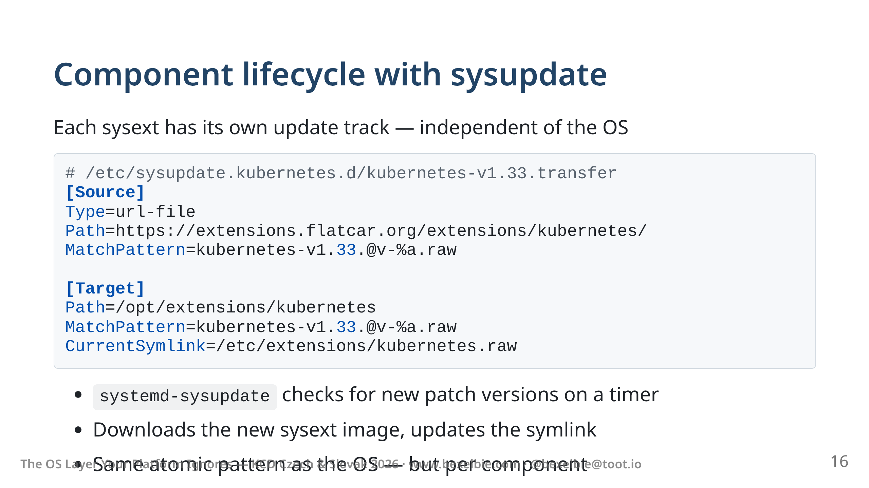
Notes:
- This is the config - look for kubernetes v1.33 patch releases at this URL - Match on z streams in this case - downloads the new sysext image next to old one - flips the symlink like flipping partitions - Unlike with the os, no reboot required

Slide 17
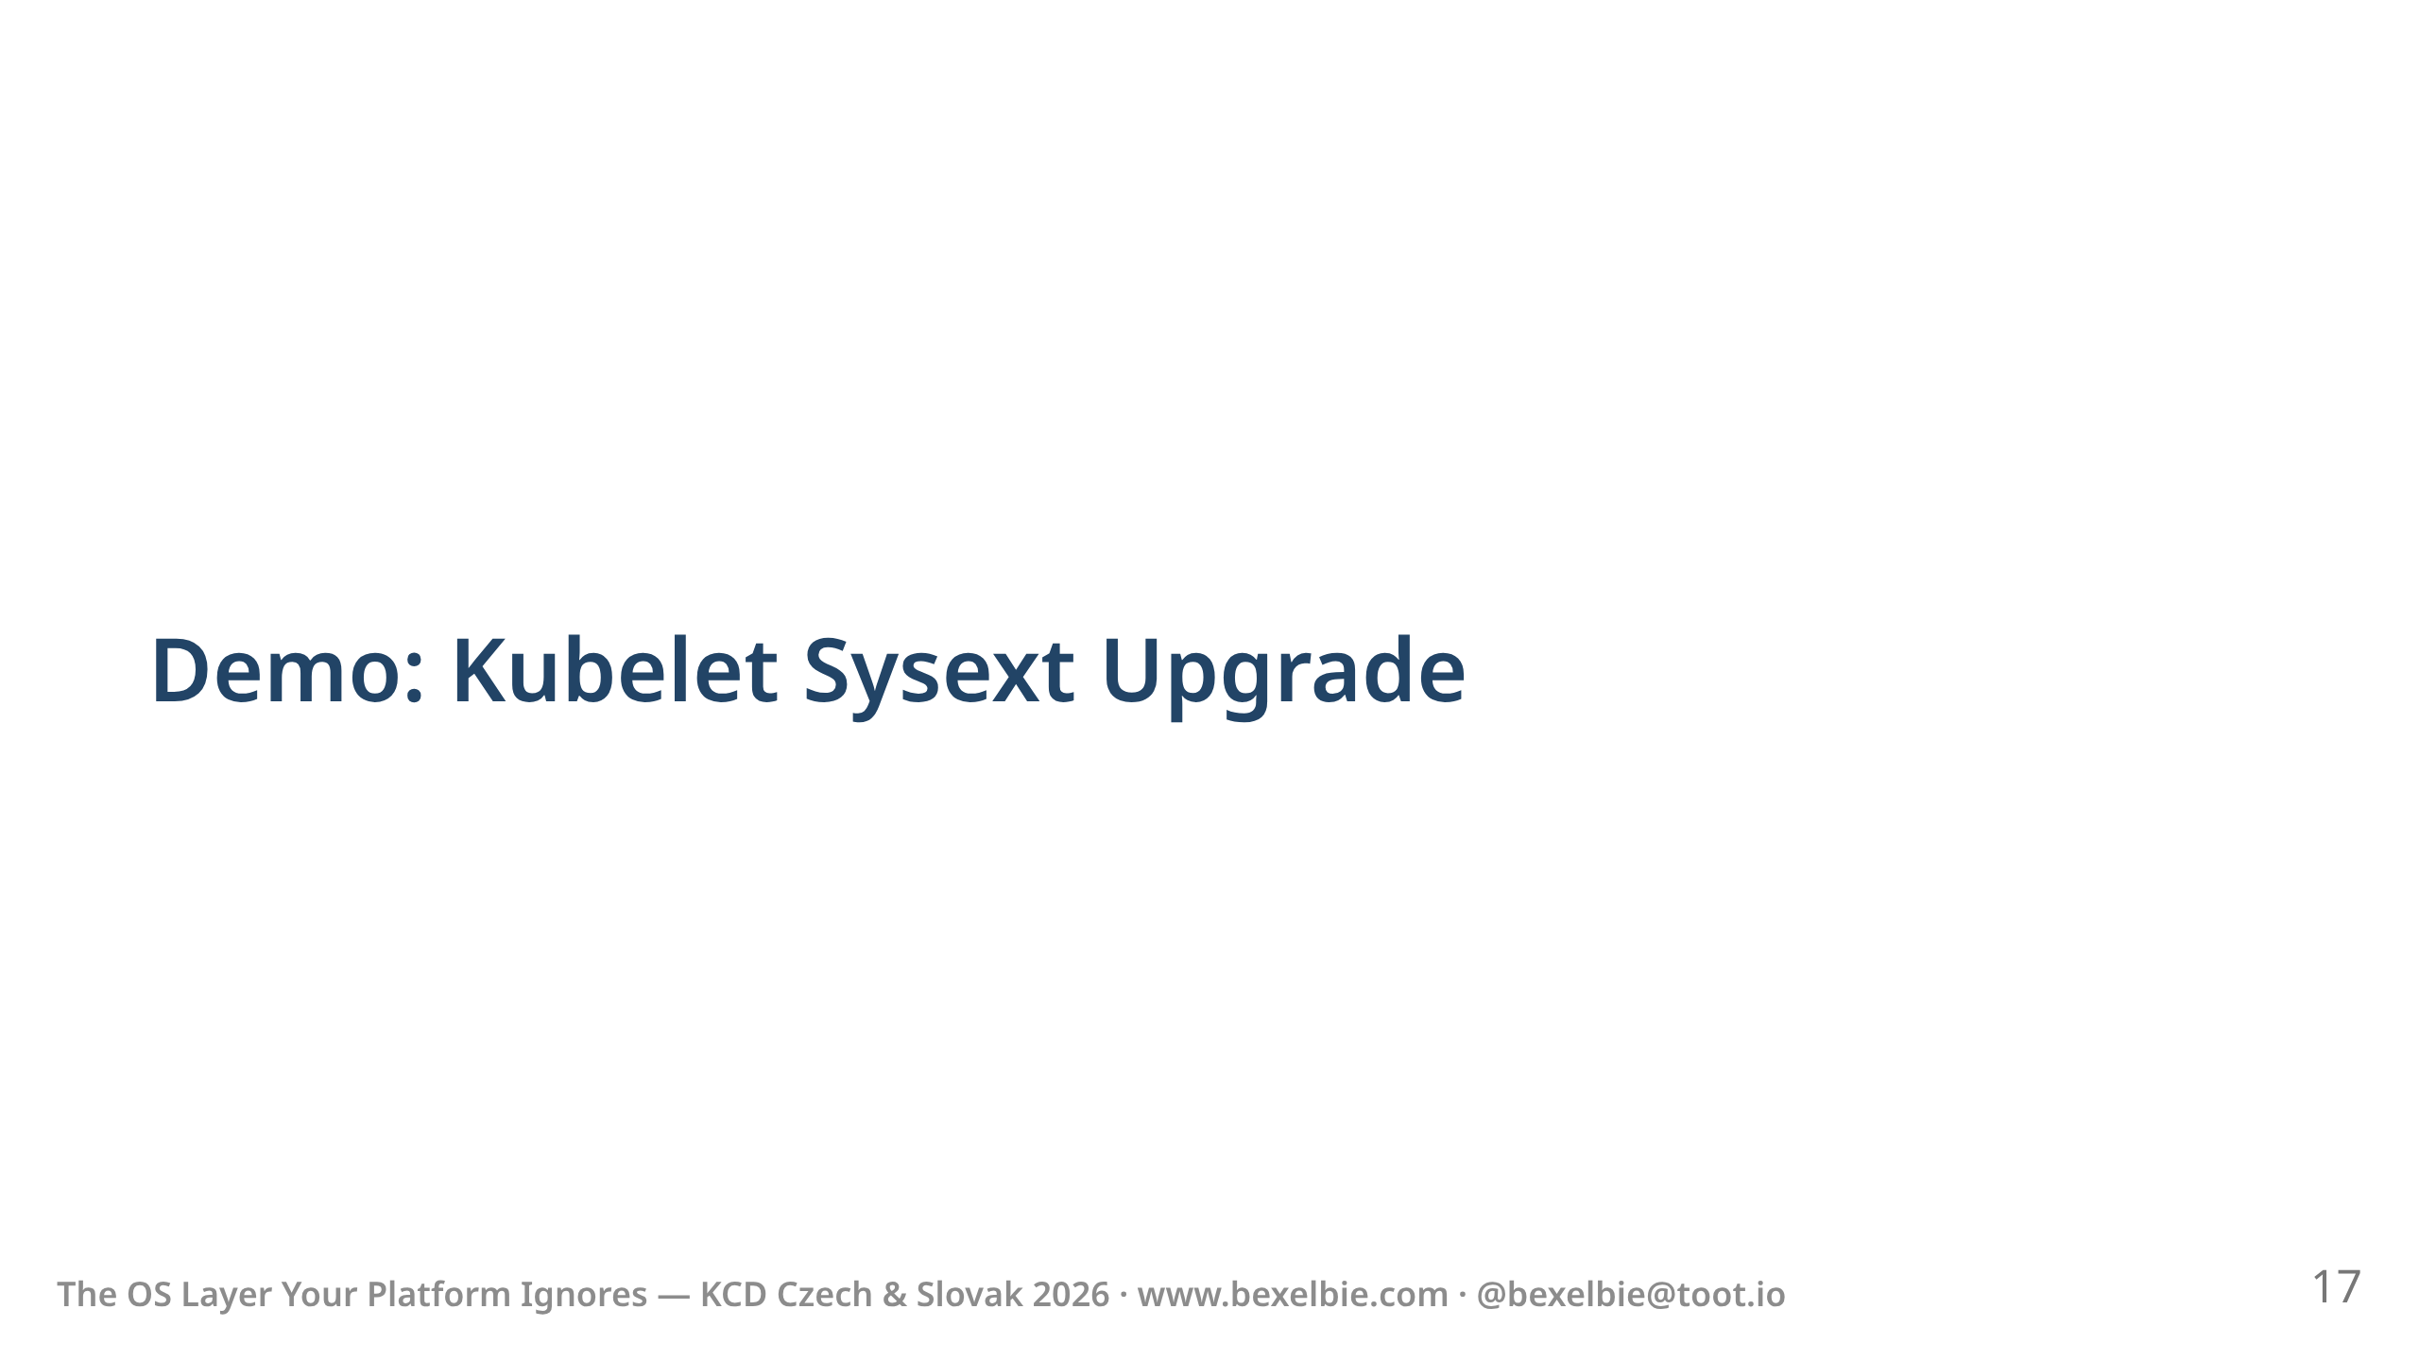

Slide 18
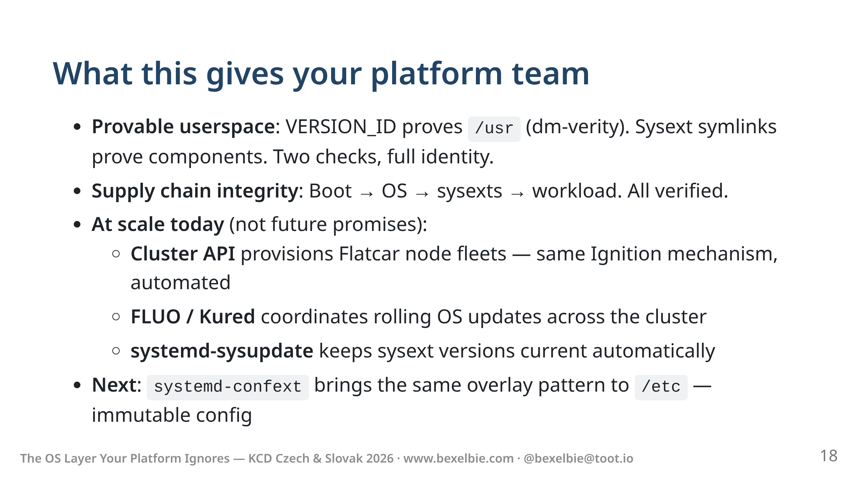
Notes:
- This isn't a research project - These tools are current, maintained, and in production. - Cluster API standard - What I showed you by hand today — done by Kube tooling - FLUO and Kured watch for update_engine's "reboot needed" signal, - drain the node, reboot it, and uncordon it — automatically. - Follow your node policy - We are working on making /etc/ the same - confext: today /usr is immutable but /etc is still writable. - systemd-confext will bring the same overlay model to /etc — - Your implementation will vary based on your needs

Slide 19
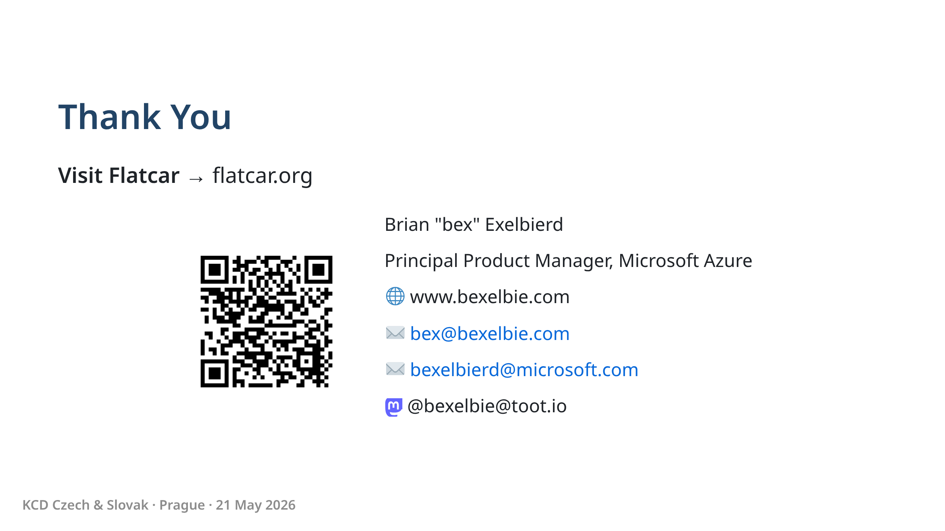
Notes:
- Thank you - Flatcar: flatcar.org — docs, community, everything - Chat: Matrix channel, CNCF Slack (#flatcar) - Office Hours: every 2nd Wednesday, 14:30 UTC — Europe-friendly - Slides online at the QR code and my website - Happy to take questions now or find me in the hallway

Slide 20
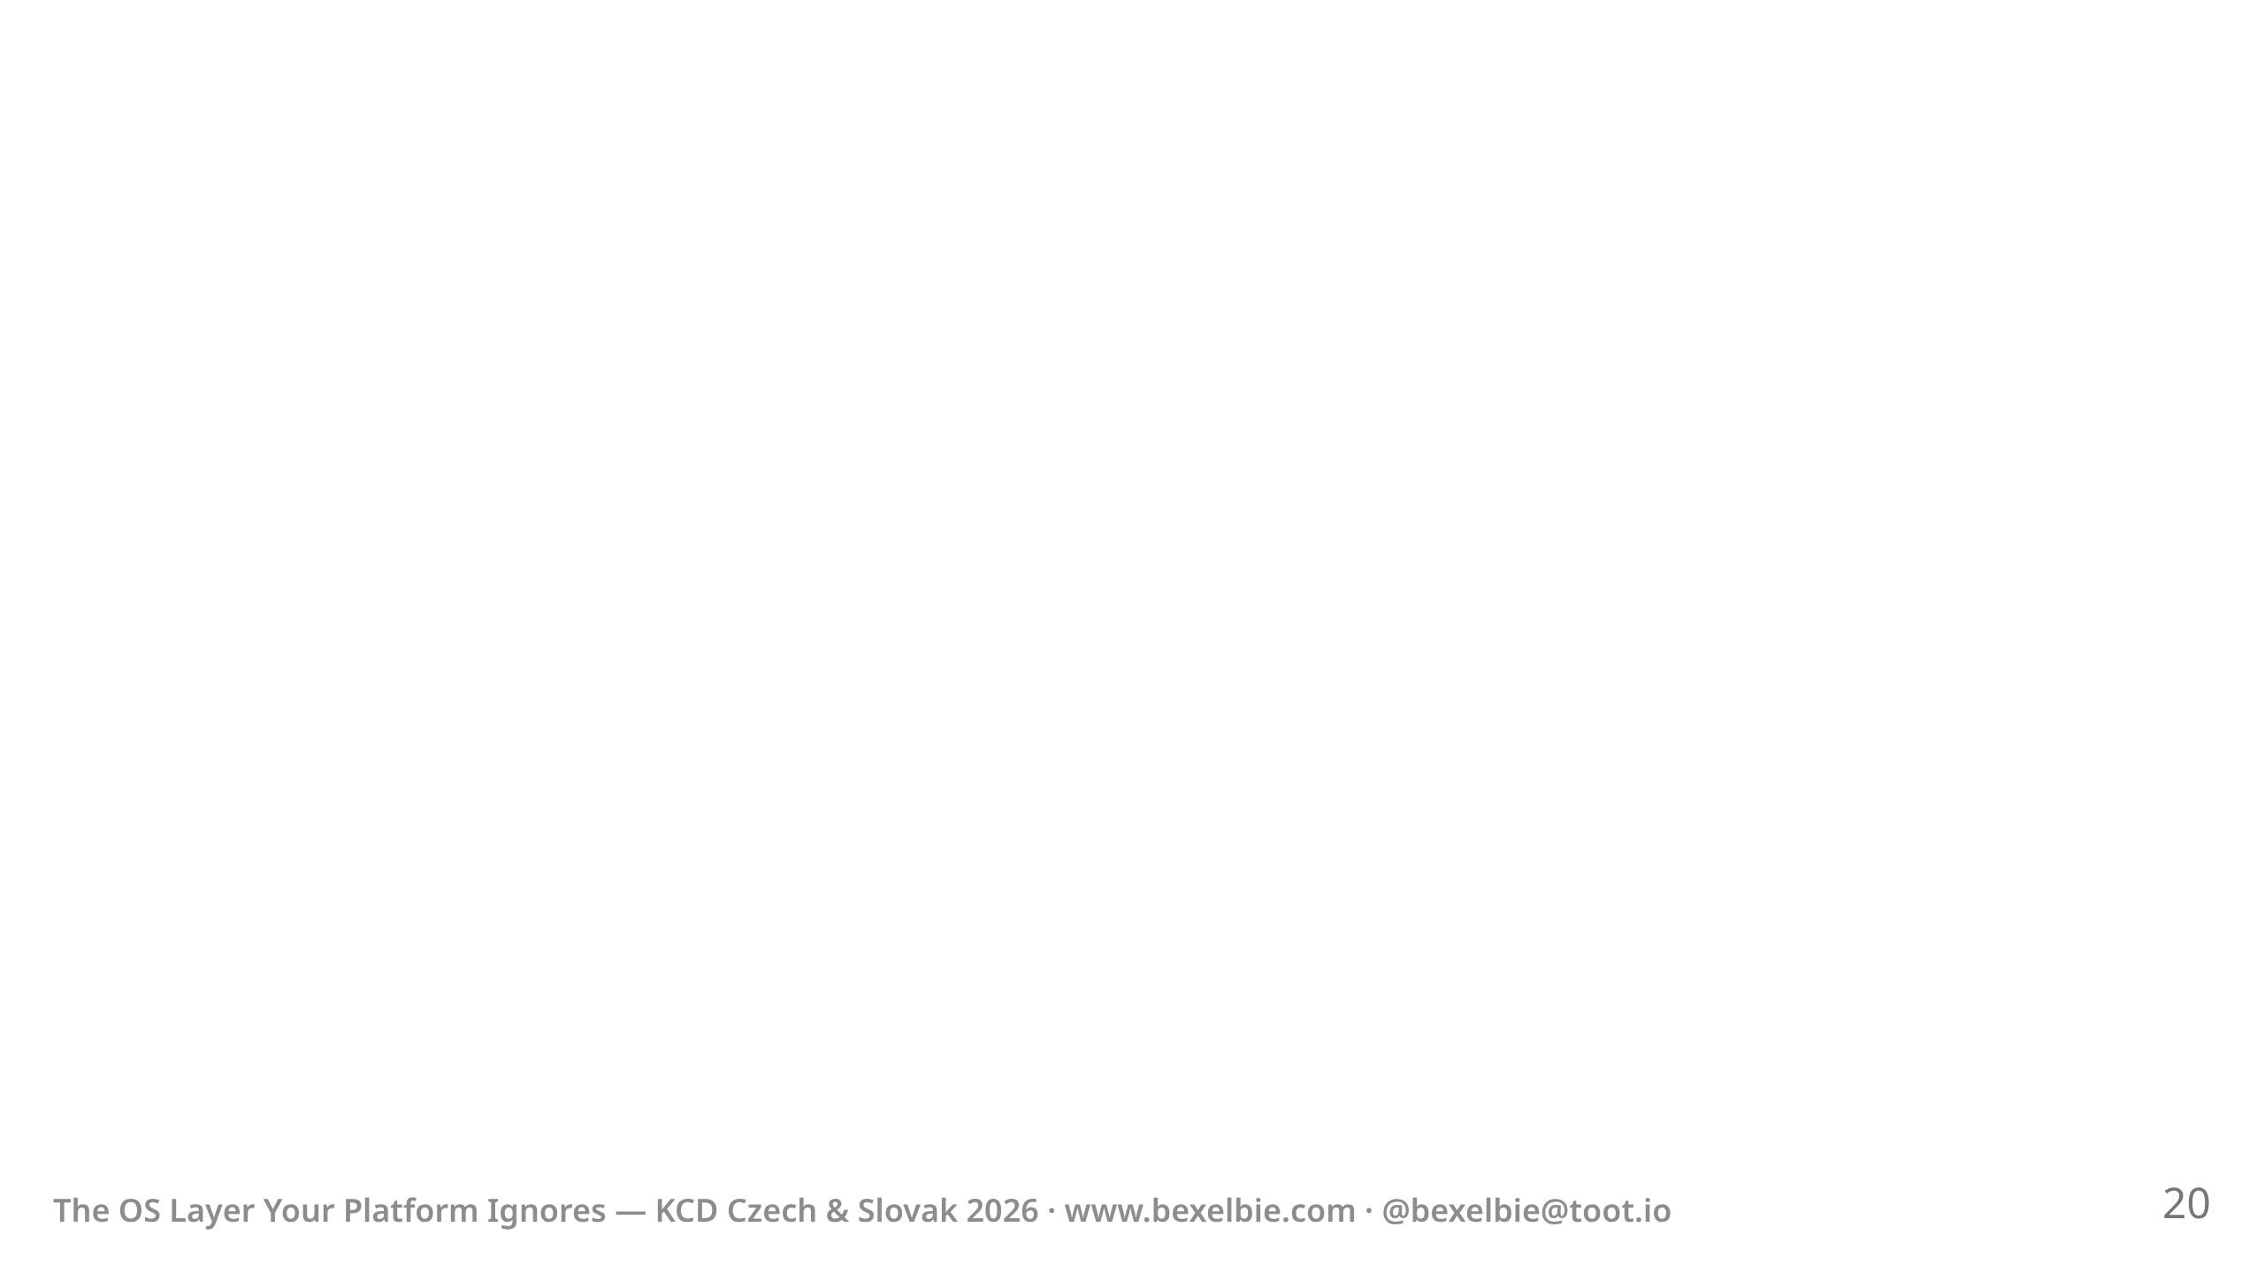
Notes:
Build Notes: Build: marp --pptx --html slides.md -o slides.pptx --allow-local-files QR Code: qrencode -o qr-bexelbie.png -s 10 -m 2 "https://www.bexelbie.com"

