Slide 1
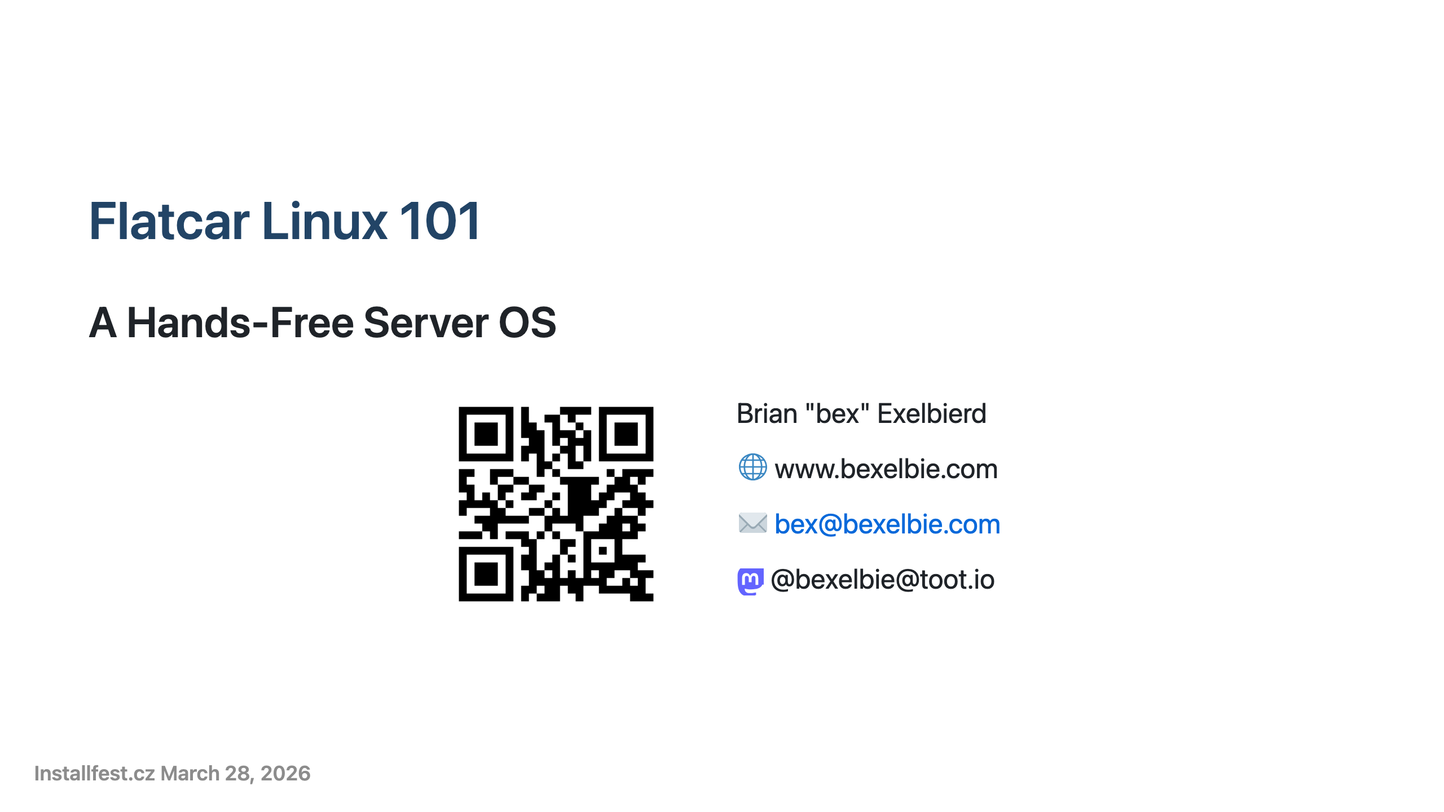
Notes:
- This talk is about Flatcar Linux - I'm Brian Exelbierd - worked with Linux for over 20 years - 10+ years at Red Hat in a variety of roles, now working on upstream and community Linux for Microsoft - I live in Brno - been in the Czech Republic for over 13 years - I don't speak great Czech, which is why this talk is in English - Slides are online at the QR Code and on my website - Disclaimer: My employer, Microsoft has funded my travel to installfest.cz

Slide 2
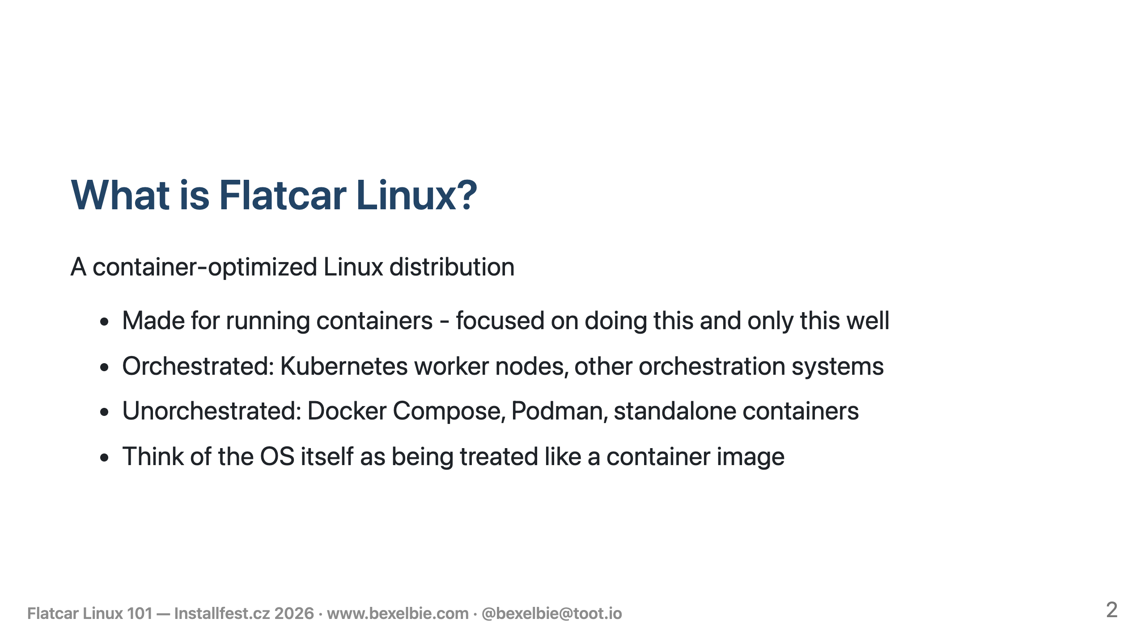
Notes:
- Flatcar is special purpose operating system - Exclusively for running containers - Supports both orchestrated and unorchestrated containers

Slide 3
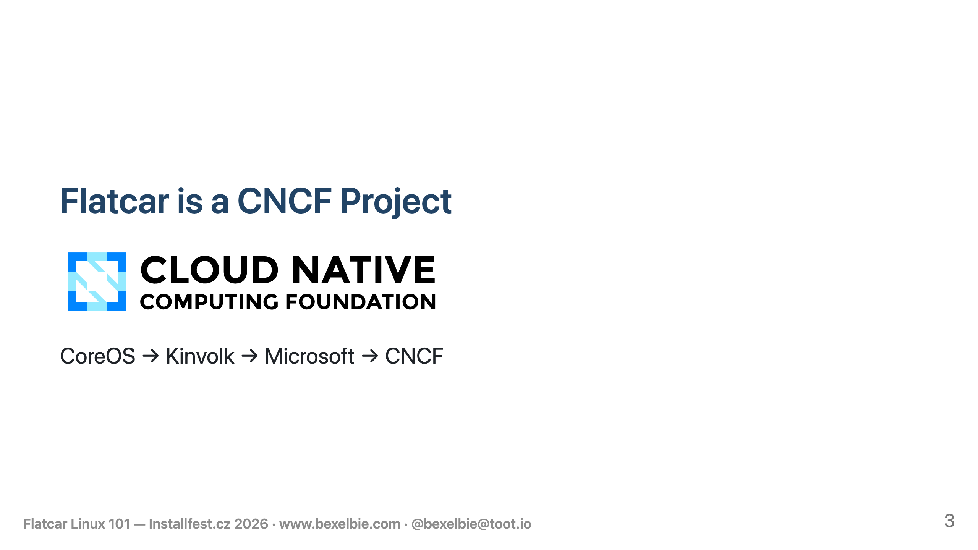
Notes:
- Flatcar is a community driven, CNCF Stewarded project - in the Cloud Native Computing Foundation - This makes it an open vendor-neutral project - the brand and all assets are CNCF IP - Flatcar has a long history: CoreOS withContainer Linux - Red Hat buys it merges with Atomic - Kinvolk takes over the original line - Microsoft buys Kinvolk - Microsoft donates Flatcar to the CNCF

Slide 4
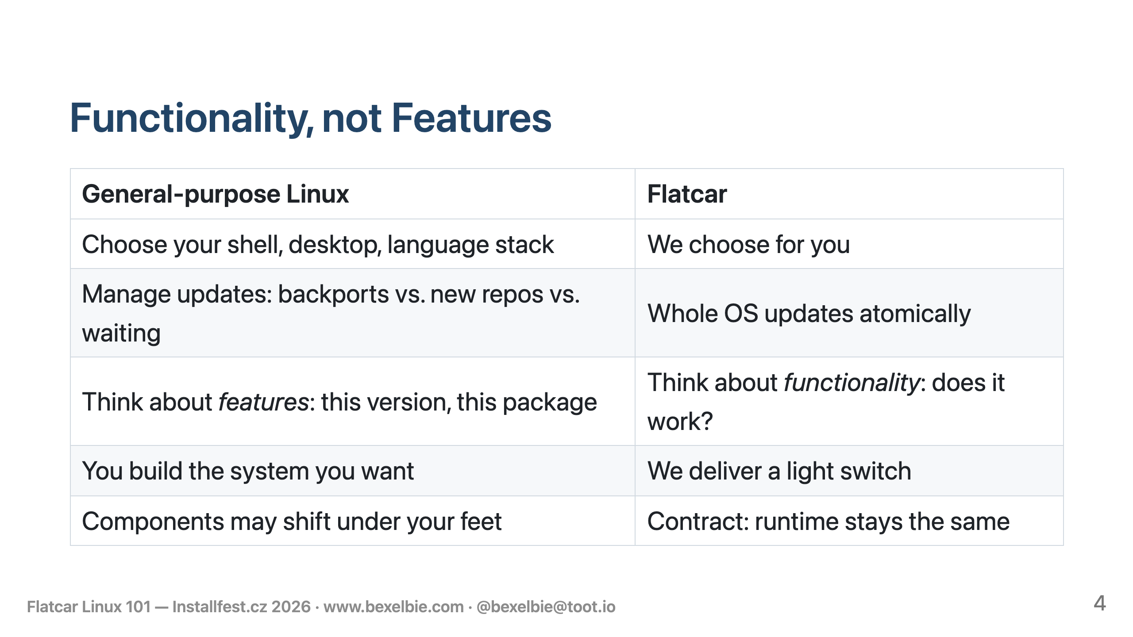
Notes:
- Defined by functionality not features - General-purpose Linux gives you a platform for choosing features - pick shell, desktop, etc. - Day 2 the choices continue - Upgrade for a new set of feature choices? - Add a third-party repo? - Backport on to my existing system? - Flatcar avoids all this choice by promising functionality - The OS is one unit released and updated as a single unit - no feature decision making - Functionality is a contract that will be maintained - Flatcar is a light switch - when you flip it, the light comes on - The type of switch is irrelevant - the functionality matters - Contract between your workload and the container run time/Machine things like GPU - Not a contract about the version of software shipped in the host - Below the line we maintain and do what's best

Slide 5
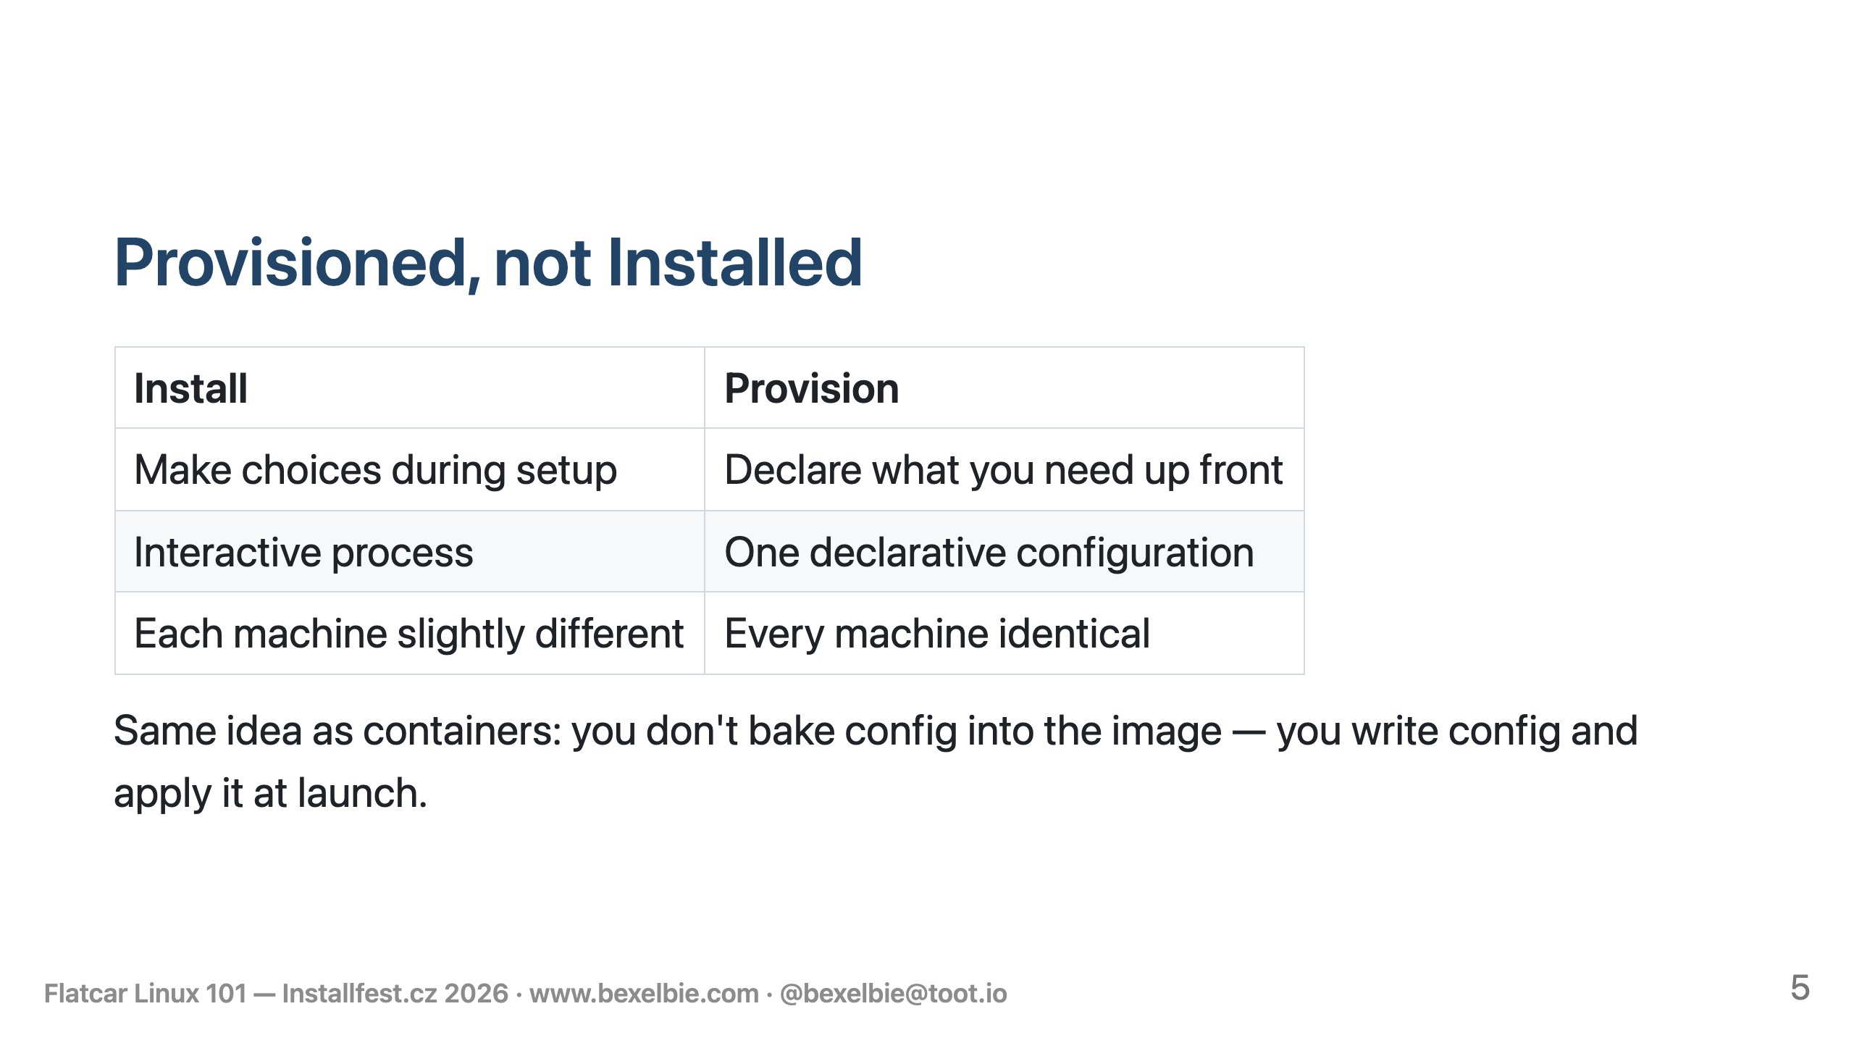
Notes:
- Flatcar is not installed - it is provisioned - Cloud users provision, most metal and virt users install - both work everywhere - Installation - Make choices as you assemble the machine - Often do two rounds a kickstart like install followed by an Ansible like post-install - possibly a third round where you log in and much around - Provisioning - Define the machine specification in a declarative configutation - A provisioner marries your config and an OS and gives you a machine - fully assembled and ready to go - Just like how we run containers - Config has Sensible defaults, no boilerplate - Booting with no config works - Post provisioning mucking around is possible but is an anti-pattern

Slide 6
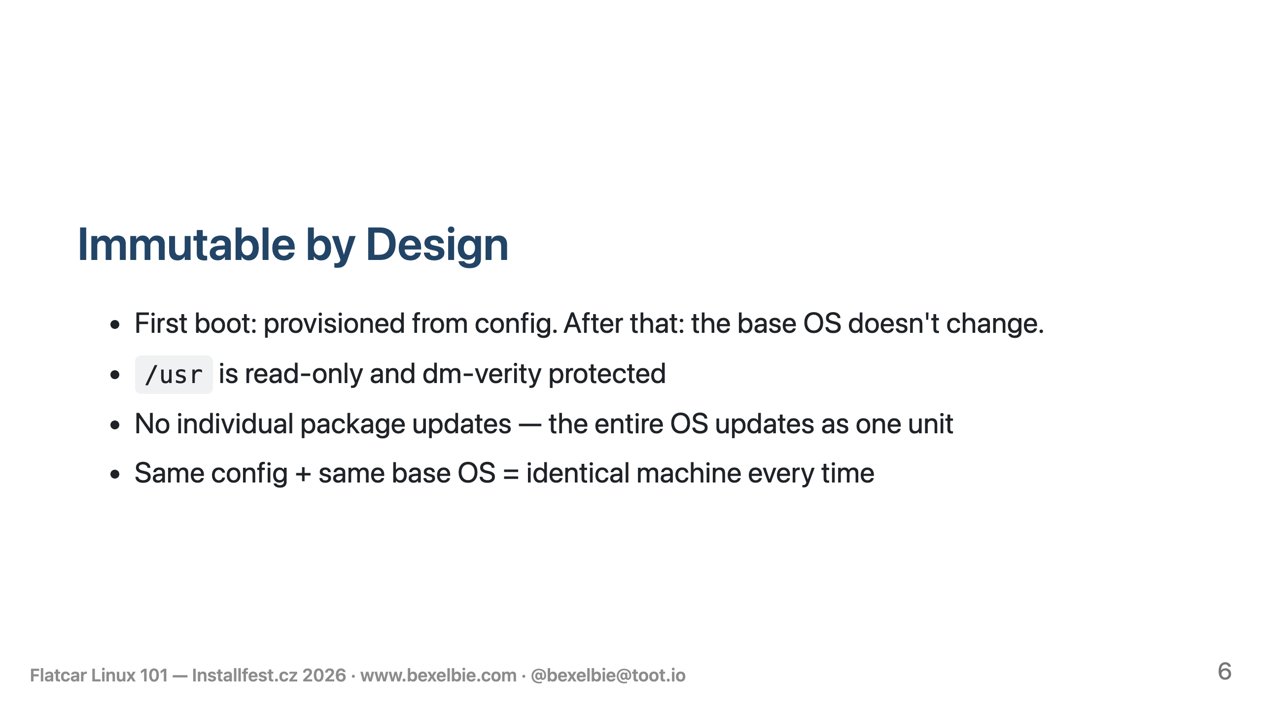
Notes:
- Configuration drift is a non-issue - Configuration happens one time at first boot and never again - Run the same provisioning twice get the same system - /usr is read-only and dm-verity protected - neither you nor attackers can modify it - the OS is provisioned as a whole disk image and updated the same way - No individual parts get updated - This also means no dependency drift - no "this system took update X but not Y" - Two machines running the same version are actually identical. Mutable systems mutate. Think about this: if I install Fedora 43 and you install Fedora 43 but I run dnf daily and you run it weekly - we are not running the same packages. - A node that has been updated is identical to an image deployed fresh at that moment

Slide 7
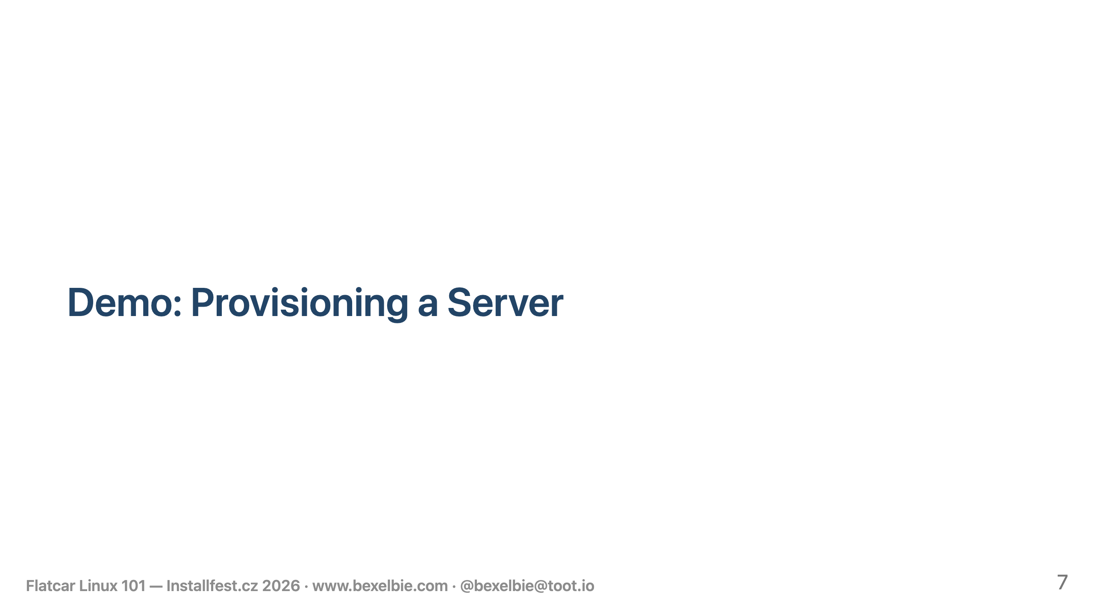
Notes:
- Demo running on a Lenovo T460S from 2016 — all local, no WiFi needed. Some steps pre-staged to avoid download spinners. The VM I am going to show is already running for the same reason. - STEP 1: cat demo1/demo1.bu - SSH key - Static IP via systemd-networkd - Custom web page - loaded from a file - nginx container - loaded from a file - Updates masked - STEP 2: butane --strict --files-dir . demo1.bu - Same content - STEP 3: curl http://192.168.122.103:8000 from the host — show the web page - STEP 4: docker ps - STEP 5: sudo touch /usr/test - sudo mount -o remount,rw /usr - STEP 7: sudo dmsetup table | grep verity - STEP 8: sudo cgpt show /dev/vda | grep -A3 USR — show priority/tries/successful flags

Slide 8
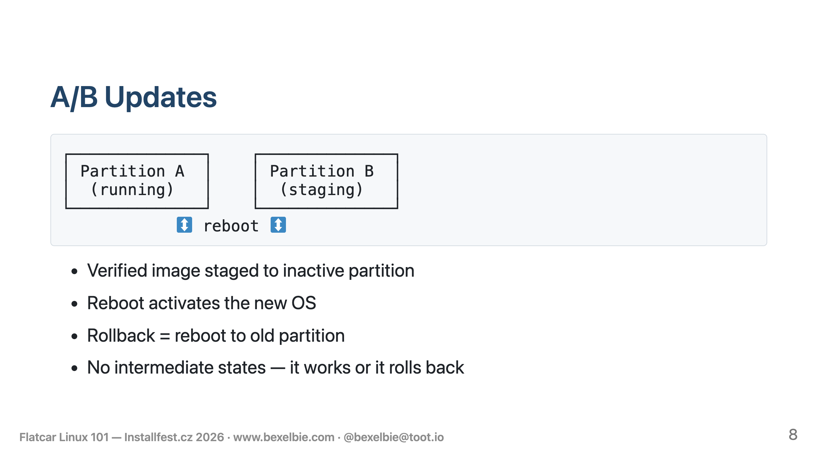
Notes:
- In-place updates via A/B partitions - nodes don't get recycled, they get updated - update agent checks for updates - Update is downloaded, validated, and written to the inactive partition - Updates are atomic - no intermediate states - Reboot to use the update - Reboot daemon manages strategy - After reboot, there is a health check OS and Workload - Health fails -> roll back by rebooting old partition

Slide 9
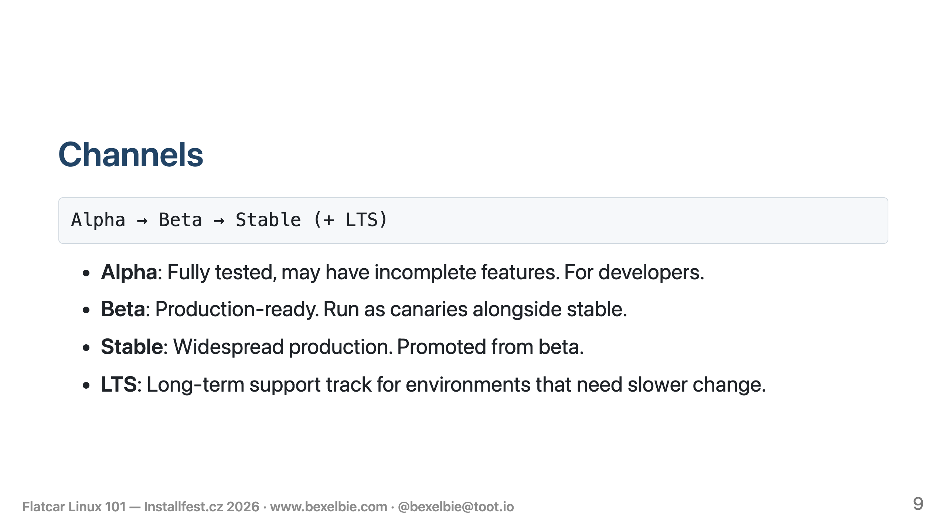
Notes:
- We have multiple update channels - Not going to read this - they are targeted - Important all are fully tested - Not unit tests - over 100+ real e2e tests - From simple 1 Node to full clusters - All are great - we recommend stable - Users are part of our stabilization - Clusters have beta nodes as a canary - their feedback lets us promote - You are always getting an O S that has been fully tested. - This means all the parts are tested against each other, not just tested individually. - Traditional distributions that are mutable tend to test only at ga, and only for a very narrow set of dependencies installed together - We have a well define set of tests and test exhaustively - We test basically every PR and commit (exceptions for docs and small non-code changes)

Slide 10
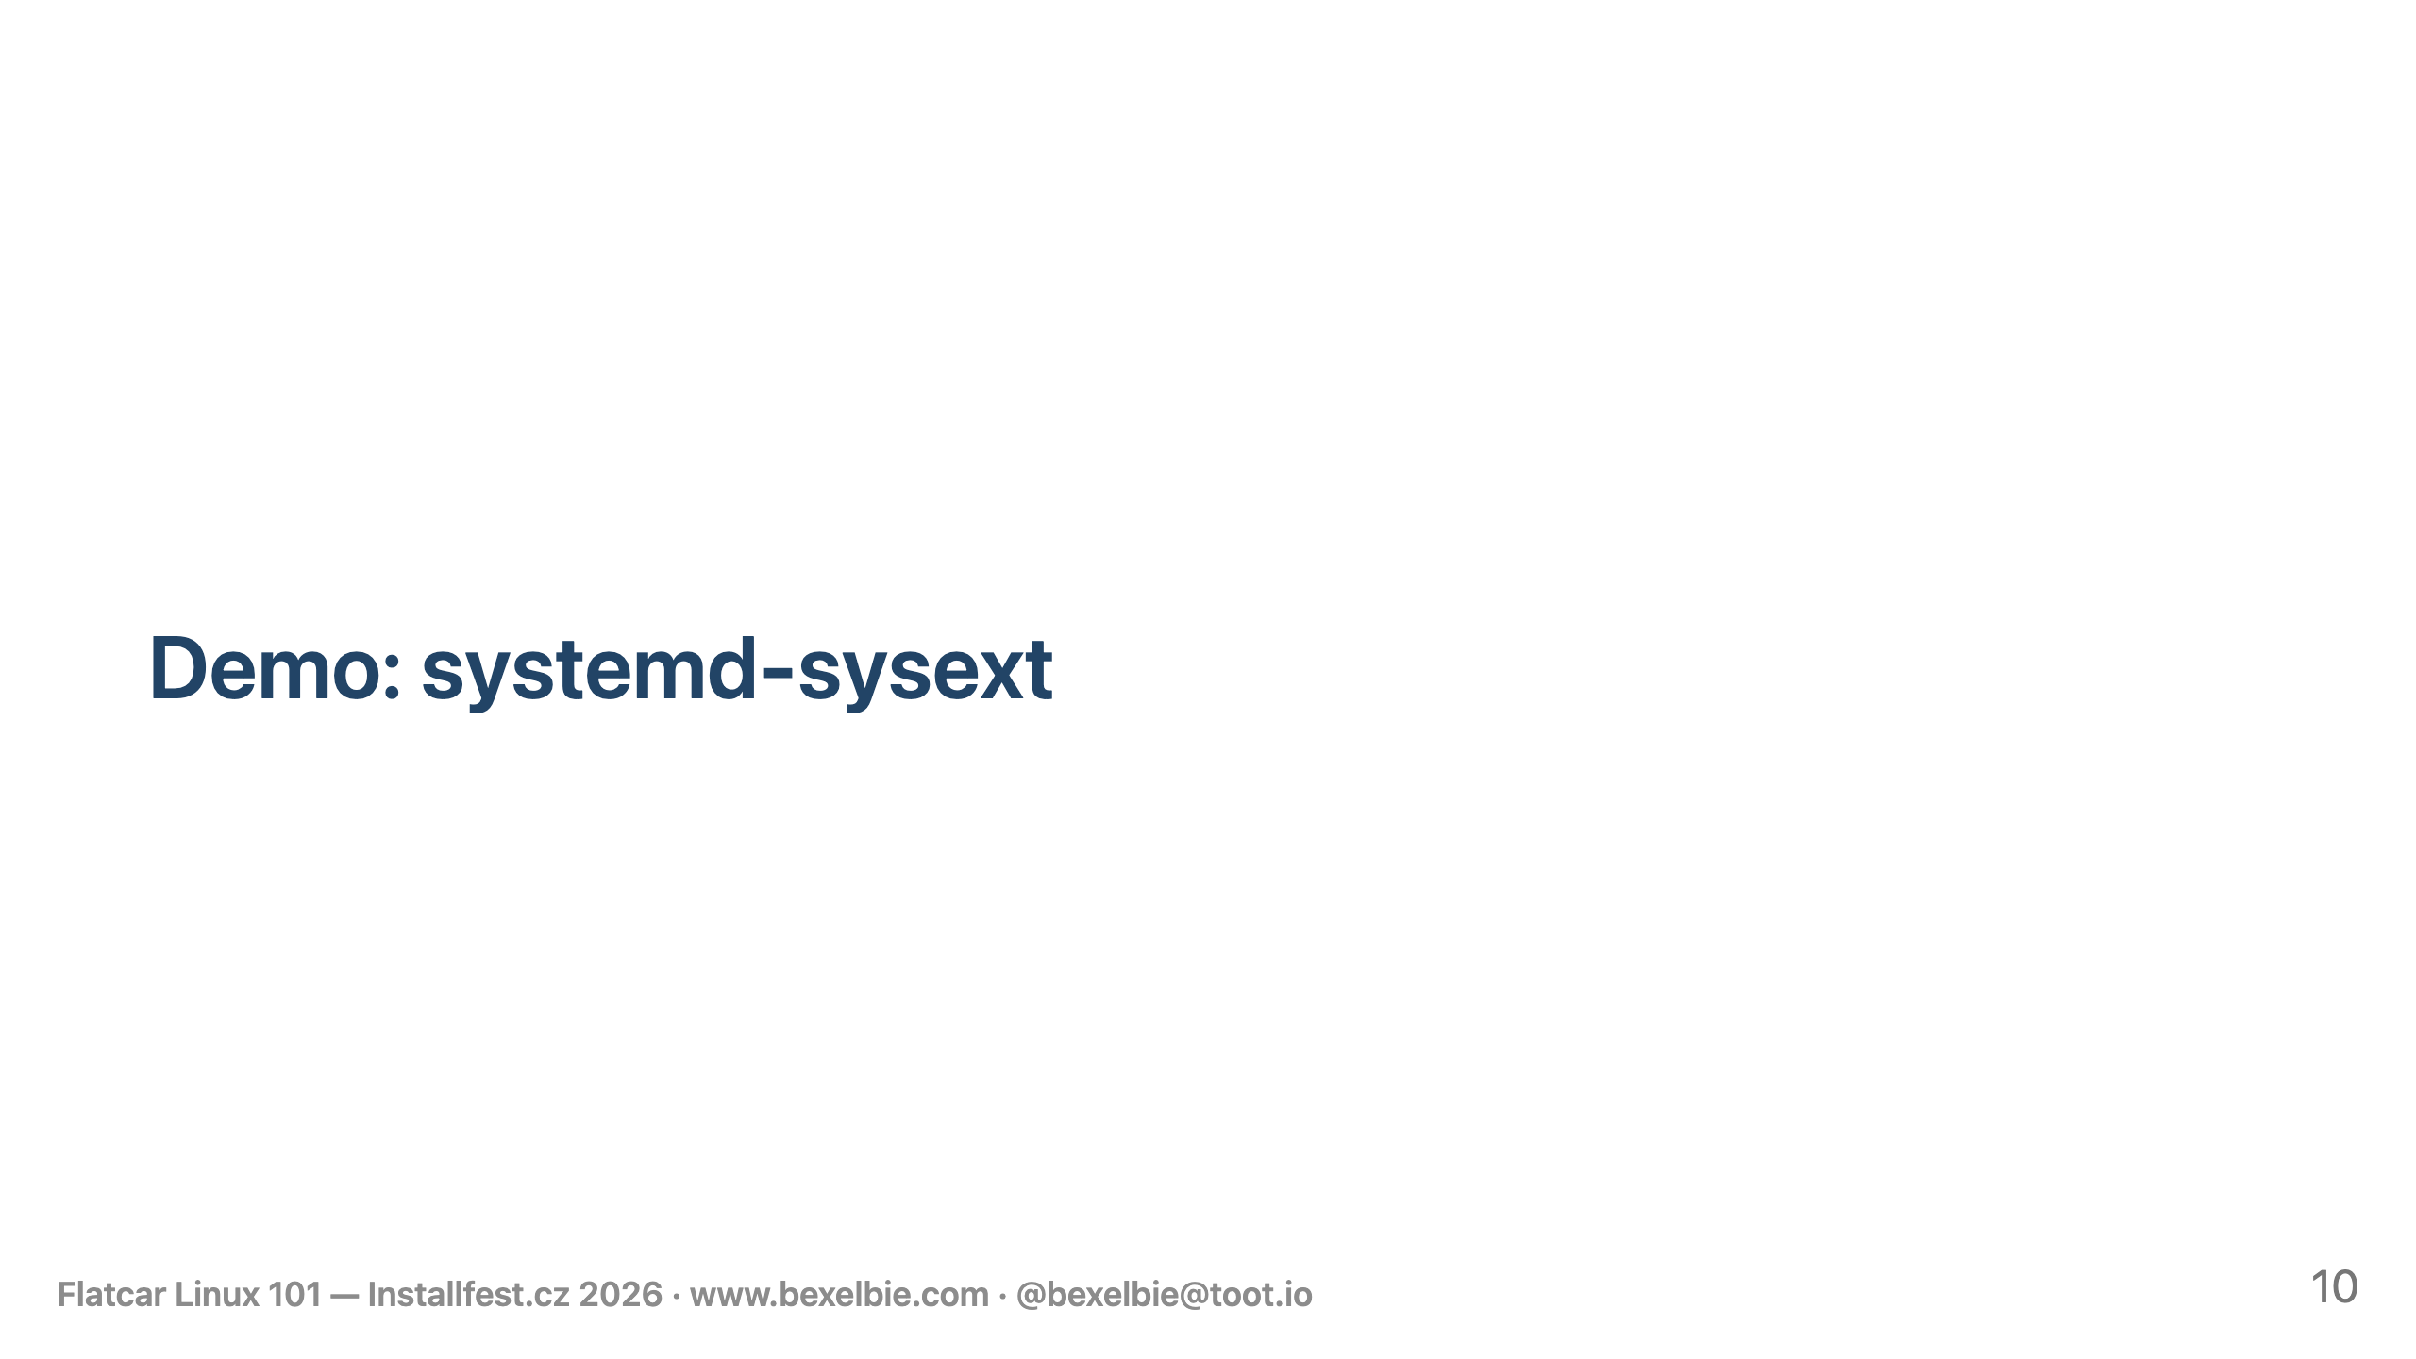
Notes:
- Demo: systemd system extensions — if /usr is immutable, how do you extend the OS? systsemd system extensions a/k/a/ sysexts. - This machine has no container runtimes - STEP 1: cat demo2.bu - /etc/extensions/docker-flatcar.raw → /dev/null - /etc/extensions/containerd-flatcar.raw → /dev/null - Flatcar ships Docker and containerd as system extensions. They're overlaid onto /usr at boot. - The system sees /dev/null and skips them. Not masked - literally not there - STEP 2: docker --version; podman --version - STEP 3: systemd-sysext status — only oem-qemu loaded - STEP 4: sudo cp /opt/sysexts/flatcar-podman.raw /var/lib/extensions/ - I am simulating the download of the sysext for podman - Could have been at provisioning - STEP 5: sudo systemd-sysext refresh - This merges in the new extension - could also have been at boot - STEP 6: podman --version; which podman - Tada - podman and where it should be - STEP 7: sudo rm /var/lib/extensions/flatcar-podman.raw - sudo systemd-sysext refresh - podman --version → No such file or directory - and gone - the path is only known because it is cached in bash - System extensions let you customize Flatcar without breaking immutability. - Official extensions come from the release server - community extensions come from the bakery - your private extensions come from your infrastructure

Slide 11
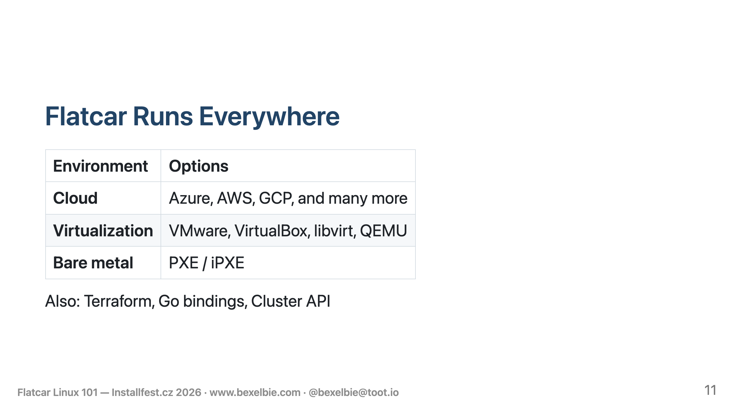
Notes:
- Flatcar supports a wide range of deployment targets - All major clouds and many tier2 or tier3 cloud providers - All favorite virtualization providers - Bare metal via PXE/iPXE

Slide 12
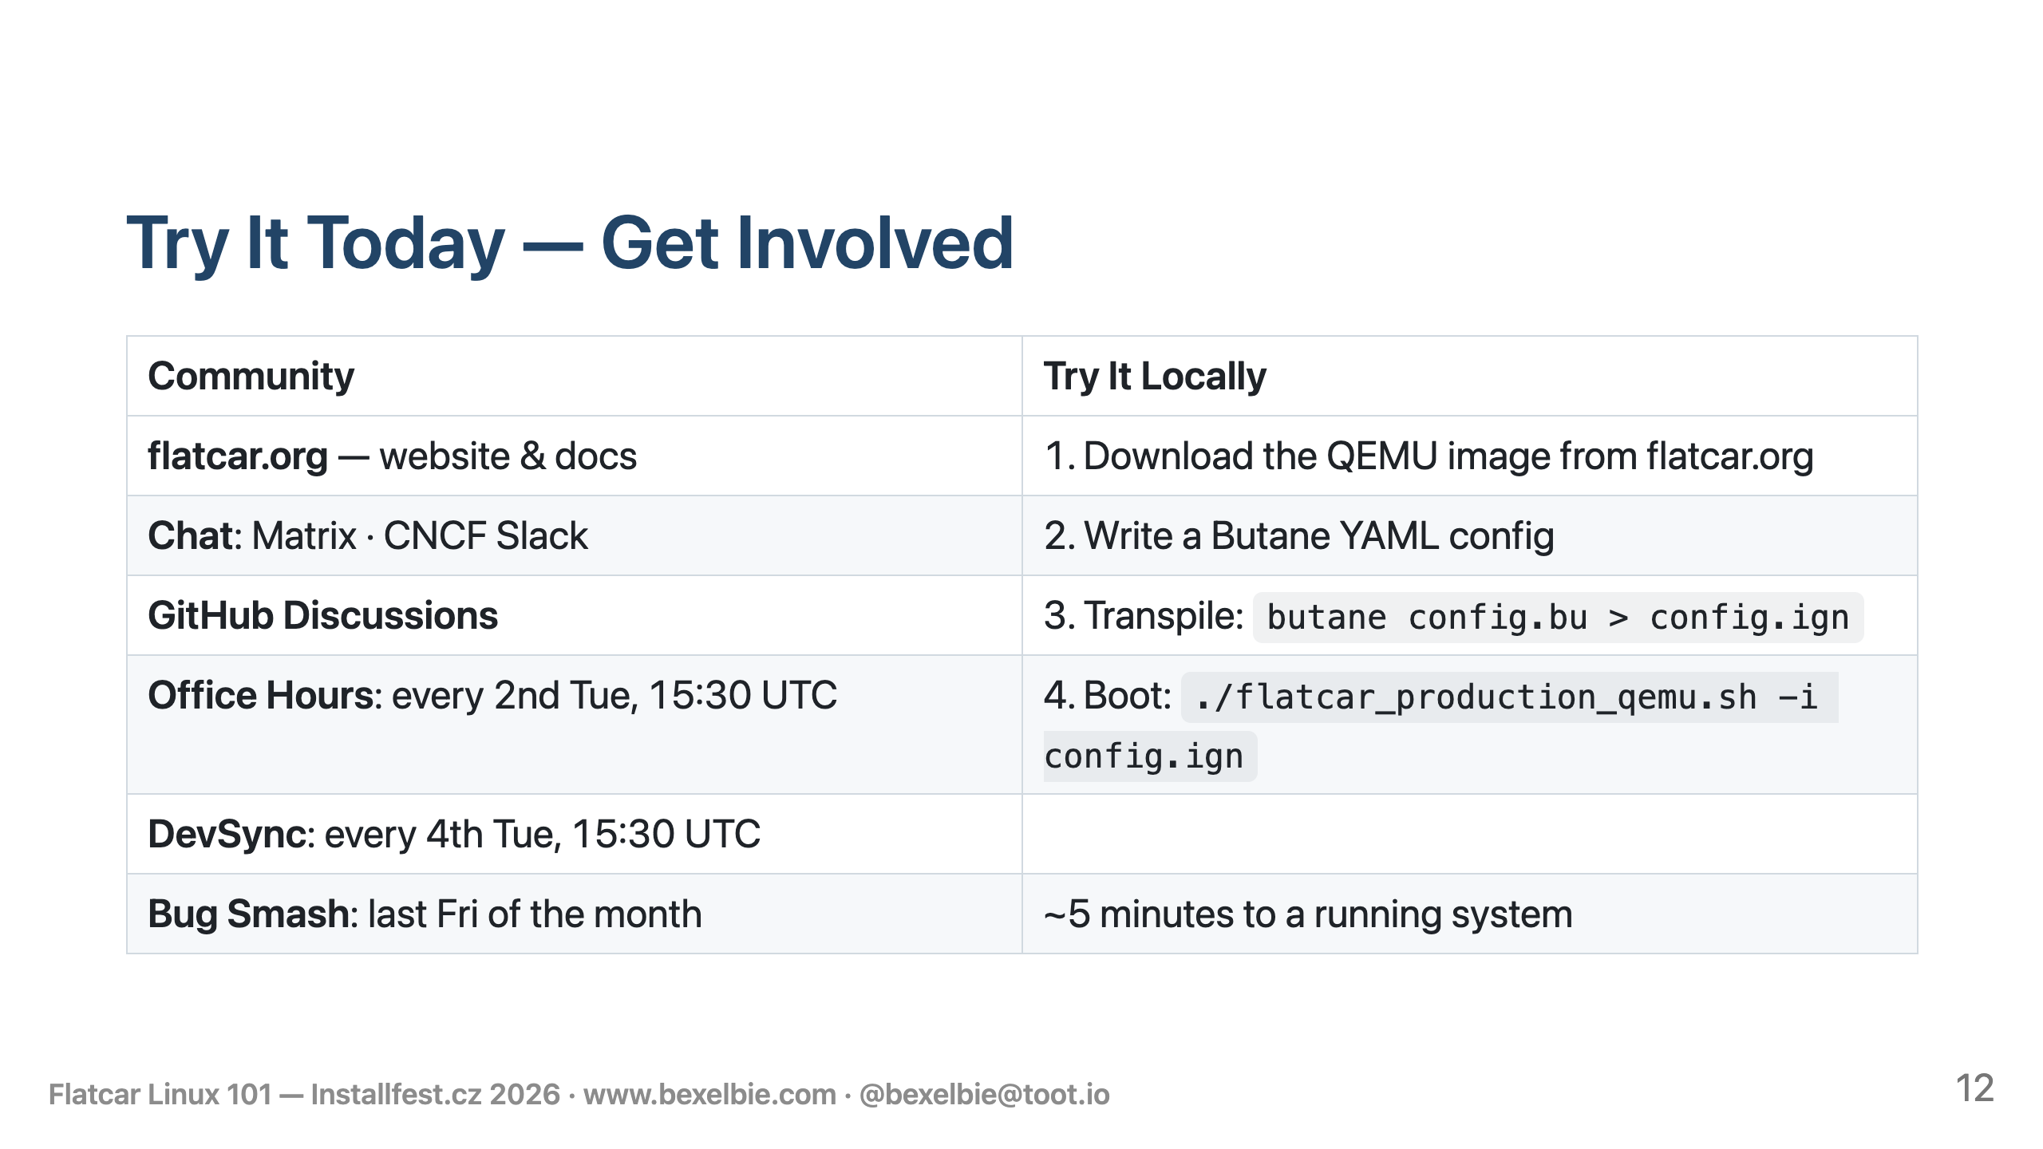
Notes:
- flatcar.org is website and you can find everything there - Chat: Matrix channel, also on CNCF Slack - GitHub Discussions - Live meetings through out the month - Europe friendly - most of the maintainers are here - Try it locally: runs in QEMU, takes about five minutes

Slide 13


Slide 14

Notes:
Build Notes: Build: marp --pptx --html 101-slides.md -o 101-slides.pptx --allow-local-files QR Code: qrencode -o /Users/bexelbie/repos/blog/bexelbie.github.io/working-notes/qr-bexelbie.png -s 10 -m 2 "https://www.bexelbie.com"

