Slide 1
R A V E
OOM
rrangement
isualizer
ngine

Slide 2
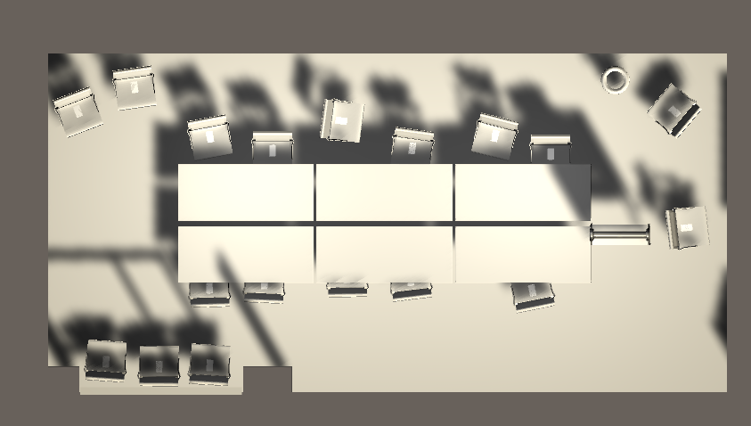
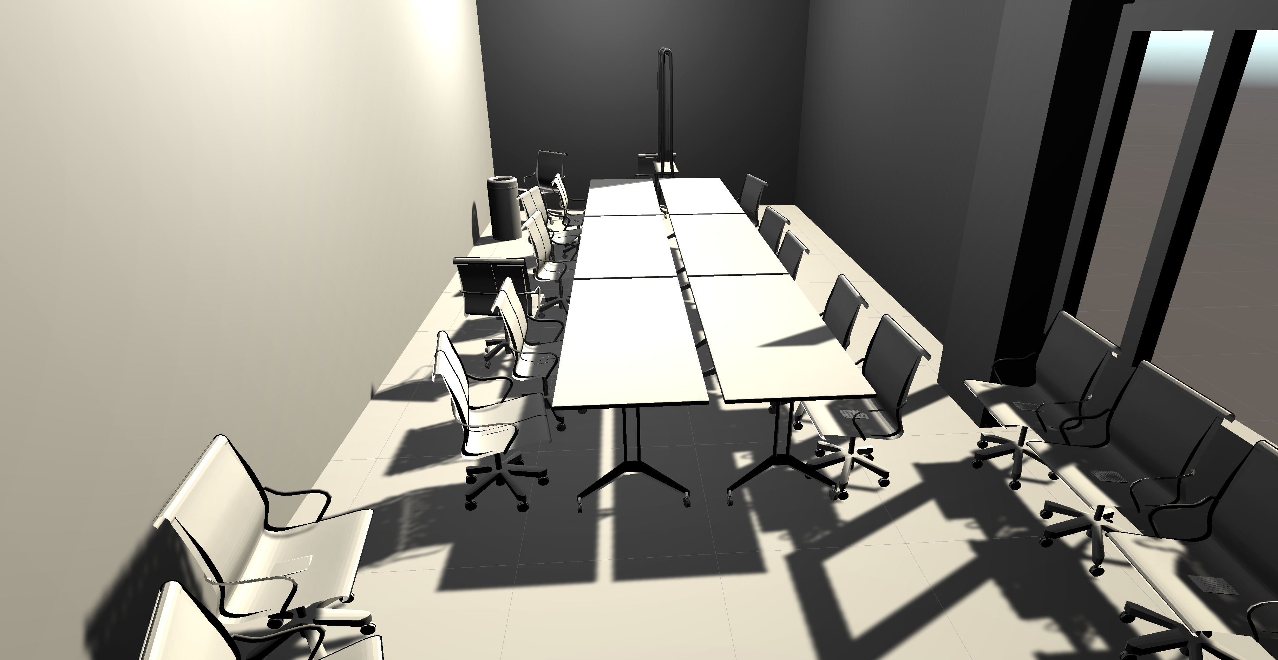
Tetons Conference room

Slide 3
RAVE
Arrange and visualize rooms
To scale models
Dynamically generate rooms

