Slide 1



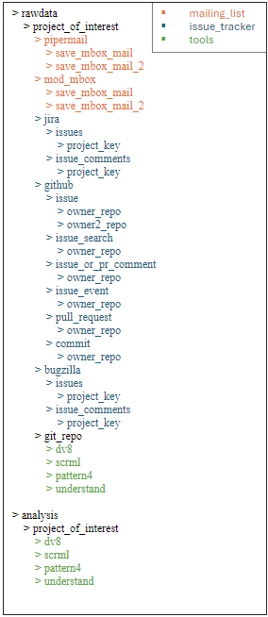
Data Configuration & Processing: : CHEAT SHEET
About
Refactoring
Config ties into Execs
Placeholder
Nick’s getter function information + decoupling notebooks
Raven’s stuff (establish relationship that different parts of config ties to different exec scripts)
Folder Organization
.yml
Mark’s folder organization information
.yml
Refactor
get()
.Rmd
.Rmd
.Rmd
.Rmd
.Rmd
.Rmd
OpenHub
Parallelization
Nick’s OpenHub API interfacing for project search
Dao’s M2 that uses these exec scripts
Kaiāulu
CC BY SA Nicholas Beydler, Mark Burgess, Dao McGill, Raven Quiddaoen, Carlos Paradis • Kaiāulu package version 0.0.0.9700 (in development) • Updated: 2025-11

