Slide 1

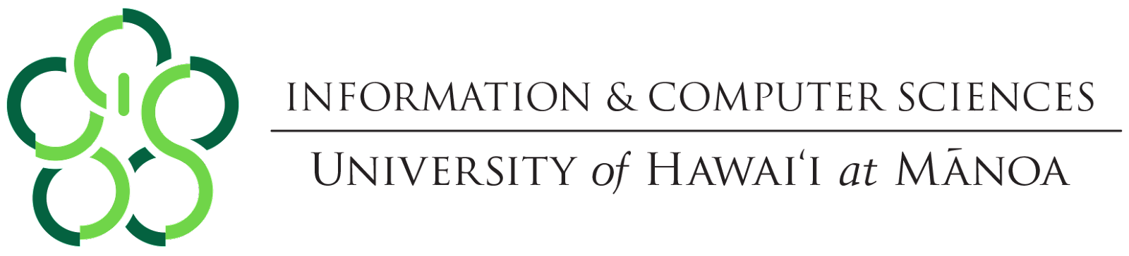

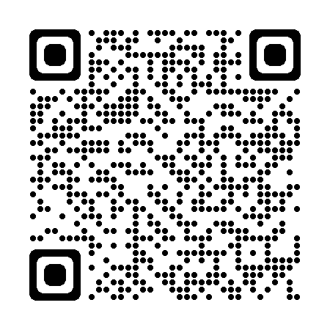
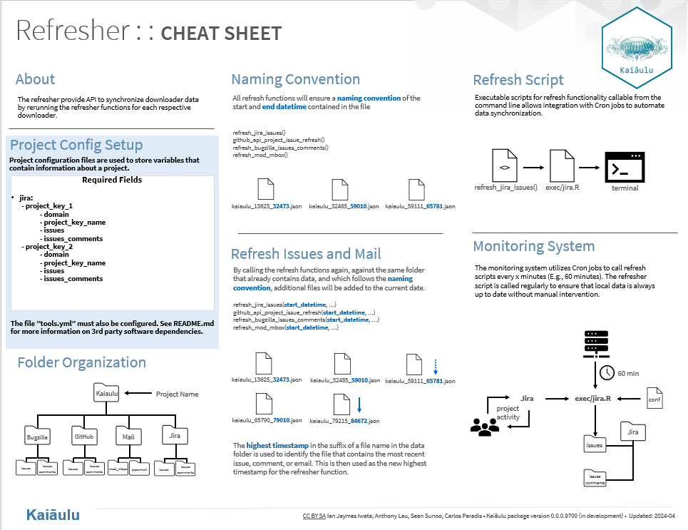
Project Management Data Synchronization
Ian Jaymes Iwata, Anthony Lau, Sean Sunoo
Project Sponsor: Rick Kazman and Carlos Paradis
ICS 496 Capstone Project – Spring 2024
https://github.com/sailuh/kaiaulu
What is Kaiāulu?
Kaiāulu is an open-source R package that helps with understanding evolving software development communities, and the artifacts (gitlog, mailing list, files, etc.) which developers collaborate and communicate with. One way it can do this is by downloading data from project manging platforms such as GitHub, JIRA, Bugzilla, etc. for data analysis.
Objective
Enchance Existing Tools: Improve functionality of existing downloader and parsers
Standardize Data Management: Ensure consistent data organization through unform file paths and naming conventions among downloaders
Implement Data Update: Develop functions to refresh local datasets with new data from project manegement sites
Schedule Regular Downloads: Write scripts that utilize Cron jobs to periodically download the latest data
Methodologies
Agile methodology for flexible and iterative development
Collaboration through GitHub Issues and Pull Requests
Bi-weekly developer meetings and weekly sponsor meetings
Roles
Sean: Technical/ Testing/ Scribe/ Communication
Anthony: Technical/ Testing/ Communication
Ian: Technical/ Testing/ Communication
Solution
Challenges
Learnings
Conclusion
Reworked file path storage and configuration files
Parse most recent data from file paths
Create functions that call various APIs to download data created/ updated only after that date
Automate downloading of new data via scripts using Cron jobs
Improve function and notebook documentation
Understanding scope of documentation requirements
Getting acclimated to coding environment
Understanding various functionalities and purposes of Kaiāulu
Installing and running 3rd party packages
Acquiring proficiency in the R language
How we overcame: Working closely with the sponsor and helping each other in meetings
Team coordination and communication leading to clearly defined (though evolving) requirements
Understanding depth and requirements of documentation, keeping in mind users who may lack familiarity withs software
Writing effective code that fits within the bounds of requirements but is tangible to future contributors
Kaiāulu is an open-source software that will be continuously updated in the future. Our overarching goal was to add refresh functionality to functions that download project data and streamline organization and naming conventions of files that were implemented incongruently by many groups in the past. Future improvements for the project include improving code logic, automating downloaders via scripting and adding more analysis to data already downloaded.

