Slide 1


Slide 2

Smart View Improving Upgrades/Migrations, Rollouts, and Reliability.
Charles Beyer
Huron Consulting Group

Slide 3


About Huron

Slide 4
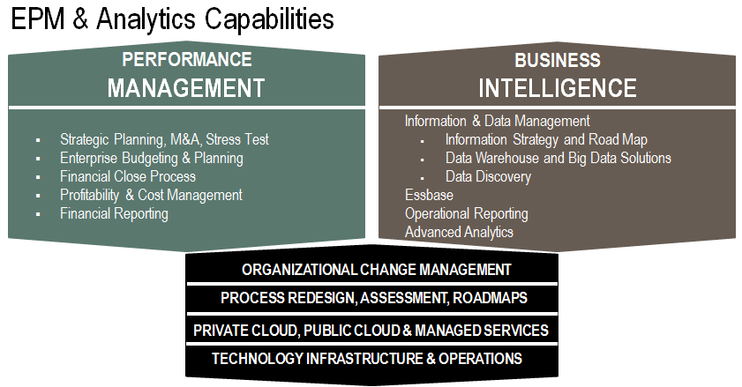
About Huron

Slide 5
About the Speaker
17 years professional experience in software development, infrastructure, and consulting.
9 years working with Oracle/Hyperion products
Published both Open Source and Commercial software products.
Always happy to help out with questions (time permitting of course!)
Contributes on blogs and OTN Discussion Boards (beyerch2)

Slide 6
Session Goals
Improve robustness of Smart View documents
Proactive Add-In Verification
Proactive Connection Monitoring
Simplify Deployment / Initial Configuration
Automate Installation
Push Default Preferences
Push Shared Connection
Ease conversion from Essbase Add-In

Slide 7
Topics Covered
This session will cover the following topics related to Smart View
Improving Smart View Documents w/ VBA & API
Simplifying Deployments of Smart View
Essbase Add-In Conversion

Slide 8
Before We Begin….
Sample Excel Documents / VBA is provided at the end of the PowerPoint!
To expedite the session (and minimize Murphy’s Law), session is combination of off-line / on-line demonstrations
Probably more material than session time, so be sure to review deck later
Please leave feedback, good or bad. All constructive feedback helps to improve presentations and is welcome!

Slide 9
Smart View
Improving Smart View Documents with VBA & Smart View API

Slide 10
VBA – Topics Covered
VBA Overview
What is VBA?
Excel Model / Events / Methods
Code Editor
Developer Menu / Design Mode / Wiring Events

Slide 11
VBA – Topics Covered (continued)
Performance Optimizations
Screen Updating
Enable Events
Calculation Mode

Slide 12
VBA Topics Covered (continued)
Examples
Performance Demonstration
Invalid Cell Identification
Add-In Presence Detection
Add-In Status Detection (Enabled/Disabled/Re-Enable)
Broken Link Detection / Correction

Slide 13
Smart View
VBA Overview

Slide 14
What is VBA?
Visual Basic for Applications is a derivative of the Microsoft Visual Basic language that enables programmatic interaction with Microsoft Office products. This allows for custom logic to be added to your Office documents. (You can even leverage this outside of Office to perform work against Office products)

Slide 15
Excel Model / Events / Methods
Excel Object Model – This model exposes the key parts of an Excel document to VBA. The following objects are typically used when working with Excel in VBA:
Application – Items that are Excel application related.
Workbook – Items that are related to a workbook
Worksheet – Items related to a worksheet
Range – Reference to one or more cells

Slide 16

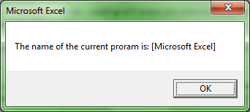
Excel Model (continued)
Application Object Example

Slide 17

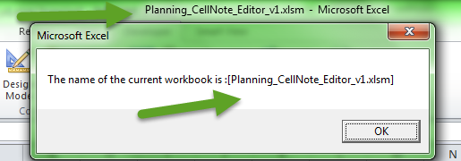
Excel Model (continued)
Workbook Object Example

Slide 18
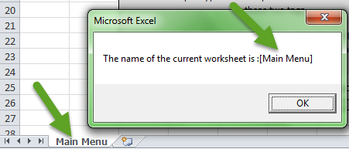
Excel Model (continued)
Worksheet Object Example

Slide 19

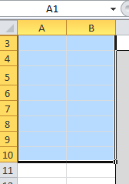
Excel Model (continued)
Range Object Example

Slide 20
Excel Methods & Properties (continued)
Methods – Code Subroutines related to an object that perform actions.
ActiveWorkbook.Close – Starts a routine to close the document.
Properties – Items related to objects that set/return variables.
Application.Name – Reads the name of application

Slide 21
Excel Events (continued)
Events – VBA code is typically executed when something happens. There are many prebuilt event “traps”, typical events are:
Open – Triggers when the application or a workbook is first opened.
Activate – Triggers when a workbook or worksheet gets “focus”

Slide 22
Excel Events (continued)
Events – VBA code is typically executed when something happens. There are many prebuilt event “traps”, typical events are:
BefSave / BefClose – Triggers before a workbook is Saved or Closed.
SheetChange / Change – Triggers when a change is detected on a worksheet / Cell

Slide 23

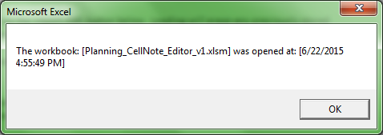
Excel Events (continued)
Workbook Open Event Example

Slide 24

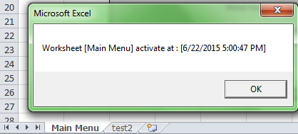
Excel Events (continued)
Worksheet Activate Event Example

Slide 25

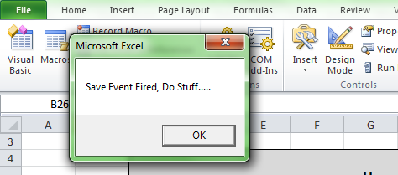
Excel Events (continued)
Workbook BefSave Event Example

Slide 26
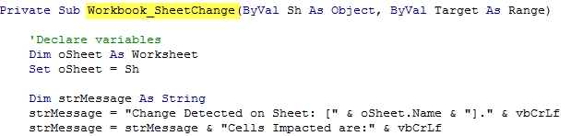
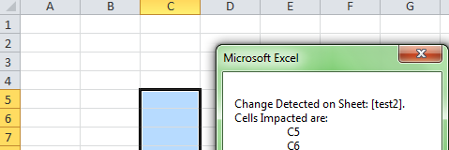
Excel Events (continued)
SheetChange Event Example

Slide 27
Excel Code Editor
Code Editor – This is the user interface that enables the user to create VBA for their Workbook. There are a few key pieces:
Project Window – This provides a listing of all VBA projects for the currently open workbooks
Properties Window – This provides an interface to update properties for Workbooks / Worksheets
Code Editor Window – This is where VBA can be edited
Immediate / Debug Window – Used during design time to debug code.

Slide 28
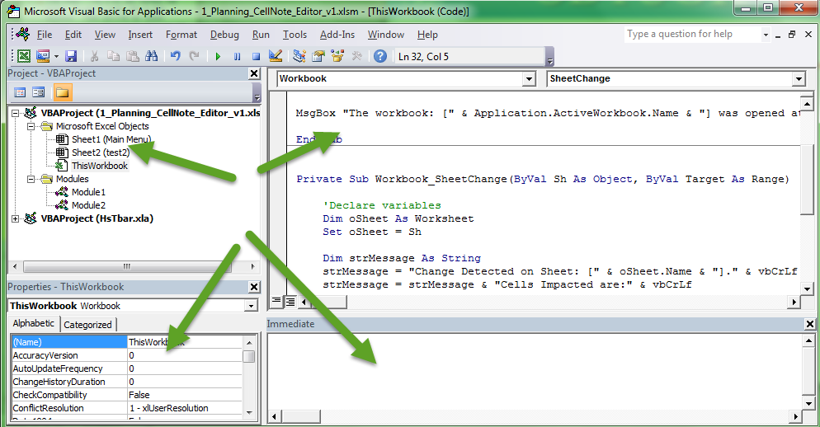
Excel Code Editor (continued)

Slide 29
Excel Code Editor (continued)
Notes:
To start the code editor, press ALT-F11from Excel.
To create code for a Worksheet / Workbook, double click on it in the Project Window.
To create code for a specific Method/Event, use the drop down menus at the top of the Code Editor portion of the screen.

Slide 30
Developer Menu / Design Mode / Wiring Events
Developer Menu – Excel toolbar consisting of app dev purposes
Design Mode – Special mode in Excel for performing form edits .
Event Wiring – Process of hooking up a form item with code execution (e.g. Button press)

Slide 31
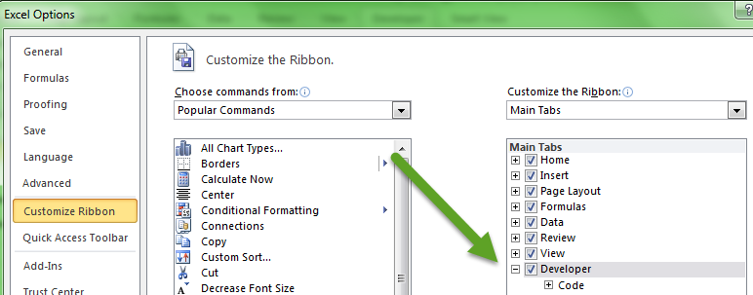
Developer Menu (continued)
To enable: Excel Options, then Customize Ribbon, then check Developer Main Tab

Slide 32
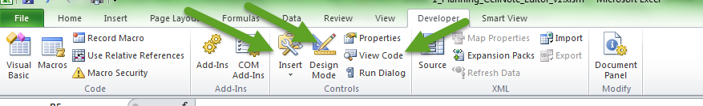
Developer Menu (continued)
Notable Items:
Insert – This allows us to add controls (e.g. Button) to worksheets
Design Mode – Allows editing of controls without events
View Code – Takes you to source editing window

Slide 33
Developer Menu (continued)
Notable Items:
Insert – This allows us to add controls (e.g. Button) to worksheets
Design Mode – Allows editing of controls without events
View Code – Takes you to source editing window

Slide 34
Design Mode / Event Wiring
DEMO [1_Planning_CellNote_Editor_v1.xlsm]

Slide 35
Performance Optimizations
VBA Performance Optimizations

Slide 36
Performance Optimizations
A few settings can make a huge difference
Screen Updating
Enable Events
Calculation Mode

Slide 37
Performance – Screen Updating
There are advantages and disadvantages to Disabling Screen Updating:
Advantages:
Unneeded screen activity confuses end users
Significant Performance Improvement
Disadvantages:
Don’t forget to turn it back on!

Slide 38


Performance – Screen Updating (continued)
Controlling Screen Updating is straightforward:
Disable
Enable

Slide 39
Performance – Events
Enabling / Disabling Events has advantages and disadvantages:
Advantages:
Prevents unnecessary events from firing
Significant Performance Improvement
Disadvantages:
Don’t forget to turn it back on!

Slide 40


Performance – Events (continued)
Controlling Events is straightforward:
Disable
Enable

Slide 41
Performance – Calculation Mode
Changing the Calculation Mode from Automatic to Manual will prevent calculations from occurring in the middle of a process. The calculations will still occur when set to Automatic or when manually started. Doing this has the following advantages and disadvantages:
Advantages:
Prevents unnecessary calculations from occurring
Significant Performance Improvement
Disadvantages:
Don’t forget to set back to Automatic!

Slide 42

Performance – Calculation Mode (continued)
Changing the Calculation Mode is straightforward:
Manual
Automatic

Slide 43
Performance Optimization
DEMO [2_PerformanceOptimizations.xlsm]

Slide 44
Invalid Cell Identification
DEMO [3_CatchNonNumericBeforeSave.xlsm]

Slide 45
Add-In Detection
DEMO [4_Discover_Addins.xlsm]

Slide 46
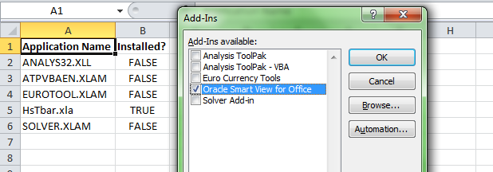
Add-In Detection (continued)
When Present and “Installed”

Slide 47
Add-In Detection (continued)
Takeaways
If HsTbar.xla is not shown as Installed, Smart View isn’t functioning and it needs to be “Installed”, this can be done automatically for the end user.
If HsTbar.xla doesn’t show up in the list of Add-Ins, Smart View has not been installed.
Disabled Items is stored in Registry and is fixed in example.
Including some detection in the Load method of the Workbook would solve a lot of end user surprises.
Excel needs to be restarted after re-enabling, though you can communicate this to user easily.

Slide 48
HsTbar Broken Link
DEMO [5_HsTbar_Broken_Links.xlsm]
Typical Causes
User does not have Smart View
Creator of document had Smart View installed to a different file path.

Slide 49
VBA Demo Summary
How can we now improve our documents?
Leverage Workbook Open Method To
Disabled / “Uninstalled” Smart View
Check for Broken Links
Leverage Save Method
Check for non-Refreshed Data / Non-Numeric
Improve Performance before large queries
ScreenUpdating, Calculation Mode, etc.

Slide 50
Smart View
Smart View API

Slide 51
Smart View API – Topics Covered
Common API Calls
Menu Functions
HypMenuVRefresh
HypMenuVRefreshAll
Connection Functions
HypConnect / HypConnected / HypConnectionExists
HypCreateConnectionEx
HypDisconnect / HypDisconnectAll / HypDisconnectEx
HypGetSetSharedConnections / HypSetSharedConnectionsURL

Slide 52


Smart View API – Menu Functions
“Menu Functions” – Menu functions expose the functionality found on the Smart View ribbon.
HypMenuVRefresh – Refreshes the active worksheet.
HypMenuVRefreshAll – Refreshes all worksheets

Slide 53
Smart View API – Menu Functions (continued)
How could we leverage previous VBA Events and these functions in our workbooks?
Workbook BeforeSave?
Before Saving your book, what if you ensured all data was refreshed?“Menu Functions” – Menu functions expose the functionality found on the Smart View ribbon.

Slide 54
Smart View API – Connection Functions
Connection Functions – Functions that deal with connection to Smart View Providers
HypConnect – Establishes a connection
HypConnected – Checks if a defined connection has been established
HypConnectionExists – Checks to see if a connection exists
HypCreateConnectionEx – Creates a connection

Slide 55
Smart View API – Connection Functions (continued)
Connection Functions – Functions that deal with connection to Smart View Providers
HypDisconnect/Ex – Disconnects the connections on the Active Worksheet
HypDisconnectAll – Disconnects connections on all worksheets in this workbook
HypGetSetSharedConnections / HypSetSharedConnectionsURL – Retrieves / Sets the Shared Connection URL

Slide 56
Smart View API – Connection Functions (continued)
How could we leverage previous VBA Events and these functions in our workbooks?
Workbook Open?
Check List of Expected Connections
Warn / Create Missing Connections
Workbook Open / Worksheet Activate?
Check Connection Status
Auto Connect w/User Prompt or Push stored credentials

Slide 57
Smart View API
DEMO [6_CreatePrivateConnection.xlsm]

Slide 58
Smart View API
More Info?
Smart View Developer’s Guide
(sv_developer.pdf)

Slide 59
Smart View
Simplifying Deployments

Slide 60
Simplifying Deployments (continued)
Three key areas
Smart View EXE Installation – How and Who performs the install?
Default Options – What are the must have settings and how to apply them?
Smart View Connections – What connections are needed and how to create?

Slide 61
Smart View Install
Smart View Install – The most efficient (and user friendly) way to install Smart View is via Silent Install
SmartView.exe /s – Installs Smart View quietly to default folder
SmartView.exe /s /v” INSTALLDIR=C:\YourDir” – Installs Smart View quietly to a directory of your choosing.

Slide 62
Smart View Install (continued)
Smart View Install Notes
UAC does not matter when installed as a System User (e.g. installed via deployment tool)
Installing as a System User makes Smart View available at the machine level
Non-Admin users can install directly; however, SV only available to them.

Slide 63
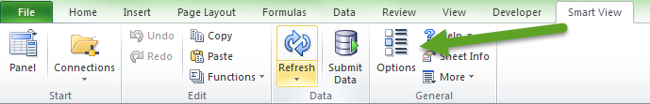
Default Options
Default Options – Default Options refer to the user configurable preferences for Smart View. These preferences are generally set via the Smart View → Options menu.
Fresh installs do not necessarily give you defaults that you want (e.g. #MISSING instead of #NUMERICZERO)

Slide 64
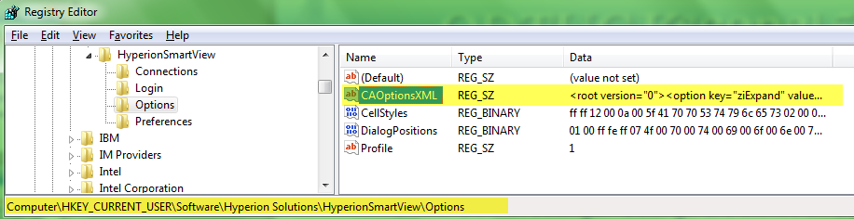
Default Options (continued)
Default Option Notes
As of 11.1.2.1.102 – Smart View no longer uses Global Default settings. Settings are stored on a per worksheet basis.
Default Options (used for new worksheets) are stored in the windows registry (*few exceptions) Computer\HKEY_CURRENT_USER\Software\Hyperion Solutions\HyperionSmartView\Options\CAOptionsXML

Slide 65
Default Options (continued)
The following items can be set
Member Options
General: Zoom In Level, Member Name Display, Indentation, Ancestor Position
Member Retention: Include Selection, Within Selected Group, Remove Unselected Groups
Comments and Formulas: Preserve Formulas and Comments, in ad hoc operations (except pivot), Formula Fill, Enable Enhanced Comment Handling, Preserve Formula on POV Change

Slide 66
Default Options (continued)
The following items can be set
Data Options
Suppress Rows: No Data/Missing, Zero, No Access, Invalid, Underscore Characters, Repeated Members
Suppress Columns: No Data/Missing, Zero, No Access
Replacement: #NoData/Missing Label, #NoAccess Label, #Invalid/Meaningless, Submit Zero, Display Invalid Data, Enable Essbase Format String
Mode: Cell Display, Navigate without Data, Suppress Missing Blocks

Slide 67
Default Options (continued)
The following items can be set
Formatting
Use Thousands Separator, Use Cell Styles, Use Excel Formatting, Retain Numeric Formatting, Adjust Column Width, Scale, Preview, Decimal Places, Preview, Repeat Member Labels
Cell Styles
*** Technically not supported; however, settings contained in the Registry Key [Computer\HKEY_CURRENT_USER\Software\Hyperion Software\HyperionSmartView\Options\CellStyles] ***

Slide 68
Default Options (continued)
The following items can be set
Advanced
General: Shared Connections URL*, Number of Undo Actions, Number of Most Recently Used Items
Logging: Log Message Display, Route Messages to File, Clear Log File on Next Launch
Display: Language, Display Smart View Shortcut Menu Only, Disable Smart View in Outlook**, Enable Ribbon Context Changing, Display options that are not valid for the active connection, Display Drill-Through Report Tool-Tips, Show Progress Information After (seconds), Progress Time Delay

Slide 69
Default Options (continued)
The following items can be set
Advanced
Compatibility: Reduce File Size***, Improve Metadata Storage****, Refresh Selected Functions and their dependents
Mode: Use Double-click for Operations

Slide 70
Default Options (continued)
* - Contained in properties.xml Win 7 – C:\Users\<user account>\AppData\Roaming|Local\Oracle\SmartView XP - C:\Documents and Settings\<user account>\Application Data\Oracle\SmartView\properties.xml
** - Contained in Registry Key [Computer\HKEY_CURRENT_USER\Software\Hyperion Software\HyperionSmartView\Preferences\OutlookDisabled ]
*** - Contained in Registry Key [Computer\HKEY_CURRENT_USER\Software\Hyperion Software\HyperionSmartView\Preferences\UseStorageCompression & SelectedOptionTab ]
**** - Contained in Registry Key [Computer\HKEY_CURRENT_USER\Software\Hyperion Software\HyperionSmartView\Preferences\IgnoreShapes]
***** - Registry Keys contained in hive: Key [Computer\HKEY_CURRENT_USER\Software\Oracle\SmartView\extensions]

Slide 71
Default Options (continued)
How to automate?
Decide what Default Options you want
Create a Registry file that contains the preferences
Create a logon / deployment script that executes for each user to apply the registry settings
Settings are PER USER, not per machine!

Slide 72
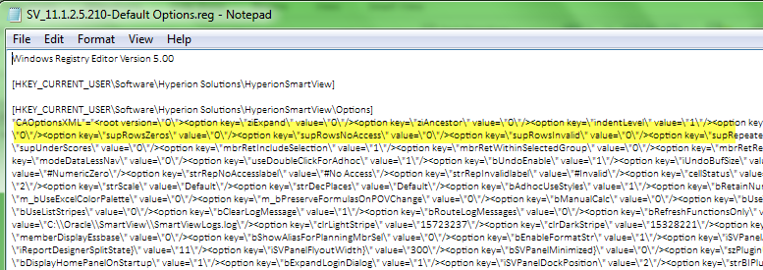
Default Options (continued)
Sample Registry File

Slide 73
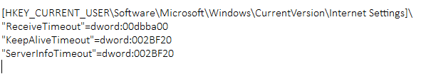
Default Options (continued)
Important Note!
If you are pushing updates to the registry, push Timeouts as well!

Slide 74
Smart View
Essbase Add-In Conversion

Slide 75
Essbase Add-In Conversion
Key Areas to Consider when migrating/upgrading
What about existing default settings?
Converting to Smart View equivalents
Automation Scripting

Slide 76
Essbase Workbook Conversion Utility
DEMO [9_EssAdd-In SmartView Option Translation Mapping.xlsx]

Slide 77
Essbase Workbook Conversion Utility
DEMO [7_Essbase_AddIn_Workbook Conversion Utility.xlsm]

Slide 78
Essbase Workbook Conversion Utility
DEMO [8_ExtractEssbaseRegistry.vbs]

Slide 79
Questions
Questions?

Slide 80
Demo Files

Slide 81
Contact Me
Charles Beyer – Huron Consulting Group
Email – cbeyer@huronconsultinggroup.com
Blog – http://charlescbeyer.com/ccb_wp/

