Slide 1
Compton Imaging
All Organic
Inorganic
Gamma Source
2 Compton scatters
2 Compton scatters
1 Compton scatter followed by full energy deposition
Systems can also be mixed

Slide 2
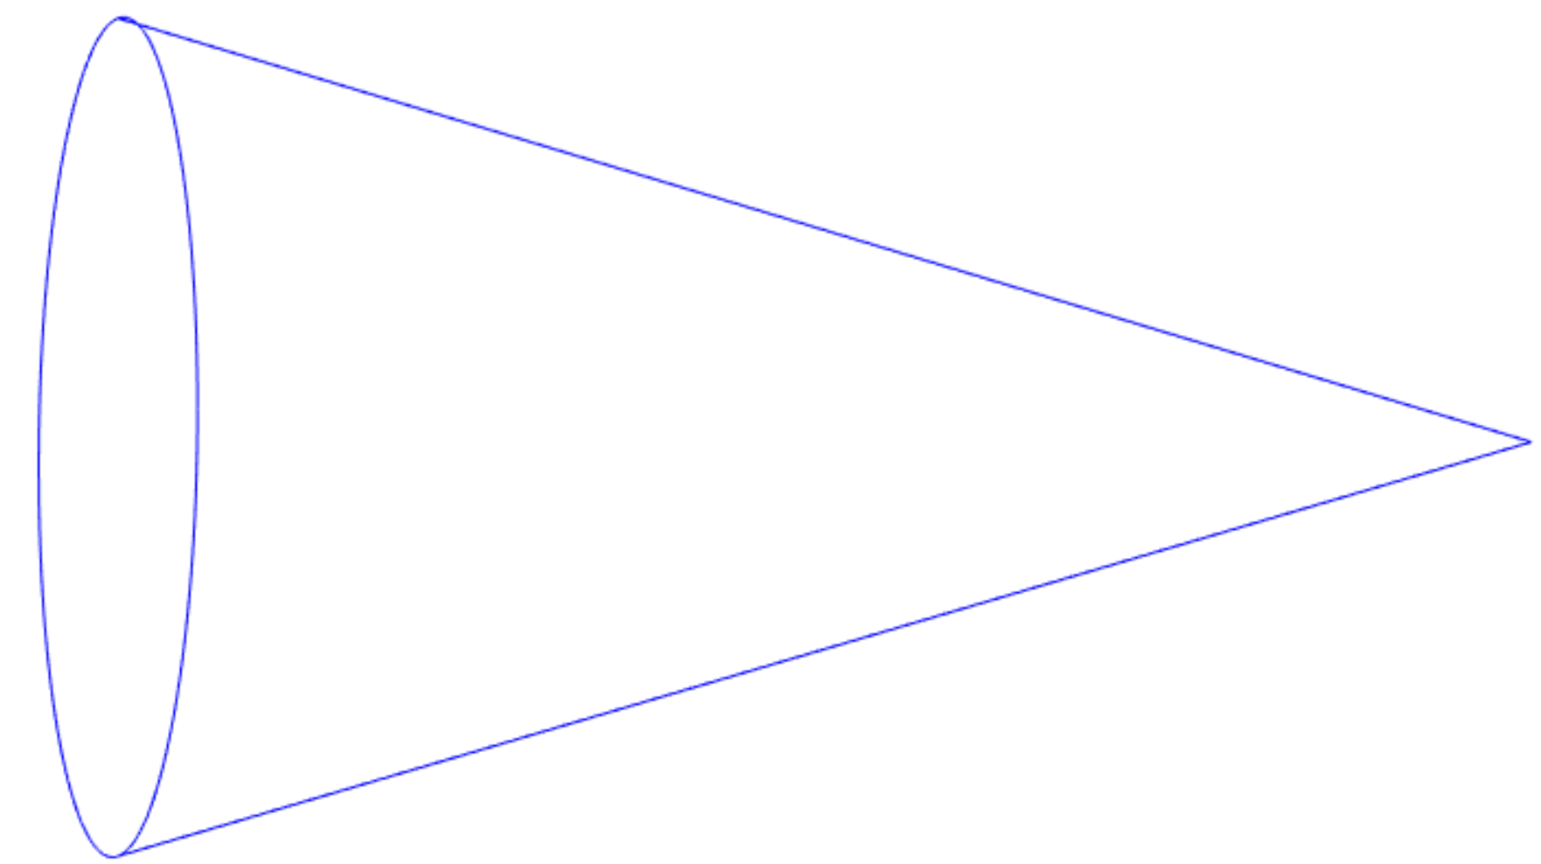
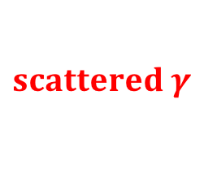





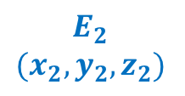

Compton Imaging: Inorganics
Incident $γ$
Photoelectric Absorption
Compton Scatter
$$ψ$$
$$scattered γ$$
Observables
$$E_{1}$$
$$\left(x_{1},y_{1},z_{1}\right)$$
$$E_{2}$$
$$(x_{2},y_{2},z_{2})$$
Source
$$E_{i}=E_{1}+E_{2}$$
$cos(ψ)=1 −\left(\frac{m_{e}c^{2}}{E_{f}}−\frac{m_{e}c^{2}}{E_{i}}\right)$
$$E_{f}=E_{2}$$

Slide 3
Compton Imaging: Inorganics
Incident $γ$
Photoelectric Absorption
Compton Scatter
$$ψ$$
$$scattered γ$$
Uncertainty dominated by intrinsic energy resolution
Observables
$$E_{1}$$
$$\left(x_{1},y_{1},z_{1}\right)$$
$$E_{2}$$
$$(x_{2},y_{2},z_{2})$$
Source
$$E_{i}=E_{1}+E_{2}$$
$cos(ψ)=1 −\left(\frac{m_{e}c^{2}}{E_{f}}−\frac{m_{e}c^{2}}{E_{i}}\right)$
$$E_{f}=E_{2}$$

Slide 4
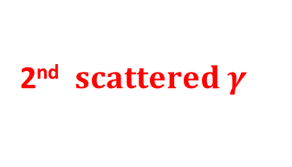
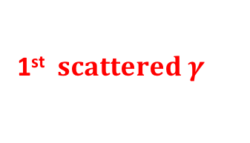




Compton Imaging: Organics
Incident $γ$
Compton Scatter
Compton Scatter
$$ψ$$
1st $scattered γ$
2nd $scattered γ$
Observables
$$E_{1}$$
$$\left(x_{1},y_{1},z_{1}\right)$$
$$E_{2}$$
$$(x_{2},y_{2},z_{2})$$
Source
$E_{i}=E_{1}+E_{2}+E_{out}$
$cos(ψ)=1 −\left(\frac{m_{e}c^{2}}{E_{f}}−\frac{m_{e}c^{2}}{E_{i}}\right)$
$$E_{f}=E_{2}+E_{out}$$

Slide 5
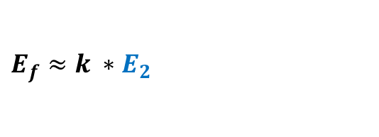
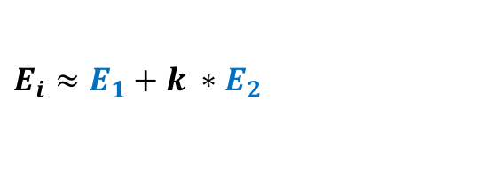
Compton Imaging: Organics
Incident $γ$
Compton Scatter
Compton Scatter
$$ψ$$
1st $scattered γ$
2nd $scattered γ$
Observables
$$E_{1}$$
$$\left(x_{1},y_{1},z_{1}\right)$$
$$E_{2}$$
$$(x_{2},y_{2},z_{2})$$
Source
$$E_{i}≈E_{1}+k ∗E_{2}$$
$cos(ψ)=1 −\left(\frac{m_{e}c^{2}}{E_{f}}−\frac{m_{e}c^{2}}{E_{i}}\right)$
$$E_{f}≈k ∗E_{2}$$

Slide 6
Compton Imaging: Organics
Incident $γ$
Compton Scatter
Compton Scatter
$$ψ$$
1st $scattered γ$
Uncertainty dominated by kinematic approximations
2nd $scattered γ$
Observables
$$E_{1}$$
$$\left(x_{1},y_{1},z_{1}\right)$$
$$E_{2}$$
$$(x_{2},y_{2},z_{2})$$
Source
$$E_{i}≈E_{1}+k ∗E_{2}$$
$cos(ψ)=1 −\left(\frac{m_{e}c^{2}}{E_{f}}−\frac{m_{e}c^{2}}{E_{i}}\right)$
$$E_{f}≈k ∗E_{2}$$

Slide 7
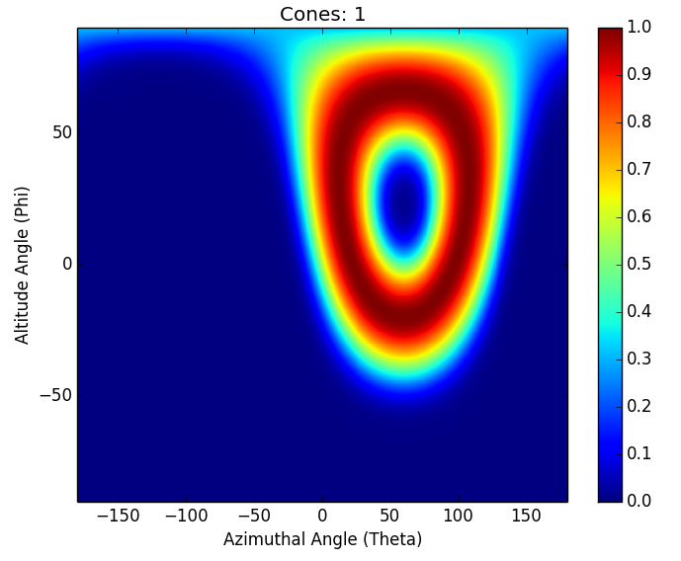
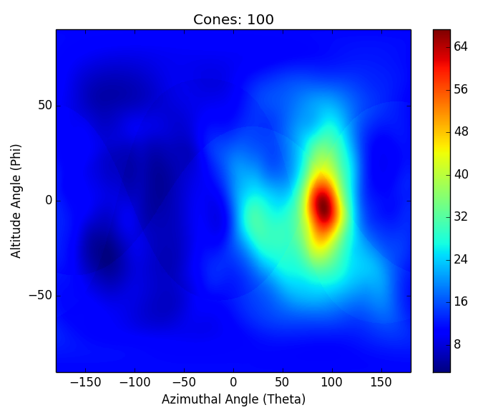

Compton Imaging
Notes:
Add a gif
Project that cone into {phi,theta} space (e.g. onto the unit sphere)
This is simple backprojection. Could do MLEM, etc.
I’m talking about reducing the uncertainty in the observables, which reduces the uncertainty in the image no matter what.

