Slide 1

Technical Trainee Aug 21, 2025 (IST) •APIs • REST • SOAP • Security
Rana Sujeet Kumar ranasujeet905@gmail.com codewithrana.online

Slide 2
CONTENTS
What is an API (simple analogy)
The Positka Connection
A Spectrum of Types and Their Missions
Choosing the Right Tool for the Job
The Titans of API Architecture - REST vs. SOAP

Slide 3
What is an API? The "Waitress" Analogy
API (Application Programming Interface) is a set of rules and protocols that allows two software applications to communicate.
Think of it as a “restaurant menu”:
You (user) → request from menu
Waiter (API) → delivers your order to kitchen (server)
Kitchen (server) → prepares and sends back your food (response)
Example: When you log into a website using “Login with Google”, the website uses Google’s API to authenticate you.

Slide 4
The API Spectrum: More Than One Type
A Connector for Every Purpose
 | Type | Who Uses It? | Real-World Example
 | Public API | Everyone | Twitter API - Lets any app display tweets.
 | Partner API | Strategic Businesses | Netflix on Comcast - Integrated into your TV.
 | Internal API | Within a Company | Bank's CRM talking to its Database.
 | Composite API | Complex Processes | "Checkout" API handling payment, inventory, & shipping at once.

Slide 5
REST: The Agile Superstar of the Web
Representational State Transfer (REST) is an architectural style built for speed and simplicity.
Its Core Principles:
Stateless: Every request is independent. No memory of the past.
Uniform Interface: Uses simple, standard HTTP Verbs:
GET - Retrieve data
POST - Create data
PUT - Update data
DELETE - Remove data
Client-Server: Clear separation of concerns.
Cacheable: Responses can be stored for blazing speed.

Slide 6
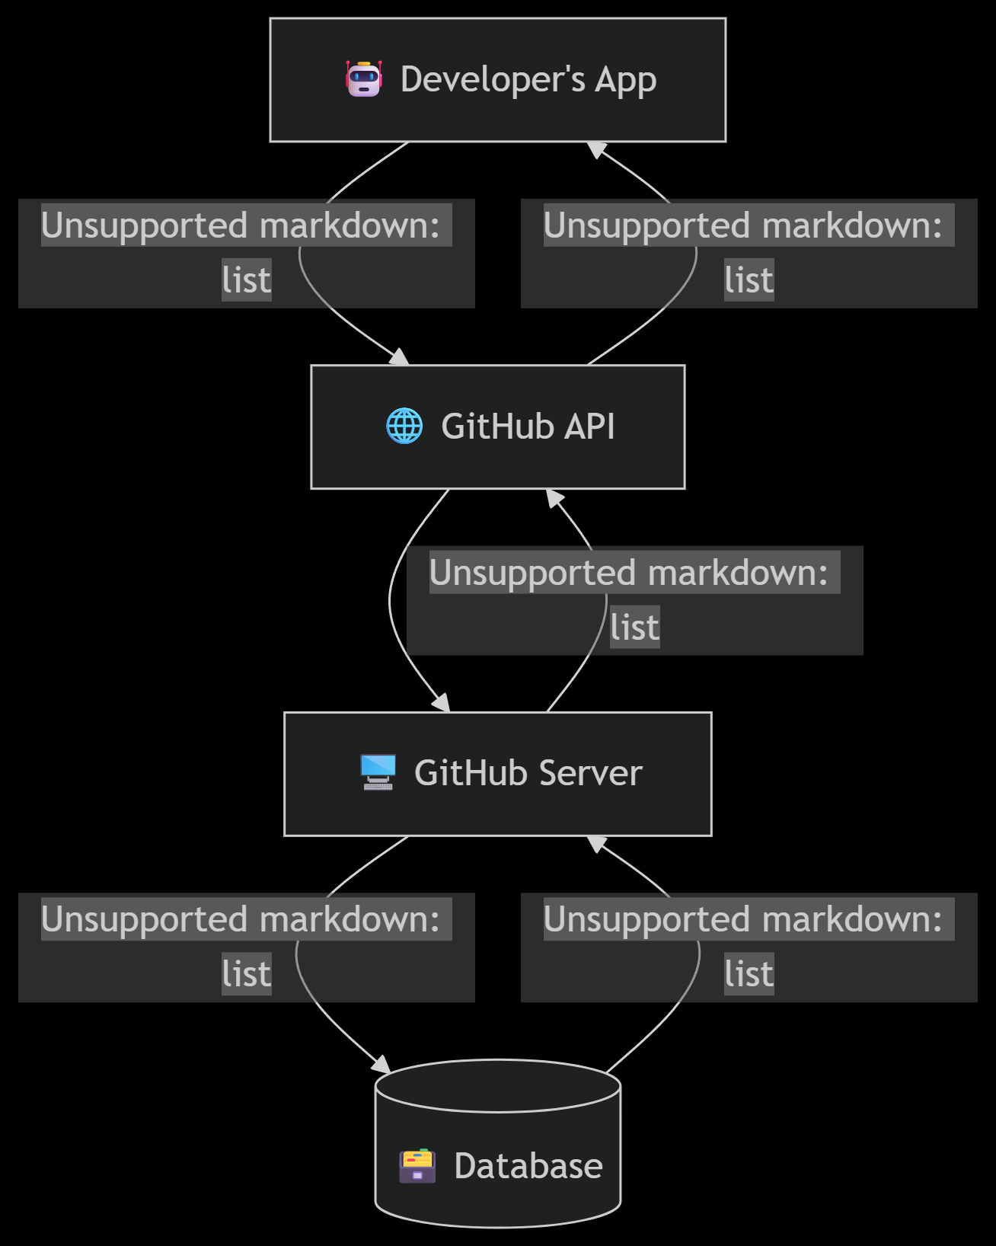
REST in Action: A Live API Call
The Result (JSON Snippet):
{
"id": 1296269,
"name": "Hello-World",
"owner": { "login": "octocat" },
"html_url": "https://github.com/octocat/Hello-World"
}

Slide 7
SOAP in Action: The Financial Transaction
A SOAP Message isn't just a request; it's a secured document.
<soap:Envelope xmlns:soap="http://www.w3.org/2003/05/soap-envelope">
<soap:Header>
<wsse:Security>
<!-- ENCRYPTED USERNAME & PASSWORD TOKEN -->
</wsse:Security>
</soap:Header>
<soap:Body>
<p:ProcessPayment xmlns:p="http://paypal.example.com/">
<p:PaymentDetails>...</p:PaymentDetails>
</p:ProcessPayment>
</soap:Body>
</soap:Envelope>
Why it's used in Banking, Payments (e.g., PayPal), Airlines:
WS-Security: Built-in encryption and digital signatures.
ACID Compliance: Guarantees transactions are processed reliably.
Standardized: Strict standards prevent errors and misinterpretation.

Slide 8
The Right Tool for the Right Job
So, Which One Do We Choose?
Choose REST for:
Public APIs for web/mobile apps (e.g., social media integration, weather data)
Scalability and speed are critical.
You want developer-friendly, easy-to-use interfaces.
Choose SOAP for:
Enterprise-grade applications (e.g., financial data, internal ERP systems).
Formal contracts and transactional reliability are non-negotiable.
You need built-in security standards like WS-Security.
The industry trend is towards REST for its agility, but SOAP remains the bedrock of secure, transactional systems.

Slide 9
Why This Matters to Me & Positka
APIs Are the Foundation of Modern Business Solutions
Understanding APIs is understanding how the digital world connects.
At Positka, working with clients like FSI (Banking) and Retail demands this knowledge:
Integrating a client's e-commerce site (REST) with a legacy inventory system.
Ensuring secure data exchange (mTLS, SOAP) for financial transactions.
I am excited to learn, contribute, and help build these critical connections that drive business value for Positka's clients.

Slide 10
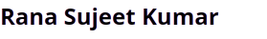
THANK YOU
Submitted By:

