Slide 1
Java mastery Rana sujeet kumar

Slide 2
agenda
Inheritance
Polymorphism
Abstract classes and Interfaces
Exception Handling

Slide 3

Concept of Inheritance
Inheritance is a fundamental concept in object-oriented programming that allows one class to inherit the properties (fields) and methods of another class. It is used to achieve a hierarchical classification and to enable code reusability.
Superclass (Parent Class): The class whose properties and methods are inherited.
Subclass (Child Class): The class that inherits the properties and methods from another class.
Method Overriding

Slide 4
Using the extends Keyword In Java, the extends keyword is used to create a subclass. The subclass inherits the non-private properties and methods of the superclass.
public class Animal {
// Method in superclass
public void eat() {
System.out.println("This animal eats food");
}
}
public class Dog extends Animal {
// Method in subclass
public void bark() {
System.out.println("The dog barks"); }
}
public class Main {
public static void main(String[] args) {
// Creating an object of the Dog class
Dog dog = new Dog();
// Calling methods of the Dog class
dog.eat(); // Inherited method
dog.bark(); // Subclass method
}
}

Slide 5
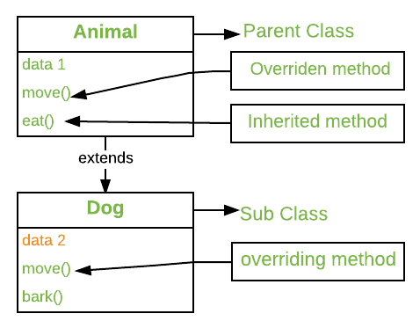
Method Overriding
Method overriding occurs when a subclass provides a specific implementation for a method that is already defined in its superclass. The overridden method in the subclass should have the same name, return type, and parameters as the method in the superclass.

Slide 6
Method Overriding examplw given below :The Dog class overrides the eat method of the Animal class.
When the eat method is called on an object of the Dog class, the overridden version in the Dog class is executed.
public class Animal {
// Method to be overridden
public void eat() {
System.out.println("This animal eats food"); }
}
public class Dog extends Animal {
// Overriding the eat method
@Override
public void eat() {
System.out.println("The dog eats bones");
}
public void bark() {
System.out.println("The dog barks");
}
}
public class Main {
public static void main(String[] args) { // Creating an object of the Dog class
Dog dog = new Dog();
// Calling the overridden method
dog.eat(); // This will call the overridden method in Dog class
// Calling the subclass method
dog.bark(); }
}

Slide 7
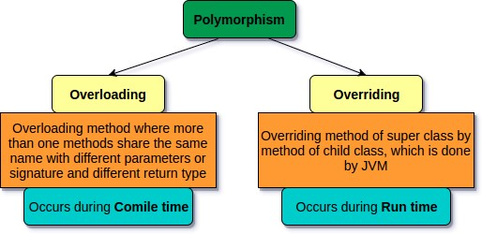
Polymorphism in Java
Polymorphism is one of the core concepts of object-oriented programming, allowing objects to be treated as instances of their parent class rather than their actual class. There are two types of polymorphism in Java:
Compile-Time Polymorphism (Method Overloading)
Runtime Polymorphism (Method Overriding)

Slide 8
Compile-Time Polymorphism (Method Overloading)
If a class has multiple methods having same name but different in parameters, it is known as Method Overloading. Method overloading is performed within class.
If we must perform only one operation, having same name of the methods increases the readability of the program.
There are three ways to overload the method in java • By changing number of arguments • By changing the data type • By changing both number of arguments and data type

Slide 9
public class MathOperations {
// Overloaded method to add two integers
public int add(int a, int b) {
return a + b;
}
// Overloaded method to add two double values
public double add(double a, double b) {
return a + b;
}
}
public class Main {
public static void main(String[] args) {
// Creating an object of the MathOperations class
MathOperations math = new MathOperations();
// Calling the overloaded methods
int sumInt = math.add(5, 10);
double sumDouble = math.add(5.5, 10.5);
// Printing the results
System.out.println("Sum of two integers: " + sumInt);
System.out.println("Sum of two doubles: " + sumDouble);
}
}
Compile-Time Polymorphism (Method Overloading) Example

Slide 10

Runtime Polymorphism (Method Overriding):
Method overriding occurs when a subclass provides a specific implementation for a method that is already defined in its superclass. The overridden method in the subclass should have the same name, return type, and parameters as the method in the superclass. This allows the subclass to provide a specific implementation of a method that is defined in its superclass.

Slide 11
Example:
public class Main {
public static void main(String[] args) {
// Creating objects of Animal, Dog, and Cat classes
Animal myAnimal = new Animal();
Animal myDog = new Dog();
Animal myCat = new Cat();
// Calling the makeSound method
myAnimal.makeSound(); // Outputs: Some generic animal sound
myDog.makeSound(); // Outputs: Bark
myCat.makeSound(); // Outputs: Meow }
}
public class Animal {
// Method to be overridden
public void makeSound() {
System.out.println("Some generic animal sound"); }
}
public class Dog extends Animal {
// Overriding the makeSound method
@Override
public void makeSound() {
System.out.println("Bark");}
}
public class Cat extends Animal {
// Overriding the makeSound method
@Override
public void makeSound() {
System.out.println("Meow");}
}

Slide 12

Abstract Classes
An abstract class is a class that cannot be instantiated on its own and must be subclassed. It can have both abstract methods (without a body) and concrete methods (with a body). Abstract classes are used when you want to provide a common base class with some common functionality that can be shared among multiple subclasses.
Abstract Method: A method that is declared without an implementation. Subclasses must provide the implementation for abstract methods.

Slide 13
Example:
public class Main {
public static void main(String[] args) {
// Animal animal = new Animal(); // This would be an error
Animal dog = new Dog();
dog.makeSound(); // Outputs: Bark
dog.sleep(); // Outputs: This animal is sleeping
}
}
public abstract class Animal { // Abstract method (no implementation)
public abstract void makeSound();
// Concrete method
public void sleep() {
System.out.println("This animal is sleeping");
}
}
public class Dog extends Animal {
// Providing implementation for the abstract method
@Override
public void makeSound() {
System.out.println("Bark");
}
}

Slide 14
Interfaces
An interface in Java is a reference type that can contain only constants, method signatures, default methods, static methods, and nested types. Interfaces cannot contain instance fields or constructors. They provide a way to achieve abstraction and multiple inheritance in Java.
Implementing Interfaces: A class can implement one or more interfaces, thereby inheriting the abstract methods of the interface(s) and providing implementations for them.

Slide 15
Example:
public class Main {
public static void main(String[] args) {
Animal dog = new Dog();
Animal cat = new Cat();
dog.makeSound(); // Outputs: Bark
cat.makeSound(); // Outputs: Meow
}
}
public interface Animal {
void makeSound();
}
public class Dog implements Animal {
// Providing implementation for the interface method
@Override
public void makeSound() {
System.out.println("Bark"); }
}
public class Cat implements Animal {
// Providing implementation for the interface method
@Override
public void makeSound() {
System.out.println("Meow"); }
}

Slide 16
Exception Handling in Java
Types of Exceptions
Checked Exceptions: These are exceptions that are checked at compile-time. They must be either caught or declared in the method using the throws keyword. Examples include IOException, SQLException, etc.
Unchecked Exceptions: These are exceptions that are not checked at compile-time but are checked at runtime. They include subclasses of RuntimeException, such as ArithmeticException, NullPointerException, ArrayIndexOutOfBoundsException, etc.
Errors: These are serious problems that a reasonable application should not try to catch. They include OutOfMemoryError, StackOverflowError, etc.

Slide 17
Final tips & takeaways
Consistent rehearsal
Strengthen your familiarity
Refine delivery style
Pacing, tone, and emphasis
Timing and transitions
Aim for seamless, professional delivery
Practice audience
Enlist colleagues to listen & provide feedback
Seek feedback
Reflect on performance
Explore new techniques
Set personal goals
Iterate and adapt

Slide 18
Try-Catch Blocks
The try block contains the code that might throw an exception. The catch block contains the code to handle the exception.
try {
int division = 10 / 0;
} catch (ArithmeticException e) {
System.out.println("Division by zero is not allowed.");
}
Finally Block
The finally block contains code that will be executed regardless of whether an exception is thrown or not. It's typically used for cleanup activities like closing files, releasing resources, etc.
try {
int division = 10 / 0;
} catch (ArithmeticException e) {
System.out.println("Division by zero is not allowed.");
} finally {
System.out.println("This block is always executed.");
}

Slide 19
Throw and Throws Keywords
throw: The throw keyword is used to explicitly throw an exception from a method or any block of code.
throws: The throws keyword is used in method signatures to declare that a method might throw one or more exceptions.
public class Example {
public void checkAge(int age) throws IllegalArgumentException {
if (age < 18) {
throw new IllegalArgumentException("Age must be 18 or above.");
}
System.out.println("Access granted.");
}
public static void main(String[] args) {
Example example = new Example();
try {
example.checkAge(15);
} catch (IllegalArgumentException e) {
System.out.println("Caught an exception: " + e.getMessage());
}
}
}

Slide 20
Thank you
Rana sujeet kumar
6203370346
ranasujeet905@gmail.

