Slide 1
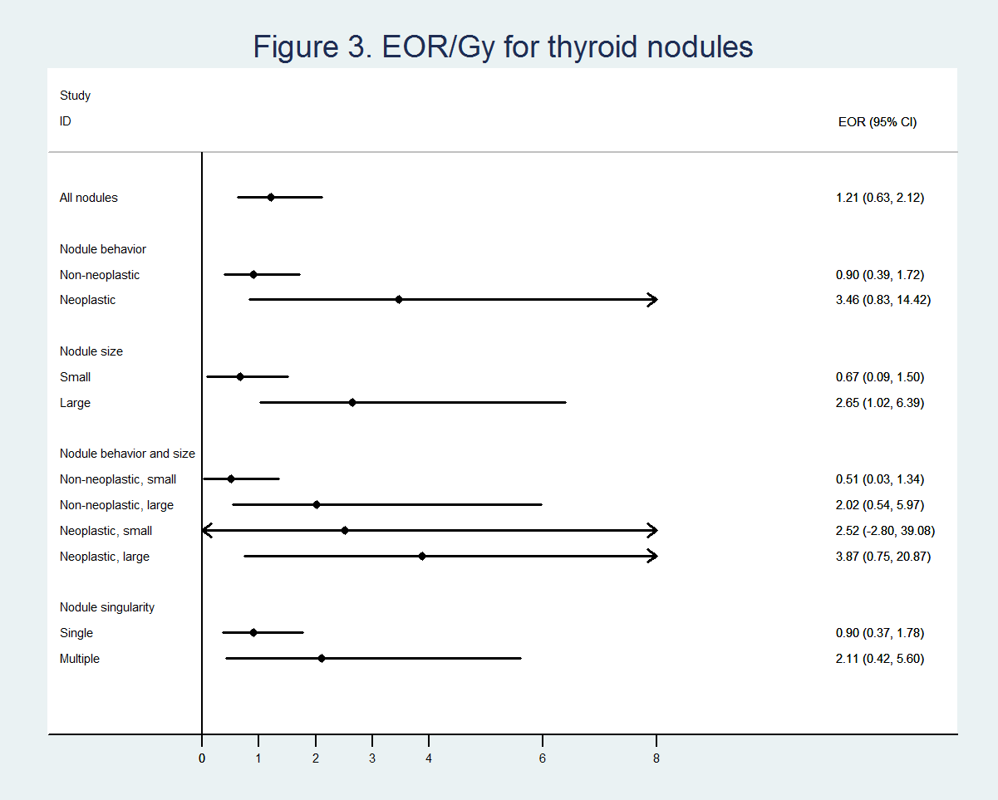
P = 0.09
P = 0.017
P = 0.069
P = 0.424
P = > 0.50
P = 0.486
P = 0.199

