Slide 1
My youtube data
Analysis
Hüseyin Beytullah Dizman

Slide 2
Table of contents
01
02
03
04
Hypothesıs
Overvıew of analysis
Graphs
summary

Slide 3

Hypothesis
v
During exam periods, there is a tendency for videos watched by me to be generally shorter, and the searched terms within these videos predominantly consist of words related to academic life.
"I would like to note that I primarily use this YouTube account during exam periods."

Slide 4

About the Project
I initially started this project by downloading my YouTube data. Subsequently, I utilized the information extracted from this data to generate graphs. Analyzing these graphs, I concluded my project.

Slide 5
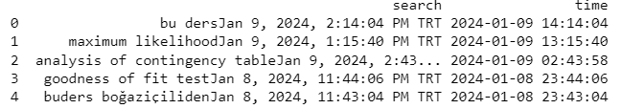
Search Hıstory
It can said that the last 5 entries in my YouTube search history support the hypothesis, and these searches were conducted before the MATH306 exam.

Slide 6
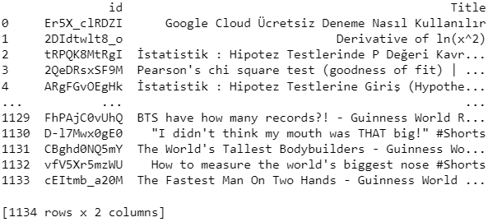
Watch Hıstory
My watch history consists of 1134 videos. Upon examining the titles of the initial videos, it can generally be said that they support the hypothesis. However, it can be noted that the videos towards the end do not align closely with the hypothesis.

Slide 7
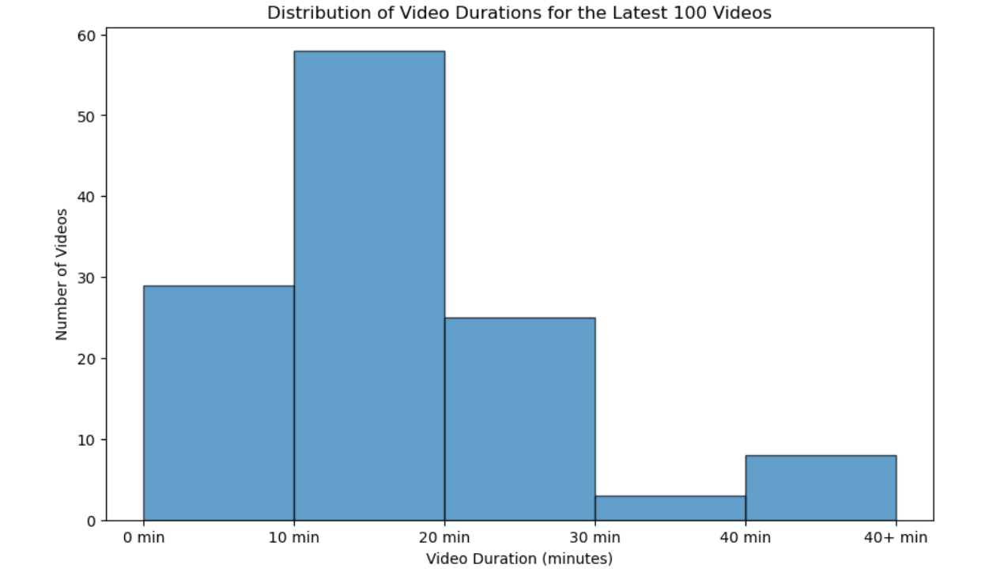
Number of vıdeos-Video duration correlation
Upon examining the provided graph, it can be inferred that the majority of video lengths fall within the range of 10 to 20 minutes, with a significant proportion of watched videos being shorter than 30 minutes. Additionally, the data presented below suggests a relatively narrow range for video lengths.

Slide 8
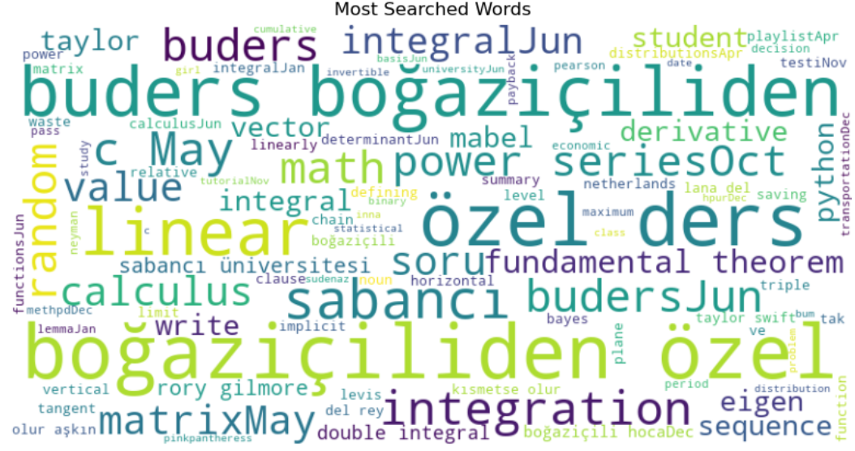
Most searched Word graph
Another crucial dataset obtained from the code is the cluster of the most searched words. Upon examination, it can be stated that the words are predominantly associated with academia. Both the words themselves and the names of YouTube channels within this cluster indicate this connection. The conclusions drawn from this observation align with the hypothesis regarding the searched terms

Slide 9
Summary!
In summary, both the analysis of graphs and the examination of the obtained data lead to the conclusion that video lengths tend to be short, and both the searched and watched video content predominantly relates to academic life. This supports the hypothesis initially stated.
Thanks, Hüseyin Beytullah Dizman

