Slide 1
GRADUATION THESIS — CHECKPOINT PRESENTATION
Behavioral DDoS Detection
at the API Layer
Robustness of Behavioral Features under Mimicry Attacks
Beyza Yavuz
Advisor: Kristin Hocam <3 Software Engineering · 2026
CHECKPOINT · BEFORE FINAL DEFENSE

Slide 2
0 · BEFORE WE BEGIN
What I Have Completed
A brief summary of the work accomplished since our last meeting
INFRASTRUCTURE & TRAFFIC
FEATURES & MODEL
EVALUATION & WRITING
▪ Built the NestJS + nginx + PostgreSQL data pipeline
▪ Per-request backend cost capture via AsyncLocalStorage
▪ Parallel telemetry: nginx access log + Prisma RequestLog
▪ Six k6 scenarios: legit, flood, low-rate, credential, mimicry, slowloris
▪ Multi-tier feature pipeline: 37 features across 4 tiers
▪ Endpoint cost profile, Markov log-likelihood, IAT KS distance
▪ Random Forest (proposed) + ISO+RF (semi-supervised alternative)
▪ Mimicry-holdout protocol — never seen during training
▪ In-distribution: 100% accuracy, 100% macro-F1 ▪ 5-fold CV stability: 99.94% ± 0.05% accuracy
▪ Mimicry holdout: 96.38% correctly flagged as attack
▪ Behavioral lift on mimicry: +23pp over rate-only (73→96%)
▪ Sensitivity analysis across three configurations (V1/V2/V3)
Today's walkthrough: the question, the system, the results, the limits, and the contributions — start to finish.
Beyza Yavuz · Thesis Checkpoint Presentation
2 / 23

Slide 3
1 · RESEARCH QUESTION
The Question in One Sentence
"
If an attacker mimics surface features — User-Agent, IP, even request rate — of a real user,
can a behavior-based detector still tell them apart?
1
Are classical rate-based defenses enough against distributed attacks?
2
How discriminative are behavioral features like endpoint cost asymmetry?
3
Can a model that never saw mimicry in training still flag it as an attack?
Beyza Yavuz · Thesis Checkpoint Presentation
3 / 23

Slide 4
1 · RESEARCH QUESTION
Why is This Question Hard?
Modern API attacks are no longer "one IP, very high rate"
①
Distributed Traffic
②
Surface Mimicry
Akamai and Cloudflare reports: a typical L7 attack spans hundreds to thousands of source IPs. Per-IP rate thresholds offer little resistance.
Attackers rotate User-Agent strings across Chrome, Safari, iPhone, etc., and vary Accept-Language and Accept-Encoding to look legitimate.
③
Asymmetric Cost
④
Testing on Unseen Attacks
An /auth/login call costs roughly 200× more than a /user/profile call because of bcrypt. Counting requests alone misses which endpoints cost what.
If a model has seen every attack type during training, it generalizes poorly. The real test is whether it catches a variant it never saw.
Beyza Yavuz · Thesis Checkpoint Presentation
4 / 23

Slide 5
2 · METHODOLOGY
System Architecture
A single data path from traffic generation to model
TRAFFIC
REVERSE PROXY
APPLICATION
STORAGE
FEATURES
MODEL
k6 + slowhttptest 6 scenarios
nginx 1.27 JSON access log
NestJS 11 Middleware + Interceptor
PostgreSQL 16 RequestLog + Connection
Tier 1-4 pipeline 37 features
Random Forest (+ISO+RF alt.)
Data Collection Details
Windowing & Labeling
nginx access log → per request: connection_id, request_time, status, upstream timing
NestJS middleware → AsyncLocalStorage isolates per-request metrics: dbQueryCount, dbTotalTimeMs, cpuTimeMs
Connection enrichment → nginx 408 timeout entries get joined into the Connection table — slowloris becomes visible
Window size: 10 seconds, aggregated by IP and /24 subnet
Label: majority traffic label per window (normal_user, http_flood, etc.)
Leakage protection: scenario_id, label, window_start removed before training — no target leakage
Beyza Yavuz · Thesis Checkpoint Presentation
5 / 23

Slide 6
2 · METHODOLOGY
Six Traffic Scenarios
Scenario 5 is special: the model only meets it during the exam
S1
Legitimate · Train · Test
S2
HTTP Flood · Train · Test
Markov navigation, log-normal think time, Zipf search terms, 100 concurrent users
Distributed high-rate requests, naive attacker UA pool
S3
Low-Rate Bot · Train · Test
S4
Credential Stuffing · Train · Test
Persistent low-rate scraping, stays under rate thresholds
Random email/password login attempts; produces 401 signal
S5
Mimicry Flood · ★ TEST ONLY
S6
Slow HTTP · Connection rule
UA + IP from legit pool, token reuse, flood-level burst
Slowloris; nginx closes at 60s; sparse 408 signal
KEY DESIGN DECISION
S5 mimicry_flood is excluded from training and validation. It is used only as a holdout test. This measures whether the model can generalize to an attack it has never seen.
Beyza Yavuz · Thesis Checkpoint Presentation
6 / 23

Slide 7
2 · METHODOLOGY
Anatomy of the Mimicry Attack
Surface looks legit, behavior is flood — this asymmetry is the thesis question
Naive HTTP Flood
Mimicry Flood
User-Agent
curl/8.7.1, python-requests, Go-http-client
User-Agent
Chrome/Safari/Firefox/iPhone — same pool as legit
IP Pool
Attacker-only pool with minimal legit overlap
IP Pool
15 IPs taken from legit pool + 5 new — overlap-heavy
Login
Re-login every request, no token reuse
Login
Token reuse, re-login every 50 iterations — sticky session
Cadence
Burst of 2-5 requests, 10-50ms apart
Cadence
Same burst pattern but inside legit-like sessions
Signature
High rate + tool UA + distinct IP cluster
Signature
Surface looks legit, but total rate and endpoint focus remain
Takeaway: the attacker can imitate the surface, but the endpoint distribution, the backend cost asymmetry, and the session pattern are harder to fake. That gap is the signal we expect the model to catch.
Beyza Yavuz · Thesis Checkpoint Presentation
7 / 23

Slide 8
2 · METHODOLOGY
Four-Tier Feature Engineering
Each tier looks at a different context — together they produce 37 features
01
Connection-level
02
Window-level (10s)
Per-TCP connection: duration, request count, keepalive, partial/timeout flags
10-second traffic summaries per source IP and /24 subnet
TIER
TIER
durationMs · requestCount · partialRequestCount · timeoutRequestCount
req_rate · iat_cv · endpoint_entropy · endpoint_cost_mean · login_present_ratio · status_4xx_ratio
03
Global (system-wide)
04
Baseline Distance
What happens system-wide in that 10-second window — the spread signature
Distance from a historical reference (NASA traces) — Markov + IAT KS
TIER
TIER
global_unique_ip · global_unique_subnet · global_req_rate · global_new_src_ratio
markov_log_likelihood · iat_ks_distance
37 numerical features in total · separate rows for IP and /24 subnet aggregations · NaN values filled with 0
Beyza Yavuz · Thesis Checkpoint Presentation
8 / 23

Slide 9
2 · METHODOLOGY
Proposed Approach: Multi-Tier Features + Random Forest
Standard supervised classifier; semi-supervised stacking tested as alternative
PROPOSED · Random Forest
ALTERNATIVE · ISO + RF Stacked
Supervised · 4-class multiclass on 37-feature pipeline
Semi-supervised extension · Reported for comparison
Input: 37 features from the 4-tier pipeline (connection, window, global, baseline-distance).
Classes: normal_user · http_flood · low_rate_bot · credential_stuffing
Setup: 200 trees, balanced_subsample class weight.
Why this model: The thesis contribution is the feature engineering pipeline, not a novel model. RF provides a strong supervised baseline that the features can be evaluated against.
Layer A: Isolation Forest trained only on normal_user, produces anomaly_score.
Layer B: Random Forest with the original 37 features + anomaly_score.
Finding: Under V3 production-realistic conditions, the ISO+RF extension provides no additional mimicry detection benefit (88.9% vs 96.4%). The unsupervised layer becomes redundant when rate signals are well-separated.
Evaluation: Proposed RF compared against rate-threshold, EWMA/CUSUM, and default RF baselines, plus ISO+RF alternative. Mimicry holdout protocol applied throughout.
Beyza Yavuz · Thesis Checkpoint Presentation
9 / 23

Slide 10
2 · METHODOLOGY
Evaluation Protocol
Three independent exams: in-distribution, holdout, and leakage check
A
In-Distribution Test
What it does: Four classes (normal / flood / low-rate / credential) with stratified train/val/test split
Metrics: Accuracy · Macro-F1 · PR-AUC · 5-fold CV stability
Purpose: Does the model separate known attack types correctly?
B
★ Mimicry Holdout
What it does: S5 is excluded from training. The model only meets it during testing.
Metrics: recall_as_flood · evasion_rate · binary_attack_recall
Purpose: Does the model also catch an attack type it has never seen?
C
Leakage & Ablation Checks
What it does: Random-label permutation (real 99.8% vs permuted 33%) + 12 feature-group ablations
Metrics: Δ accuracy (real vs permuted) · per-group validation + mimicry recall
Purpose: Is the model learning real signal, or just taking shortcuts?
Three independent exams. When all three point the same way, the central claim becomes defensible.
Beyza Yavuz · Thesis Checkpoint Presentation
10 / 23

Slide 11
3 · RESULTS
Result 1 — In-Distribution Performance
On the four known classes, the model is perfect
100%
100%
100%
TEST ACCURACY
MACRO-F1
MEAN PR-AUC
Per-class performance (Proposed Random Forest · Test set, n=1446)
Class | Precision | Recall | F1-score | Support
credential_stuffing | 1.0000 | 1.0000 | 1.0000 | 396
http_flood | 1.0000 | 1.0000 | 1.0000 | 332
low_rate_bot | 1.0000 | 1.0000 | 1.0000 | 145
normal_user | 1.0000 | 1.0000 | 1.0000 | 573
Reading: zero misclassifications across 1446 test windows. Random-label permutation sanity (real 99.8% vs permuted 33%) confirms genuine signal, not memorization.
Beyza Yavuz · Thesis Checkpoint Presentation
11 / 23

Slide 12
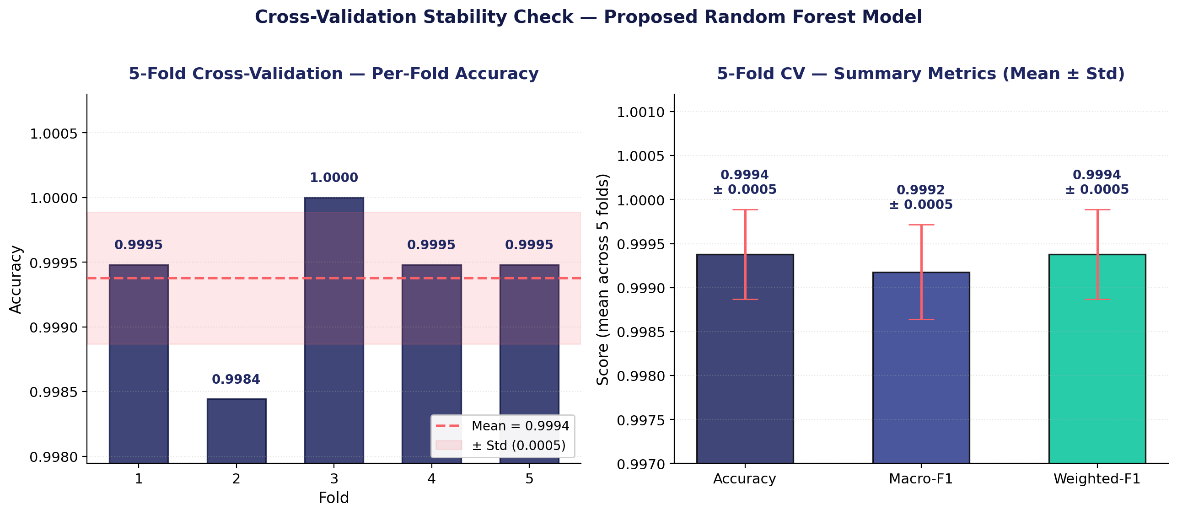
3 · RESULTS
Cross-Validation Stability Check
Checking whether high in-distribution performance is stable across folds
Observations
99.94% ± 0.05%
Mean accuracy across 5 folds
99.92% ± 0.05%
Mean macro-F1 across 5 folds
All folds ≈ 1.00
Performance remains stable across partitions
Main takeaway
The high in-distribution result is not only a single-split artifact
Beyza Yavuz · Thesis Checkpoint Presentation
12 / 23

Slide 13
3 · RESULTS · THE KEY EXPERIMENT
★ Mimicry Holdout — The Heart of the Thesis
The model never saw this attack during training. It only met it during the exam.
96.38%
3.08%
96.92%
classified CORRECTLY as http_flood
missed as normal_user (evasion rate)
BINARY ATTACK RECALL (total)
Proposed Random Forest vs ISO+RF (alternative) — mimicry predictions
13 / 23

Slide 14
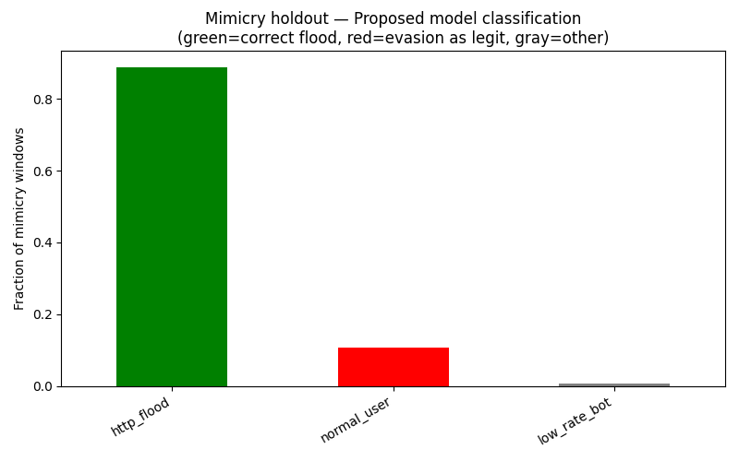
3 · RESULTS · INTERPRETATION
How to Read the Mimicry Result
Three layers: what the attacker did, what they couldn't fake, and why it matters
LAYERS OF INTERPRETATION
1
What the attacker did well
Surface mimicry worked: UA pool, IP overlap, token reuse, sticky sessions — all successfully imitated. Even per-window request rate overlaps normal_user.
2
What the attacker could not fake
Endpoint distribution (search-burst only), endpoint cost asymmetry (heavy login + search), login pattern, status code mix — these behavioral signatures bleed through.
3
Why this matters
The model never saw the mimicry variant of these features during training. It still flagged 96.92% of mimicry windows as attack — the features GENERALIZE to a new attack type.
Beyza Yavuz · Thesis Checkpoint Presentation
14 / 23

Slide 15
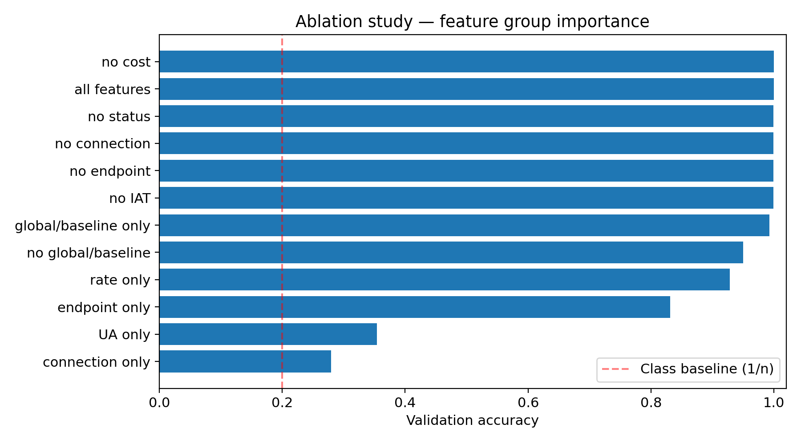
3 · RESULTS · ABLATION
★ Proving the Behavioral Lift on Mimicry
Rate-only recalls 73% of mimicry; the full feature pipeline recalls 96% — a +23pp gap
KEY MIMICRY-RECALL FINDINGS
96.4%
All features (full)
The proposed pipeline detection.
73.1%
Rate-only
Rate alone insufficient against mimicry. Behavioral lift: +23pp.
13.2%
UA-only
Below class baseline. Model does NOT use UA shortcut.
14.9%
No global/baseline
Removing global features collapses mimicry detection (-81pp).
Beyza Yavuz · Thesis Checkpoint Presentation
15 / 23

Slide 16
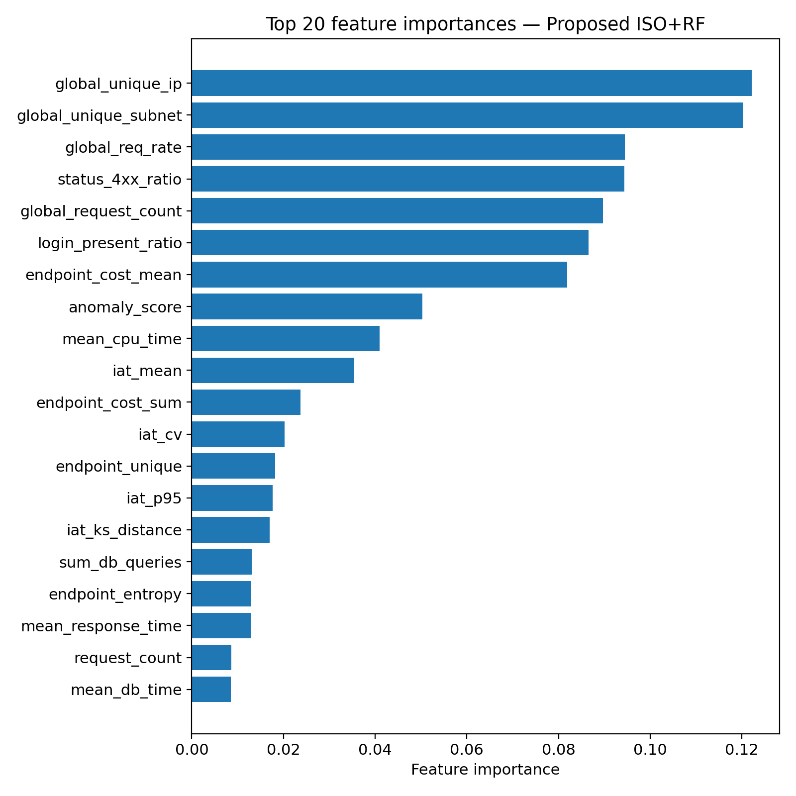
3 · RESULTS · FEATURES
What Features Is the Model Actually Using?
Top feature importances · Proposed Random Forest model
DISCRIMINATIVE GROUPS
Source Diversity (global)
global_unique_ip (#1) · global_unique_subnet (#2) · global_req_rate (#3)
How distributed and how fast is the attack?
Identity & Status
status_4xx_ratio (#5) · login_present_ratio (#7)
Auth pattern + error signal
Endpoint Cost (behavioral)
endpoint_cost_mean (#4) · endpoint_cost_sum (#10) · mean_cpu_time (#8)
Backend cost asymmetry — hard for attacker to fake
Timing Behavior
iat_mean (#9) · iat_cv · iat_p95 · iat_ks_distance
Request timing patterns — strong on mimicry
Beyza Yavuz · Thesis Checkpoint Presentation
16 / 23

Slide 17
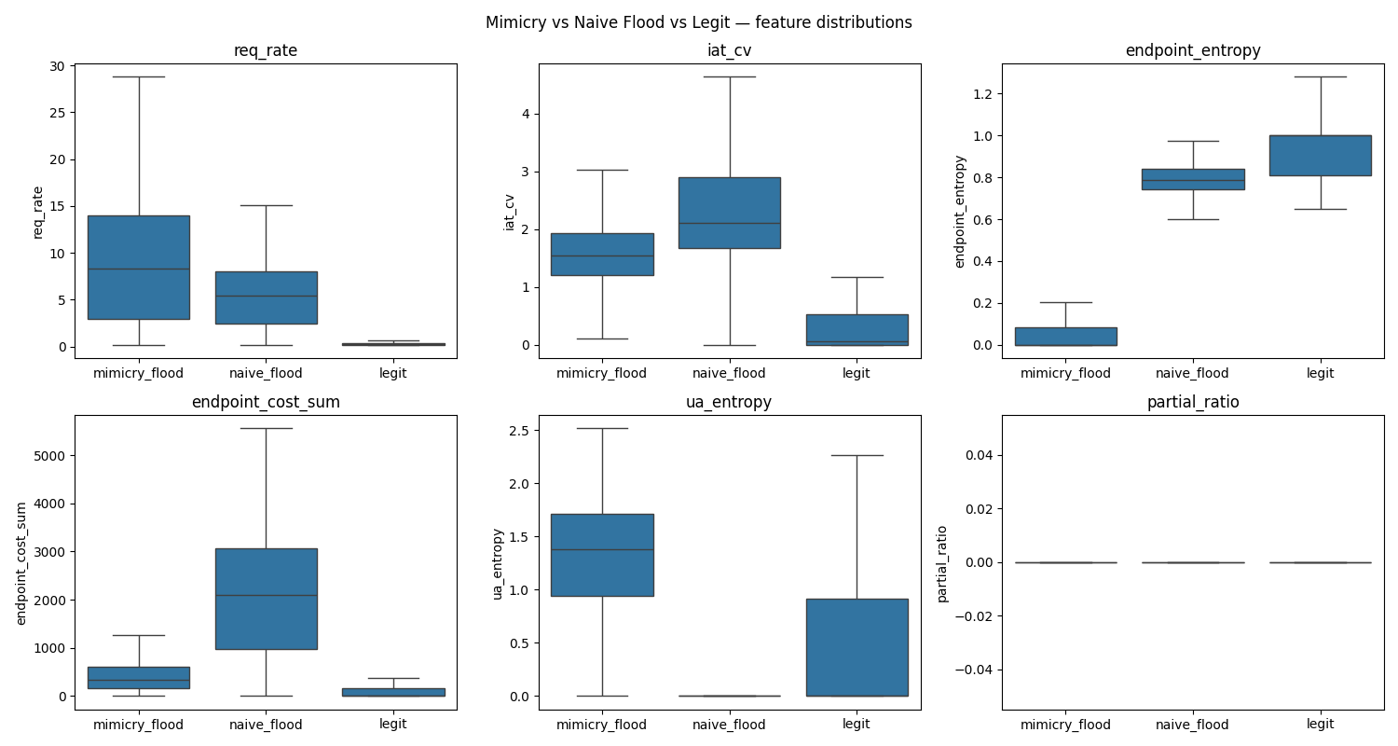
3 · RESULTS · DEEP-DIVE
Mimicry, Flood, and Legit — Side by Side
Which features overlap, which ones separate?
SEPARATION POINTS
req_rate
OVERLAPS
All three classes share similar rate distributions — rate alone cannot tell mimicry from legit.
endpoint_entropy
SEPARATES
Legit ~0.9, mimicry ~0.05. Mimicry only bursts on search — its distribution is narrow.
endpoint_cost_sum
SEPARATES
Naive flood high (heavy logins), mimicry mid, legit varied. Cost asymmetry signal.
ua_entropy
INVERTED
Higher in mimicry — the attacker DIVERSIFIES UA strings, and that itself is a signal.
Beyza Yavuz · Thesis Checkpoint Presentation
17 / 23

Slide 18
3 · RESULTS · OPERATIONAL
Detection Latency and False Positive Rate
How fast does the system react, and how often does it bother real users?
Detection summary
False positives on normal users
Metric | Value
Median detection latency | 0.0 sec (first window)
Mimicry binary attack recall | 96.92%
In-distribution test accuracy | 100%
Behavioral lift on mimicry (ablation) | +23 percentage points
S6 slowloris (sparse, rule-based) * | see §5.3
0
false-positive windows
∞
windows per false alarm
0.000
FPR / legit IP-minute
* Slow HTTP evaluated by connection-level rule — see Discussion §5.3
OPERATIONAL READING
Median detection is in the first 10-second window. Under V3 production-realistic conditions, the model produces zero false positives across all normal-user windows — a clean signal even with stricter (more realistic) legit baseline.
Beyza Yavuz · Thesis Checkpoint Presentation
18 / 23

Slide 19
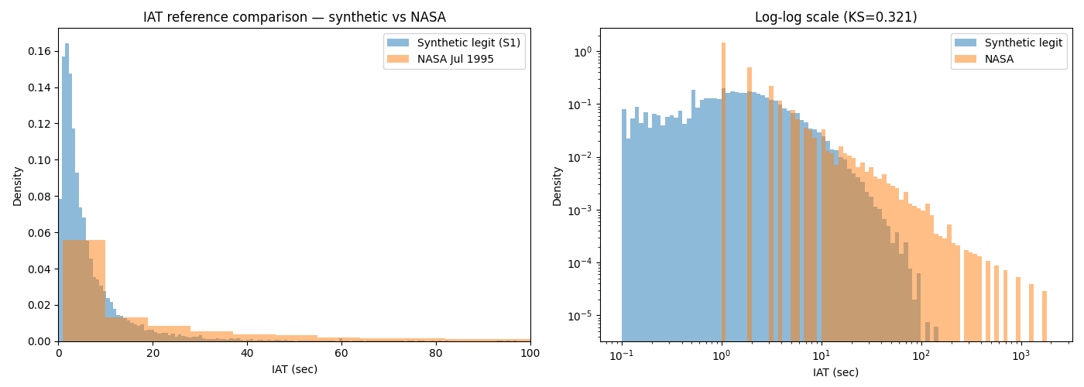
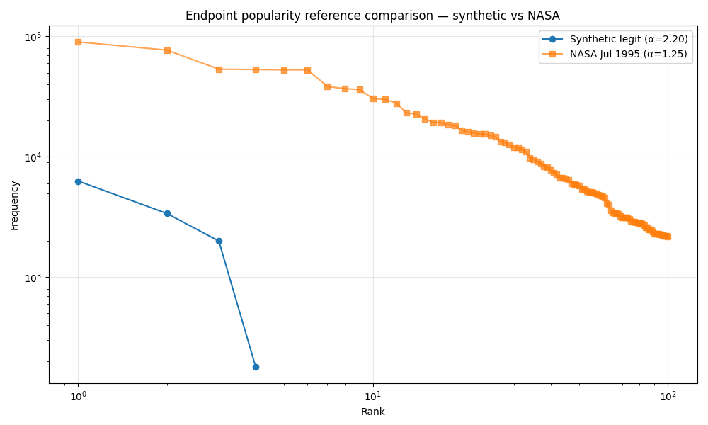
3 · RESULTS · CALIBRATION
Calibration Improvement — Synthetic Aligns with NASA
After bug fix + 100 VU, IAT KS dropped from 0.994 to 0.321
IAT distribution (KS = 0.321) — substantial alignment in 0.1-10s range
Endpoint Zipf (α: synthetic 2.20 vs NASA 1.25)
WHAT'S PRESERVED, WHAT'S RE-PARAMETERIZED
Synthetic traffic now closely tracks NASA structure.
After applying log-normal think times and scaling to 100 concurrent users, IAT KS dropped from 0.994 to 0.321 — a substantial alignment improvement.
Structural properties preserved: log-normal IAT shape, Zipf endpoint popularity, Markov navigation graph.
Numerical parameters re-parameterized per deployment context: α 2.20 (4 routes) vs NASA 1.25 (hundreds of paths) — expected; structure transfers, context-specific values do not.
Beyza Yavuz · Thesis Checkpoint Presentation
19 / 23

Slide 20
4 · CONTRIBUTIONS & LIMITS
Scientific Contributions
Three methodological moves that make this thesis stand out
01
Multi-Tier Behavioral Feature Pipeline
37 features across four tiers (connection / window / global / baseline-distance). Ablation shows +23pp behavioral lift on mimicry recall over rate-only features.
features
architecture
02
Mimicry Holdout Protocol
The mimicry attack variant is explicitly excluded from training and validation, evaluated only on holdout. This stricter protocol tests generalization to unseen attacks.
protocol
evaluation
03
Sensitivity-Analyzed Reporting (V1/V2/V3)
Two implementation issues were identified, corrected, and the central finding (behavioral feature contribution on mimicry) was re-verified across three experimental configurations to demonstrate robustness.
robustness
transparency
Beyza Yavuz · Thesis Checkpoint Presentation
20 / 23

Slide 21
4 · CONTRIBUTIONS & LIMITS
Limitations — The Honest List
Aligned with Discussion §5.6 — a complete inventory
SCOPE
Single application
DATA
Synthetic traffic
All results are from one NestJS API. Endpoint cost profile is application-specific.
Generated by k6 and slowhttptest in a controlled setting. No production trace validation.
ADV.
No adaptive adversary
SIGNAL
Slow HTTP is sparse
Mimicry is static. The attacker does not iteratively optimize against detector feedback.
nginx 60s timeout kills slowloris early; evaluated by rule rather than as a supervised class.
AUTH
Auth-layer rate limiting DISABLED
FIXED
Bug 1: UserService Prisma client
To isolate the behavioral signal, AuthService IP block and account lockout were deliberately turned off.
Initially used a separate PrismaClient bypassing query timing. CORRECTED in V2/V3.
FIXED
Bug 2: Think-time sleep missing
EXT.
External validation is limited
k6 legit flow computed think times but didn't apply sleep(). CORRECTED in V2/V3.
CIC-DDoS2019 sanity check performed but feature space differs from API-layer model.
Beyza Yavuz · Thesis Checkpoint Presentation
21 / 23

Slide 22
4 · CONTRIBUTIONS & LIMITS
Future Work
Five natural extensions of this thesis
→
Multi-application validation
Test the same pipeline on 3-5 APIs with different endpoint structures and cost profiles.
→
Adaptive adversary
Scenarios where the attacker observes detection feedback and iteratively optimizes endpoint, IP, and timing choices.
→
Production trace validation
Run the model on anonymized production API logs; explore synthetic-to-real transfer learning.
→
Protocol-level features
TLS JA3/JA4 fingerprints, HTTP/2 behavior, and browser automation traces (Selenium, Puppeteer).
→
Richer slow HTTP telemetry
More detailed reverse-proxy and socket-level metrics to model slowloris as a continuous rather than sparse signal.
Beyza Yavuz · Thesis Checkpoint Presentation
22 / 23

Slide 23
CLOSING
Summary and Verdict
✓
Behavior-based API-layer detection is robust to surface mimicry under production-realistic conditions.
Mimicry holdout 96.38% · FPR = 0 · Behavioral lift +23pp over rate-only · UA-only 13% (no shortcut)
01
The mimicry holdout protocol is the methodological core — the model generalizes to an unseen attack at 96.4% recall.
02
Ablation rules out shortcut-learning — rate-only mimicry recall is 73%, behavioral features add +23 percentage points.
03
Implementation issues were identified, corrected, and the central finding re-verified across three configurations (sensitivity analysis).
23 / 23

