Slide 1
GRADUATION THESIS — FINAL DEFENSE
Behavioral DDoS Detection
at the API Layer
Robustness of Behavioral Features under Mimicry Attacks
Beyza Yavuz Advisor: Kristin Hocam
Software Engineering · Graduation Thesis · 2026
FINAL THESIS DEFENSE

Slide 2
0 · OVERVIEW
What This Thesis Accomplished
End-to-end behavioral DDoS detection pipeline with strict generalization testing
INFRASTRUCTURE & TRAFFIC
FEATURES & MODEL
EVALUATION & VALIDATION
▪ NestJS + nginx + PostgreSQL data pipeline
▪ Per-request backend cost capture via AsyncLocalStorage
▪ Parallel telemetry: nginx access log + Prisma RequestLog
▪ Six k6 scenarios: legit, flood, low-rate, credential, mimicry, slowloris
▪ Multi-tier feature pipeline: 37 features across 4 tiers
▪ Endpoint cost profile, Markov log-likelihood, IAT KS distance
▪ Random Forest (proposed) + ISO+RF (semi-supervised alternative)
▪ Strict mimicry-holdout protocol — never seen during training
▪ In-distribution: 100% accuracy, 100% macro-F1
▪ 5-fold CV: 99.94% ± 0.05% (stability confirmed)
▪ Mimicry holdout: 96.38% recall as attack (unseen variant)
▪ Behavioral lift: +23pp over rate-only ablation
This defense walks through the research question, methodology, results across three configurations, and limitations.
Beyza Yavuz · Graduation Thesis · Final Defense
2 / 23

Slide 3
1 · RESEARCH QUESTION
The Question in One Sentence
"
If an attacker mimics surface features — User-Agent, IP, even request rate — of a real user,
can a behavior-based detector still tell them apart?
1
Are classical rate-based defenses enough against distributed attacks?
2
How discriminative are behavioral features like endpoint cost asymmetry?
3
Can a model that never saw mimicry in training still flag it as an attack?
Beyza Yavuz · Graduation Thesis · Final Defense
3 / 23

Slide 4
1 · RESEARCH QUESTION
Why is This Question Hard?
Modern API attacks are no longer "one IP, very high rate"
Distributed Traffic
Surface Mimicry
Akamai and Cloudflare reports: a typical L7 attack spans hundreds to thousands of source IPs. Per-IP rate thresholds offer little resistance.
Attackers rotate User-Agent strings across Chrome, Safari, iPhone, etc., and vary Accept-Language and Accept-Encoding to look legitimate.
Asymmetric Cost
Testing on Unseen Attacks
An /auth/login call costs roughly 200× more than a /user/profile call because of bcrypt. Counting requests alone misses which endpoints cost what.
If a model has seen every attack type during training, it generalizes poorly. The real test is whether it catches a variant it never saw.
Beyza Yavuz · Graduation Thesis · Final Defense
4 / 23

Slide 5
2 · METHODOLOGY
System Architecture
A single data path from traffic generation to model
TRAFFIC
REVERSE PROXY
APPLICATION
STORAGE
FEATURES
MODEL
k6 + slowhttptest 6 scenarios
nginx 1.27 JSON access log
NestJS 11 Middleware + Interceptor
PostgreSQL 16 RequestLog + Connection
Tier 1-4 pipeline 37 features
Random Forest (+ISO+RF alt.)
Data Collection Details
Windowing & Labeling
nginx access log → per request: connection_id, request_time, status, upstream timing
NestJS middleware → AsyncLocalStorage isolates per-request metrics: dbQueryCount, dbTotalTimeMs, cpuTimeMs
Connection enrichment → nginx 408 timeout entries get joined into the Connection table — slowloris becomes visible
Window size: 10 seconds, aggregated by IP and /24 subnet
Label: majority traffic label per window
Leakage protection: scenario_id, label, window_start removed before training
Beyza Yavuz · Graduation Thesis · Final Defense
5 / 23

Slide 6
2 · METHODOLOGY
Six Traffic Scenarios
Scenario 5 is special: the model only meets it during the exam
S1
Legitimate · Train · Test
S2
HTTP Flood · Train · Test
Markov navigation, log-normal think time, Zipf search terms, 100 concurrent users
Distributed high-rate requests, naive attacker UA pool
S3
Low-Rate Bot · Train · Test
S4
Credential Stuffing · Train · Test
Persistent low-rate scraping, stays under rate thresholds
Random email/password login attempts; produces 401 signal
S5
Mimicry Flood · ★ TEST ONLY
S6
Slow HTTP · Connection rule
UA + IP from legit pool, token reuse, flood-level burst
Slowloris; nginx closes at 60s; sparse 408 signal
KEY DESIGN DECISION
S5 mimicry_flood is excluded from training and validation. It is used only as a holdout test. This measures whether the model can generalize to an attack it has never seen.
Beyza Yavuz · Graduation Thesis · Final Defense
6 / 23

Slide 7
2 · METHODOLOGY
Anatomy of the Mimicry Attack
Surface looks legit, behavior is flood — this asymmetry is the thesis question
Naive HTTP Flood
Mimicry Flood
User-Agent
curl/8.7.1, python-requests, Go-http-client
User-Agent
Chrome/Safari/Firefox/iPhone — same pool as legit
IP Pool
Attacker-only pool with minimal legit overlap
IP Pool
15 IPs taken from legit pool + 5 new — overlap-heavy
Login
Re-login every request, no token reuse
Login
Token reuse, re-login every 50 iterations — sticky session
Cadence
Burst of 2-5 requests, 10-50ms apart
Cadence
Same burst pattern but inside legit-like sessions
Signature
High rate + tool UA + distinct IP cluster
Signature
Surface looks legit, but total rate and endpoint focus remain
Takeaway: the attacker can imitate the surface, but the endpoint distribution, the backend cost asymmetry, and the session pattern are harder to fake. That gap is the signal we expect the model to catch.
Beyza Yavuz · Graduation Thesis · Final Defense
7 / 23

Slide 8
2 · METHODOLOGY
Four-Tier Feature Engineering
Each tier looks at a different context — together they produce 37 features
01
Connection-level
02
Window-level (10s)
TIER
Per-TCP connection: duration, request count, keepalive, partial/timeout flags
TIER
10-second traffic summaries per source IP and /24 subnet
durationMs · requestCount · partialRequestCount · timeoutRequestCount
req_rate · iat_cv · endpoint_entropy · endpoint_cost_mean · login_present_ratio · status_4xx_ratio
03
04
Global (system-wide)
Baseline Distance
TIER
What happens system-wide in that 10-second window — the spread signature
TIER
Distance from a historical reference (NASA traces) — Markov + IAT KS
global_unique_ip · global_unique_subnet · global_req_rate · global_new_src_ratio
markov_log_likelihood · iat_ks_distance
37 numerical features in total · separate rows for IP and /24 subnet aggregations · NaN values filled with 0
Beyza Yavuz · Graduation Thesis · Final Defense
8 / 23

Slide 9
2 · METHODOLOGY
Proposed Approach: Multi-Tier Features + Random Forest
Standard supervised classifier; semi-supervised stacking tested as alternative
PROPOSED · Random Forest
ALTERNATIVE · ISO + RF Stacked
Supervised · 4-class multiclass on 37-feature pipeline
Semi-supervised extension · Reported for comparison
Input: 37 features from the 4-tier pipeline.
Classes: normal_user · http_flood · low_rate_bot · credential_stuffing
Setup: 200 trees, balanced_subsample class weighting.
Why RF: The thesis contribution is the feature pipeline, not a novel classifier. RF is a strong, well-understood baseline that lets the features speak.
Layer A: Isolation Forest trained only on normal_user produces anomaly_score.
Layer B: Random Forest with original 37 features + anomaly_score.
Finding: Under production-realistic conditions, ISO+RF gives 88.9% mimicry recall vs 96.4% from supervised RF. The unsupervised layer becomes redundant when supervised signal is sufficient.
Evaluation: Proposed RF compared against rate-threshold, EWMA/CUSUM, default RF baselines, plus ISO+RF alternative.
Beyza Yavuz · Graduation Thesis · Final Defense
9 / 23

Slide 10
2 · METHODOLOGY
Evaluation Protocol
Four independent checks: in-distribution, stability, holdout, and leakage
In-Distribution Test
A
What: Stratified train/val/test split on the four known classes
Metrics: Accuracy · Macro-F1 · PR-AUC · Confusion Matrix
5-Fold Cross-Validation (Stability)
B
What: 5-fold stratified CV on combined in-distribution pool (n=9,638)
Metrics: Mean ± std of accuracy and F1 scores across folds
★ Mimicry Holdout
C
What: S5 excluded from training; model only meets it during testing
Metrics: recall_as_flood · evasion_rate · binary_attack_recall
Leakage & Ablation Checks
D
What: Random-label permutation + 12 feature-group ablations
Metrics: Δ accuracy (real vs permuted) · per-group mimicry recall
Four independent checks. When all four point the same way, the central claim becomes defensible.
Beyza Yavuz · Graduation Thesis · Final Defense
10 / 23

Slide 11
3 · RESULTS
A $⋅$ In-Distribution Performance
On the four known classes, the model is perfect
100%
100%
100%
TEST ACCURACY
MACRO-F1
MEAN PR-AUC
Per-class performance (Proposed Random Forest · Test set, n=1446)
Class | Precision | Recall | F1-score | Support
credential_stuffing | 1.0000 | 1.0000 | 1.0000 | 396
http_flood | 1.0000 | 1.0000 | 1.0000 | 332
low_rate_bot | 1.0000 | 1.0000 | 1.0000 | 145
normal_user | 1.0000 | 1.0000 | 1.0000 | 573
Reading: zero misclassifications across 1,446 test windows. Verified by 5-fold CV (next slide) and permutation sanity (real 99.8% vs permuted 33%).
Beyza Yavuz · Graduation Thesis · Final Defense
11 / 23

Slide 12
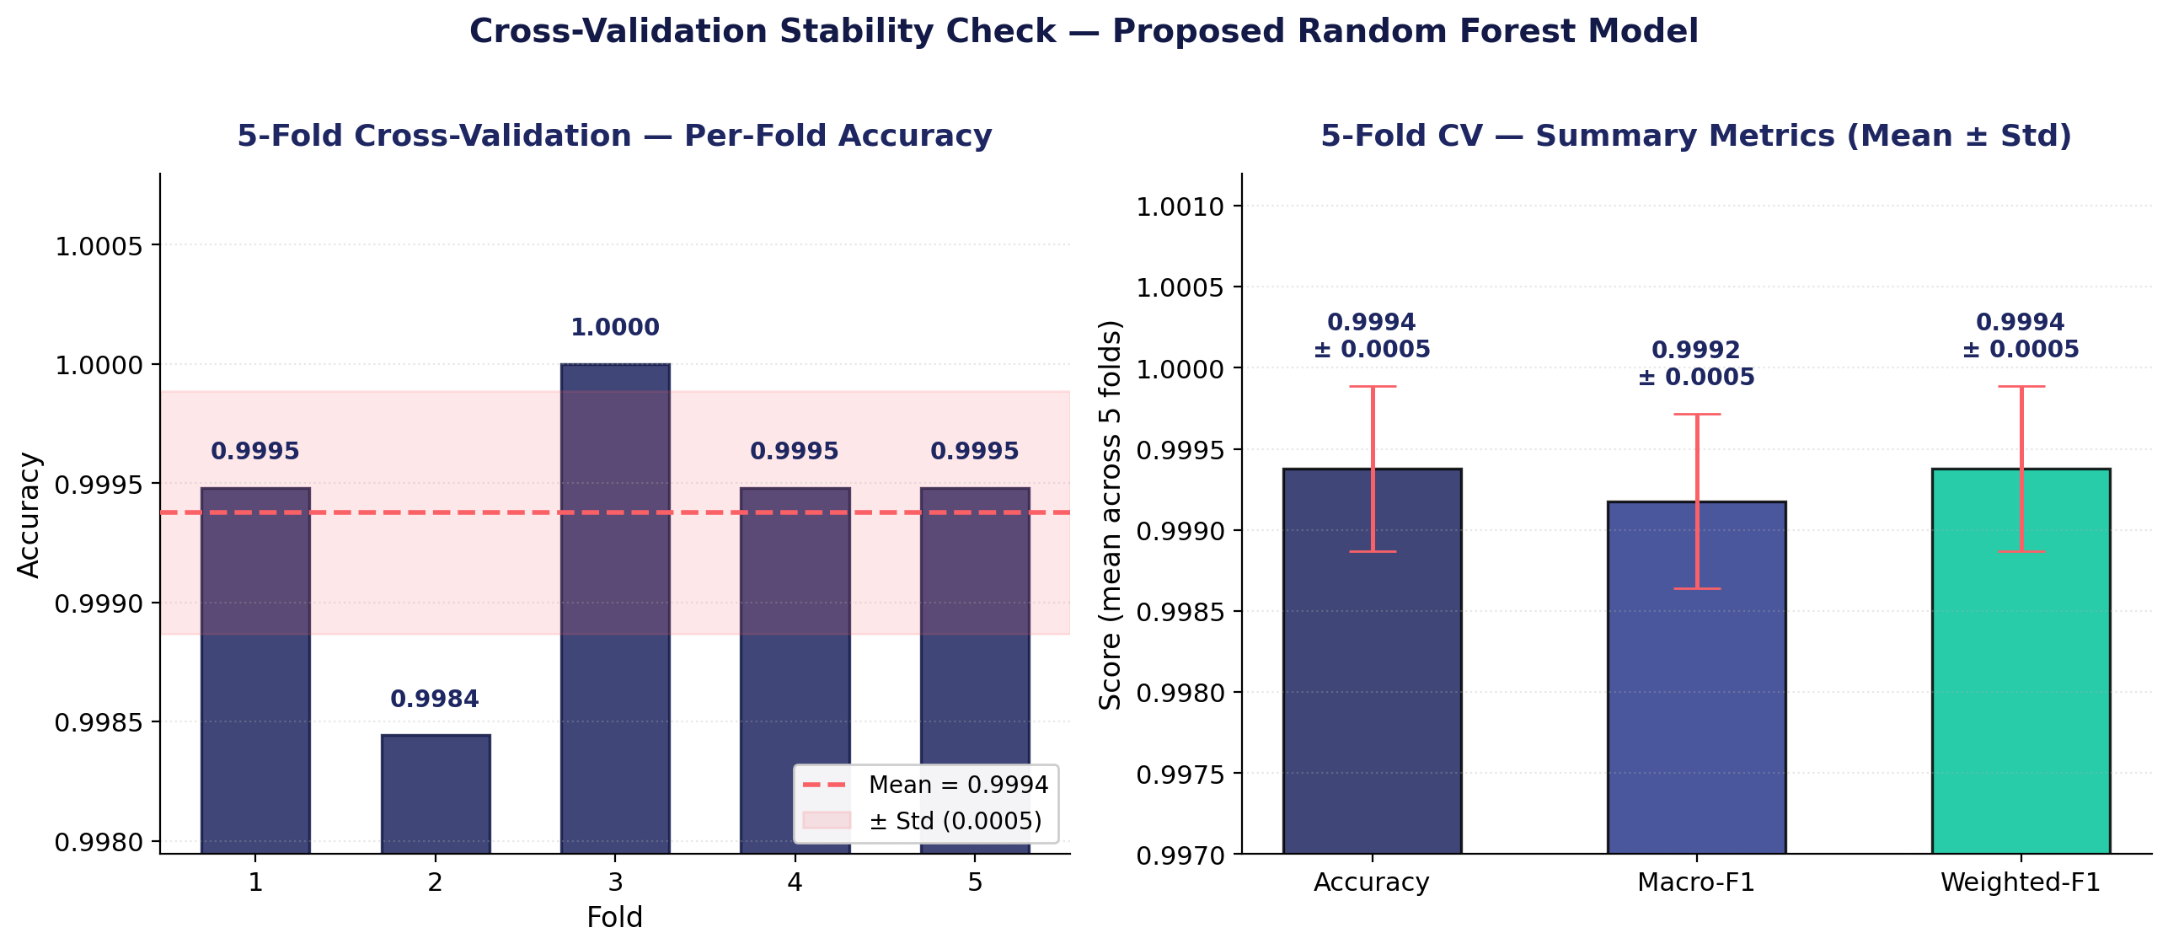
3 · RESULTS · STABILITY
B $⋅$ Cross-Validation Stability Check
5-fold stratified CV confirms the single-split result is not an artifact
99.94%
± 0.05%
Accuracy
99.92%
± 0.05%
Macro-F1
99.94%
± 0.05%
Weighted-F1
STABILITY EVIDENCE
Per-fold range: 99.84% – 100%. Std = 0.0005 confirms the in-distribution result is not a single-split artifact. Combined with the permutation sanity (real 99.8% vs permuted 33%), this provides multi-layered evidence against overfitting.
Beyza Yavuz · Graduation Thesis · Final Defense
12 / 23

Slide 13
3 · RESULTS · THE KEY EXPERIMENT
C $⋅$ Mimicry Holdout — The Heart of the Thesis
The model never saw this attack during training. It only met it during the exam.
96.38%
3.08%
96.92%
classified CORRECTLY as http_flood
missed as normal_user (evasion rate)
BINARY ATTACK RECALL (total)
Proposed Random Forest vs ISO+RF (alternative) — mimicry predictions
13 / 23

Slide 14
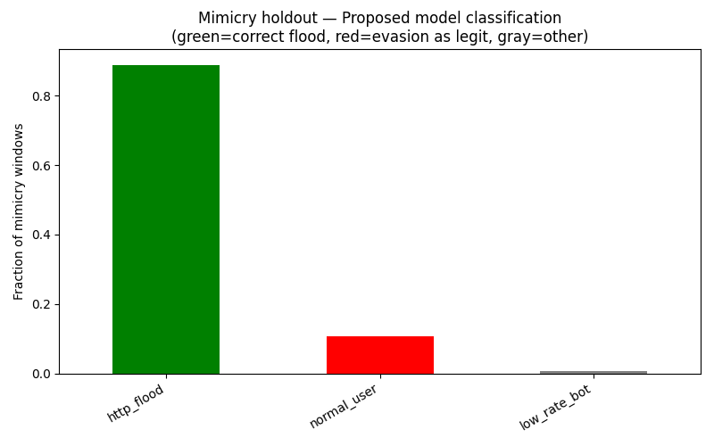
3 · RESULTS · INTERPRETATION
C $⋅$ How to Read the Mimicry Result
Three layers: what the attacker did, what they couldn't fake, and why it matters
LAYERS OF INTERPRETATION
1
What the attacker did well
Surface mimicry worked: UA pool, IP overlap, token reuse, sticky sessions — all successfully imitated. Even per-window request rate overlaps normal_user.
2
What the attacker could not fake
Endpoint distribution (search-burst only), endpoint cost asymmetry, login pattern, status code mix — these behavioral signatures bleed through.
3
Why this matters
The model never saw the mimicry variant during training. It still flagged 96.92% as attack — the features GENERALIZE to a new attack type.
Beyza Yavuz · Graduation Thesis · Final Defense
14 / 23

Slide 15
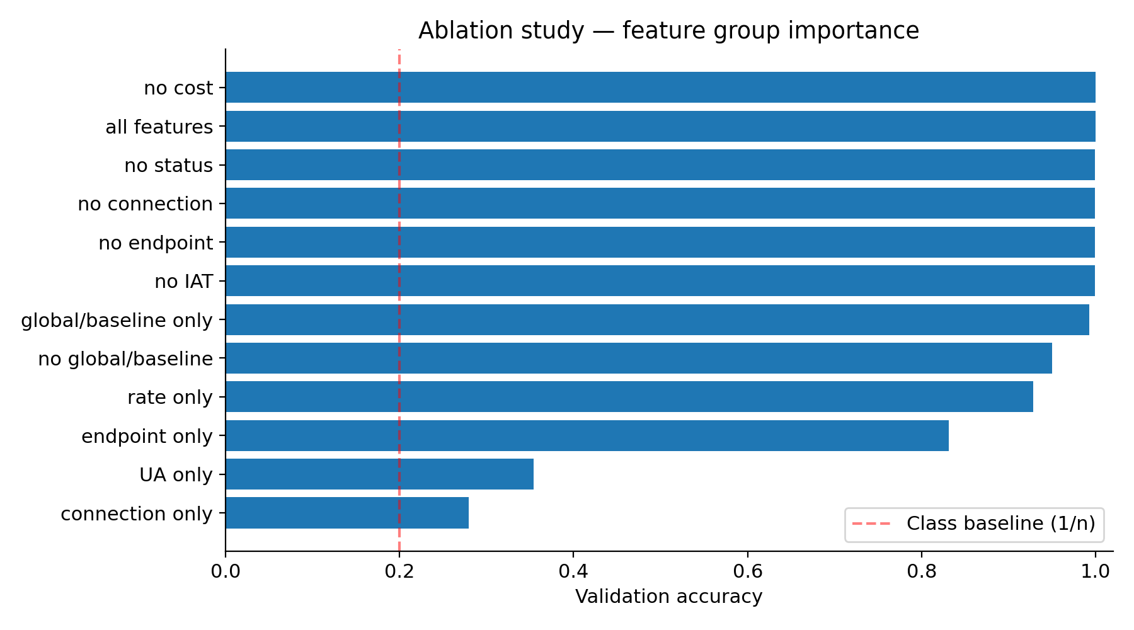
3 · RESULTS · ABLATION
D $⋅$ Proving the Behavioral Lift on Mimicry
Rate-only recalls 73% of mimicry; the full feature pipeline recalls 96% — a +23pp gap
KEY MIMICRY-RECALL FINDINGS
96.4%
All features (full)
The proposed pipeline detection.
73.1%
Rate-only
Rate alone insufficient against mimicry. Behavioral lift: +23pp.
13.2%
UA-only
Below class baseline. Model does NOT use UA shortcut.
14.9%
No global/baseline
Removing global features collapses mimicry detection (-81pp).
Beyza Yavuz · Graduation Thesis · Final Defense
15 / 23

Slide 16
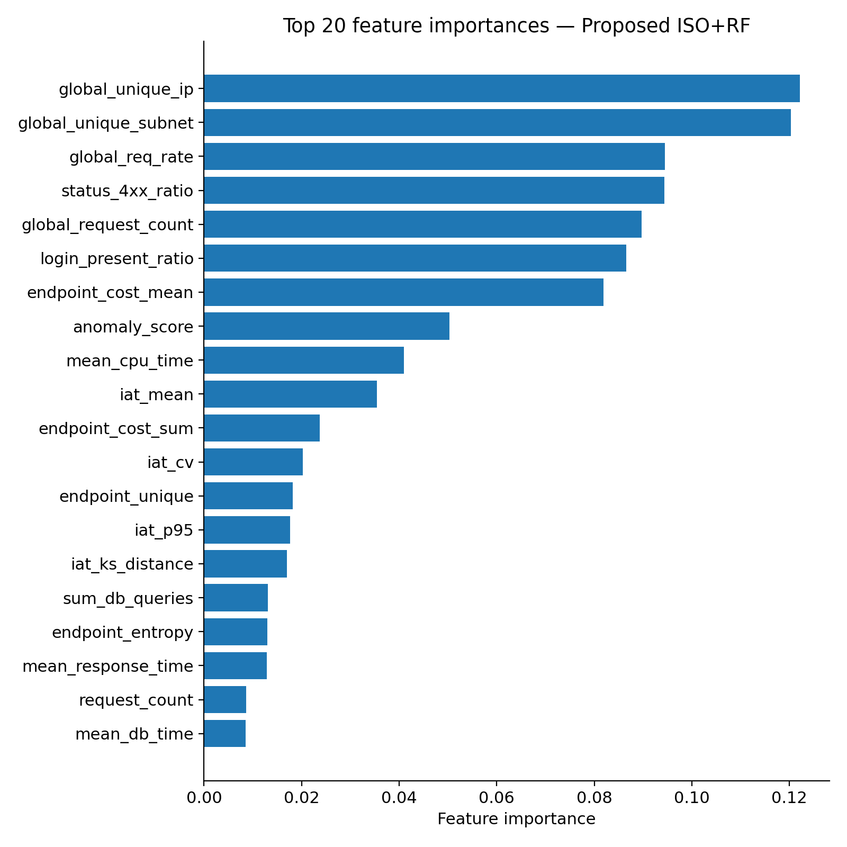
3 · RESULTS · FEATURES
What Features Is the Model Actually Using?
Top feature importances · Proposed Random Forest model
DISCRIMINATIVE GROUPS
Source Diversity (global)
global_unique_ip (#1) · global_unique_subnet (#2) · global_req_rate (#3)
How distributed and how fast is the attack?
Identity & Status
status_4xx_ratio (#5) · login_present_ratio (#7)
Auth pattern + error signal
Endpoint Cost (behavioral)
endpoint_cost_mean (#4) · endpoint_cost_sum (#10) · mean_cpu_time (#8)
Backend cost asymmetry — hard for attacker to fake
Timing Behavior
iat_mean (#9) · iat_cv · iat_p95 · iat_ks_distance
Request timing patterns — strong on mimicry
Beyza Yavuz · Graduation Thesis · Final Defense
16 / 23

Slide 17
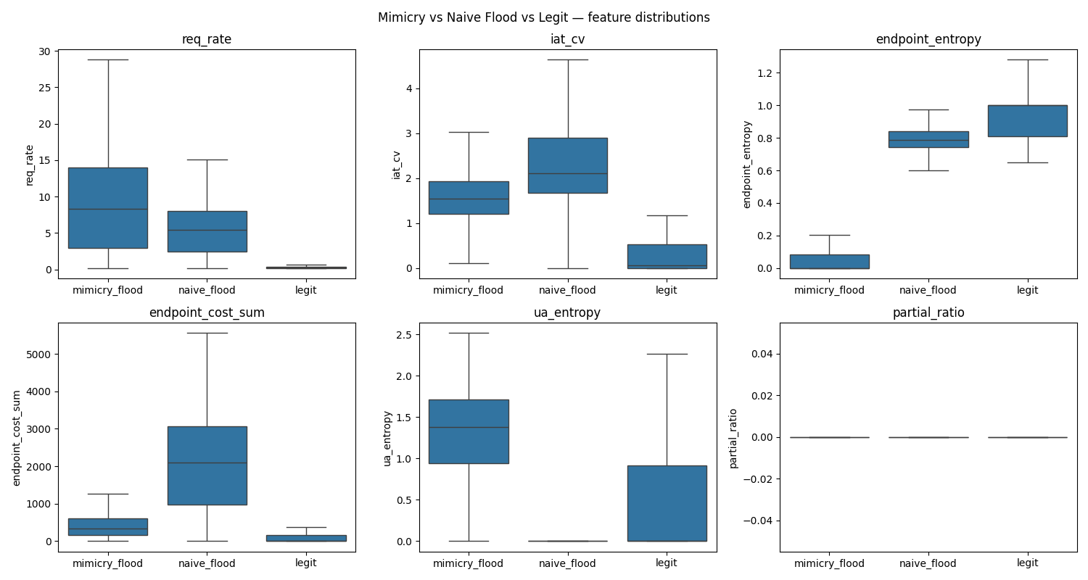
3 · RESULTS · DEEP-DIVE
Mimicry, Flood, and Legit — Side by Side
Which features overlap, which ones separate?
SEPARATION POINTS
req_rate
OVERLAPS
All three classes share similar rate distributions — rate alone cannot tell mimicry from legit.
endpoint_entropy
SEPARATES
Legit ~0.9, mimicry ~0.05. Mimicry only bursts on search — its distribution is narrow.
endpoint_cost_sum
SEPARATES
Cost asymmetry signal — attacker cannot fake the asymmetry.
ua_entropy
INVERTED
Higher in mimicry — the attacker DIVERSIFIES UA strings, and that itself is a signal.
Beyza Yavuz · Graduation Thesis · Final Defense
17 / 23

Slide 18
3 · RESULTS · OPERATIONAL
Detection Latency and False Positive Rate
How fast does the system react, and how often does it bother real users?
Detection summary
False positives on normal users
Metric | Value
Median detection latency | 0.0 sec (first window)
Mimicry binary attack recall | 96.92%
In-distribution test accuracy | 100% (CV: 99.94 ± 0.05%)
Behavioral lift on mimicry (ablation) | +23 percentage points
S6 slowloris (sparse, rule-based) * | see §5.3
0
false-positive windows
∞
windows per false alarm
0.000
FPR / legit IP-minute
* Slow HTTP evaluated by connection-level rule — see Discussion §5.3
OPERATIONAL READING
Median detection is in the first 10-second window. Under V3 production-realistic conditions, the model produces zero false positives across all normal-user windows — a clean signal even with stricter (more realistic) legit baseline.
Beyza Yavuz · Graduation Thesis · Final Defense
18 / 23

Slide 19
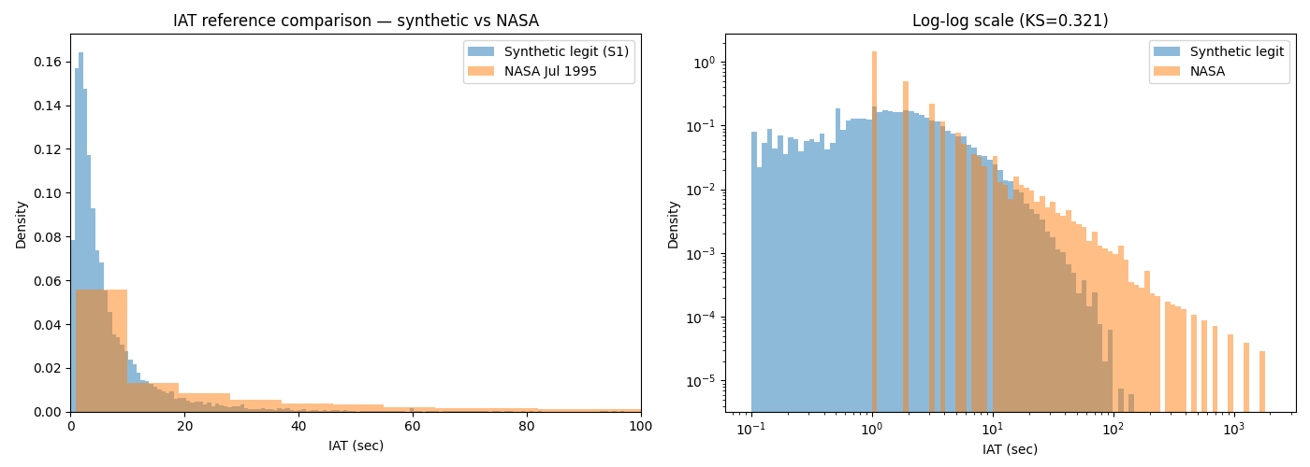
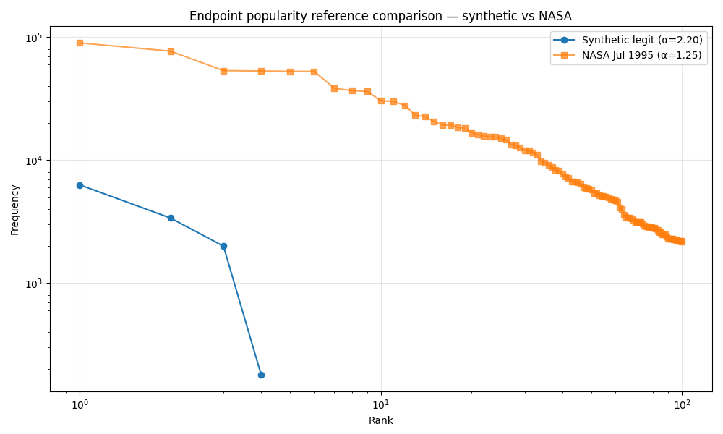
3 · RESULTS · CALIBRATION
Calibration Against Historical Web Traces
Synthetic legitimate traffic aligns structurally with NASA 1995
IAT distribution (KS = 0.321) — substantial alignment in 0.1-10s range
Endpoint Zipf (α: synthetic 2.20 vs NASA 1.25)
WHAT'S PRESERVED, WHAT'S RE-PARAMETERIZED
Synthetic traffic closely tracks NASA structure.
IAT KS dropped from 0.994 to 0.321 after bug fixes and production-realistic legit scaling.
Structural properties preserved: log-normal IAT shape, Zipf endpoint popularity, Markov navigation graph.
Numerical parameters re-parameterized per deployment context: α 2.20 (4 routes) vs NASA 1.25 (hundreds of paths) — expected; structure transfers, context-specific values do not.
Beyza Yavuz · Graduation Thesis · Final Defense
19 / 23

Slide 20
4 · CONTRIBUTIONS & LIMITS
Scientific Contributions
Three methodological moves that make this thesis stand out
Multi-Tier Behavioral Feature Pipeline
01
37 features across four tiers (connection / window / global / baseline-distance). Ablation shows +23pp behavioral lift on mimicry recall over rate-only features.
features
architecture
Mimicry Holdout Protocol
02
Attack variant excluded from training and validation, evaluated only on holdout. Stricter protocol tests generalization to unseen attacks.
protocol
evaluation
Validation and Sanity Checks
03
5-fold CV, mimicry holdout, ablation, and leakage checks were used to test whether the main result was stable and not caused by shortcuts.
robustness
transparency
Beyza Yavuz · Graduation Thesis · Final Defense
20 / 23

Slide 21
4 · CONTRIBUTIONS & LIMITS
Limitations — The Honest List
Aligned with Discussion §5.6 — a complete inventory
SCOPE
Single application
DATA
Synthetic traffic
Results from one NestJS API. Endpoint cost profile is application-specific.
Generated by k6 and slowhttptest. No production trace validation.
ADV.
No adaptive adversary
SIGNAL
Slow HTTP is sparse
Mimicry is static. No iterative optimization against detector feedback.
nginx 60s timeout kills slowloris early; evaluated by rule rather than supervised.
AUTH
Auth-layer rate limiting DISABLED
EXT.
External validation limited
Deliberate, to isolate the behavioral signal. Both layers would coexist in production.
CIC-DDoS2019 sanity check; feature space differs from API-layer model.
Beyza Yavuz · Graduation Thesis · Final Defense
21 / 23

Slide 22
4 · CONTRIBUTIONS & LIMITS
Future Work
Five natural extensions of this thesis
→
Multi-application validation
Test the same pipeline on 3-5 APIs with different endpoint structures.
→
Adaptive adversary
Scenarios where the attacker iteratively optimizes against detector feedback.
→
Production trace validation
Run the model on anonymized production API logs; explore synthetic-to-real transfer.
→
Protocol-level features
TLS JA3/JA4 fingerprints, HTTP/2 behavior, browser automation traces.
→
Richer slow HTTP telemetry
Reverse-proxy and socket-level metrics for continuous slowloris modeling.
Beyza Yavuz · Graduation Thesis · Final Defense
22 / 23

Slide 23
CLOSING
Summary and Verdict
✓
Behavior-based API-layer detection is robust to surface mimicry under production-realistic conditions.
Mimicry holdout 96.38% · FPR = 0 · CV 99.94% ± 0.05% · Behavioral lift +23pp · UA-only 13%
01
The mimicry holdout protocol is the methodological core — the model generalizes to an unseen attack at 96% recall.
02
Ablation rules out shortcut-learning — rate-only mimicry recall is 73%; behavioral features add +23 points.
03
Implementation issues identified, corrected, and re-verified across three configurations + 5-fold cross-validation.
23 / 23

