Slide 1

ELM 368 Proje Sunumu
Civciv ve Tavuk Sesinin Ayrıştırılması
Erhan GÖK - 2001020020387
Beyzanur CAM - 210102002037
Efe BAYRAKÇEKEN - 210102002026

Slide 2
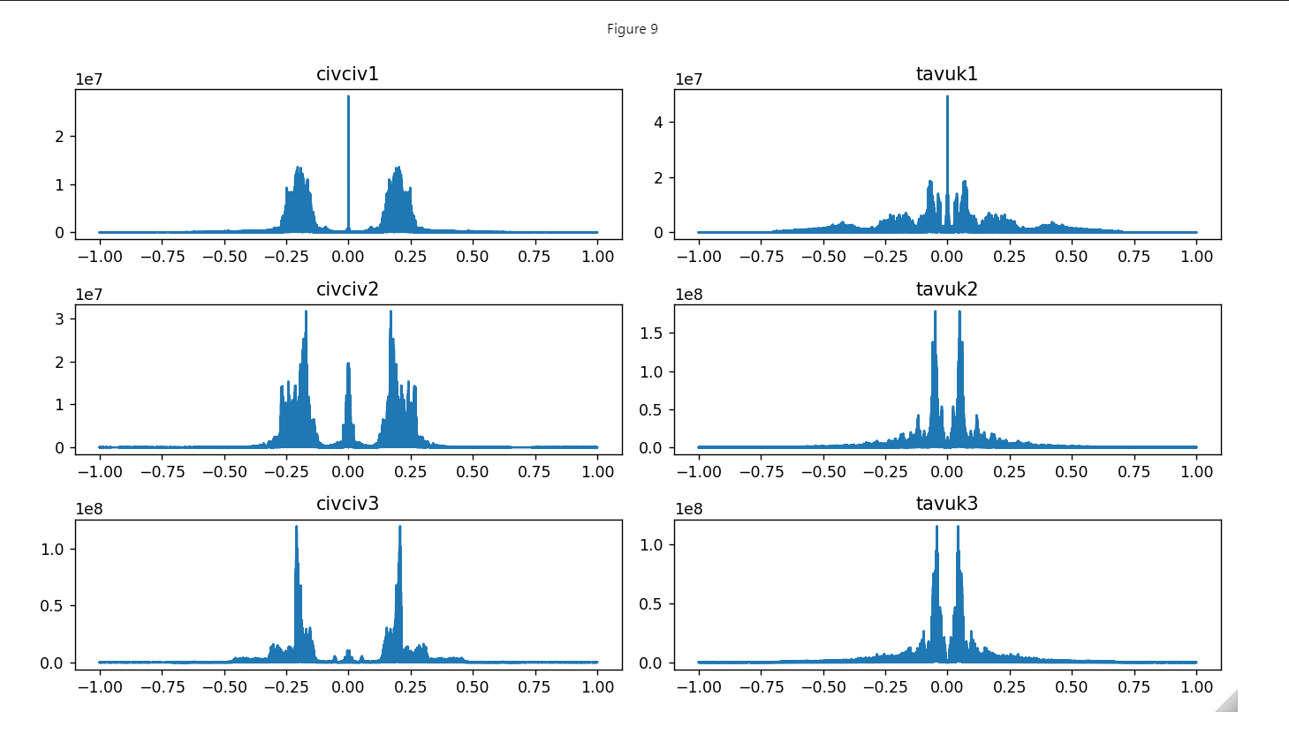
Spectrums of train datas

Slide 3
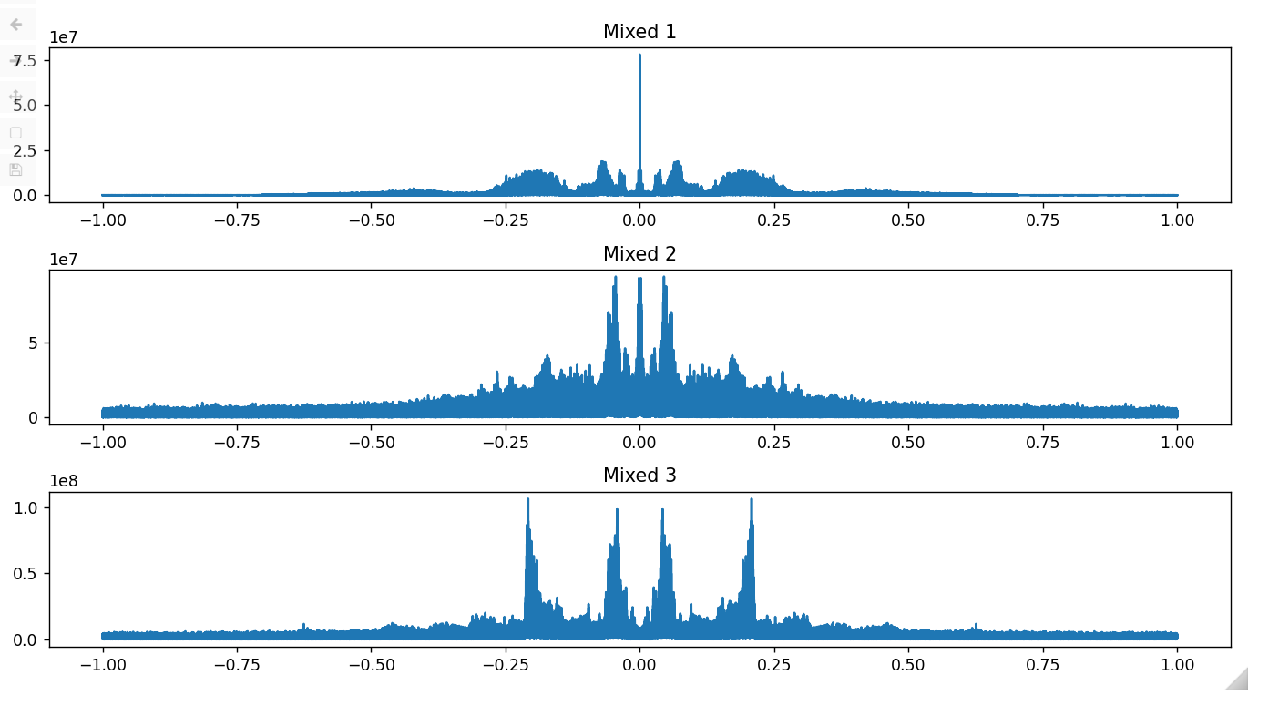
Mixed Signals Spectrum

Slide 4
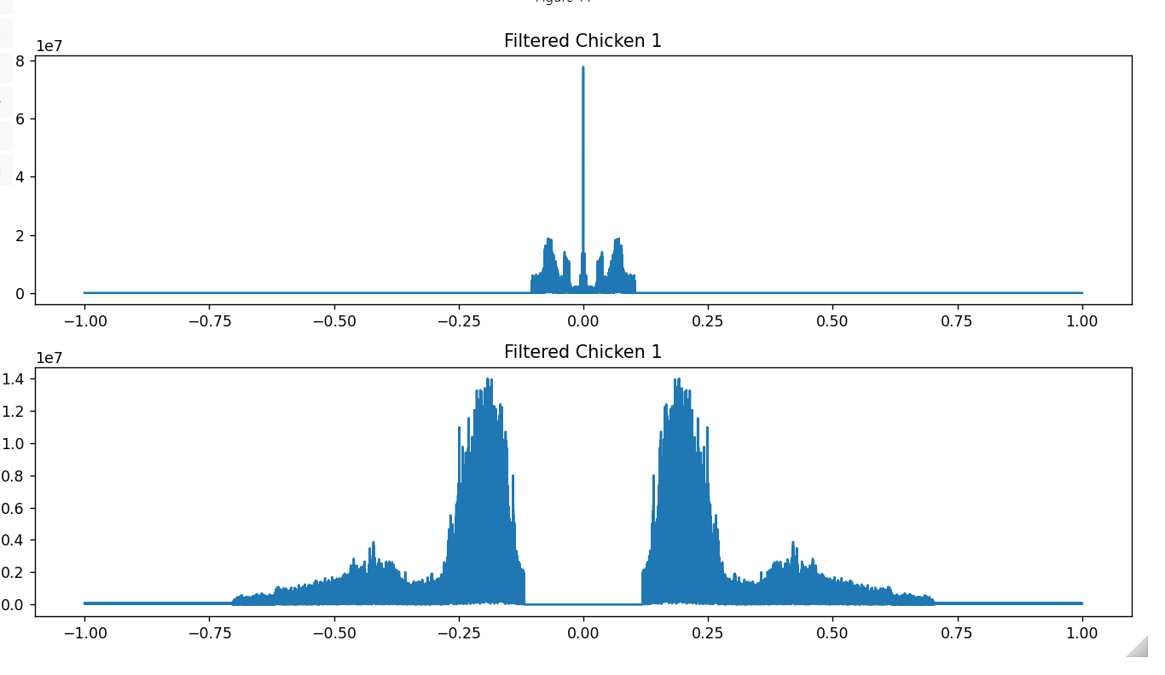
Ideal Filter Applied to Mixed Signals

Slide 5
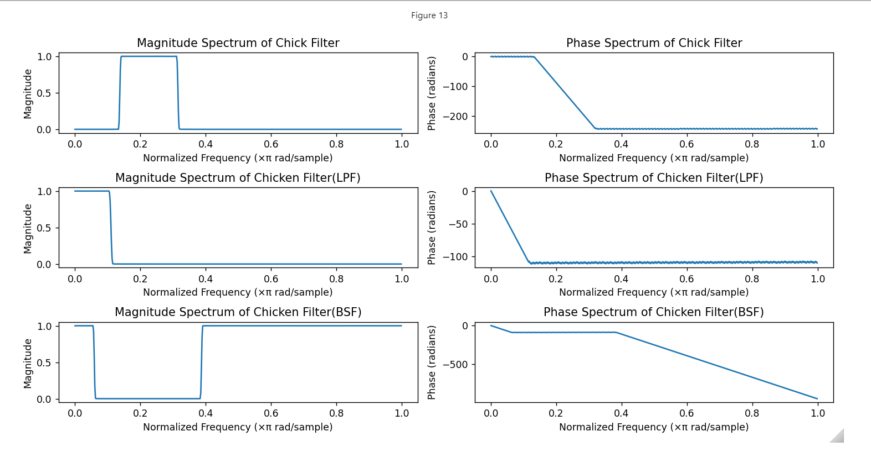
FIR Filter Design and Application

Slide 6
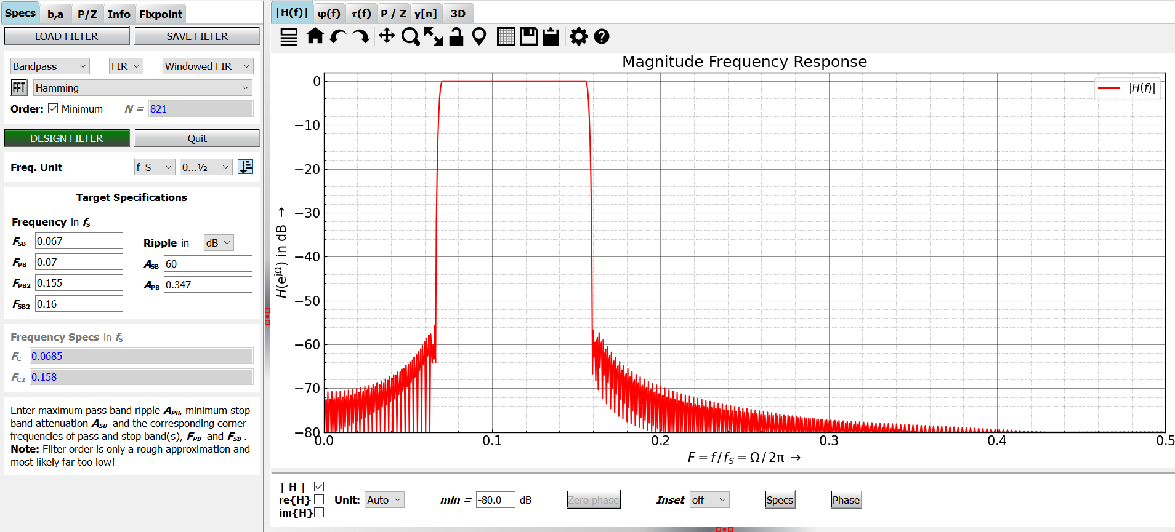
Chick bandpass filter on pyFDA

Slide 7
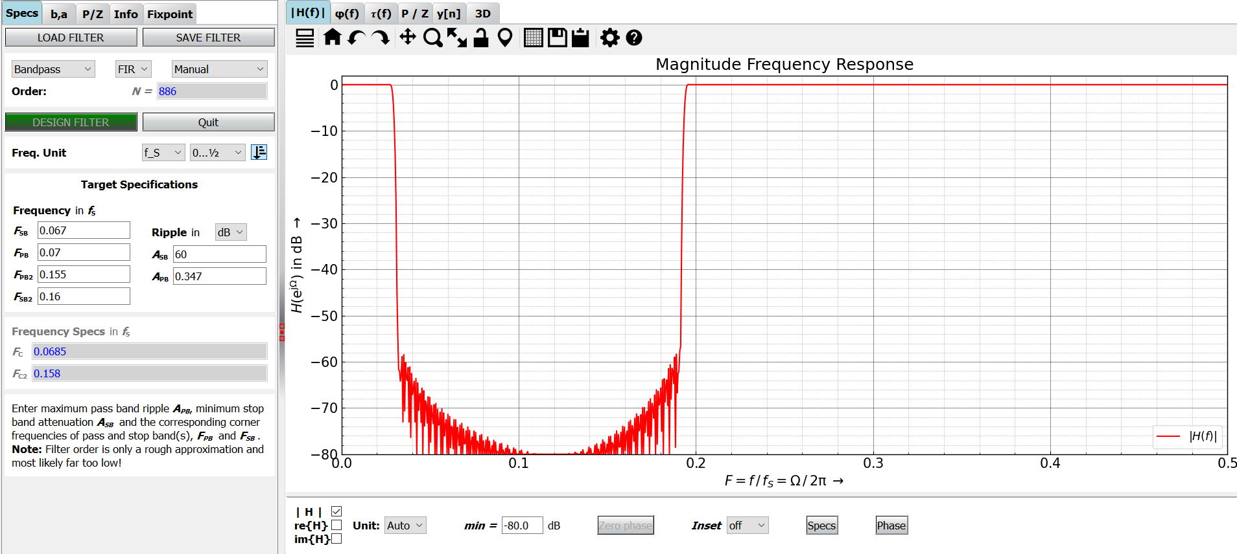
Chicken bandstop filter on pyFDA

Slide 8
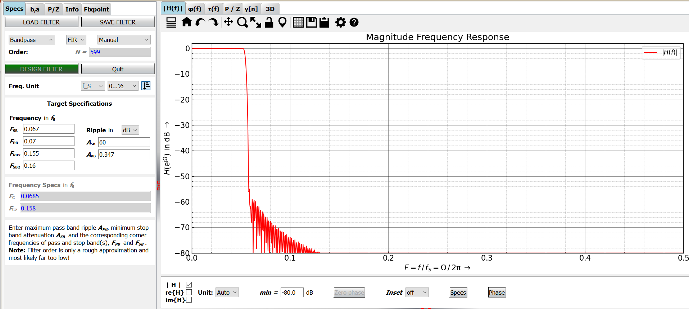
Chicken bandpass filter on pyFDA

Slide 9
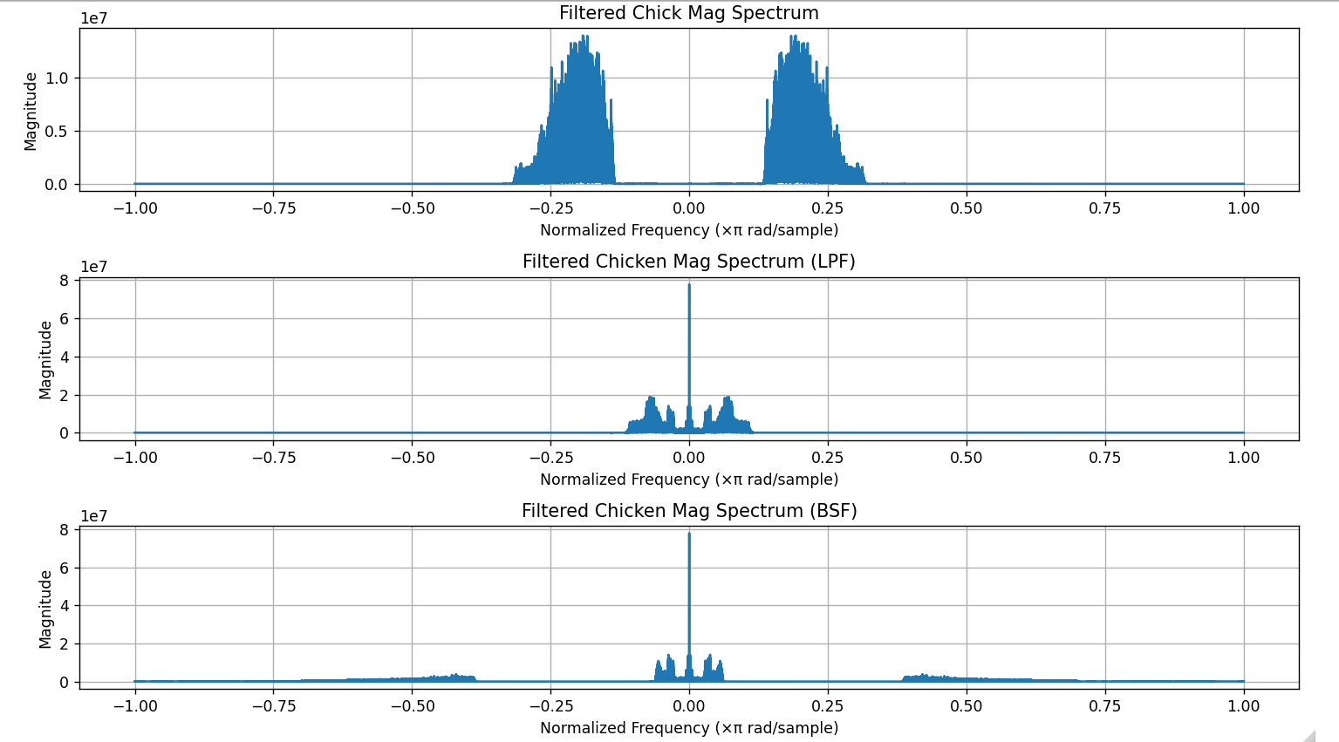
Mixed Signal 1

Slide 10
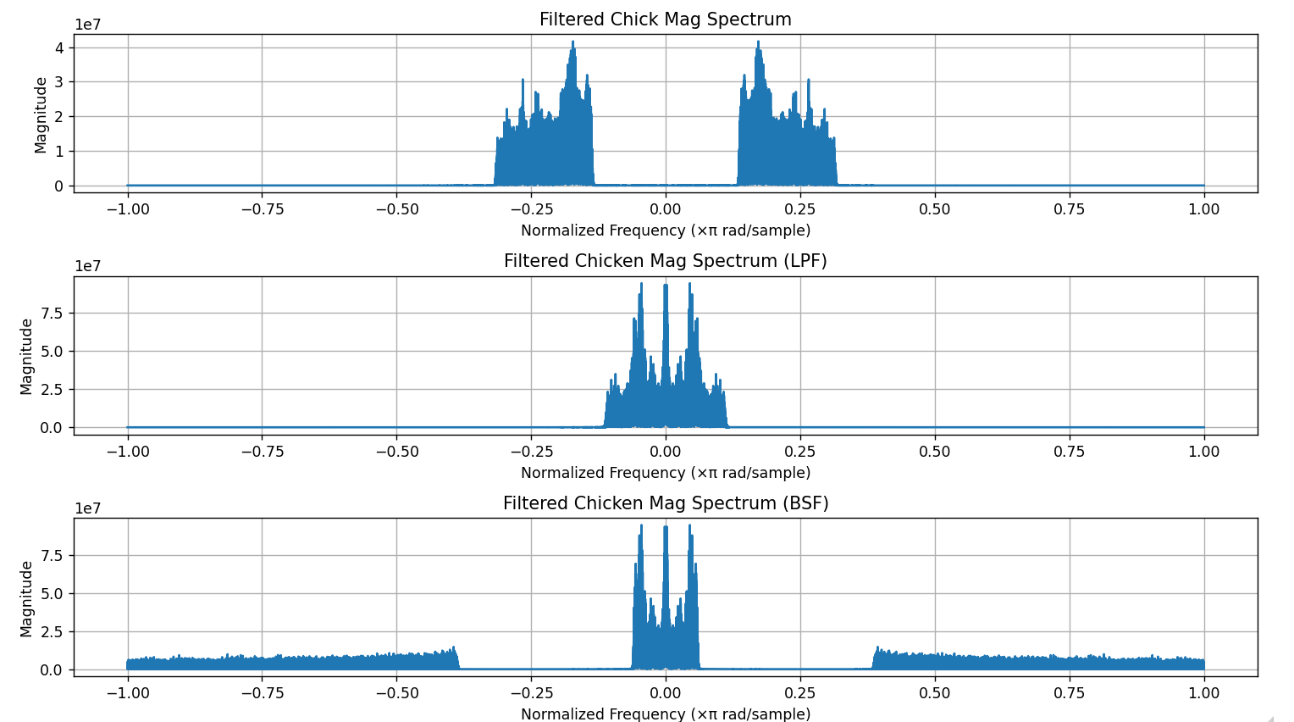
Mixed Signal 2

Slide 11
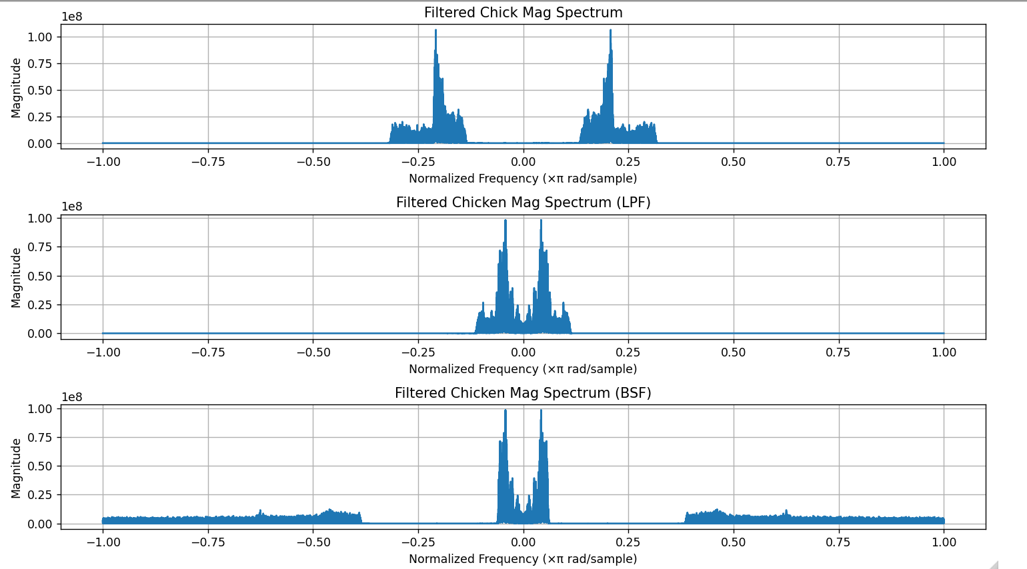
Mixed Signal 3

Slide 12
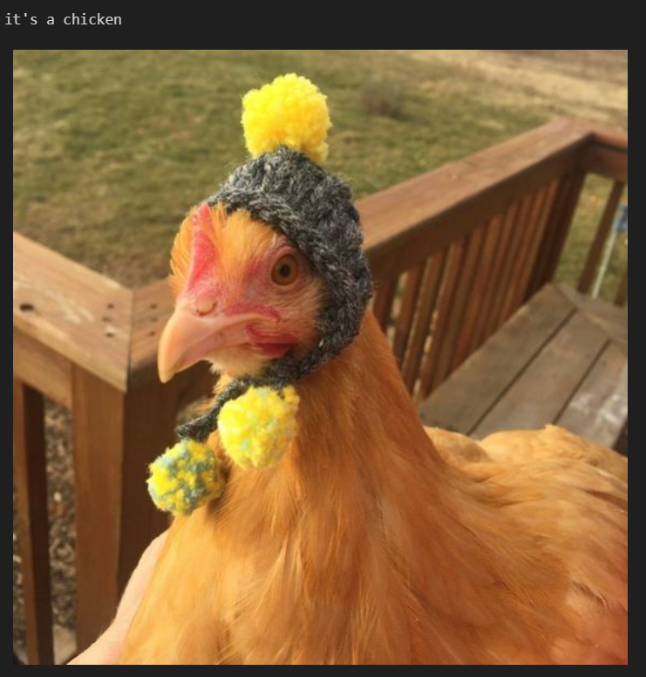
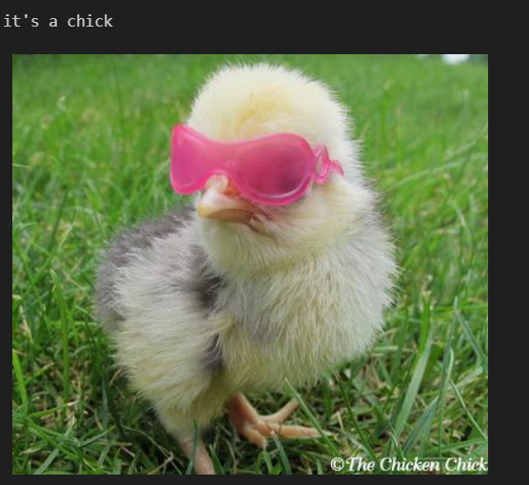
Is it Chick or Chicken?

Slide 13
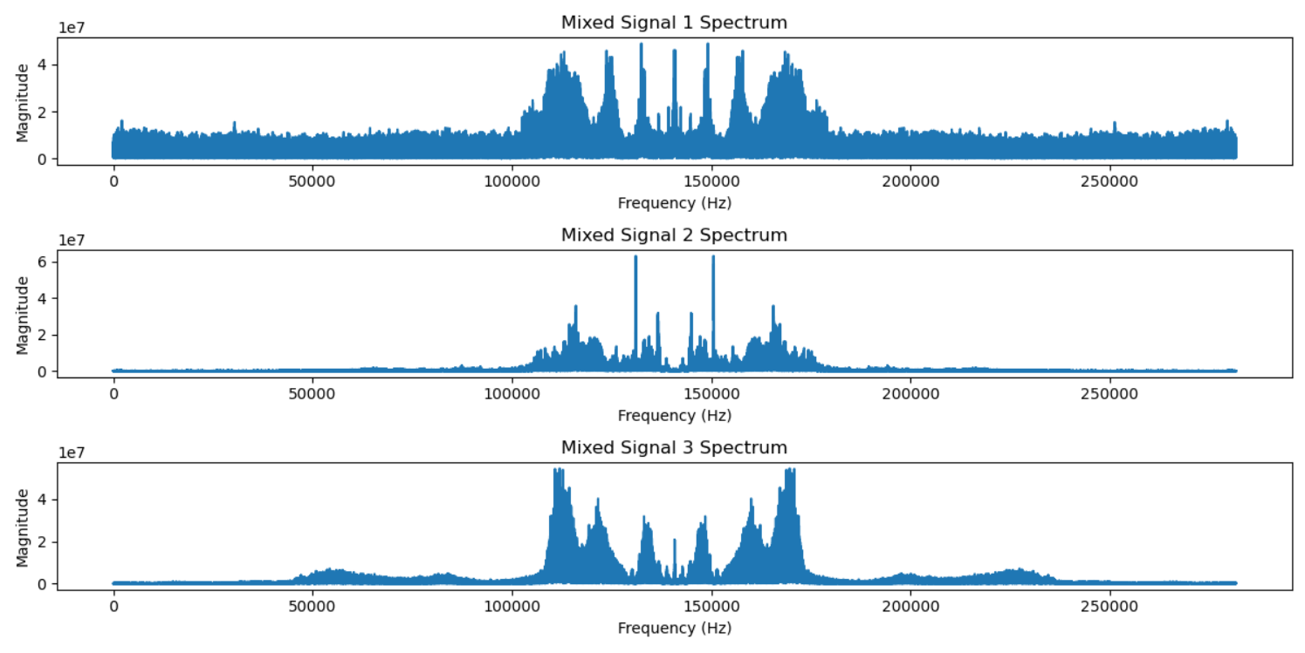
Testing Sounds and Spectrums

Slide 14
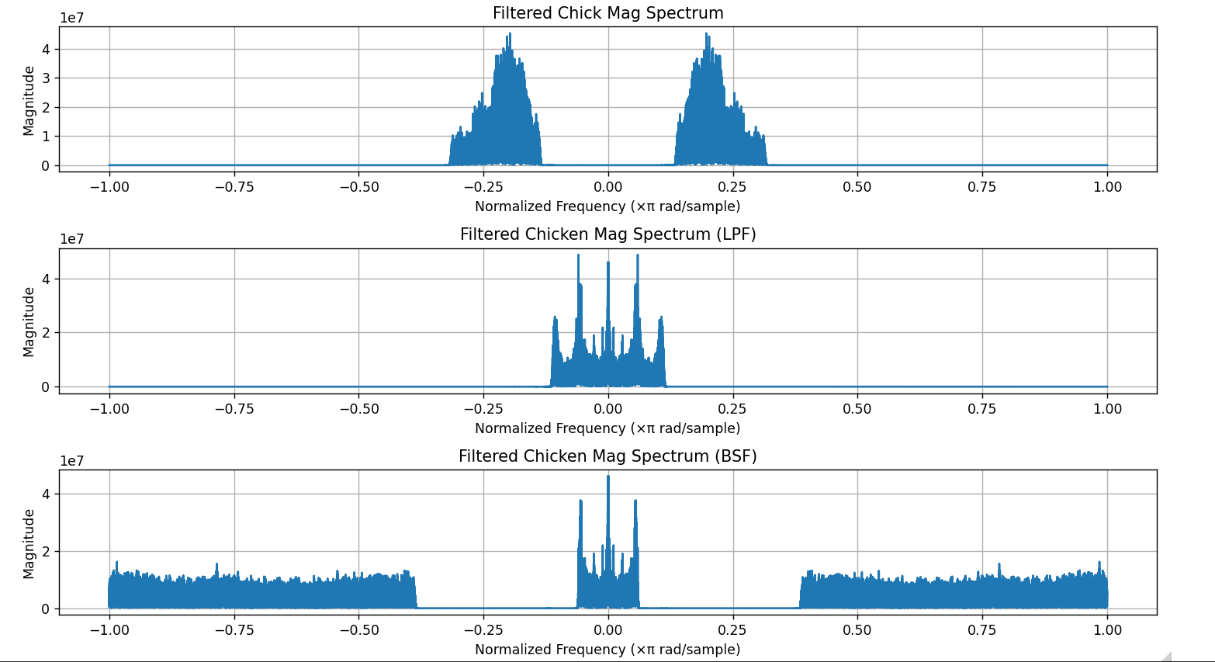
Mixed 1 Testing

Slide 15
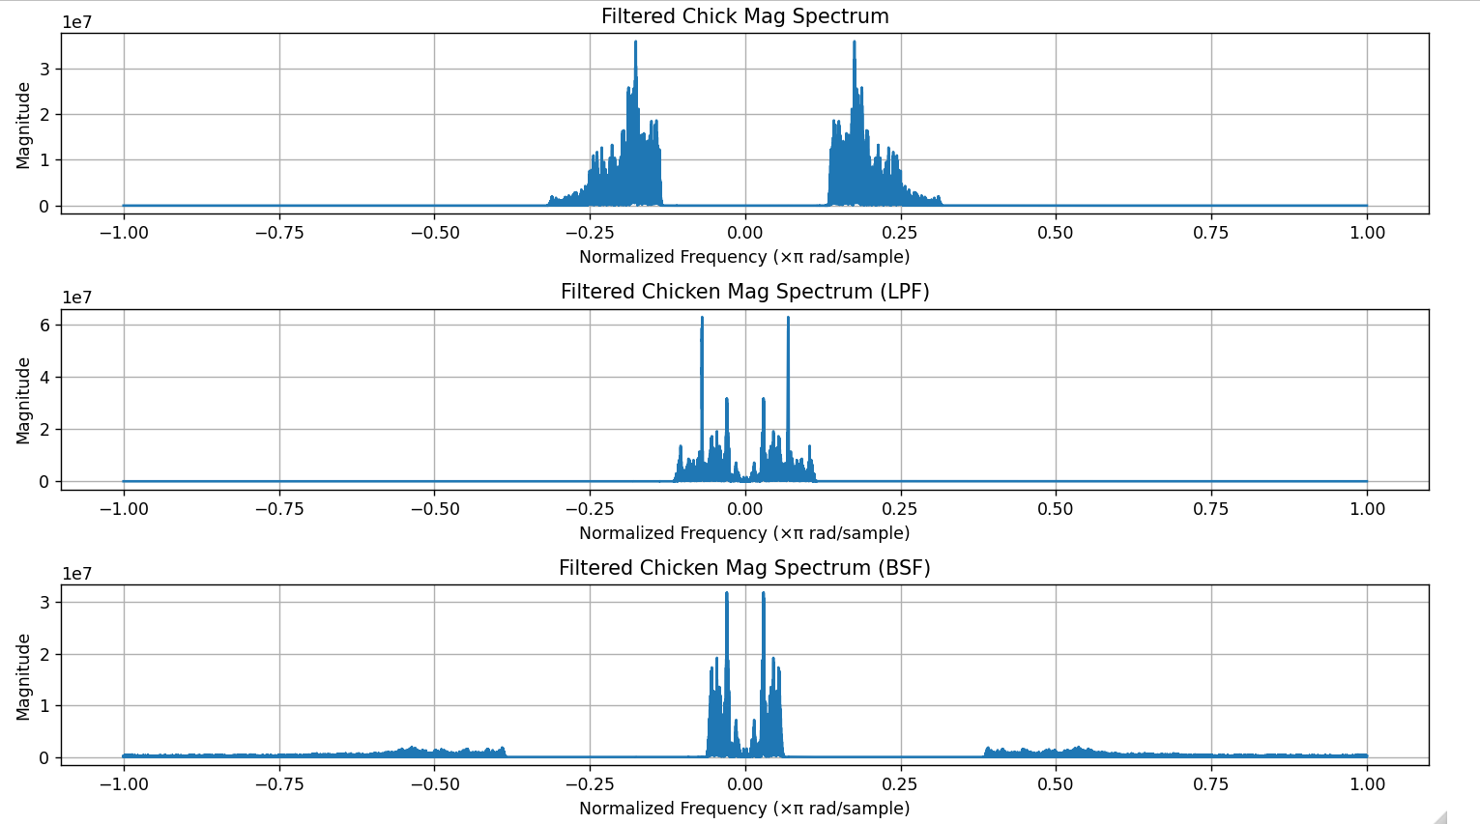
Mixed 2 Testing

Slide 16
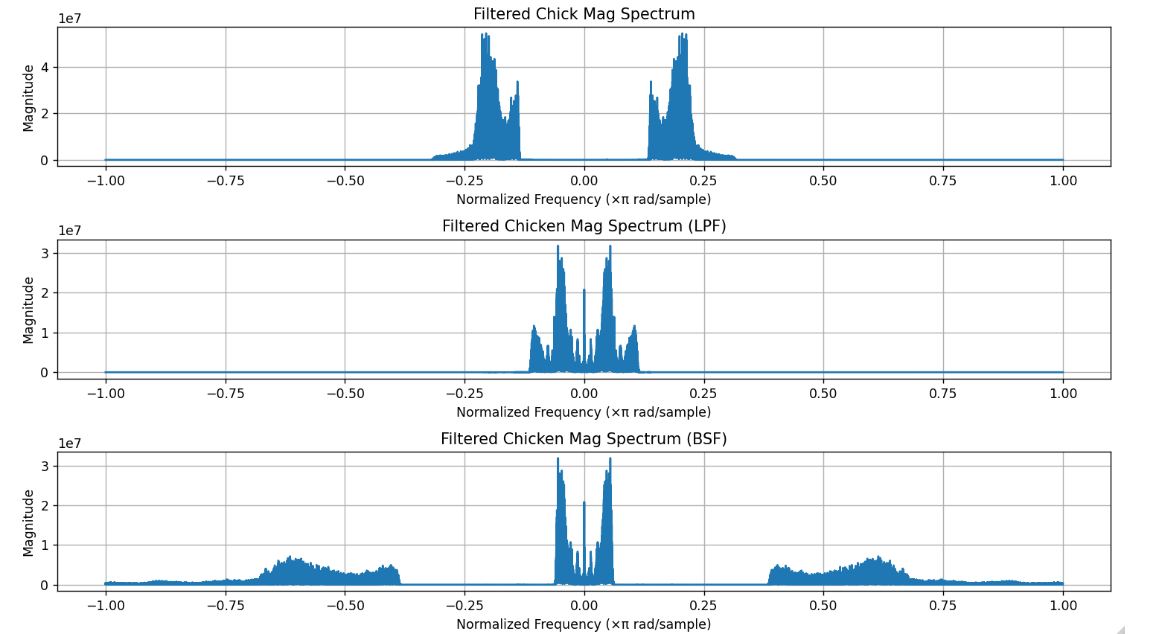
Mixed 3 Testing

Slide 17
Teşekkürler

