Slide 1
SOFTWARE ENGINEERING · UNIVERSITY OF GENOA
Text Quality
Analyzer & Rewriter
An intelligent writing assistant that corrects grammar,
detects pleonasms, and rewrites Italian texts.
Emanuela Ibra · Yakup Gürer

Slide 2
Problem Statement
Traditional Tools
Example
✗ Correct grammar only
✗ Ignore redundancy
✗ Miss pleonasms
✗ Don't reduce repetition
✗ No global quality improvement
BEFORE
Collaborare insieme è molto importante.
Il risultato finale è stato positivo.
▼
AFTER
Collaborare è molto importante.
Il risultato è stato positivo.

Slide 3
Project Objectives
Create an intelligent writing assistant for Italian texts
✓
Grammar Correction
✓
Repetition Detection
Detect & fix grammatical errors
Lexical, lemma-based, and synonym repetition
✓
Pleonasm Detection
✓
Semantic Redundancy
JSON-based knowledge base for Italian pleonasms
Sentence-level similarity analysis with spaCy
✓
Text Rewriting
✓
Google Docs Integration
Rule-based and AI-powered (Ollama) rewriting
Native sidebar integration into Google Docs

Slide 4
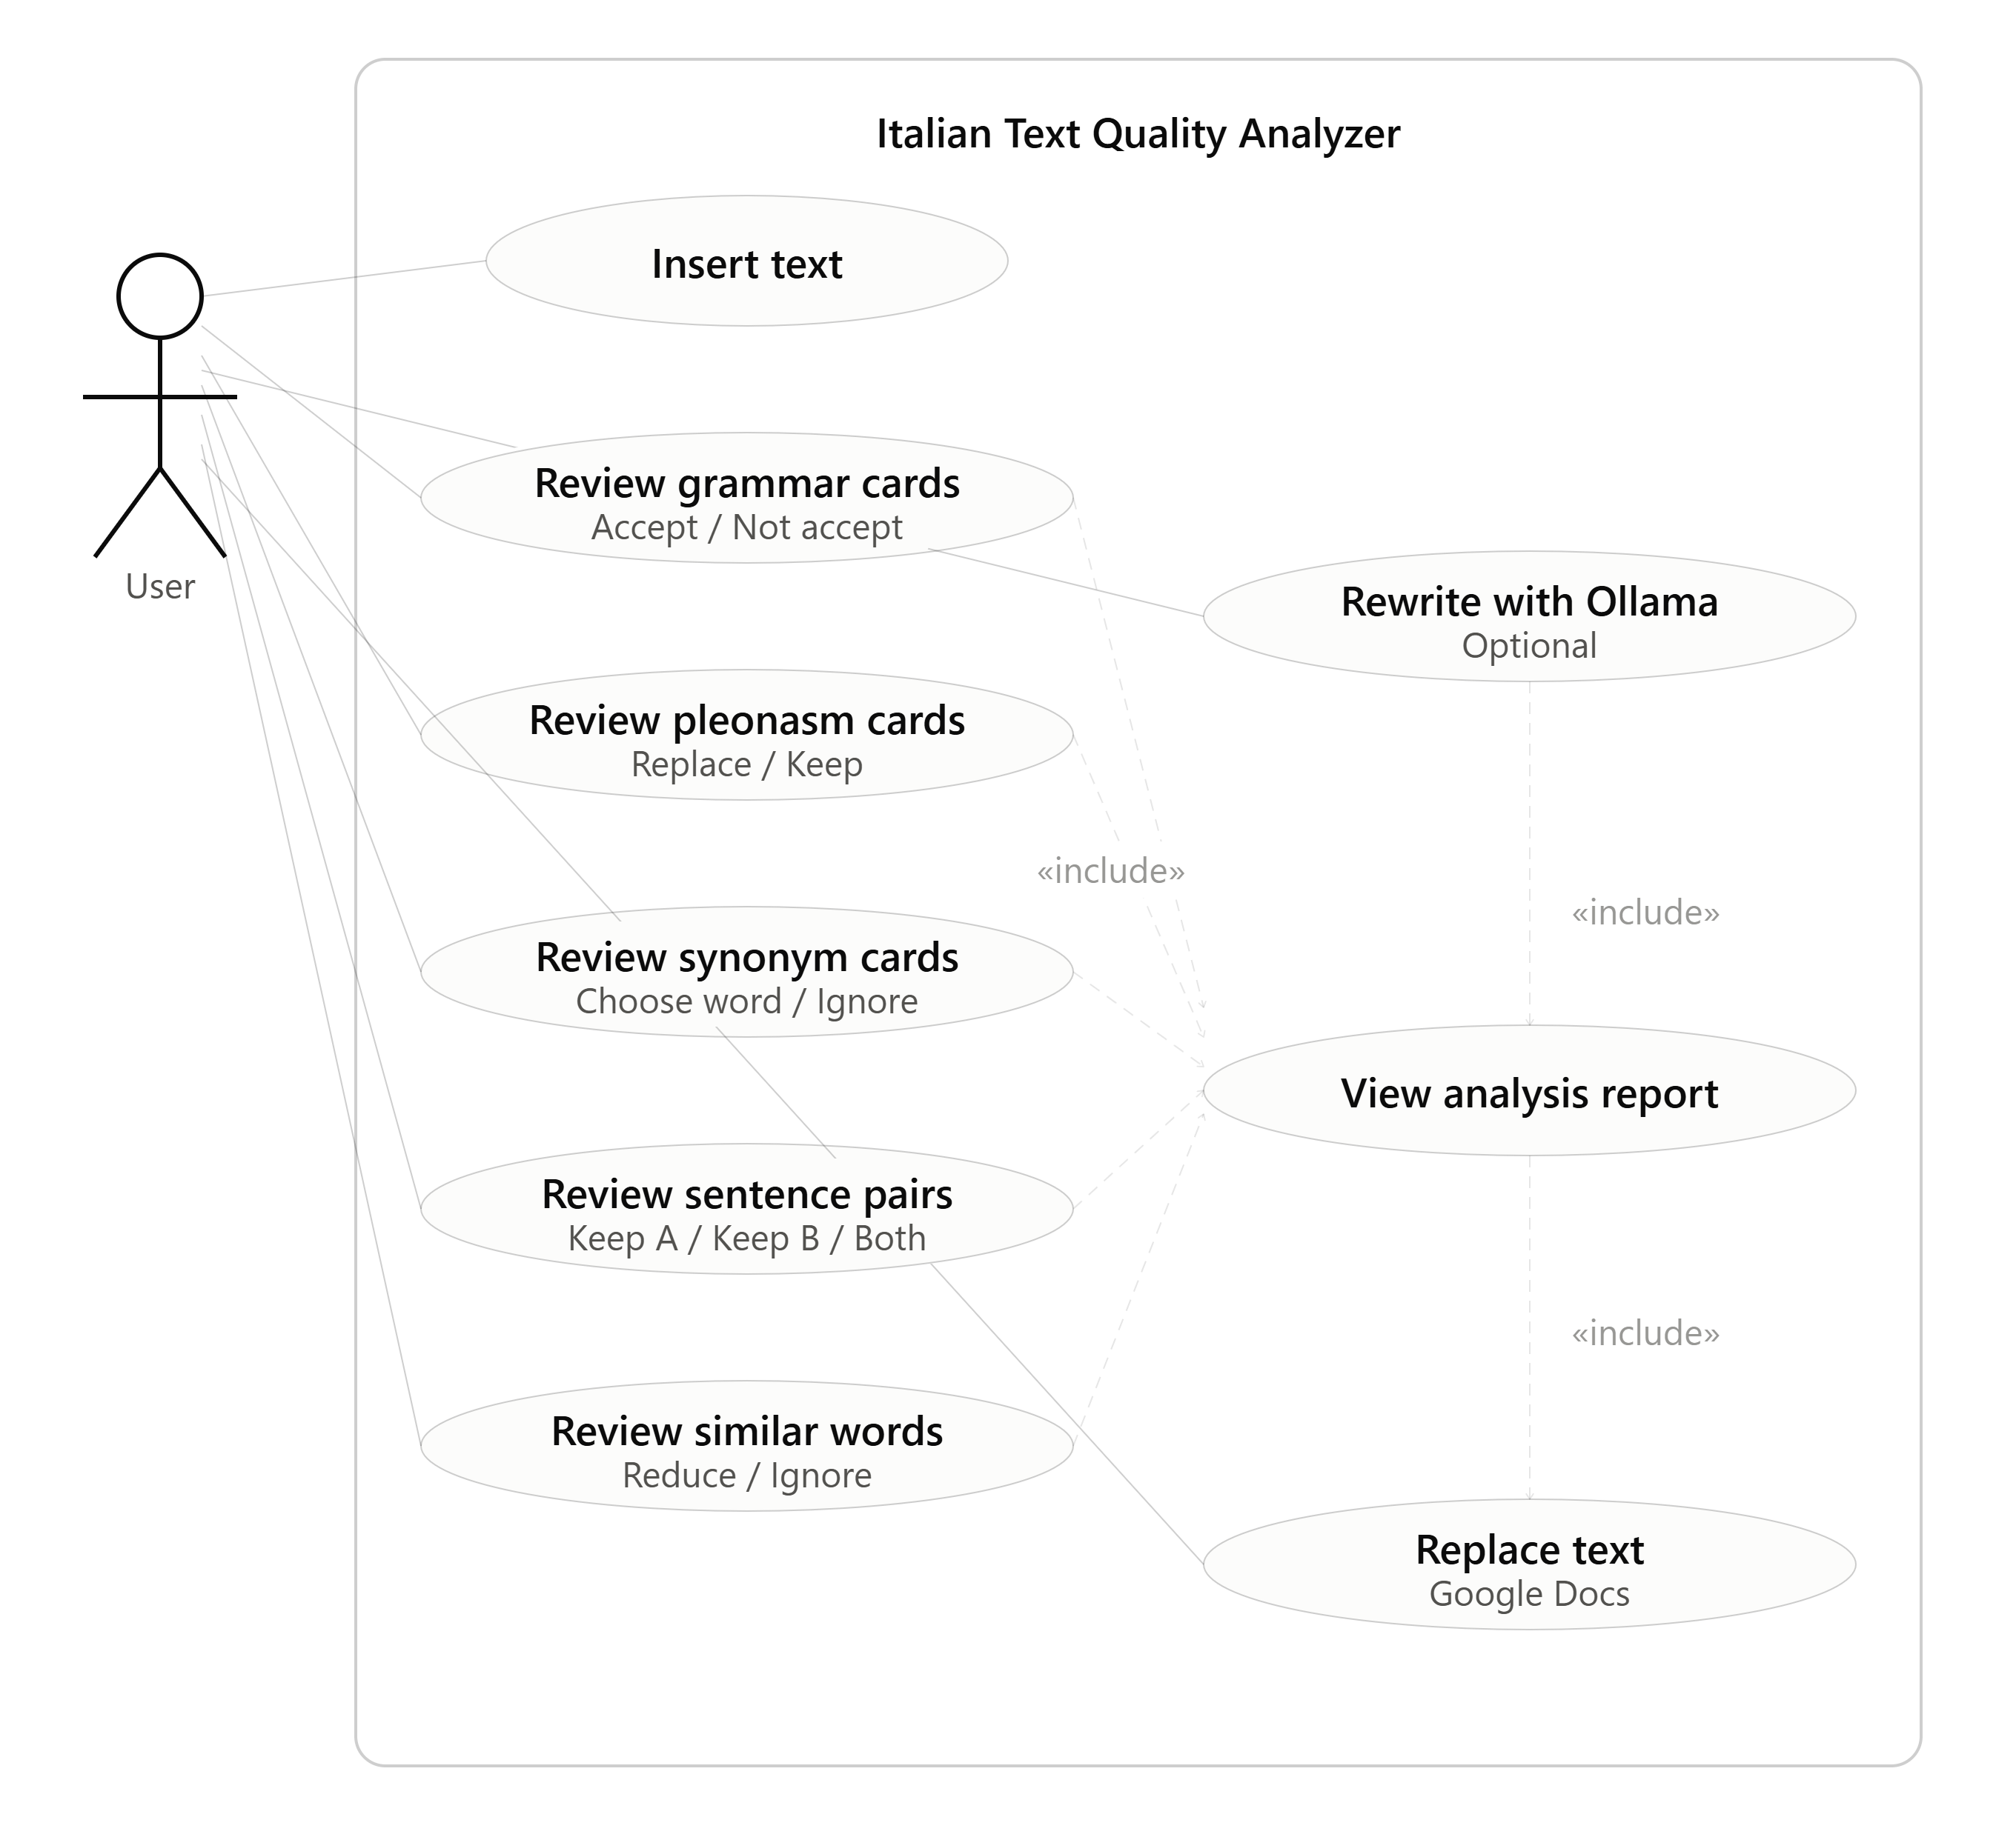
Use Case Diagram

Slide 5
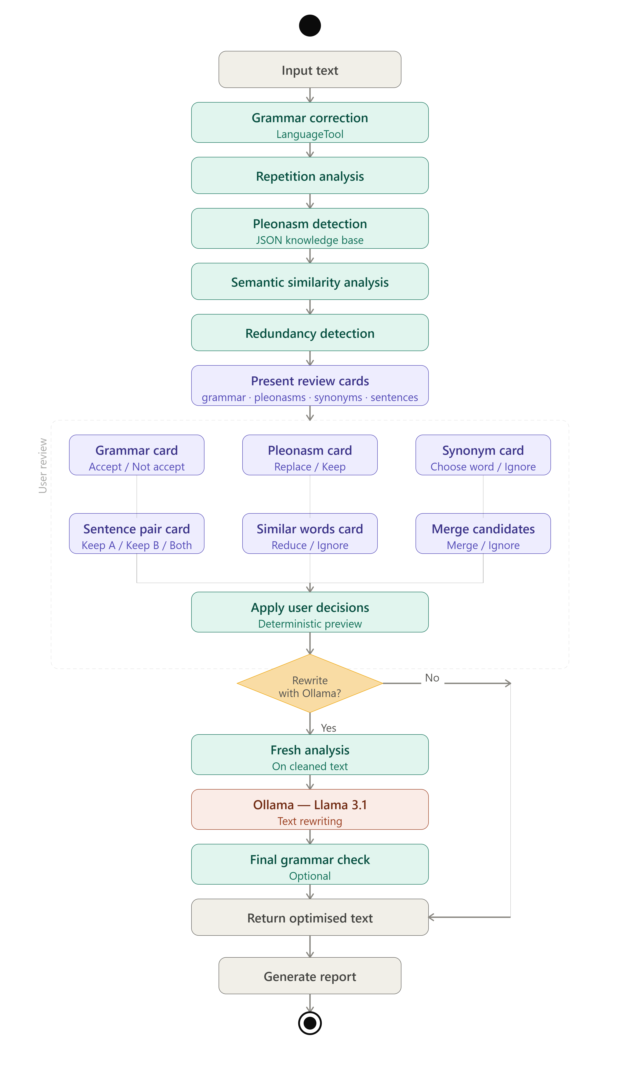
Activity Diagram

Slide 6
Grammar Correction Module
LanguageTool,spyCy
Example
What It Detects
INPUT (grammar error):
Gli studenti va a scuola.
✓ Grammatical errors
↓ corrected
✓ Spelling mistakes
Gli studenti vanno a scuola.

Slide 7
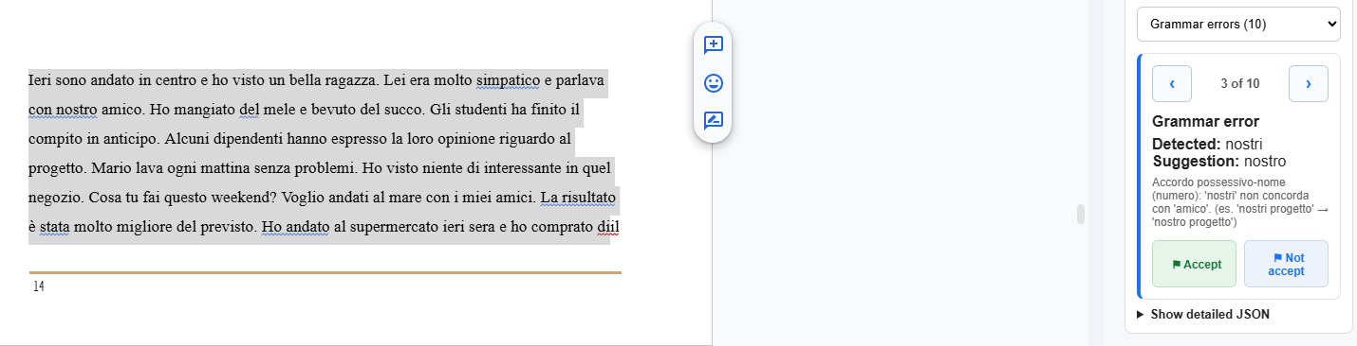
Grammar Correction Module

Slide 8
Repetition Analysis
Lexical Repetition
progetto progetto progetto
Same word repeated multiple times in close proximity
Lemma Repetition
migliora · migliorato · miglioramento
Different forms of the same root word repeated
Synonym Repetition
importante · significativo · fondamentale
Semantically equivalent words used redundantly

Slide 9
Pleonasm Detection
Examples
JSON Knowledge Base
Pleonasm | Corrected
risultato finale | risultato
regalo gratuito | regalo
pianificazione futura | pianificazione
collaborare insieme | collaborare
scendere giù | scendere
Instead of hardcoding pleonasms in Python:
PLEONASMS = {...}
A dedicated JSON file is used:
italian_pleonasms.json
Matching is lemma-based, NOT exact-string.

Slide 10
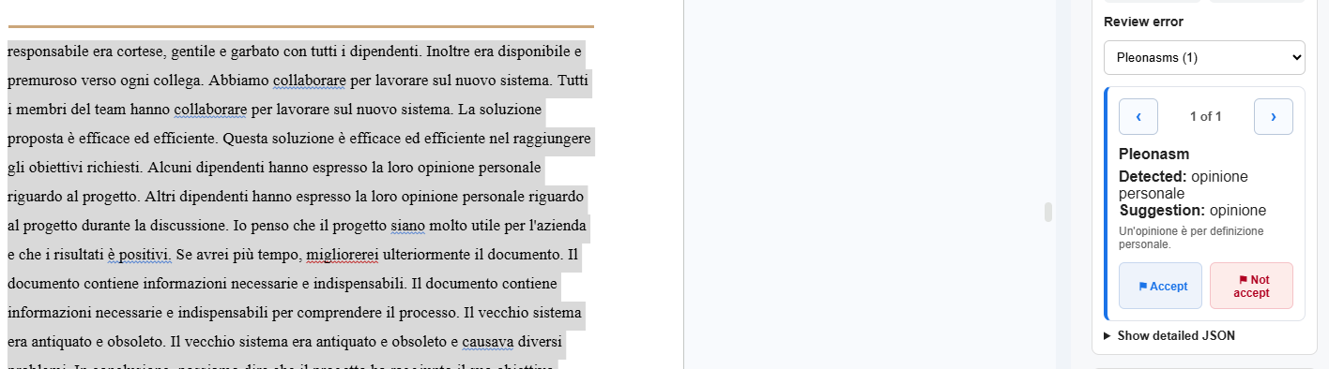
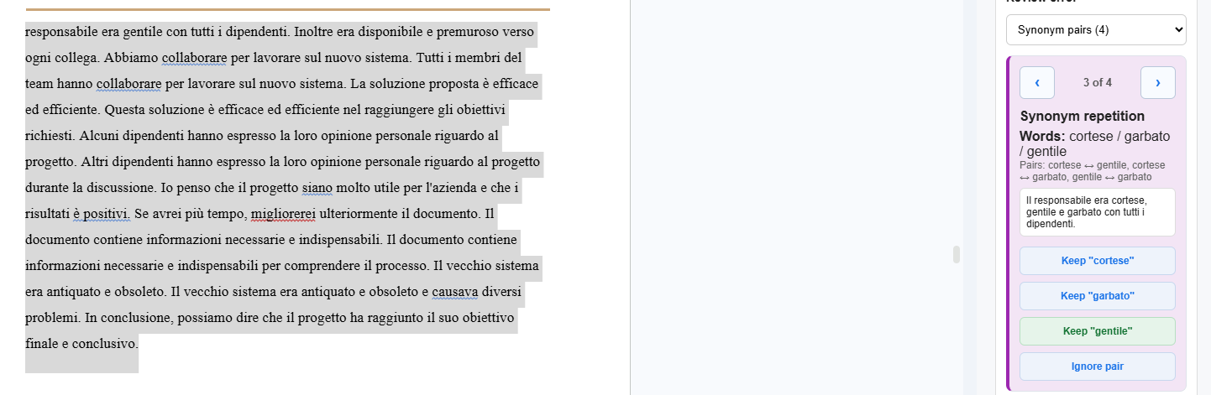
Repetition And Pleonasm

Slide 11
Redundancy Detection
Semantic Similarity Analysis
The system uses a multilingual Sentence-Transformer model to compare the meaning of complete sentences, not only individual words.
Each sentence is converted into a semantic vector. Then the system calculates cosine similarity between all sentence pairs.
If the similarity score is high, the pair is classified as:
Duplicate: almost identical meaning
Manual review: user chooses which sentence to keep
Merge candidate: the system may merge them during rewriting
Example
Le vendite sono diminuite nel terzo trimestre.
SIMILAR MEANING
Sentence-Transformer Embeddings
Nel terzo trimestre le vendite hanno registrato un calo.
Multilingual semantic sentence vectors
Cosine Similarity Matrix
Similarity > threshold
→ Flagged as redundant
Compares every sentence pair
Threshold Classification
Merge Candidate/ Manual Review

Slide 12
Pre-Merging Strategy
Why is this needed? If we directly pass both sentences to the AI, information may be lost.
Sentence Pair
↓
Similarity Score (Sentence -Tranformers)
↓
Score > Delete
Threshold
Merge < Score <
Delete Threshold
Score < Merge
Threshold
↓
↓
↓
Let User choose what to keep
Send as Merge
Candidate
Keep Unchanged

Slide 13
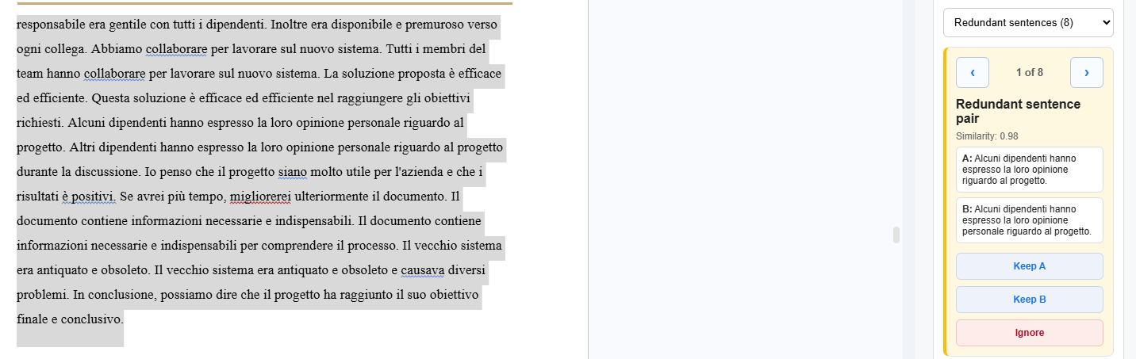
Redundant Pair

Slide 14
Rewriting Engine
AI Model (Ollama)
1. Get text
2. Build prompt with context
3. Send to local LLM (Ollama)
4. Parse model output
5. Return rewritten text
🤖 Better quality · Context-aware · Natural output

Slide 15
Google Docs Integration
Select Text
Sidebar Opens
1
2
User selects text in Google Docs
Extension sidebar opens automatically
Sent to API
Analysis Displayed
3
4
Text is sent to FastAPI backend
Errors, pleonasms, and issues shown
User Reviews
Text Replaced
5
6
User reviews suggestions & accepts
Original text replaced with improved version

Slide 16
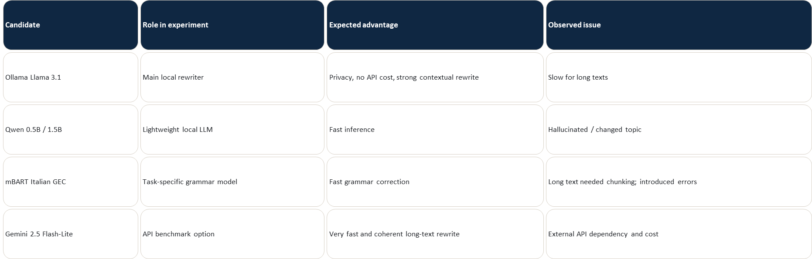
Model Candidates Tested

Slide 17
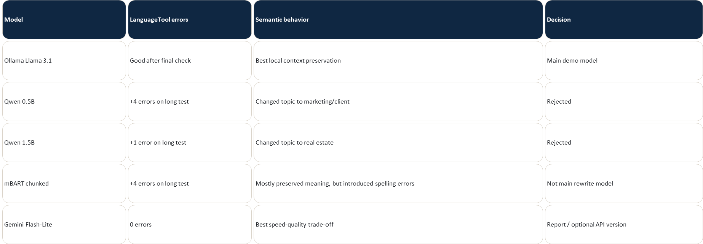
How we compared alternatives

Slide 18
Conclusion
A complete Italian writing assistant
✓
Italian grammar correction (LanguageTool)
✓
Repetition detection (lexical, lemma, synonym)
✓
Pleonasm detection (JSON knowledge base)
✓
Semantic redundancy analysis (Sentence-Tranformer)
✓
Pre-merging strategy
✓
Google Docs integration (real application)
✓
AI rewriting (Ollama — high quality)
Thank You

