Slide 1

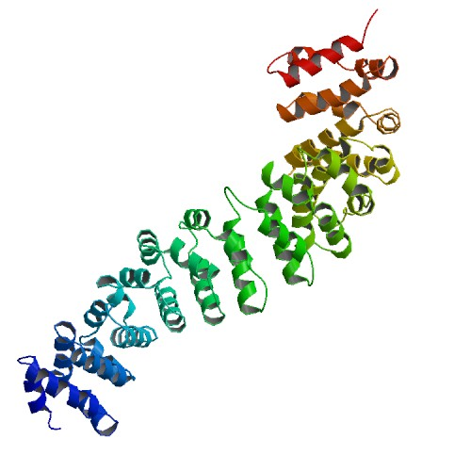
Computer Engineering Senior Design Project
Machine Learning-Based Drug Repurposing Discovery for Disordered (Non-Globular) MYC and CTNNB1 Oncoproteins
Author: Beyza Yörük
beyzayoruk@posta.mu.edu.tr
Advisor: Assoc. Prof. Dr. Tugba Önal SÜZEK
Muğla Sıtkı Koçman University
Department of Computer Engineering

Slide 2

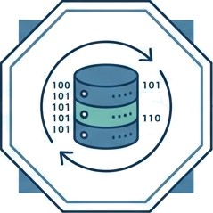
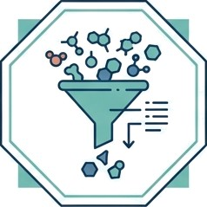

Summary
An innovative computational approach to bridge the gap for 'undruggable’ cancer targets.
The Problem The Solution
The Process The Impact
1 01
The Problem
The Solution
The Process
The Impact
MYC & CTNNB1 are 'undruggable’ IDPs lacking stable pockets
ML strategy using ChEMBL bioactivity data (RF & GNN models)
Screening PubChem library & validating via 100ns MD Simulations
Innovative computational method & list of validated candidate molecules

Slide 3
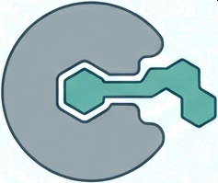
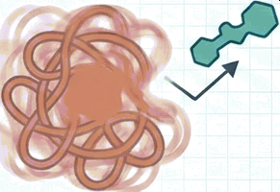
Introduction: The ‘Undruggable’ Challenge
Structural Failure Modes
Classical “Lock and Key” The IDP Reality (MYC & ẞ-catenin)
Stable binding pockets allow
traditional drugs to lock in.
Conformational heterogeneity
prevents stable binding.
Why Methods Fail: Traditional structure-based drug design relies on static shapes.
IDPs are dynamic, lacking the deep pockets required for this approach. Current research
focuses on characterization, leaving a gap in ligand binding prediction.

Slide 4
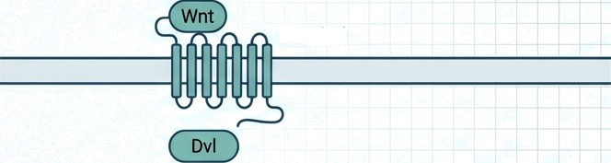
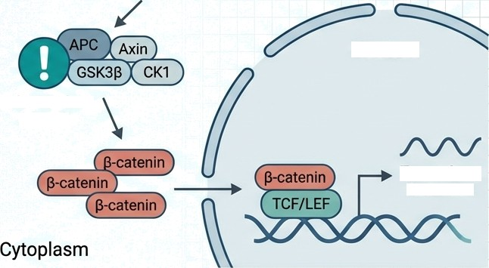
Introduction: The Cancer Targets
The Stakes: Cancer is a leading global
health problem. Identifying molecular
treatment targets is critical.
Frizzled
Target 1: MYC
A transcription factor central to cell
proliferation and metabolism.
Overactivation is a hallmark of many
cancers.
Target 2: CTNNB1 (ẞ-catenin)
Key effector of the Wnt/ẞ-catenin signaling pathway.
Key Statistic: APC mutations found in
81.9% of colorectal cancers; direct
CTNNB1 mutations in 48%.
Nucleus
APC Mutations (81.9P)
Target Gene Activation

Slide 5
Research Question
Can potential inhibitors targeting disordered MYC and CTNNB1 oncoproteins be predicted using machine learning models based on bioactivity data?
Shifting the paradigm from structure-based search
to data-driven bioactivity prediction.
This research was developed within the scope of the TÜBİTAK 2209-A Undergraduate Students Research Projects Support Program for the 2025 first-period application.

Slide 6
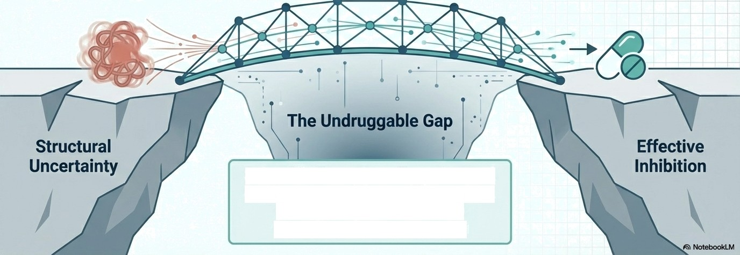
Hypothesis
The Proposition
ML models trained on large-scale bioactivity data can identify binders independent of protein shape.
The Goal
Demonstrate applicability
of ML strategies for MҮC
and ẞ-catenin.
Bioactivity-Based
Machine Learning
Scientific Precedent: Experimental confirmation of druggability exists.
Lehrich et al. (ẞ-catenin)
Singh et al. (MYC protein)

Slide 7
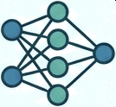
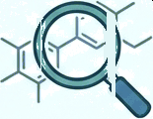



Concrete Objectives
r
r
Develop
Identify
Validate
Develop high—accuracy classification models (Random Forest, Gradlent Boosting, GNN) using data from ChEMBL, PubChem, and BindingDB (>1o,ooo,ooo molecules).
Screen the PubChem BioAssay database to find hit molecules with low toxicity that can be repurposed for MYC-MAX and
§-catenin-TCFJ interactions.
Computationally validate binding affinities of the top hits (nssJ via Molecular docking (AutoDockVina), MD simulations (loo ns), and
MM-GBSA calculations.

Slide 8
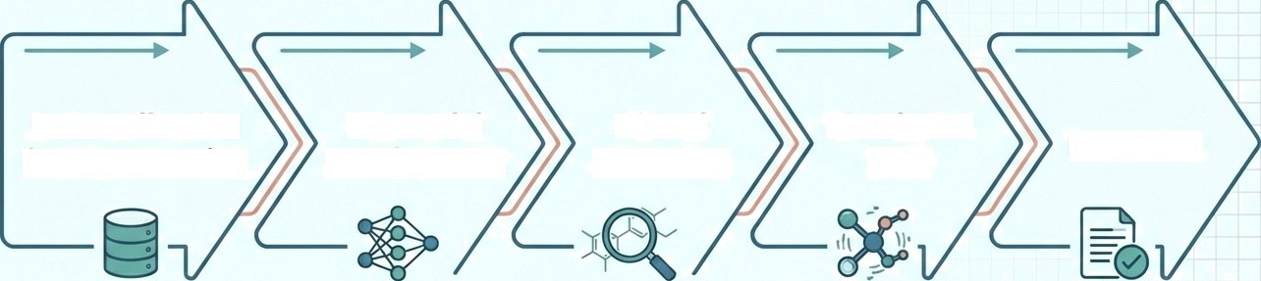
Methods: Workflow Overview
Based on QSAR-ML workflows (Sharma & Arumugam) and Bayesian ML (Vignaux et a1.)
Data Collection
& Preprocessing
ML Model
Development
Virtual
Screening
Simulation
(MD)
Reporting
ChEMBL,
PubChem,
BindingDB
RF, GBM, GNN
Training
PubChem BioAssay Filtering
100ns
Validation
Candidate List & Paper

Slide 9
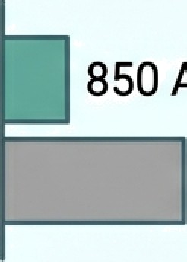
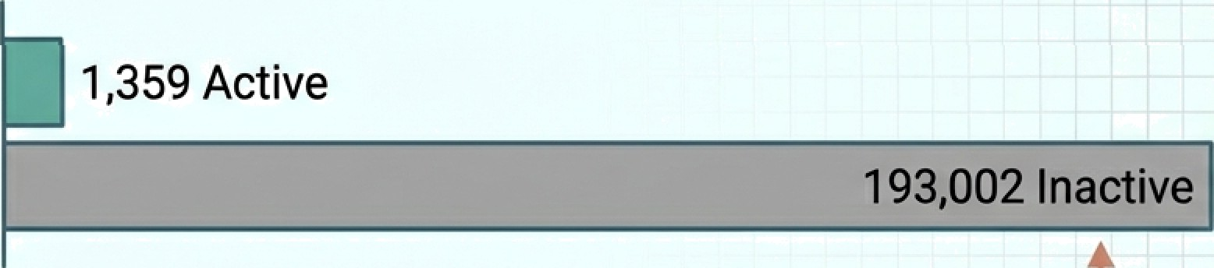
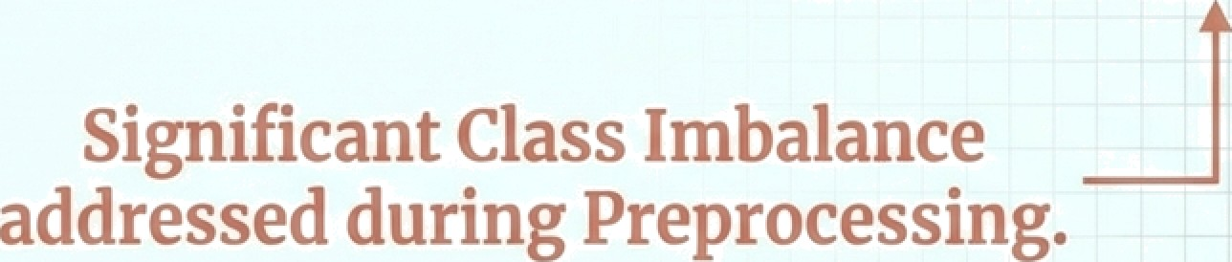
2.1 Data Collection and Preprocessing
MYC Data Volume
Sources: ChEMBL, PubChem, and BindingDB.
Target Interactions:
MYC-M4X and 9
catenin-TCF4
850 Active
16,689 Inactive
CTNNB1 Data Volume
1,359 Active

Slide 10
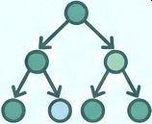
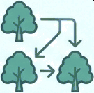
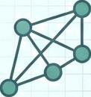
2.2 Machine Learning Model Development and Optimization
Algorithms
Random Forest (RF)
Gradient Boosting Machines (GBM)
Graph Neural Networks (GNN)
Optimization Strategy: Hyperparameter optimization via Grid Search and Randomized Search.
Validation Metrics:
10-fold cross-validation
evaluating AUC, precision, recall,
and F1-score.
Optimization & Metrics
 | Literature Benchmarks: - Random Forest: 98% AUC (Sharma & Arumugam) - Graph Neural Networks: 99% Accuracy vs 82% traditional (Noor et al.)
Benchmarks

Slide 11
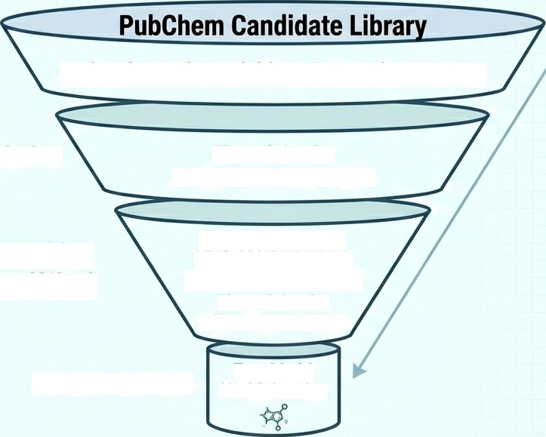
2.3 Virtual Screening and Hit Molecule Identification
Molecules with available activity & low toxicity
ML Model Prediction
Filter Criteria:
Prediction Score ≥ 0.80
Molecular Docking
(AutoDock VinafGlide)
Target Structures: MYC-MAX (1NKP) &
B-catenin-TCF4 (1G3J)
Filter Criteria:
AG<-7.0 kcal/mol
Final Selection
Top 20-30
Hit Molecules

Slide 12

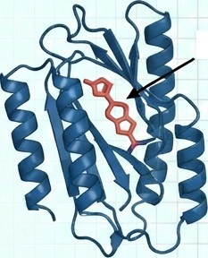
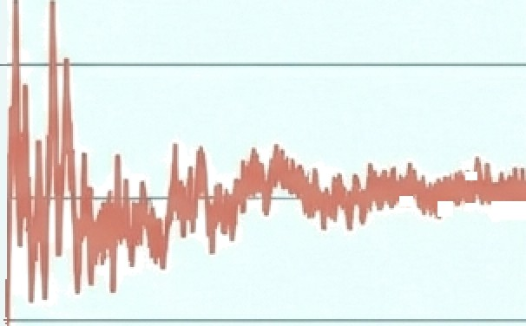
2.4 Molecular Dynamics Simulations
Validating physical stability in a 100ns simulation environment.
The Setup
Soflware: GROMACS
or AMBER
The Visualization
RMSD Analysis
Ligand
Duration: 1o0 ns
RMSD(å )
Metrics: RMSD
(Root Mean Square
Deviation), RMSF,
Hydrogen Bond
Formation.
0
0 20 40 60 80 100
Time (ns)
Protein-Ligand
Complex Stability.

Slide 13
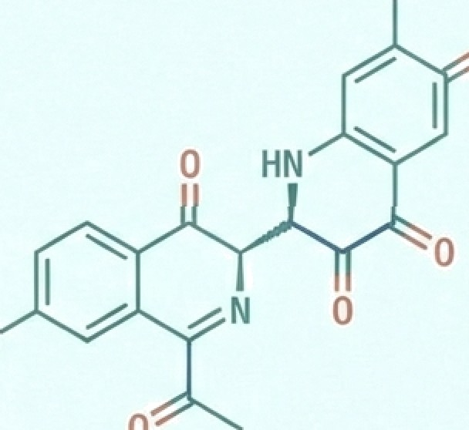








Results& Deliverables
Drug Candidate Data Card
ML Prediction Score:
0.96
Docking Score: -8.2 kcal/mol
ADMET Profile:
Low Toxicity
MD Stability: Stable at 100ns
Primary Deliverable:
A comprehensive project report containing a prioritized list of candidate molecules.
Dissemination:
Report conversion into
a conference paper article.

Slide 14
Future Plans
• Conference Submission & International Visibility: One of our immediate targets is to prepare an abstract based on our results for the ML4NGP (Machine Learning for Non-Globular Proteins) COST Action conference. Since my advisor is an active working group member of this network, this will be a strategic opportunity to present our findings as a poster or oral presentation to an international audience
• Web Visualization & Data Sharing: To increase the accessibility of our research, we plan to develop a web-based visualization platform. This tool will allow other researchers to interact with our 100 ns molecular dynamics results and explore the chemical properties of our identified hit molecules

Slide 15
Key References
Chen et al. (2024). Design of target specific peptide inhibitors using generative deep learning. Nature Communications.
Cui et al. (2018). Is ẞ-Catenin a Druggable Target for Cancer Therapy? Trends in Biochemical Sciences.
Karadkhelkar et al. (2023). Demystifying the Druggability of the MYC Family. JACS.
Lehrich et al. (2025).Precision targeting of ẞ-catenin induces tumor reprogramming. Nature Communications.
Noor et al. (2024). Deep learning pipeline for accelerating virtual screening. Scientific Reports.
Sharma & Arumugam (2025). MLAssisted QSAR for tankyrase inhibitors. Computers in Biology and Medicine.
Vignaux et al. (2020). Machine Learning for Discovery of GSK3ẞ Inhibitors. ACS Omega.

Slide 16
Thanks..

