Slide 1
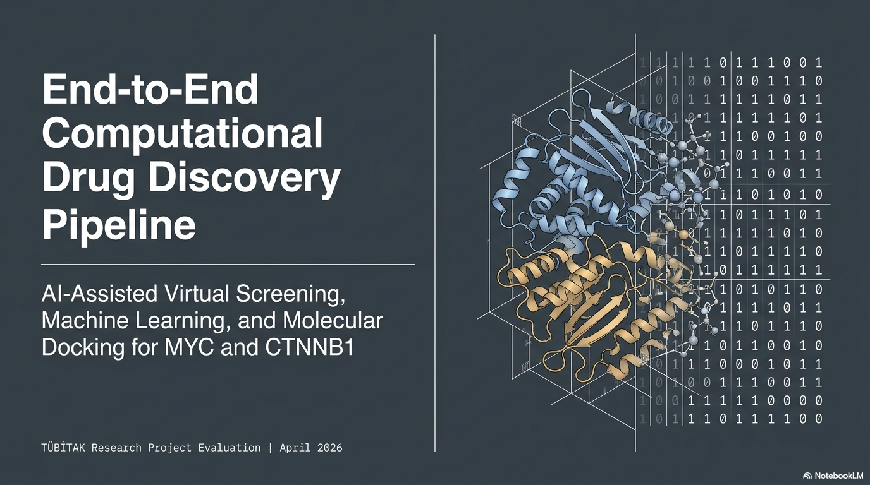

Machine Learning-Based Drug Repurposing Discovery for Non-Globular MYC and CTNNB1 Oncoproteins
Computer Engineering Senior Design Project 18.04.2026
Author: Beyza Yörük
beyzayoruk@posta.mu.edu.tr
Advisor: Assoc. Prof. Dr. Tugba Önal SÜZEK
Muğla Sıtkı Koçman University
Department of Computer Engineering

Slide 2
Market & Target Audience
* Unlocking the 'Undruggable' Oncology Market
The Problem: Over 70% of cancers involve MYC or CTNNB1, yet they remain "undruggable" due to their disordered structures.
The Solution: An AI-driven pipeline that decodes these targets to identify high-affinity leads from 119 million compounds.
Target Audience:
Big Pharma: Filling oncology pipelines with novel, first-in-class inhibitors.
Biotech Hubs: Accelerating R&D for intrinsically disordered protein (IDP) therapies.
Value Proposition: Reducing initial screening costs by 99% while providing structurally validated, diverse drug candidates.

Slide 3
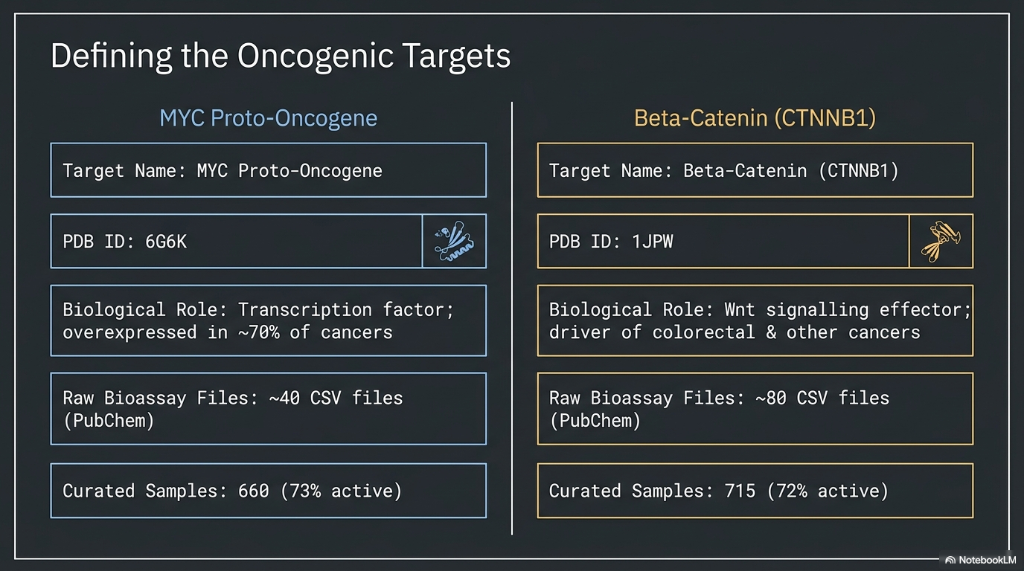

Slide 4
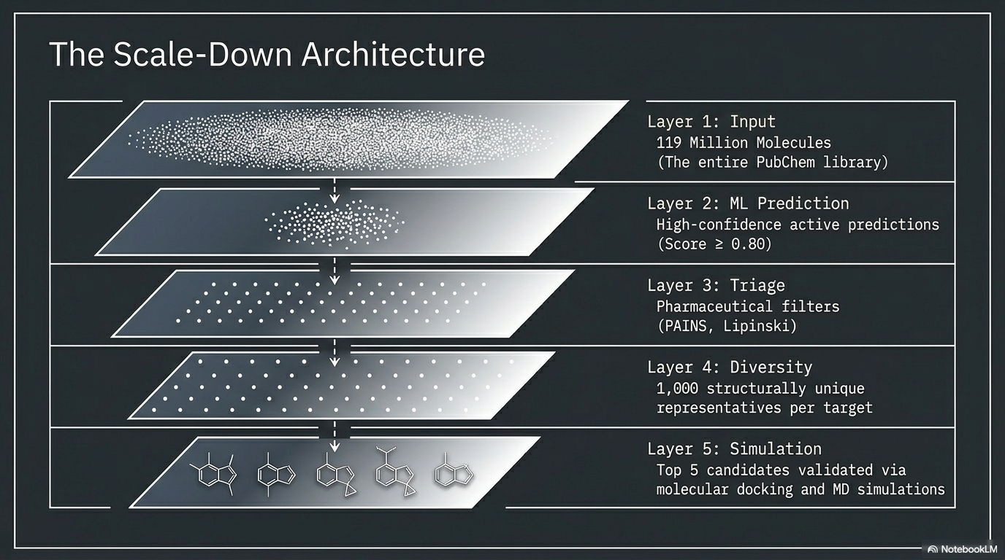

Slide 5
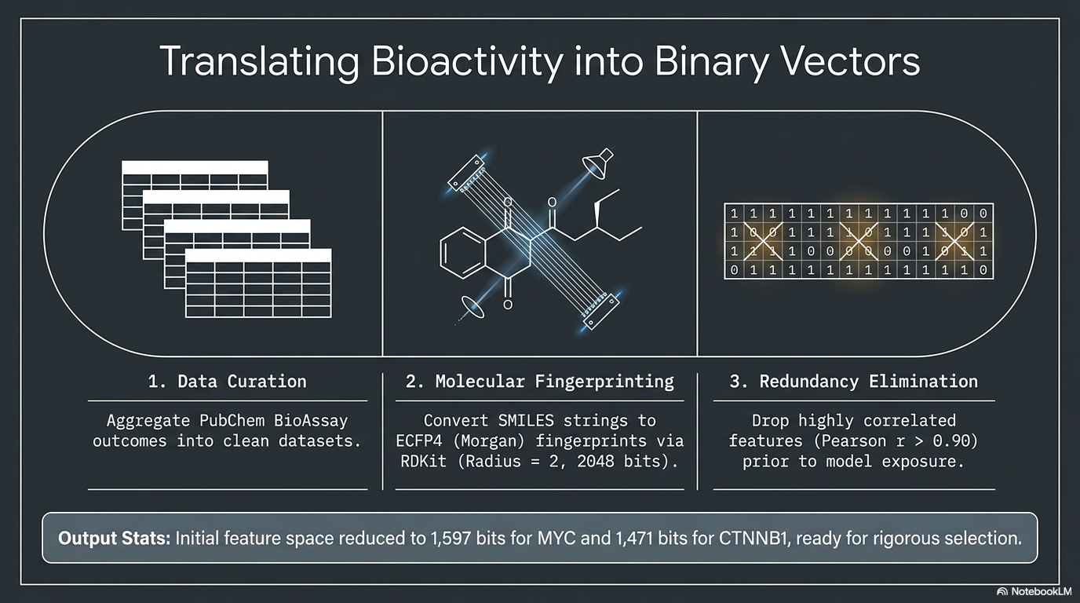

Slide 6
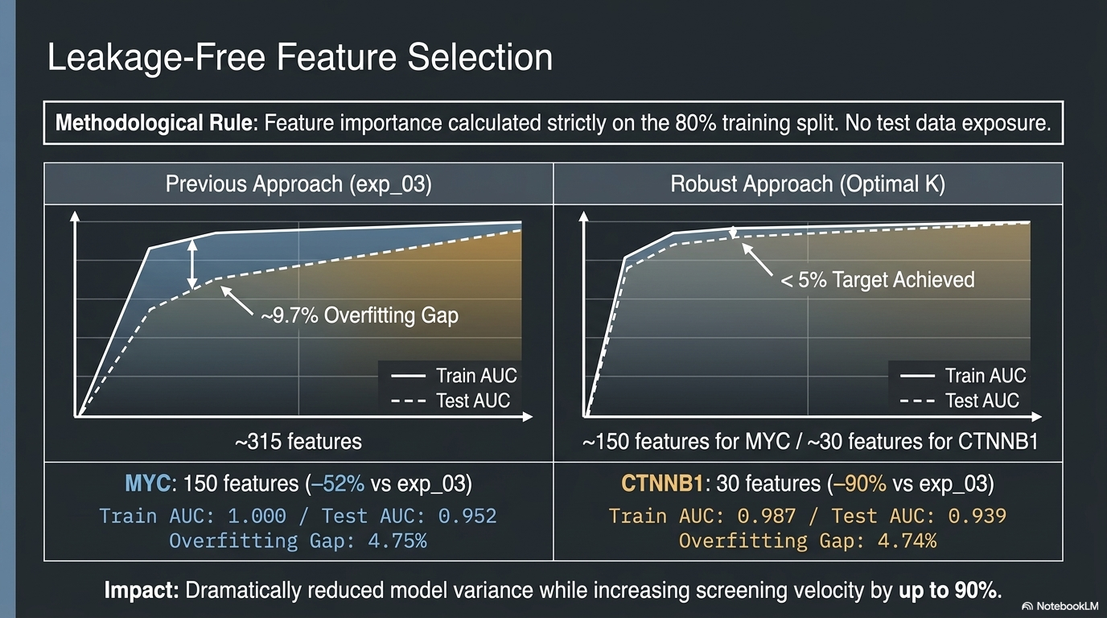

Slide 7
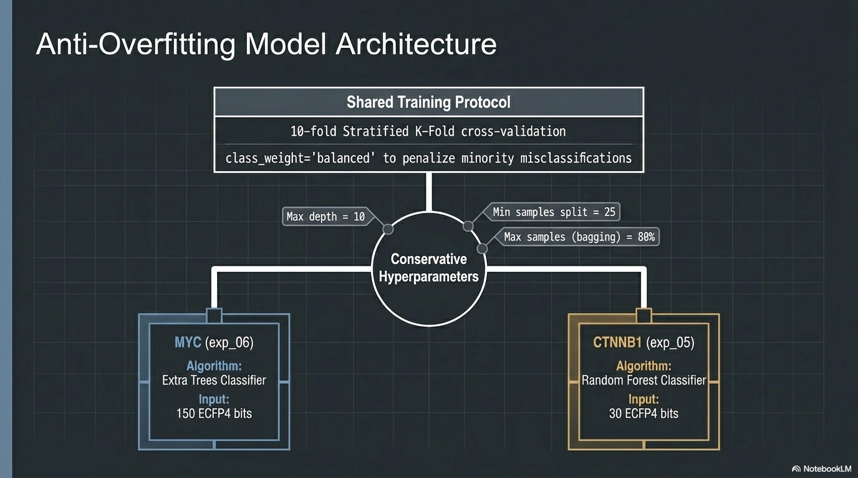

Slide 8
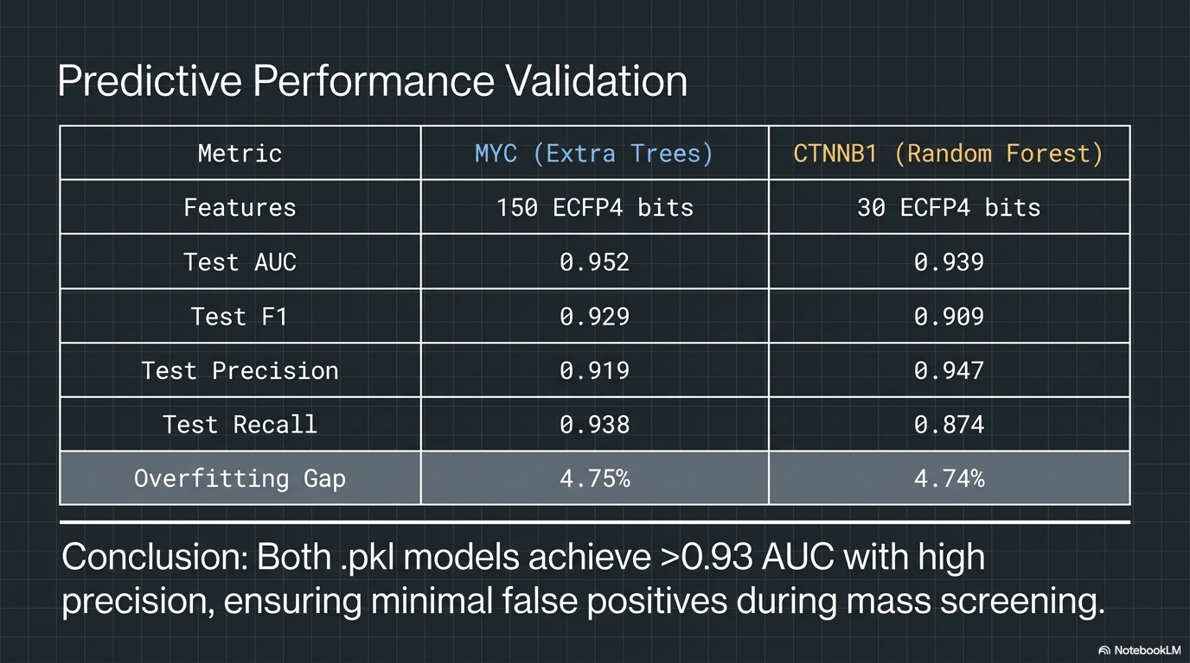

Slide 9
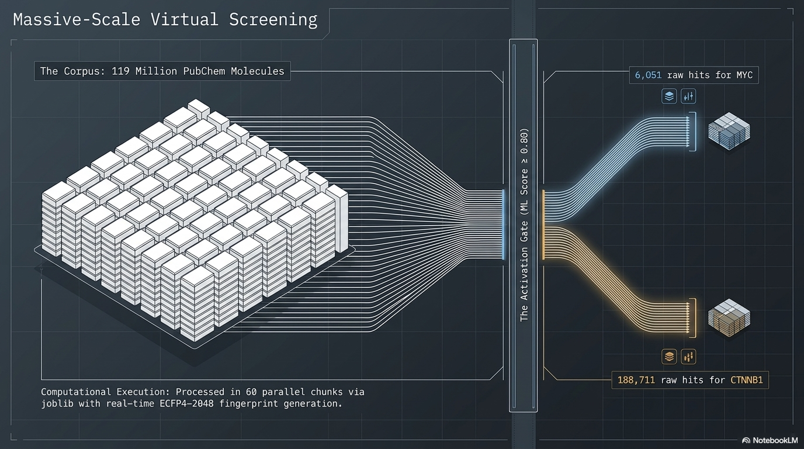

Slide 10
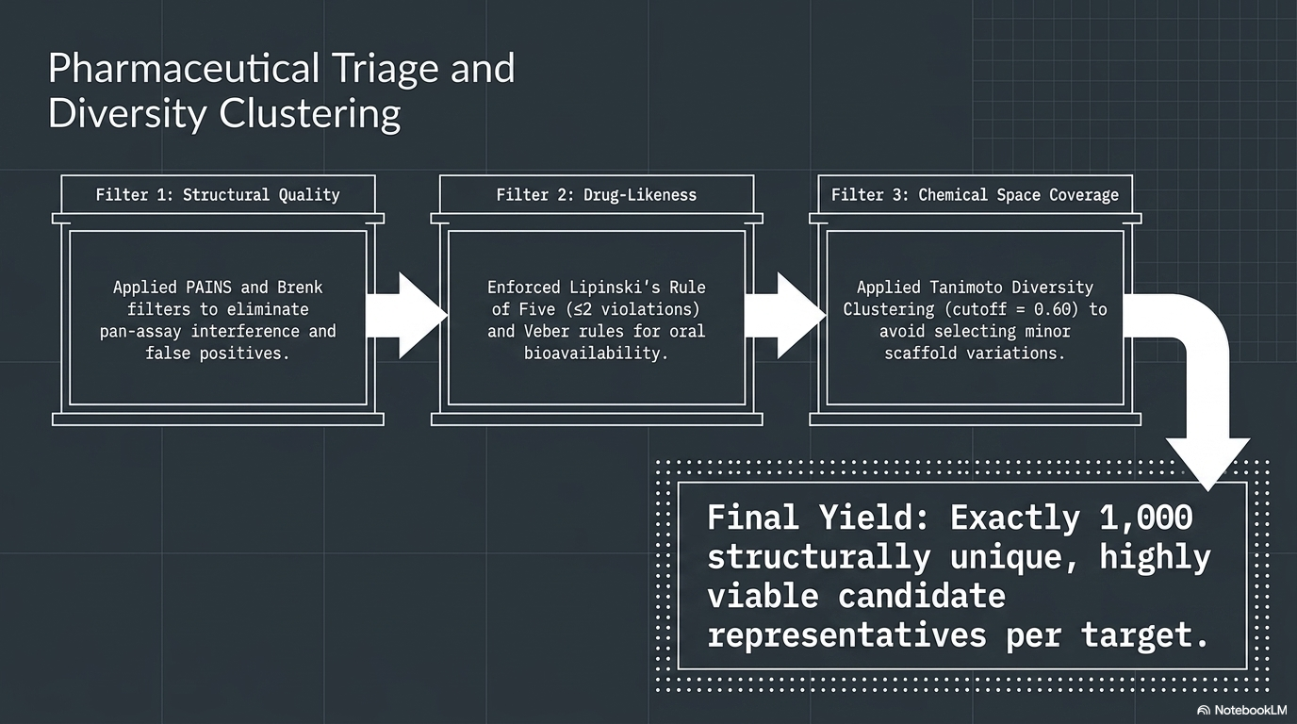

Slide 11
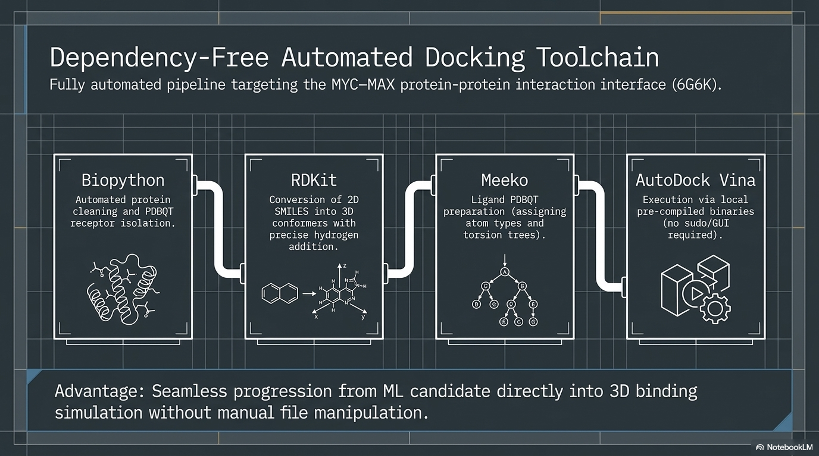

Slide 12
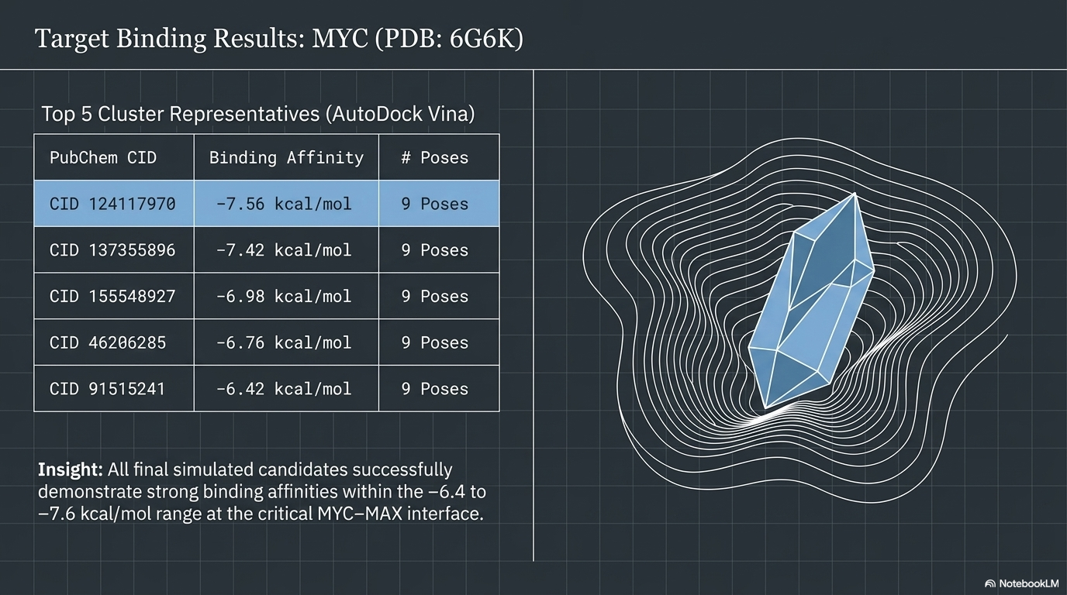

Slide 13
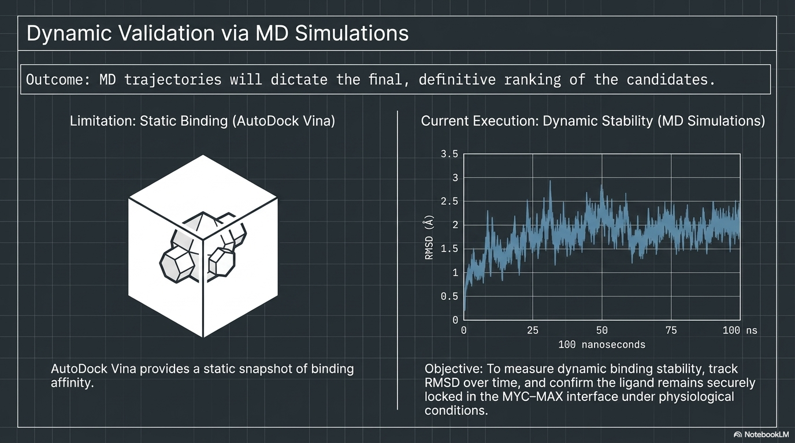

Slide 14
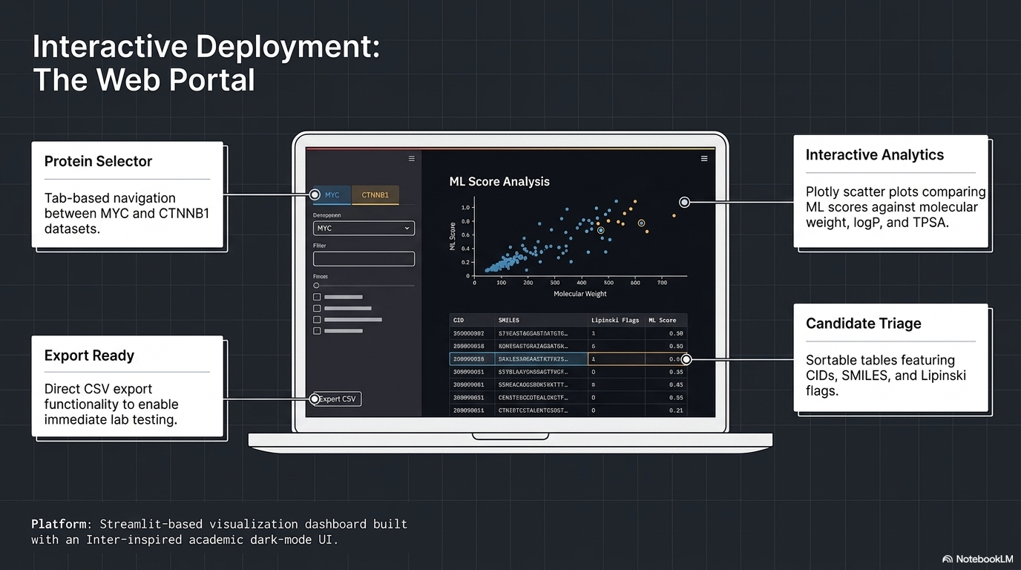

Slide 15
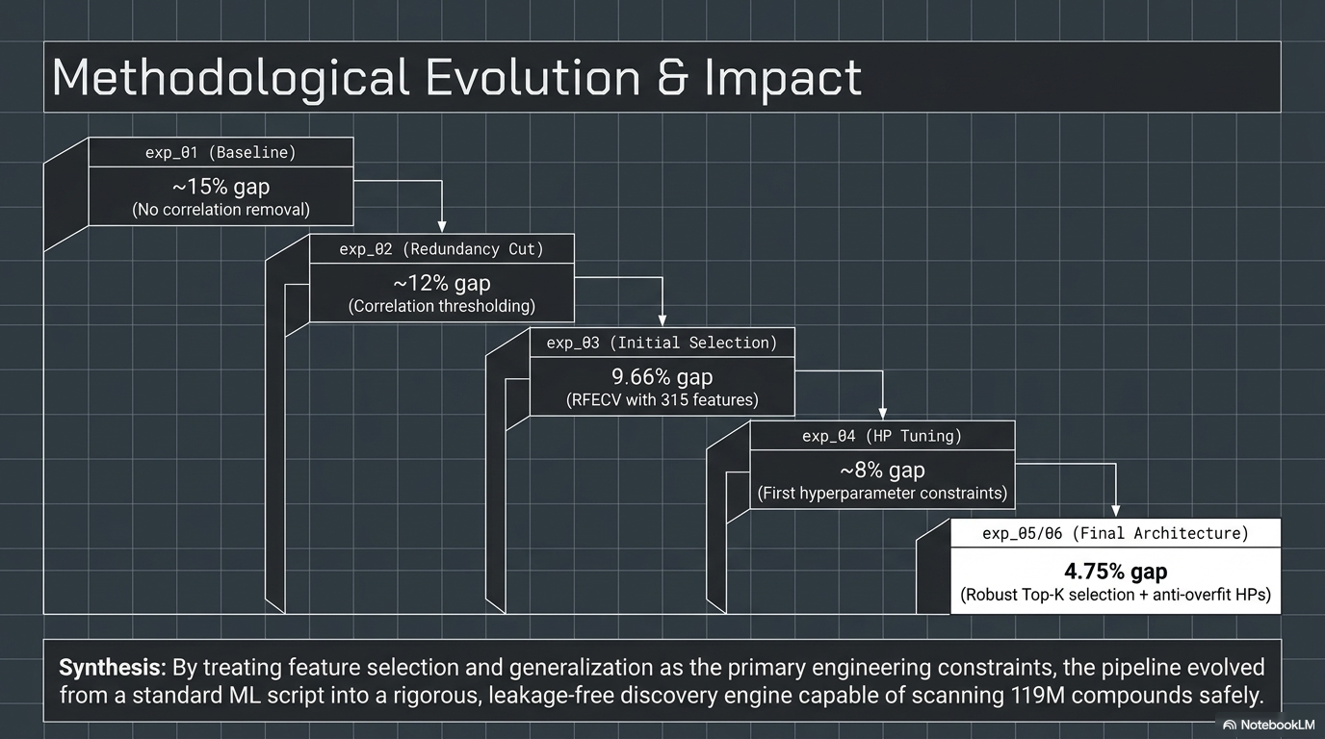

Slide 16
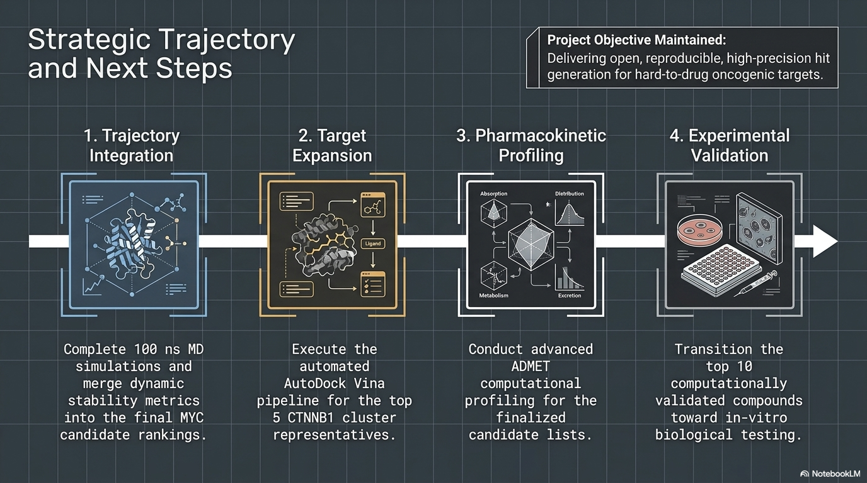

Slide 17
THANKS ..
Explore the Results:
Portal: http://172.16.10.190:8502
Access: The portal is currently hosted on the university's research server for data security. ( Accessible via MSKU Campus Network.)

