Slide 1
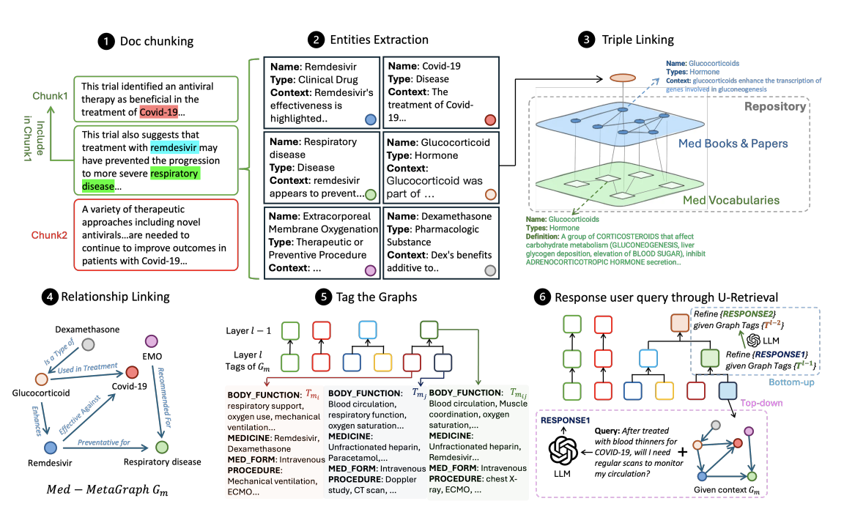

Active Graph Navigation for Medical RAG
From Replicating MedGraphRAG to Implementing Agentic Traversal
Beyza Kaya S021747
AI 525 Large Language Models

Slide 2
Motivation & Problem Statement
The Challenge
Medical queries require multi-hop reasoning (e.g., “How does Drug X affect Pathway Y?”).
Standard RAG (Retrieval-Augmented Generation) often retrieves irrelevant context (“Noise”), confusing the LLM.
The Replication Goal
Existing SOTA (MedGraphRAG): Resource-heavy (Requires Neo4j, ~50GB storage, Multi-GPU).
My approach:
  Reverse-Engineer the architecture from scratch in Python (NetworkX + Llama-3).
  Environment: Lightweight Google Colab implementation (4-bit Quantization).
  Benefit: Full control to inspect internal steps and replace the retrieval layer.

Slide 3
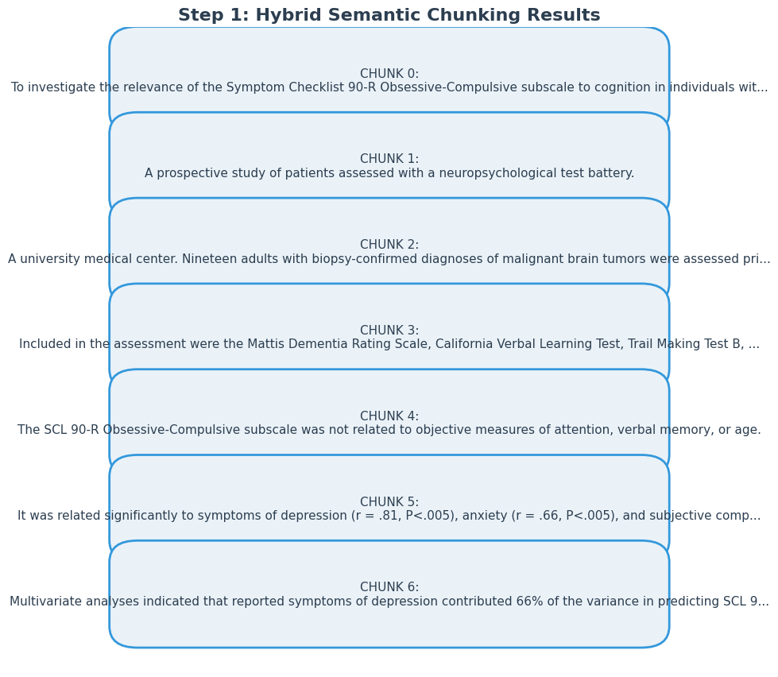
Baseline - Step 1: Hybrid Semantic Chunking
The Logic
Standard RAG splits text blindly (e.g., every 512 tokens).
This breaks medical context (separating symptoms from diagnoses).
My Implementation
Sliding Window Algorithm:
  Holds Sentence A and looks at Sentence B.
  LLM Judge: “Are these sentences about the exact same topic?”
  Result: Contextually complete chunks.

Slide 4
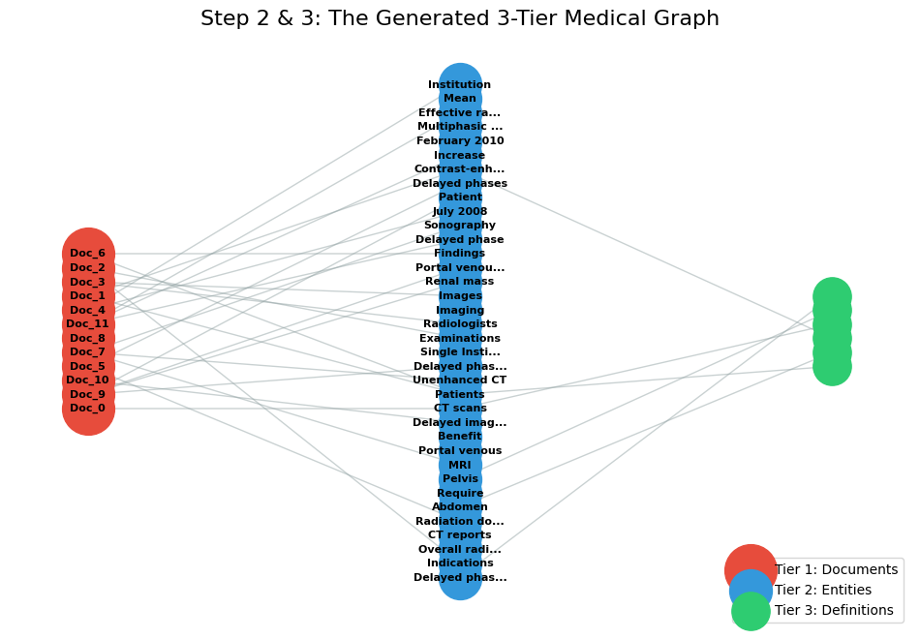
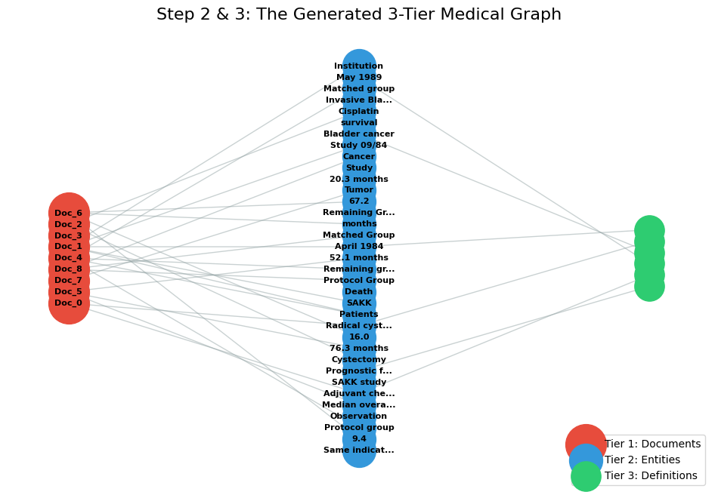
Baseline - Step 2 & 3: Graph Construction
Structuring Unstructured Data
Tier 1 (Red): Source Documents (The raw chunks).
Tier 2 (Blue): Entities (Extracted via LLM).
Tier 3 (Green): Definitions.
Innovation in Replication
Parametric Knowledge Injection:
  Lacked access to paid UMLS API.
  Solution: Used Llama-3 to generate strict medical definitions, simulating an external Knowledge Base.

Slide 5
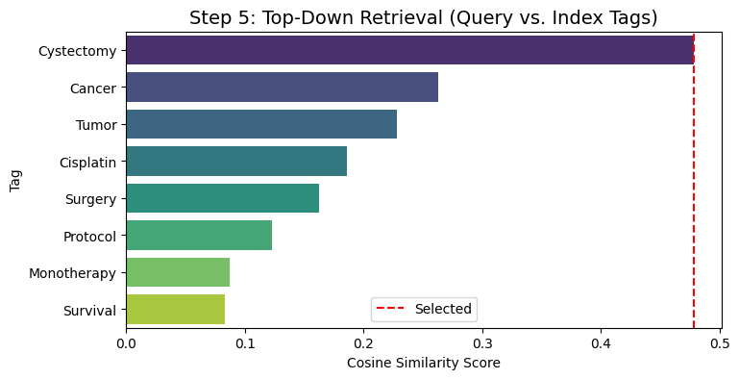
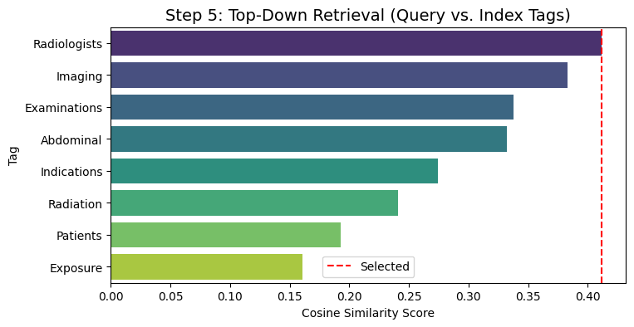
Baseline - Step 4 & 5: Static U-Retrieval
The "Control Group" Mechanism
Indexing: Extracted Keywords (Tags) for every document node.
Process:
  Top-Down: Match Query → → Tags → → Documents.
  Bottom-Up: Retrieve the full subgraph (Document + Neighbors).
"One-Shot" Retrieval: It cannot correct itself if the initial tag match is slightly off.

Slide 6
The Pivot - Why Agentic?
The "Noise" Problem:
  Static retrieval grabs all neighbors of a document.
  For complex queries, this floods the context window with irrelevant entities.
The Missing Link:
  Retrieval should be a decision process, not just a similarity match.
The Proposal:
  Transition from Static Retrieval (Soft Attention) to Active Navigation (Hard Attention).

Slide 7
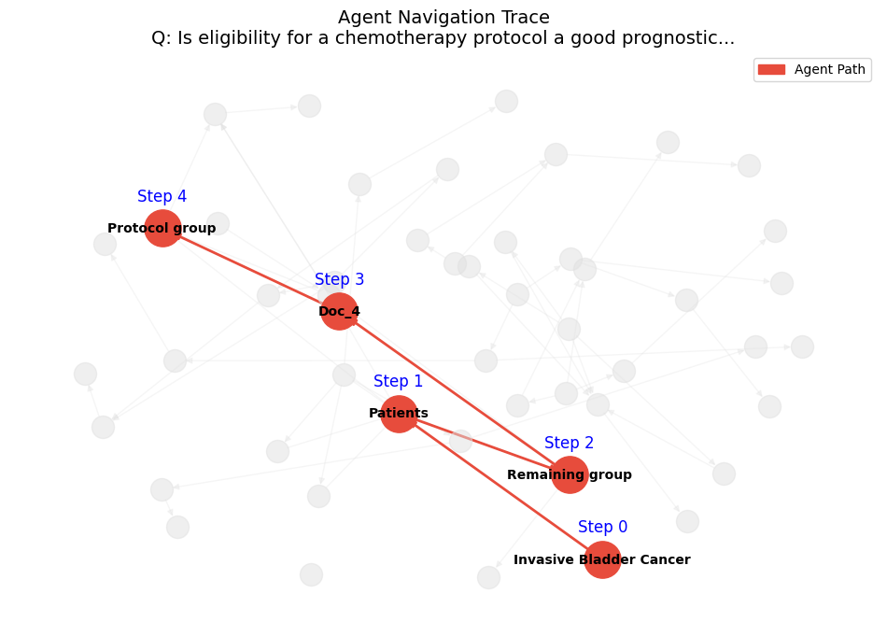
Proposed Solution: The Medical Graph Agent
Treat the Knowledge Graph as a navigable environment (like a maze).
The Agent (Llama-3):
  Start: Vector Search to find the most relevant entry Entity.
  Observe: Look at immediate neighbors (Local Perception).
  Think: Reason about which neighbor is most likely to answer the question.
  Act: Move to that neighbor and repeat.

Slide 8
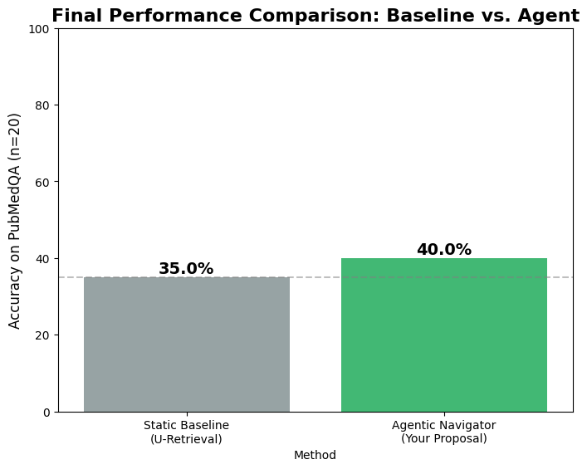
Quantitative Results
Experimental Setup
  Dataset: PubMedQA (PQA-L).
  Comparison: Exact Match Accuracy on 20 Fixed Random Seeds.
Final Results
  Static Baseline: 35% Accuracy.
  Agentic Navigator: 40% Accuracy.

Slide 9
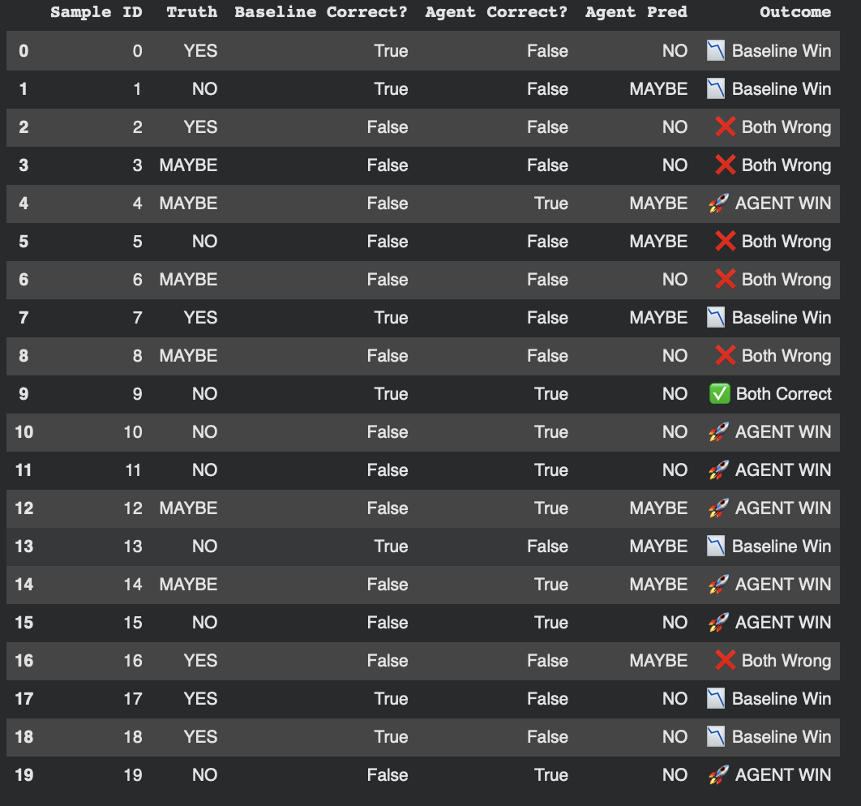
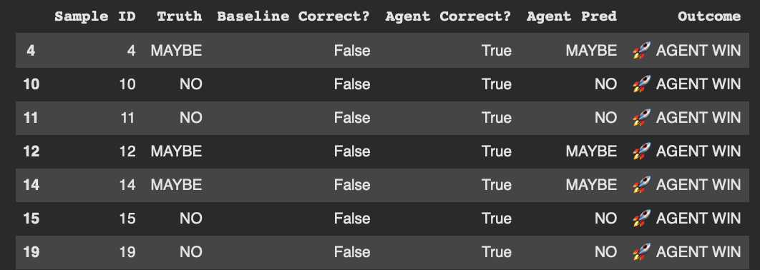
Quantitative Results

Slide 10
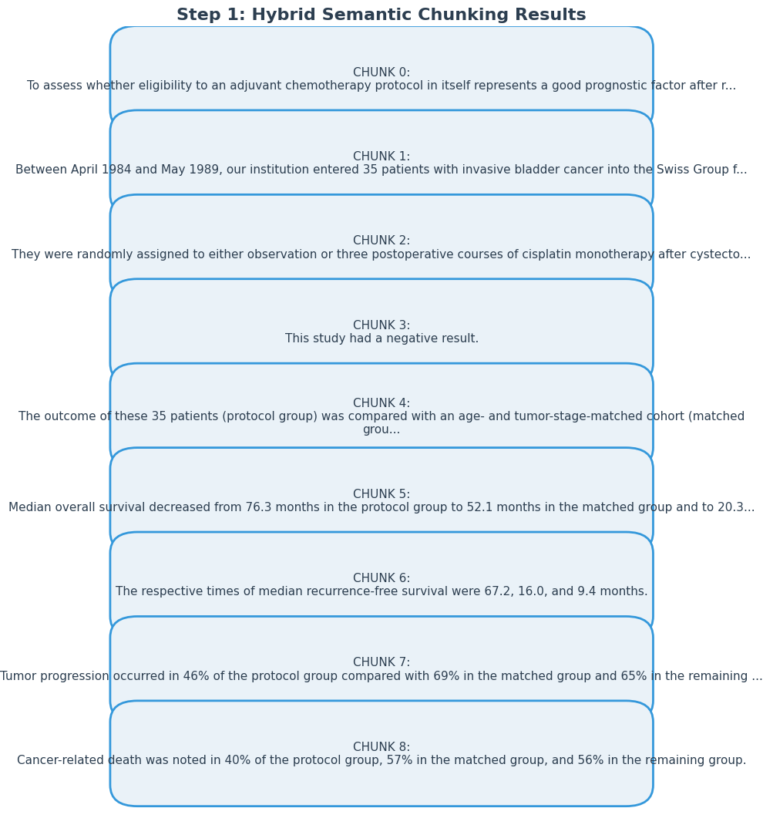
Conclusion
Summary of Contributions
  Replication: Successfully reverse-engineered MedGraphRAG in a constrained environment.
  Innovation: Designed a novel Agentic Navigator with robust error handling (V5).
  Result: Achieved measurable improvement (+5%) and superior explainability.
Limitation:
  Graph Gaps: If the graph has a missing link, the Agent cannot "jump" over it like Vector Search can.

