Slide 1

Sentiment Analysis on Amazon Product Reviews
By: Bezawit Ayalew, Vinod Kumar & Srinivas Peri

Slide 2

Introduction
In the bustling world of e-commerce, understanding customer sentiments is paramount for business success
Importance: Uncovering consumer sentiments holds the key to enhancing user experiences and driving business growth.
Objective: This study aims to explore sentiment analysis techniques and their pivotal role in improving e-commerce platforms' understanding of customer feedback, particularly analyzing sentiments in Amazon product review
This Photo by Unknown author is licensed under CC BY-SA-NC.

Slide 3

Methodology
Data Preprocessing: Cleaning and preparation of the Amazon product reviews dataset.
Model Training: Training Support Vector Machines (SVM), Logistic Regression, LSTM, and Convolutional Neural Network (CNN) models using Natural Language Processing (NLP) techniques.
Model Evaluation: Assessing the performance of each model based on accuracy in sentiment classification.
Evaluation Strategy: Addressing over-fitting and under-fitting using k-fold cross-validation.
Ablation Study: Investigating the impact of different model configurations on performance.
Insightful Analysis: Examination of extreme errors to gain deeper insights.

Slide 4
Data Processing
The Amazon product reviews dataset is used here it contains two files the train datafile and test data file .
The Amazon Review dataset Is structured as classes that are labelled as __label__1 and __label__2, and there is only one class per row. __label__1 corresponds to 1- and 2-star reviews, and __label__2 corresponds to 4- and 5-star reviews. (3-star reviews i.e., reviews with neutral sentiment were not included in the original), The review titles, followed by ':' and a space, are prepended to the text.
The given data is cleaned using the clean function which is used to remove noise and irrelevant information.

Slide 5
Tokenization
The text data is tokenized using the Tokenizer class from the Keras library.
The Tokenizer class is used to vectorize a text corpus by converting text into sequences of integers, where each integer represents a unique token (word).
The fit_on_texts method of the Tokenizer class is used to fit the tokenizer on the training text data, building the vocabulary of words from the text.
The texts_to_sequences method of the Tokenizer class is then used to convert the text data into sequences of integers based on the tokenizer's vocabulary.
Finally, the sequences are padded or truncated to a fixed length using the pad_sequences function to ensure uniform input size for the model.

Slide 6
MODELS
Support Vector Machine (SVM): SVM is a supervised learning algorithm used for classification tasks. In this methodology, a linear SVM model is trained using the TF-IDF transformed training data. The model learns to classify reviews into positive or negative sentiment categories based on the extracted features.
Logistic Regression: Logistic Regression is another classification algorithm commonly used in sentiment analysis tasks. Similar to SVM, a Logistic Regression model is trained on the TF-IDF transformed training data. It learns to predict the probability of a review belonging to a particular sentiment class.
Convolutional Neural Network (CNN): CNNs are deep learning models particularly effective in processing spatially structured data such as images and, in this case, sequential data like text. A CNN model is constructed using the Keras Sequential API and trained on padded sequences of the training data. The model learns hierarchical representations of text features through convolutional layers, enabling it to capture patterns at different levels of abstraction.
LSTM: Long Short-Term Memory (LSTM): LSTM is a type of recurrent neural network (RNN) architecture used in deep learning to process sequences of data. It's designed to remember important information and forget non-essential data, making it effective for tasks involving sequential dependencies, such as language modeling and time-series analysis.

Slide 7
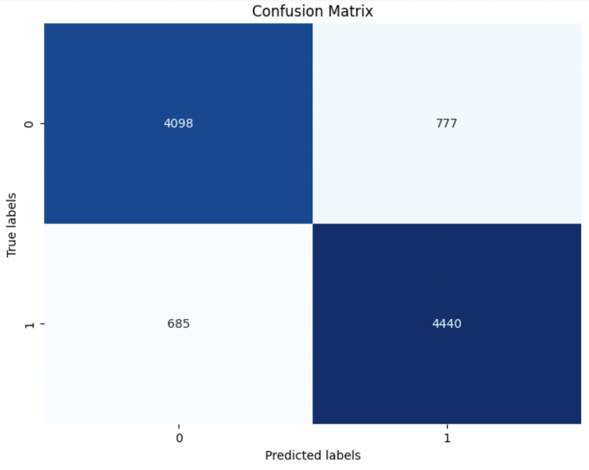
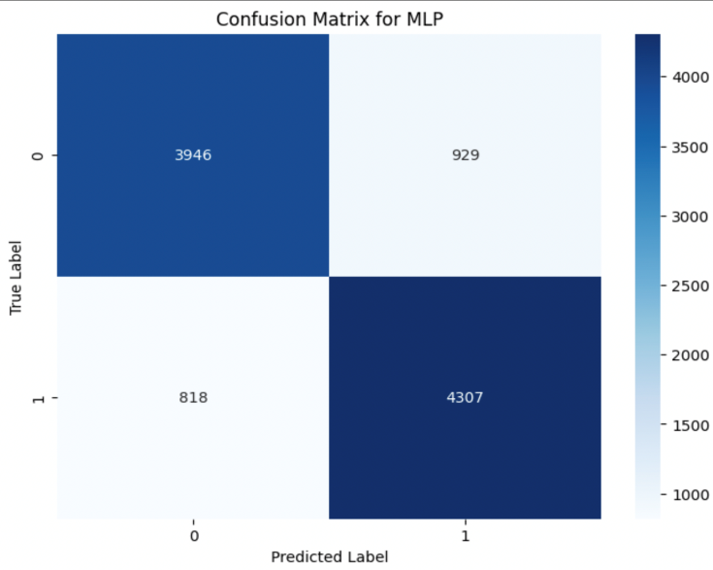
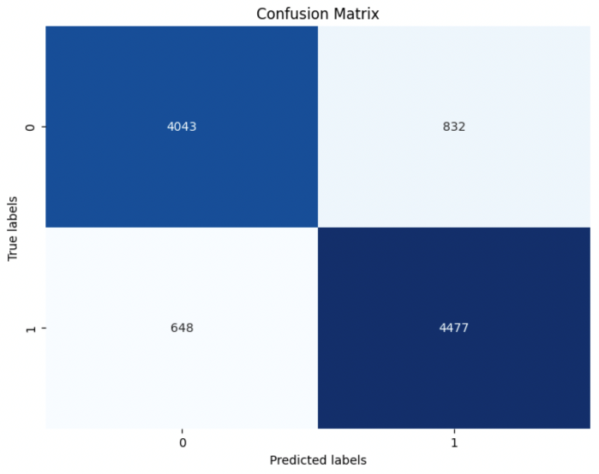
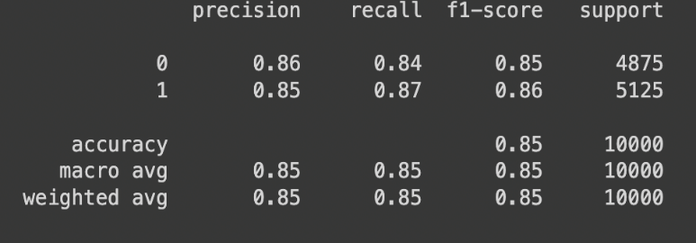
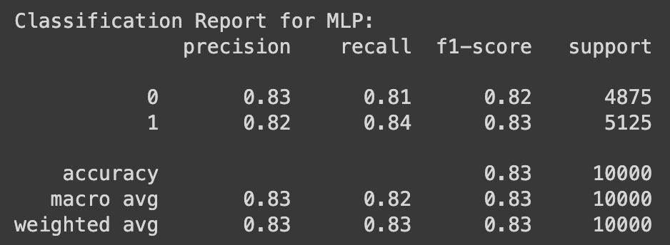
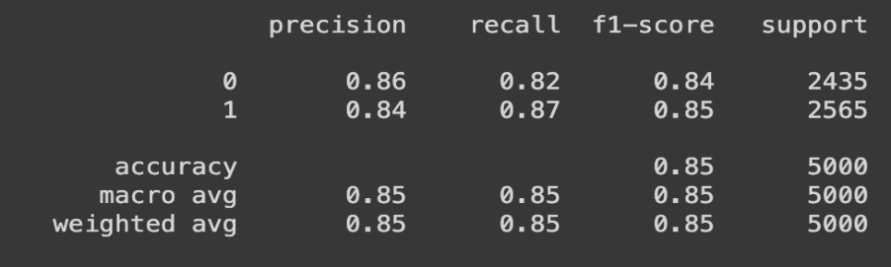
Performance Evaluation: SVM, Linear Regression, MLP
LR
MLP
SVM

Slide 8
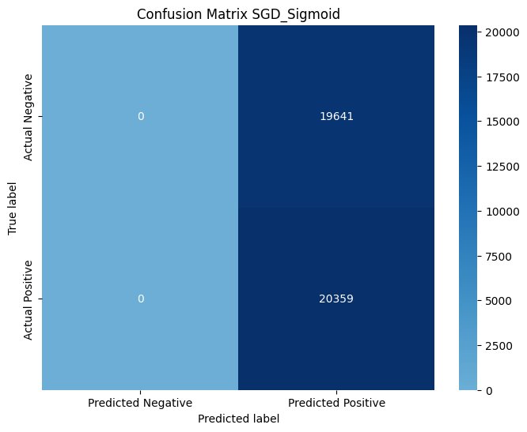
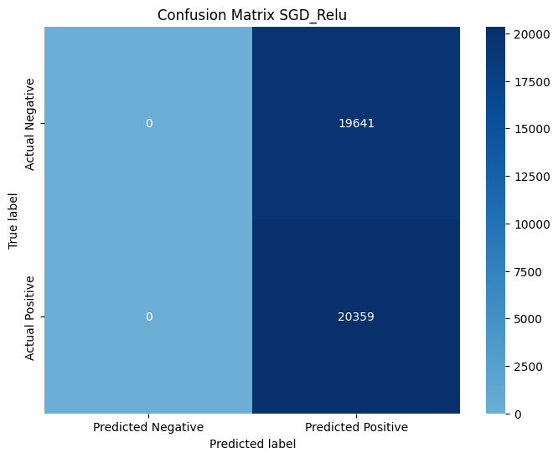
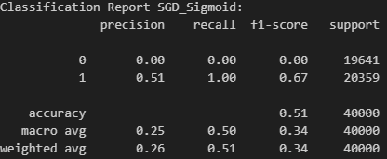
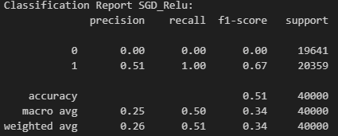
Performance Evaluation: LSTM with varying Parameters
SGD_Sigmoid
SGD_Relu

Slide 9
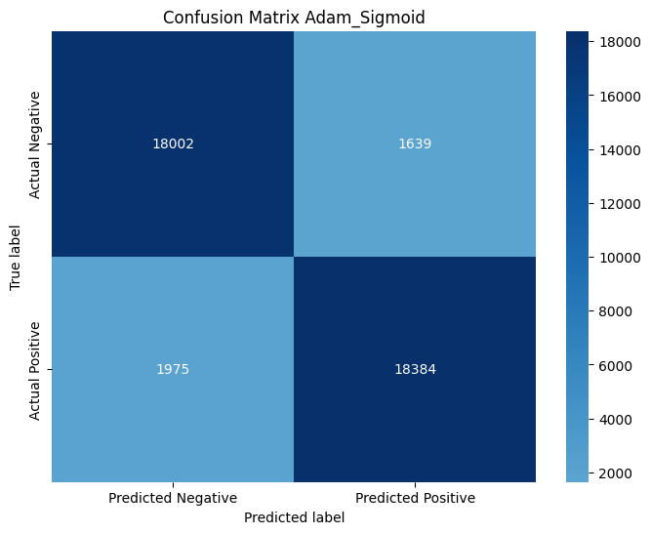
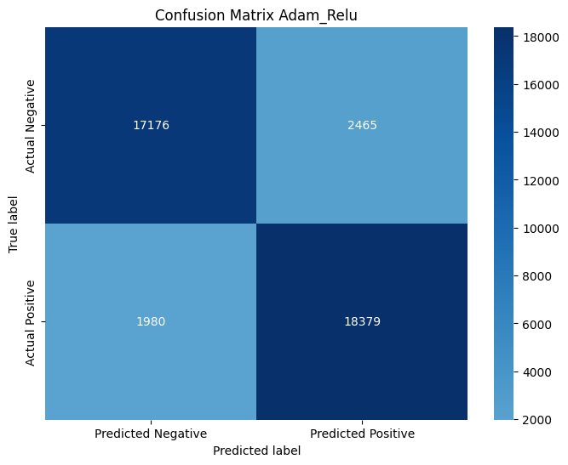
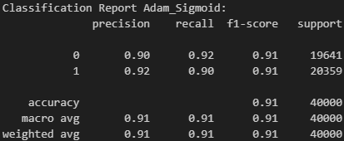
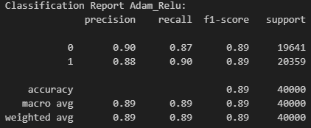
Performance Evaluation: LSTM with varying Parameters
Adam_Sigmoid
Adam_Relu

Slide 10
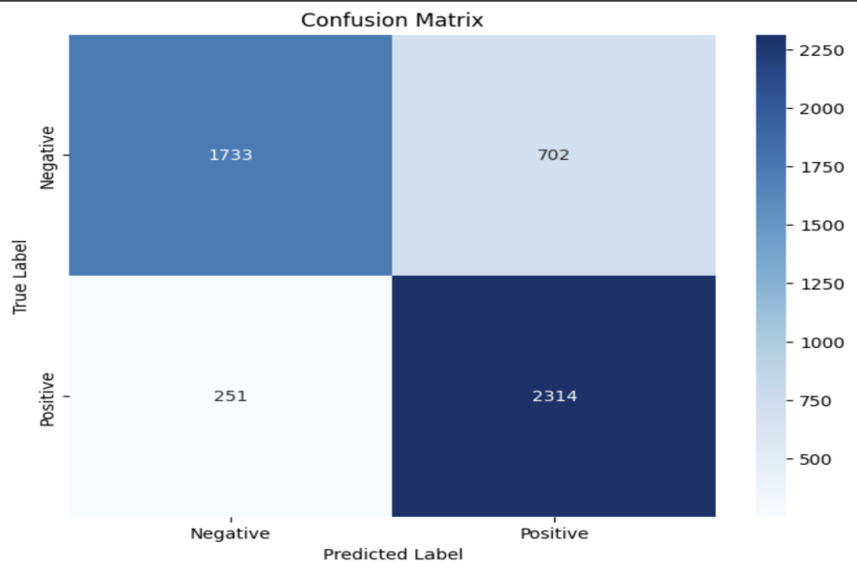
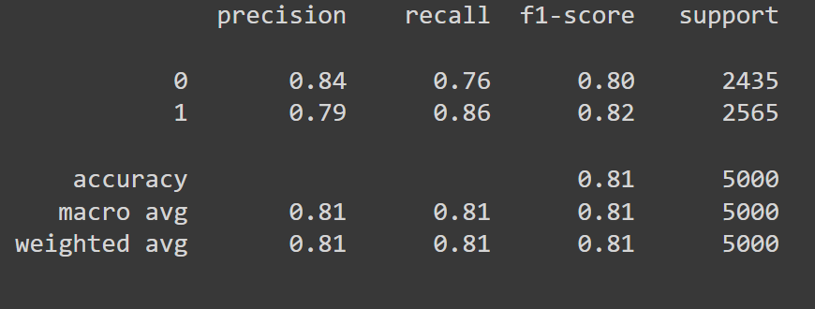
Performance Evaluation: CNN
CNN

Slide 11
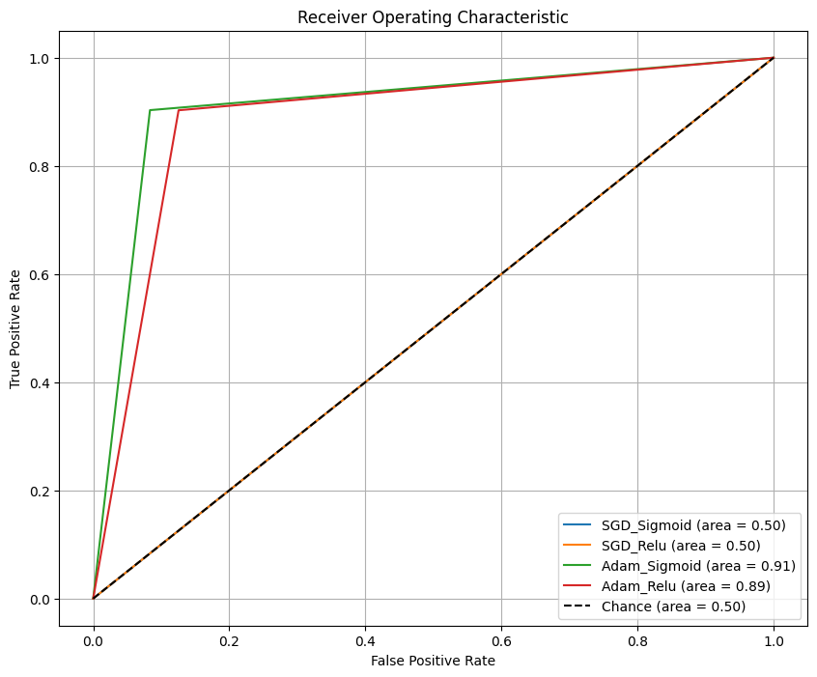
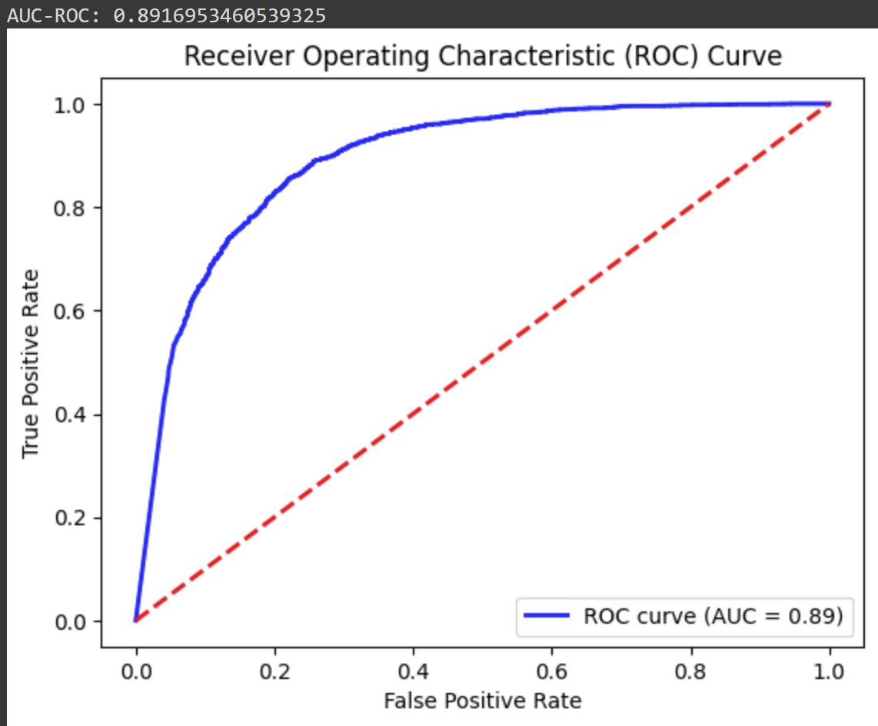
Performance Evaluation: LSTM Models & CNN Model AUC-ROC

Slide 12

Best Performance Models:
SVM
LSTM
CNN

Slide 13

Conclusion
Top Performers: LSTM with Adam Optimizer and Sigmoid activation function show promising results over Support Vector Machine (SVM) and Convolutional Neural Network (CNN).
Business Impact: Accurate sentiment analysis can enhance customer satisfaction and marketing strategies.
Customer-Centric Approach: Advancements in sentiment analysis empower businesses to better understand and respond to consumer sentiments, fostering loyalty and success.​

Slide 14
Future Work
Model Optimization: Explore advanced neural network architectures and ensemble methods for improved performance.
Domain-Specific Adaptation: Tailor models to specific e-commerce domains for more accurate insights.
Real-time Analysis: Develop techniques for swift responses to changing consumer sentiments.
Feature-Level Analysis: Investigate sentiment towards specific product attributes for deeper insights.
Personalization Integration: Combine sentiment analysis with recommendation systems for enhanced shopping experiences.
Bias Mitigation: Continuously assess and mitigate bias in models to ensure fairness. Slide

Slide 15

Thank you!

