Slide 1
Economic Determinants of Right Wing Populism & Climate Sceptisim

Slide 2
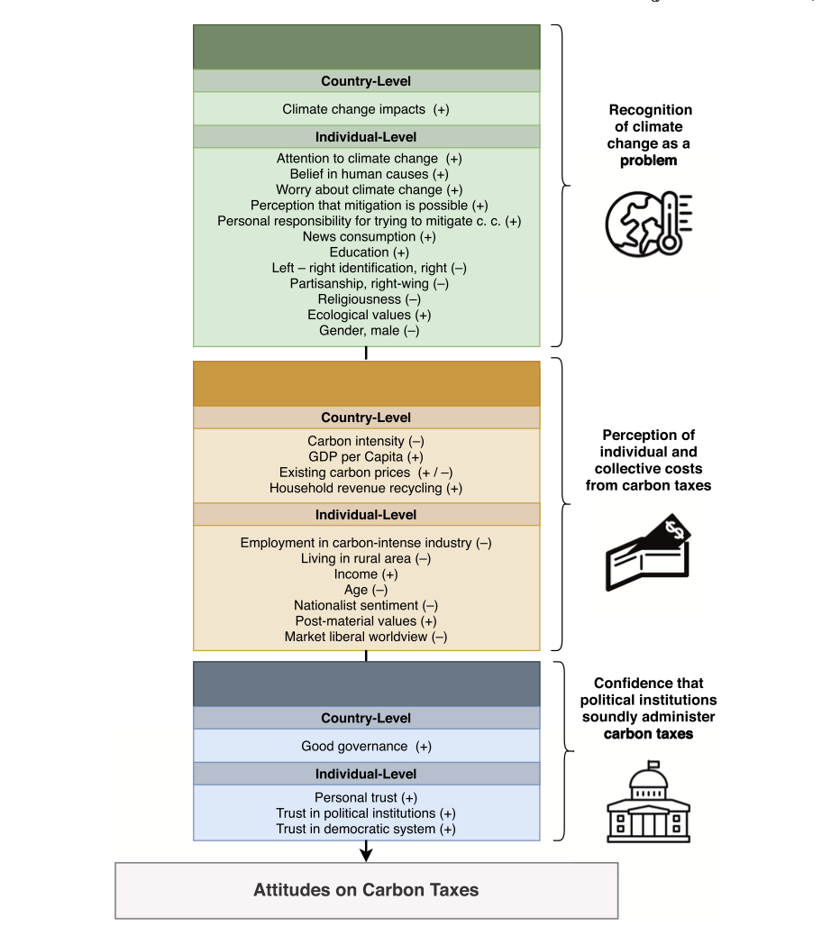
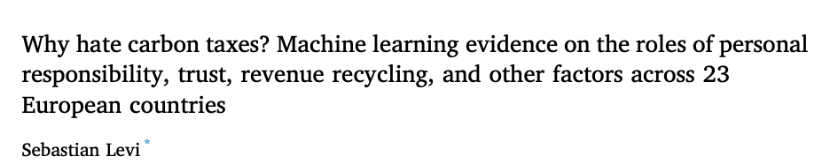

Slide 3
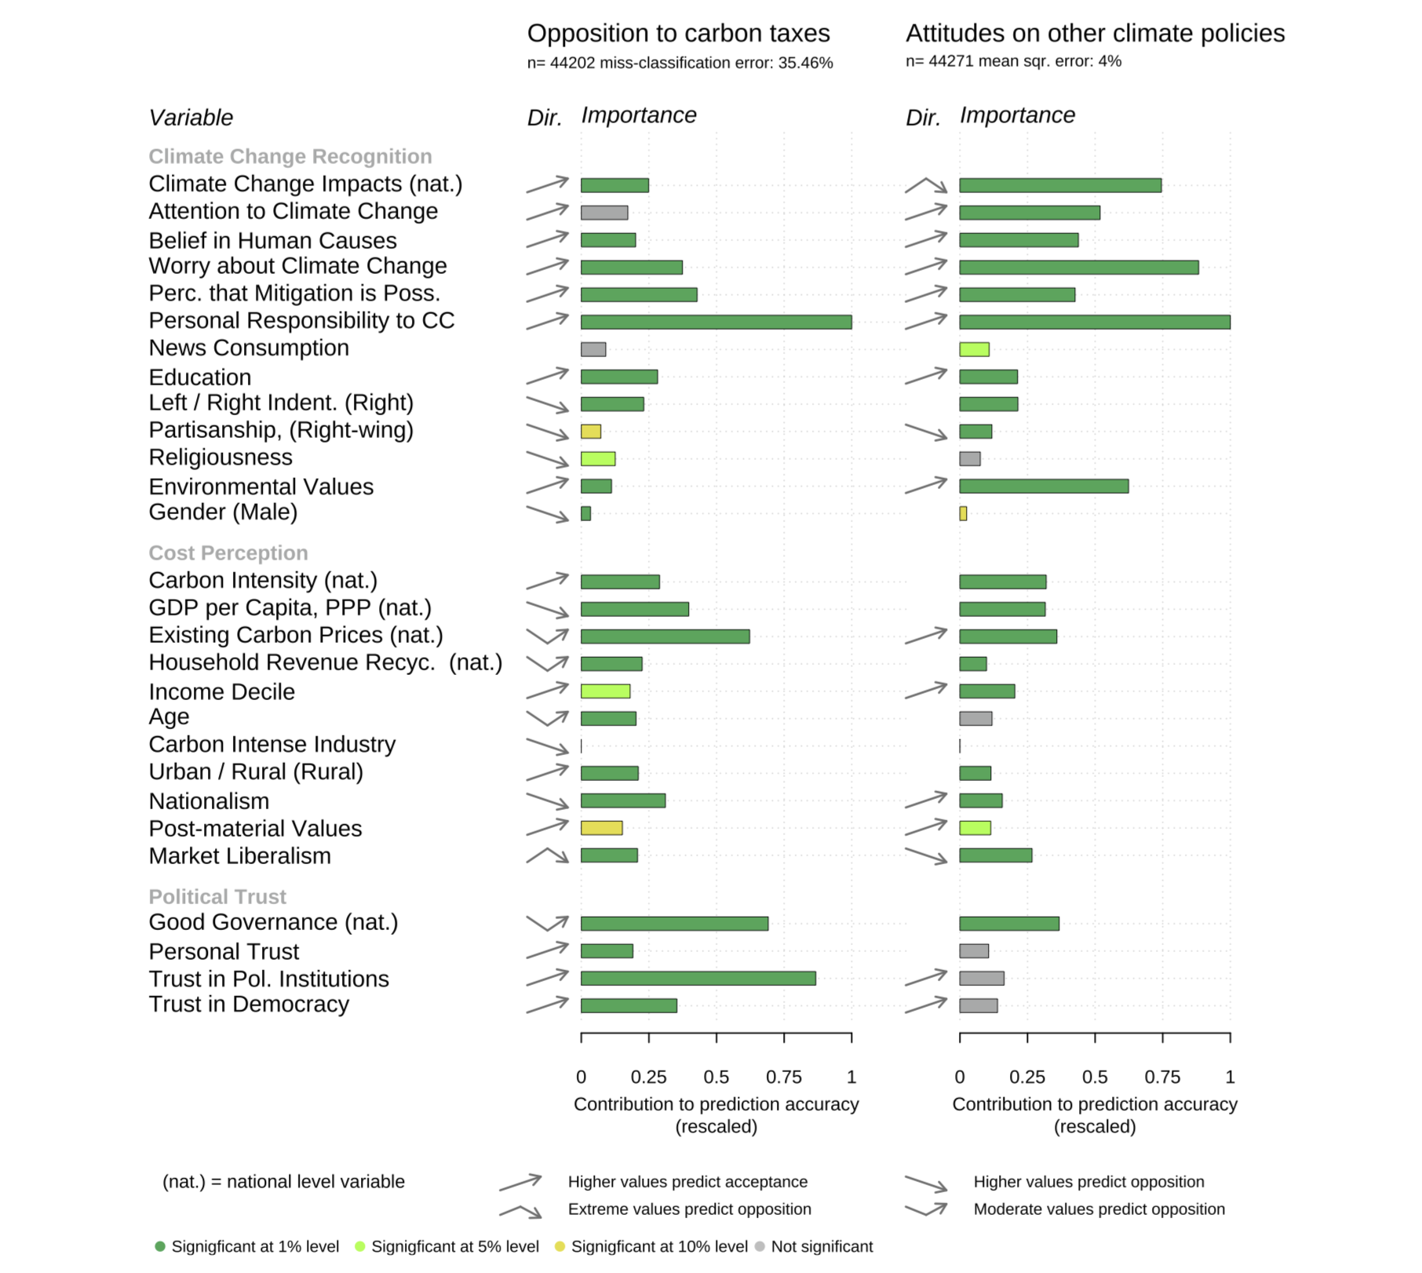

Slide 4
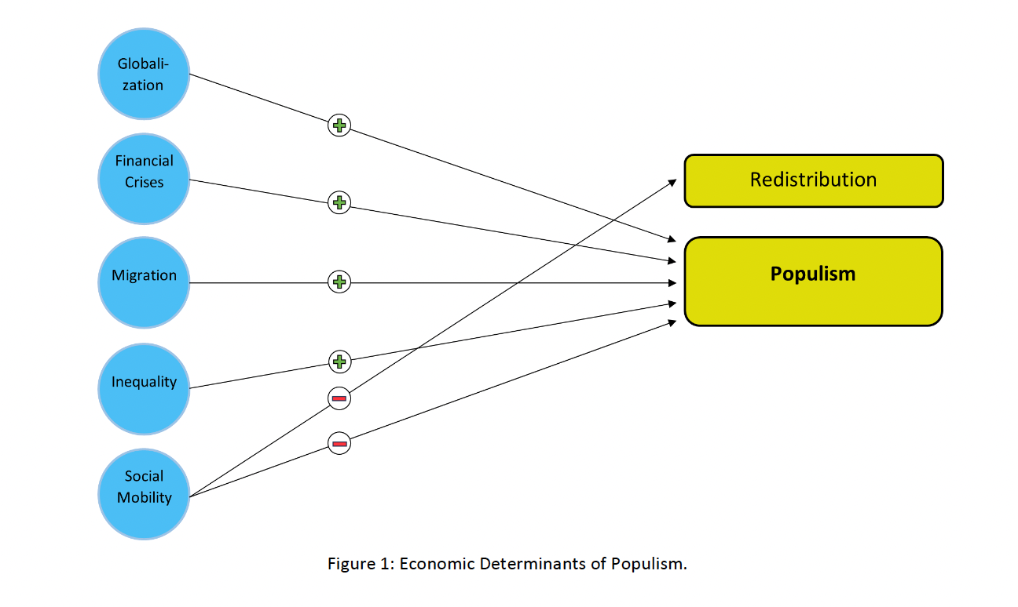

Slide 5
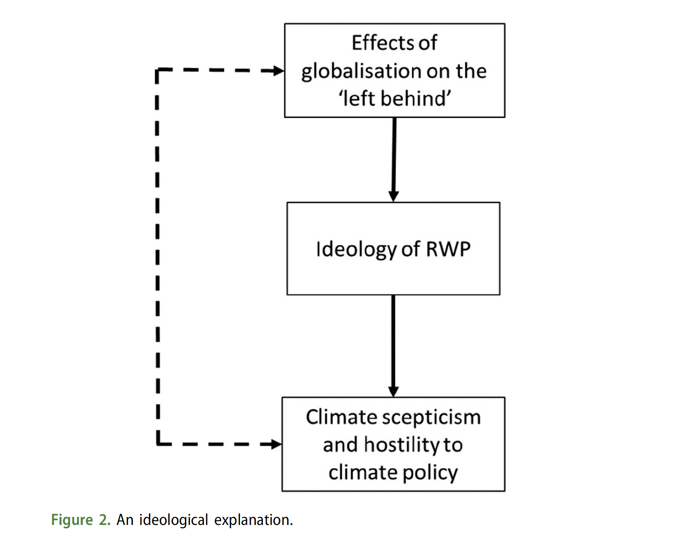
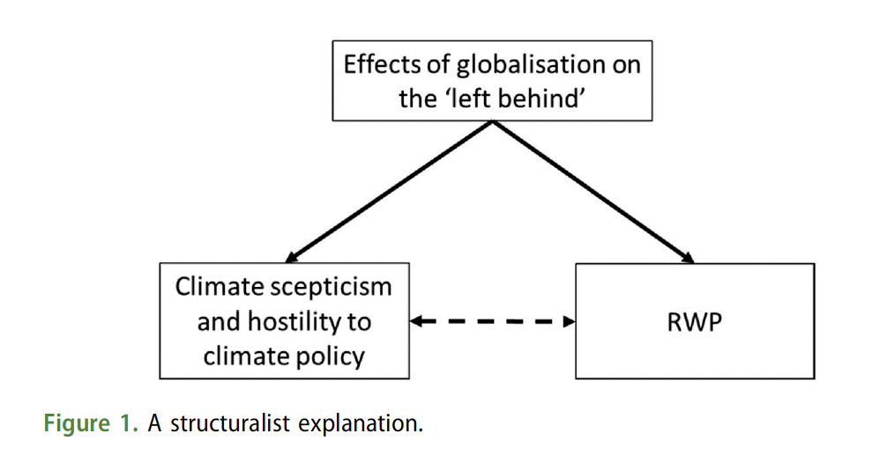
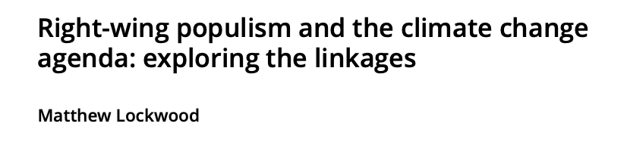
Literature on Right Wing Populism & Climate Sceptisim
Ideologogical Approach
A structuralist approach
Causal Mediation Model
Interaction model (measuring contextual effect)
Machine Learning – Random Forrest for Variable Selection
Fitting Mediator from treatment assignment
Causal Trees not appropriate for mediation? Propensity Score Matching
Notes:
What about potential confounders that influence the probability of voting RWP as well as climate sceptisim ?? Confounders that influence the treatment ( voting for RWP) as well as the outcome ( hostility to climate policies). Alternatively, not focusing on the causal impact, but instead the influence of RWP on outcome when holding only economic conditions constant. This means no causality. But still assessing to what extend the structuralist approach is better at explaining climate hostility.
Comparing the R2 of the structuralist approach in explaining the outcome ( hostility to climate policies) to the Ideological approach
-

Slide 6
Variable Selection & Data
Independent Variables
Mediation / Contextual effect
Which Party feel closest
RWP (y/n)
Individual factors
Type of Industry (Nace 2.0) (e.g. Mining of coal and lignite)
Recent Unemployment
Income (relative to Country)
Member of Trade Union
Sociodemographics (Education, Gender)
Dependet Variable
How worried about Climate change?
Climate change caused by natural processes, human activity, or both
Regional/ National factors
Social Mobility - ?
Globalisation – trade shocks?
Employment Regional
Inequality
National Gini
Cambridge Econometrics
Migration – Eurostat – Net changes
Social Spending (% of GDP) - Eurostat
Data European Social Survey – November 2023
& Other Economic Data
Notes:
What about time periods

Slide 7
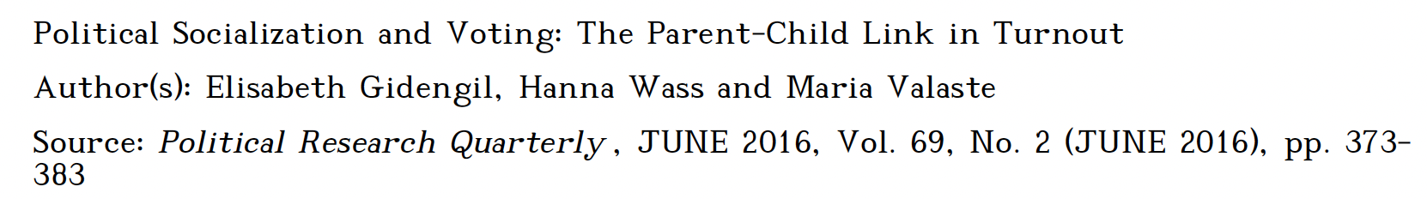
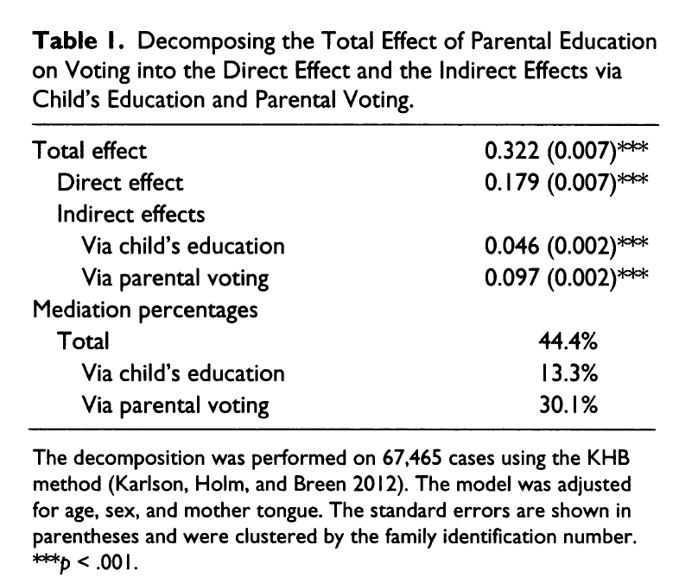
DAG Causal Mediation
Unobsevered confounders
Parental Education
Parental Voting
Child Voting
Unobservered Confounders
- shared social millieu
- local political context
- exposure to political campaigns
- Reverse Causation ( Young excited adults incite parents to vote)

Slide 8
DAG Causal Mediation
Unobsevered confounders ?
Economic effects (Regional & Individual)
Feeling closest to RWP
Climate Sceptisism
Confounders
- Political Ideology ?
- Exposure to Media – Fixed Effects Controlling for NUTS 3
- Psychological Factors (Individual personally traits) (EFA)
- Trust in politics (Mediator as a consequence of Economic Effects)
- Elite Cues
Notes:
Matching equivalent to Conditional Average treatment effect? Not necessarily causal model, but instead, one can see how much more R2 of climate hostility is explained by the people that voted for RWP in comparison of those who did not. What about time periods ?

Slide 9
Further Questions
Political system allows people to have a say in what government does
Trust in country's parliament
polintr - How interested in politics
trstplt - Trust in politicians
How emotionally attached to [country]
The media are free to criticise the government
National elections are free and fair
How important for you to live in democratically governed country
Notes:
Most are a result of economic effects -> therefore mediators, not control them for

