Slide 1
Hands-on with OpenShift
Why
What
How

Slide 2
Why use OpenShift
Container advantages
DevOps Features

Slide 3

CONTAINER ADOPTION CHALLENGES
CONTAINERIZING THE DATACENTER REQUIRES A COMPLETE PLATFORM
Organizations need a secure and reliable integrated platform on which they can run and orchestrate multi-container based applications at scale

Slide 4


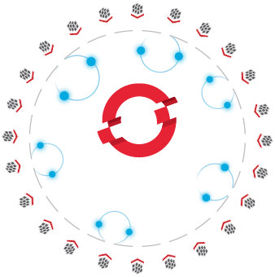







Critical features for both Dev and Ops
Self-Service
Standards-based
Multi-language
Web-scale
Open Source
Automation
Collaboration
Enterprise Grade
Seamless
Secure
Notes:
OpenShift
Provides key features for both Dev and Ops and helps enable DevOps
In recent IDC study we found that organizations found tremendous benefits when using OpenShift

Slide 5




TRADITIONAL DEVELOPMENT PIPELINE
Nordea
MULTIPLE MANUAL STEPS IN MULTIPLE HETROGENOUS ENVIRONMENTS
COMMIT
10
weeks
BUILD
PRE-PROD
PRODUCTION
TEST
UAT
PRODUCTION
QA
A
PRODUCTION
B
1
C
D
2
3
4
OPerationS
DEVelopment
Notes:
It’s not that operations people hates developers, they different teams just happen to have different focuses, and this creates the friction.
DEV: Deploy, time-to-market, deliveries. OPS: Compliance, efficiency, security

Slide 6
TIME FOR CHANGE!
Nordea
WHAT IF WE COULD INTEGRATE AND AUTOMATE ALL THOSE STEPS?
COMMIT
BUILD
PRE-PROD
PRODUCTION
TEST
UAT
PRODUCTION
QA
A
PRODUCTION
B
1
C
D
2
3
4
DEVelopment
OPerationS
DEVOPS
Notes:
It’s not that operations people hates developers, they different teams just happen to have different focuses, and this creates the friction.
DEV: Deploy, time-to-market, deliveries. OPS: Compliance, efficiency, security

Slide 7



OPENSHIFT DEVELOPMENT PIPELINE
Nordea
AN AUTOMATED AND INTEGRATED DEVELOPMENT PIPELINE
COMMIT
BUILD
TEST
QA
UAT
PRE-PROD
PRODUCTION
“We used to have 10 weeks from code commit to production, with OpenShift we are down to 20 min. It is a game changer.”
Nordea

Slide 8
WhAT IS OpenShift
Architecture Overview

Slide 9
OpenShift: built on Open Container Standards
(CONTAINER FORMAT)
(CONTAINER ORCHESTRATION)
docker
kubernetes
Red Hat is top contributor along with Docker Inc
Red Hat is top contributor along with Google

Slide 10









A COMPLETE CONTAINER PLATFORM
YOU NEED A COMPLETE AND INTEGRATED CONTAINER PLATFORM TO SCALE
Orchestration
Build Automation
Deployment Automation
Change management
Self Service
Logs & Metrics
Compliance
Monitoring
Operational Management
Charge back
A secure Linux-OS
=

Slide 11



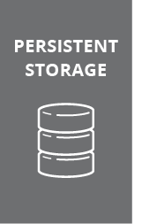
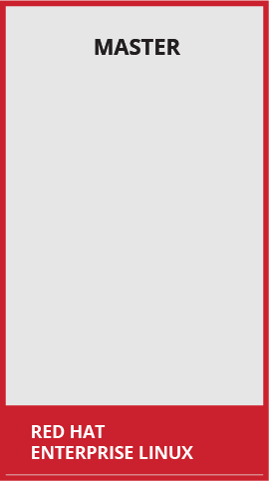
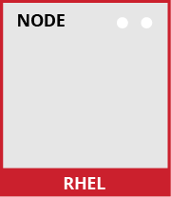





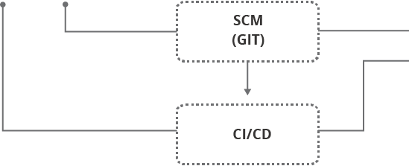






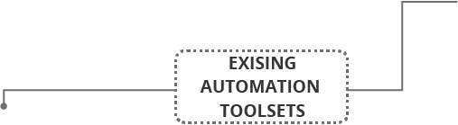



10,000 foot overview
Notes:
Speaker:
* This is a high level architecture diagram of the OpenShift 3 platform. On the subsequent slides we will dive down and investigate how these components interact within an OpenShift infrastructure.
Discussion:
* Set the stage for describing the OpenShift architecture.
Transcript:
OpenShift has a complex multi-component architecture. This presentation is usable to help prospects understand how the components work together.

Slide 12
OpenShift runs on your choice of infrastructure
Notes:
Speaker:
* From bare metal physical machines to virtualized infrastructure, or in private or certified public clouds, OpenShift is supported anywhere that Red Hat Enterprise Linux is.
* This includes all the supported virtualization platforms - RHEV, vSphere or Hyper-V.
* Red Hat’s OpenStack platform and certified public cloud providers like Amazon, Google and more are supported, too.
* You can even take a hybrid approach and deploy instances of OpenShift Enterprise across all of these infrastructures.
Discussion:
* Show the flexibility of deploying OpenShift
* Technically only x86 platforms are supported.
Transcript:
OpenShift is fully supported anywhere Red Hat Enterprise Linux is. Hybrid deployments across multiple infrastructures can be achieved, but many customers are still adopting OpenShift inside their existing, traditional virtualized environments.

Slide 13
Nodes are instances of RHEL where apps will run
Notes:
Speaker:
* OpenShift has two types of systems. The first are called nodes.
* Nodes are instances of RHEL 7 or RHEL Atomic with the OpenShift software installed.
* Ultimately, Nodes are where end-user applications are run.
Discussion:
* The Nodes are what the Masters will orchestrate - you will learn about Masters shortly.
* Nodes are just instances of RHEL or Atomic.
* OpenShift’s node daemon and other software runs on a node.
Transcript:
OpenShift can run on either RHEL or RHEL Atomic. Nodes are just instances of RHEL or Atomic that will ultimately host application instances in containers.

Slide 14
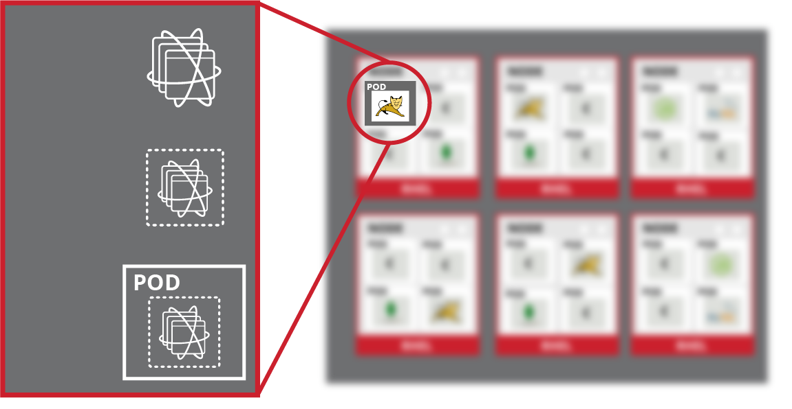
Apps and components run in containers
Container Image
Container
Pod
Notes:
Speaker:
* Application instances and application components run in Docker containers
* Each OpenShift Node can run many containers
Discussion:
* A node’s capacity is related to the memory and CPU capabilities of the underlying “hardware”
Transcript:
All of the end-user application instances and application components will run inside Docker containers on the nodes. RHEL instances with bigger CPU and memory footprints can run more applications.

Slide 15
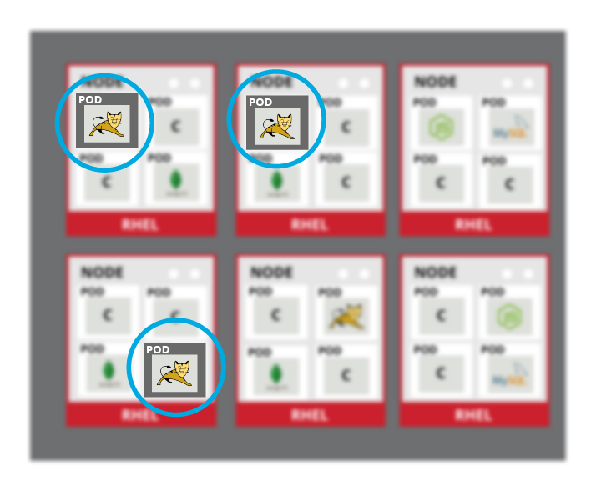
Pods are the orchestrated unit in OpenShift
Notes:
Speaker:
* While app components run in Docker containers, the “unit” that OpenShift is orchestrating and managing is called a Pod
* In this case, a Docker image is the executable or runnable components, and the container is the actual running instance with runtime and environment parameters
* One or more containers make up a Pod, and OpenShift will schedule and run all containers in a Pod together
* Complex applications are made up of many Pods each with their own containers, all interacting with one another inside an OpenShift environment
Discussion:
* OpenShift consumes Docker Images and runs them in containers wrapped by the meta object called a Pod.
* The Pod is what OpenShift schedules, manages and runs.
* Pods can have multiple containers but there are not many well-defined use cases
* Services, described soon, are how different application components are “wired” together. Different application components (eg: app server, db) are not placed in a single Pod
Transcript:
OpenShift can use any native Docker image, and schedules and runs containers in a unit called a Pod. While Pods can have multiple containers, generally a Pod should provide a single function, like an app server, as opposed to multiple functions, like a database and an app server. This allows for individual application components to be easily scaled horizontally.

Slide 16
Masters are the Control Plane
Notes:
Speaker:
* The other type of OpenShift system is the Master
* Masters keep and understand the state of the environment and orchestrate all activities on the Nodes
* Masters are also instances of RHEL or Atomic, and multiple masters can be used in an environment for high availability
* Masters have four primary jobs or functions
Discussion:
* The OpenShift Master is the orchestrator of the entire OpenShift environment.
* The OpenShift Master knows about and maintains state within the OpenShift environment.
* Just like Nodes, Masters run on RHEL or Atomic
* You will discuss the four primary functions of the Master in the next slides
Transcript:
Just like Nodes, the OpenShift Master is installed on RHEL or Atomic. The Master is the orchestration and scheduling engine for OpenShift, and is responsible for knowing and maintaining the state of the OpenShift environment. The Master has four primary functions which you will now describe.

Slide 17
API and Authentication
Notes:
Speaker:
* The Master provides the single API that all tooling and systems interact with. Everything must go through this API.
* All API requests are SSL-encrypted and authenticated. Authorizations are handled via fine-grained role-based access control (RBAC)
* The Master can be tied into external identity management systems, from LDAP and AD to OAuth providers like GitHub and Google
Discussion:
* All requests go through the Master’s API
* The Master evaluates requests for both AuthentacioN (AuthN - you are who you say you are) and AuthoriZation (AuthZ - you’re allowed to do what you requested)
* The Master can be tied into external identity management systems like LDAP/AD, OAuth, and more
* Apache modules can also be used for authentication in front of the API
Transcript:
The Master is the gateway to the OpenShift environment. All requests must go through the Master and must be both authenticated and authorized. A wide array of external identity management systems can be the source of authentication information in an OpenShift environment.

Slide 18
Desired and Current State
Notes:
Speaker:
* The desired and current state of the OpenShift environment is held in the data store
* The data store uses etcd, a distributed key-value store
* Other things like the RBAC rules, application environment information, and non-application-user-data are kept in the data store
Discussion:
* etcd holds information about the desired and current state of OpenShift
* Additionally, user account info, RBAC rules, environment variables, secrets, and many other bits of OpenShift information are held in the data store
* More generally, any OpenShift data object is stored in etcd
Transcript:
Etcd is another of the critical components of the OpenShift architecture. It is the distributed key-value data store for state and other information within the OpenShift environment. Reads and writes of information generally are going to hit the data store.

Slide 19
Scheduler Pulls From The Registry
Notes:
Speaker:
* The scheduler portion of the Master is the specific component that is responsible for determining Pod placement
* The scheduler takes the current memory, CPU and other environment utilization into account when placing Pods on the various nodes
Discussion:
* The scheduler is responsible for Pod placement
* Current CPU, Memory and other environment utilization is considered during the scheduling process
Transcript:
The OpenShift scheduler uses a combination of configuration and environment state to determine the best fit for running Pods across the Nodes in the environment.

Slide 20
Orchestration and Scheduling
Notes:
Speaker:
* The scheduler portion of the Master is the specific component that is responsible for determining Pod placement
* The scheduler takes the current memory, CPU and other environment utilization into account when placing Pods on the various nodes
Discussion:
* The scheduler is responsible for Pod placement
* Current CPU, Memory and other environment utilization is considered during the scheduling process
Transcript:
The OpenShift scheduler uses a combination of configuration and environment state to determine the best fit for running Pods across the Nodes in the environment.

Slide 21
Placement by Policy
Notes:
Speaker:
* The real-world topology of the OpenShift deployment (regions, zones, and etc) is used to inform the configuration of the scheduler
* Administrators can configure complex scenarios for scheduling workloads
Discussion:
* The scheduler is configured with a simple JSON file in combination with node labels to carve up the OpenShift environment to make it look like the real world topology
Transcript:
The topology of the real-world environment is used by platform administrators to determine how to configure the scheduler and the Node labels.

Slide 22





Services connect application components
Notes:
Speaker:
* OpenShift’s service layer enables application components to easily communicate with one another
* The service layer provides for internal load balancing as well as discovery and code reusability
Discussion:
* The service layer is used to connect application components together
* OpenShift automatically injects some service information into running containers to provide for ease of discovery
* Services provide for simple internal load balancing across application components
Transcript:
OpenShift’s service layer is how application components communicate with one another. A front-end web service would connect to database instances by communicating with the database service. OpenShift would automatically handle load balancing across the database instances. Service information is injected into running containers and provides for ease of application

Slide 23
Health and Scaling
Notes:
Speaker:
* The Master is responsible for monitoring the health of Pods, and for automatically scaling them as desired
* Users configure Pod probes for liveness and readiness
* Currently pods may be automatically scaled based on CPU utilization
Discussion:
* The Master handles checking the health of pods by executing the defined liveness and readiness probes
* Probes can be easily defined by users
* Autoscaling is available today against CPU only
* The next slides will depict a health event for you to describe
Transcript:
The OpenShift Master is capable of monitoring application health via user-defined Pod probes. The Master is also capable of scaling out Pods based on CPU utilization metrics.

Slide 24

What about unhealthy Pods?
Notes:
Speaker:
* What happens when the Master sees that a Pod is failing its probes?
* What happens if containers inside the Pod exited because of a crash or other issue?
Discussion:
* Here you are describing the beginning of how the Master detects failures and remediates them
Transcript:
This first slide allows you to ask the question “What happens when…?”. The next slide will describe the remediation process for failed Pods.

Slide 25
The Master remediates Pod failures
Notes:
Speaker:
* The Master will automatically restart Pods that have failed probes or possibly exited due to container crashes.
* Pods that fail too often are marked as bad and are temporarily not restarted.
* OpenShift’s service layer makes sure that it only sends traffic to healthy Pods, maintaining component availability -- all orchestrated by the Master automatically.
Discussion:
* The Master will restart Pods that are determined to be failing, for whatever reason.
* The Service layer is automatically updated with only healthy Pods as endpoints.
* All of this is done automatically.
* Pods that continually fail are not restarted for a while. This is a “crash loop back-off”.
Transcript:
The OpenShift Master is capable of remediating Pod failures automatically. It manages the traffic through the Service layer to ensure application availability and handles restarting Pods, all automatically and without any user intervention.

Slide 26
What about app data?
Notes:
Speaker:
* Applications are only as useful as the data they can manipulate.
* Docker containers are natively ephemeral - data is not saved when containers are restarted or created.
* OpenShift provides a persistent storage subsystem that will automatically connect real-world storage to the right Pods, allowing for stateful applications to be used on the platform.
* A wide array of persistent storage types are usable, from raw devices (iSCSI, FC) to enterprise storage (NFS) to cloud-type options (Gluster/Ceph, EBS, pDisk, etc)
Discussion:
* OpenShift’s persistent volume system automatically connects storage to Pods
* The persistent volume system allows stateful apps to be used on the platform
* OpenShift provides flexibility in the types of storage that Pods can consume
Transcript:
OpenShift’s persistent volume system allows end users to consume a wide array of storage types to enable stateful applications to be run on the platform. Whether OpenShift is running locally in the datacenter or in the cloud, there are storage options that can be used.

Slide 27
Routing layer for external accessibility
Notes:
Speaker:
* Not every consumer of applications exists inside the OpenShift platform. External clients need to be able to access things running inside OpenShift
* The routing layer is a close partner to the service layer, providing automated load balancing to Pods for external clients
* The routing layer is pluggable and extensible if a hardware or non-OpenShift software router is desired
Discussion:
* The OpenShift router runs in pods on the platform itself, but receives traffic from the outside world and proxies it to the right pods
* The router uses the service endpoint information to determine where to load balance traffic, but it does not send traffic through the service layer
* The router is built with HAProxy, but is a pluggable solution. Red Hat currently supports F5 integration as another option.
Transcript:
OpenShift’s routing layer provides access for external clients to reach applications running on the platform. The routing layer runs in Pods inside OpenShift, and features similar load balancing and auto-routing around unhealthy Pods as the Service layer.

Slide 28
Access via Web UI, CLI, IDE, API
Notes:
Speaker:
* All users, either operators, developers, or application administrators, access OpenShift through the same standard interfaces
* Ultimately, the Web UI, CLI and IDEs all go through the authenticated and RBAC-controlled API
* Users do not need system-level access to any of the OpenShift hosts -- even for complicated debugging and troubleshooting.
* Continuous Integration (CI) and Continuous Deployment (CD) systems can be easily integrated with OpenShift through these interfaces, too.
* Operators and Administrators can utilize existing management and monitoring tooling in many ways.
Discussion:
* All interaction with the OpenShift environment and its tools goes through the API and is controlled by the defined RBAC settings.
* The tools and the API provide for ways to access application instances -- even for things like shells and terminals for debugging
* Existing RHEL management tooling and many existing monitoring suites can be integrated with OpenShift
* CI/CD solutions can be integrated with OpenShift to provide for complete automated lifecycle management.
Transcript:
Interacting with OpenShift boils down to interacting with the API, no matter what tools are being used. CI, CD, management, monitoring and other tooling can all go through the OpenShift API for automation purposes. And, since OpenShift is built on top of RHEL, existing systems management and systems monitoring tools can be used, too.

Slide 29
How to use OpenShift
Build and Deployment Process
“Safely Agile”
Hands-On

Slide 30



Build Process
Source2Image Container
Build Configuration
Image
Image Stream
Source Code

Slide 31

Deployment Process
Image from ImageStream
Deployment Configuration
Pod
Service
Config Map, Secrets

Slide 32




”Safely Agile”
Dev
Prod
Build
Tag
Deploy
Deploy
latest
OK?
latest
Tag
ready4prod

Slide 33
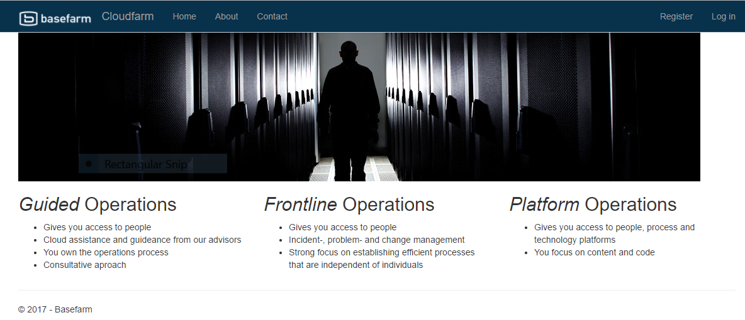
Hands-on
https://github.com/bf-demos/ocp-handson

