Slide 1
YAML, what is it good for?
by Benjamin Fleischer
@hazula
github/bf4/yaml_resources
bf@benjaminfleischer.com
RailsIsrael 2013

Slide 2
Audience Opinions
How many of you have used YAML in your own projects?
What have you used YAML for? Configuration? Logging? Data Store?
What tools / libraries do you know that rely on YAML. e.g. Rubygems, Outside of Ruby?

Slide 3
Audience Opinions
Is YAML safe?

Slide 4
January 8, 2013
CVE-2013-0156
The parameter parsing code of Ruby on Rails allows applications to automatically cast values from strings to certain data types. Unfortunately the type casting code supported certain conversions which were not suitable for performing on user-provided data including creating Symbols and parsing YAML. These unsuitable conversions can be used by an attacker to compromise a Rails application.
https://groups.google.com/forum/#! topic/rubyonrails-security/61bkgvnSGTQ

Slide 5
January 28, 2013
CVE-2013-0333
The JSON Parsing code in Rails 2.3 and 3.0 support multiple parsing backends. One of the backends involves transforming the JSON into YAML, and passing that through the YAML parser. Using a specially crafted payload attackers can trick the backend into decoding a subset of YAML.
https://groups.google.com/forum/#! topic/rubyonrails-security/1h2DR63ViGo

Slide 6
February 11, 2013
CVE-2013-0277
The +serialize+ helper in Active Record allows developers to store various objects serialized to a BLOB column in the database. The objects are serialized and deserialized using YAML. If developers allow their users to directly provide values for this attribute, an attacker could use a specially crafted request to cause the application to deserialize arbitrary YAML. Vulnerable applications will have models similar to this:
class Post < ActiveRecord::Base serialize :tags end
and will allow foreign input to be directly assigned to the serialized column like this:
post = Post.new post.tags = params[:tags]
https://groups.google.com/forum/#! topic/rubyonrails-security/KtmwSbEpzrU

Slide 7
January / February 2013
CVE-2013-0156
CVE-2013-0277
CVE-2013-0333
Three catastrophic Ruby/Rails exploits:
all YAML-related
Informs some opinions

Slide 8
What is YAML good for?
“YAML is terrible and should be driven from the face of the Earth.”
https://github.com/markbates/configatron/issues/48
Security issues aside (remember what happened to rubygems a few months back?), Ruby keeps changing it's YAML engine out with almost every release making the code around using YAML a real mess.
Factor in supporting other implementations like jRuby, Rubinius, etc... and it becomes a real nightmare.
I would rather just use JSON or Ruby.

Slide 9
YAML, changing opinions
Sprockets 2 stores manifest in JSON. Why?
@barelyknown “I like to use YAML for semi-small data loading tasks.... [A]ny chat about YAML vs. JSON also deserves a CSV mention. That's what I use for seeding (or dumping) larger tables.”
What do you think?

Slide 10
YAML, is it safe?
Answer: Of course. YAML is just text.
Data serialization is handled by each language natively.

Slide 11
YAML: F7U12 by Aaron Patterson
People seem to be giving YAML a bad rap over these exploits.
The truth is that all of these exploits exist in any scheme that allows you to create arbitrary objects in a target system.
This is why nobody uses Marshal to send objects around. Think of YAML as a human readable Marshal.

Slide 12
YAML: F7U12 by Aaron Patterson
Should we stop using YAML? No.
But we probably shouldn’t use it to read foreign data...
My opinion of “safe” puts YAML on the same field as JSON as far as “objects that can be transferred” is concerned.

Slide 13
YAML: F7U12 by Aaron Patterson
Anyway, I think it’s important to see we have three things going on in these exploits.
We have
1. YAML the language, which defines schemes for arbitrary object serialization,
2. Psych which honors those requests, and
3. user land code which is subject to the exploits.
YAML the language doesn’t say any of this code should be executed, and in fact Psych won’t eval random input. The problem being that certain YAML documents can be fed to Psych to create objects that interact with user code in unexpected ways.
The user land code is what gets exploited, YAML and Psych are merely a vehicle.
http://tenderlovemaking.com/2013/02/06/yaml-f7u12.html

Slide 14
Where did YAML come from?
How did it get so popular?
How long do you think YAML has been around?

Slide 15
Where did YAML come from?
How did it get so popular?
A Brief History of YAML
* Early 2001 – Ingy write Data::Denter
* April 2001 – Clark and Oren start YAML, call Ingy.
Neil Watkiss and Steven Howell start PyYAML and libyaml.
* July 2001 - Ingy and ActiveState give YAML demo @ OSCON
* January 2002 - Ingy releases YAML.pm
* 2002-2004 - The YAML Wars
* 2003 - _why writes libsyck
* 2003 - Ruby adopts YAML
* 2004 - YAML 1.0 Spec
* 2005 - JSON RFC by Douglas Crockford
* 2006 - YAML 1.1 Spec
* 2006 – PyYaml 3000 and libyaml by Kirill Simonov. In Fall of 2006 Ingy gets Perl grant to port libyaml to Perl 6 months later
* 2006 - Psych
* 2009 - YAML 1.2. Ingy OSCON Talk
* 2009 – today – Not much. YAML2 never comes about. 1.2 never fully implemented.

Slide 16
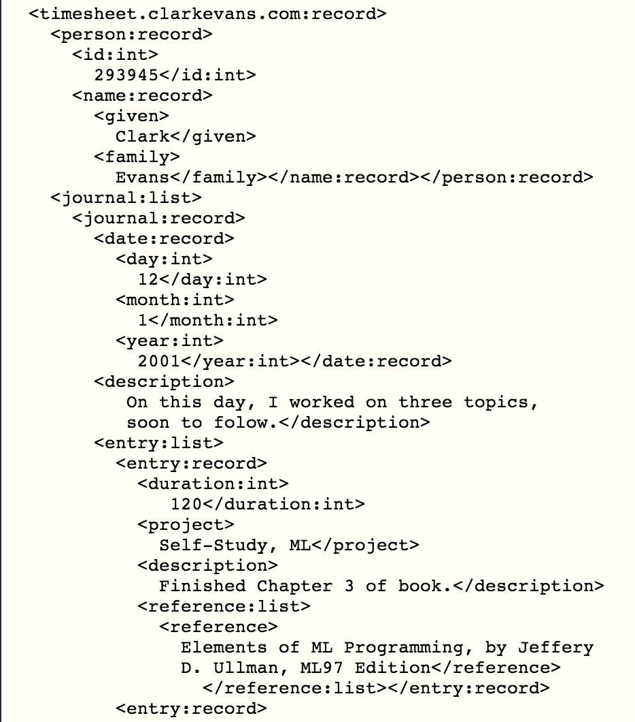
Early YAML draft was XML-like
http://web.archive.org/web/20010330220051/http://www.yaml.org/

Slide 17



Where did YAML come from?
How did it get so popular?
2001 – Escape from XML,
Clark Evans, Oren ben-Kiki, Ingy döt Net.

Slide 18
Where did YAML come from?
How did it get so popular?
Syntax
'-' Probably from Ward Cunningham's WikiWiki
':','[]','{}' unknown origin, possibly Javascript
Readability was a use-case for cce's invoicing app where lawyers wanted to be able to print un-modified object that were readable.

Slide 19
Where did YAML come from?
How did it get so popular?
2003 - _why's libsyck included in Ruby 1.8
2004/5 - Rails

Slide 20

Where did YAML come from?
How did it get so popular?
2005 – JSON 'discovered' by Douglas Crockford.
2006 July - JSON: RFC 4626

Slide 21
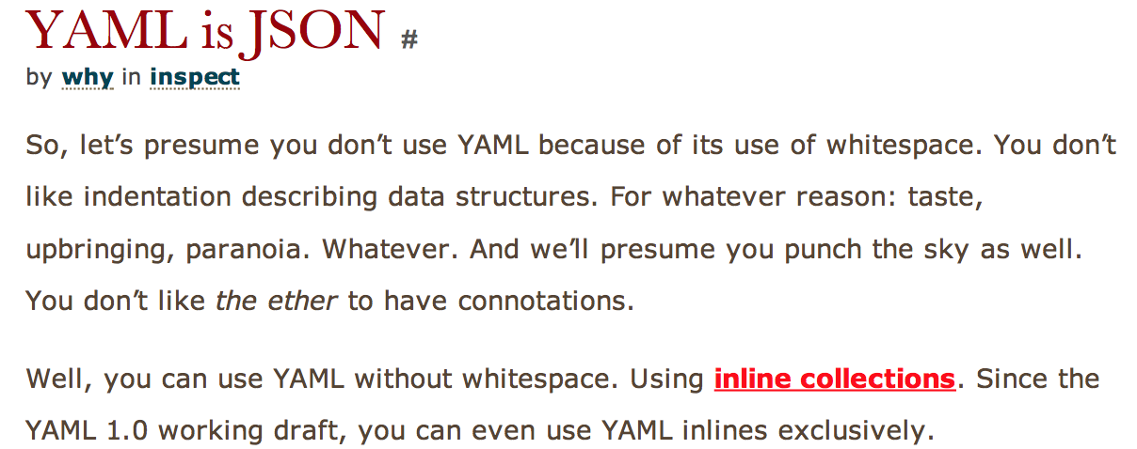
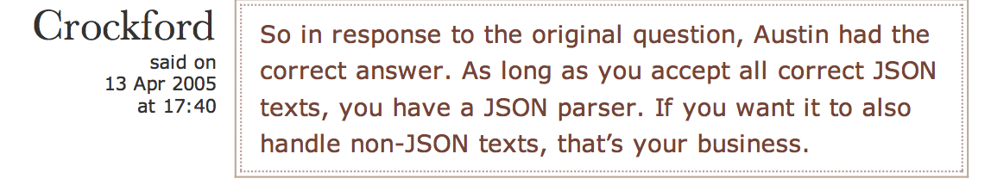
Where did YAML come from?
How did it get so popular?
_why discovers YAML 1.1 is basically JSON.
YAML 1.2 spec aligns them, but never fully implemented

Slide 22
JSON, really? a.k.a. Avoid significant whitespace.
{ foo: bar } → {"foo"=>"bar"}
---\nfoo: bar\n → {"foo"=>"bar"}
[ 'foo', 'bar' ] → ["foo", "bar"]
---\n- foo\n- bar\n → ["foo", "bar"]
[ true, false, null, 1, NaN] → [true, false, nil, 1, "NaN"]

Slide 23
Where did YAML come from?
How did it get so popular?
2006 – libsyck unmaintained and buggy,
Kirill Simonov gets Google Summer of Code Grant to rewrite PyYAML → libyaml
-> in 3 mos. Better than the spec! Becomes reference.
2009 – today – YAML2 never comes out. YAML 1.1/1.2 spec remains buggy, incomplete

Slide 24
Where did YAML come from?
How did it get so popular?
Clark C. Evans:
  How could something so broken be adopted so widely?
  Answer: Good enough. Better than XML

Slide 25
YAML Vocabulary
- Indicator:
Collection (Mapping and Sequence): ['?', ':', '-', ',', '[]', '{}']
Scalar: ['''', '"', '|', '>'] # Folded >, Literal |
Document: ['%', '---', '...']
Misc: ['#']
- Anchor (node label): '&'
- Alias (ref to anchored node): '*'
- Keys: '<<'
- Types (Repository):
Core: ['!!map', '!!seq', '!!str']
More: ['!!omap', '!!set']
- Stream, Document, Node, Block scoping, Flow (Curly/Square) scoping, Literal, Dump, Load, Canonical
- Language Independent:
Null: ['~', 'null']
Decimal: 1234
Hexadecial: 0x4D2
Octal: 02333
sexagesimal: 190:20:30
Fixed Float: 1_230.15
Exponential Float: 12.3015e+02
Time:
Infinity: ['.inf', '-.Inf']
Not a Number: Nan
Boolean: ['Y', 'true', 'Yes', 'ON', 'n', 'FALSE', 'No', 'off']
Base64 Binary: '? !!binary R0lG...BADS='
- Tag (Directive):
Explicit:
'!': Primary tag handle (primary namespace)
'!!': Secondary tag handle
Application-specific: local. e.g. language-specific, '!ruby/object:Set'
Global:

Slide 26
YAML vs. The World
* XML is a ... MARKUP LANGUAGE...
* JSON is a ... DATA INTERCHANGE FORMAT
* YAML is a ... DATA SERIALIZATION FORMAT
+ YAML is THE ONLY interlingual *Data Serialization* Language.
[ Ruby, Perl, Python, PHP, Java, Haskell, JavaScript ]
== YAML - YAML Ain't Markup Language
* Programs have lots of languages
* Data has only a few. XML, JSON, ASN.1, Protocol Buffers, Message Pack
* YAML is Human Friendly
* When Data is well organized, Programming is easier

Slide 27
YAML vs. XML
Many have fled XML. Many fear it. It requires a chainsaw.
It is a markup language that has become used for data serialization even though it lacks an information model
They're really for different things.
“XML Matters: YAML improves on XML” www.ibm.com/developerworks/library/x-matters23.html
SML: “Evans moves against angle brackets in MinML” www.xmlhack.com/read.php_item=1213&v=1

Slide 28
YAML vs. internal DSL
Internal DSL may be too flexible → accretions in complexity and deteriorating readability.

Slide 29
YAML vs. JSON Data Model
Similar:
* map to primitives
* arrays and hashes
* scalars (String, Number, Boolean, Null)
Differences:
* JSON only supports arrays and string-keyed-maps
* YAML adds data references/pointers
** Allows cyclic data
* YAML adds complex keys (with '?')
* YAML adds an extensible type system
** All nodes are typed
** Usually implicitly
* Encoding / Whitespace

Slide 30
YAML vs. JSON Grammar
JSON Model Grammar
JSON :=(MAP|ARRAY)
NODE :=(MAP|ARRAY|SCALAR)
MAP := (STRING, NODE)*
ARRAY :=NODE*
SCALAR := (string | number | boolean | null)
YAML Model Grammar
YAML := NODE*
NODE := (typed)(MAP | ARRAY | SCALAR | ALIAS) MAP := (NODE, NODE)*
ARRAY := NODE*
SCALAR := typed_string
https://github.comingydotnet/yaml-oscon2009-talk/slides.vroom

Slide 31
YAML vs. JSON Quotes
Clark C. Evans of YAML:
JSON is brilliant. It's the 80/20 rule.
I hand-write and scan YAML files. I don't do that with JSON.
That said, JSON is the format of Web 2.0 data interchange.
JSON is the XML killer
Douglas Crockford, JSON promoter:
I intended for JSON to be used by machines, but it seems some humans like it too.
It is harder to convince humans to strictly follow good practices, so YAML has a role.
JSON from the beginning was language independent. Some of the first uses of JSON were Java-to-Java.

Slide 32

YAML vs. JSON Logo
Notes:
http://tools.ietf.org/html/rfc4627
JavaScript Object Notation (JSON) is a lightweight, text-based,
language-independent data interchange format. It was derived from
the ECMAScript Programming Language Standard. JSON defines a small
set of formatting rules for the portable representation of structured
Data.
a text format for the
serialization of structured data
four primitive types (strings, numbers, booleans,
and null) and two structured types (objects and arrays).
An object is an unordered collection of zero or more name/value
Pairs,
JSON's design goals were for it to be minimal, portable, textual, and
a subset of JavaScript.
A JSON text is a sequence of tokens. The set of tokens includes six
structural characters, strings, numbers, and three literal names.
A JSON text is a serialized object or array.
JSON-text = object / array
These are the six structural characters:
begin-array = ws %x5B ws ; [ left square bracket
begin-object = ws %x7B ws ; { left curly bracket
end-array = ws %x5D ws ; ] right square bracket
end-object = ws %x7D ws ; } right curly bracket
name-separator = ws %x3A ws ; : colon
value-separator = ws %x2C ws ; , comma
Insignificant whitespace is allowed before or after any of the six
structural characters.
ws = *(
%x20 / ; Space
%x09 / ; Horizontal tab
%x0A / ; Line feed or New line
%x0D ; Carriage return
)
2.1. Values
A JSON value MUST be an object, array, number, or string, or one of
the following three literal names:
false null true
4. Parsers
A JSON parser transforms a JSON text into another representation. A
JSON parser MUST accept all texts that conform to the JSON grammar.
A JSON parser MAY accept non-JSON forms or extensions.
An implementation may set limits on the size of texts that it
accepts. An implementation may set limits on the maximum depth of
nesting. An implementation may set limits on the range of numbers.
An implementation may set limits on the length and character contents
of strings.
5. Generators
A JSON generator produces JSON text. The resulting text MUST
strictly conform to the JSON grammar.
Encoding considerations: 8bit if UTF-8; binary if UTF-16 or UTF-32
Security considerations:
Generally there are security issues with scripting languages. JSON
is a subset of JavaScript, but it is a safe subset that excludes
assignment and invocation.
A JSON text can be safely passed into JavaScript's eval() function
(which compiles and executes a string) if all the characters not
enclosed in strings are in the set of characters that form JSON
tokens. This can be quickly determined in JavaScript with two
regular expressions and calls to the test and replace methods.
var my_JSON_object = !(/[^,:{}\[\]0-9.\-+Eaeflnr-u \n\r\t]/.test(
text.replace(/"(\\.|[^"\\])*"/g, ''))) &&
eval('(' + text + ')');

Slide 33
What is it good for?
* Config File Format
* Viewing Complex Objects (Readable)
* Maps to primitives
* Making your Thoughts into Objects
* Storing and Retrieving Objects
* Interprocess Messaging

Slide 34
What is it not for?
YAML is optimized for human-readability.
  It's slower than binary representations such as Marshal. Who is audience?
  It's slower than JSON (due to complexity), though JSON cannot serialize arbitrary objects.
Don't use for untrusted data

Slide 35
Bugs / Mistakes
Base 60 Considered Harmful:
> ruby -e 'require "yaml"; puts YAML.load("--- 8:30\n")'
30600
> perl -E 'use YAML::XS; say Load "--- 8:30\n"'
8:30
> python -c 'import yaml; print yaml.load("--- 8:30\n")'
510
> node -e 'console.log(require("js-yaml").load("--- 8:30\n"))'
510
https://gist.github.com/ingydotnet/6815655
http://web.archive.org/web/20030815094927/http://yaml.org/type/int/

Slide 36
Bugs / Mistakes
Encoding, UTF-8
Complicated Type System, Productions

Slide 37
Audience Questions
What tools / libraries do you know that rely on YAML. e.g. Rubygems, Outside of Ruby?
Did you know that YAML includes JSON?
Do you now the difference between the YAML spec and the various implementations
- Syck, Psych, libyaml
Did you know Rails serializers use YAML, not Marshal?
Have you written a custom Marshal dump/load using YAML?

Slide 38
libsyck: March 14, 2003
why the lucky stiff
Here's the deal. I became sick and delirious about a month ago. In my deranged state, I felt it imperative that I should recode YAML.rb's parser in C. I have just now come to my senses, incident to the powerful fumes of a passing onion truck. And yet, I am sitting before a new YAML parser that is as wide and wonderful as any of the world's finest onion trucks!
It is like I am an Olympic diver who has developed a serious case of amnesia mid­pike. There is nothing I can do now.
So I am please to present Syck, the new YAML parser/toy on the block. I have included Ruby, Python and PHP extensions, though the last two need some work. An OCaml extension is in progress as well.
Please jump in and voice your support for YAML in the Ruby distribution! YAML.rb has only been a module for eight months and has seen widespread usage. Wouldn't you like to <require 'yaml'> with no worries?
Best of luck. And I can feel my amnesia wearing off already. Time for a dive.
_why

Slide 39
Psych vs. Syck
Syck was buggy impl by _why
Psych is wrapper of excellent libyaml by Kirill Simonov
- Syck shipped with Ruby 1.8.0
- Had Death and Repudiation for dead people. (https://github.com/indeyets/syck/blob/master/COPYING#L26) (whereas JSON shall be used for good not evil.)
Psych by Aaron Patterson moved into Ruby in 2010. There were a lot of transition pains, but it's mostly over.

Slide 40
Psych 2.0: Safe Load
Psych.safe_load(Psych.dump(object), whitelist)
https://github.com/tenderlove/psych/blob/master/test/psych/test_merge_keys.rb#L7
yml = Psych.dump :foo
assert_raises(Psych::DisallowedClass) do
Psych.safe_load yml # '--- !ruby/symbol foo'
end
assert_equal(:foo, Psych.safe_load(yml, [Symbol], [:foo]))

Slide 41
Psych: Dumping Options
https://github.com/tenderlove/psych/blob/master/test/psych/test_psych.rb#L12
yml = Psych.dump('123456 7', { :line_width => 5 })
yml = Psych.dump({:a => {'b' => 'c'}}, {:indentation => 5})
yml = Psych.dump({:a => {'b' => 'c'}}, {:canonical => true})
yml = Psych.dump({:a => {'b' => 'c'}}, {:header => true})
yml = Psych.dump({:a => {'b' => 'c'}}, {:version => '1.1'})

Slide 42
Psych: Evented Parsing
https://github.com/tenderlove/psych/blob/master/test/psych/test_parser.rb#L131
@handler = EventCatcher.new
@parser = Psych::Parser.new @handler
@handler.parser = @parser
:start_stream
:start_document
:start_sequence
:scalar
:end_sequence
:end_document
:end_stream

Slide 43
Psych: Custom Variable Dumping
https://github.com/tenderlove/psych/blob/master/test/psych/test_to_yaml_properties.rb#L54
string = "okonomiyaki"
class << string
def to_yaml_properties
[:@tastes]
end
End
string.instance_variable_set(:@tastes, 'delicious')
v = Psych.load Psych.dump string
assert_equal 'delicious', v.instance_variable_get(:@tastes)

Slide 44
What's Needed Going Forward?
YAML2: Help needed. Please step up!
https://github.com/yaml/YAML2/wiki/Examples

Slide 45
YAML2
Submit RFC to IETF, include JSON
House Cleaning
Custom Loader (separate scanner from generator)
New name?
Address myths
Remove implicit/explicit typing
Eliminate Directives
Folded Block Scalars 1024 Limit
Tag URI Scheme
Unicode Strictness

Slide 46
Recipes
https://github.com/bf4/yaml_resources/tree/master/recipes

Slide 47
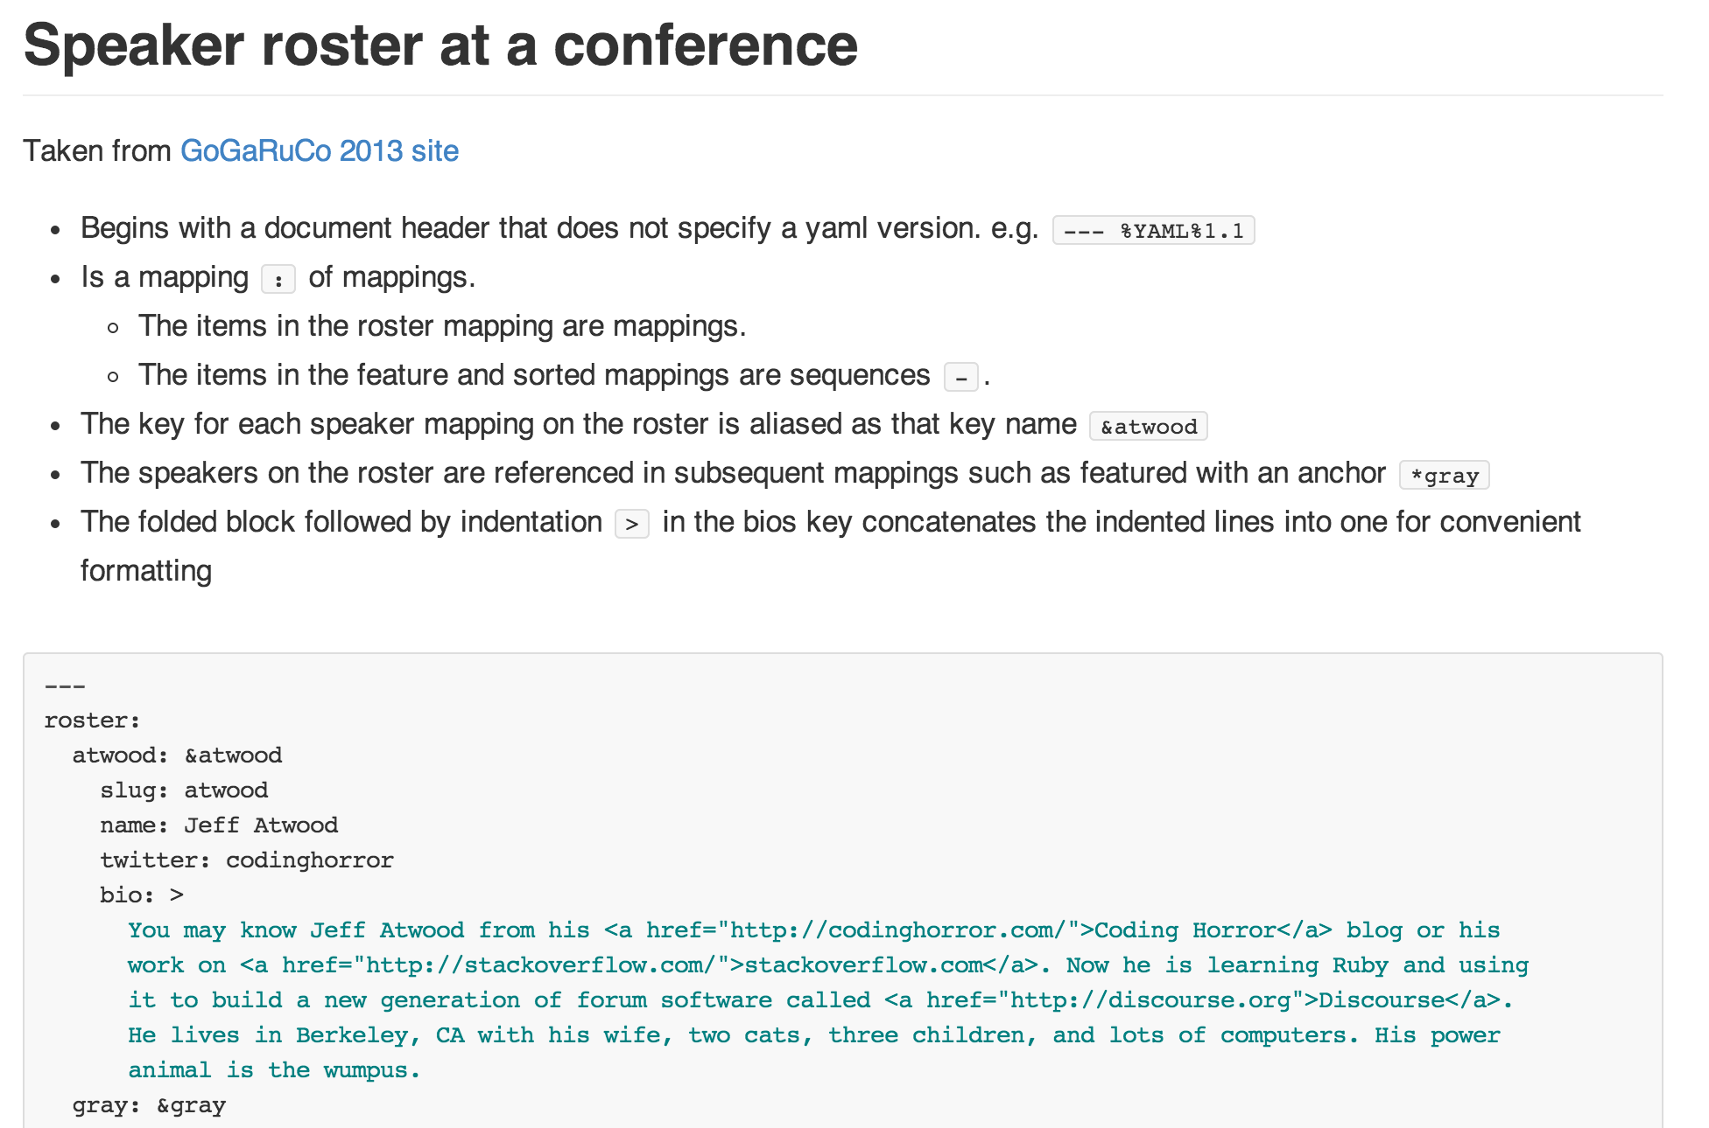
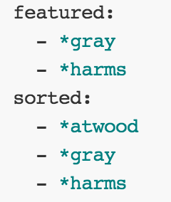

Slide 48
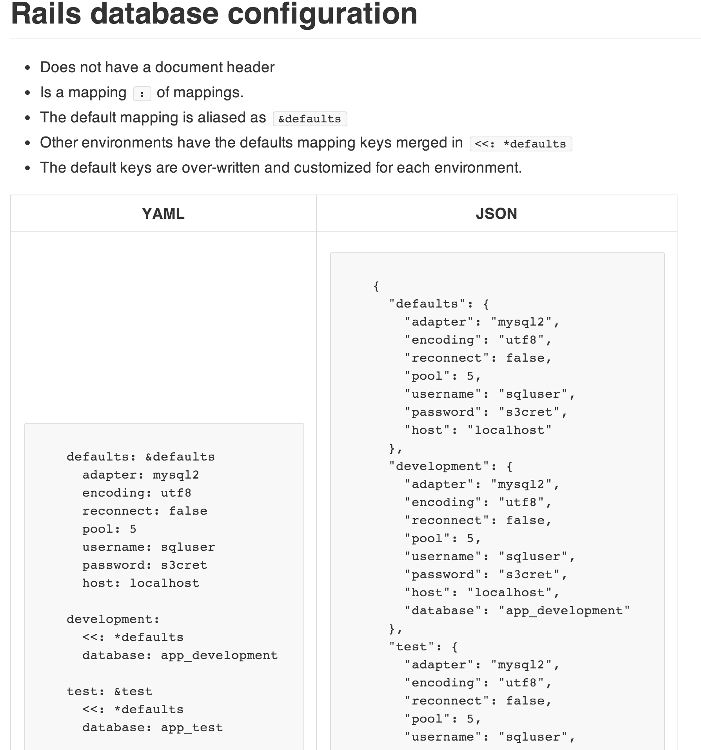

Slide 49
YAML-related PSA
http://www.benjaminfleischer.com/2013/08/21/psa-gem-versions/
I too-frequently see rubyists misunderstand the meaning of the ‘~>’ tiddly-wakka
‘~> 2.2’ is equivalent to: [‘>= 2.2’, ‘< 3.0’]
‘~> 2.2.0’ is equivalent to: [‘>= 2.2.0’, ‘< 2.3.0’]
http://www.benjaminfleischer.com/2013/07/12/make-the-world-a-better-place-put-a-license-in-your-gemspec/
Some companies will only use gems with a certain license. The canonical and easy way to check is via the gemspec which is configured as e.g.
spec.license = 'MIT'
# or
spec.licenses = ['MIT', 'GPL-2']

Slide 50
YAML, It's Pretty Good
Thanks
Benjamin Fleischer
@hazula
github.com/bf4/yaml_resources
bf@benjaminfleischer.com

