Slide 1
cosmic ray
Searching for
Cosmic Ray Muon Showers
Evidence for Correlated Multi-Detector Coincidences
Zachary · Muhlenberg College Physics · March 2026
μ μ μ μ μ

Slide 2
cosmic
ray
What Are Cosmic Ray Air Showers?
Upper Atmosphere
High-energy particles — protons and heavier nuclei — stream in from outer space at nearly the speed of light
When they hit the upper atmosphere (~15 km up), they collide with air molecules and create a cascade of secondary particles: an air shower
The shower produces pions and kaons, which quickly decay into muons
Muons are highly penetrating and reach the ground in tight temporal bunches — hundreds of them, spread over a footprint up to ~100 m wide
A single shower can trigger multiple nearby detectors within 1–2 microseconds
π, K →
muons (μ)
detector array
All muons arrive within ~1–2 µs of each other

Slide 3
Our Experimental Setup
8
10 s
~1 Hz
Detector Panels
Sync Pulses
Background Rate
Plastic scintillator panels, each read out by a dedicated Arduino Nano with its own independent crystal oscillator clock
A central Arduino Uno broadcasts a sync pulse to all 8 Nanos every 10 seconds — used to correct for clock drift between detectors
Each panel registers ~0.8–1.25 cosmic-ray hits per second — consistent with expected single-muon background flux
Run 1 (Feb 27, 2026) · 60 min · 28,935 total hits · 357 sync events per Nano · True timing floor: ~75 µs (spike-excluded) · ~1.26 ms spike-inclusive (~1.4% of intervals affected)

Slide 4
The Null Hypothesis We Are Testing
H₀ — Null Hypothesis
H₁ — Signal Hypothesis
Each detector fires as an independent, stationary Poisson process. Multi-detector coincidences arise only by chance — random overlap of unrelated single-particle events.
Cosmic ray air showers deposit bursts of muons across multiple detectors nearly simultaneously, creating correlated coincidences in genuine excess of the accidental rate.
If detectors are independent: expected k-fold accidentals in time T with window ±τ
E_k = T_eff × (2τ)^(k−1) × Σ [ r₁ × r₂ × ··· × rₖ ]
At τ = 0.5 ms, r ≈ 1 Hz, T = 60 min: E₂ ≈ 202 · E₃ ≈ 0.8 · E₄ ≈ 0.003 · E₅ < 0.001

Slide 5
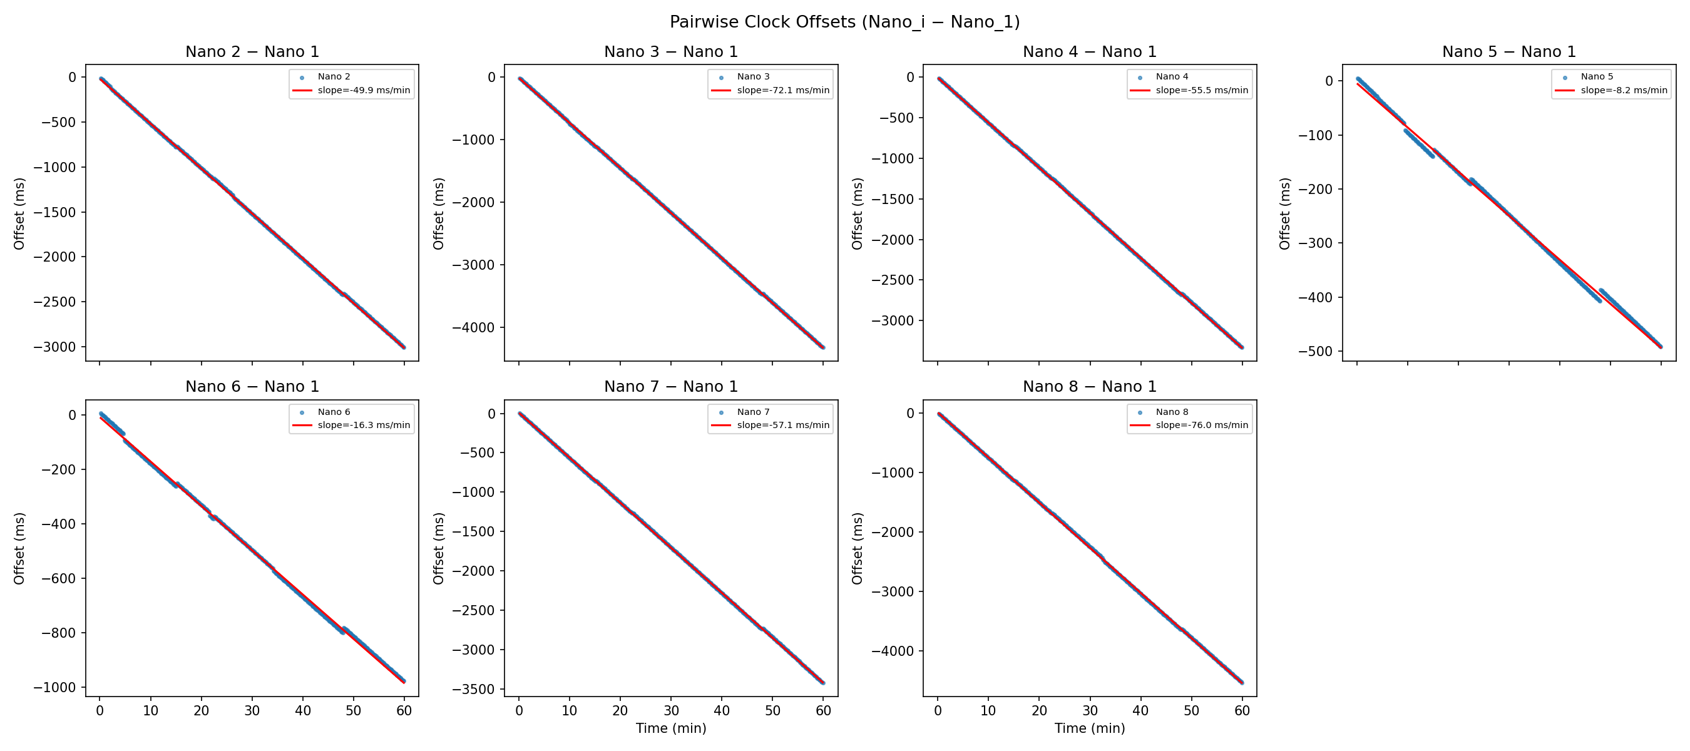
Clock Drift & Calibration
Each of the 8 Nanos has its own crystal oscillator — clocks drift independently at rates up to −1,264 ppm
The shared sync pulse arrives at all Nanos simultaneously; each records its own local timestamp
We build a piecewise-linear correction mapping each Nano's clock to a common reference frame (Nano 1)
Out-of-sample calibration RMS: ~1.26 ms across all intervals — but ~1.4% of intervals contain spike artifacts from firmware interrupt deferral, which dominate this figure
Excluding spike intervals, the true timing floor is ~75 µs combined — making the 1 ms coincidence window well-justified

Slide 6
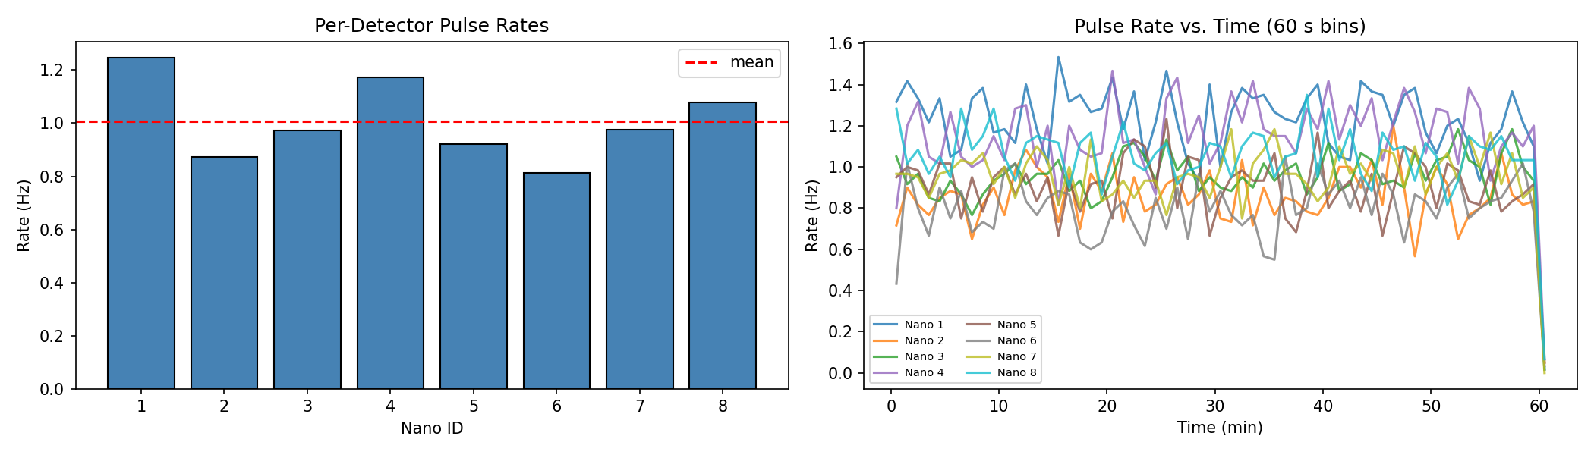
Per-Detector Rates: Validating the Poisson Model
Left: All 8 detectors fire at 0.8–1.25 Hz — consistent with the ambient cosmic-ray background flux. Right: Rates are stable over the full 60-minute run, confirming the stationary Poisson assumption.

Slide 7
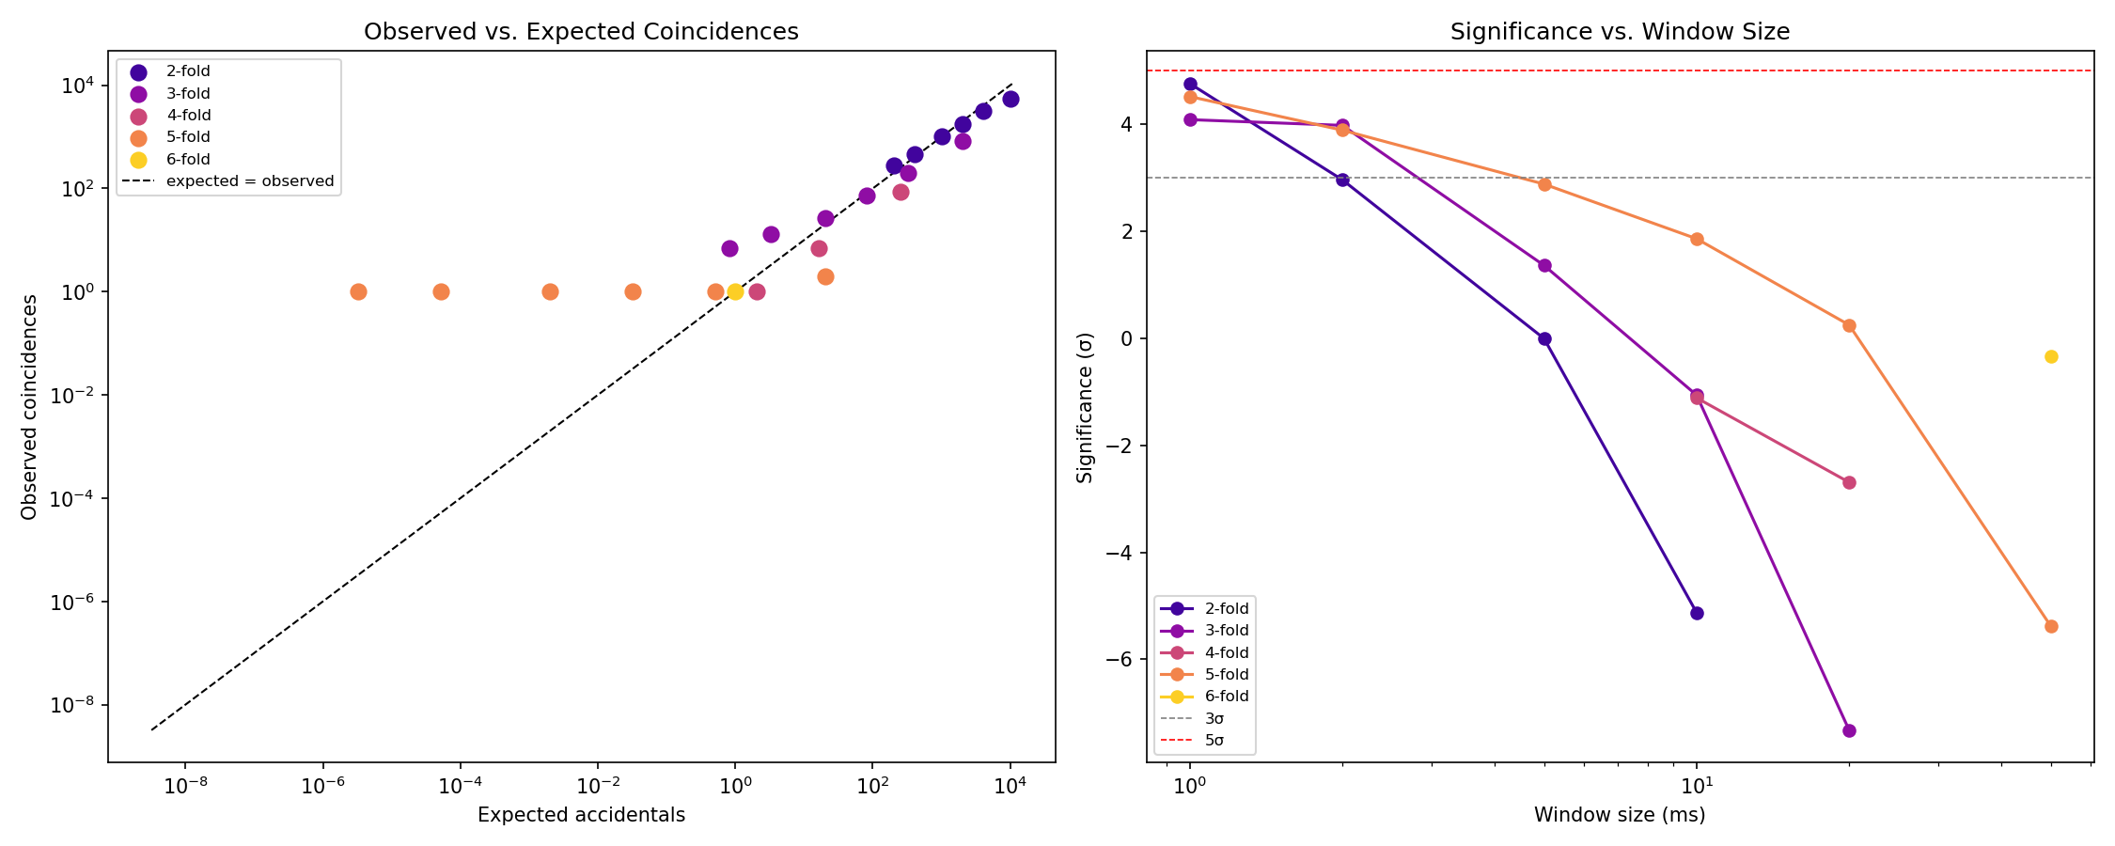
Main Result: Excess Coincidences Above Prediction
2-fold
Obs: 274 · Exp: 202
+4.8σ
3-fold
Obs: 7 · Exp: 0.8
+4.1σ
5-fold
Obs: 1 · Exp: <0.001
+4.5σ
Left: Points above the diagonal = more coincidences than expected by chance. Right: Significance peaks sharply at narrow windows — consistent with sub-millisecond correlated events.

Slide 8
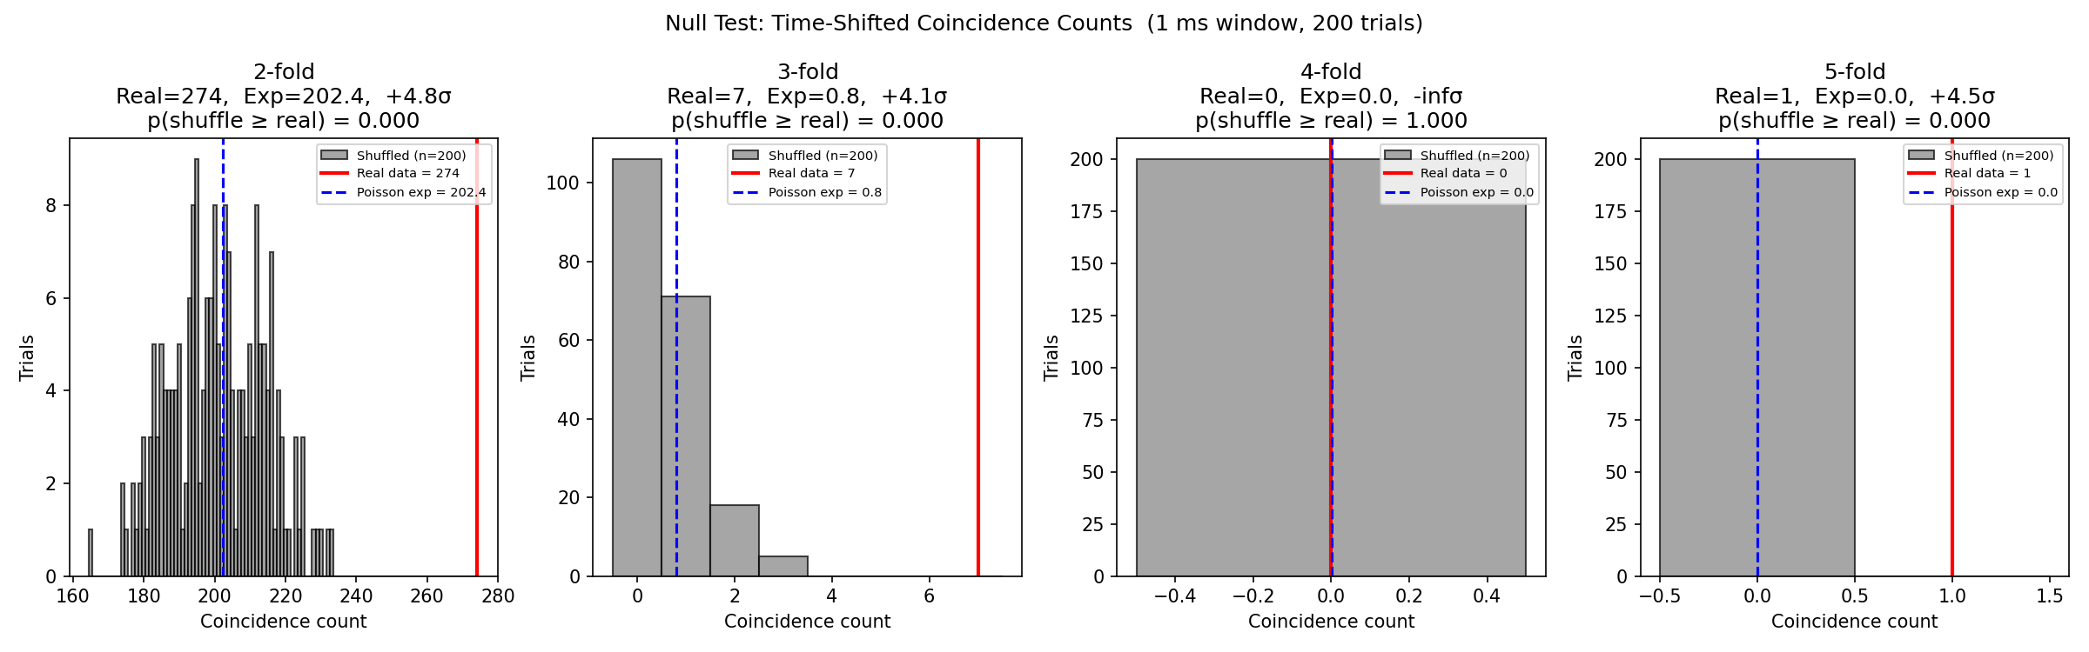
Null Test: Signal Is Not an Analysis Artifact
Method: randomly time-shift each Nano's event stream 200 times and re-run the analysis. Gray histograms: shuffled data (accidentals only). Red line: real observation. Blue dashed: Poisson prediction. Real 2-fold (274) and 3-fold (7) counts lie far outside the null distribution — p < 0.001.

Slide 9
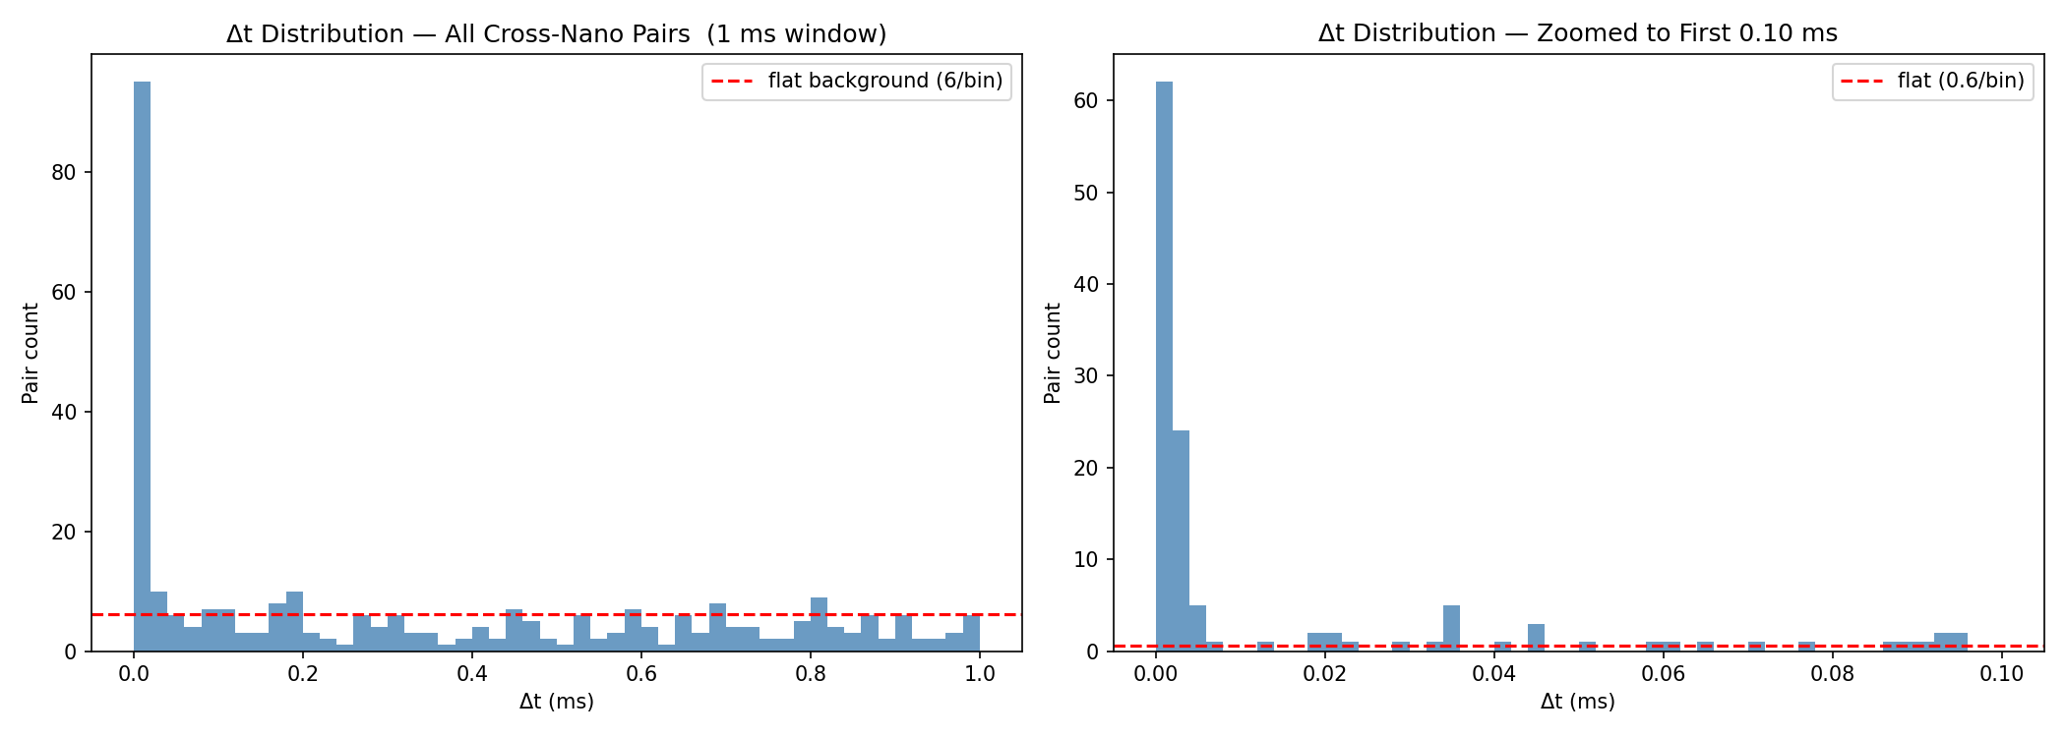
Direct Evidence: Excess of Near-Simultaneous Hits
What this shows
Time differences Δt between all detector pairs within a 1 ms window
If hits were independent, Δt would be flat (uniform random)
Instead: a sharp spike near Δt ≈ 0 — hits arriving nearly simultaneously
~70 excess pairs at Δt < 0.1 ms vs. only ~0.6 expected by chance
This is direct evidence that multiple detectors are responding to the same physical event
Left: full 1 ms range. Right: zoomed to 0.1 ms — the pile-up near zero is the fingerprint of correlated shower particles.

Slide 10
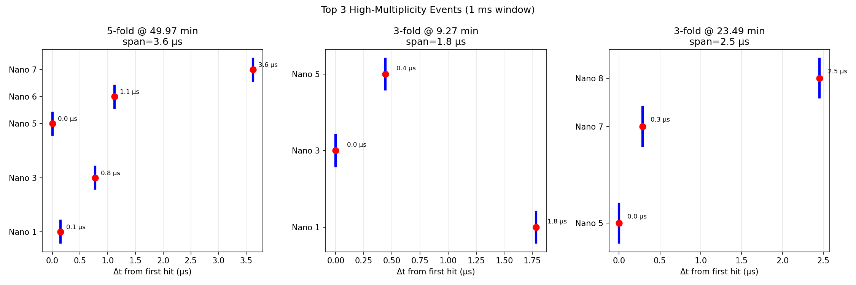
Shower Candidates: Timing Ladder Diagrams
Best Candidate
5-fold · t = 49.97 min
Nanos 1, 3, 5, 6, 7
Span: 3.6 µs
Expected accidents:
< 0.001
Significance:
~4.5σ

Slide 11
Where We Stand & Next Steps
Current Evidence
Next Steps
2-fold: 274 observed vs. 202 expected (+4.8σ)
3-fold: 7 observed vs. 0.8 expected (+4.1σ)
5-fold: 1 observed vs. <0.001 expected (+4.5σ)
Null test (200 shuffles) confirms real signal
5-detector event spans only 3.6 microseconds
Analyze Run 2 (Mar 14, ~2 hr) with 1-second sync for higher timing precision
Combine datasets to push toward 5σ discovery threshold
Apply jump-veto version to rule out hardware timing anomalies
Develop time-of-flight analysis to reconstruct shower geometry
Explore Δt structure to characterize shower front geometry
Current status: ~4σ evidence — strong and internally consistent, but not yet at the 5σ discovery threshold. Run 2 data should resolve this.

