Slide 1
Optimizing Public Transit Operations
An Exploratory Data Analysis of MetroMove Transit Solutions
Capstone Project by Blessing Kugbiyi
October 2025

Slide 2
Project Background
MetroMove operates buses, trains, ferries, and trams.
Thousands of daily trips across multiple cities.
Objective: Use data to improve performance and customer experience.
MetroMove wanted to understand its operations through data — identifying inefficiencies and usage patterns.

Slide 3
Dataset Summary
Total records: 1000 trips
Columns: 10 variables (Trip ID, Mode, Stations, Fare, Duration, etc.)
Missing values found in Passenger_Count, Fare_Amount, Trip_Duration_Minutes
Data cleaning steps:
- Removed nulls and 'Unnamed' columns
- Standardized text formats (Bus, Train, Tram, Ferry)
- Converted date/time fields for analysis

Slide 4
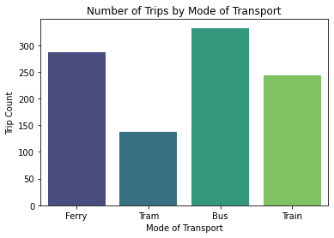
Usage Patterns by Mode of Transport
Bus trips dominate the dataset — higher service frequency.
Ferries and trams operate less frequently.

Slide 5
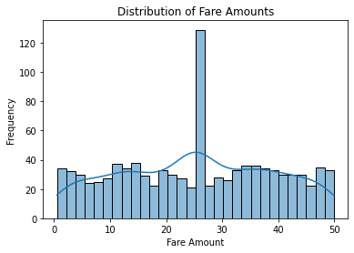
Fare and Duration Distributions
Fares mostly cluster at lower values, with few high outliers.
Trip durations vary widely — possible long routes or delays.

Slide 6
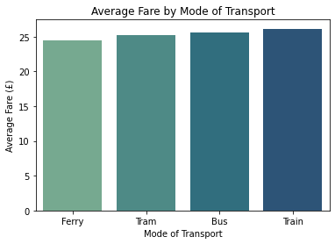
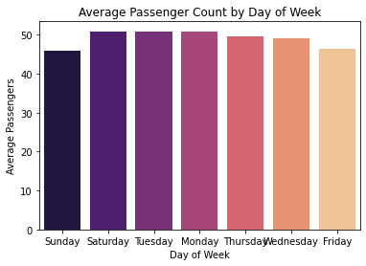
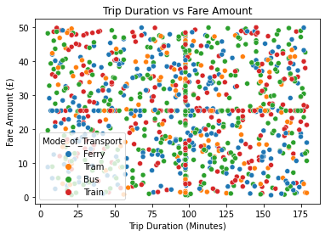
Fare, Passenger Count, and Weekday Trends
Trains have the highest fares; buses are cheapest.
Fridays show the highest passenger volume.
Fare increases with trip duration.

Slide 7
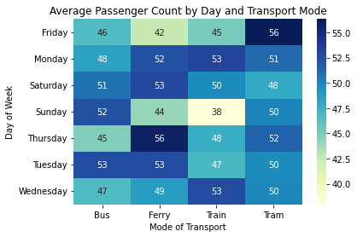
Passenger Count by Day and Transport Mode
• Buses and trains peak on weekdays.
• Ferries and trams show weekend surges.

Slide 8
Key Findings and Next Steps
Findings:
Buses: most frequent but lowest fare.
Trains: fewer trips, higher revenue.
Peak usage: Fridays and Mondays.
Some trips show unusually long durations.
Recommendations:
Optimize scheduling for high-demand days.
Review ferry pricing and utilization.
Investigate long-duration trips for delays.
Improve ongoing data quality monitoring.

