Slide 1
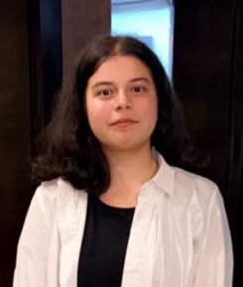







PRANJAL GUPTA GRAPHICS/UI/UX DESIGNER
PROFILE
I have always been excited to try my hands on different things ,I have a great passion to learn new things and desire to make notable contributions .
Looking forward for new opportunities as a learner and ensuring to give my best at work, I m the young enthusiast of this era .
EDUCATION
CONTACT
Phone No. – 9520079113
Email – avismriti12@gmail.com
Behance –https://www.behance.net/avismriti
Linked In - https://www.linkedin.com/in/pranjal-gupta-aab1501b6
BANASTHALI VIDYAPITH
GRADUATION
2020 - 2024
SOFTWARE SKILLS
CERTIFICATES
U demy Course (Graphic Design Master Class) .
U demy Course (User Experience Design –Figma .
U demy Course ( Figma UI/UX Project) . HOW
Workshop (Sustainable Crafts course).
Adobe Illustrator
Adobe Photoshop
Adobe Premier Pro
Figma
Adobe After Effects
Autodesk Maya
vizrt
EXPERIENCE
ACHIEVEMENTS
INTERNED AT : ZEE MEDIA CORPORATE LIMITED (5 MONTH )
Designing of online news was an all new experience , with the enhancement of the design skill and working with colours in the at most favourable senses .
Learning how a news corporation works was as interesting as it was to learn a news software for the news designs.
I played a major role and contributed in the projects of 2024 election .
As media is considered as the fourth pillar of the democracy so, does it requires the responsibilities to be taken over .(the amount of time and responsibilities were taken seriously and honestly were been fulfilled ).
My seniors (mentor) used to appreciate me for the fast adaptation and grasping of work, the sincerity for my work is what made me sustain in difficult situations at work.
Management of time and meeting the deadlines seemed to be really difficult at the beginning but with constant practice and persistence it all became quite normal to work .

